Slide 1
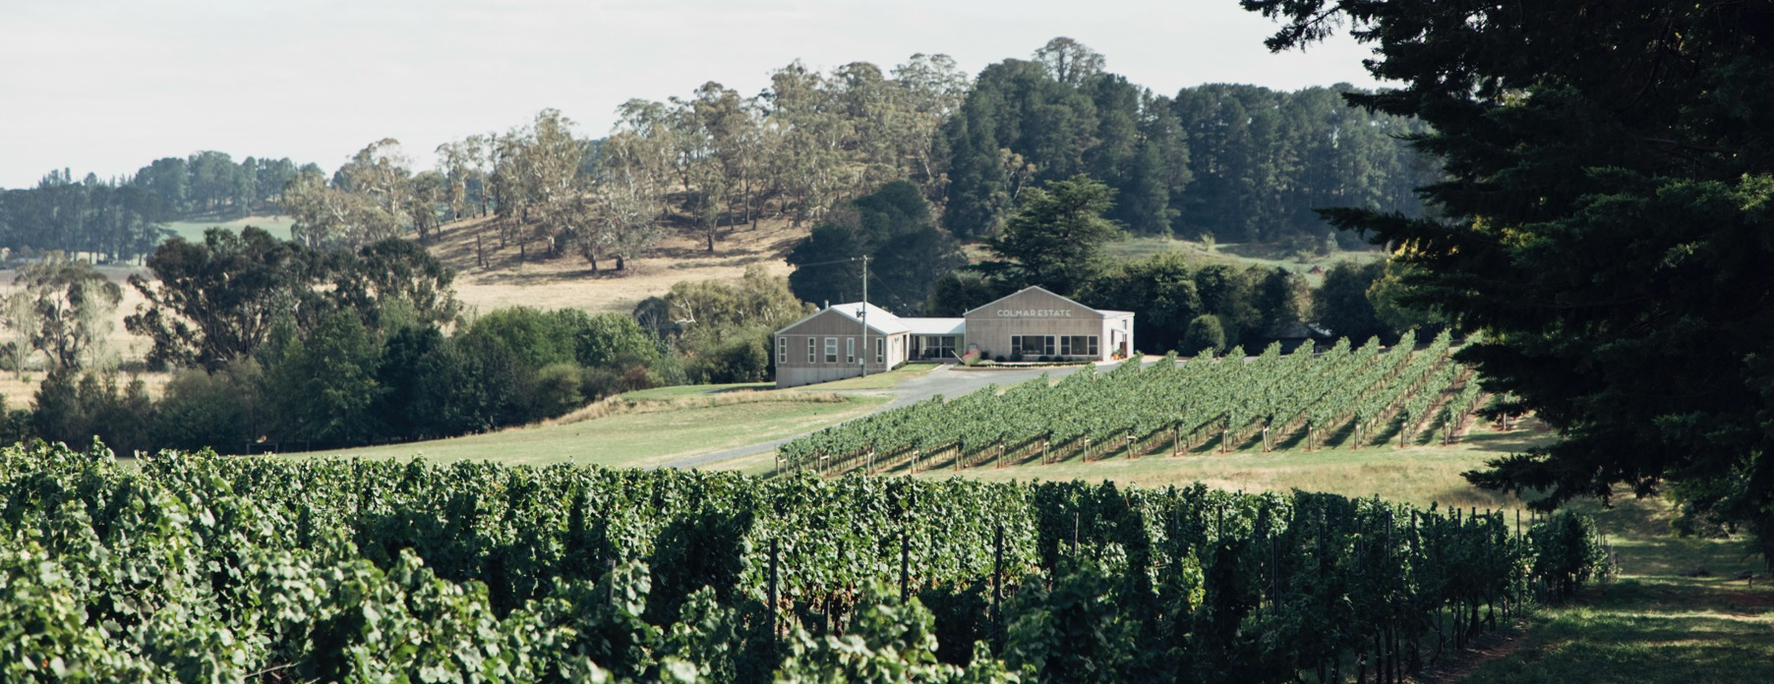
ORANGE
Notes:
Altitude may define Orange, but there’s much more to it than the number of metres above sea level. Explore the foundations, conditions, evolving viticulture, winemaking practices and grape varieties that make this region such a success.
Check these notes for additional slide information and suggested discussion points. To download more topics and resources, including presentations like this one, visit www.australianwinediscovered.com

Slide 2


Crafted from grapes grown under vast and diverse climates, across landscapes millions of years in the making, every glass of Australian wine tells a story.
Like those who came before us, our modern growers and makers continue to be passionate, resilient and creative; constantly driven to explore new ways to perfect old techniques. Our community is connected by a mutual respect and shared love of crafting exceptional wine, while protecting the natural wonders for future generations to enjoy. Applying modern thinking to our ancient lands, we take playful experimentation very, very seriously.
So, if you’re looking for the taste of adventure, let Australian wine be your compass. Because in every bottle of Australian wine, you’ll experience the wonders of Australia – a reminder of the adventure and diversity that defines our culture and our land.

Slide 3

AUSTRALIA
ORANGE

Slide 4
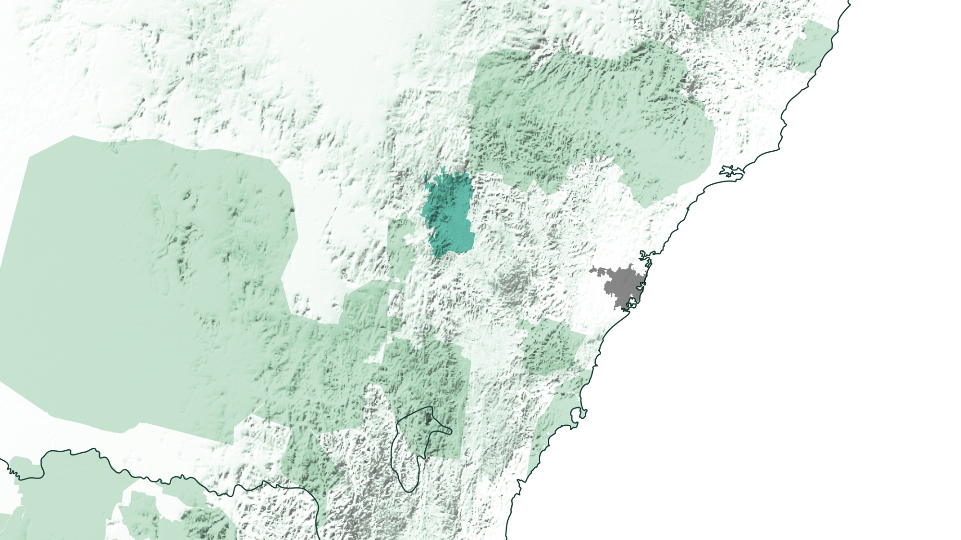
NSW
Sydney
ORANGE
Notes:
Situated on the western slopes of the Great Dividing Range, in the heart of the Central Ranges wine zone, Orange is the largest cool-climate, high-altitude wine region in New South Wales – and Australia’s highest wine region.

Slide 5
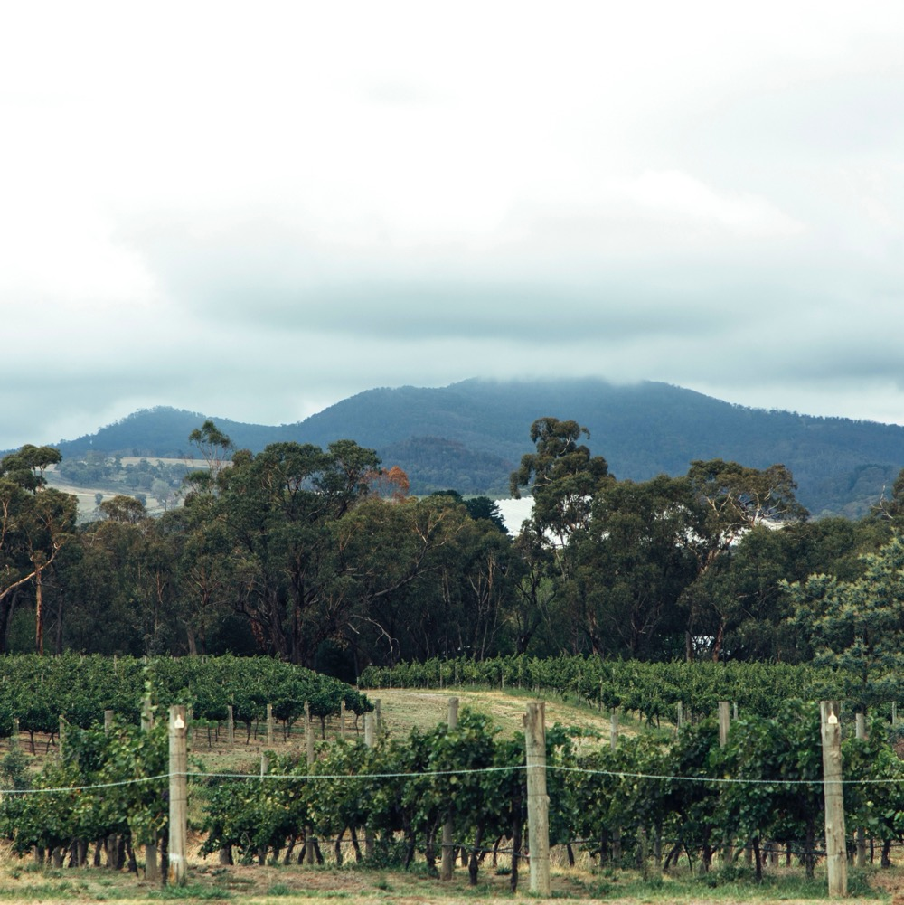
ORANGE
ALL ABOUT ALTITUDE
In its short history, Orange has cemented itself as a small but seminal region, known for a broad spectrum of high-quality, terroir-driven wines.
Australia’s highest wine region
Cool climate, rich volcanic soils and
diverse geology
Classic varieties are the calling card, but a host of alternative varieties perform well
A renowned gastronomic hotspot.

Slide 6

TODAY WE’LL COVER
The history of Orange
Geography, climate and soil
Viticulture and Winemaking
Prominent varieties

Slide 7
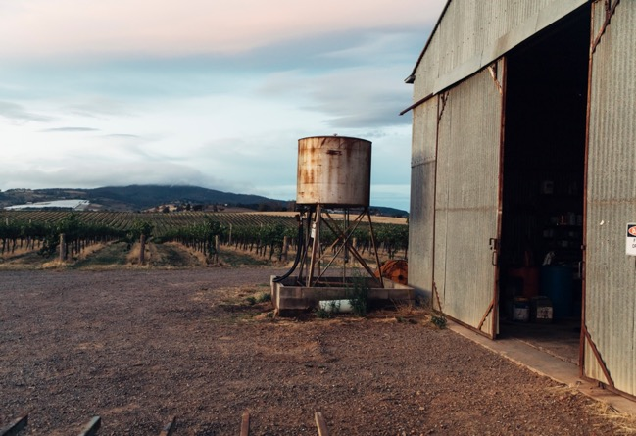
1844
HISTORY OF
1851
ORANGE
Australia’s first payable goldfields are discovered just outside Orange, spurring considerable development of the region over the following years.
John Glasson plants the first grapes in the region for wine production at Byng.
1846
Late 1850s – 1860s
The site for the village of Orange is officially established.
More vineyards are established across the region, by John Hicks at Canobolas in 1858, and by Catherine and John Bohringer, who planted Muscatel, Verdelho, Riesling, Shiraz and Pinot Noir at Borenore between 1865 and 1866.

Slide 8
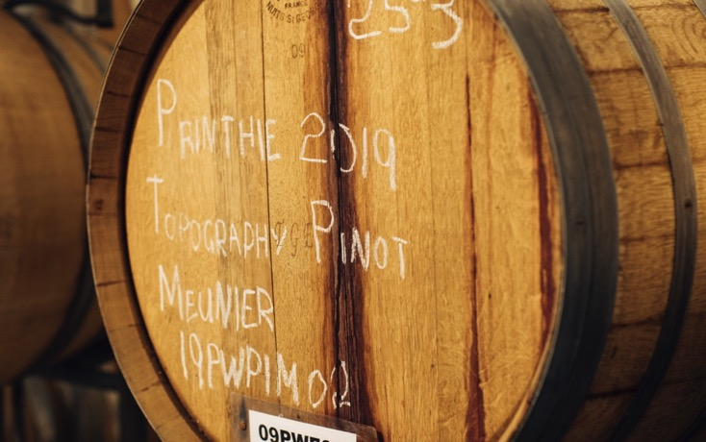
1880s
The planting of fruit orchards and proliferation of table-grape cultivation commences, eventually overtaking wheat growing as the major industry in Orange.
1877
1952
1980s
The Orange railway station opens, allowing farmers to shift their crops to market cheaper and faster.
NSW Government viticulturist Harry Manuel plants a five-acre experimental vineyard with Jack Pryde at Molong.
The modern winemaking community takes shape with the foundation of Nashdale Vineyard, Millthorpe (now Sons & Brothers), Midas Tree (now Cargo Road Wines), Bloodwood Wines and Canobolas-Smith Wines.

Slide 9
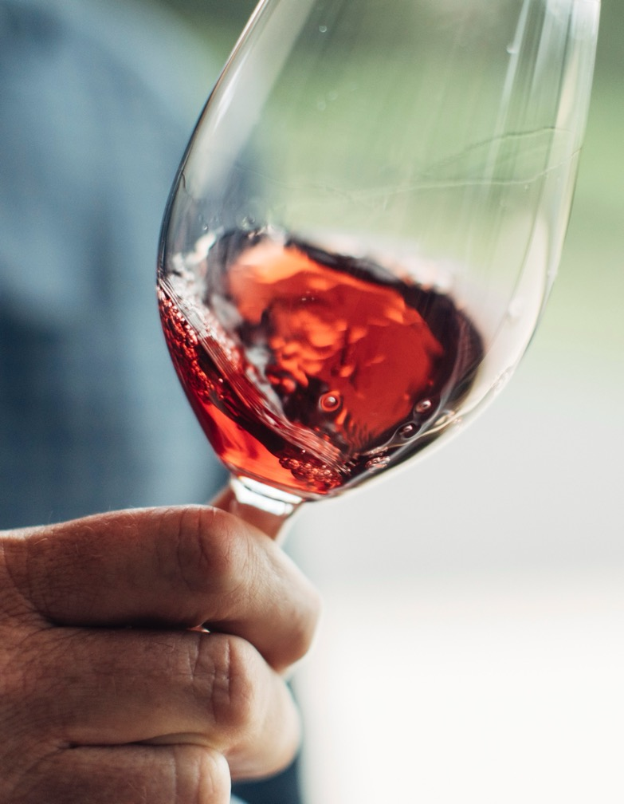
Today
1997
Orange is now a bona fide gourmet destination with an established and well-respected food and wine culture. The region is home to over 60 wineries and 40 cellar doors – many of which are small and family-run.
Orange becomes officially registered as an Australian GI within the Central Ranges wine zone.
1988
2002
Philip Shaw purchases and plants 47 hectares of vines at the Koomooloo vineyard.
The inaugural Orange Wine Show is held.
Notes:
SUGGESTED DISCUSSION POINTS:
– What does Orange’s relatively short history as a wine region mean for viticulture and winemaking today?
– Given its substantive agricultural history, why do you think Orange only emerged as a wine region somewhat recently?

Slide 10
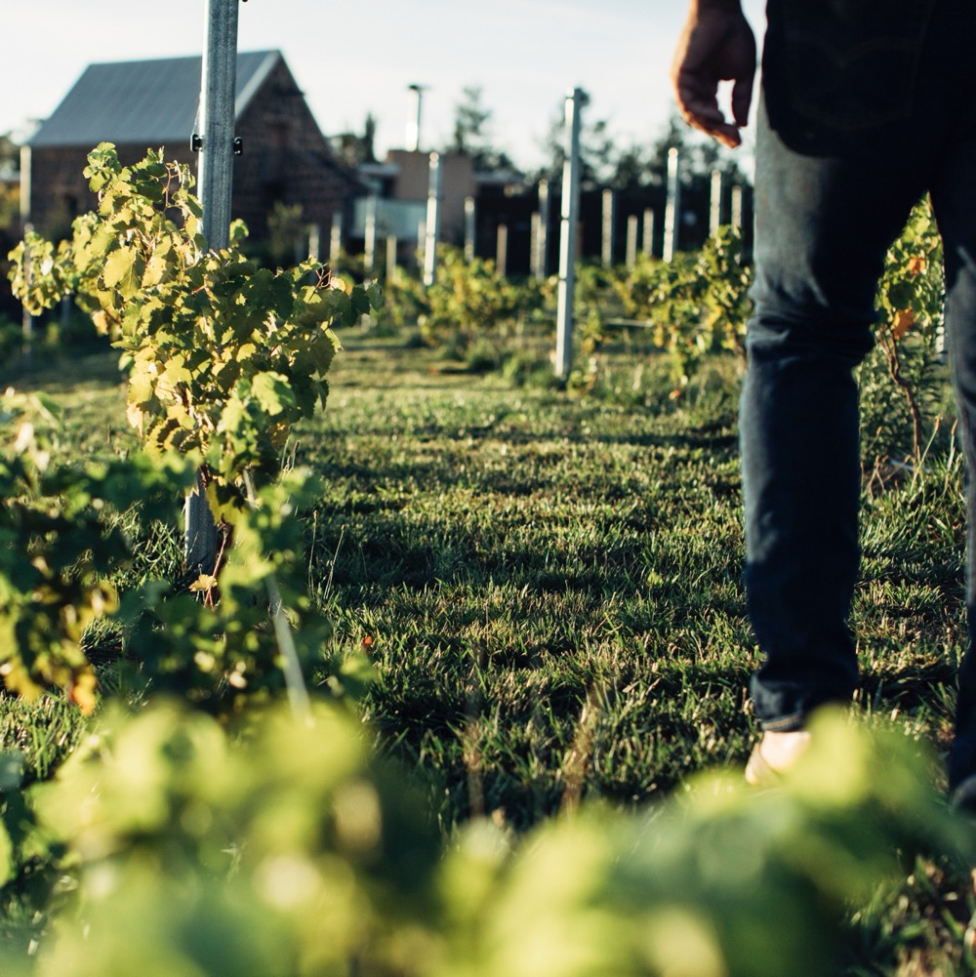
GEOGRAPHY, CLIMATE AND SOIL
COOL, ELEVATED AND PICTURESQUE
Just over 200 kilometres west of Sydney, in Central Ranges of New South Wales
Australia’s highest wine region
Continental climate heavily influenced by the elevation
A sloping landscape and rich, diverse soils, due to volcanic activity more than 10 million years ago.
Notes:
Mount Canobolas, a long-extinct volcano, has had a profound influence on the region. A series of eruptions that took place more than 10 million years ago, and the erosion that’s occurred since, have given rise to a rich, sloping landscape of diverse geology, soil types and ages, all of which are determined by elevation. The cool continental climate is a result of the lofty altitude, with temperatures and weather patterns governed by their proximity to Mount Canobolas. These distinctive geographical and climatic attributes make for a thriving agricultural region and create ideal conditions for high-quality cool climate wine production.

Slide 11
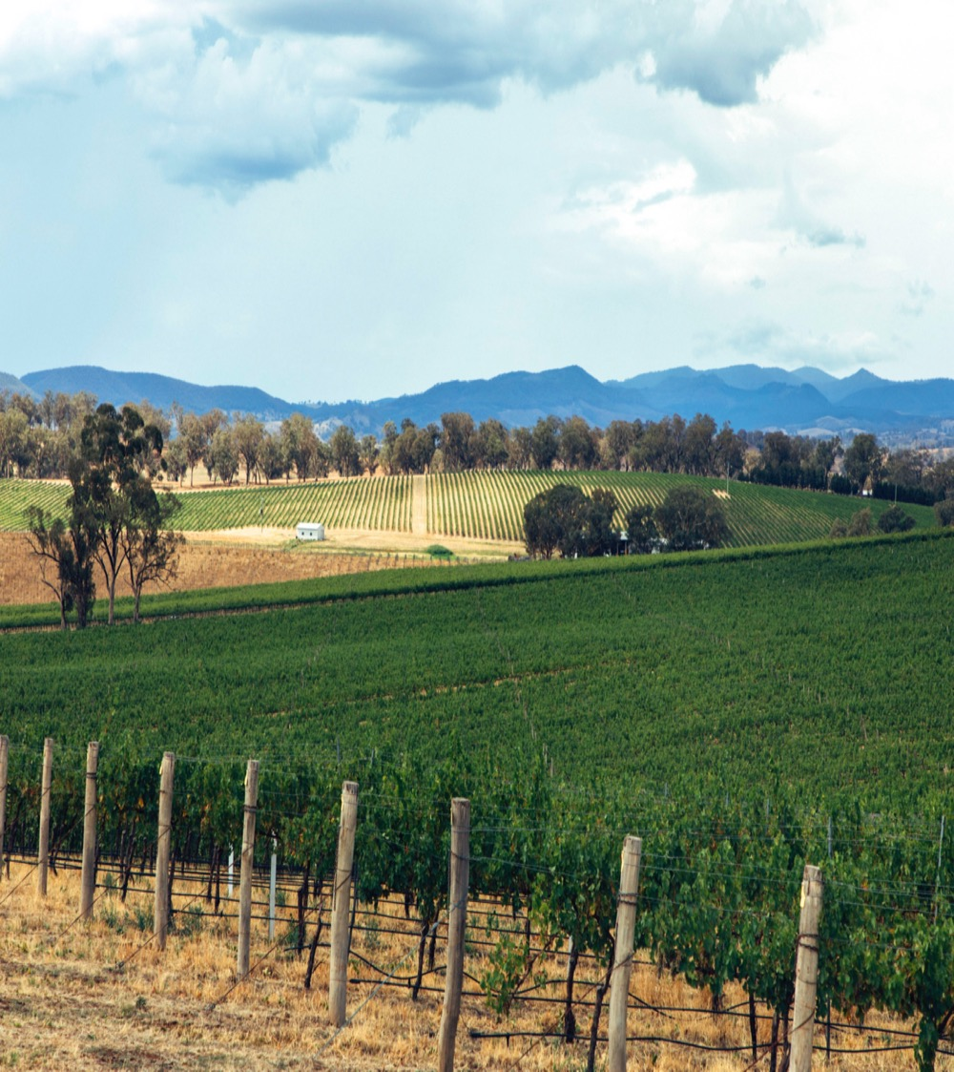
CLIMATE
ALTITUDE
CONTINENTAL
VERY HIGH
1000m +
(>3,280ft +)
ORANGE
600–1,046M (1,968–3,432FT)
HIGH
750–999m
(2,460–3,279ft)
LARGELY DEPENDENT ON ELEVATION
MEDIUM
500–749m
(1,640–2,459ft)
LOW
0–499m
(0–1,639ft)
Notes:
Mean January temperature: 21.6˚C (71°F)
Growing season rainfall: 450mm (18in)

Slide 12
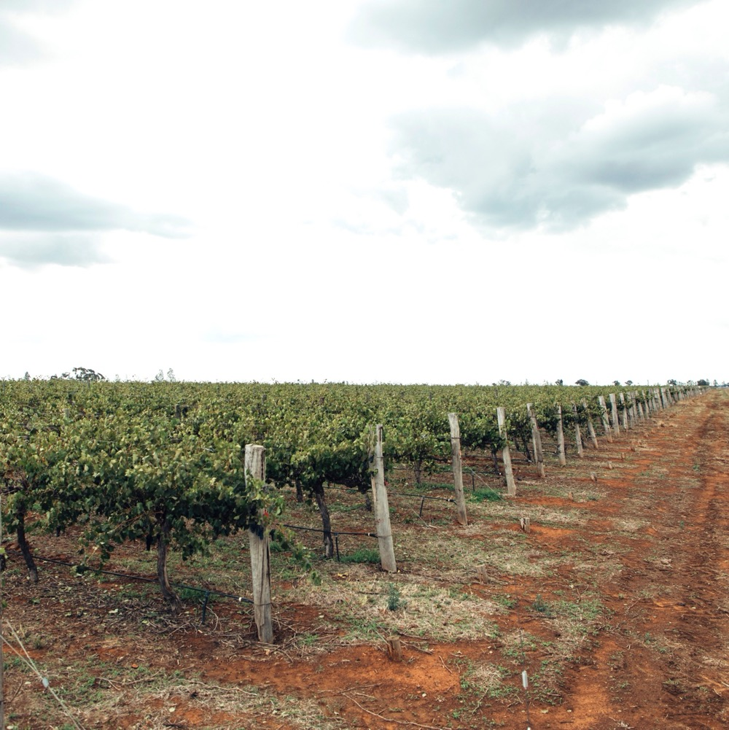
SOIL
Soils are rich, volcanic and fall into four main groups:
Vigorous, well-drained, friable, deep red-brown clays derived from basalt near Mount Canobolas.
Vigorous, deep red-brown/yellow- brown clay loams of mixed origin, including volcanic ash.
Moderately vigorous red-brown podzolic clay loam overlaying a gravel, medium clay and shale base.
Terra rossa with visible limestone at low elevations.
Notes:
SUGGESTED DISCUSSION POINTS:
– What makes the altitude such a critical factor in Orange? How might it affect the decisions made by growers and producers?
– How has Mount Canobolas affected Orange’s evolution as a wine region?

Slide 13
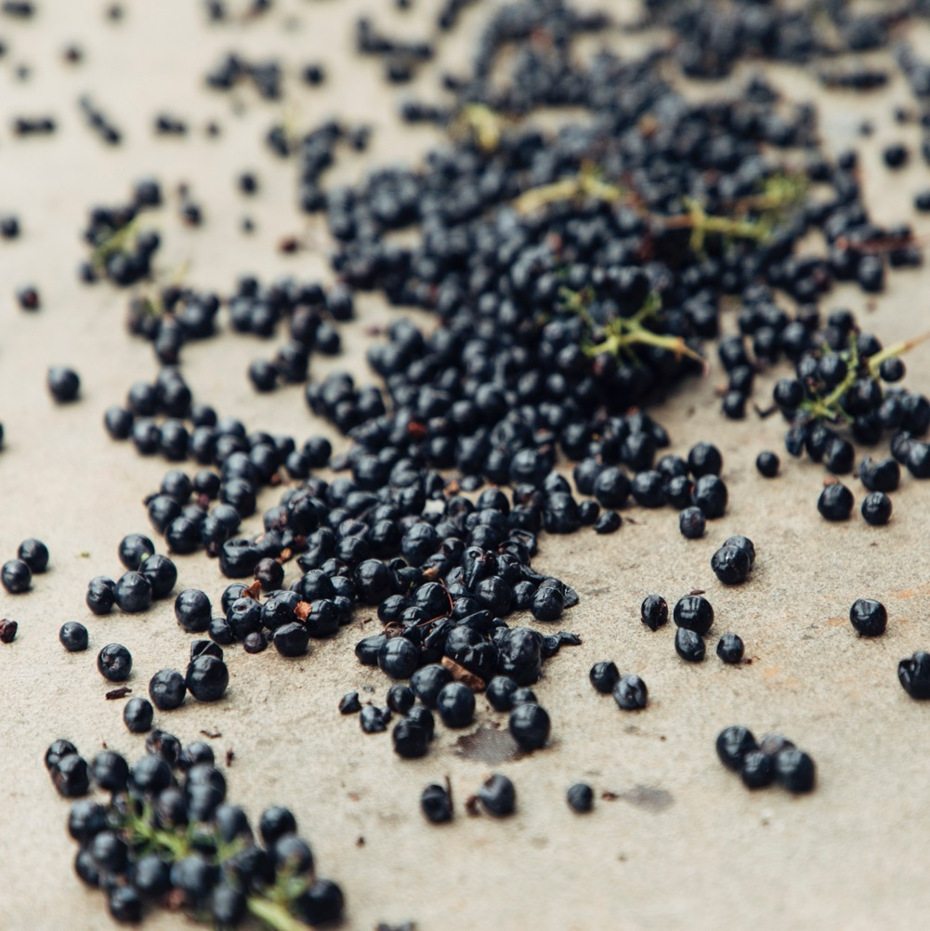
VITICULTURE AND WINEMAKING
IN ORANGE

Slide 14
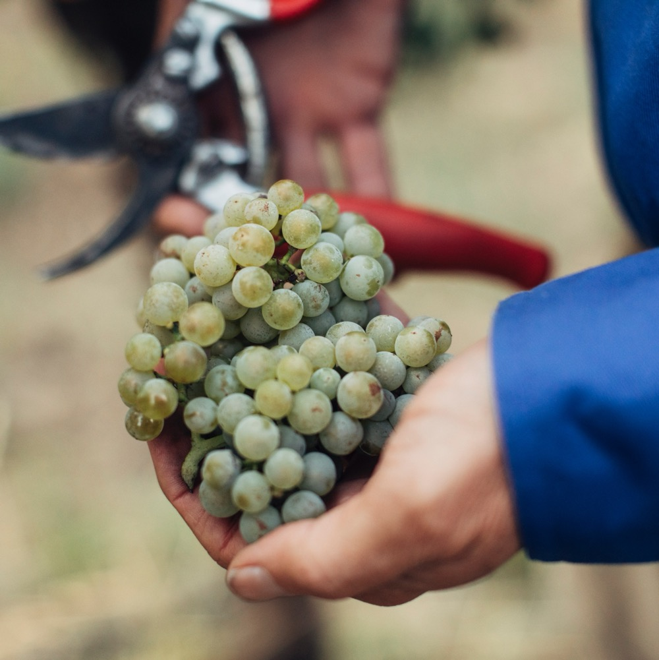
GRAPE GROWING
IN ORANGE
Conditions are favourable for an array of grape varieties
Site selection is vital, with soil types and weather conditions highly dependent on elevation
Vineyards are labour intensive, with many tended to by hand
Environmentally-friendly farming practices are an increasing priority
Harvest: mid-February to late April.

Slide 15
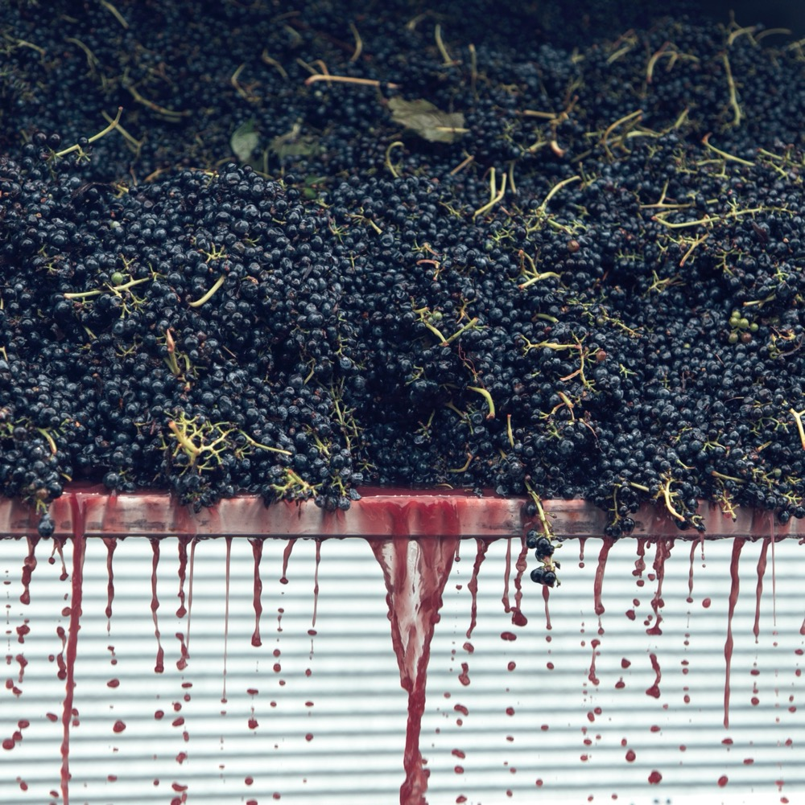
WINEMAKING
IN ORANGE
Producers take diverse approaches,
but wines typically stay true to
classic cool-climate style.
Traditional winemaking techniques prevail.
Fermentation with both cultured and
wild yeasts, with retention of natural
acidity a top priority.
Maturation vessels vary, depending
on desired palate weight and style.
Organic and preservative-free winemaking are growing focal points.
Notes:
SUGGESTED DISCUSSION POINTS:
– Why might site selection matter more in Orange than in some other Australian regions?
– Orange winemakers typically employ traditional techniques in the vineyard and winery. What are some reasons that might be the case, and how does it affect the winemaking community?
– What are the stylistic hallmarks of cool-climate wines? How would warmer years impact these characteristics?

Slide 16


ORANGE
TOP 5 VARIETIES
CABERNET
SAUVIGNON
SAUVIGNON BLANC
SHIRAZ
CHARDONNAY
MERLOT
SHIRAZ
23%
CHARDONNAY
19%
CABERNET SAUVIGNON
13%
SAUVIGNON BLANC
12%
MERLOT
10%

Slide 17
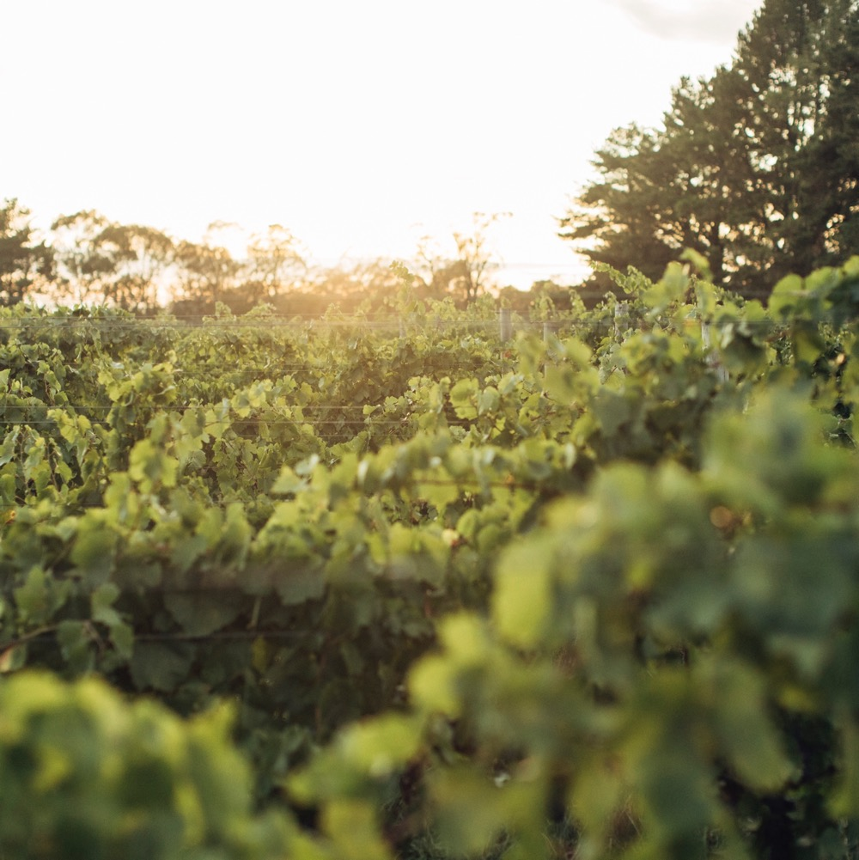
TASTE OF ORANGE
NOTEWORTHY VARIETIES
Notes:
Now is an appropriate time to taste and discuss your selected mix of wines.
+ COMPLEMENTARY TOPICS: You’ll find materials for these varieties and more at www.australianwinediscovered.com

Slide 18

ORANGE
SAUVIGNON BLANC
WELL
SUITED TO ORANGE’S COOL CLIMATE
TYPICALLY EXHIBITS TRADEMARK TROPICAL FRUIT CHARACTERS
SAUVIGNON BLANC
TYPICAL FLAVOURS
Passionfruit
Tropical fruit
Gooseberry
Grass
Herbs
Flint
SOME PRODUCERS
HAVE HAD SUCCESS WITH OAK AGEING IN THE STYLE OF FUMÉ BLANC
Notes:
Orange’s cool climate suits this aromatic variety well, producing wines with pronounced trademark tropical fruit characters – especially when grown at altitudes above 750m (2,460ft).

Slide 19
SAUVIGNON BLANC characteristics
COLOUR
Sauvignon Blanc
Light
Medium
Full
BODY
Dry
Medium dry
Sweet
SAUVIGNON BLANC
SWEETNESS
Low
Medium
High
OAK
(Barrel-fermented)
ACIDITY
8%
12% – 13%
17%
ALCOHOL

Slide 20
ORANGE
CHARDONNAY
THE REGION’S STAR WHITE WINE
GROWS WELL AT ALL ELEVATIONS. PRODUCERS AN ARRACY OF STYLES
CHARDONNAY
TYPICAL FLAVOURS
Stone fruit
Lemon
Grapefruit
Melon
Cashew
BENCHMARK EXAMPLES
HAVE MEDIUM-TERM (4-5 YEARS) CELLARING POTENTIAL
Notes:
Wines range from crisp and elegant through to robust and full-flavoured, with suggestions of citrus, stone fruit, melon and cashew.

Slide 21
CHARDONNAY characteristics
COLOUR
Chardonnay
Light
Medium
Full
BODY
Dry
Medium dry
Sweet
SWEETNESS
CHARDONNAY
Low
Medium
High
OAK
ACIDITY
8%
12.5% – 13.5%
17%
ALCOHOL

Slide 22

ORANGE
PINOT NOIR
WELL SUITED TO THE CLIMATE AND ELEVATION OF THE REGION
CAN BE JUST AS INTENSE IN TEXTURE AND FLAVOUR AS CABERNET SAVIGNON AND SHIRAZ
PINOT NOIR
TYPICAL FLAVOURS
Cherry
Plum
Raspberry
Strawberry
Violets
THE REGION
IS ALSO KNOWN FOR ITS ROSÉ AND SPARKLING WINES MADE WITH PINOT NOIR GRAPES
Notes:
Balanced oak use and fruit purity are highlights, with fresh fruit flavours like cherry, plum, raspberry and strawberry.

Slide 23
PINOT NOIR characteristics
COLOUR
Pinot Noir
Light
Medium
Full
BODY
Dry
Medium dry
Sweet
SWEETNESS
Low
Medium
High
PINOT NOIR
OAK
TANNIN
ACIDITY
8%
12.5% – 13.5%
17%
ALCOHOL

Slide 24

ORANGE
CABERNET SAUVIGNON/
MERLOT
USUALLY BLENDED, BUT SOMETIMES PRODUCED AS SINGLE VARIETAL WINES
TYPICALLY OF MEDIUM WEIGHT AND BODY, WITH FINE TANNINS, EARTHY, HERBACEOUS AND DARK-FRUITED
CABERNET SAUVIGNON/MERLOT
TYPICAL FLAVOURS
Blackberry
Red berries
Violets
Mulberry
Cassis
Mixed herbs
SOMETIMES BLENDED
WITH WINES FROM WARMER REGIONS LIKE MUDGEE, HUNTER VALLEY AND COWRA
Notes:
The flavours run through the herbaceous and earthy spectrum with dark-berry sweetness. They are of medium weight and body and have fine tannins.

Slide 25
CABERNET SAUVIGNON/MERLOT characteristics
COLOUR
Cabernet Sauvignon/Merlot
Light
Medium
Full
BODY
Dry
Medium dry
Sweet
SWEETNESS
CABERNET SAUVIGNON/MERLOT
Low
Medium
High
OAK
TANNIN
ACIDITY
8%
13.5% – 14.5%
17%
ALCOHOL

Slide 26
ORANGE
SHIRAZ
MOST WIDELY PLANTED GRAPE VARIETY IN ORANGE
TYPICALLY ELEGANT WITH EXCEPTIONAL COLOUR AND TRUE VARIETAL FLAVOUR
SHIRAZ
TYPICAL FLAVOURS
Cherry
Red berries
Blueberry
Black pepper
White pepper
Warm spices
Green herbs
PLANTED MORE RECENTLY, BUT HAS PROVEN VERY SUCCESSFUL
Notes:
Though more recently planted than others, Shiraz has proven its worth in its short lifespan, showing elegance, exceptional colour and true varietal flavours like red berries and warming spices.

Slide 27
SHIRAZ characteristics
COLOUR
Shiraz
Light
Medium
Full
BODY
Dry
Medium dry
Sweet
SWEETNESS
Low
Medium
High
SHIRAZ
OAK
TANNIN
ACIDITY
8%
13% – 14.5%
17%
ALCOHOL
Notes:
Orange’s climate, unique topography and volcanic soil types create excellent growing conditions for a considerable number of both classic and emerging grape varieties across a range of styles. Traditional varieties may dominate, but later plantings of lesser-known varieties are gaining momentum. Other noteworthy varieties include:
Pinot Gris
Prosecco
Riesling
Tempranillo
Gamay
Barbera
SUGGESTED DISCUSSION POINTS:
– How does the high elevation influence the overall characteristics of Orange wines?
– Do wines from Orange have distinguishing qualities as a whole, or do they depend more on altitude and site selection?
– How might Orange’s cool-climate Shiraz differ from Shiraz produced in warmer regions like the Hunter Valley or Barossa Valley?

Slide 28
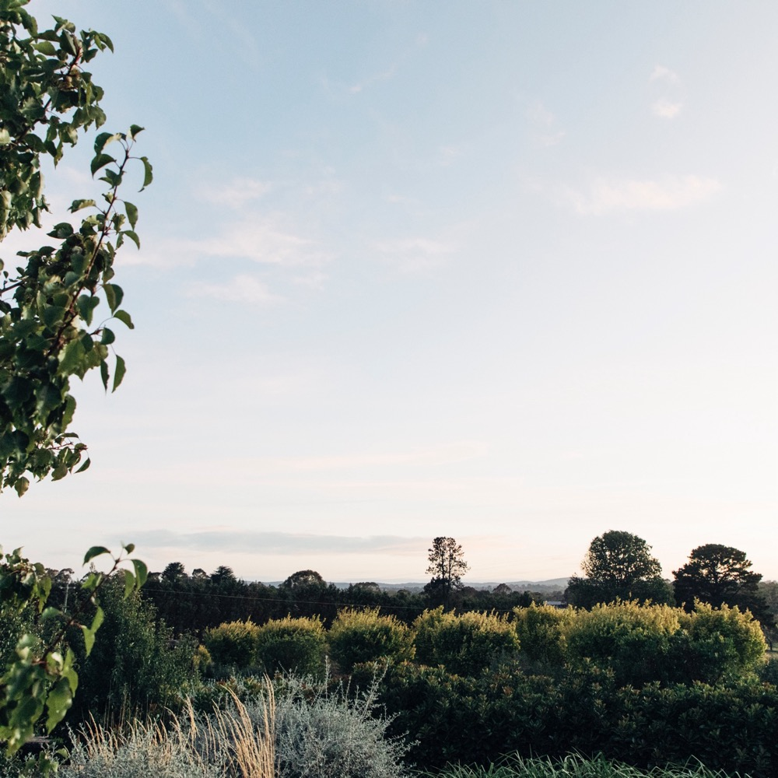
ORANGE
UP, UP
AND AWAY
A rural beauty of a region with a winning combination of altitude, climate and culture that keeps going from strength to strength.

Slide 29
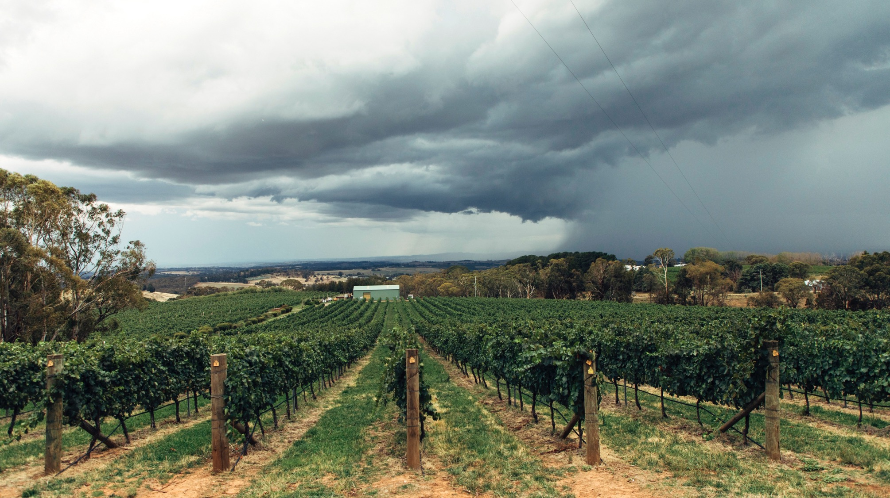
THANK YOU
Notes:
For more topics, tools and resources, visit www.australianwinediscovered.com
For enquiries, email discovered@wineaustralia.com

