Slide 1
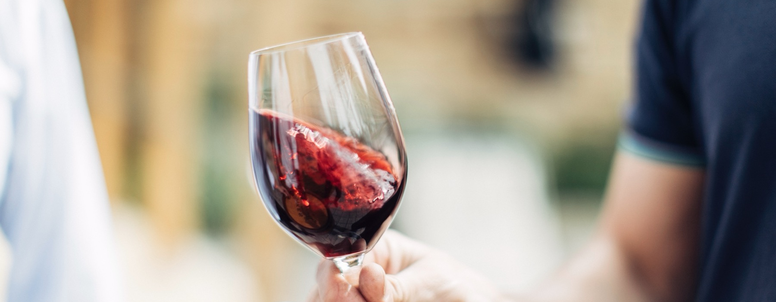
INTRODUCTION TO WINE

Slide 2


Crafted from grapes grown under vast and diverse climates, across landscapes millions of years in the making, every glass of Australian wine tells a story.
Like those who came before us, our modern growers and makers continue to be passionate, resilient and creative; constantly driven to explore new ways to perfect old techniques. Our community is connected by a mutual respect and shared love of crafting exceptional wine, while protecting the natural wonders for future generations to enjoy. Applying modern thinking to our ancient lands, we take playful experimentation very, very seriously.
So, if you’re looking for the taste of adventure, let Australian wine be your compass. Because in every bottle of Australian wine, you’ll experience the wonders of Australia – a reminder of the adventure and diversity that defines our culture and our land.

Slide 3

UNIQUE WINES
FROM UNSPOILT LANDS
Australia has one of the most diverse wine scenes in the world, with more than 150 different grape varieties grown across 65 wine regions.
The Australian wine community is renowned for its creativity and willingness to experiment.
Australian wines are an authentic expression of the people who craft them and the country’s varied soils and climate.
Australia is home to a highly-skilled winemaking community, crafting premium wines that stand among the world’s best.

Slide 4
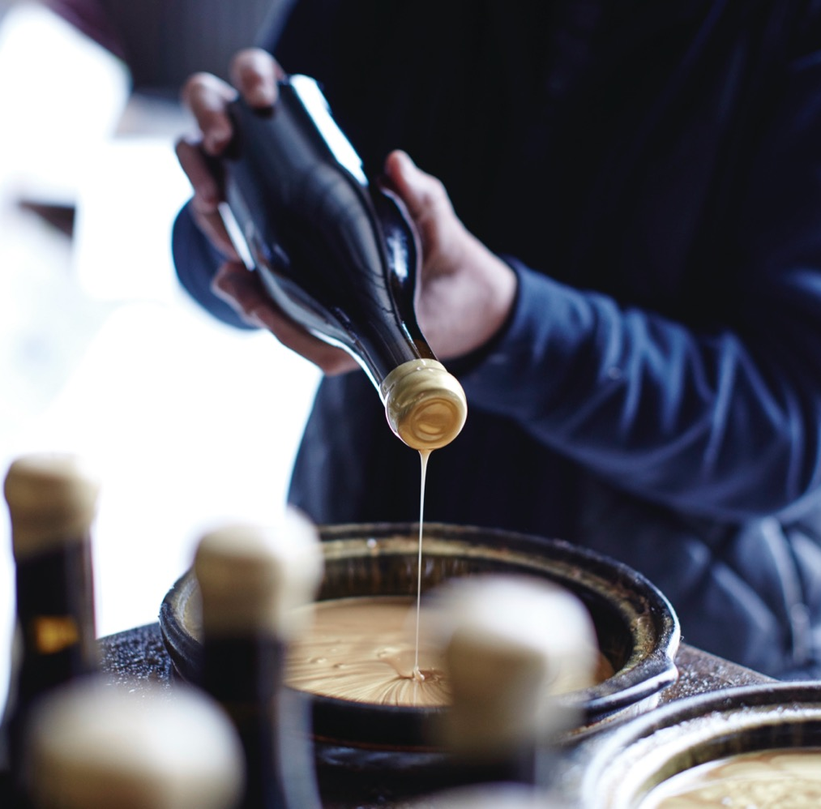
TODAY
WE’LL
COVER
What wine is
Regional influences
on grape growing
How wine is made
How to taste
Different wine styles
and varieties
Australia’s best-known
wine regions
How to serve and enjoy
Wine faults and how
to identify them

Slide 5
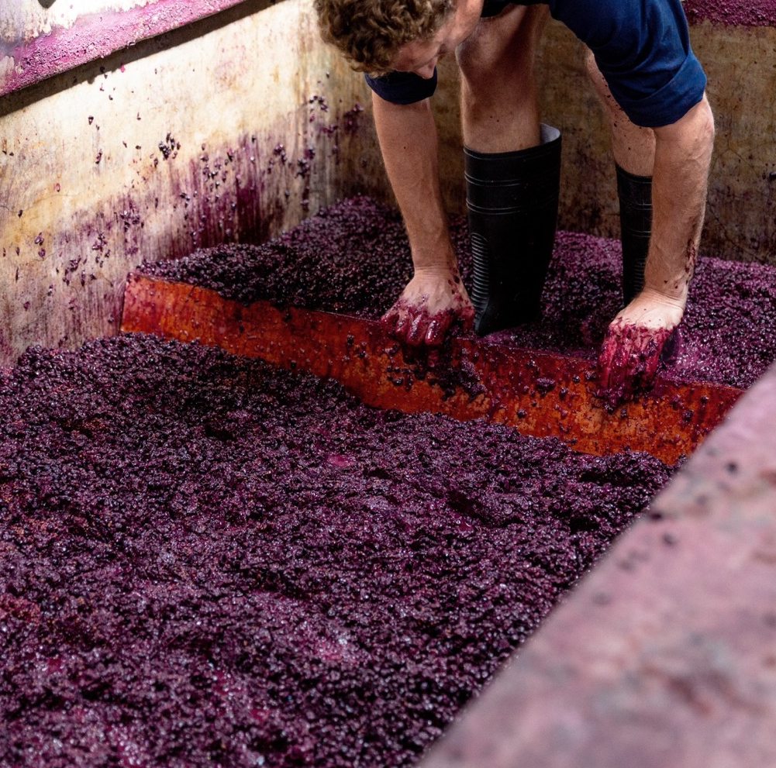
WHAT IS
WINE?
An alcoholic drink made by fermenting grape juice.
Why grapes?
Higher acidity to preserve the wine
Higher sugar content for better fermentation
Notes:
Old vines
First vines -

Slide 6
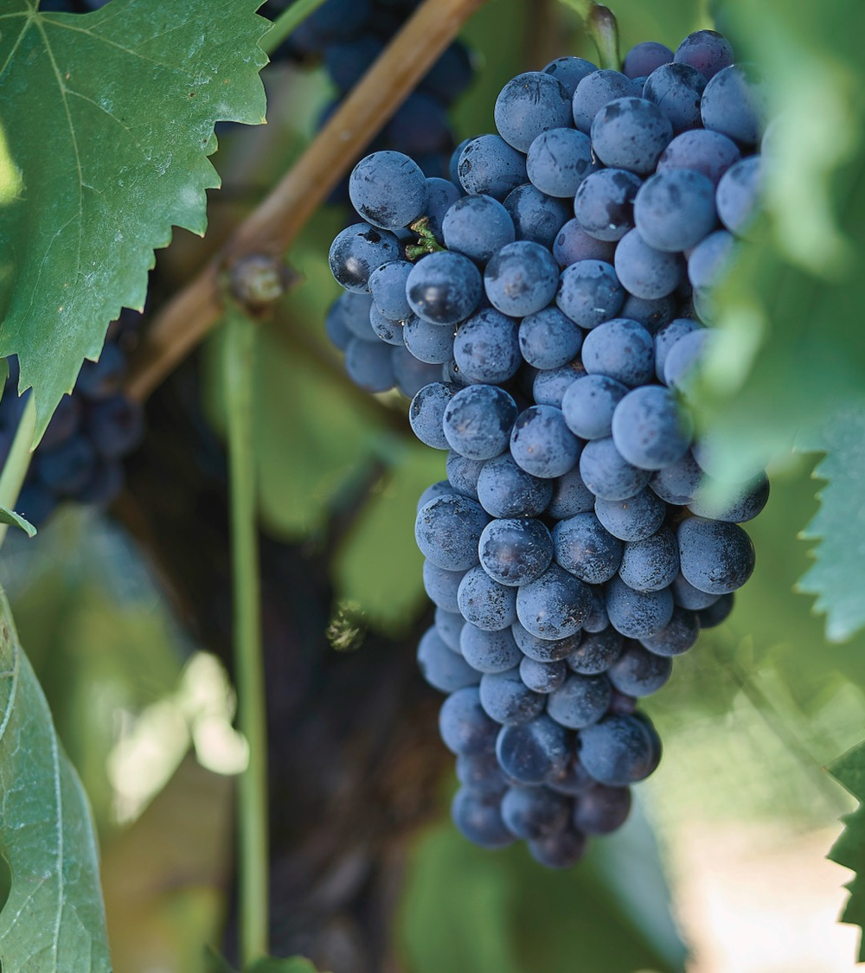
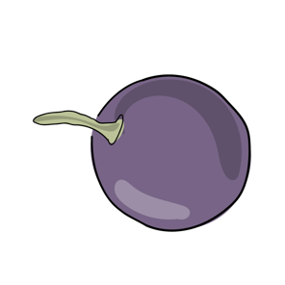
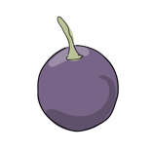
WINE GRAPES
VERSUS TABLE GRAPES
Key differences:
Origin
Size
Skin thickness
Sweetness
Seeds
WINE GRAPE
TABLE GRAPE

Slide 7
KEY FACTORS
INFLUENCING GRAPE GROWING
DIURNAL TEMPERATURE RANGE
HOURS OF SUNSHINE
CLIMATE
WEATHER PATTERNS
RAINFALL
WATER QUALITY
SOIL
TOPOGRAPHY
PROXIMITY TO BODIES OF WATER
MICROBES PRESENT IN THE REGION
And the list goes on…

Slide 8
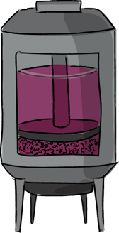


HOW RED WINE IS MADE
1. HARVEST
2. DESTEMMING AND CRUSHING
3. FERMENTATION
4. PRESSING
5. MALOLACTIC FERMENTATION
9. BOTTLING
8. FINING AND FILTERING
7. MATURATION
6. BLENDING

Slide 9
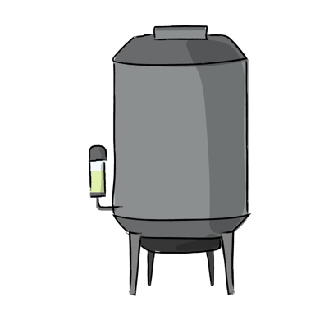
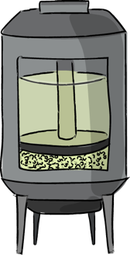
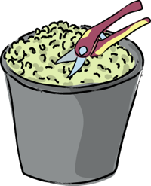
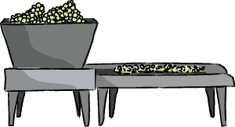
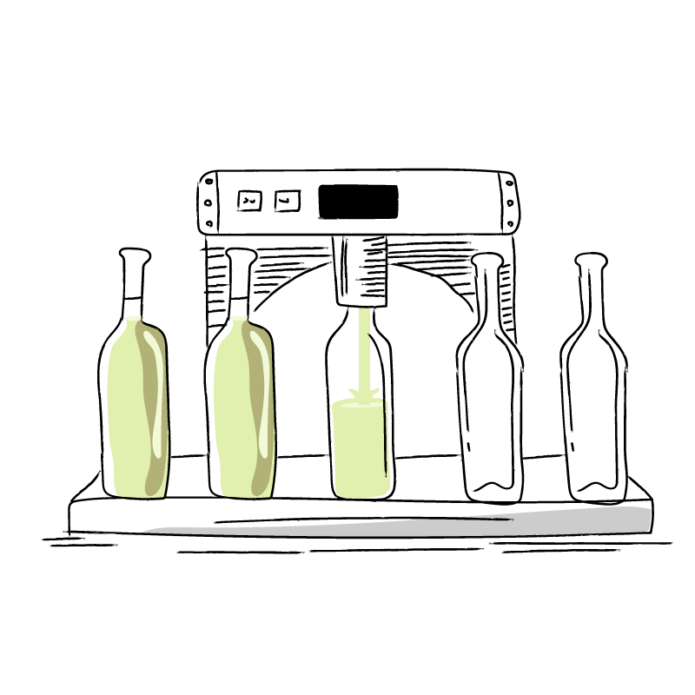
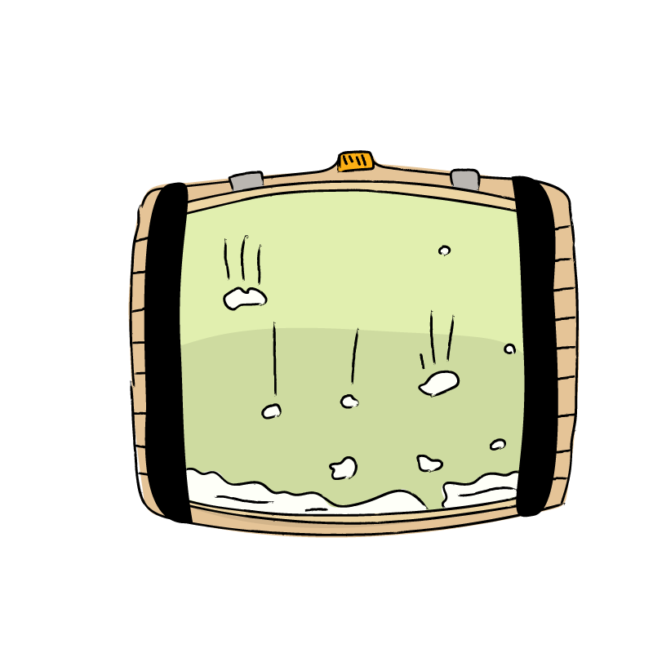
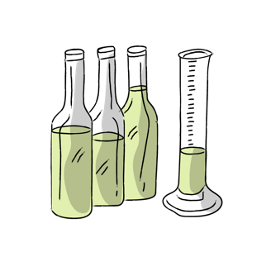
HOW WHITE WINE IS MADE
1. HARVEST
2. DESTEMMING AND CRUSHING
3. FERMENTATION
4. PRESSING
5. MALOLACTIC FERMENTATION
9. BOTTLING
8. FINING AND FILTERING
7. MATURATION
6. BLENDING

Slide 10
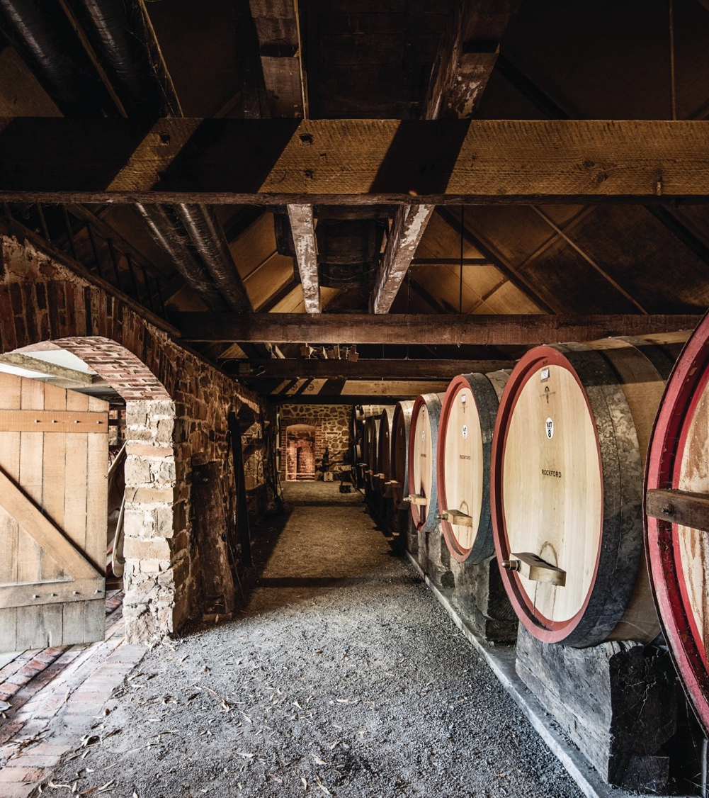
THE ART OF AGEING
Oak barrels or stainless steel?
New oak or used barrels?
French oak or American oak?
How long will the wine age for?
It could be anywhere from a few months to several years

Slide 11
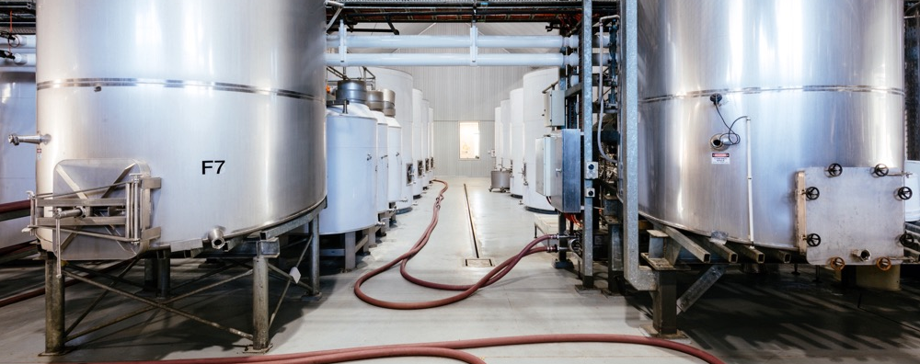
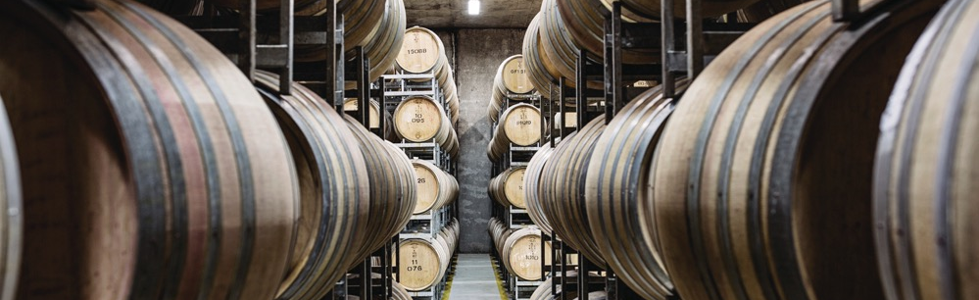
Oak
versus
stainless
steel
tanks
Oak barrels increase wine’s exposure to oxygen,
giving it complex flavours and softening the tannin structure in red wines.
Stainless steel tanks minimise oxygen exposure,
ensuring wines retain their fruitiness and floral flavours.
Notes:
Old vines
First vines -

Slide 12
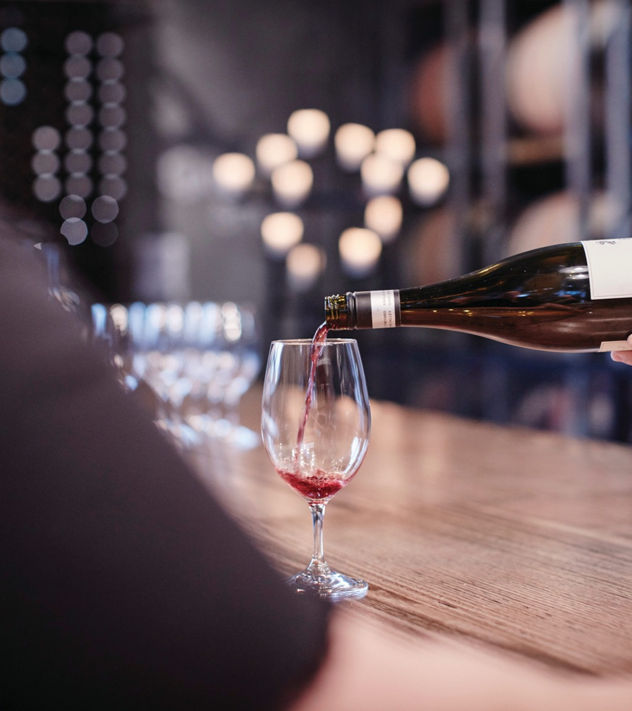
HOW TO TASTE
WINE
LOOK
SWIRL
SMELL
TASTE
CONCLUDE
Notes:
Old vines
First vines -

Slide 13
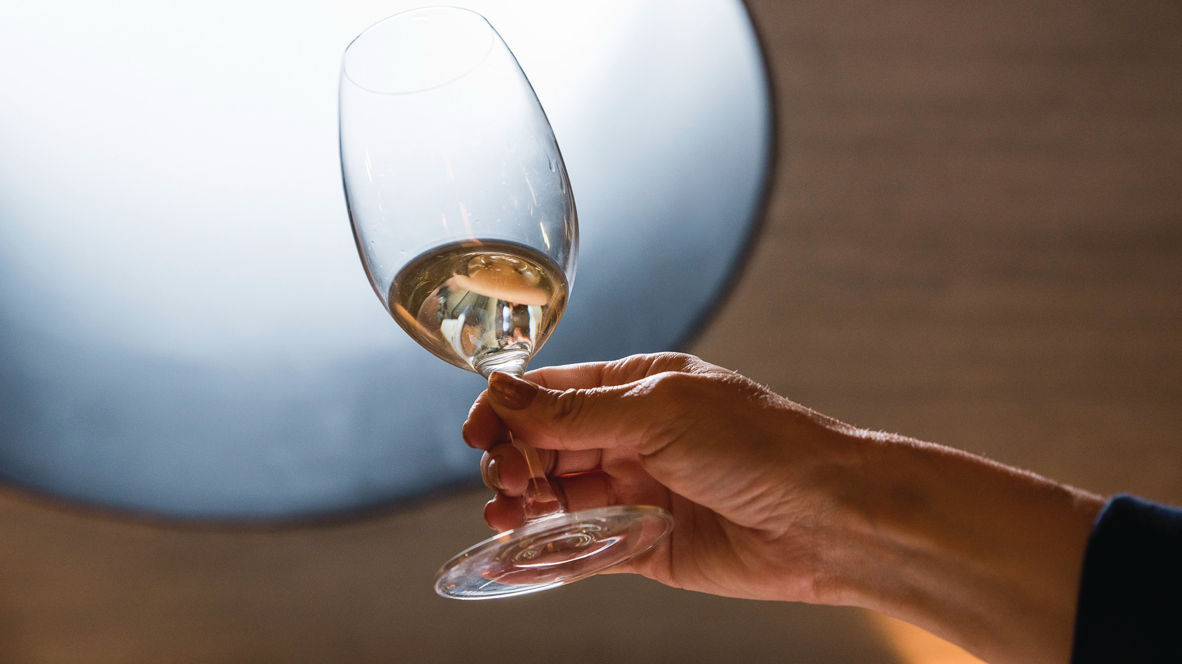
1. LOOK
Glass about one-third full
Hold it at a 45-degree angle against
a white background
Observe the colour of the wine

Slide 14
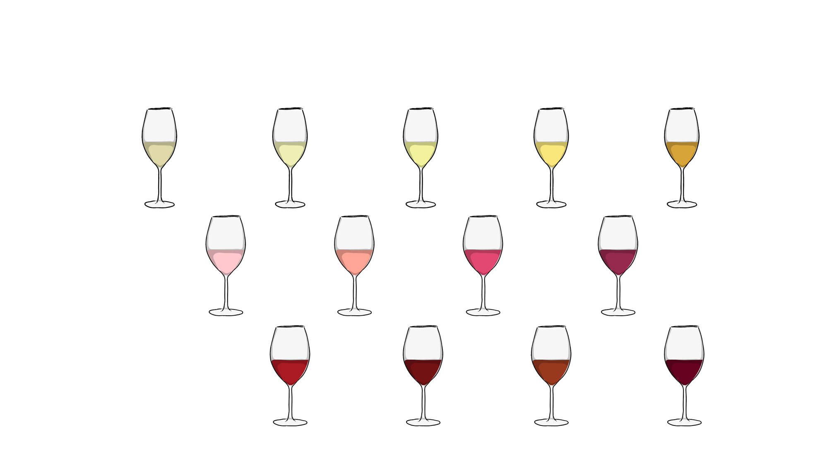
THE COLOUR OF WINE
Straw
Lemon
Yellow
Gold
Brown
Pink
Salmon
Magenta
Purple
Ruby
Garnet
Tawny
Brown

Slide 15
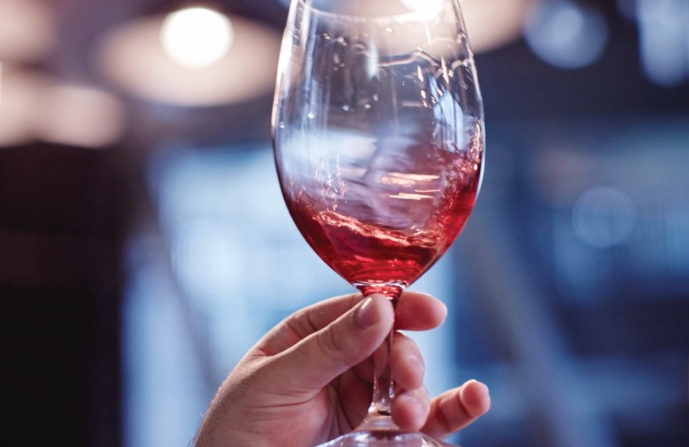
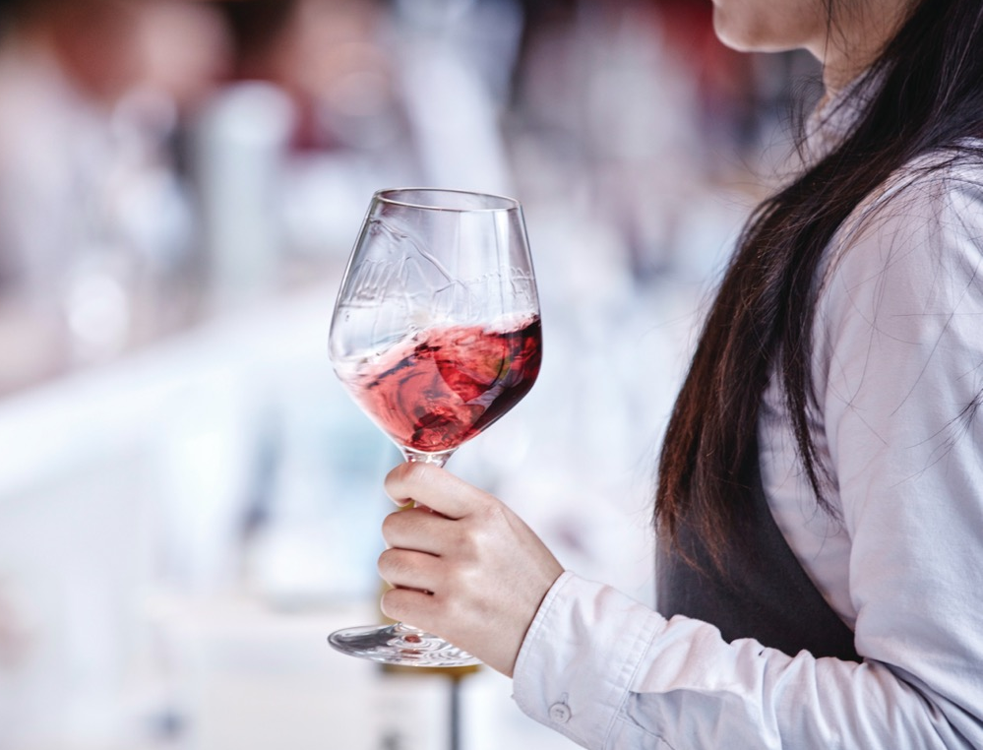
2. SWIRL
WINE LEGS
Swirling wine helps to open up the aromas
Swirl the glass while holding firmly on a flat surface
See if the wine forms ‘legs’ or ‘tears’
A wine with more legs is generally bigger, riper and more mouth-filling
Notes:
Old vines
First vines -

Slide 16
3. SMELL
The most important step
Humans can identify thousands of different odours
Experts can learn almost everything about a wine by smelling it
Deep inhalation versus quick short sniffs – find a style that works for you

Slide 17
The three types of
WINE AROMAS
PRIMARY
AROMAS
Fruit, herbs,
florals
SECONDARY
AROMAS
Bready, yeasty, toast, vanilla, chocolate, spice
TERTIARY
AROMAS
Earth, mineral, leather, tobacco
Notes:
Old vines
First vines -

Slide 18
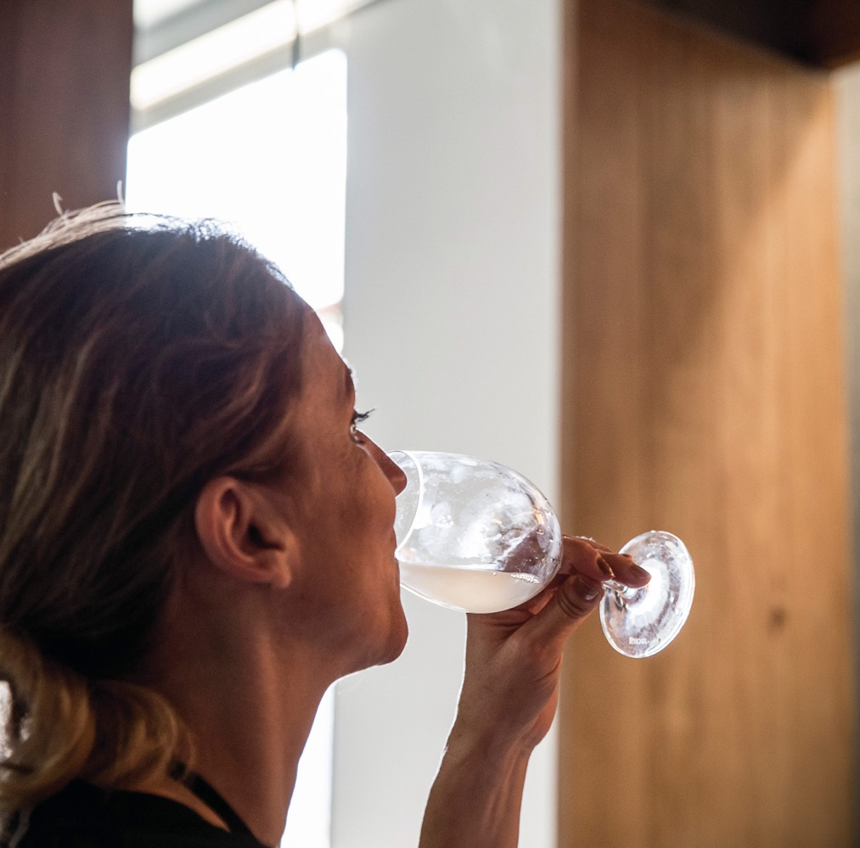
4. TASTE
Five main elements to note:
Sweetness/dryness
Acidity
Tannin
Alcohol
Body

Slide 19

SWEETNEsS/
DRYNESS
SWEETNEsS SCALE
Bone-dry
What it feels like:
A bone-dry wine can feel as though it’s drawing moisture from your tongue. But this sensation can also be due to high tannin
Light tingling sensation on the tip of your tongue
Slightly oily sensation on the middle of your tongue
Sweeter wine will have sweetness on the finish
The natural sweetness of fruit juice.
Dry
Off-dry
Medium-dry
Medium-sweet
Sweet
Notes:
Old vines
First vines -

Slide 20

TASTES
Green apple
Herbs
Lemon
Tropical fruit
Figs
Honey
Tropical Fruit
DRY WHITE
SWEET WHITE

Slide 21

TASTES
Candied fruit
Honey
Flowers
Ripe berries
Tart fruit
Herbs
Dark berries
SWEET RED
DRY RED

Slide 22
ACIDITY
ACIDITY SCALE
Low
What it feels like:
Mouth-watering
Tart
Rush of juiciness
on both sides of
your tongue
Comparison:
Eating a green apple
or lemon.
Medium
High
Notes:
Old vines
First vines -

Slide 23
TANNIN
TANNIN SCALE
Low
Tannins add structure, backbone and complexity to a wine, particularly in reds. They’re also vital if the wine needs to
age, as they act as a preservative.
What it feels like:
Bitterness on the sides of your tongue
Texture throughout your mouth
Strong tannins make your tongue and teeth dry out and cause a puckering feeling on your gums
Comparison:
Strongly brewed tea turned cold.
Medium
High
Notes:
Old vines
First vines -

Slide 24
BODY
BODY SCALE
Light-bodied
Swish the wine around your mouth to coat your tongue, cheeks and palate. Generally, the more alcohol, the fuller
the body.
What it feels like:
Light-bodied wine: lighter, thinner, less viscous mouthfeel
Full-bodied wine: heavy or creamy
Comparison:
Light-bodied wine: non-fat milk
Medium-bodied wine: whole milk
Very full-bodied wine: heavy cream
Medium-bodied
Full-bodied
Notes:
Old vines
First vines -

Slide 25
ALCOHOL
ALCOHOL SCALE
8% Low
What it feels like:
Heat in the middle of your tongue, throat and chest
Fortified wine will produce a warming glow in your mouth, throat and chest
Comparison:
The warm, burning sensation of spirits.
Tastes:
Wines high in alcohol can taste more tannic or sweeter.
9%
10%
11%
12%
13%
14%
15%
16%
17% High
Notes:
Old vines
First vines -

Slide 26
5. CONCLUDE
Short or long finish?
Does it taste balanced?
Do the flavours linger?
Do any particular characteristics stand out?
What have you learned about the wine?

Slide 27
WINE STYLE
AND VARIETIES

Slide 28
SPARKLING
WINE
A number of methods have been developed for producing sparkling wine, each resulting in a slightly different style.
Traditional method (méthode traditionnelle)
Transfer
Ancestral
Tank
Carbonation
Notes:
Old vines
First vines -

Slide 29

LIGHT-BODIED WHITE WINE RIESLING
Internationally renowned
NATURAL
ACIDITY
REGIONS
GROWS PRIMARILY IN:
Clare Valley
Eden Valley
Tasmania
Orange
Canberra District
Great Southern
Henty
CHARACTERISTICS
RIESLING
AGES WELL
Citrus fruits
Green apple
Bright fruit characters

Slide 30
LIGHT-BODIED WHITE WINE SEMILLON
COMMONLY BLENDED WITH SAUVIGNON BLANC
REGIONS
GROWS IN MANY REGIONS:
particularly the Hunter Valley and Margaret River. The unique style of Hunter Valley Semillon ages well
SEMILLON
LIGHT TO MEDIUM BODIED
Citrus
Floral
Green apple
Stone fruits

Slide 31

FULL-BODIED WHITE WINE CHARDONNAY
50%+ of Australia’s white wine production
REGIONS
GROWS IN ALL REGIONS
Big oaky styles replaced by wines with crisper acidity, minerality and elegance
CHARACTERISTICS
HARDY, VERSATILE GRAPE
Pear
Apple
Peach
Citrus
Toasty
Subtle Oak
CHARDONNAY

Slide 32
AROMATIC WHITE WINE MOSCATO
Popular as an aperitif and dessert wine
BEST EXAMPLES FROM COOLER REGIONS
PAIRING
Big oaky styles replaced by wines with crisper acidity, minerality and elegance
CHARACTERISTICS
Light, refreshing, sweet wine
Pretty, floral characteristics
MOSCATO
LOW ALCOHOL CONTENT

Slide 33
ROSé wine
ROSé
Popular modern style is pale and dry
GROWN ACROSS AUSTRALIA
REGIONS
EXTREMELY
DIVERSE STYLES
made from a variety
of red wine grapes
ROSÉ
FRESH RED FRUITS:
Cherry
Strawberry
Raspberry

Slide 34
LIGHT-BODIED RED WINE PINOT NOIR
Australia’s most popular light red
YOUNG
REGIONS
FOCUS ON COOL–CLIMATE
regions such as Yarra Valley, Mornington Peninsula and Tasmania
bright red and black fruit flavours
CHARACTERISTICS
PINOT NOIR
AGED
STYLES VARY
depending on region and winemaking process
more complex characters such as tobacco, forest floor, earthsmoke and spice

Slide 35
FULL-BODIED RED WINE SHIRAZ
Australia’s most famous wine export
WARM CLIMATES
REGIONS
GROWN IN ALL REGIONS
with the Barossa Valley and Hunter Valley the most well-known
Rich, ripe fruit flavours, spicy styles
CLIMATE
SHIRAZ
COOLER CLIMATES
WORLD’S OLDEST SHIRAZ VINES STILL IN PRODUCTION
Fresh, mint-weight, elegant styles

Slide 36
FULL-BODIED RED WINE CABERNET SAUVIGNON
Australia’s third most planted grape variety
THICK SKINNED, ROBUST, FIRM TANNIN STRUCTURE
REGIONS
Grown in all regions, with the Barossa Valley and Hunter Valley the most well-known
CABERNET SAUVIGNON
CHARACTERISTICS
GREAT AGEING POTENTIAL
Blackcurrant
Capsicum
Mint
Often blended with Merlot, Shiraz, Cabernet Franc and Petit Verdot

Slide 37
LATE HARVEST AND SWEET WINE
BOTRYTIS SEMILLON
Australia’s most celebrated sweet wine style
REGIONS
Botrytis breeds best in humid conditions such as the Riverina and Hunter Valley regions
BOTRYTIS
SEMILLON
PALE YELLOW TO DEEP GOLDEN IN COLOUR
Stone fruit flavours, most often apricot
Citrus
Honey

Slide 38
FORTIFIED WINE
Fortified wine is still wine that has been fortified with a distilled grape spirit
REGIONS
RUTHERGLEN MUSCAT:
Rutherglen is a benchmark region, renowned for its incredible Muscats
ALCOHOL LEVELS
FORTIFIED WINE
Rich, luscious and molasses-like, with sticky sweetness and great complexity
BETWEEN 15.5
and 20%

Slide 39
single Varietals versus blends

Slide 40
VARIETAL
WINES
Made from a single grape variety
Able to tell a story of the grape, region, climate and soil, and winemaker
Some wines sold as single varietals contain a percentage of other grapes – in Australia up to 15% (15% in France, 25% in US)
Notes:
Old vines
First vines -

Slide 41
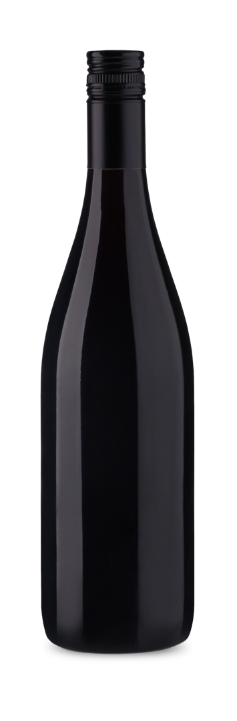
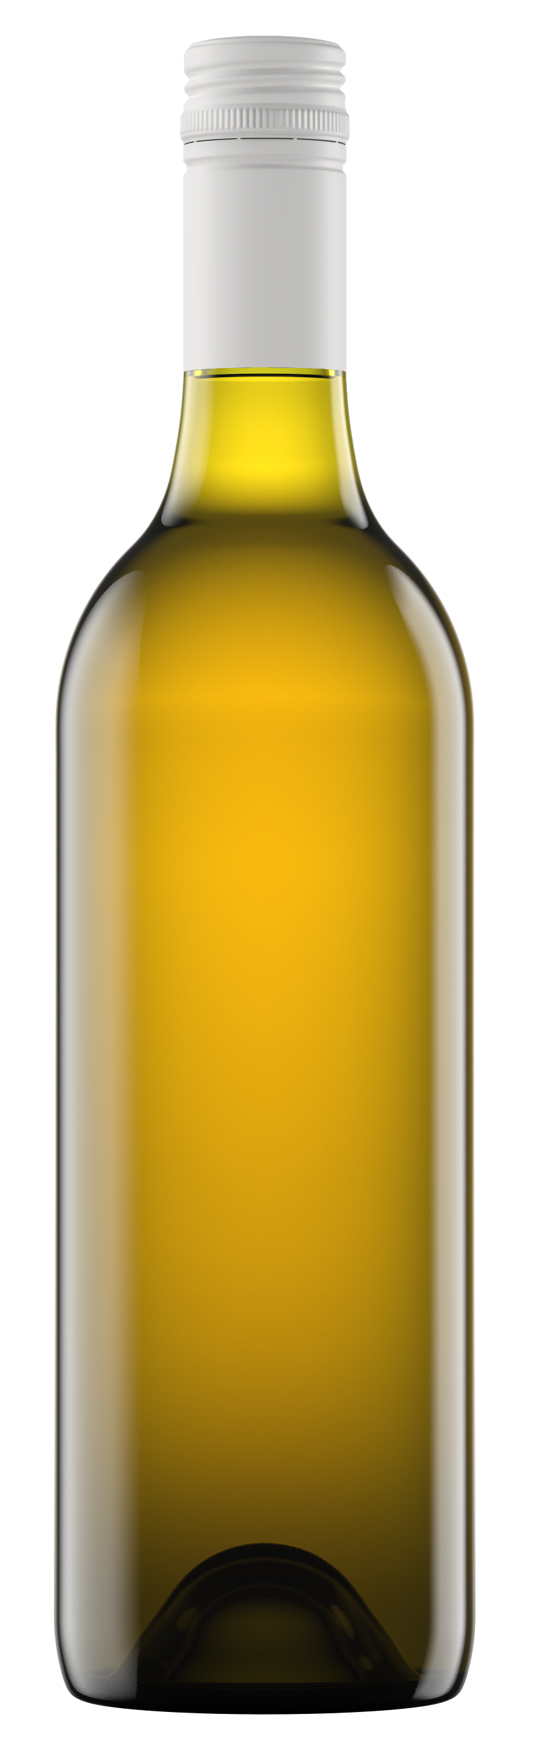
CLASSIC AUSTRALIAN BLENDS
SAUVIGNON BLANC SEMILLON
GRENACHE SHIRAZ MATARO
REGIONS
BAROSSA VALLEY MCLAREN VALE
Dry, crisp and refreshing with grassy, herbal aromas
SHIRAZ
adds richness and weight in the mouth
SAUVIGNON BLANC SEMILLON
GRENACHE SHIRAZ MATARO
SEMILLON
brings lemony notes
SAUVIGNON BLANC
contributes tropical fruits and sharper acidity
MATARO (MOURVÈDRE)
gives perfume and anise characters and grainy tannins
GRENACHE
provides aromatic spiciness and delicacy

Slide 42
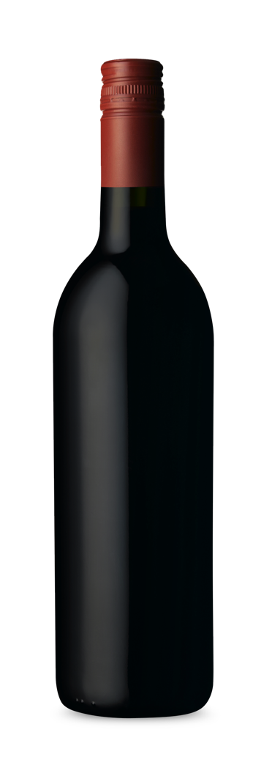
CLASSIC AUSTRALIAN BLENDS
CABERNET SHIRAZ
CABERNET MERLOT
EXCELLENT STRUCTURE WITH GOOD AGEING POTENTIAL AND LONG FINISH
DEEP TANNINS
FLAVOURS
CHARACTERISTICS
CABERNET SHIRAZ
CABERNET MERLOT
Blueberry
Black fruits
Mint
Olive
Bold, powerful style
Long finish
Well-balanced
AROMAS
Cassis
Mocha
Sweet spice

Slide 43
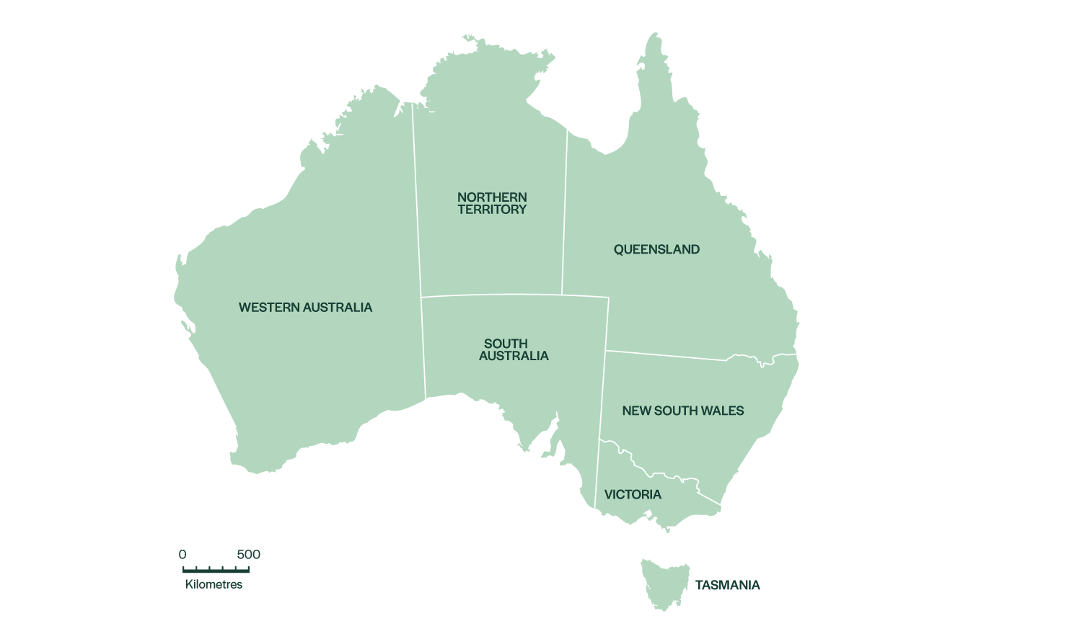
AUSTRALIA’S WELL-KNOWN
WINE REGIONS
Adelaide Hills, SA
Barossa Valley, SA
Canberra District, ACT
Clare Valley, SA
Coonawarra, SA
Heathcote, VIC
Hunter Valley, NSW
Margaret River, WA
McLaren Vale, SA
Mornington Peninsula, VIC
Tasmania
Yarra Valley, VIC
4
7
2
1
8
9
3
5
6
12
10
11

Slide 44
single Varietals versus blends

Slide 45
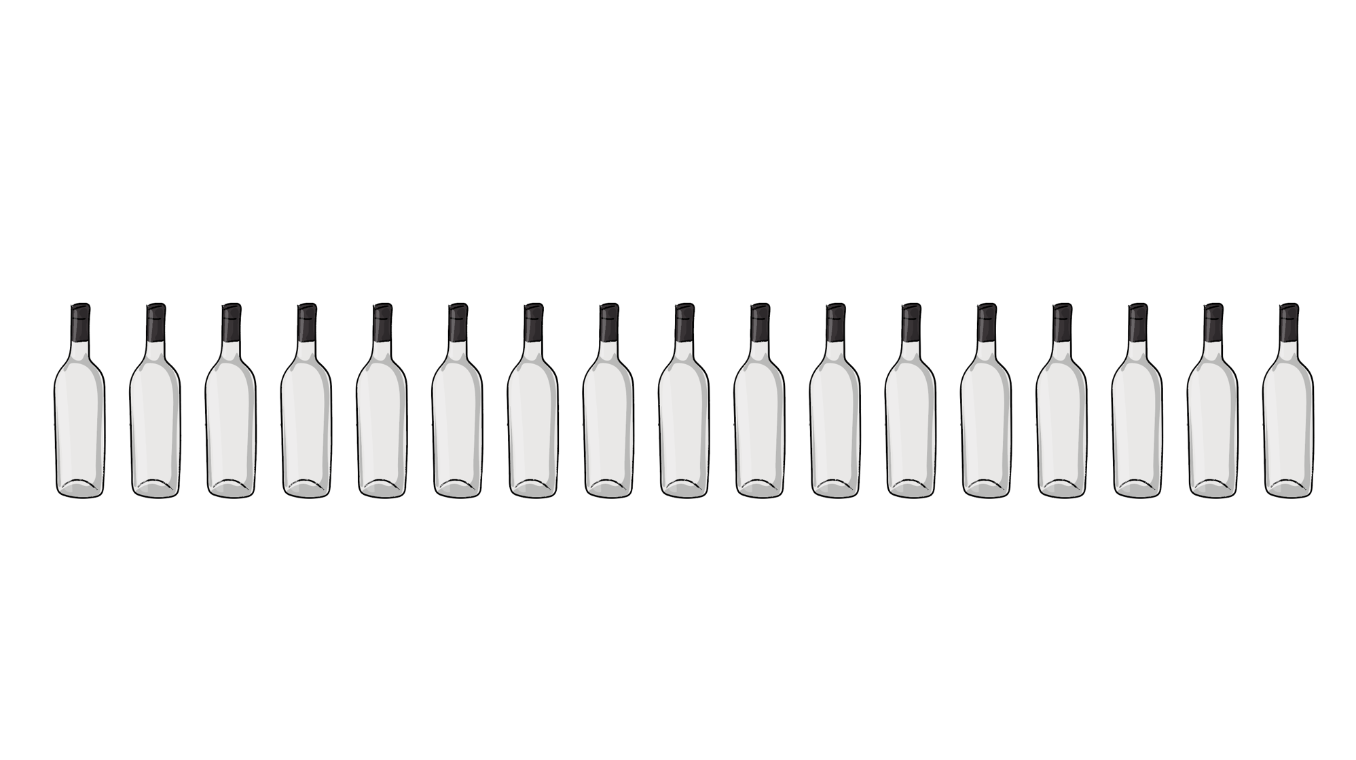
WINE SERVING TEMPERATURE
SPARKLING WINE
ICE COLD
LIGHT-BODIED RED WINE
COOL
5ºC
6ºC
7ºC
8ºC
9ºC
10ºC
11ºC
12ºC
13ºC
14ºC
15ºC
16ºC
17ºC
18ºC
19ºC
20ºC
21ºC
WHITE WINE AND ROSÉ
FRIDGE COLD
FULL-BODIED RED WINE
SLIGHTLY COOL

Slide 46
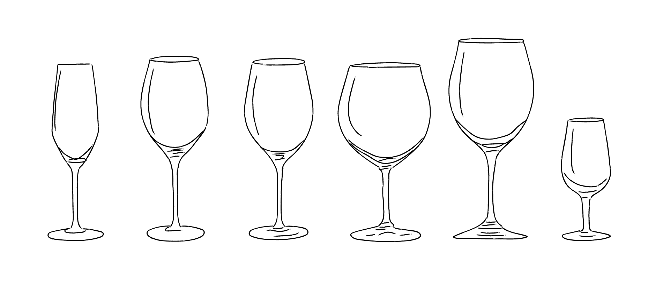
Selecting the right glass
SPARKLING
WINE
WHITE
WINE
ROSÉ
LIGHT-BODIED
RED WINE
FULL-BODIED
RED WINE
FORTIFIED
WINE

Slide 47
FOOD PAIRING
AND WINE
A complementary pairing creates balance through similar flavour profiles, with neither the wine nor the food overpowering the other.
A contrasting pairing creates balance by combining opposing qualities that still have a common element to link them.
Notes:
Old vines
First vines -

Slide 48
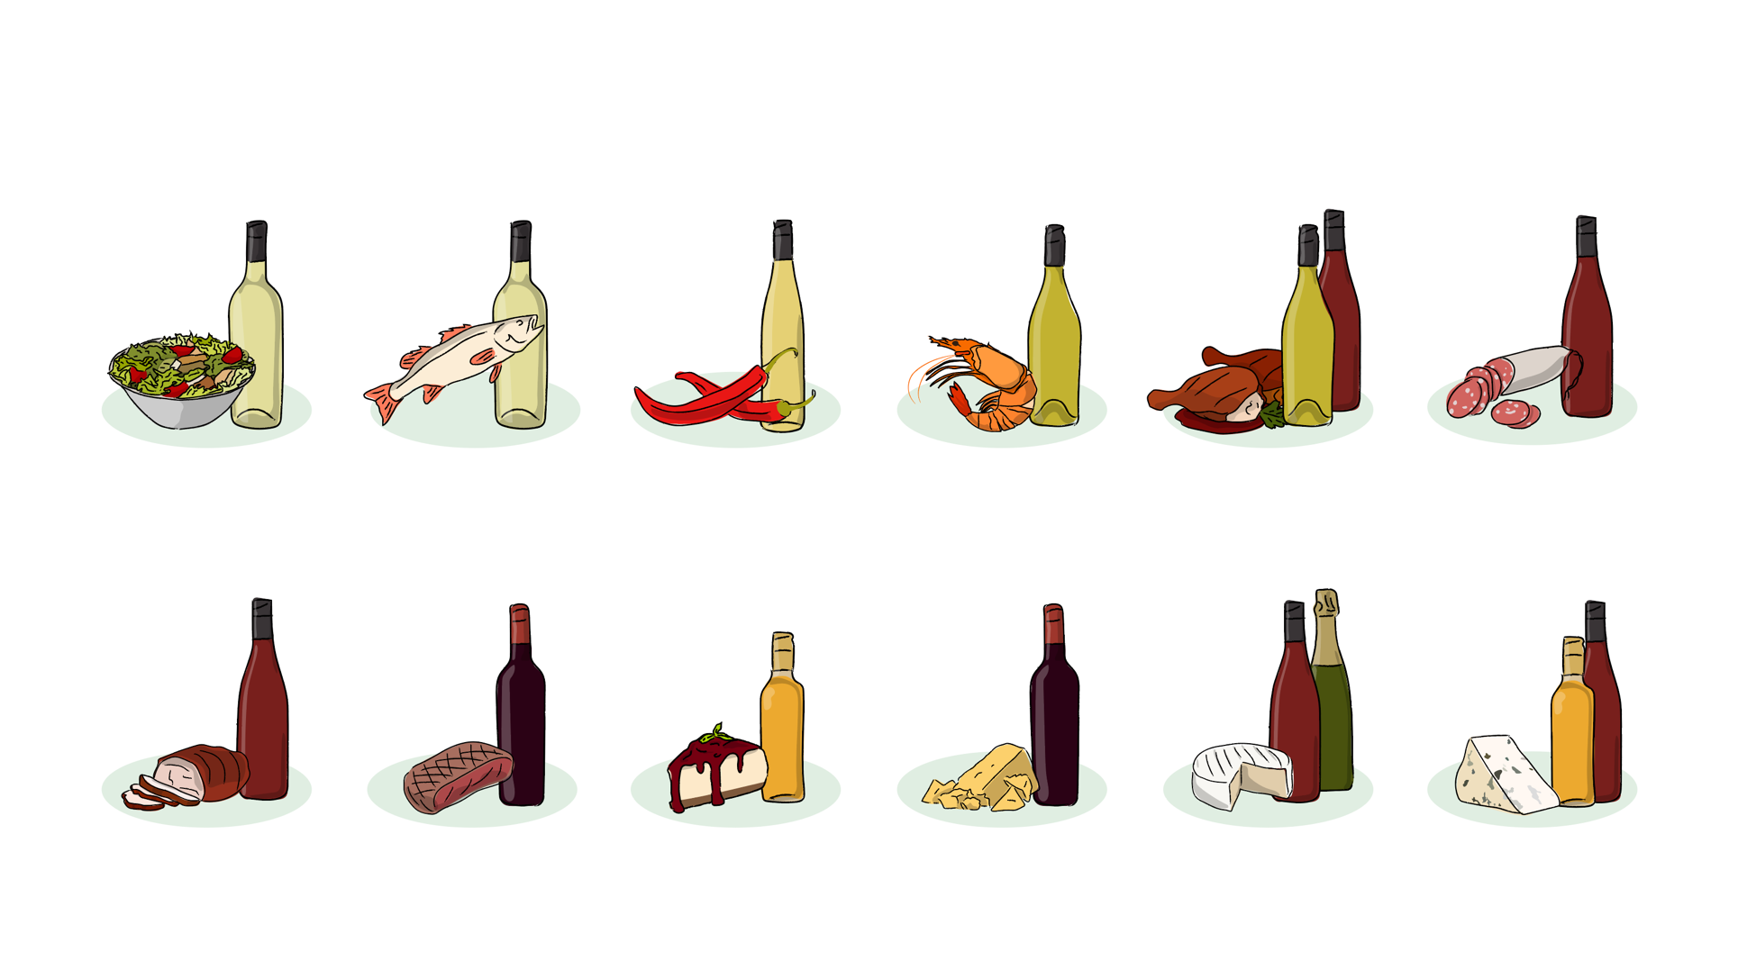
CLASSIC FOOD AND WINE PAIRINGS
Salad
Light white
Fish
Light to
medium white
Spicy food
Aromatic,
off-dry white
Shellfish
Medium to
full-bodied white
Poultry
Light red or medium
to full-bodied white
Cured meat
Light red
Pork
Medium red
Red meat
Full-bodied red
Dessert
Sweet wine,
dessert wine
Hard cheese
Bold red
Soft cheese
Light red or sparkling
Pungent cheese
Medium red or dessert wine

Slide 49
WINE FAULTS
AND HOW TO IDENTIFY THEm

Slide 50
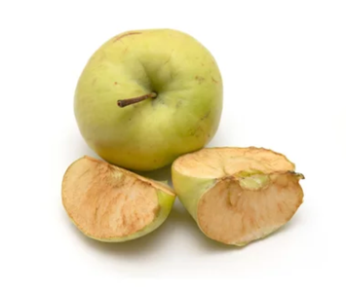
OXIDATION
When wine has been exposed to oxygen.
How you can tell:
Loss of primary, fruity aromas
Dull colour
Lacking vibrant character on palate
Flat flavours
Oxidation in fruit

Slide 51
CORK TAINT
When wine has come into contact with
2,4,6-trichloroanisole (TCA) through the cork or oak barrels.
How you can tell:
Smells like wet cardboard, musty newspapers, mushrooms, mouldy basement
Other flavours and aromas hidden in background

Slide 52

THANK YOU

