Slide 1
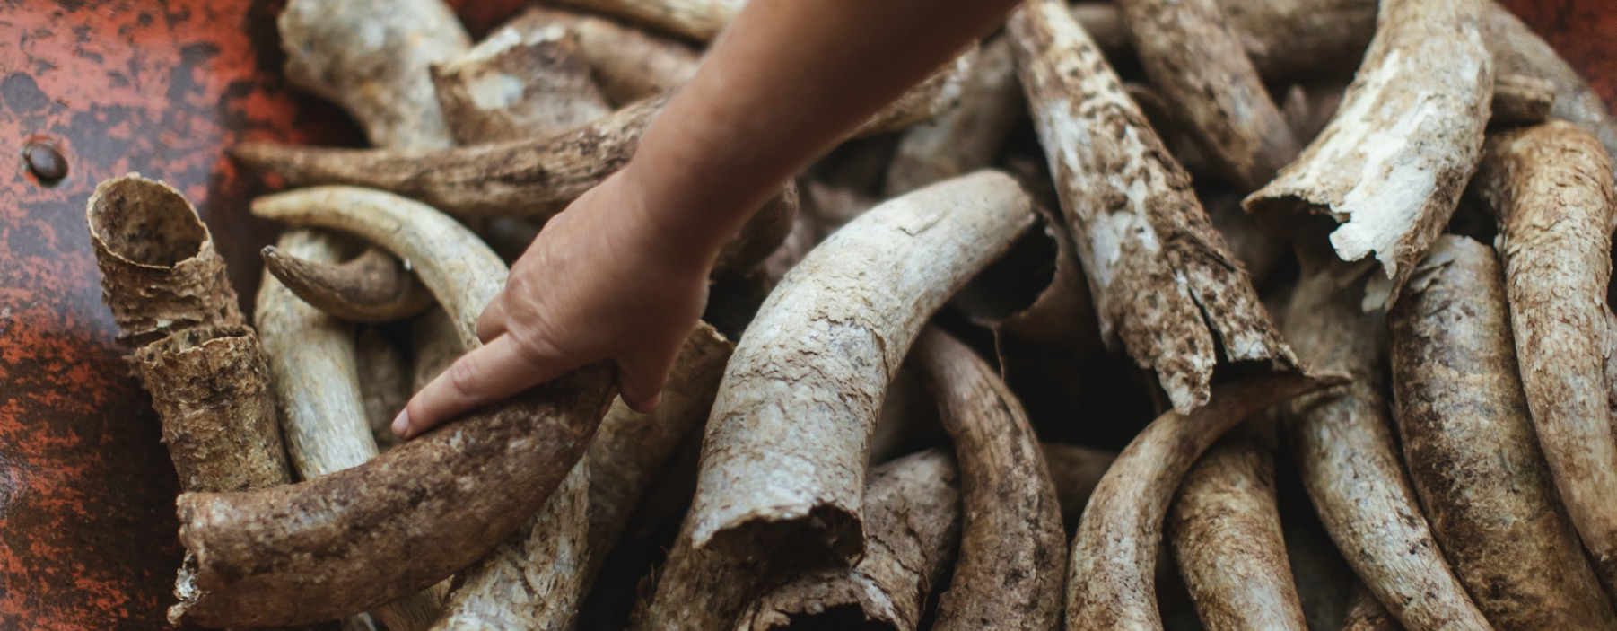
ORGANIC AND BIODYNAMIC WINE
Notes:
Australian Wine Discovered is a comprehensive, free education program providing information, tools, and resources to discover Australian wine.
To access course presentations, videos, and tasting tools, as well as other programs, visit www.australianwinediscovered.com

Slide 2


Crafted from grapes grown under vast and diverse climates, across landscapes millions of years in the making, every glass of Australian wine tells a story.
Like those who came before us, our modern growers and makers continue to be passionate, resilient and creative; constantly driven to explore new ways to perfect old techniques. Our community is connected by a mutual respect and shared love of crafting exceptional wine, while protecting the natural wonders for future generations to enjoy. Applying modern thinking to our ancient lands, we take playful experimentation very, very seriously.
So, if you’re looking for the taste of adventure, let Australian wine be your compass. Because in every bottle of Australian wine, you’ll experience the wonders of Australia – a reminder of the adventure and diversity that defines our culture and our land.

Slide 3
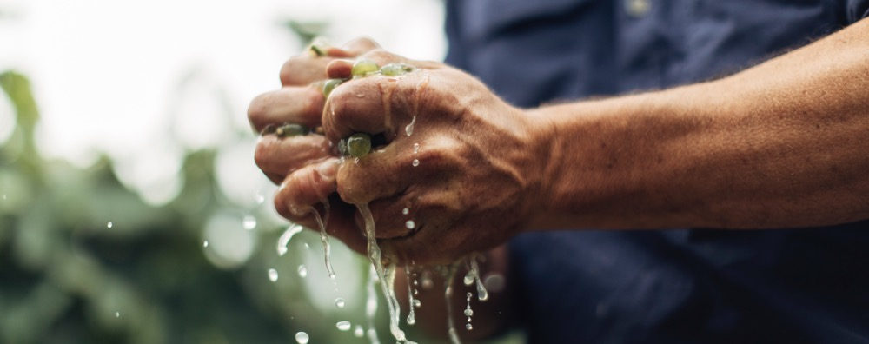
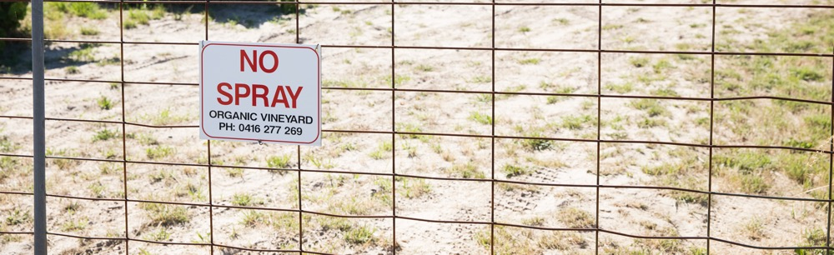
The Australian wine community is finding bold, creative and innovative ways to ensure our long-term environmental, social and economic viability,
meeting consumer demands and protecting our diverse terroirs.
DID YOU KNOW?
Australia has the largest amount of certified-organic agricultural land worldwide.
Notes:
Consumers are increasingly interested in and concerned about the products they buy, as well as how and where they’re produced.
The Australian wine community is finding creative and innovative ways to satisfy consumer interests, to ensure our long-term viability and leave a lighter footprint on our planet.

Slide 4
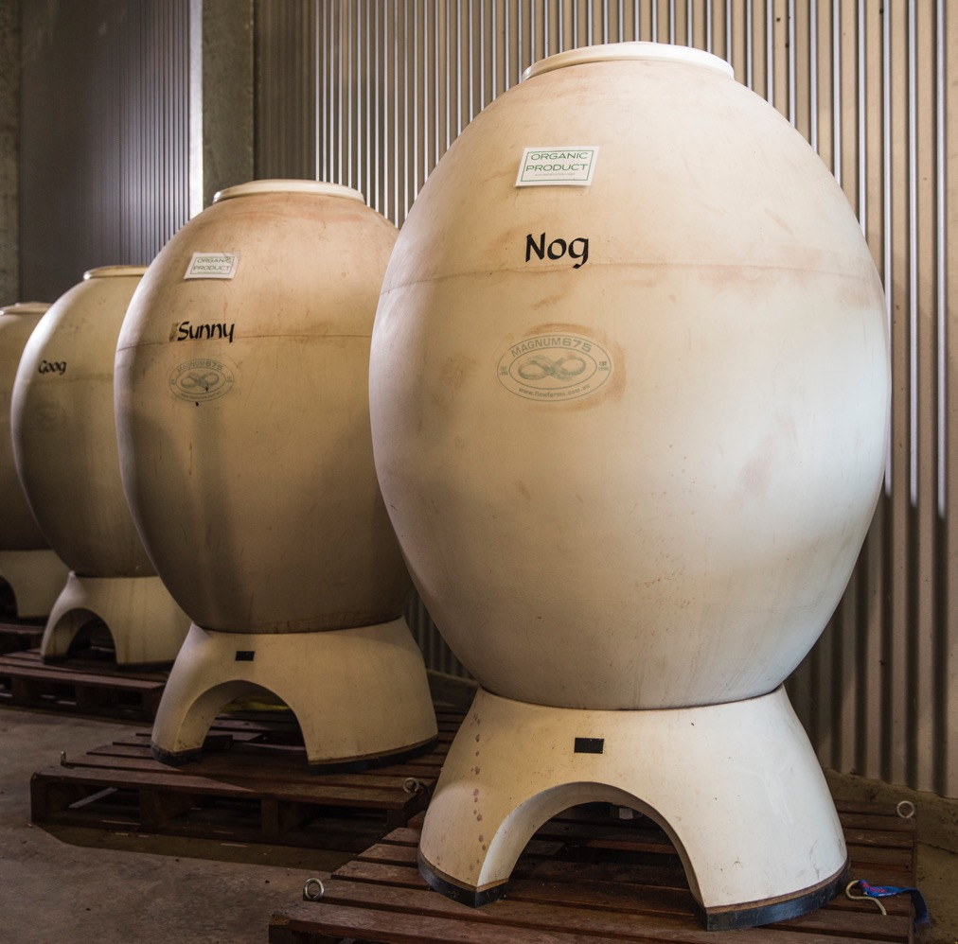
TODAY
WE’LL
COVER
Organic and biodynamic viticulture and winemaking in Australia
Other environmental considerations
Producer case studies
The rise in alternative varieties

Slide 5
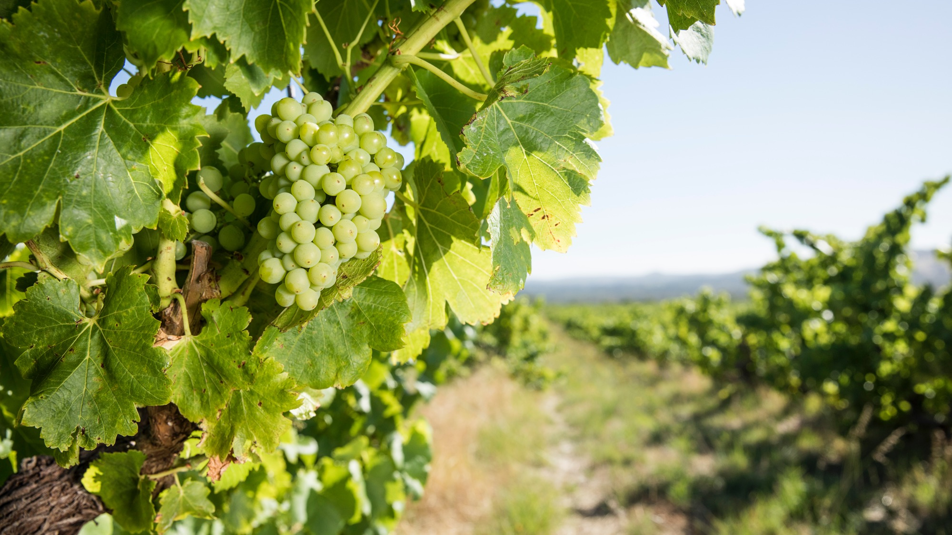
ORGANIC viticulture
Grapes are grown and processed using no synthetic or artificial additives, chemicals, herbicides, pesticides, fertilisers or genetically modified products and organisms.
Notes:
Organic viticulture is the production of grapes in an environmentally friendly way.
This involves keeping a natural balance in the vineyard and the surrounding area, without the use of synthetic fertilisers, herbicides, insecticides or fungicides.

Slide 6
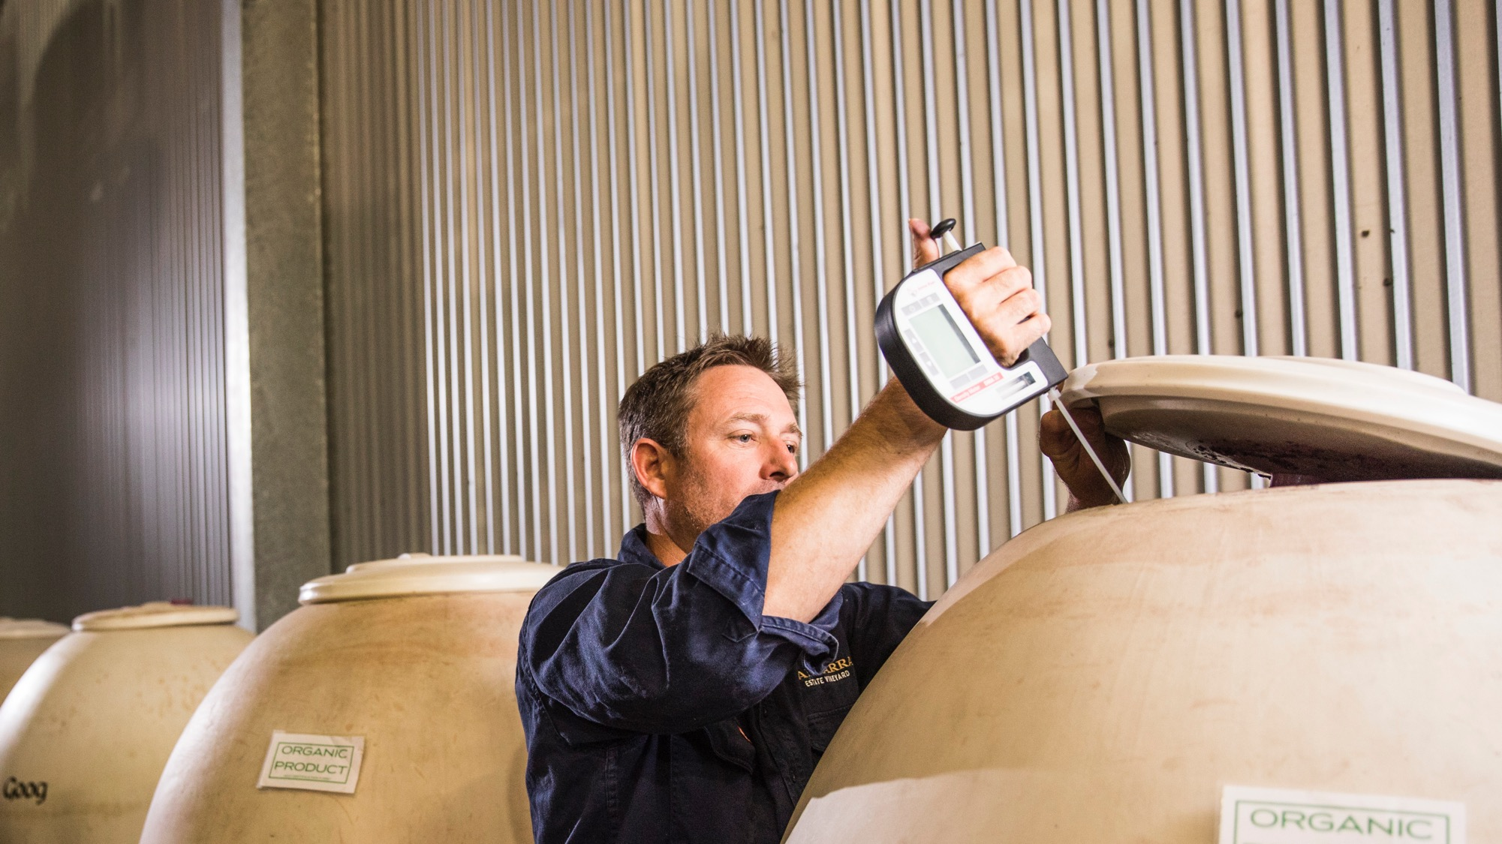
CERTIFIED
ORGANIC
The whole winemaking process – from growing the vines to bottling the wine – must be organic. Not all wines labelled ‘organic’ are certified.
Notes:
To ensure a product is genuinely organic, it can be ‘certified organic’ by an organic certifying body approved by Australia’s Department of Agriculture and Water Resources, or the Bio-Dynamic Research Institute’s DEMETER mark.
The Australian government endorses a number of certifying bodies, including the largest Australian certifier for organic and biodynamic produce: Australian Certified Organic (ACO). A strict standard, the ACO certification verifies and guarantees that a product complies with national production standards and that its provenance can be traced.
To make sure the wine you’re buying or drinking is certified organic, look for a certification logo, such as ACO or NCO (National Association for Sustainable Agriculture Australia Certified Organic).

Slide 7
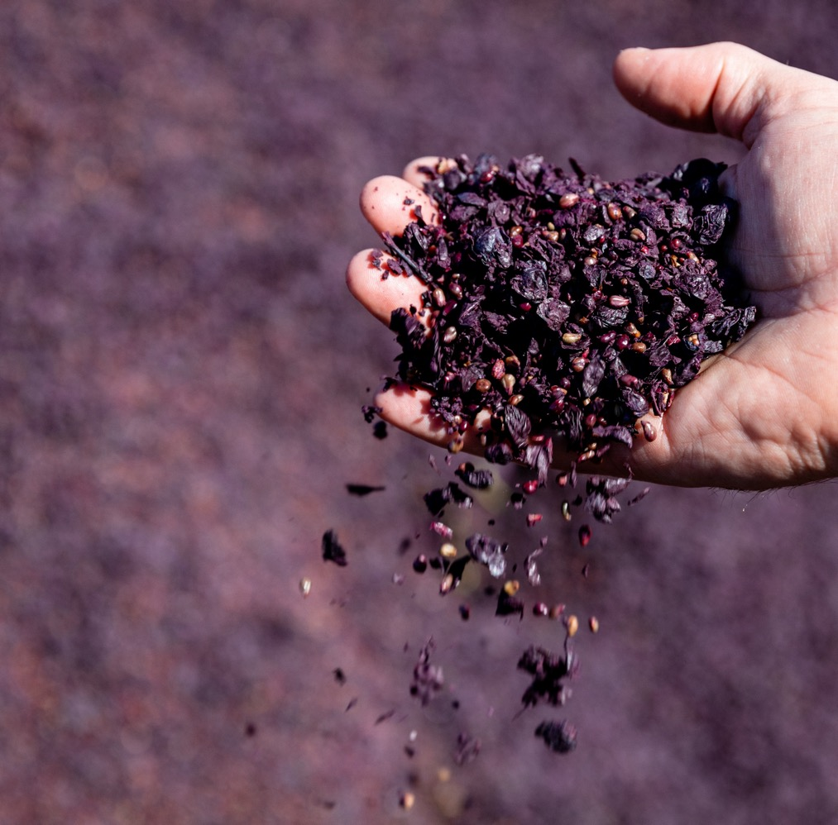
BIODYNAMIC VITICULTURE
Biodynamic viticulture is a holistic approach based on organic farming principles with specific biodynamic preparations and practices. In addition, astrological and spiritual elements strongly inform practices and timing.
Notes:
Two factors distinguish biodynamic viticulture from other forms of organic farming: the use of herbal sprays and composting techniques, known as ‘preparations’; and the timing of the operations on the land, which is strictly regulated by the cycles of the moon.
Since 1957, the Bio-Dynamic Research Institute has been involved in research and practical development of the Australian DEMETER Bio-Dynamic Method of Agriculture, demanding the highest quality application of the biodynamic method from farms and businesses, and encouraging community-based, sustainable, ecological activities.

Slide 8
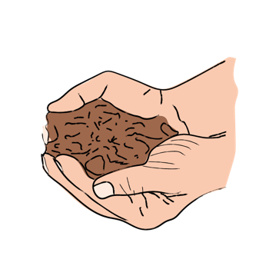
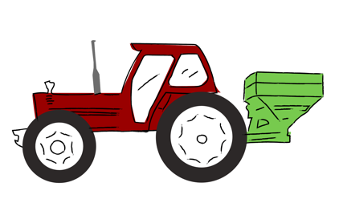
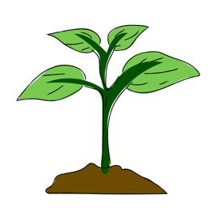
VINEYARD MANAGEMENT
THREE VITICULTURAL APPROACHES
CONVENTIONAL
(NON-ORGANIC) VITICULTURE
draws on a range of agricultural practices, including traditional farming methods, some synthetic sprays and fertilisers, modern technology and environmentally-conscious approaches.
ORGANIC VITICULTURE
can also draw on both traditional and modern farming practices
but avoids the use of synthetic fertilisers, pesticides and herbicides. Instead, organic materials such as rock phosphate, plant-based materials, animal-based products and chemical-free sprays are used.
BIODYNAMIC VITICULTURE
is drawn from the ideas of Rudolf Steiner. It’s similar to organic viticulture, but also incorporates the phases of the moon and special soil preparations.
Notes:
When vines first arrived in Australia in the 19th century and right through to the middle of last century, growers did all the vineyard work by hand.
When agrochemicals such as synthetic fertilisers, herbicides and fungicides were introduced, they made viticulture attractively cheaper and more productive. However, there was some backlash against this chemical use.
Through the1990s and 2000s, and a new generation of consumers were increasingly concerned about what went into their food and wine. This led to a rethink of vineyard management methods.
Today, wine producers may use one or a combination of these three viticultural practices.

Slide 9












LUNAR CYCLE
AND BIODYNAMIC VITICULTURE
FRUIT DAYS
ROOT DAYS
BEST TIME TO HARVEST GRAPES
Moon is in Aries,
Leo or Sagittarius
BEST TIME FOR PRUNING
Moon is in Virgo,
Taurus or Capricorn
BEST TIME TO LEAVE VINEYARD ALONE
Moon is in Aquarius, Libra or Gemini
BEST TIME TO IRRIGATE
Moon is in Pisces, Cancer or Scorpio
FLOWER DAYS
LEAF DAYS
Notes:
With biodynamic winemaking, the lunar cycle breaks down the production process into four periods. Biodynamic wine producers also employ nine biodynamic preparations (BD preps) in their farming practices and winemaking to enhance the soil and compost and to stimulate plant life. They comprise manure, fermented herbs and minerals. At its heart, biodynamics is a supercharged version of organic farming, and together, biodynamic and organic viticulture have become much more common in the past few decades.
WHICH APPROACH?
Converting from conventional vineyards to organic or biodynamic viticulture is challenging. Fungal diseases are tricky to control with just sulphur and copper.
Growers need to apply these at the right time and correctly, because they must cover the whole canopy and fruit zone.
As a result, many wine producers use a combination of conventional, organic and biodynamic practices as they move towards sustainable viticulture.
NATURAL WINE IN AUSTRALIA
Natural wines – an unofficial term used to describe certain wines produced by organic or biodynamic vineyards – are made in the winery with no heavy machinery, no manipulation and no additions except for low levels of sulphur (with some producers refusing to use any sulphur at all), and bottling occurs without filtering or fining. The first shift toward natural wine began with the trend of minimal intervention by producers who opted to do less in winemaking, refusing additions and fermenting using wild yeasts.
The modern incarnation of natural wine comes with much experimentation - winemakers use ceramic eggs, fermented white grapes on their skins to create skin-contact wines, and bottle wild, unfettered wines from varying sources to create a culture that celebrates uninhibited winemaking.

Slide 10
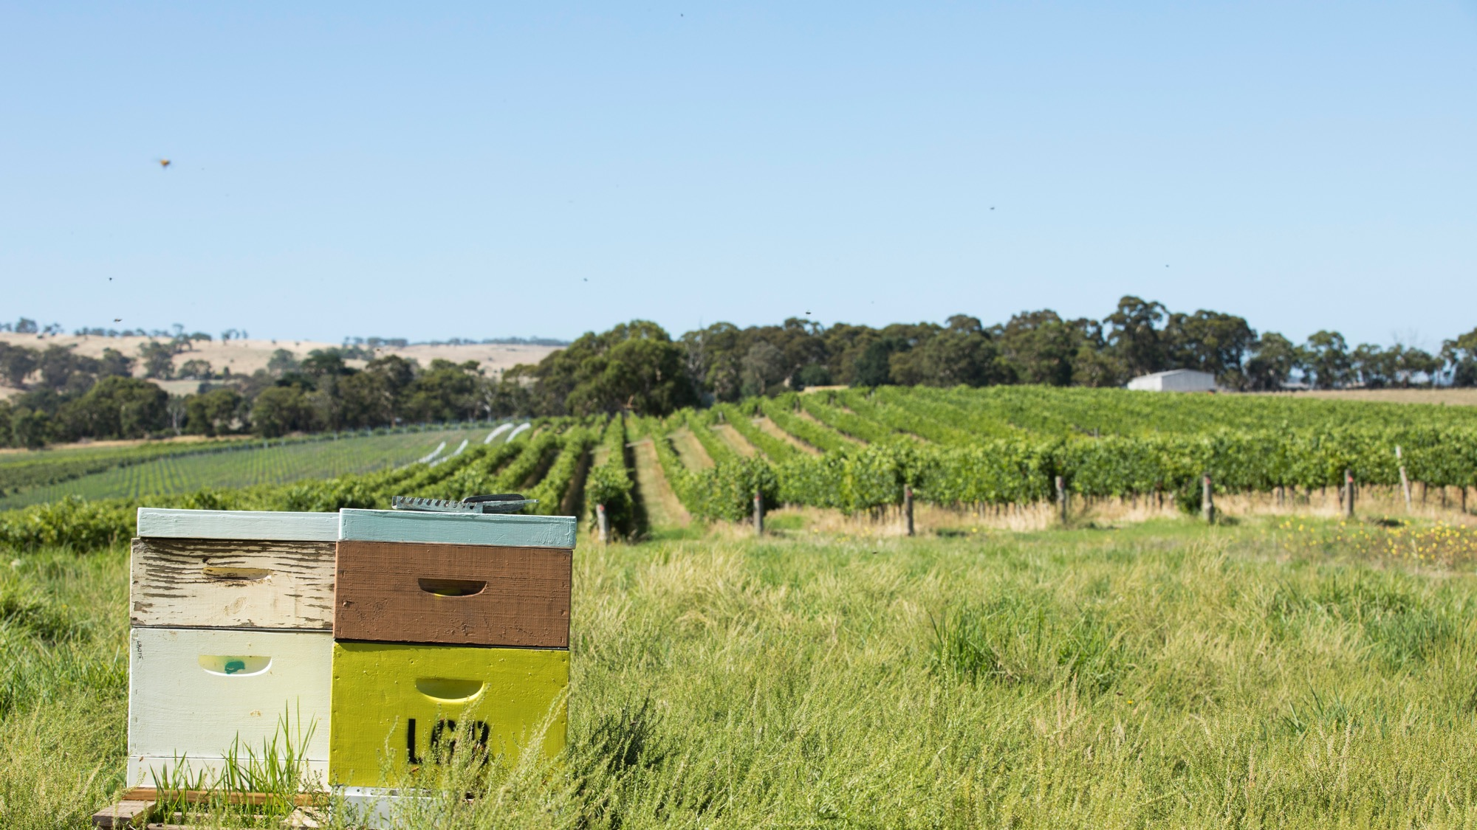
OTHER ENVIRONMENTAL
CONSIDERATIONS
FOR VINEYARDS AND WINERIES
Notes:
The decision to use a conventional, organic or biodynamic approach affects almost all aspects of viticulture and winemaking. On top of this are several key environmental considerations, such as energy efficiency, water conservation and recycling. While some wineries will prioritise environmental considerations more than others, they certainly don’t need to be organic or biodynamic to do so.

Slide 11
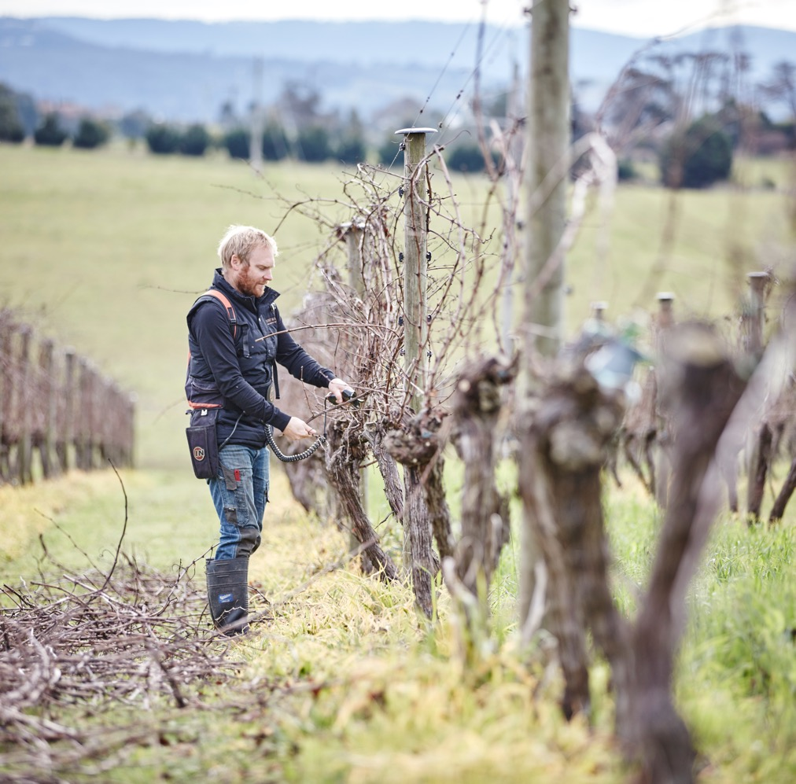
Adapting to climate and climate change
Increasing irrigation efficiency
Modifying irrigation practices in response to heatwaves and frosts
Retaining soil moisture
Using alternative varieties, rootstocks or both
Modifying canopy-management practices
Establishing vineyards in cooler regions, sourcing cooler-climate fruit or both
Delaying pruning to manipulate harvest dates
Notes:
Strategies for managing the impact of heatwaves, drought, increased fire risk and salinity to mitigate their effect on grapevine physiology and on grape and wine quality has become an integral part of vineyard management.

Slide 12
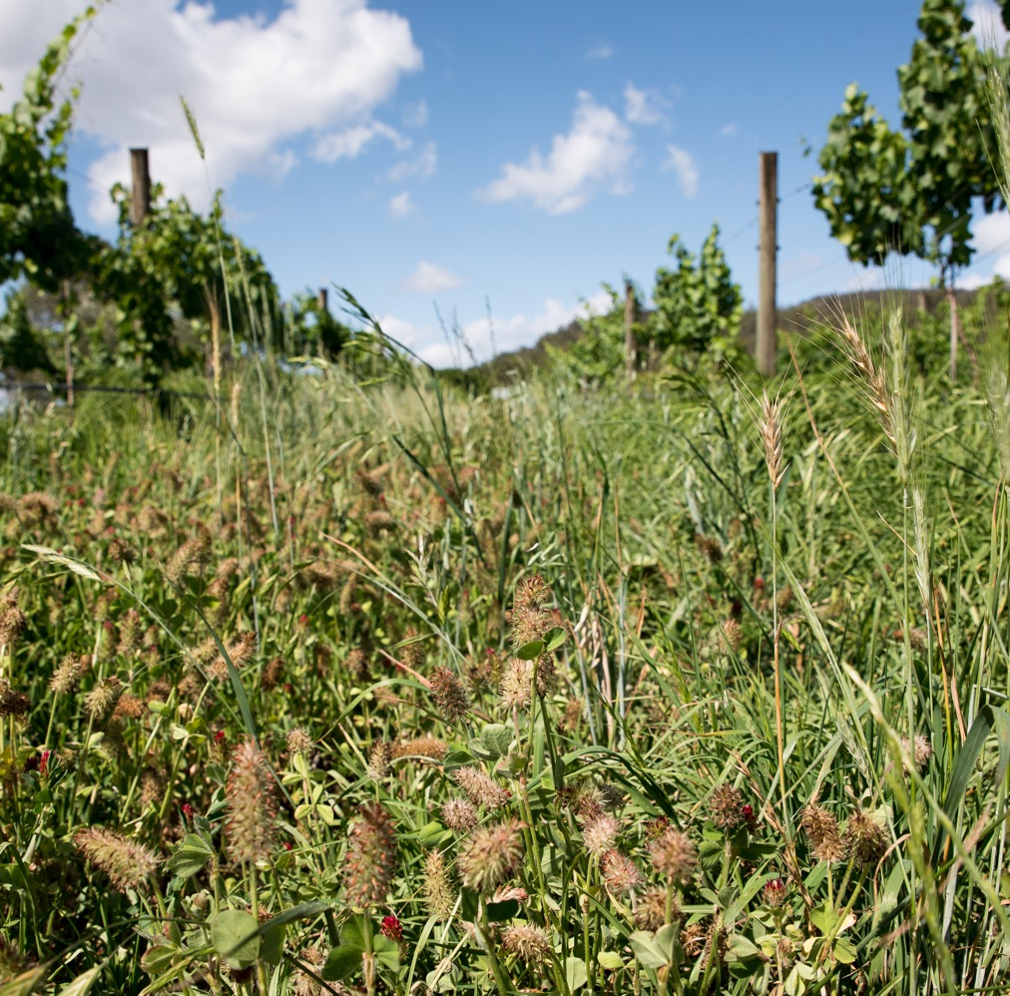
Carbon neutrality and energy efficiency
Reducing fuel use, e.g. minimising use of tractors and other vehicles, changing grasses planted between vine rows to reduce need for mowing
Reducing refrigeration in winemaking and using more energy-efficient heating methods
Switching to lightweight bottles (fewer carbon emissions and less fuel for transport)
Installing solar panels
Notes:
Some Australian wineries are choosing to go ‘carbon neutral’, which means getting the net greenhouse-gas (carbon-dioxide) emissions resulting from winery and vineyard production processes to reach zero. They get to zero by:
– Gauging their emissions.
– Reducing those emissions as much as they can.
– Buying carbon credits to offset the remaining emissions.
In addition to carbon neutrality, some of these adjustments also contribute to greater energy efficiency on wineries and in vineyards.

Slide 13
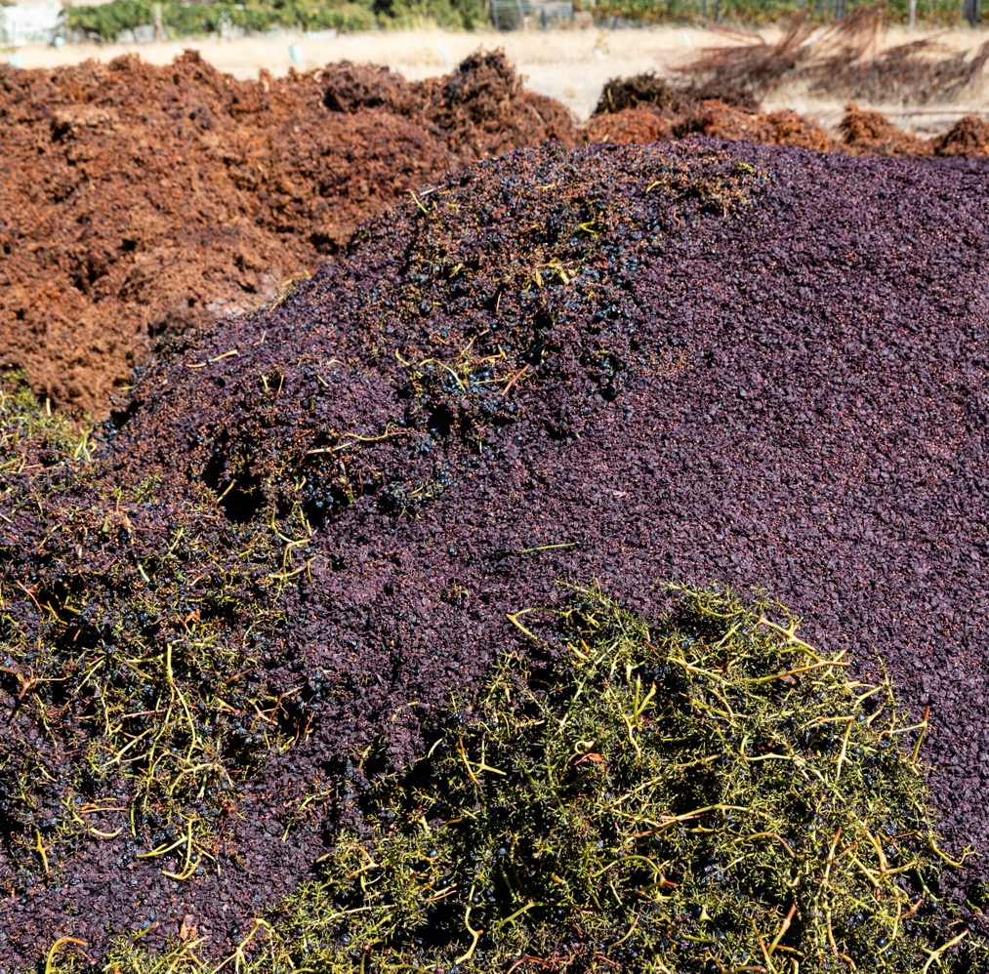
INCREASING VINEYARD BIODIVERSITY
Planting cover crops or using mulch to increase plant diversity and ‘good’ insects that can eliminate pests
Minimising mechanical cultivation to reduce soil compaction, which improves soil drainage and aeration, allowing water infiltration and biological activity
Regularly monitoring soil quality
Monitoring pests and disease and using environmentally friendly sprays
Using low-input, organic and biodynamic farming practices; avoiding chemicals; and employing compost and manure
Notes:
Biodiversity in the vineyard reflects the natural balance of the vineyard environment and its interactions with fauna (animal life) and flora (plant life).
An established ecosystem contains a community of living things in balance with each other and their environment.
The more numerous and genetically diverse these interactions are, the higher the biodiversity and the more sustainable a system will be.

Slide 14
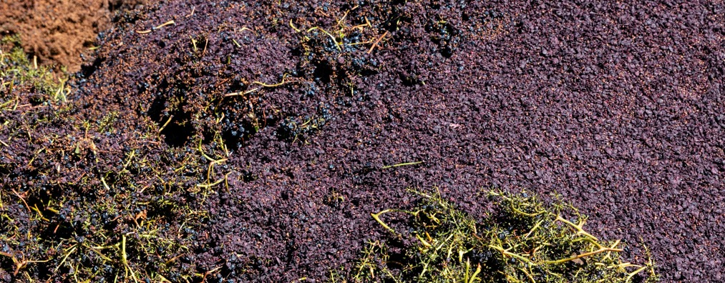
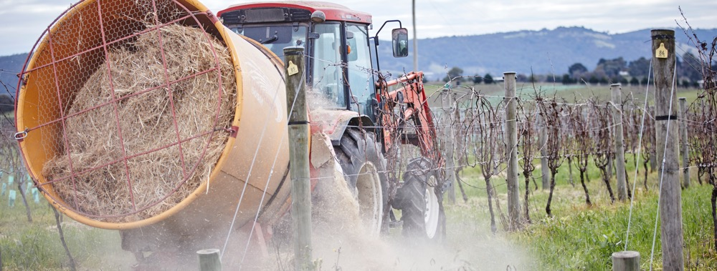
Compost: Decayed organic material that contains humus, which breaks down animal and vegetable matter. Humus aids soil fertility, improves soil structure and provides moisture
Mulch: Material that grapegrowers spread over grapevine roots to protect them
COMPOSTING
and MULCHING
Notes:
Some vineyards employ compost and mulch instead of synthetic fertilisers to improve soil quality, feed the grapevines nutrients, promote healthy vine growth and protect vine roots.
Placing mulch underneath vines can reduce the amount of water the soil loses through evaporation, so the vine has more water on which to draw. It can also keep soil cool and control weeds.

Slide 15
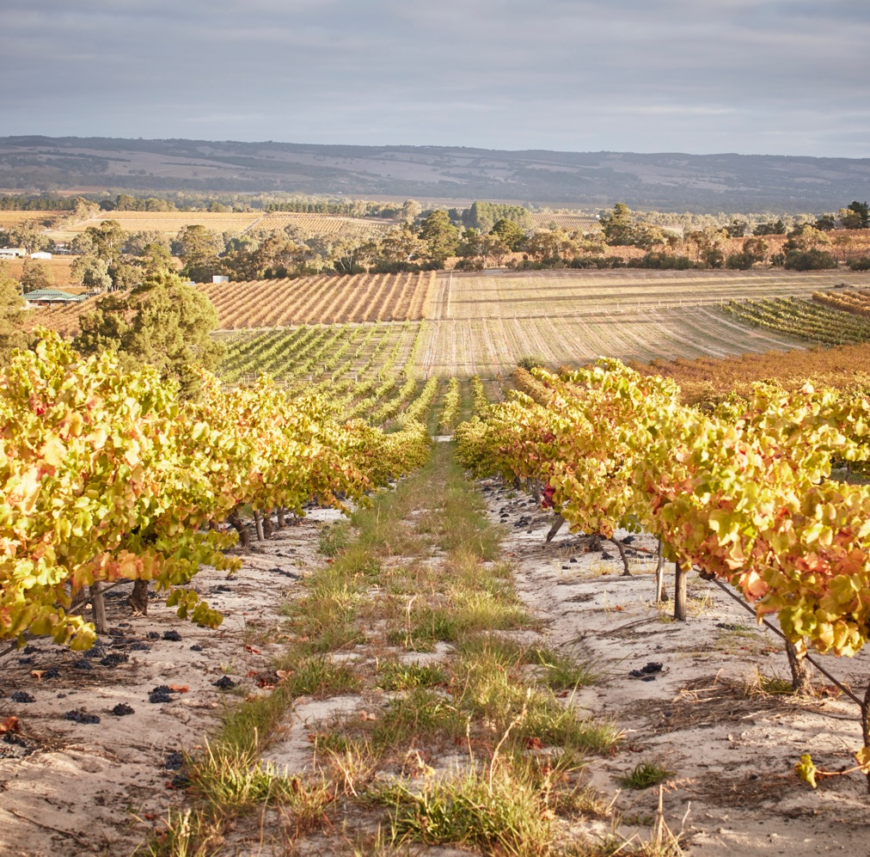
WATER CONSERVATION water reuse and wastewater management
Drier regions rely on water conservation, reuse and wastewater management. Some innovative Australian wineries have gone so far as to establish their own wastewater‑recycling facilities.
Irrigation can be a large drain on water resources. Drip irrigation systems may be used to minimise wastage.
Notes:
Viticultural and winemaking processes require a great deal of water.
Wine producers can significantly reduce their water use by:
– Conducting audits on water use.
– Investigating water recycling opportunities.
– Utilising precision irrigation system.
– Managing soil moisture.
– Capturing rainwater.
– Reusing winery wastewater when quality allows.
– Using recycled water
- Using drip irrigation to slowly drip water on an as-needed basis through narrow tubes directly into the soil or onto the root system.

Slide 16
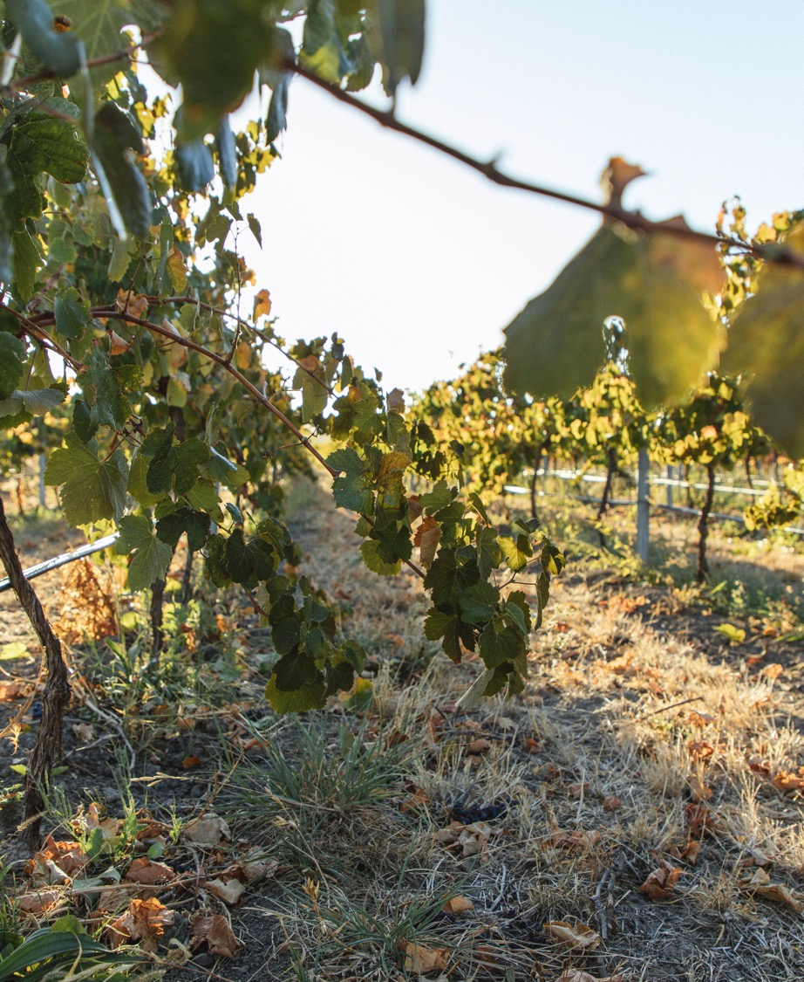
McLAREN VALE
A case study in water
management and reuse
McLaren Vale is at the forefront of efforts to both conserve and reuse water, having not used sprinkler or flood irrigation in more than a quarter‑century. Instead, it uses:
Groundwater aquifers
Surface catchment dams that collect and store water from natural run-off
Treated, reclaimed water piped in from a wastewater-treatment facility
Notes:
Some innovative Australian wineries have gone so far as to establish their own wastewater-recycling facilities. Taylors Wines in South Australia’s Clare Valley, for example, recycles 100% of the wastewater from its winery and bottling facility for reuse in the vineyards. The winery also collects and reuses stormwater and run-off from winery buildings.

Slide 17
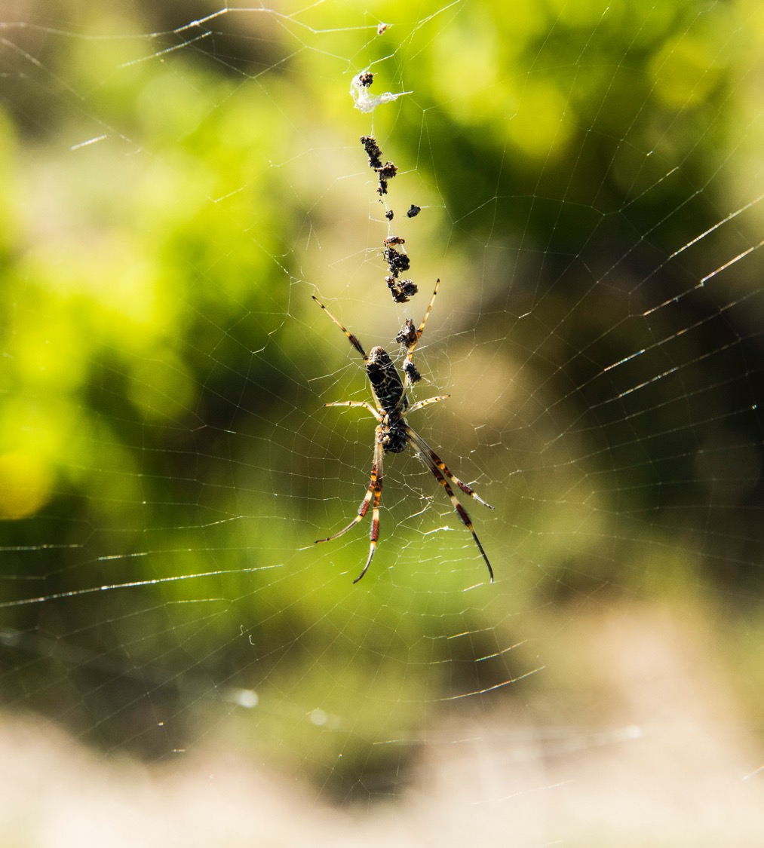
Integrated pest management
(IPM) strategies
IPM encourages organic growers to understand:
Life cycles of vineyard pests
Pest population levels
Useful parasites and predators

Slide 18
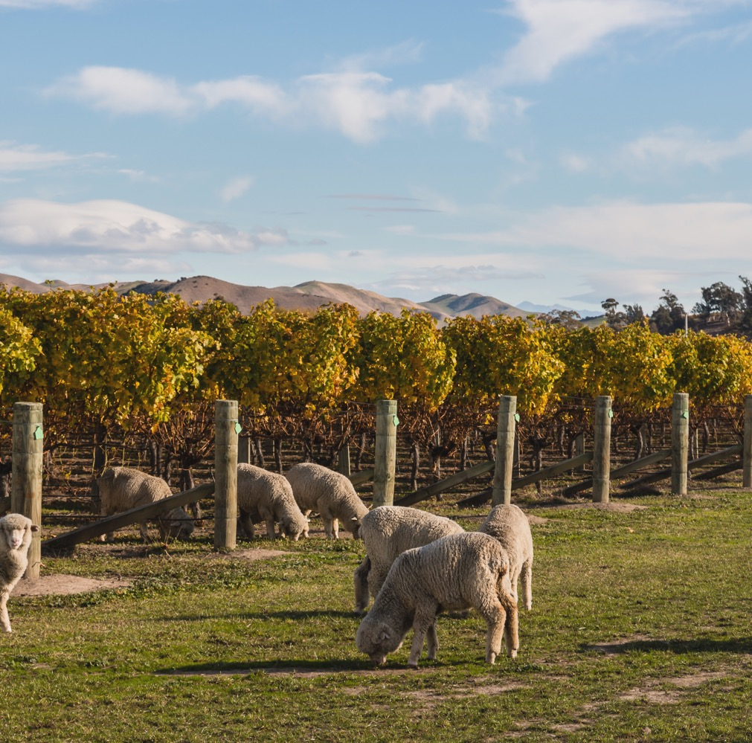
ANIMAL
GRAZING
Keeps weeds and winter grasses under control, meaning fewer herbicides
Lessens the need for tractors to spray and mow grass, reducing fuel use
Can make use of animal manure as a soil conditioner and natural fertiliser
Notes:
Despite Australia’s isolation and strict quarantine processes, some domestic pests and diseases, such as grey rot, can still severely impact grape yield, berry quality and wine quality, so strategies to control these are necessary.
One strategy involves allowing animals to graze in the vineyard.
Other approaches include eliminating broad-spectrum insecticide use, targeted spraying in only the most affected areas, and monitoring weather conditions (air temperature, wind speed and humidity) during spraying activity.

Slide 19
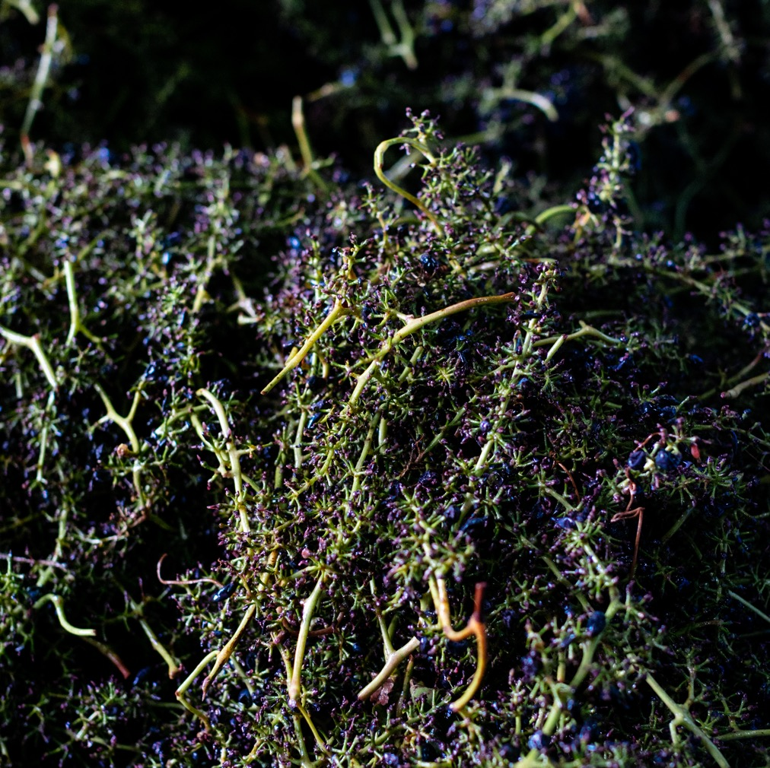
RECYCLING
AND REUSE
Wineries can minimise landfill waste by disposing of:
Glass waste
Cardboard
Paper
Organic solid residuals
Scrap metal
E-waste
Notes:
In addition to wastewater recycling and other reuse practices, there are a number of materials that wineries and vineyards can dispose of sustainably to minimise waste to landfill.

Slide 20
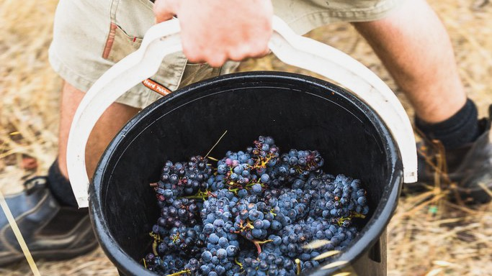
CASE
STUDIES
Notes:
The following is a sampling of just some inspirational Australian wineries practising ‘green’ viticulture or winemaking techniques.

Slide 21

How Temple Bruer Wines WENT
CARBON-NEUTRAL
SWITCHED TO
LIGHTWEIGHT
WINE BOTTLES
INSTALLED SOLAR PANELS
WINES
Planted trees and native vegetation in and around the vineyard
Increased minimum temperature for air conditioning in winery offices
TEMPLE BRUER
Discontinued airfreighting shipments to overseas distributors
REDUCED REFRIGERATION REQUIREMENTS
Notes:
Temple Bruer in Langhorne Creek is one of Australia’s only 100% certified-organic and carbon-neutral wineries.
The winery prides itself on trying to maintain this status as much as possible through its own actions, focusing on environmental practices from the vineyard to the time the wines leave the distributor.

Slide 22
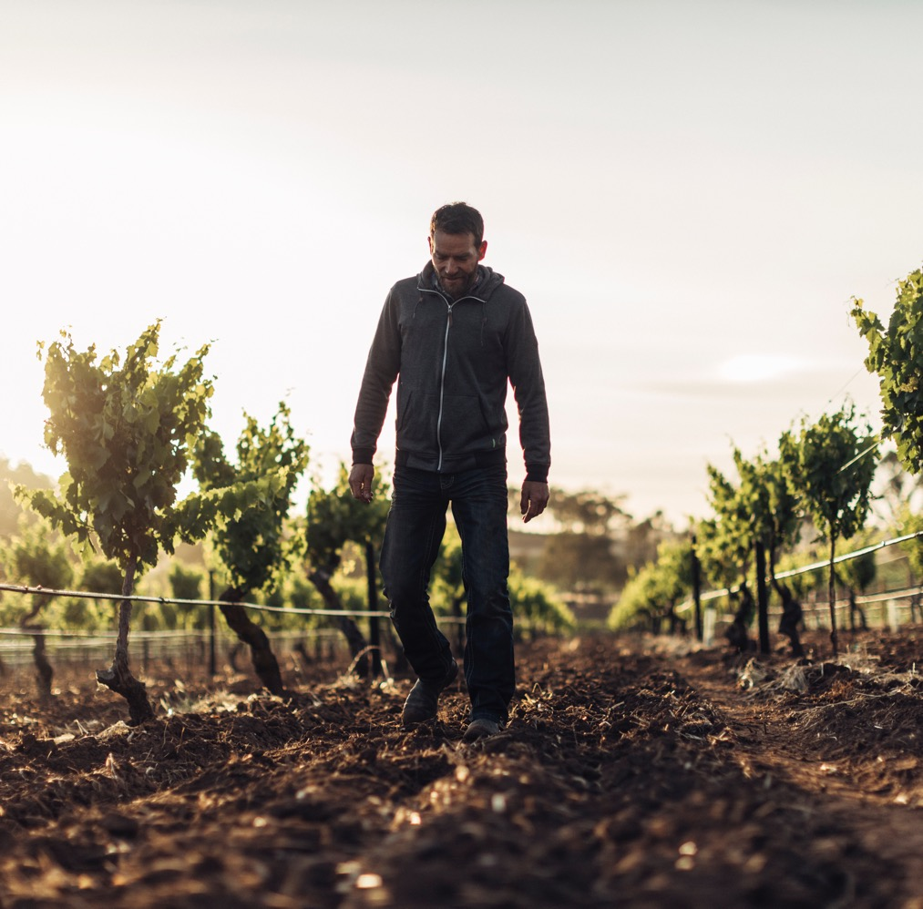
Kalleske’s organic and biodynamic practices IN THE VINEYARD
Controlling weeds mechanically and naturally nourishing vines without chemical fertilisers
Using composts and natural fertilisers (kelp and rock dust) in the soil
Applying BD preps to the soil and grapevines
Using natural sprays rather than fungicides or insecticides
Notes:
Kalleske is the oldest certified-organic/biodynamic vineyard and winery in Barossa Valley.
Its winemaking approach focuses on the relationship between soil health, vine health, grape quality and minimal intervention to produce premium wines.
From a biodynamic standpoint, Kalleske monitors the phases of the moon and aims to harvest and rack its wines during favourable lunar conditions.
The winery has also installed solar energy, which produces enough electricity to power the whole winery.
It also takes an environmental approach to water management, using a 250,000-litre rainwater tank to collect water from the winery and vineyard sheds.

Slide 23

Kalleske’s
TRADITIONAL, MINIMAL INTERVENTION
APPROACH IN THE WINERY
ADDS NO TANNINS, ENZYMES OR FINING AGENTS
NATURALLY CLARIFIES ITS WINES WITH RACKING AND NO FILTRATION
WINES
KALLESKE’S
Relies on natural yeasts for primary fermentation and natural malolactic bacteria for malolactic fermentation

Slide 24
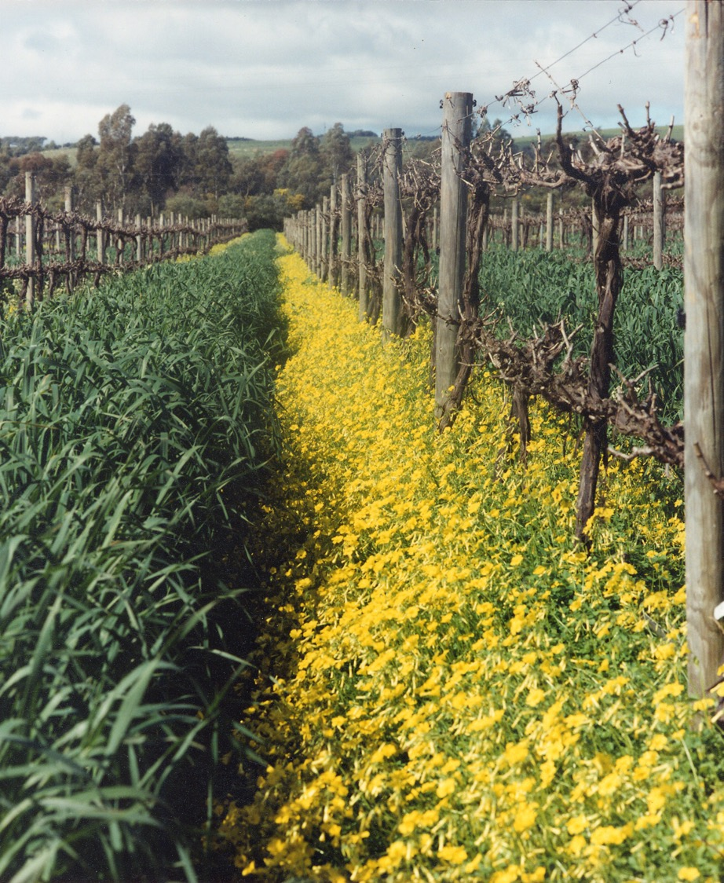
Battle of Bosworth’s ORGANIC CONVERSION
Runs its vineyards as it would have before synthetic fertilisers and pesticides came along
Uses soursob (a flower used in the fight against weeds) for weed management
Employs modified vineyard machinery to improve efficiency and reduce environmental impact
Has undergone extensive revegetation, removing problematic species and replanting natives
Photo courtesy of Joch Bosworth
Notes:
McLaren Vale’s Battle of Bosworth winery has a variety of grapevines that have been ACO certified organic for decades.
Gaining organic certification took Battle of Bosworth four years, with yearly audits and random produce sampling.
Soursob. the pretty yellow flower, helps with weed management and nicely complements grapevines, as it takes advantage of water when the vine is dormant and dies in summer when the vines need more water.

Slide 25
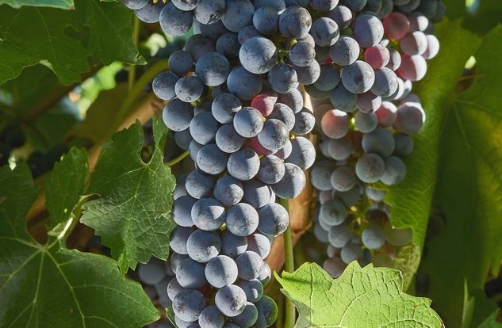
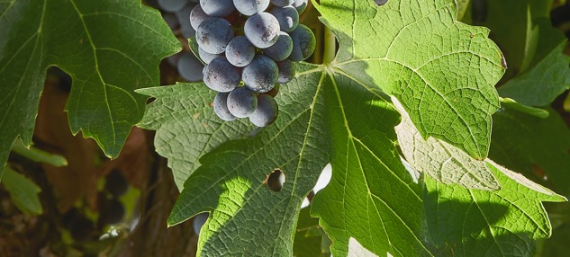
2003
2006
Certified organic and converted to biodynamic farming.
Voluntarily offset its carbon footprint by purchasing carbon credits.
CULLEN WINES' ENVIRONMENTAL TIMELINE
1998
2004
2014
Switched to organic viticulture, implementing drains, composting and cover crops.
First vineyard (Cullen) received certified biodynamic status; second (Mangan) in 2008.
Installed a 45-kilowatt solar-energy system, which provides for a decent proportion of Cullen’s average consumption.
Notes:
Cullen Wines in Margaret River is committed to being sustainable at all levels of its business and has steadily implemented a number of initiatives to reduce the environmental impact of its viticultural and winemaking practices:
– Carbon-reduced bottles for the majority of its wines.
– Locally purchased cardboard packaging to cut down on transport distances.
– Segregated waste to take advantage of local waste-recycling programs.
Cullen takes a biodynamic and minimal intervention approach to both the winery and the vineyard by:
– Naturally fermenting all its wines.
– Maintaining a biodynamic vegetable garden for use in its restaurant.

Slide 26
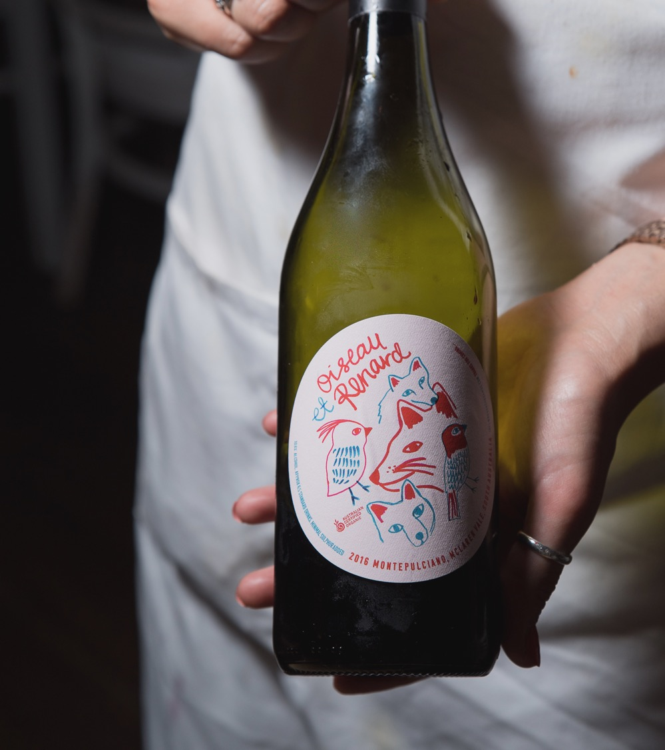
THE RISE OF
ALTERNATIVE
VARIETIES
IN AUSTRALIA
Arneis
Barbera
Fiano
Gamay
Grüner Veltliner
Montepulciano
Nebbiolo
Nero d’Avolo
Sangiovese
Tempranillo
Touriga Nacional
Vermentino
Notes:
‘Alternative varieties’ come from grapes that are not part of the mainstream varieties widely planted across Australia.
Note that not all alternative-variety wines are organic, biodynamic or other.
Winemakers are increasingly looking to alternative varieties - creating more choice for consumers and contributing to Australia’s diverse viticultural landscape.
Innovative winemakers are also exploring whether these varieties are better suited to the Australian environment and climate, and therefore more environmentally-friendly.

Slide 27
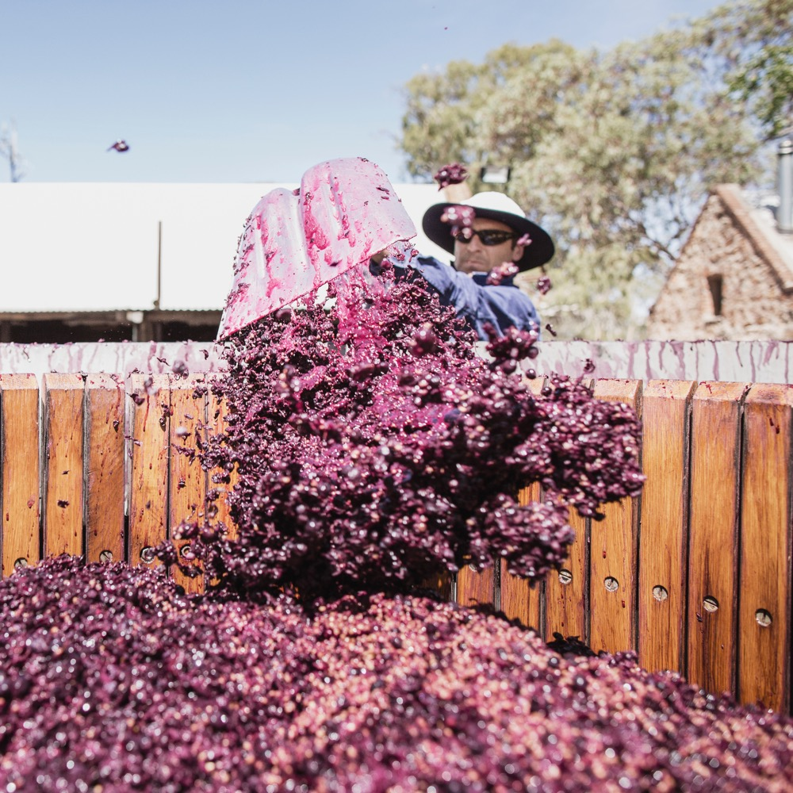
ENSURING AUSTRALIA’S
GENERATIONS-OLD
VINEYARDS, VITICULTURE
AND WINEMAKING
ENDURE AND
EXCITE FOR
YEARS TO COME.
Notes:
Wine consumers and wine producers are increasingly on a quest for authenticity, individuality and expressions of place.
As part of this, a growing number of wineries are adapting their vine and grape-growing methods in favour of more environmentally-friendly practices, such as organic or biodynamic. These practices can also help ensure the country’s generations-old vineyards, viticulture and winemaking will endure for years to come.
As Australian winemakers gain an even deeper understanding of their land and consumers demand ever-more quality and choice of wines, the future of Australian wine will be driven by curious winemakers always looking for ways to innovate, while also reflecting on traditional techniques.

Slide 28
THANK YOU

