Slide 1
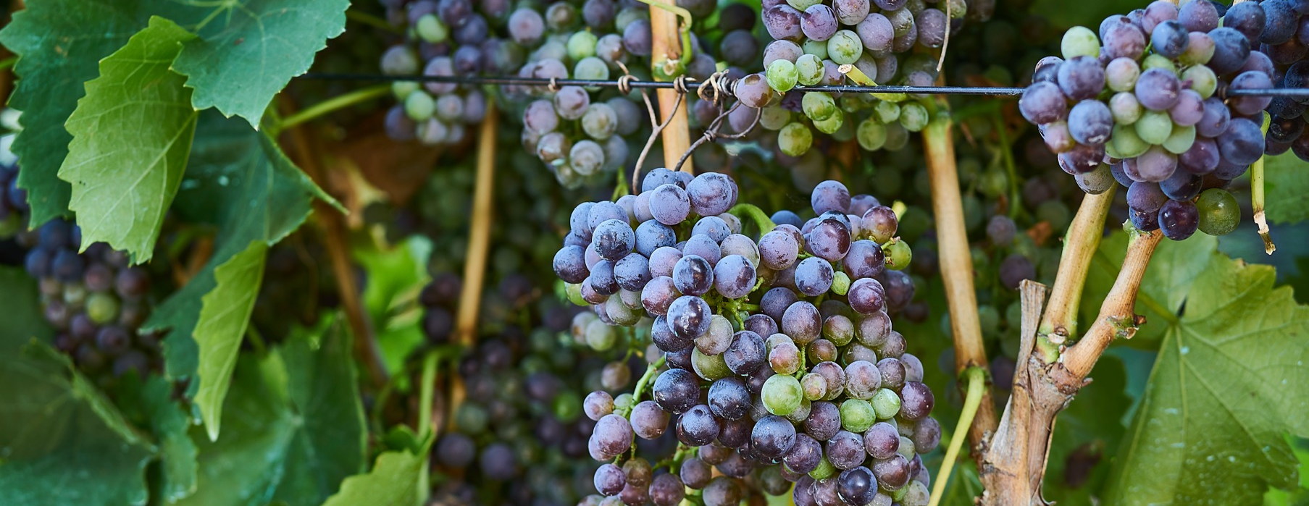
GRENACHE
AND BLENDS

Slide 2


Crafted from grapes grown under vast and diverse climates, across landscapes millions of years in the making, every glass of Australian wine tells a story.
Like those who came before us, our modern growers and makers continue to be passionate, resilient and creative; constantly driven to explore new ways to perfect old techniques. Our community is connected by a mutual respect and shared love of crafting exceptional wine, while protecting the natural wonders for future generations to enjoy. Applying modern thinking to our ancient lands, we take playful experimentation very, very seriously.
So, if you’re looking for the taste of adventure, let Australian wine be your compass. Because in every bottle of Australian wine, you’ll experience the wonders of Australia – a reminder of the adventure and diversity that defines our culture and our land.

Slide 3
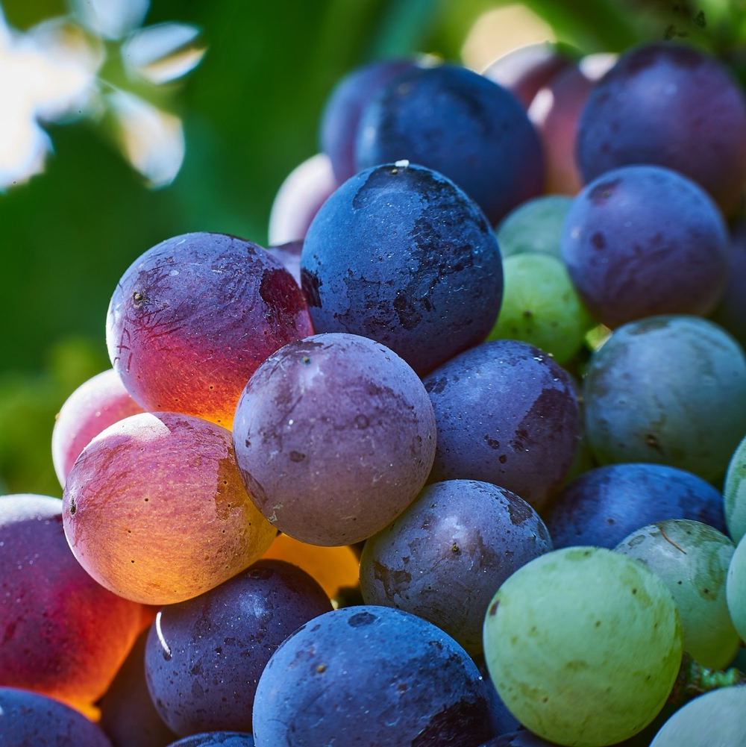
GRENACHE
THE REBIRTH OF A CLASSIC
While somewhat overlooked in
the past, Grenache is a variety that truly expresses its terroir, capturing the unique combination of country, climate and culture.

Slide 4
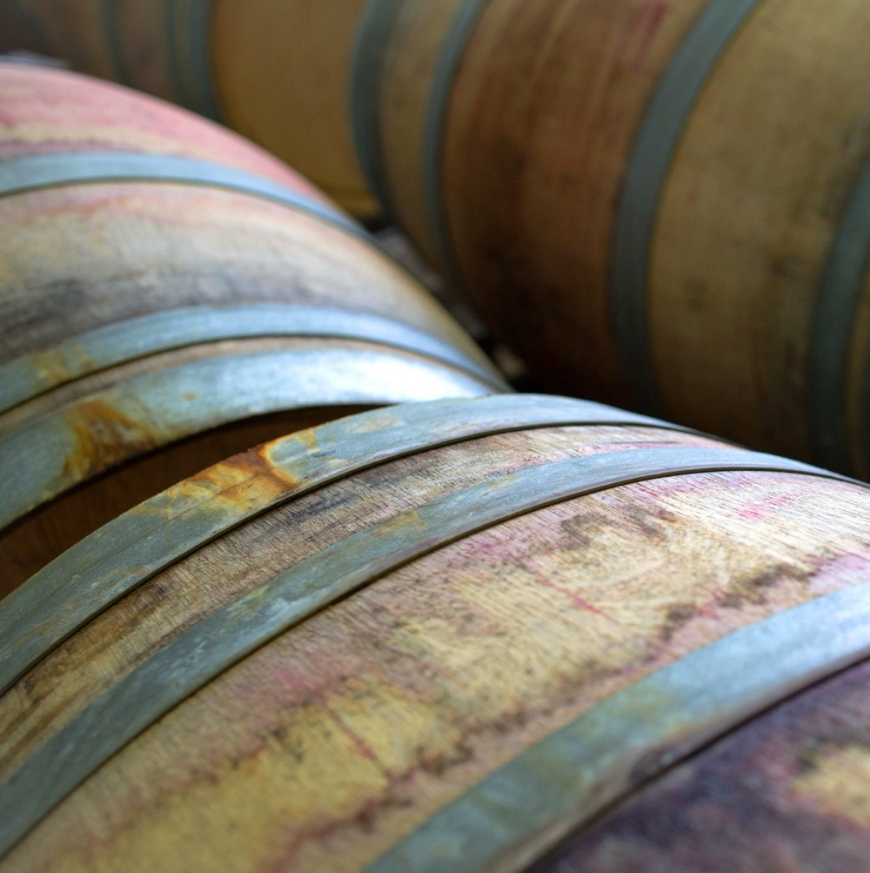
TODAY WE’LL COVER
The history of Grenache in Australia
How it’s grown
How it’s made
The art of blending
Where it’s grown
Characteristics and flavour profiles

Slide 5
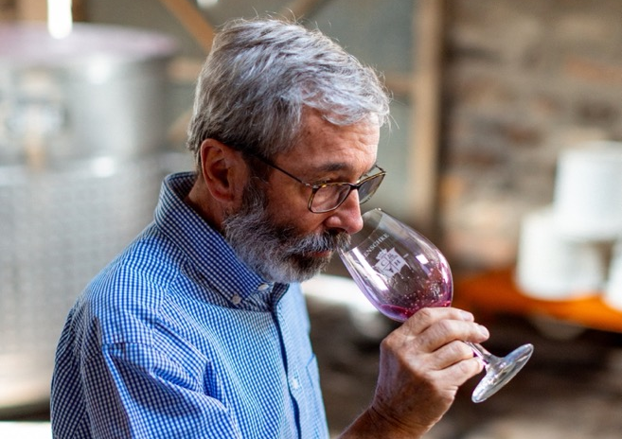
1832
THE HISTORY OF GRENACHE IN AUSTRALIA
Mid 1920s – Late 1960s
1970s
A popular choice for fortified wine production (which made up 80% of the industry in 1960).
Consumer preferences shift to table wines. Grenache production dramatically decreases.
Late 1830s
Grenache was one of the original varieties brought to Australia by James Busby, the ‘father of Australian wine’.
First Grenache vineyard planted in South Australia, thriving in the warm, dry conditions.

Slide 6
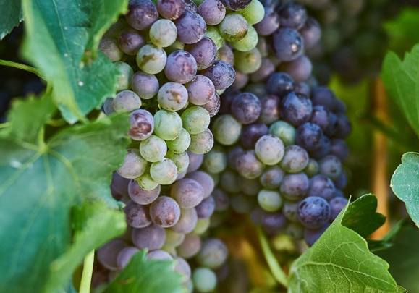
1988
Winemaker Charles Melton experiments with the classic GSM blend, creating the first batch of now legendary ‘Nine Popes’.
1980s
1990s & 2000s
Today
Wirra Wirra winery removes Grenache from renowned ‘Church Block’ blend, replacing it with Cabernet Sauvignon and Merlot.
Winemakers begin to appreciate what old-vine, low-yielding Grenache can offer.
The new, lighter styles of Grenache are much-loved by consumers and critics alike, so we can expect to see much more of this perfumed red wine in all its forms.

Slide 7
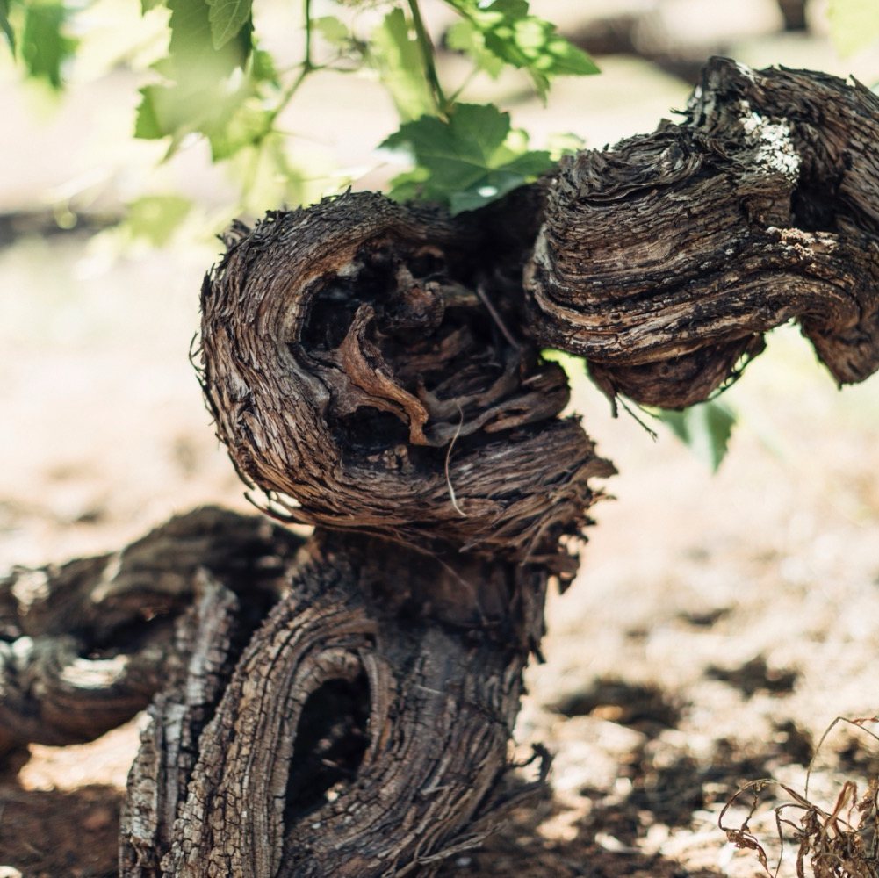
AUSTRALIA’S
OLDEST VINES
Australia boasts some of the oldest continually producing vines in the world. Unlike many international wine regions, South Australia’s wine regions weren’t affected by Phylloxera, a tiny insect that can devastate vines.

Slide 8
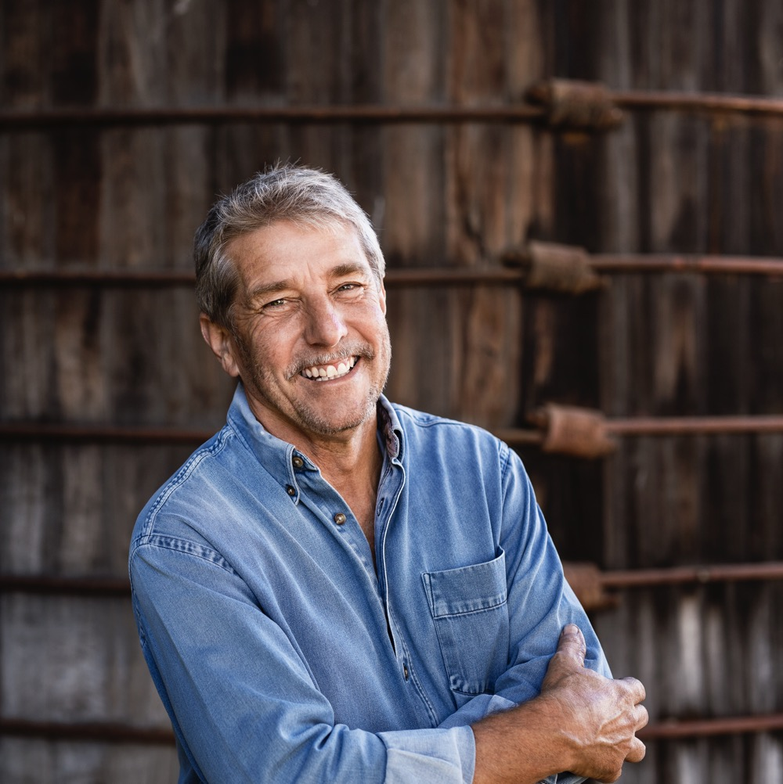
THE ORIGINAL CHAMPION FOR AUSTRALIAN GRENACHE
CHARLES MELTON
As one of the first people to recognise the value and tradition of old-vine Grenache blends, Charlie Melton is part of a group of winemakers responsible for retaining the viticultural heritage of the Barossa Valley.
FUN FACT
When looking for a name for his new GSM blend, Charlie named his now legendary wine ‘Nine Popes’ after the French appellation, Châteauneuf-du-Pape. Little did he know the more accurate translation is actually “The Pope’s New Castle”.”…

Slide 9
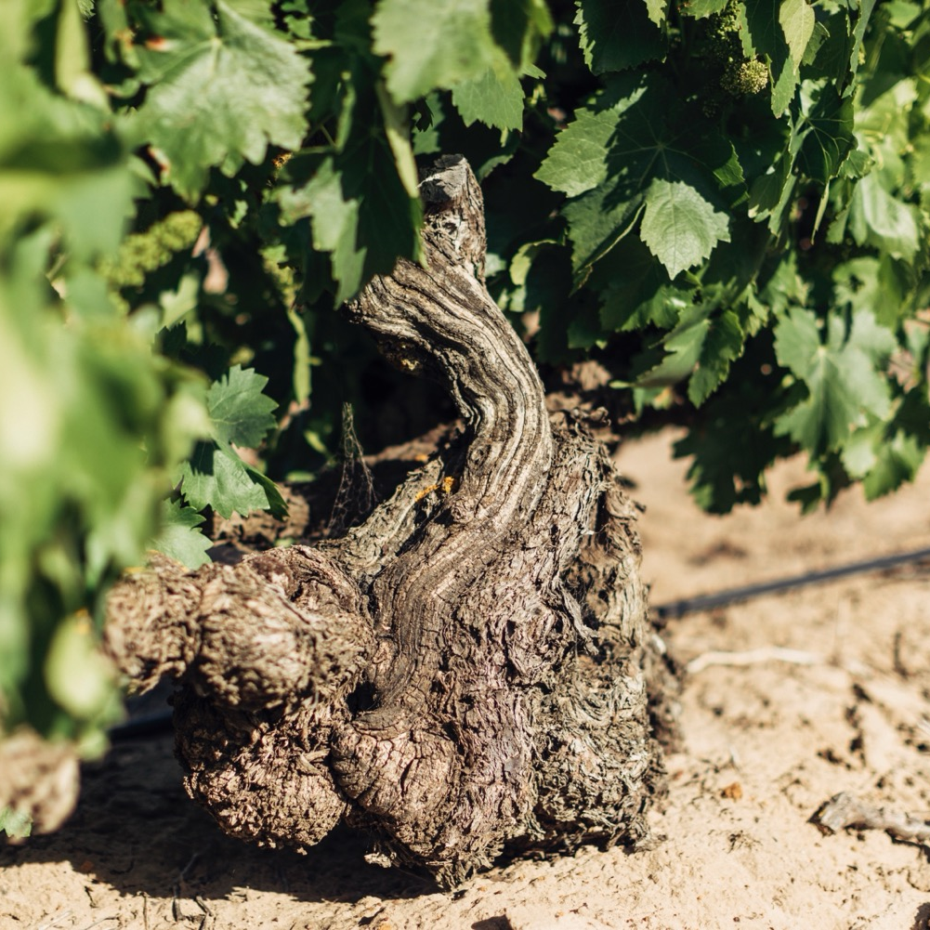
VITICULTURE
HOW GRENACHE IS GROWN IN AUSTRALIA
DRY GROWN
Copes well in hot conditions with no irrigation and harsh pruning.
HIGH YIELDS
Fruity, less complex wines.
LOW YIELDS
More concentrated flavour and character.
OLD BUSH (GOBLET) WINES

Slide 10
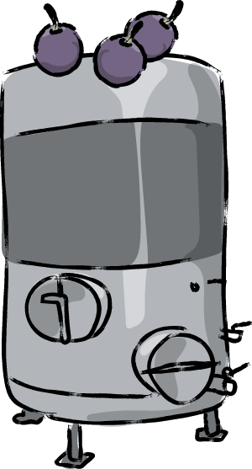
WINEMAKING:
TECHNIQUES INFLUENCING GRENACHE STYLE
STEMS ARE ADDED
BUNCHES LEFT INTACT
WHOLE BERRY FERMENTATION
STEM INCLUSION
WHOLE CLUSTER FERMENTATION

Slide 11
WINEMAKING:
TECHNIQUES INFLUENCING GRENACHE STYLE
UNBROKEN GRAPE CLUSTERS STILL ON THE STEMS
EXTENDED MACERATION TIMES
CARBONIC MACERATION
EXTENDED SKIN CONTACT
STAINLESS STEEL TANKS
MATURATION

Slide 12

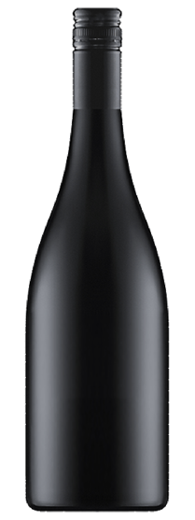
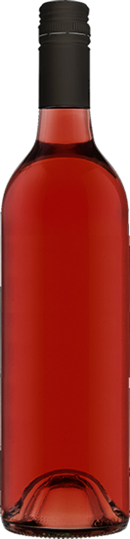
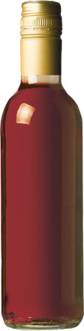
GRENACHE
AND BLENDING
GRENACHE
ROSÉ
BLEND
FORTIFIED
SINGLE VARIETAL WINE
BLENDS
As blended material, particularly with Shiraz and Mataro (Mouvédre) in GSM blends
ROSÉ
FORTIFIED WINES
Especially Tawny styles

Slide 13
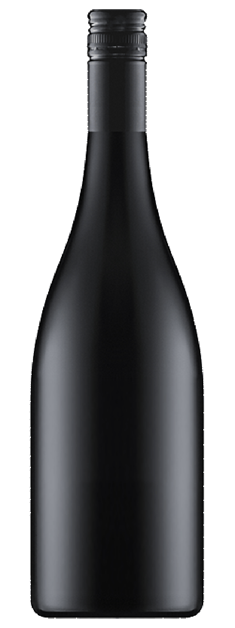
GSM
BLEND
GRAINY TANNINS
MATARO (MOURVÉDRE)
PERFUME
AND ANISE CHARACTERS
INCREASES ALCOHOL
LEVEL
LOWERS
TANNIN AND ACIDITY
GSM BLEND
SHIRAZ
ADDS RICHNESS AND WEIGHT IN THE MOUTH
GRENACHE
Adds extra spice flavours
Adds red fruit characters

Slide 14
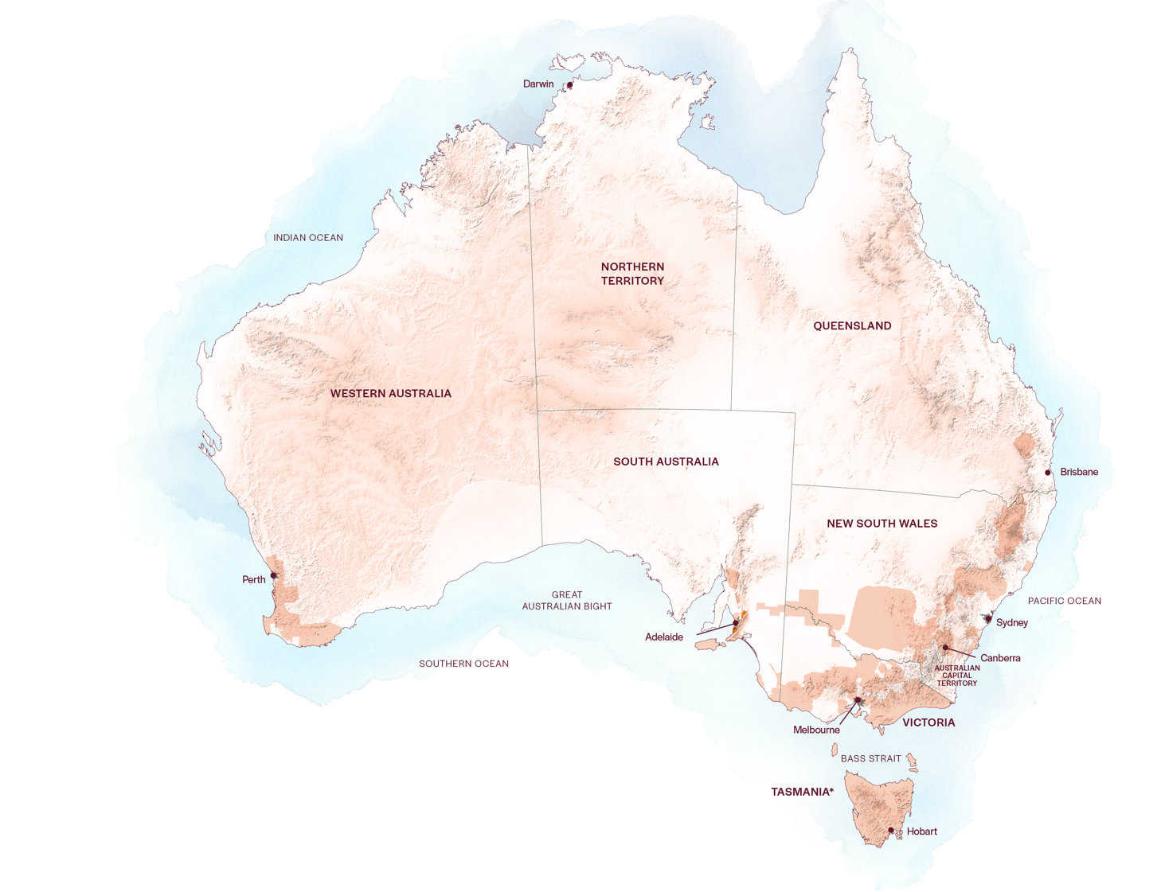
AUSTRALIAN
GRENACHE
REGIONS
BAROSSA VALLEY
McLAREN VALE

Slide 15
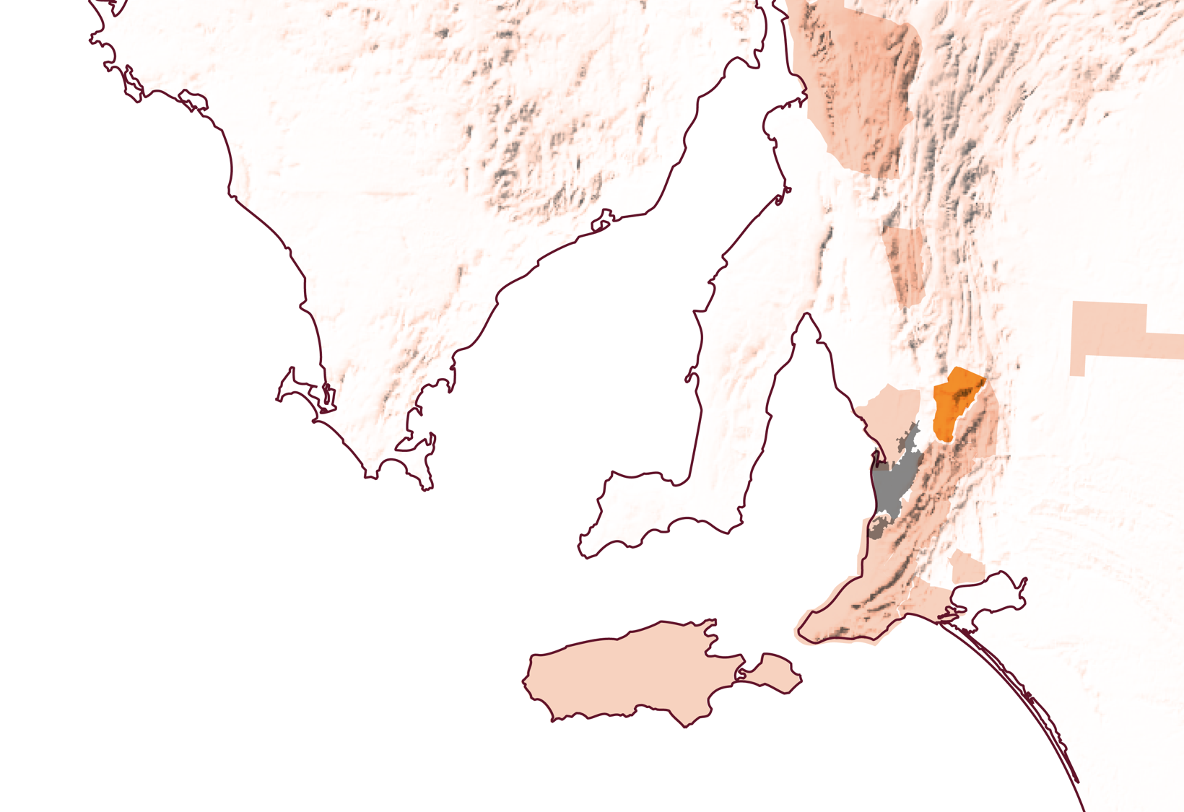
SOUTH
AUSTRALIA
BAROSSA VALLEY

Slide 16
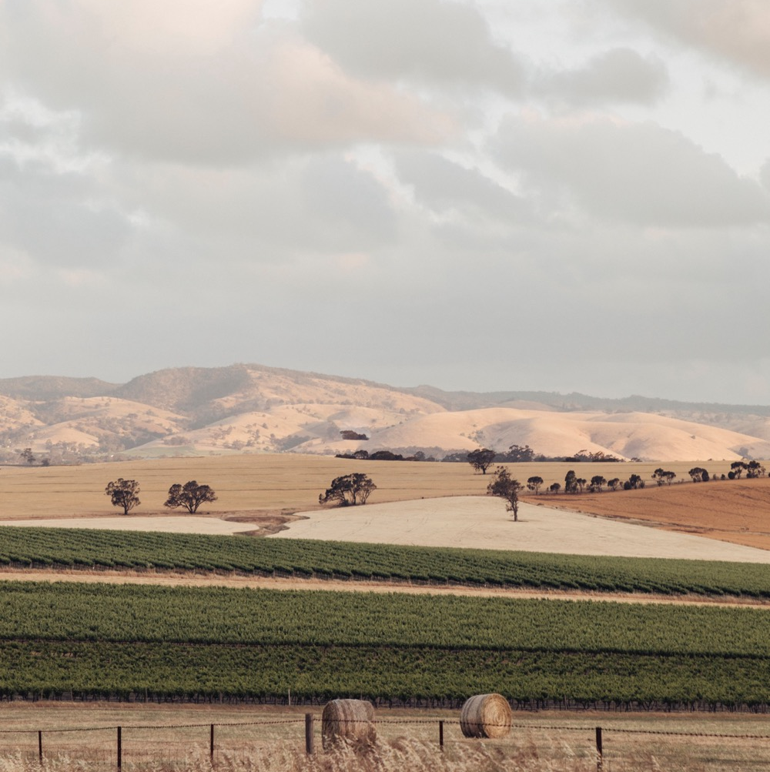
BAROSSA VALLEY
Strong food and wine culture
A rich viticultural history
World-renowned wines
Innovative winemaking

Slide 17
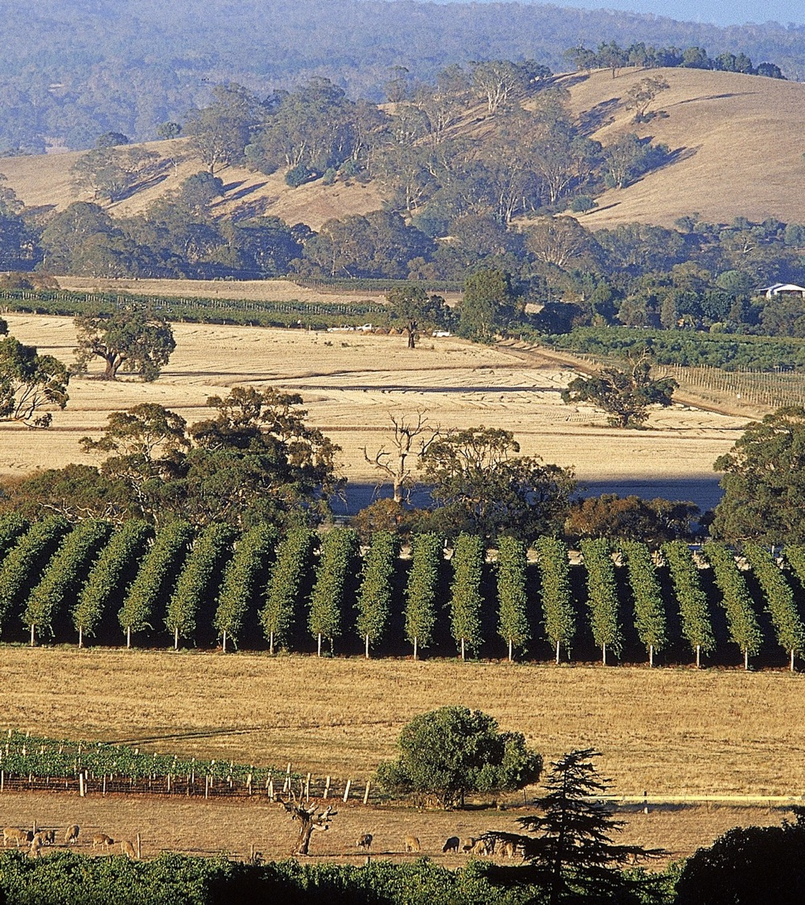
CLIMATE
ALTITUDE
MEDITERRANEAN
VERY HIGH
1000m +
(>3,280ft +)
HIGH
750–999m
(2,460–3,279ft)
BAROSSA VALLEY
130–430M (427–1,411FT)
MEDIUM
500–749m
(1,640–2,459ft)
LOW
0–499m
(0–1,639ft)

Slide 18

SOIL
Barossa soil types vary greatly, ranging from deep sandy loams to clay and red-brown earths. Grenache is typically grown in the deep, rich, fertile black soils of the Barossa Valley floor.

Slide 19

SOUTH
AUSTRALIA
McLAREN VALE

Slide 20
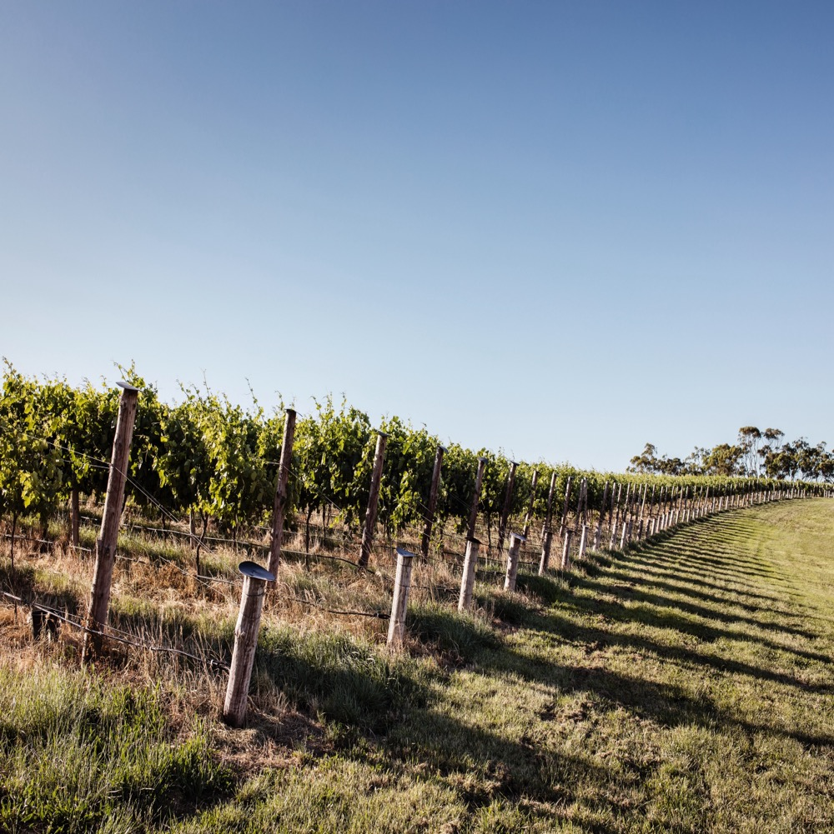
McLAREN VALE
The birthplace of wine in South Australia
Diverse natural beauty
Grenache a star performer
Boutique wineries with a creative spirit
Environmentally conscious

Slide 21

CLIMATE
ALTITUDE
WARM MEDITERRANEAN
VERY HIGH
1000m +
(>3,280ft +)
WITH A RANGE OF MESOCLIMATES AND MICROCLIMATES
HIGH
750–999m
(2,460–3,279ft)
McLAREN VALE
10–350M (33–71,148FT)
MEDIUM
500–749m
(1,640–2,459ft)
LOW
0–499m
(0–1,639ft)

Slide 22

SOIL
McLaren Vale is one of the most geologically diverse regions in the world. Red-brown sandy loams, light clays interspersed with lime, distinctly sandy soils – all this and more can be found in the same region.

Slide 23

GRENACHE
CHARACTERISTICS AND FLAVOUR PROFILES
COLOUR
Grenache
Light
Medium
Full
BODY
Dry
Medium dry
Sweet
SWEETNESS
Low
Medium
High
GRENACHE
OAK
FLAVOURS
Strawberry
Earth
Cherry
Dark raspberry
White pepper
Spice
TANNIN
ACIDITY
8%
13.5% – 15.5%
17%
ALCOHOL

Slide 24

FOOD PAIRINGS
CHARCUTERIE
GAME
DARKER MEATY FISH
SUCH AS TUNA
GRENACHE
GRILLED & BBQ MEAT
LIGHT TO MODERATELY SPICED DISHES & CURRIES
SOFTER, WASHED RIND CHEESES

Slide 25
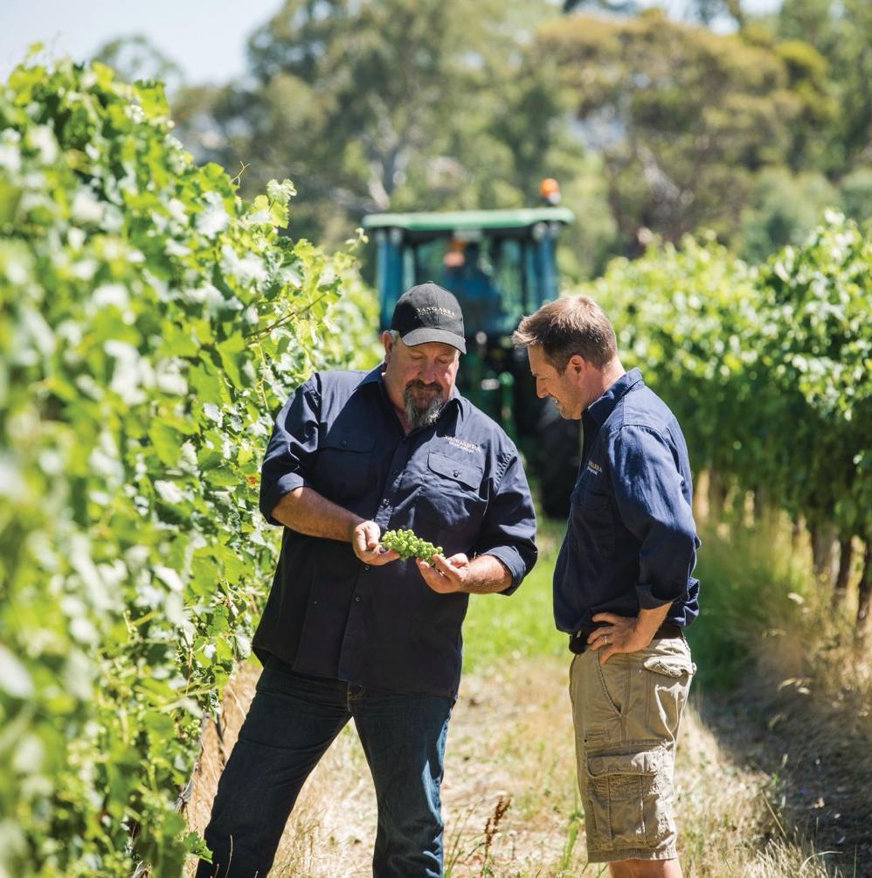
GRENACHE
A BRIGHT FUTURE FOR AN OLD CLASSIC

Slide 26
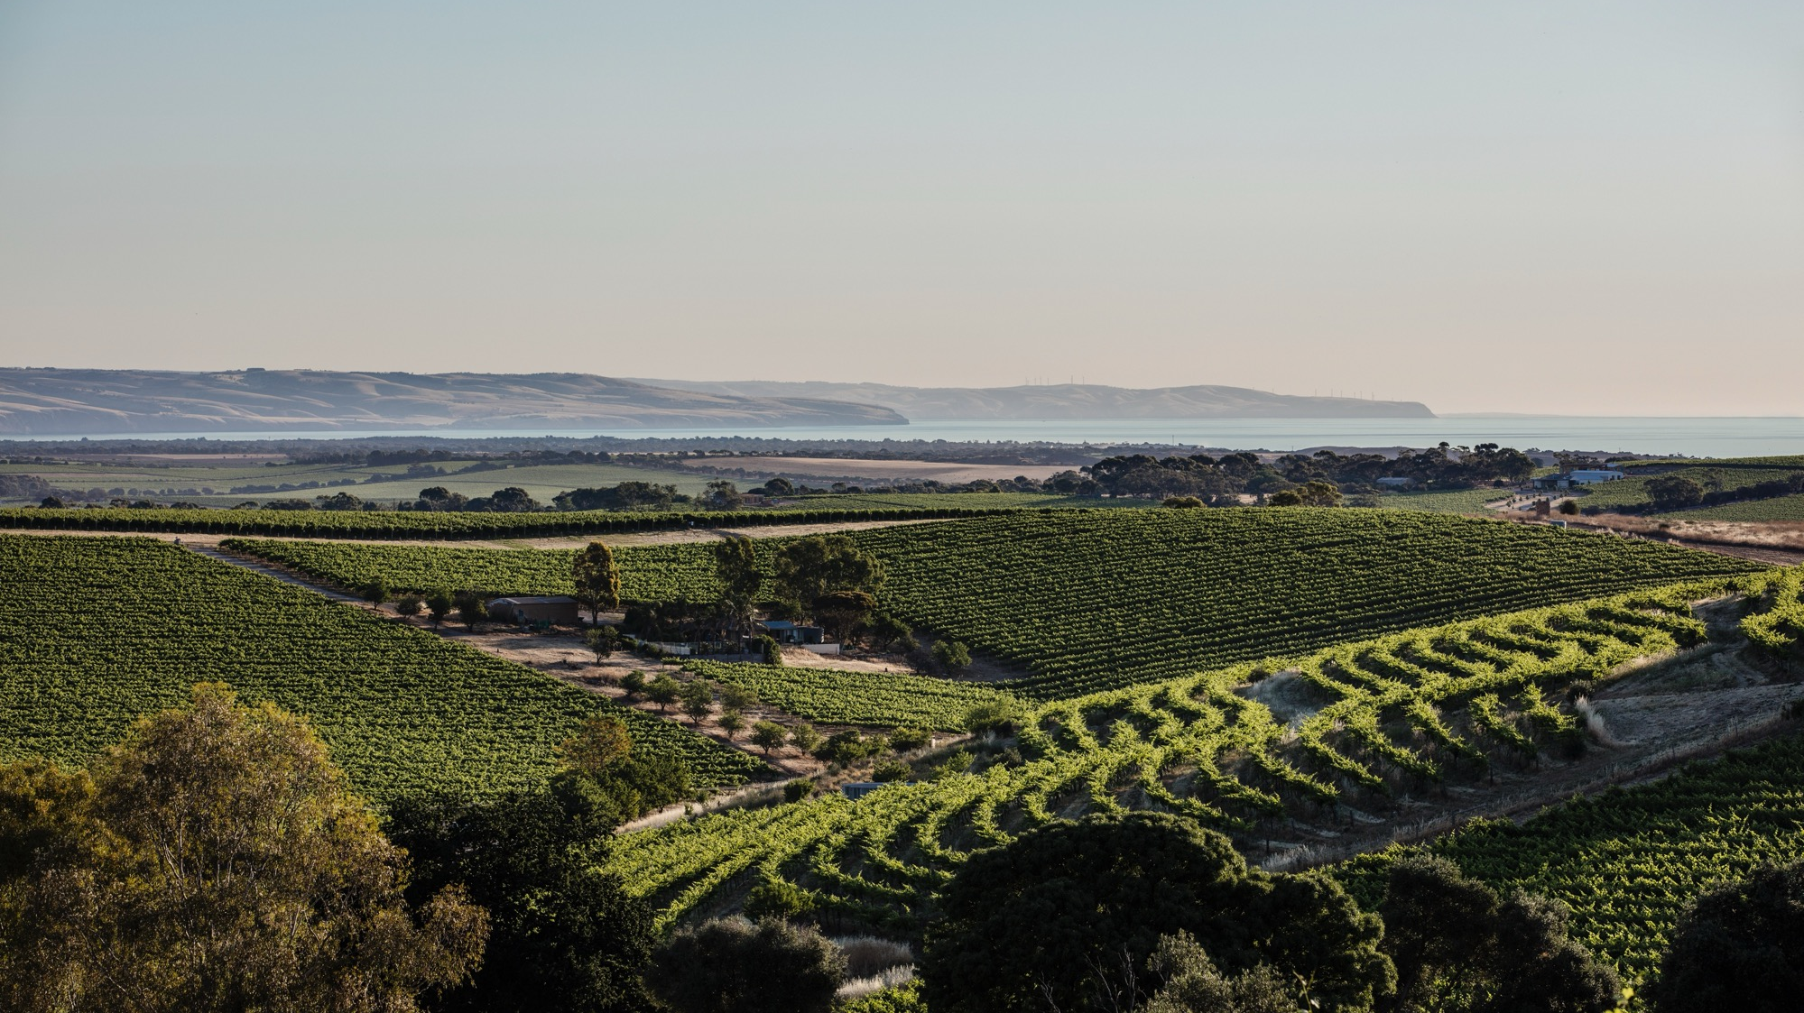
THANK YOU

