Slide 1
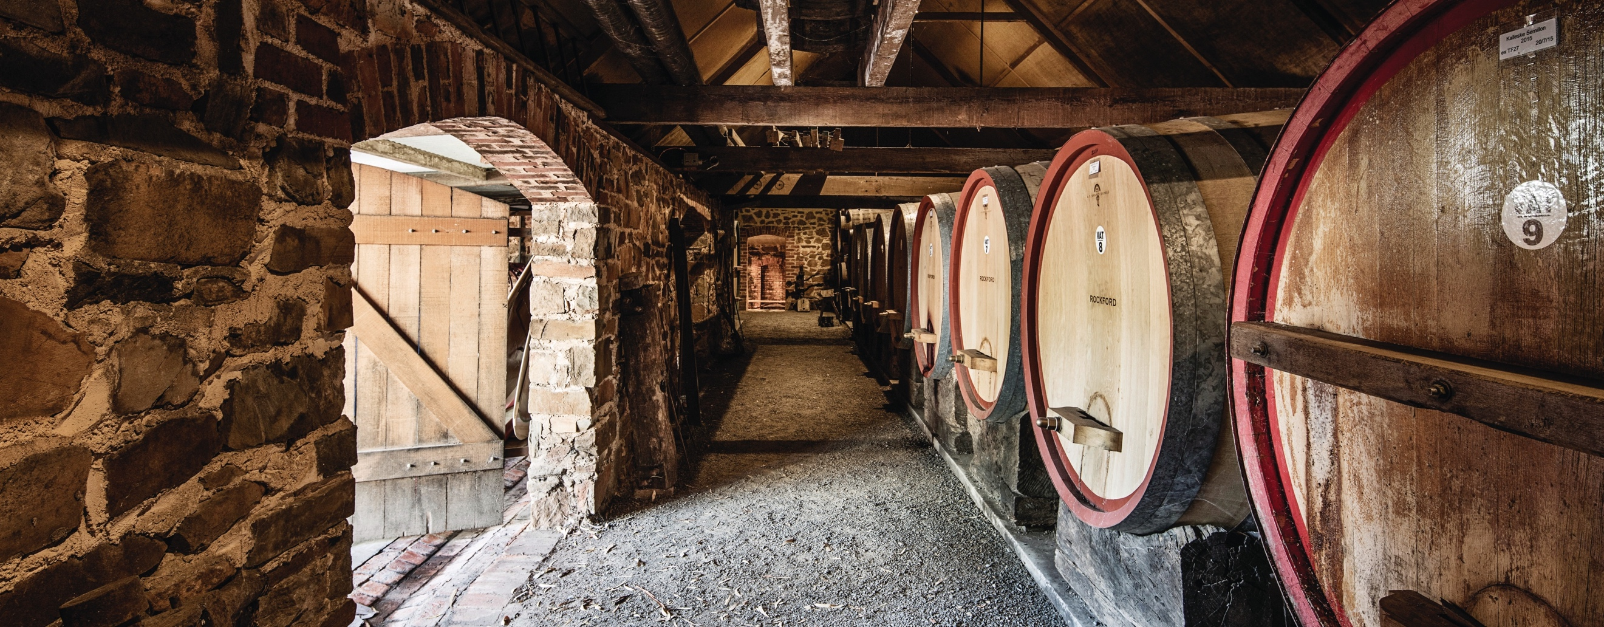
BAROSSA

Slide 2


Crafted from grapes grown under vast and diverse climates, across landscapes millions of years in the making, every glass of Australian wine tells a story.
Like those who came before us, our modern growers and makers continue to be passionate, resilient and creative; constantly driven to explore new ways to perfect old techniques. Our community is connected by a mutual respect and shared love of crafting exceptional wine, while protecting the natural wonders for future generations to enjoy. Applying modern thinking to our ancient lands, we take playful experimentation very, very seriously.
So, if you’re looking for the taste of adventure, let Australian wine be your compass. Because in every bottle of Australian wine, you’ll experience the wonders of Australia – a reminder of the adventure and diversity that defines our culture and our land.

Slide 3

AUSTRALIA
BAROSSA

Slide 4
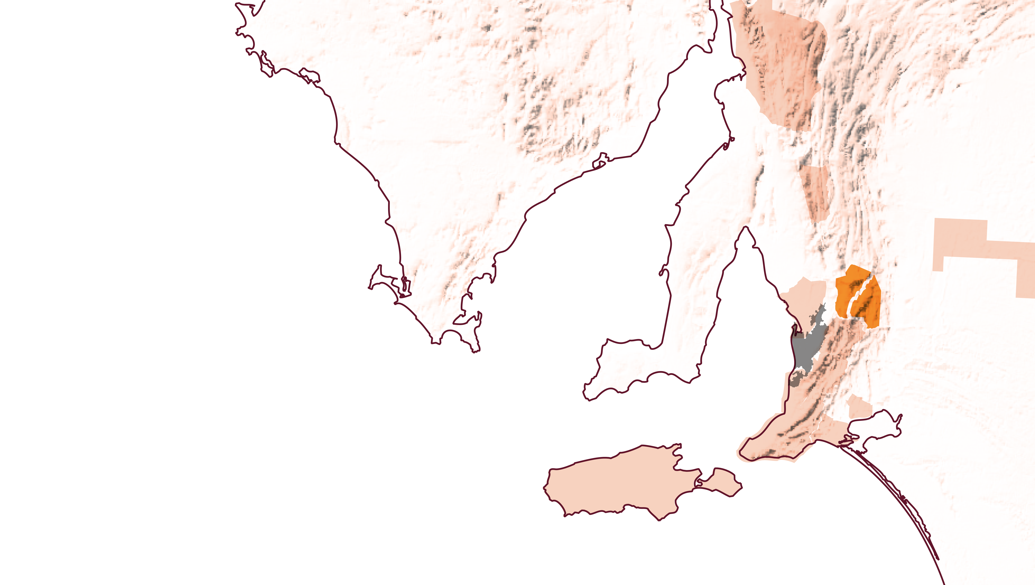
SOUTH
AUSTRALIA
BAROSSA VALLEY
EDEN VALLEY

Slide 5
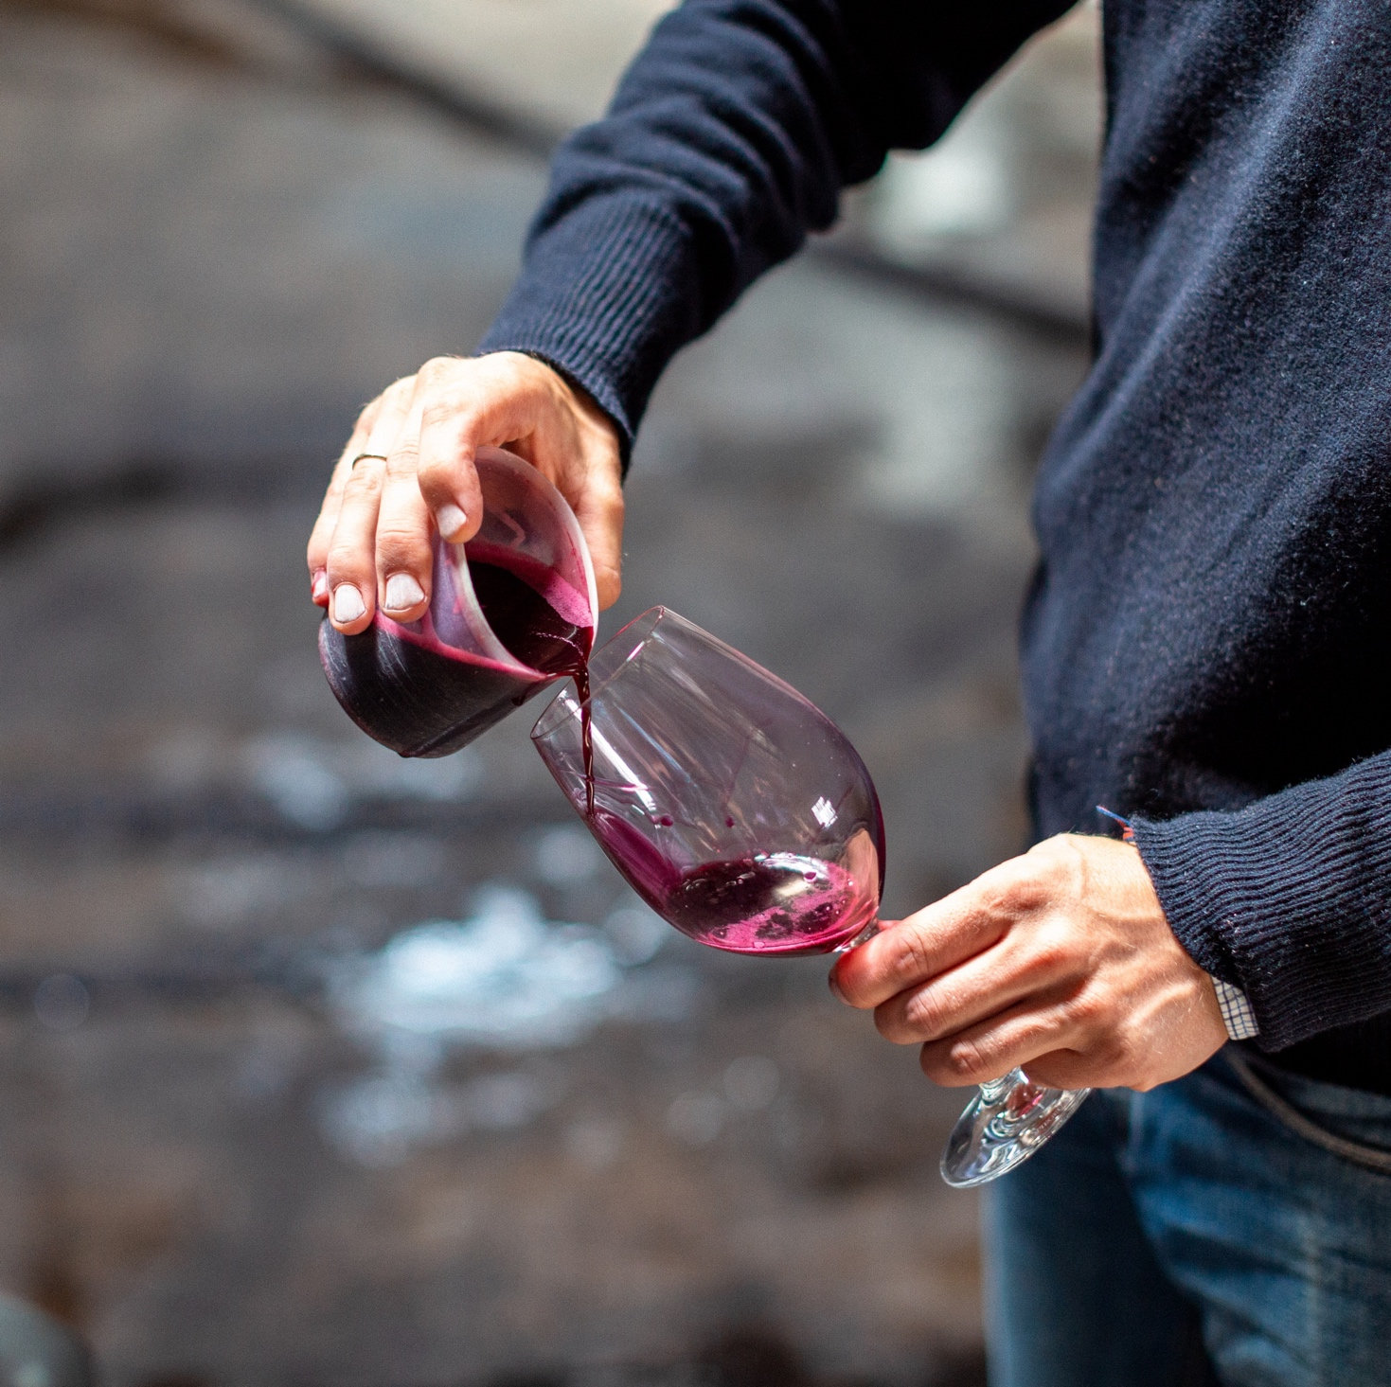
TODAY WE’LL COVER
The history of Barossa
Geography, climate and soil
Viticulture and winemaking
Old vines
Prominent varieties

Slide 6
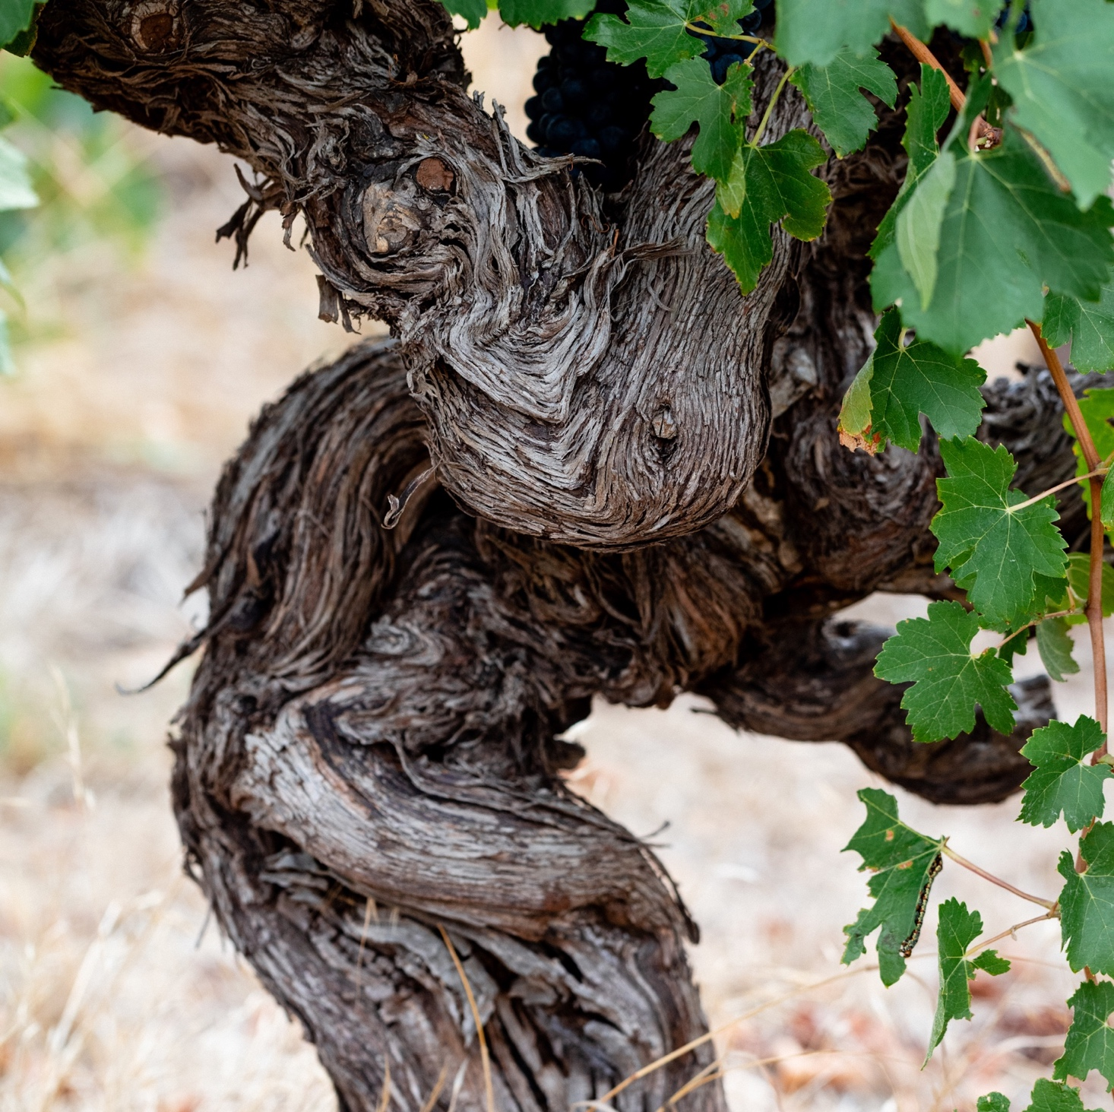
BAROSSA
HISTORY AND EVOLUTION
Encompassing Barossa Valley and Eden Valley, Barossa is one of Australia’s most historic and prominent wine regions.
Rich history dating back to 1840s
Community includes long-established wine families and younger artisan and boutique producers
Diversity of soils, climate and topography
Some of the world’s oldest grapevines
Strong culinary culture and gourmet
local produce

Slide 7
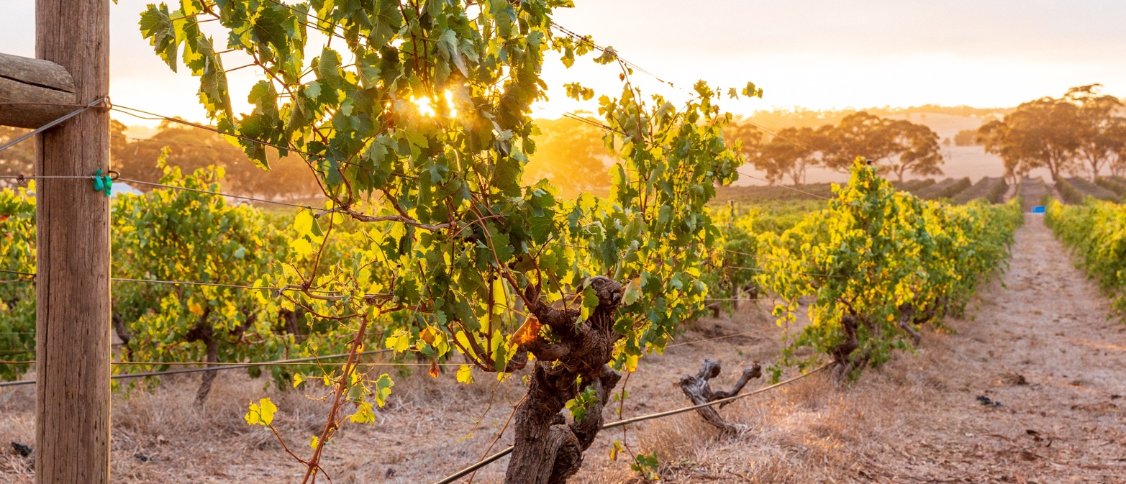
1830s
THE HISTORY OF BAROSSA
A VIBRANT PAST AND BRIGHT FUTURE
1840s – 1850s
LATE 1800s – 1960s
Shortly after the establishment of South Australia, Barossa is identified as a fertile area well suited to agriculture and viticulture.
Barossa is first developed by the British. Soon after, Silesian Lutheran immigrants arrive and give the region a German flavour. Shiraz, Cabernet Sauvignon, Grenache, Mataro, Semillon and Riesling vines
are planted.
Barossa steadily grows, becoming a specialist in fortified wines to satisfy consumer tastes.

Slide 8
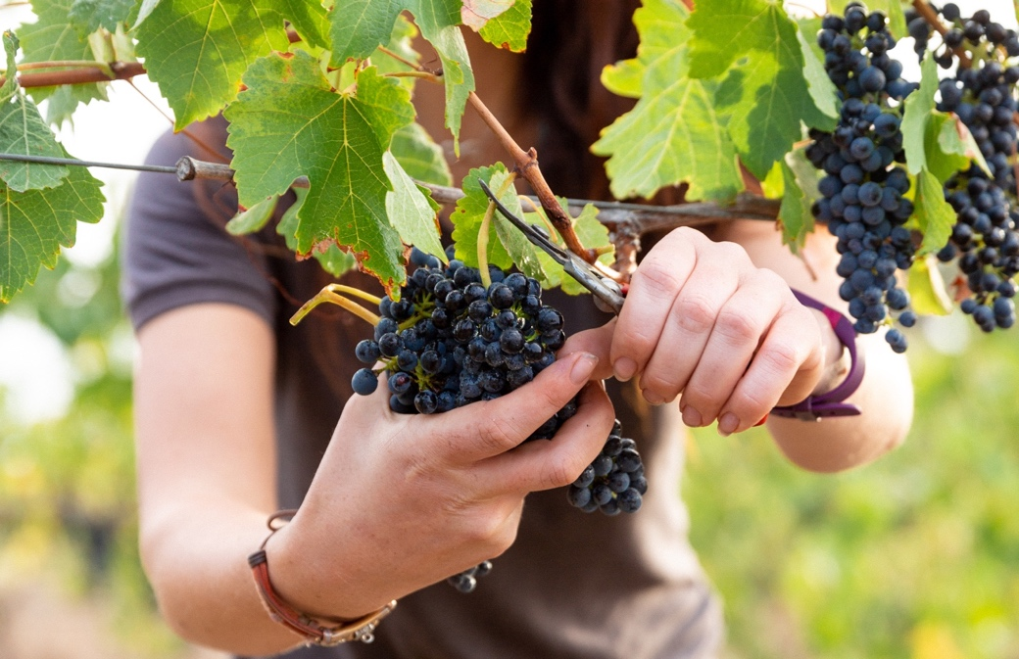
2010s – Today
Late 1990s – Early 2000s
Traditional Barossa varieties have been joined by a new wave of Mediterranean varieties, as well as a new breed of grape growers and winemakers exploring innovative techniques.
Intense, concentrated and heavily oaked wines become the fashion, and Barossa Shiraz, Grenache and red blends are in high demand.
1970s – 1980s
2009
Barossa wines diversify as consumer tastes evolve. They soon gain a global reputation, heralding a golden era for the region.
The Barossa Old Vine Charter, which aims to recognise and preserve old vines, is launched.

Slide 9
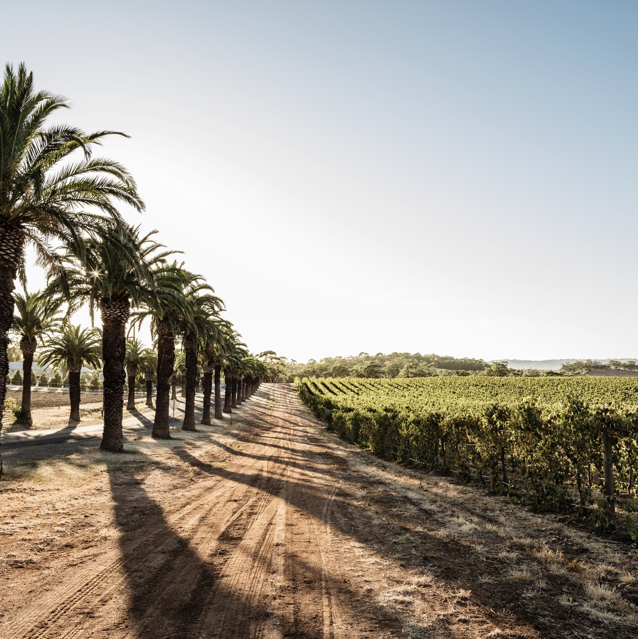
GEOGRAPHY, CLIMATE AND SOIL
DRIVEN BY DIVERSITY
Barossa is classified geographically as a zone, encompassing:
Barossa Valley region
Eden Valley region
High Eden sub-region

Slide 10

CLIMATE
ALTITUDE
MEDITERRANEAN
HIGH
750–999m
(2,460–3,279ft)
BAROSSA VALLEY
130–430M (427–1,411FT)
MEDIUM
500–749m
(1,640–2,459ft)
LOW
0–499m
(0–1,639ft)

Slide 11
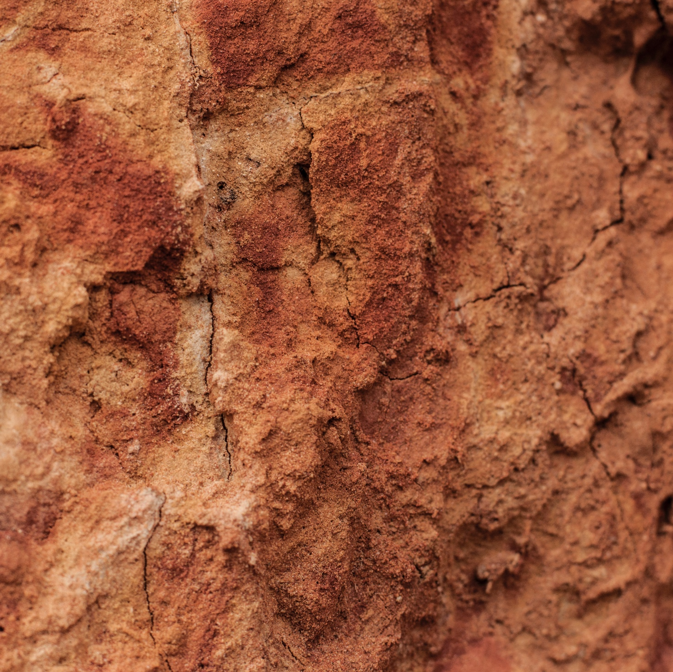
SOIL
BAROSSA VALLEY
While Barossa Valley’s soils vary widely, they are typically rich and deep and all fall within a family of relatively low-fertility clay loam through to more sandy soils, ranging through grey to brown to red.

Slide 12
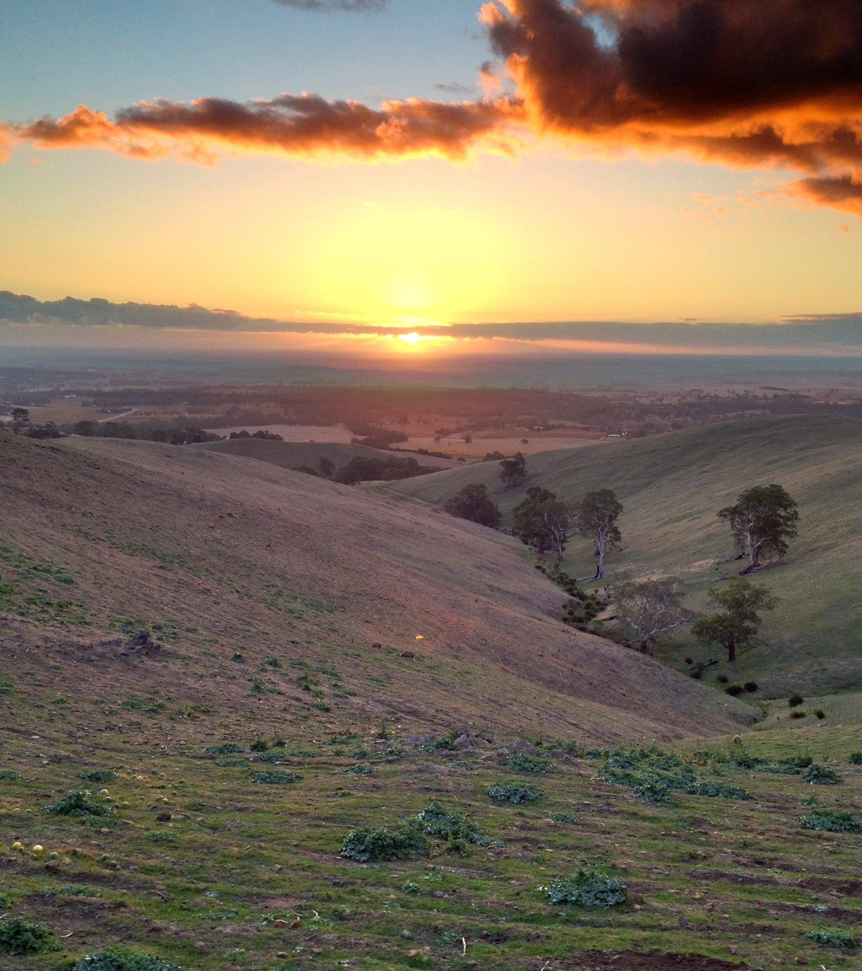
ALTITUDE
EDEN VALLEY
310–540M (1,017–1,472FT)
HIGH
750–999m
(2,460–3,279ft)
MEDITERRANEAN
MEDIUM
500–749m
(1,640–2,459ft)
CLIMATE
COOLER CLIMATE WITH VARIOUS MESOCLIMATES
LOW
0–499m
(0–1,639ft)

Slide 13
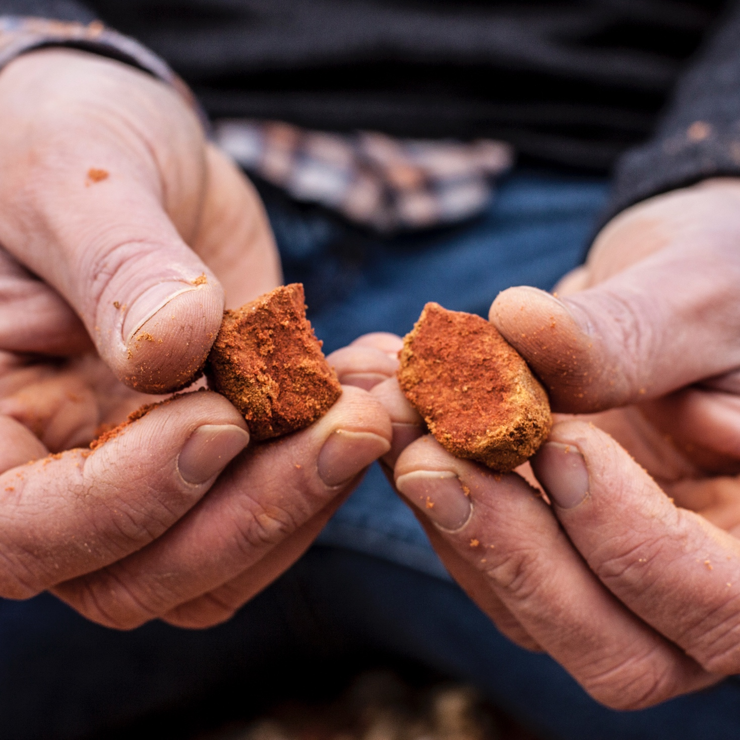
SOIL
EDEN VALLEY
The varied terrain of Eden Valley means there are a number of soil types. The most common are shallow and rocky, and range from grey to brown in colour, and from loamy sand to clay loams.

Slide 14
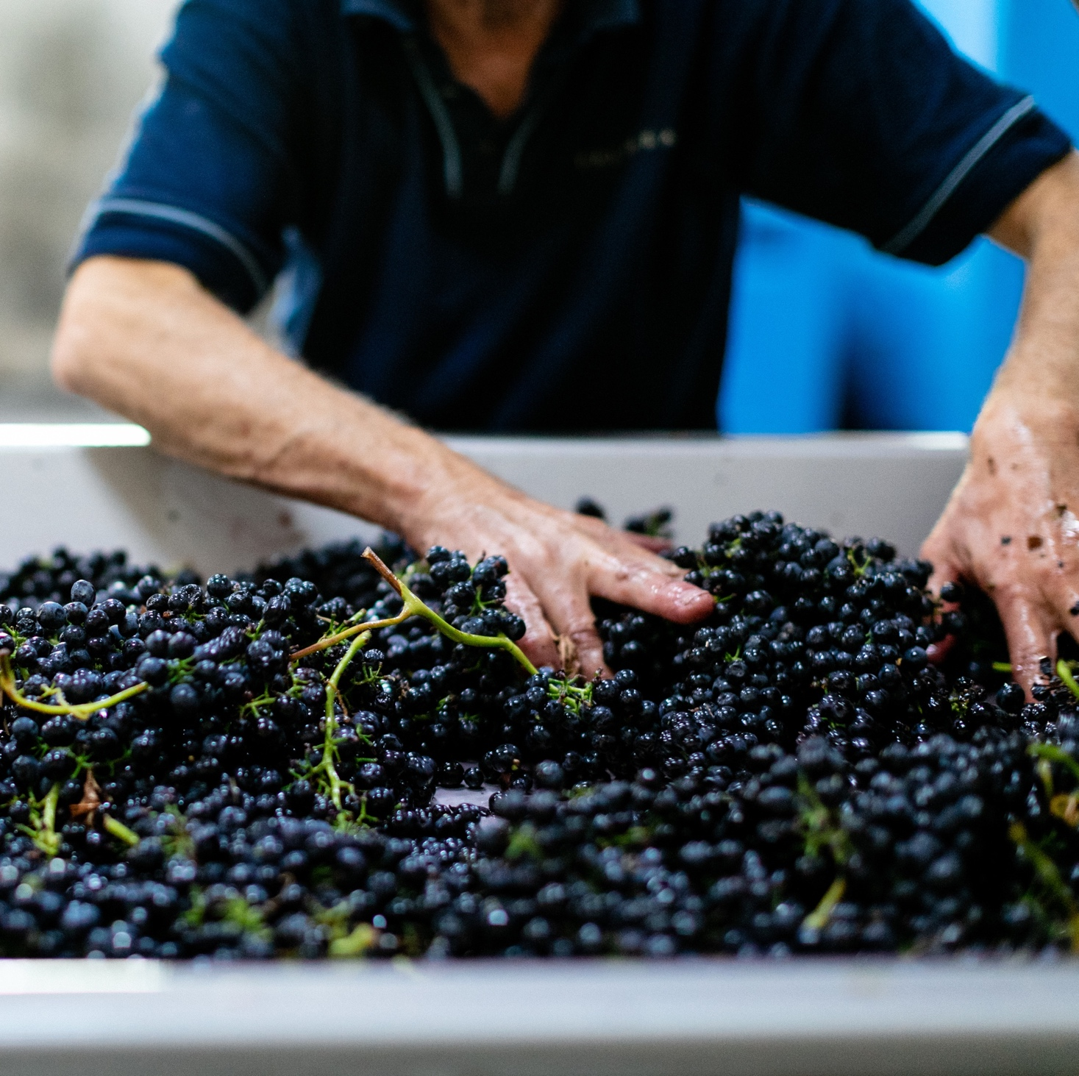
VITICULTURE AND WINEMAKING
IN THE BAROSSA
GRAPE GROWING:
TRADITION MEETS INNOVATION
500+ grapegrowers
Fifth- and sixth-generation growers
Growing focus on sustainable viticultural practices
HARVEST:
Barossa Valley: Mid-February to late April
Eden Valley: Mid-March to April/early May
High Eden: Up to one month after Eden Valley

Slide 15
WINEMAKING
AUTHENTICITY AND EXPERIMENTATION
COLD MACERATION
DIFFERENT YEAST TYPES
WHOLE BUNCH FERMENTATION
POST FERMENTATION MACERATION

Slide 16
WINEMAKING
AUTHENTICITY AND EXPERIMENTATION
FRENCH OR AMERICAN OAK BARRELS, OPEN CONCRETE VATS, LARGE STAINLESS STEEL TANKS, AMPHORAE
ADDITION OF
TARTARIC ACID
To some
warmer-climate wines
SCREW CAP

Slide 17
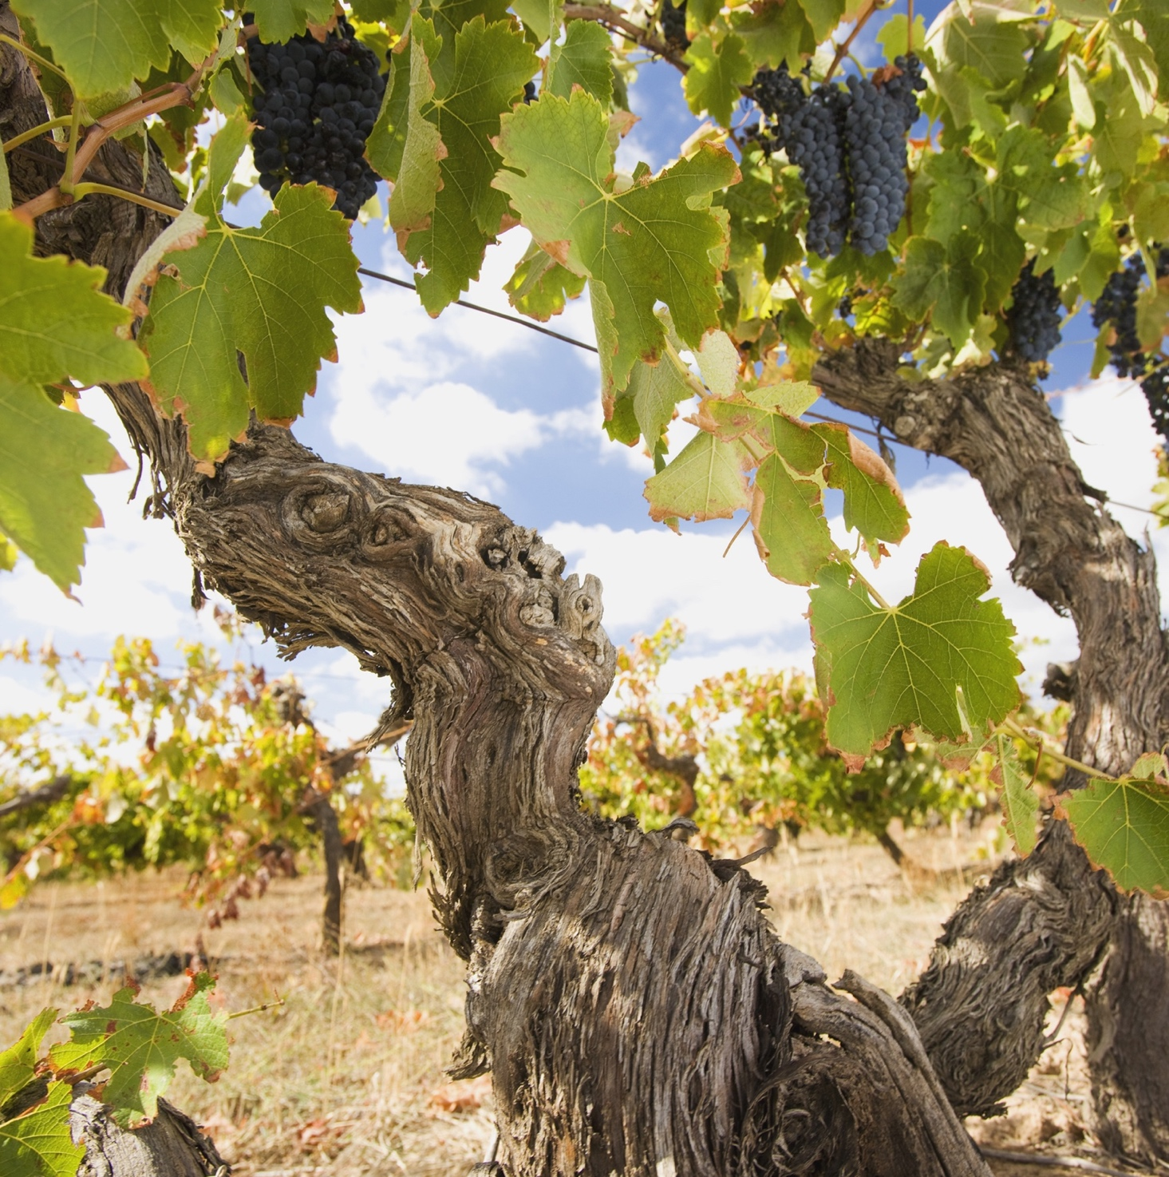
A GROWING HISTORY
OLD VINES
Barossa has some of the world’s oldest vines
Shiraz, Grenache, Cabernet Sauvignon, Semillon, Riesling & Mataro
Old vines can produce more complex wines

Slide 18
BAROSSA OLD VINE CHARTER
ANCESTOR VINES
CENTENARIAN VINES
SURVIVOR VINES
OLD VINES
35+
70+
100+
125+
AGE IN
YEARS

Slide 19


BAROSSA VALLEY
TOP 5 VARIETIES
SHIRAZ
CABERNET
SAUVIGNON
GRENACHE
CHARDONNAY
MERLOT
SHIRAZ
63%
CABERNET
SAUVIGNON
13%
GRENACHE
5%
CHARDONNAY
4%
MERLOT
3%

Slide 20

EDEN VALLEY
TOP 5 VARIETIES
RIESLING
CHARDONNAY
CABERNET
SAUVIGNON
MERLOT
SHIRAZ
RIESLING
30%
SHIRAZ
27%
CHARDONNAY
13%
CABERNET
SAUVIGNON
10%
MERLOT
3%

Slide 21

EDEN VALLEY
RIESLING
STRONG
LEMON - LIME AROMAS
with a great intensity
of flavour
MOST IMPORTANT WHITE GRAPE VARIETY ACCOUNTING FOR ROUGHLY 1/4 OF TOTAL CRUSH
RIESLING
THRIVES IN THE COOL,
HIGHER-ALTITUDE VINEYARDS
PRIMARY FLAVOURS
Lemon juice
Lime juice
Green apple
Ginger flower
SECONDARY FLAVOURS
Toast
Almond
Honey
Marmalade

Slide 22
EDEN VALLEY RIESLING
CHARACTERISTICS
COLOUR
Riesling
Light
Medium
Full
BODY
Dry
Medium dry
Sweet
SWEETNESS
RIESLING
Low
Medium
High
OAK
ACIDITY
8%
11% – 13.5%
17%
ALCOHOL

Slide 23

BAROSSA VALLEY
GRENACHE
RICHLY TEXTURED AND RIPE WITH RED FRUIT, SPICE AND PEPPERY CHARACTERISTICS
A VERSATILE GRAPE MADE
AS A SINGLE VARIETAL AND BLENDED WINE
GRENACHE
Dark Raspberry
Strawberry
Cherry
White Pepper

Slide 24
BAROSSA GRENACHE characteristics
COLOUR
Grenache
Light
Medium
Full
BODY
Dry
Medium dry
Sweet
SWEETNESS
Low
Medium
High
GRENACHE
OAK
TANNIN
ACIDITY
8%
17%
13.5% – 15.5%
ALCOHOL

Slide 25
BAROSSA VALLEY
SHIRAZ
FULL BODIED, RICH AND ROBUST IN STYLE WITH RIPE FRUIT AND FIRM TANNINS
BAROSSA VALLEY’S SIGNATURE
WINE
SHIRAZ
WELL OVER
1/2
OF ANNUAL
CRUSH
Blackberry
Blackcurrant
Plum
Black Pepper
Liquorice
Chocolate

Slide 26
BAROSSA VALLEY SHIRAZ characteristics
COLOUR
Shiraz
Light
Medium
Full
BODY
Dry
Medium dry
Sweet
SWEETNESS
Low
Medium
High
SHIRAZ
OAK
TANNIN
ACIDITY
8%
17%
13.5% – 15.5%
ALCOHOL

Slide 27
EDEN VALLEY
SHIRAZ
MEDIUM TO FULL BODIED
VERY SMOOTH AND VIBRANT IN STYLE WITH RIPE TANNINS THAT ARE INTEGRATED AND WELL BALANCED
COOLER CONDITIONS THAN BAROSSA VALLEY RESULTING IN ELEGANT AND PERFUMED WINE
SHIRAZ
AROUND
1/3
OF ANNUAL
CRUSH
Raspberry
Black Pepper
Mulberry
Blackberry
Sage
Black Olive
Spice

Slide 28
EDEN VALLEY SHIRAZ characteristics
COLOUR
Shiraz
Light
Medium
Full
BODY
Dry
Medium dry
Sweet
SWEETNESS
Low
Medium
High
SHIRAZ
OAK
TANNIN
ACIDITY
8%
17%
13.5% – 15.5%
ALCOHOL

Slide 29
BAROSSA VALLEY
CABERNET SAUVIGNON
RICH, OPULENT STYLES WITH A RIPER FRUIT CHARACTER AND SOFTER TANNINS THAN COONAWARRA AND MARGARET RIVER
SOMETIMES BLENDED WITH OTHER VARITIES INCLUDING SHIRAZ
DOES BEST IN COOLER SITES AND VINTAGES
CABERNET SAUVIGNON
MORE THAN
10%
OF ANNUAL
CRUSH
Blackcurrant
Blackberry
Prunes
Black Olive
Eucalyptus

Slide 30
BAROSSA VALLEY CABERNET SAUVIGNON characteristics
COLOUR
Cabernet (youthful)
Light
Medium
Full
BODY
Dry
Medium dry
Sweet
SWEETNESS
Low
Medium
High
CABERNET SAUVIGNON
OAK
TANNIN
ACIDITY
8%
13.5% – 15.5%
17%
ALCOHOL

Slide 31
EDEN VALLEY
CABERNET
SAUVIGNON
VINEYARDS ON HIGHER, COOLER SITES PRODUCE DIFFERENT STYLES TO THOSE AROUND EDEN VALLEY VILLAGE
CABERNET SAUVIGNON
MORE THAN
10%
OF ANNUAL
CRUSH
Blueberry
Blackcurrant
Plum
Tomato Leaf
Violets
Menthol

Slide 32
EDEN VALLEY CABERNET SAUVIGNON
characteristics
COLOUR
Cabernet
Light
Medium
Full
BODY
Dry
Medium dry
Sweet
SWEETNESS
Low
Medium
High
CABERNET SAUVIGNON
OAK
TANNIN
ACIDITY
8%
13.5% – 15.5%
17%
ALCOHOL

Slide 33

BAROSSA
BEST OF THE REST
CHARDONNAY
Second most planted white grape in Barossa
South Australia’s first commercial Chardonnay vineyards established in Eden Valley in 1973
Rich, complex wines with classic flavours ranging through melon, fig and cashew.
SEMILLON
One of Barossa Valley’s three most prominent white grape varieties
Traditional style is oak-aged and rich, while more modern styles are lighter and crisper
Can be blended with Sauvignon Blanc.

Slide 34
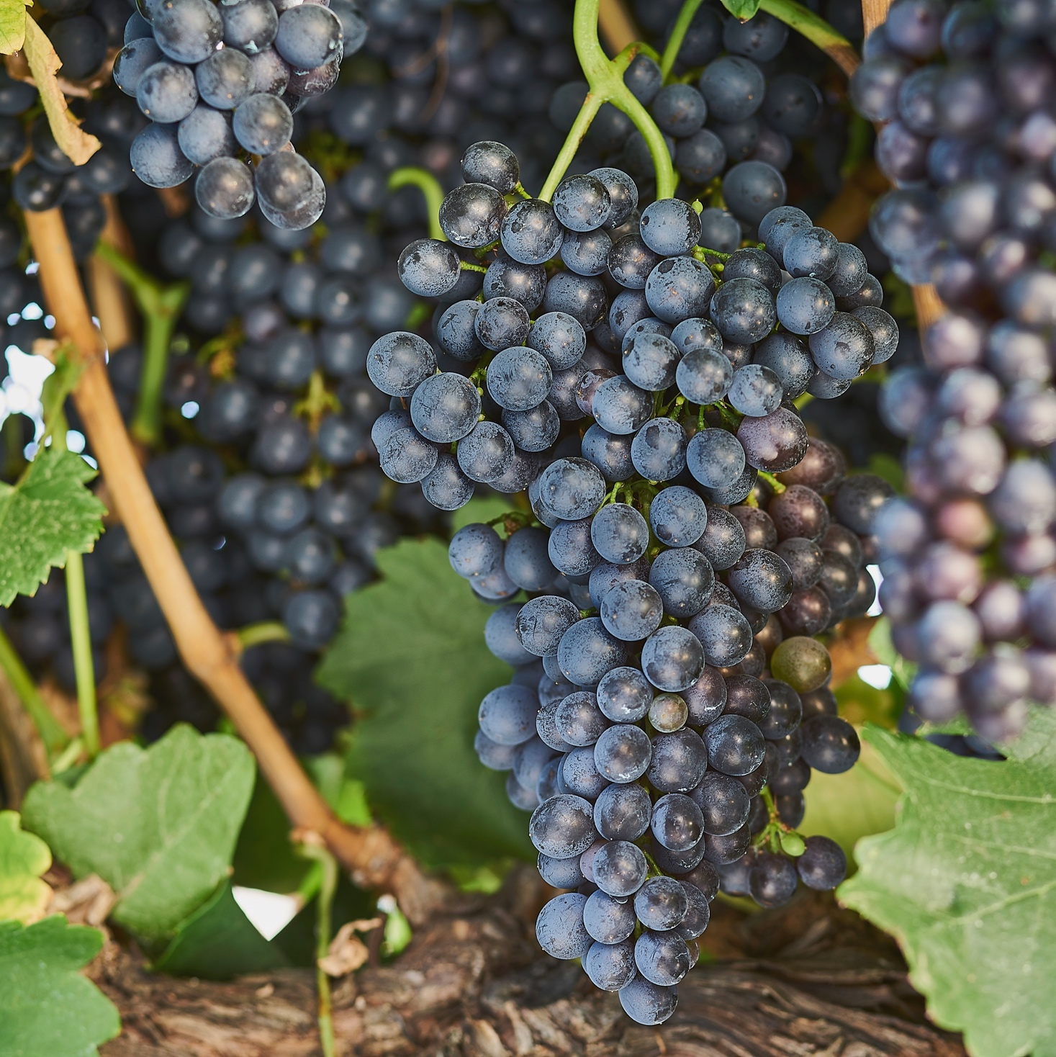
MATARO/MOURVÉDRE
Barossa Valley accounts for roughly 1/5 of annual crush in Australia
It has the oldest Mataro vineyard
in the world, planted in 1853
Mataro is commonly used in blends, bringing colour, weight and intense flavours.
FORTIFIED WINES
Barossa Valley has a long history
of producing fortified wines
Less common today but still world-class
One of Australia’s most expensive wines is a Barossa fortified – the Seppeltsfield 1879 Para Tawny.

Slide 35
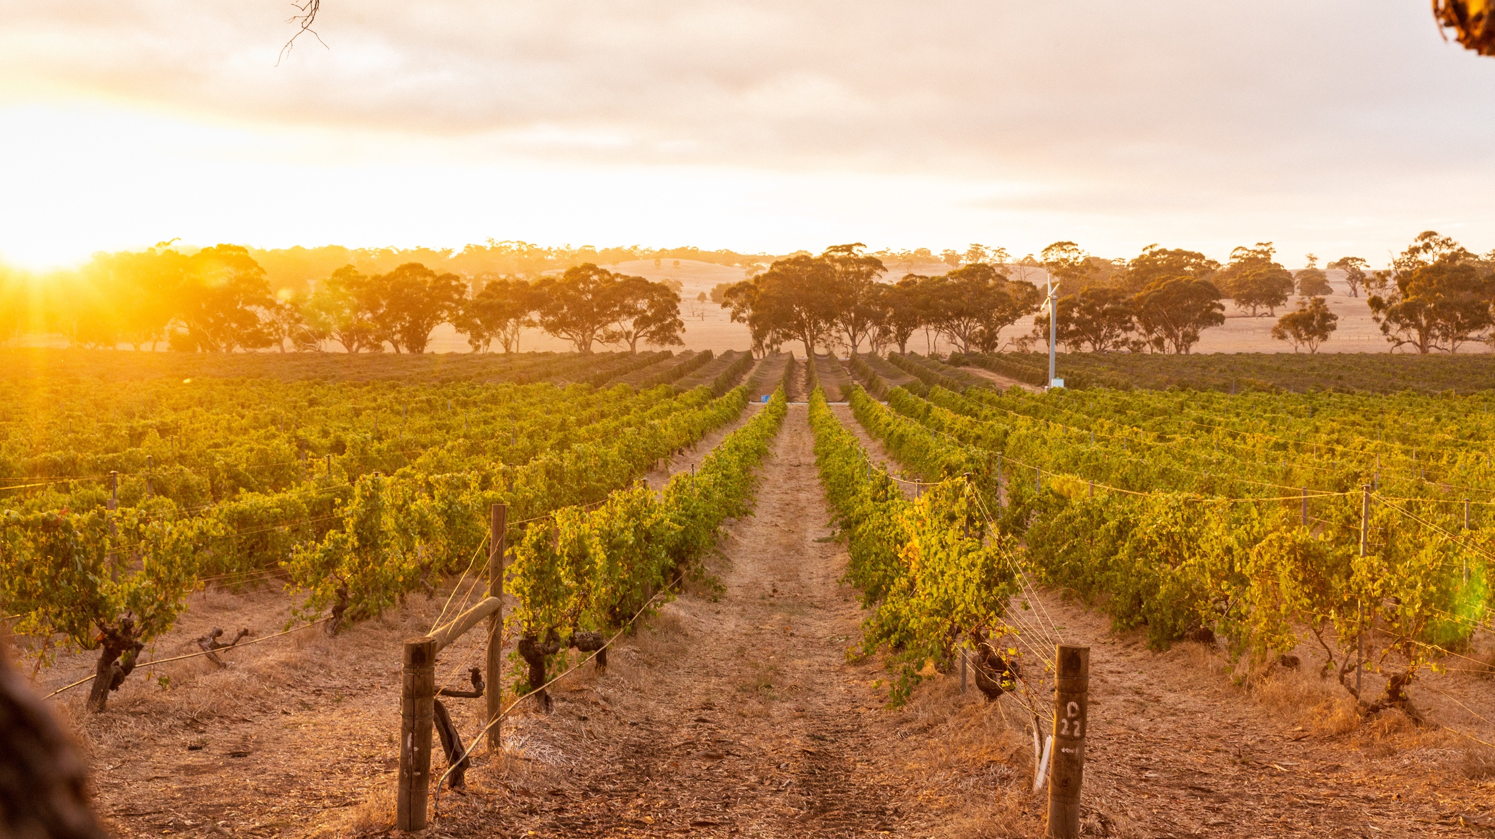
BAROSSA
A RICH HERITAGE AND AN EXCITING FUTURE FOR THIS WORLD-LEADING WINE REGION

Slide 36
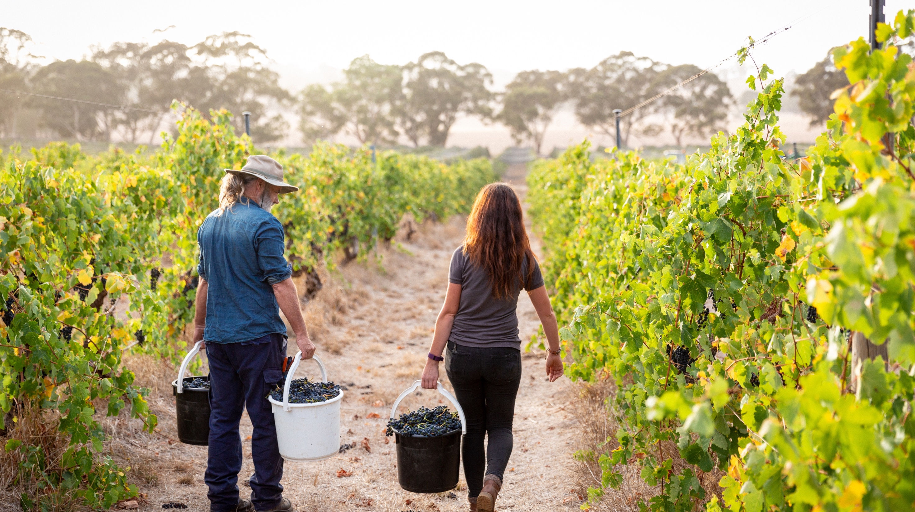
THANK YOU

