Slide 1
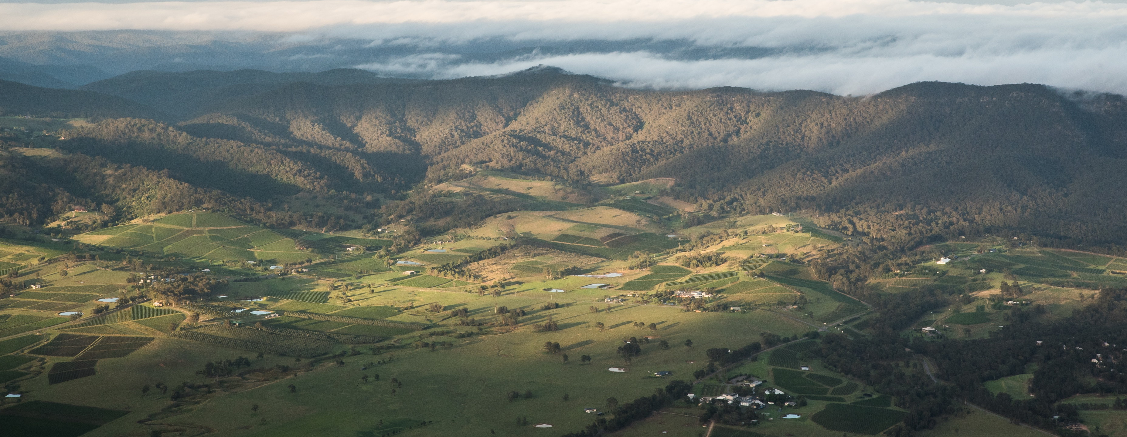
HUNTER VALLEY

Slide 2


Crafted from grapes grown under vast and diverse climates, across landscapes millions of years in the making, every glass of Australian wine tells a story.
Like those who came before us, our modern growers and makers continue to be passionate, resilient and creative; constantly driven to explore new ways to perfect old techniques. Our community is connected by a mutual respect and shared love of crafting exceptional wine, while protecting the natural wonders for future generations to enjoy. Applying modern thinking to our ancient lands, we take playful experimentation very, very seriously.
So, if you’re looking for the taste of adventure, let Australian wine be your compass. Because in every bottle of Australian wine, you’ll experience the wonders of Australia – a reminder of the adventure and diversity that defines our culture and our land.

Slide 3
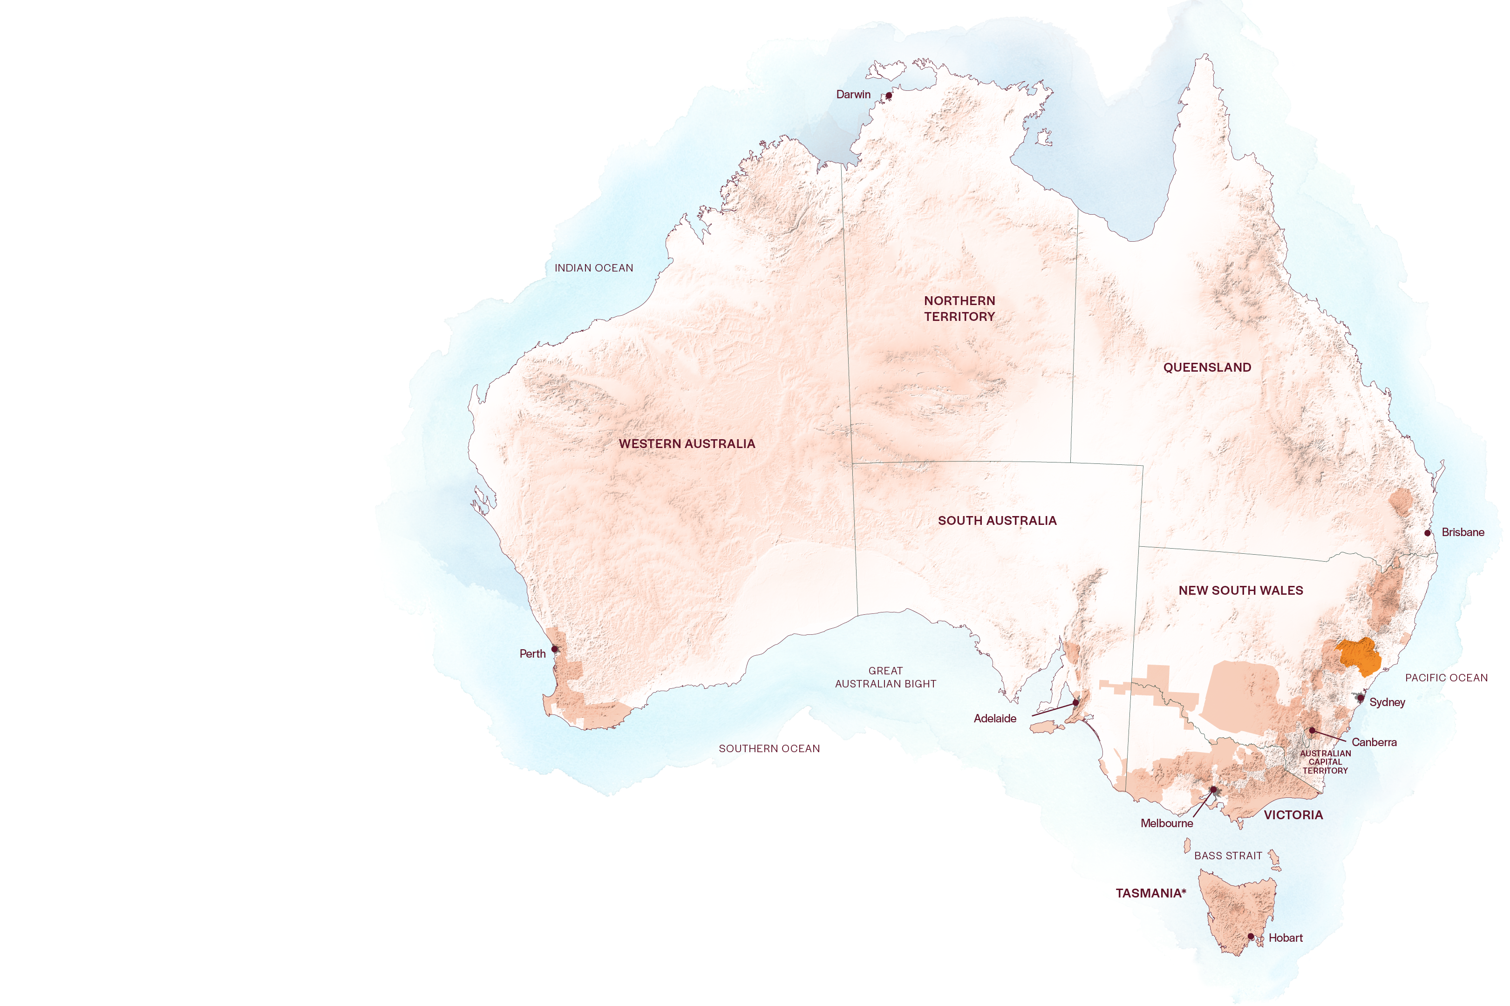
AUSTRALIA
HUNTER VALLEY

Slide 4
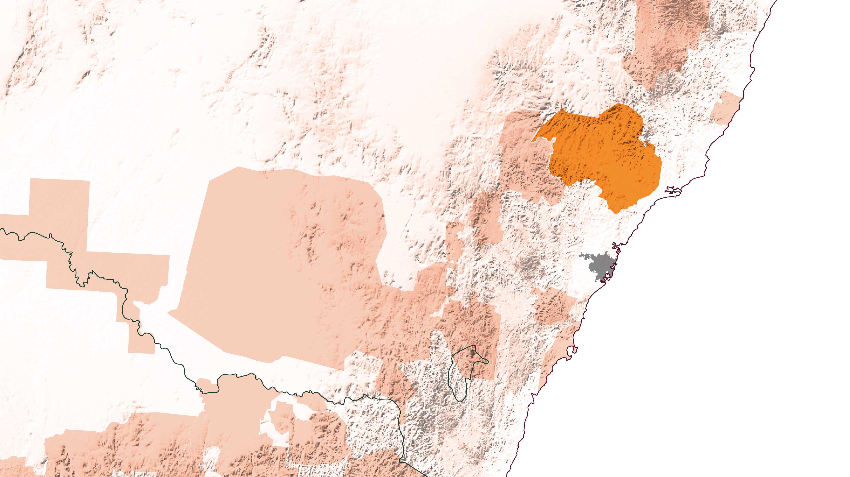
NSW
HUNTER VALLEY
Sydney

Slide 5
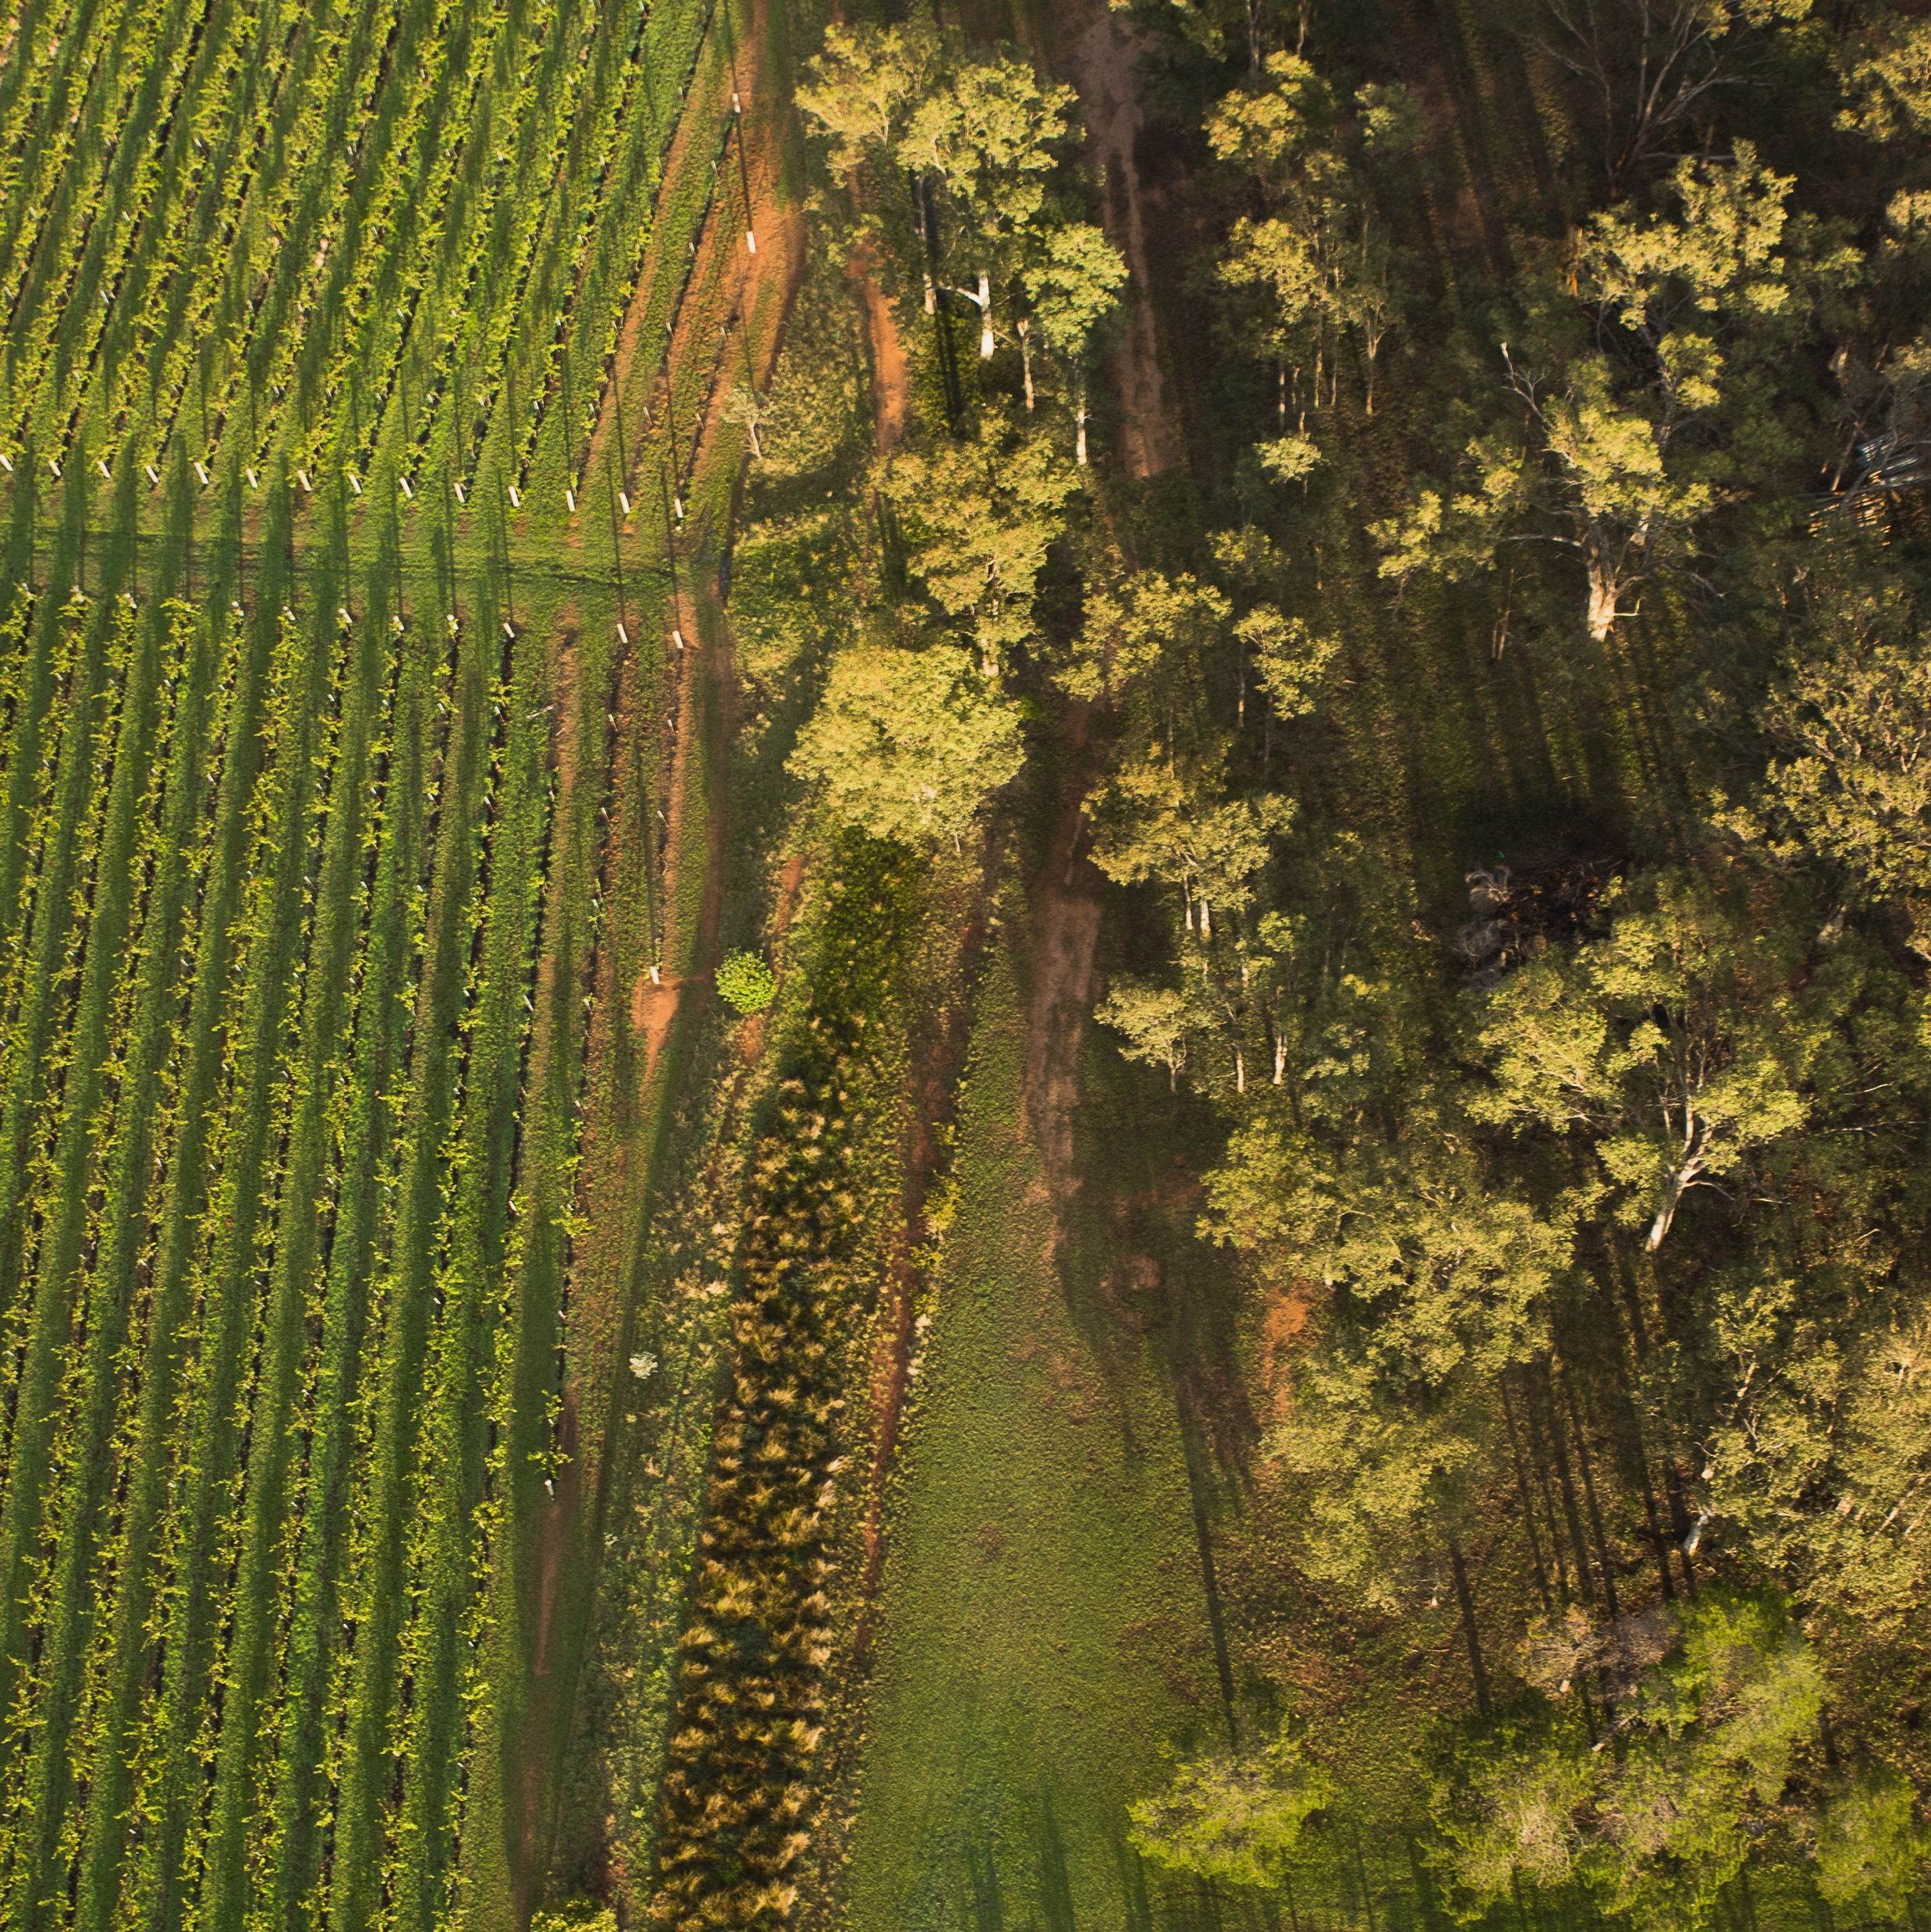
HUNTER VALLEY
THE BIRTHPLACE OF AUSTRALIAN WINE
One of Australia’s oldest wine regions, the Hunter Valley remains a star of the Australian wine community.
Warm, humid climate
Producing world-class Semillon, Chardonnay and Shiraz
Home to some of the world’s oldest vine stock
Popular tourist destination

Slide 6
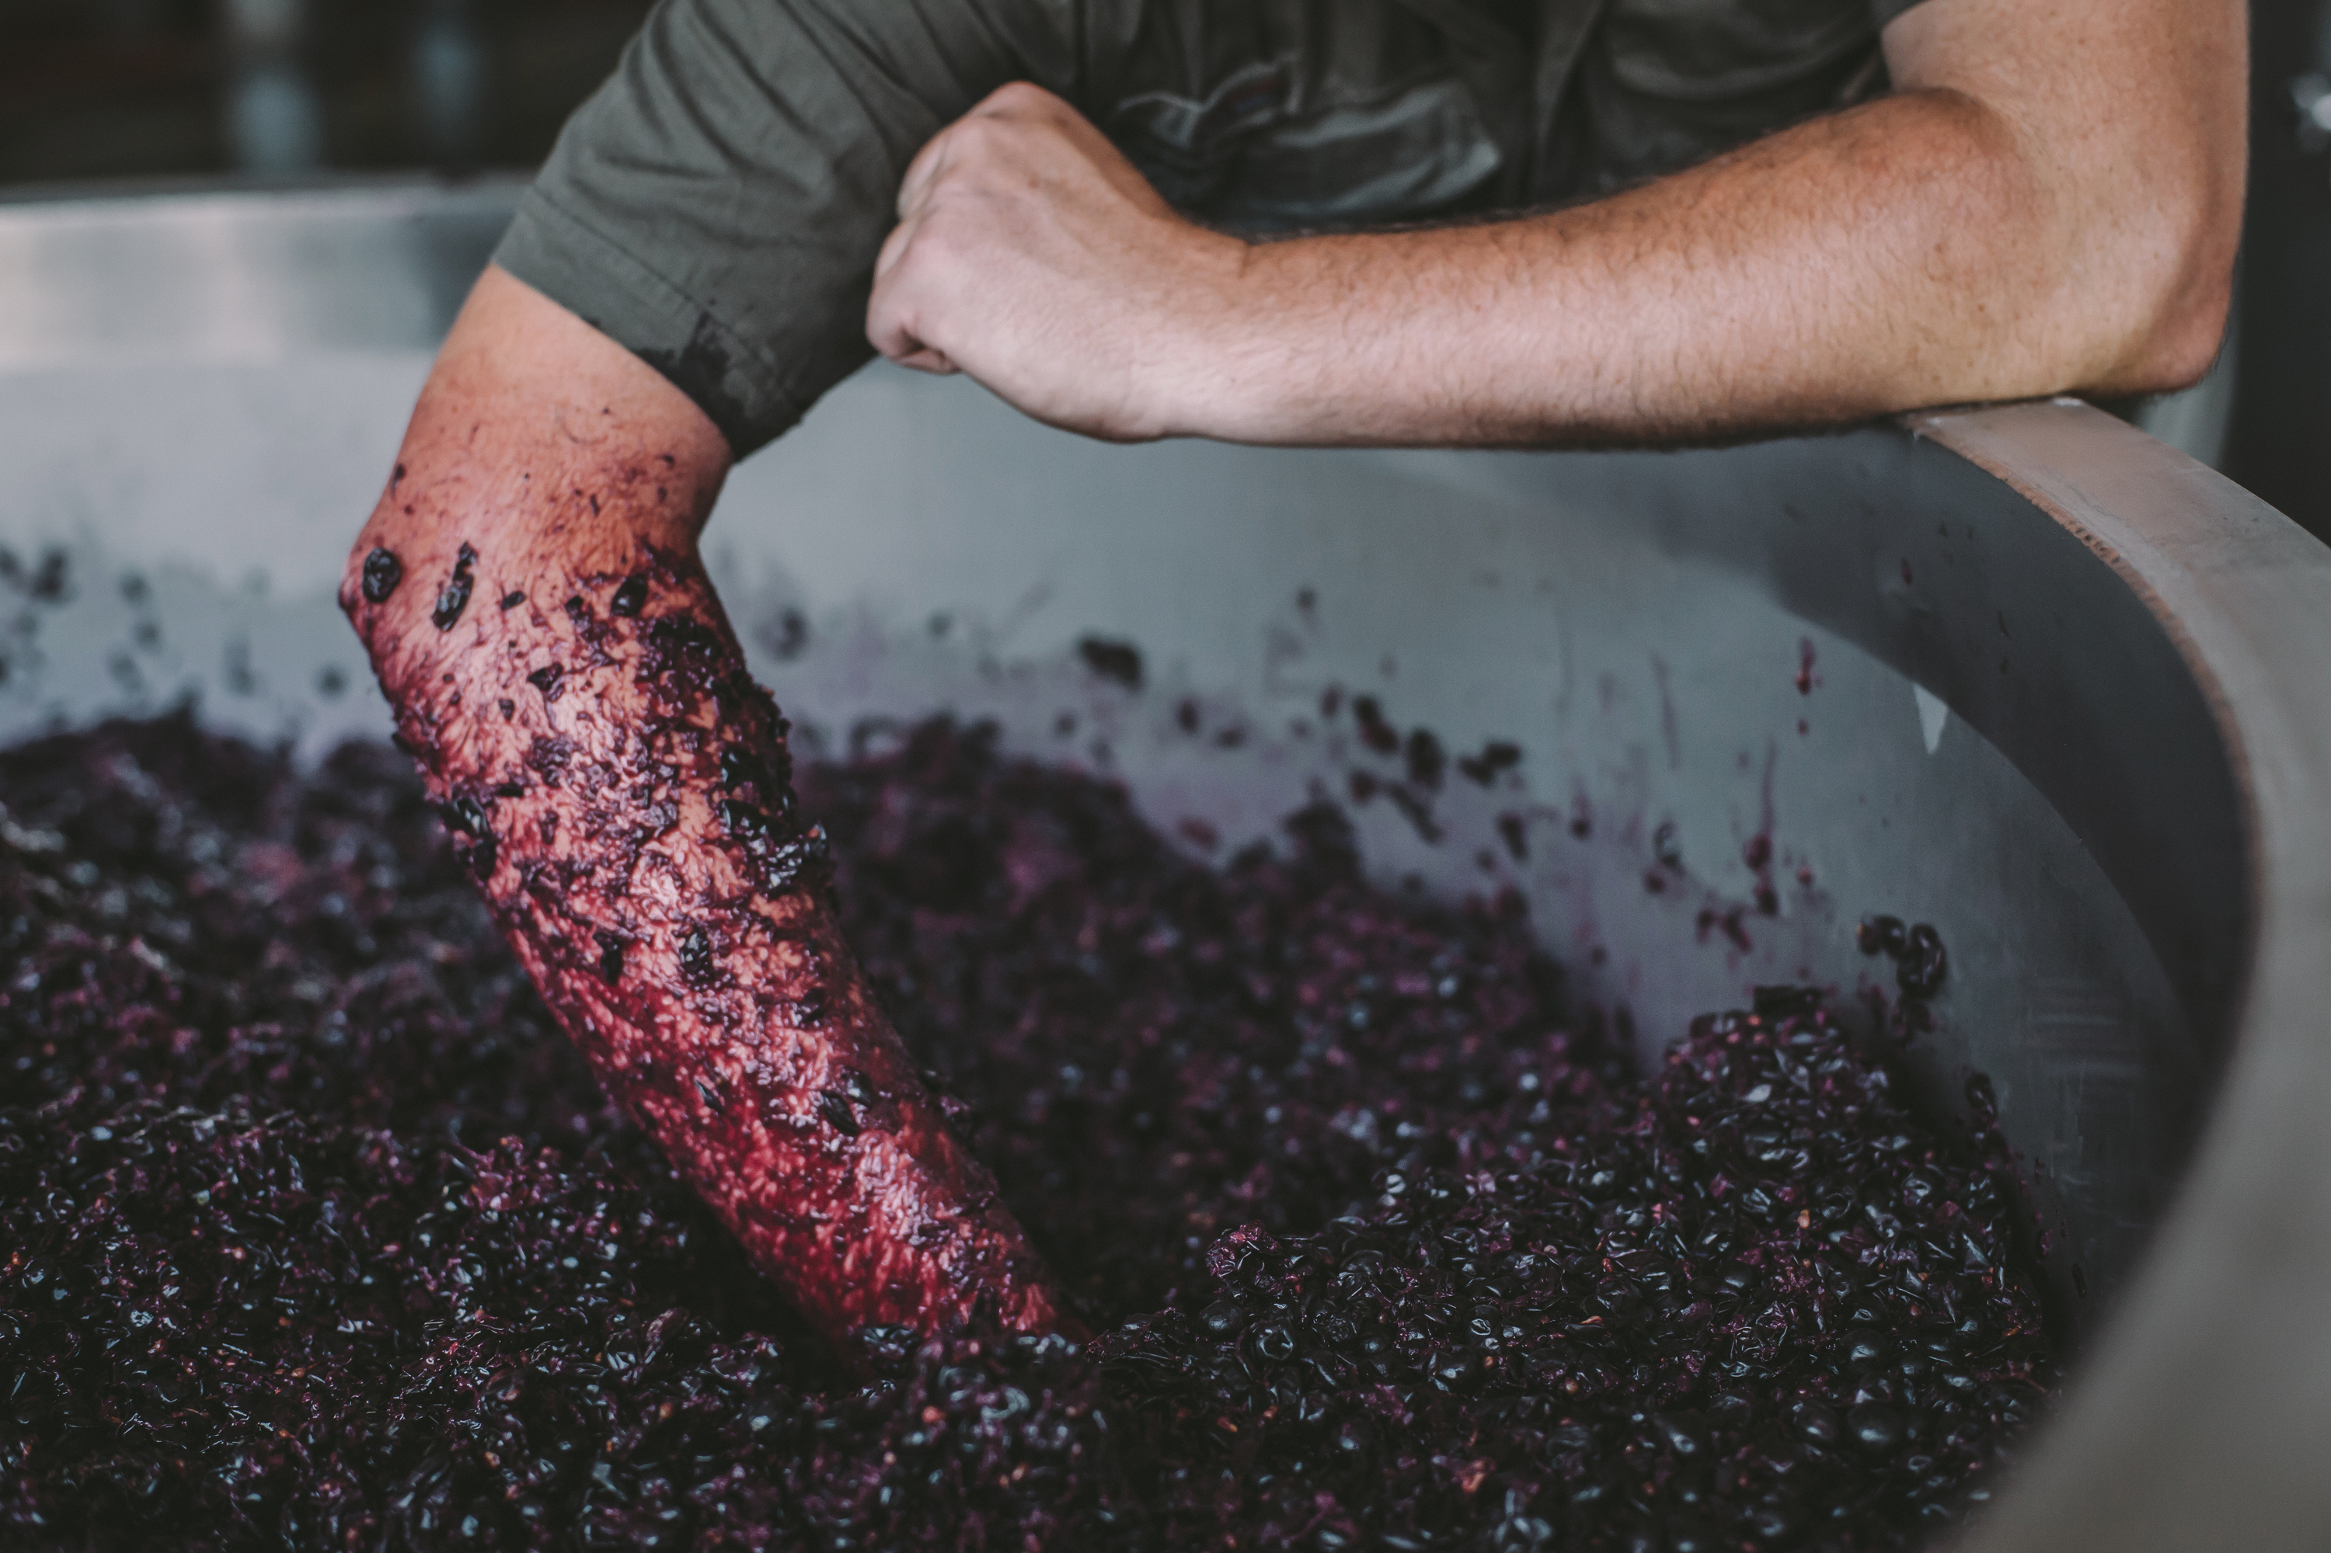
TODAY WE’LL COVER
The history of Hunter Valley
Geography, climate and soil
Viticulture and winemaking
Old vines
Prominent varieties

Slide 7
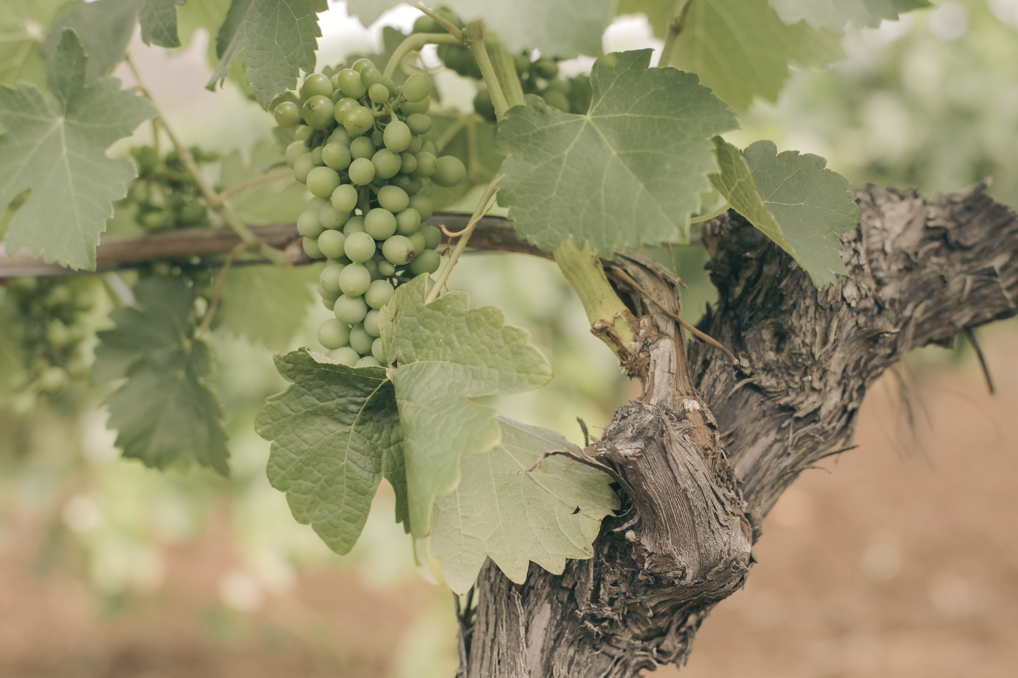
1820s
THE HISTORY OF
HUNTER VALLEY
AN AUSTRALIAN PIONEER
1830s
Mid 1800s
Early European settlers begin planting vines.
Among the early pioneers
is Scottish immigrant James Busby, who helps establish the Hunter Valley after introducing vine cuttings from Europe.
Dr Henry Lindeman moves to Australia and quickly earns a reputation for exceptional wines. He becomes president of the local vineyard association and helps establish key varieties including Semillon, Verdelho and Shiraz.

Slide 8
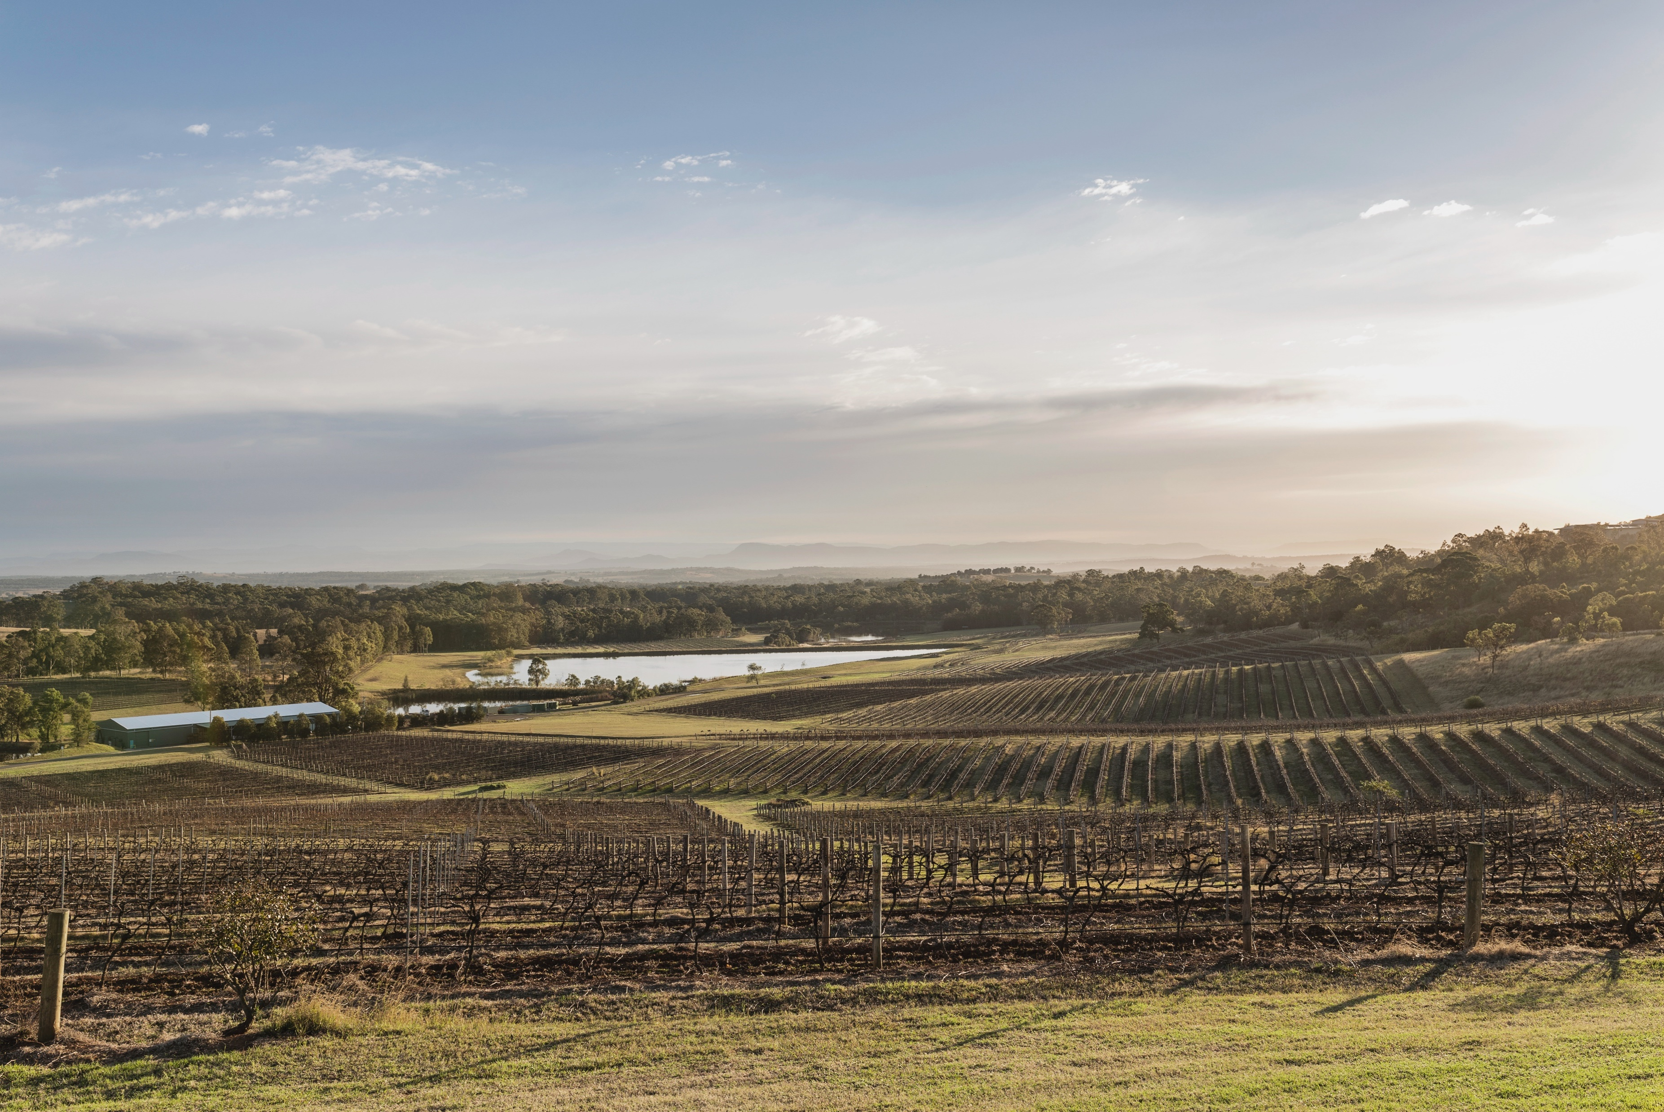
Early 1900s
Tyrrell’s HVD vineyard is
planted, today one of the oldest Chardonnay vineyards in the world. Pokolbin begins to make its mark as a reputable wine‑producing area. Maurice O’Shea and his family purchase the historic Mount Pleasant property.
Today
Hunter Valley is one of the most visited wine regions in Australia. It continues to impress with world-class Semillon, Chardonnay and Shiraz.
Late 1800s
Late 1900s
The Hunter Valley gains a reputation locally and globally as a prominent wine region. Early pioneers pave the way, including the Tyrrell, Tulloch, Wilkinson and Drayton families.
Penfolds establishes a 600-acre site at Wybong Park, beginning a new chapter in viticulture in the Upper Hunter area. The Hunter Valley’s wine industry flourishes and the region becomes known for superb Semillon.

Slide 9
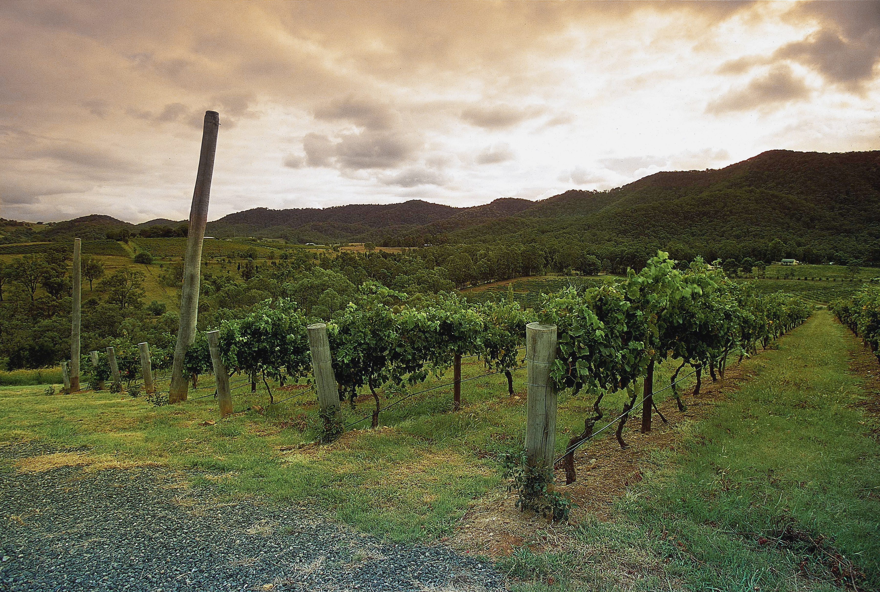
A WARM CLIMATE REGION OF
NATURAL WONDERS
Hunter Valley is classified geographically as a zone encompassing:
Hunter region
Broke Fordwich subregion
Pokolbin subregion
Upper Hunter Valley subregion

Slide 10

CLIMATE
ALTITUDE
SUBTROPICAL
VERY HIGH
1000m +
(>3,280ft +)
HIGH
750–999m
(2,460–3,279ft)
WITH MARITIME INFLUENCES
HUNTER VALLEY
22–254M (72–833FT)
MEDIUM
500–749m
(1,640–2,459ft)
LOW
0–499m
(0–1,639ft)

Slide 11
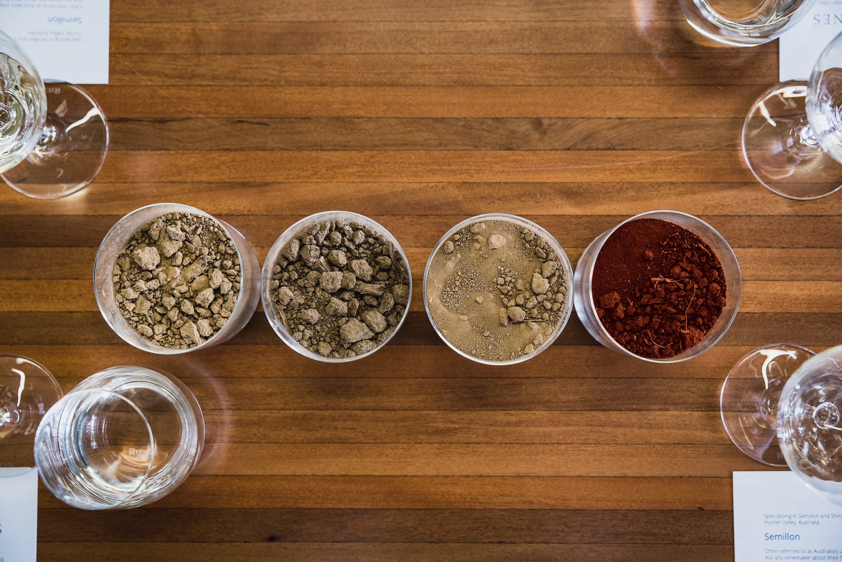
SOIL
Varied across the region
Shiraz typically does best on friable red duplex and loam soils
Semillon typically does best
on sandy alluvial flats

Slide 12
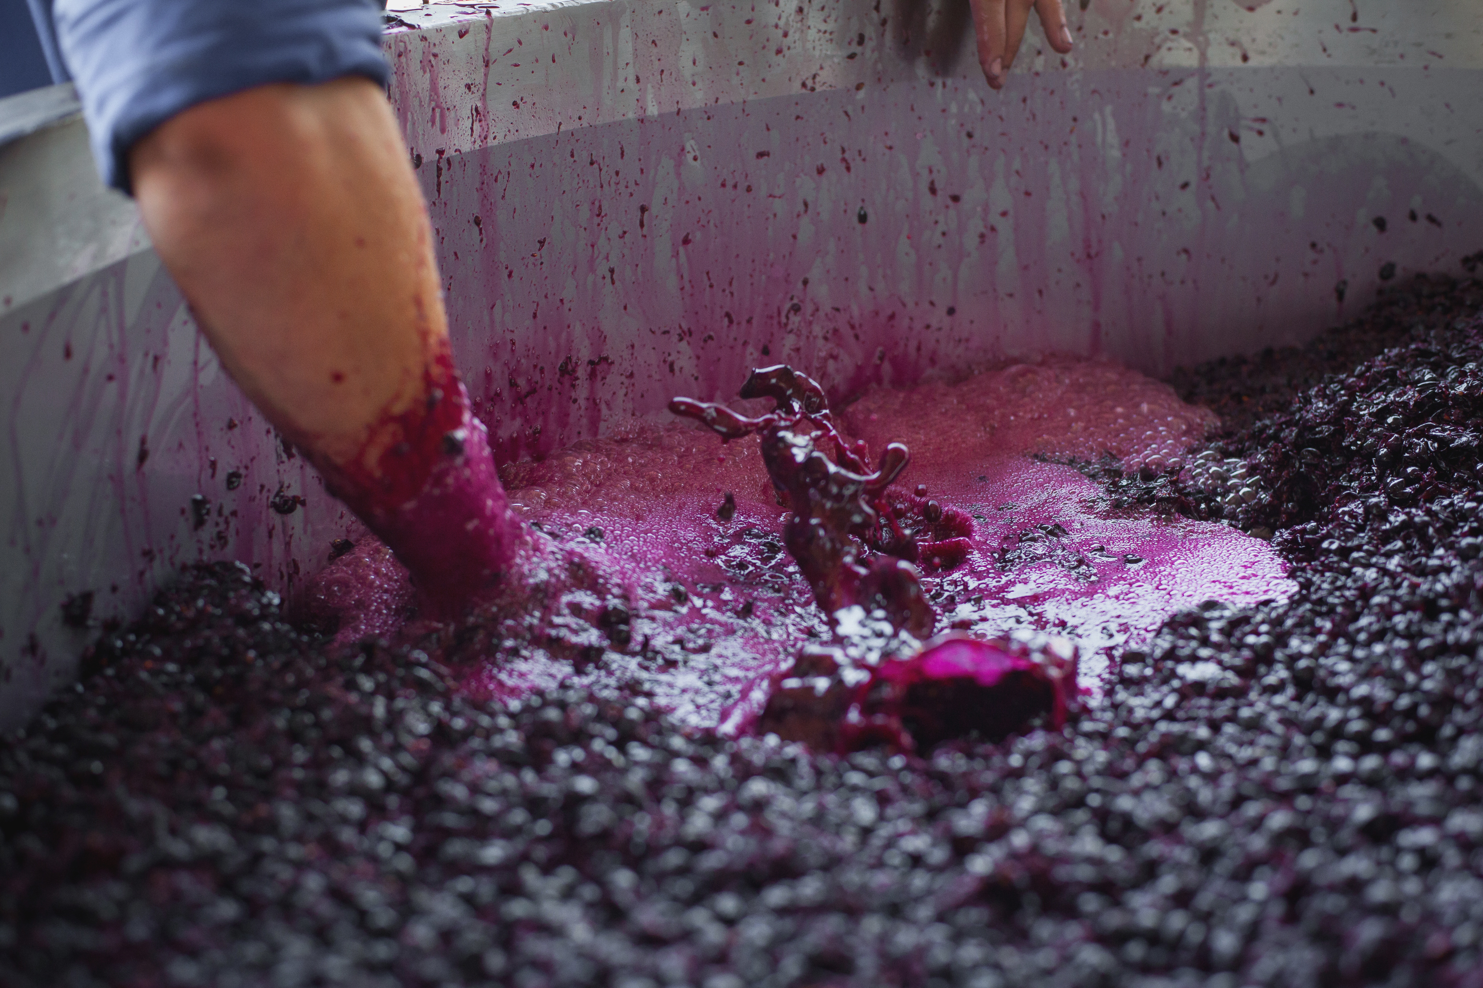
VITICULTURE AND WINEMAKING
SUCCESS AGAINST THE ODDS

Slide 13
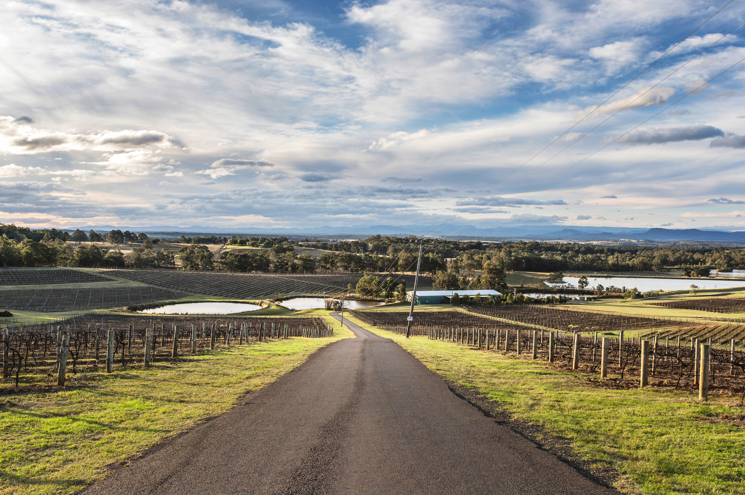
CHALLENGES AND REWARDS FOR
GRAPEGROWERS
A history of skilled grapegrowers adapting to climate and market changes
Quality over quantity
Signature varieties: Semillon,
Chardonnay, Shiraz
Subtropical climate, heavy rains and summer storms present a challenge

Slide 14
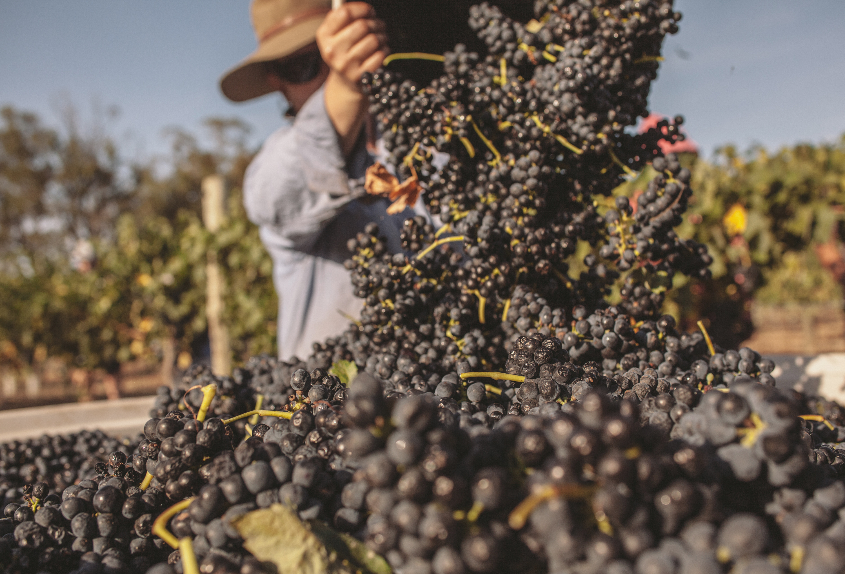
HARVEST
Early January to mid-February
Earlier than most other Australian regions

Slide 15
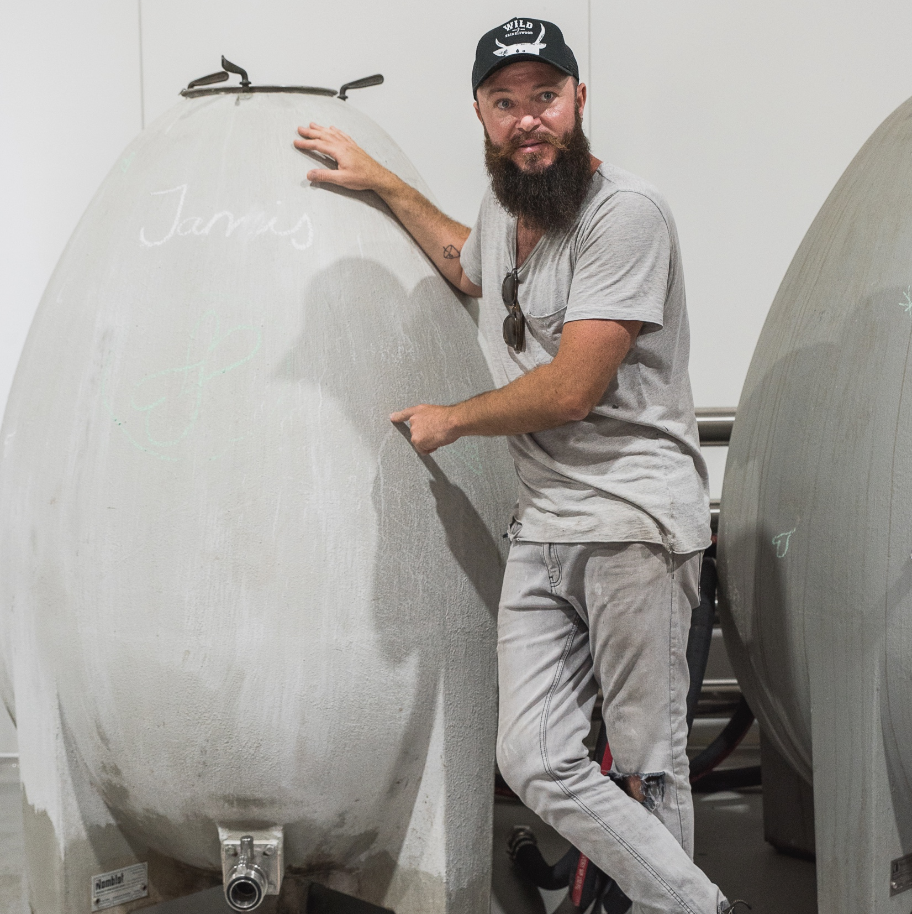
WINEMAKING
AN EMPHASIS ON PREMIUM
Long winemaking tradition
New breed of innovative winemakers
Minimal intervention, preservative-free Semillon, alternative varieties, Shiraz and Pinot Noir blends

Slide 16
A GROWING HISTORY
OLD VINES
Vineyards dating back to the 1860s
The oldest Chardonnay vines in the world
Significant acreage of old vines, mainly Shiraz growing on its own roots

Slide 17


HUNTER VALLEY
TOP 5 VARIETIES
SEMILLON
SHIRAZ
CHARDONNAY
VERDELHO
TEMPRANILLO
SEMILLON
27%
SHIRAZ
24%
CHARDONNAY
23%
VERDELHO
15%
TEMPRANILLO
2%

Slide 18
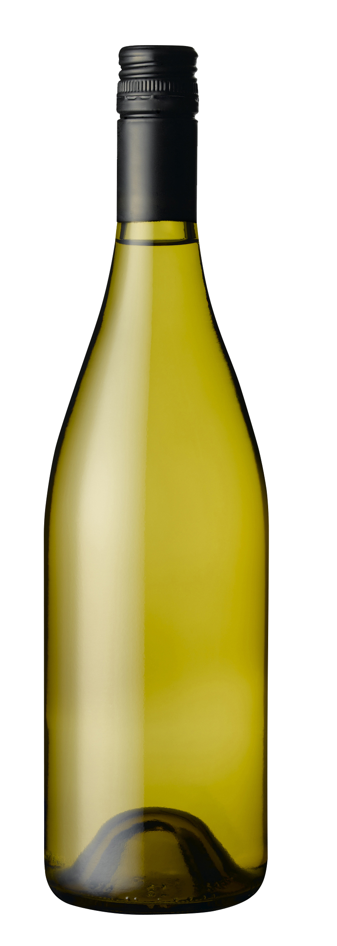
SEMILLON (YOUTHFUL) characteristics
Youthful, unoaked style
COLOUR
Semillon (Youthful)
Light
Medium
Full
BODY
TYPICAL FRUIT FLAVOURS
Lemon
Green apple
Quince
Dry
Medium dry
Sweet
SWEETNESS
SEMILLON
Low
Medium
High
TYPICAL SECONDARY FLAVOURS
OAK
Herbs
Grassiness
ACIDITY
8%
10% – 11.5%
17%
ALCOHOL

Slide 19
SEMILLON (BOTTLE-AGED) characteristics
Bottle
aged, unoaked style
COLOUR
Semillon (Bottle-aged)
Light
Medium
Full
BODY
TYPICAL FRUIT FLAVOURS
Lemon
Apple
Quince
Fig
Dry
Medium dry
Sweet
SWEETNESS
SEMILLON
Low
Medium
High
TYPICAL SECONDARY FLAVOURS
OAK
Toast
Straw
Honey
Honeysuckle
Vanilla
ACIDITY
8%
10% – 11.5%
17%
ALCOHOL

Slide 20
CHARDONNAY characteristics
COLOUR
Chardonnay
TYPICAL FRUIT FLAVOURS
Lemon
Apple
Pear
Peach
Nectarine
Melon
Mango
Pineapple
Light
Medium
Full
BODY
Dry
Medium dry
Sweet
TYPICAL OAK
MATURATION FLAVOURS
SWEETNESS
CHARDONNAY
Low
Medium
High
OAK
Toast
Vanilla
Butter
Toffee
Honey
Crème brulée
Cinnamon
Coconut
Nougat
Toasted almond
Spice
Chalk
Minerality
ACIDITY
8%
12.5% – 14.5%
17%
ALCOHOL

Slide 21

SHIRAZ characteristics
COLOUR
Shiraz
Light
Medium
Full
BODY
TYPICAL FLAVOURS
Pepper
Blackberry
Spice
Plum
Dark cherry
Chocolate
Coffee
Dry
Medium dry
Sweet
SWEETNESS
Low
SHIRAZ
Medium
High
OAK
TANNIN
ACIDITY
8%
17%
13.5% – 15.5%
ALCOHOL

Slide 22
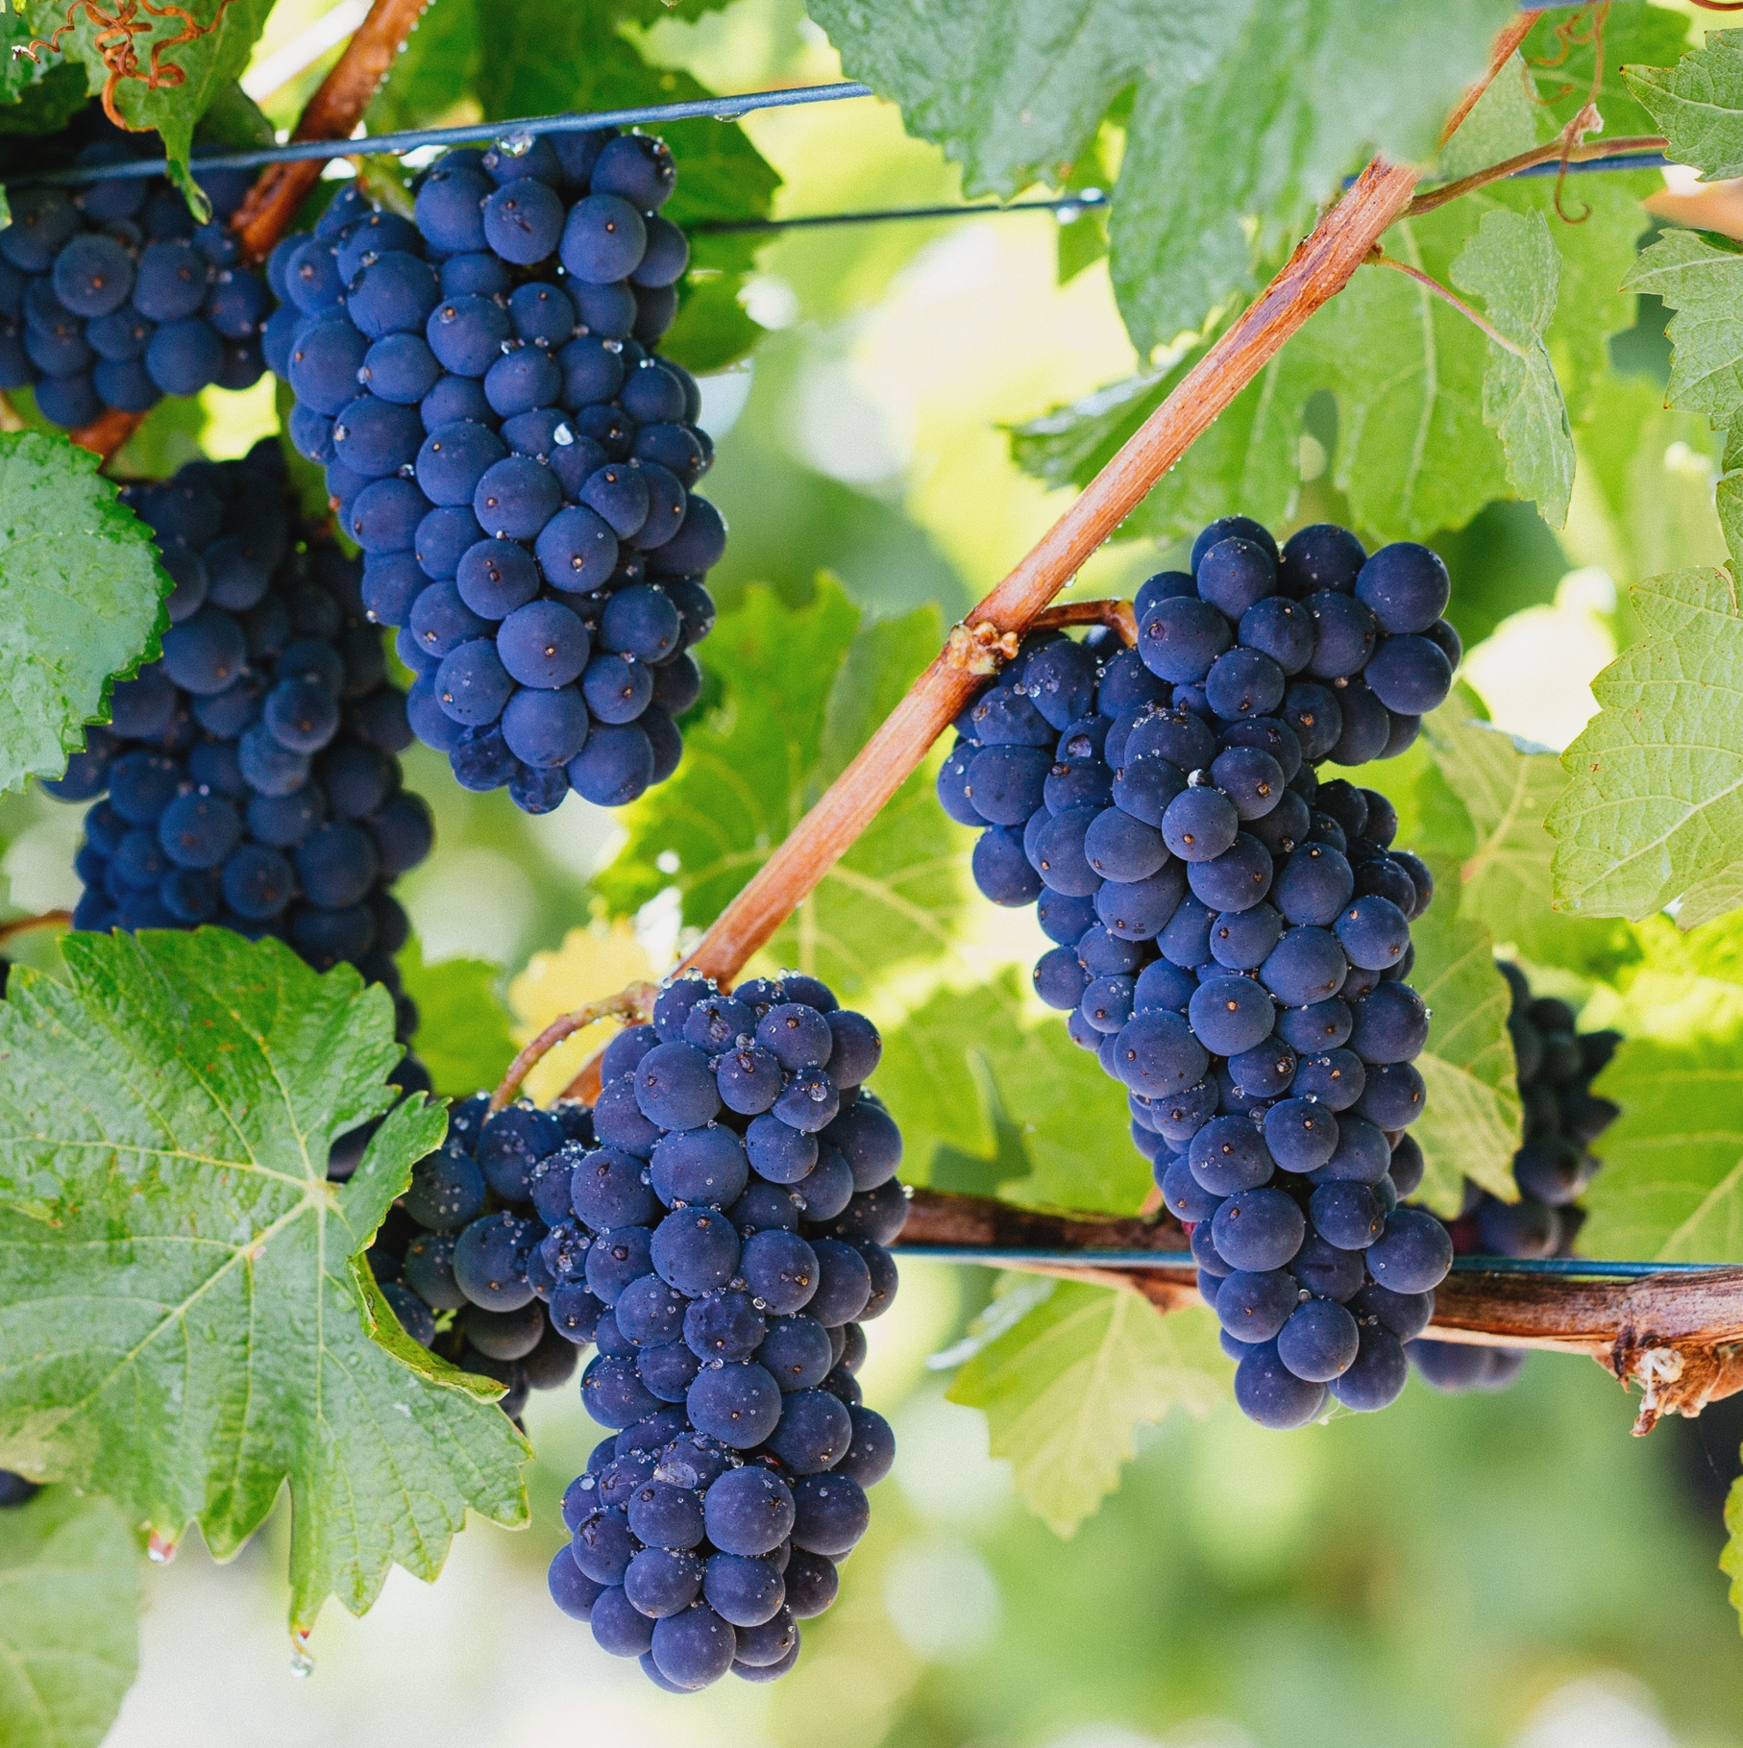
BEST OF
THE REST
Other notable varieties:
Verdelho
Pinot Noir
Tempranillo
Cabernet Sauvignon

Slide 23
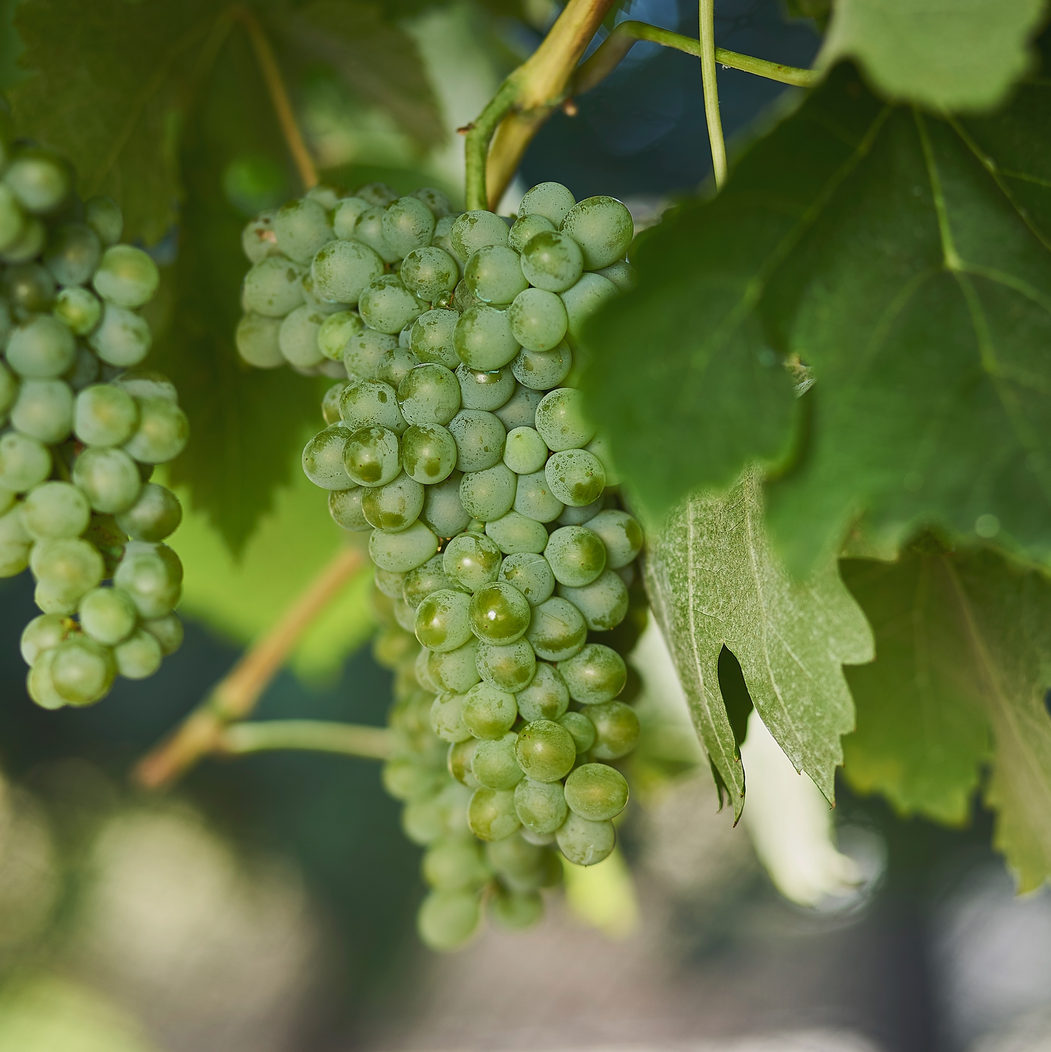
EMERGING VARIETIES
Pinot Gris/Grigio
Fiano
Gewürztraminer
Cabernet Franc
Barbera
Sangiovese

Slide 24
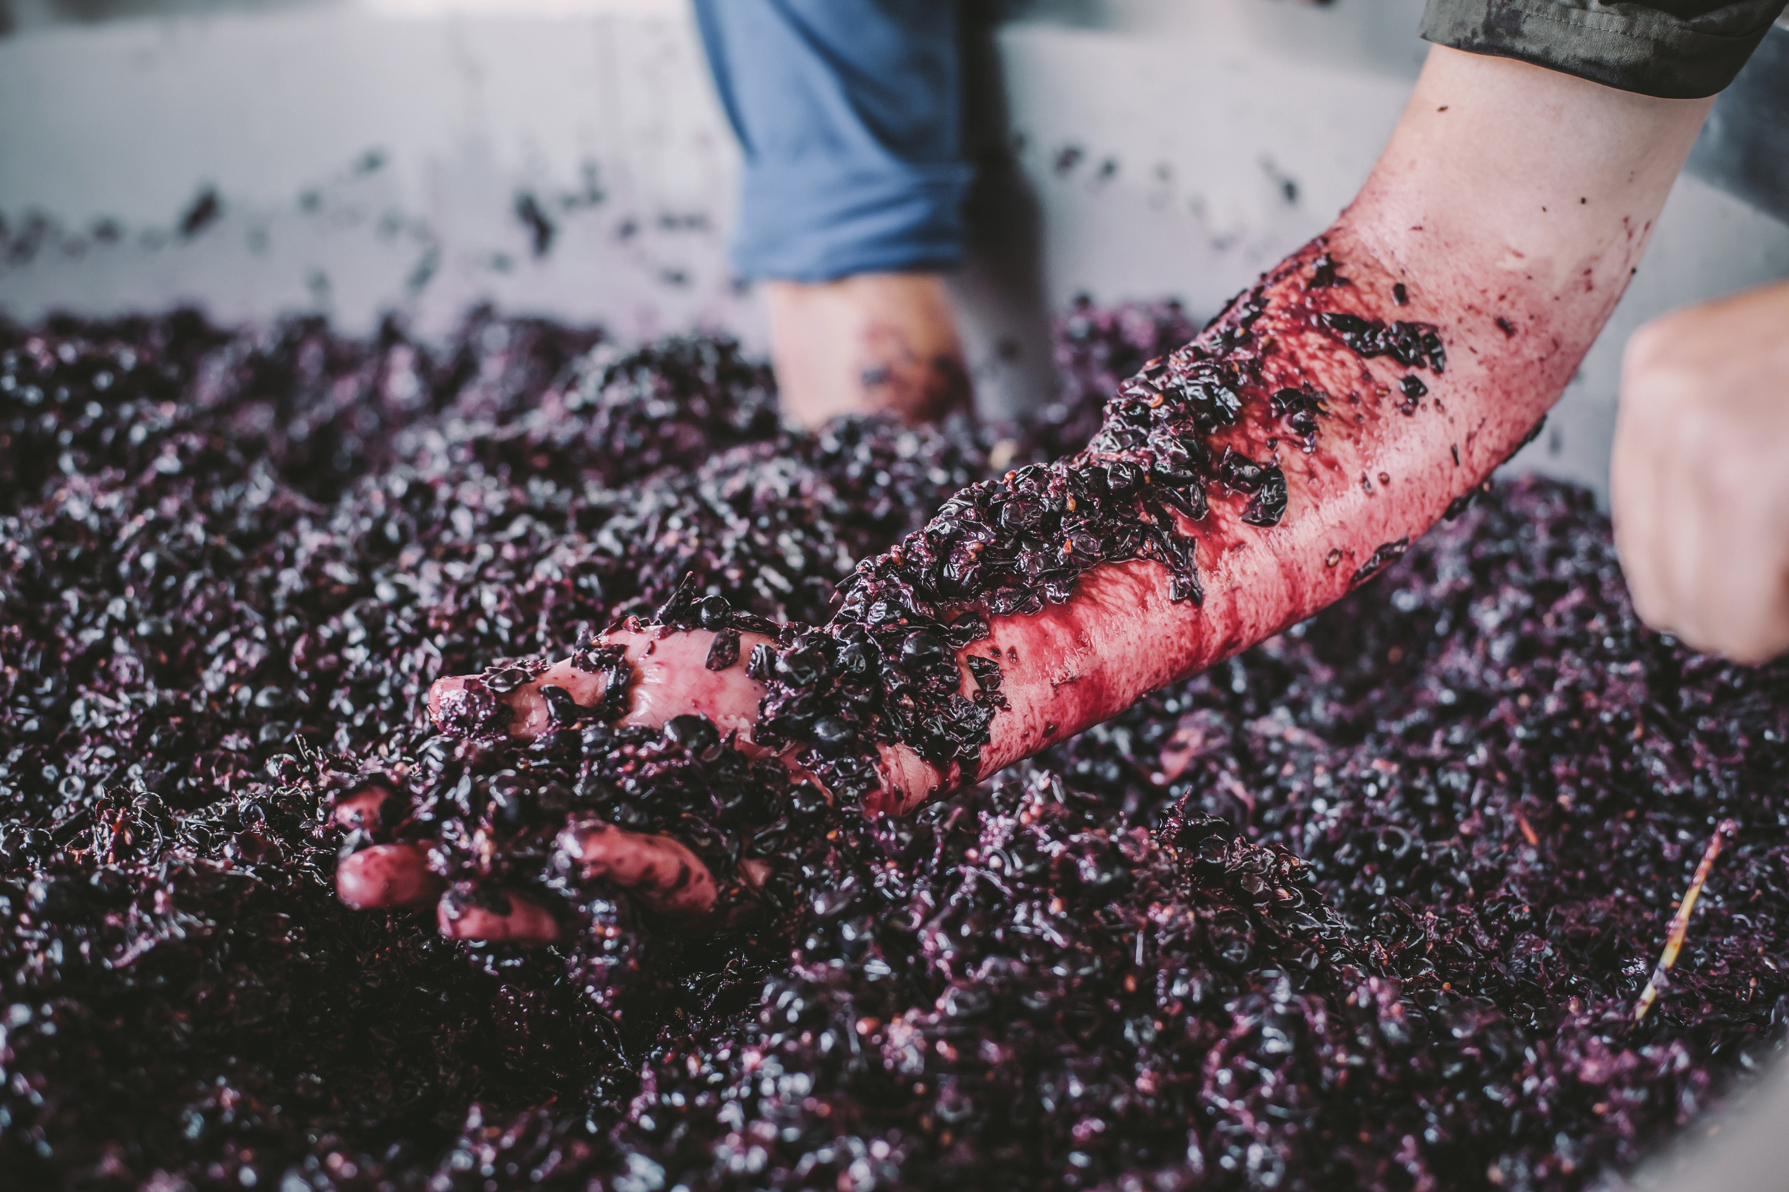
ICONS AND
INNOVATION
A historic wine region that’s only getting better with age.

Slide 25
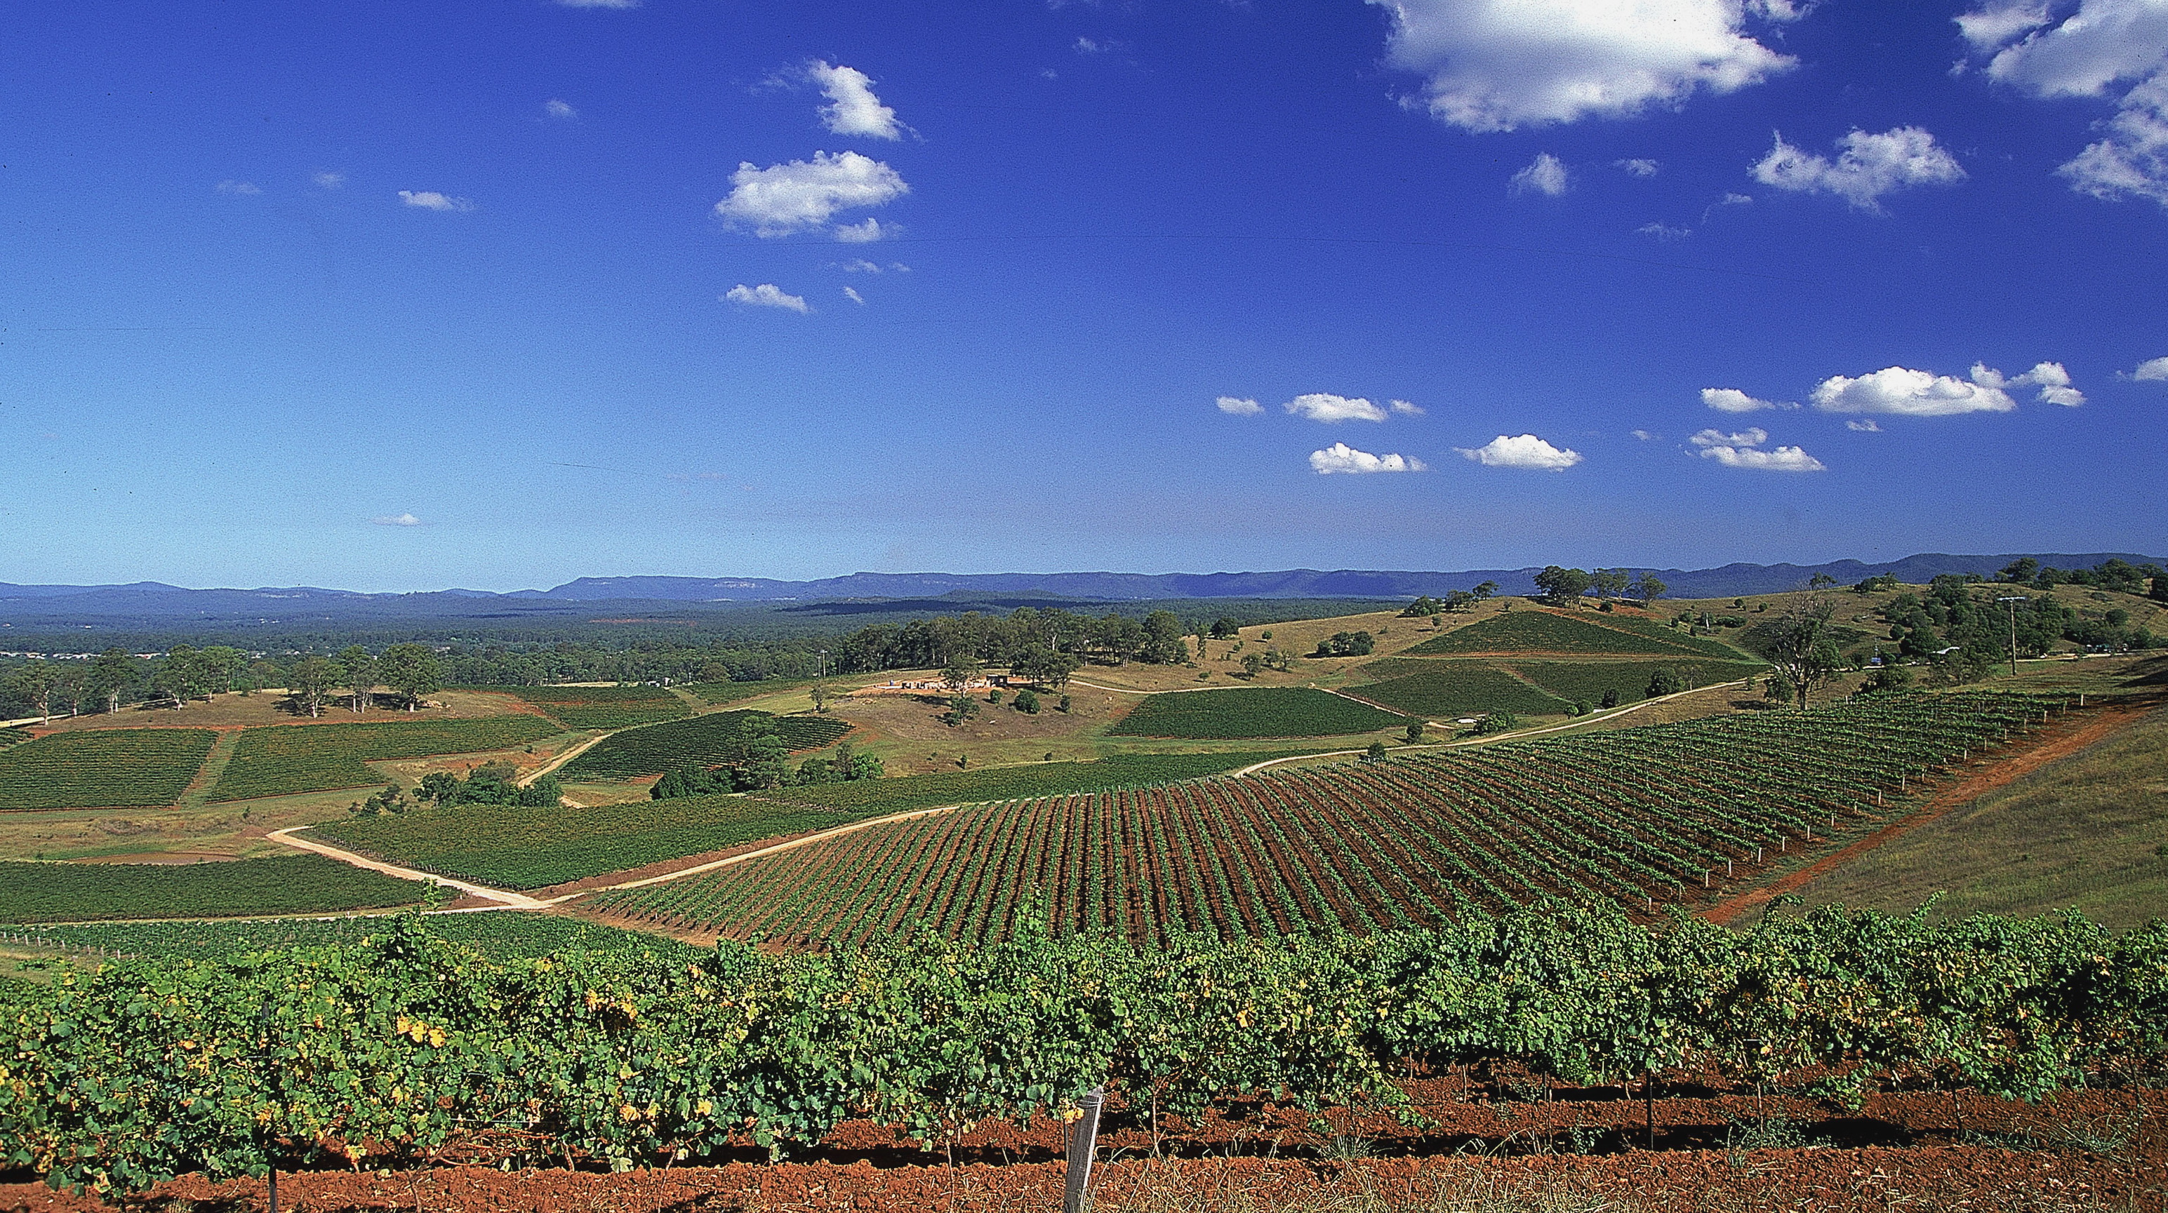
THANK YOU

