Slide 1
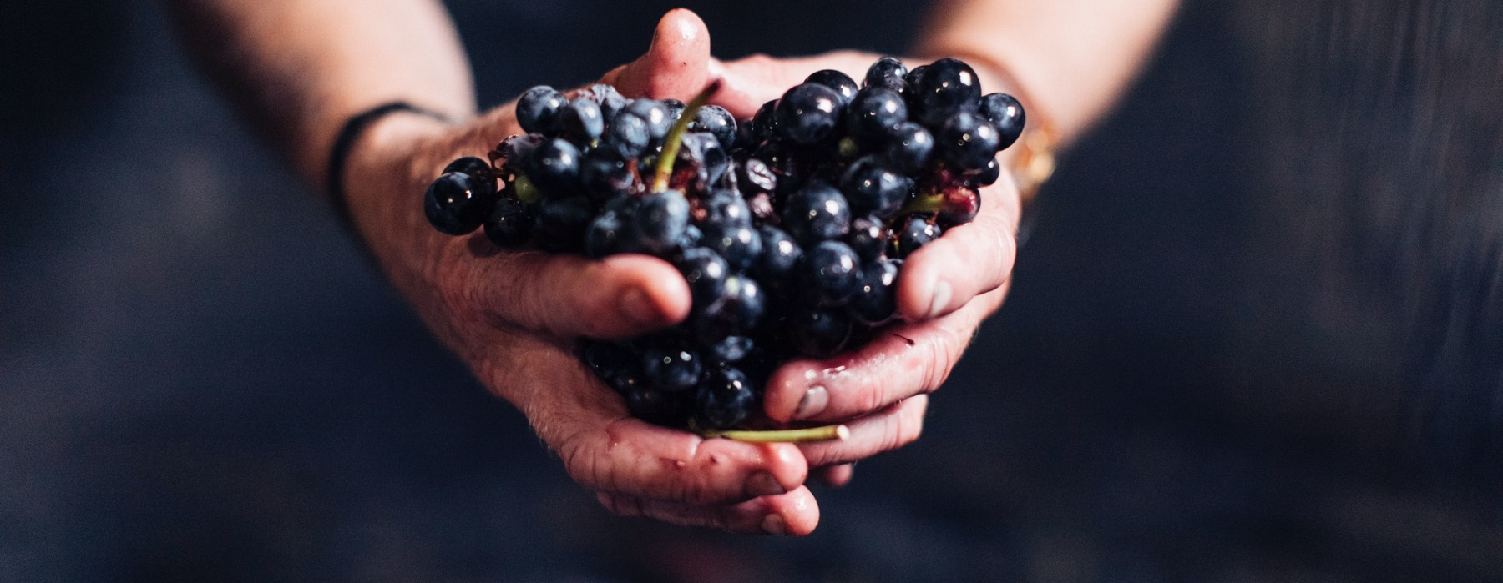
FOUNDATIONS
OF AUSTRALIAN WINE

Slide 2


Crafted from grapes grown under vast and diverse climates, across landscapes millions of years in the making, every glass of Australian wine tells a story.
Like those who came before us, our modern growers and makers continue to be passionate, resilient and creative; constantly driven to explore new ways to perfect old techniques. Our community is connected by a mutual respect and shared love of crafting exceptional wine, while protecting the natural wonders for future generations to enjoy. Applying modern thinking to our ancient lands, we take playful experimentation very, very seriously.
So, if you’re looking for the taste of adventure, let Australian wine be your compass. Because in every bottle of Australian wine, you’ll experience the wonders of Australia – a reminder of the adventure and diversity that defines our culture and our land.

Slide 3

UNIQUE WINES
FROM UNSPOILT LANDS
Australia has one of the most diverse wine scenes in the world, with more than 150 different grape varieties grown across 65 wine regions.
The Australian wine community is renowned for its creativity and willingness to experiment.
Australian wines are an authentic expression of the people who craft them and the country’s varied soils and climate.
Australia is home to a highly-skilled winemaking community, crafting premium wines that stand among the world’s best.

Slide 4
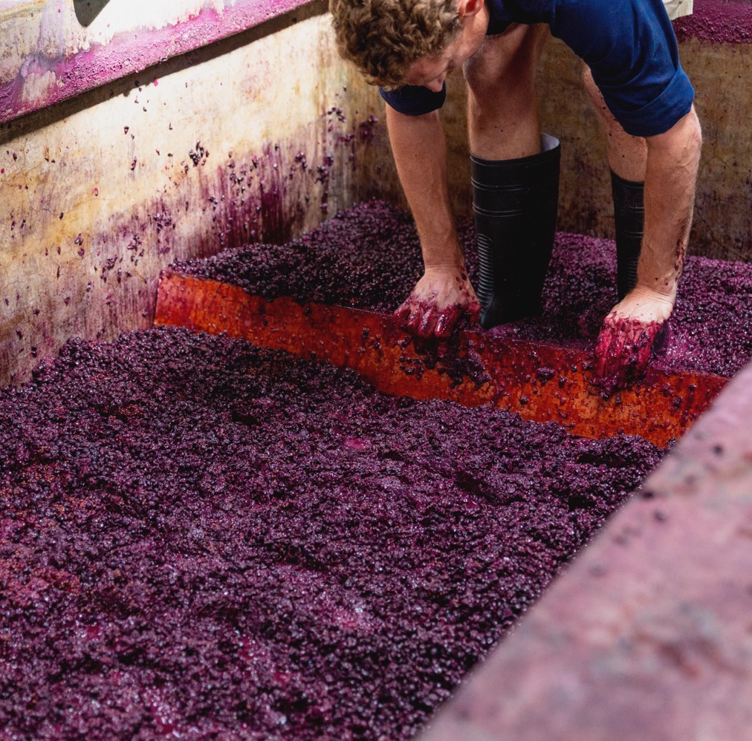
TODAY
WE’LL
COVER
The history of Australian wine
Geography, climate and soil
Noteworthy regions
Key varieties and wine styles

Slide 5

The fortified era:
1900 to 1940s
Driven by domestic and export demand, fortified wine dominated production and trade
Rutherglen Muscats and Muscadelles were a highlight of this era
The thirst for fortified wines meant that old Shiraz, Mataró (Mourvèdre) and Grenache vines were maintained – to be rediscovered and treasured decades later
THE HISTORY OF AUSTRALIAN WINE
The pioneer era:
Late 1700s, 1800s
Australia’s wine pioneers planted vines, expanded their vineyards and began exporting
Important regions were established, including the Hunter Valley, Tasmania, Yarra Valley, McLaren Vale, the Barossa and Rutherglen
James Busby brought back hundreds of cuttings from Europe, which today are the source of precious old vines

Slide 6

The renaissance era:
1940s to 1960s
Ambitious growers and winemakers defied consumer demands for fortifieds to produce tiny amounts of some of Australia’s finest table wines
The popularity of fortified wine reached its peak and people began to develop a taste for table wines
The GOLDEn age:
1960s to TODAY
Food and table‑wine culture grew, and trailblazing winemakers discovered or rediscovered an array of cool-climate regions
Red wine sales boomed in the 1970s and demand for white wine rose in the 1980s
By the early 1980s, Australia was the 18th largest wine exporter; by the early 1990s it was sixth
Today the Australian wine community is diverse, unique and truly world class

Slide 7
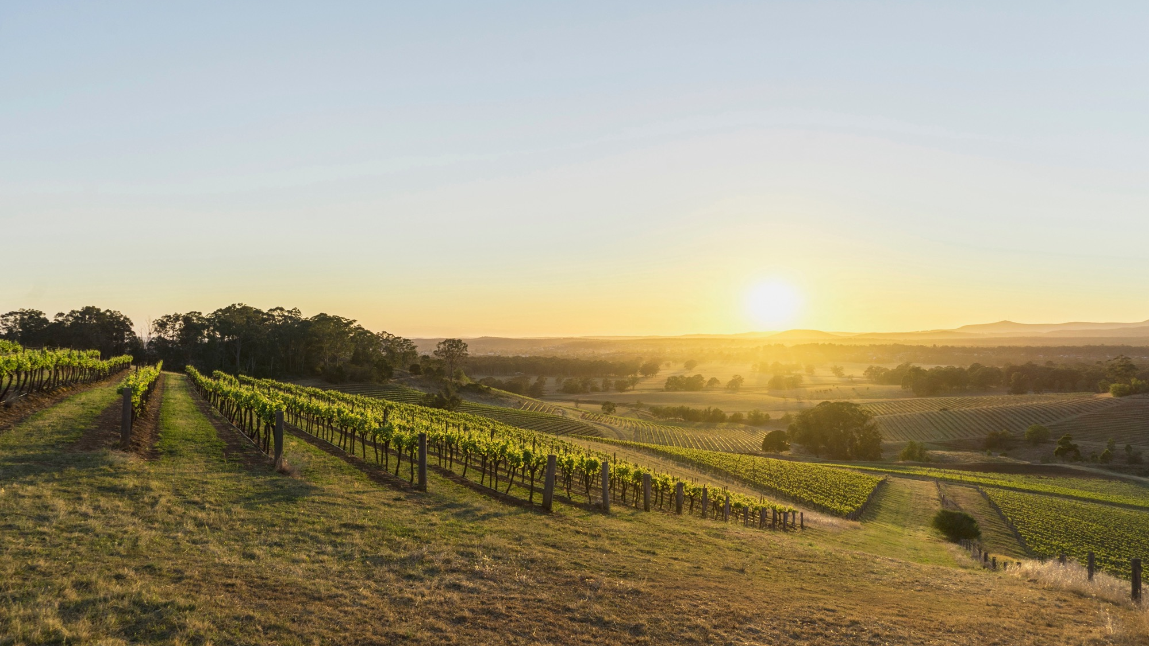
Ancient and diverse
Australia’s geography, climate and soils

Slide 8
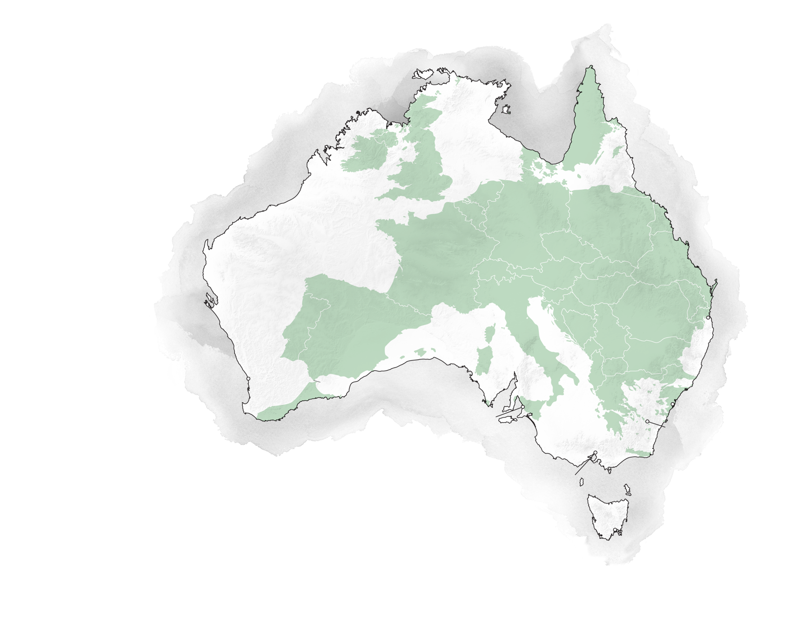
AUSTRALIA
Darwin
SWEDEN
IRELAND
WORLD’S SIXTH-LARGEST COUNTRY, BIGGER THAN EUROPE
UK
GERMANY
POLAND
FRANCE
Geologically ancient and biologically diverse
Vineyards across the country, but concentrated in the southeast and southwest
The cold Southern Ocean keeps temperatures cool in the south, ideal for making wine
AUSTRIA
PORTUGAL
ROMANIA
Brisbane
SPAIN
ITALY
Perth
GREECE
Sydney
Adelaide
Canberra
Melbourne
Hobart

Slide 9
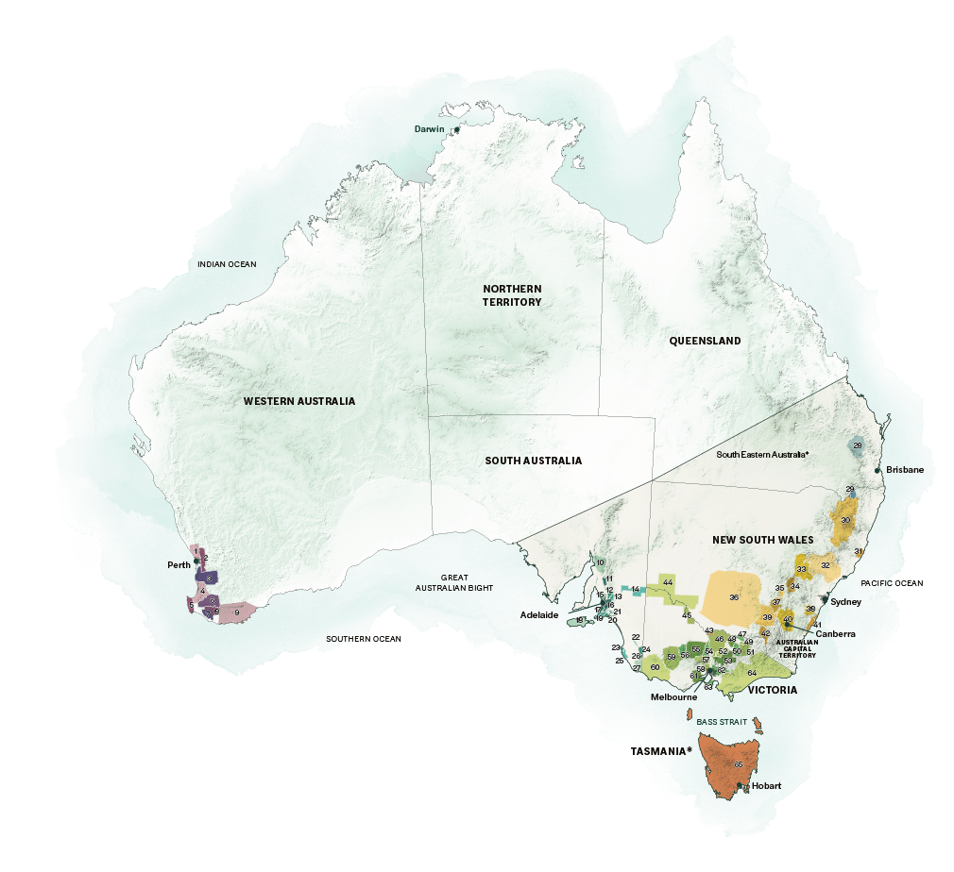
WINE REGIONS
OF AUSTRALIA
WESTERN AUSTRALIA
1 Swan District
2 Perth Hills
3 Peel
4 Geographe
5 Margaret River
6 Blackwood Valley
7 Pemberton
8 Manjimup
9 Great Southern
SOUTH AUSTRALIA
10 Southern Flinders Ranges
11 Clare Valley
12 Barossa Valley
13 Eden Valley
14 Riverland
15 Adelaide Plains
16 Adelaide Hills
17 McLaren Vale
18 Kangaroo Island
19 Southern Fleurieu
20 Currency Creek
21 Langhorne Creek
22 Padthaway
23 Mount Benson
24 Wrattonbully
25 Robe
26 Coonawarra
27 Mount Gambier
QUEENSLAND
28 South Burnett
29 Granite Belt
NEW SOUTH WALES
30 New England Australia
31 Hastings River
32 Hunter
33 Mudgee
34 Orange
35 Cowra
36 Riverina
37 Hilltops
38 Southern Highlands
39 Gundagai
40 Canberra District
41 Shoalhaven Coast
42 Tumbarumba
43 Perricoota
VICTORIA
44 Murray Darling
45 Swan Hill
46 Goulburn Valley
47 Rutherglen
48 Glenrowan
49 Beechworth
50 King Valley
51 Alpine Valleys
52 Strathbogie Ranges
53 Upper Goulburn
54 Heathcote
55 Bendigo
56 Pyrenees
57 Macedon Ranges
58 Sunbury
59 Grampians
60 Henty
61 Geelong
62 Yarra Valley
63 Mornington Peninsula
64 Gippsland*
TASMANIA
65 Tasmania*
*South Eastern Australia
and Gippsland are zones,
Tasmania is a state.
Notes:
Great Southern Ocean -

Slide 10
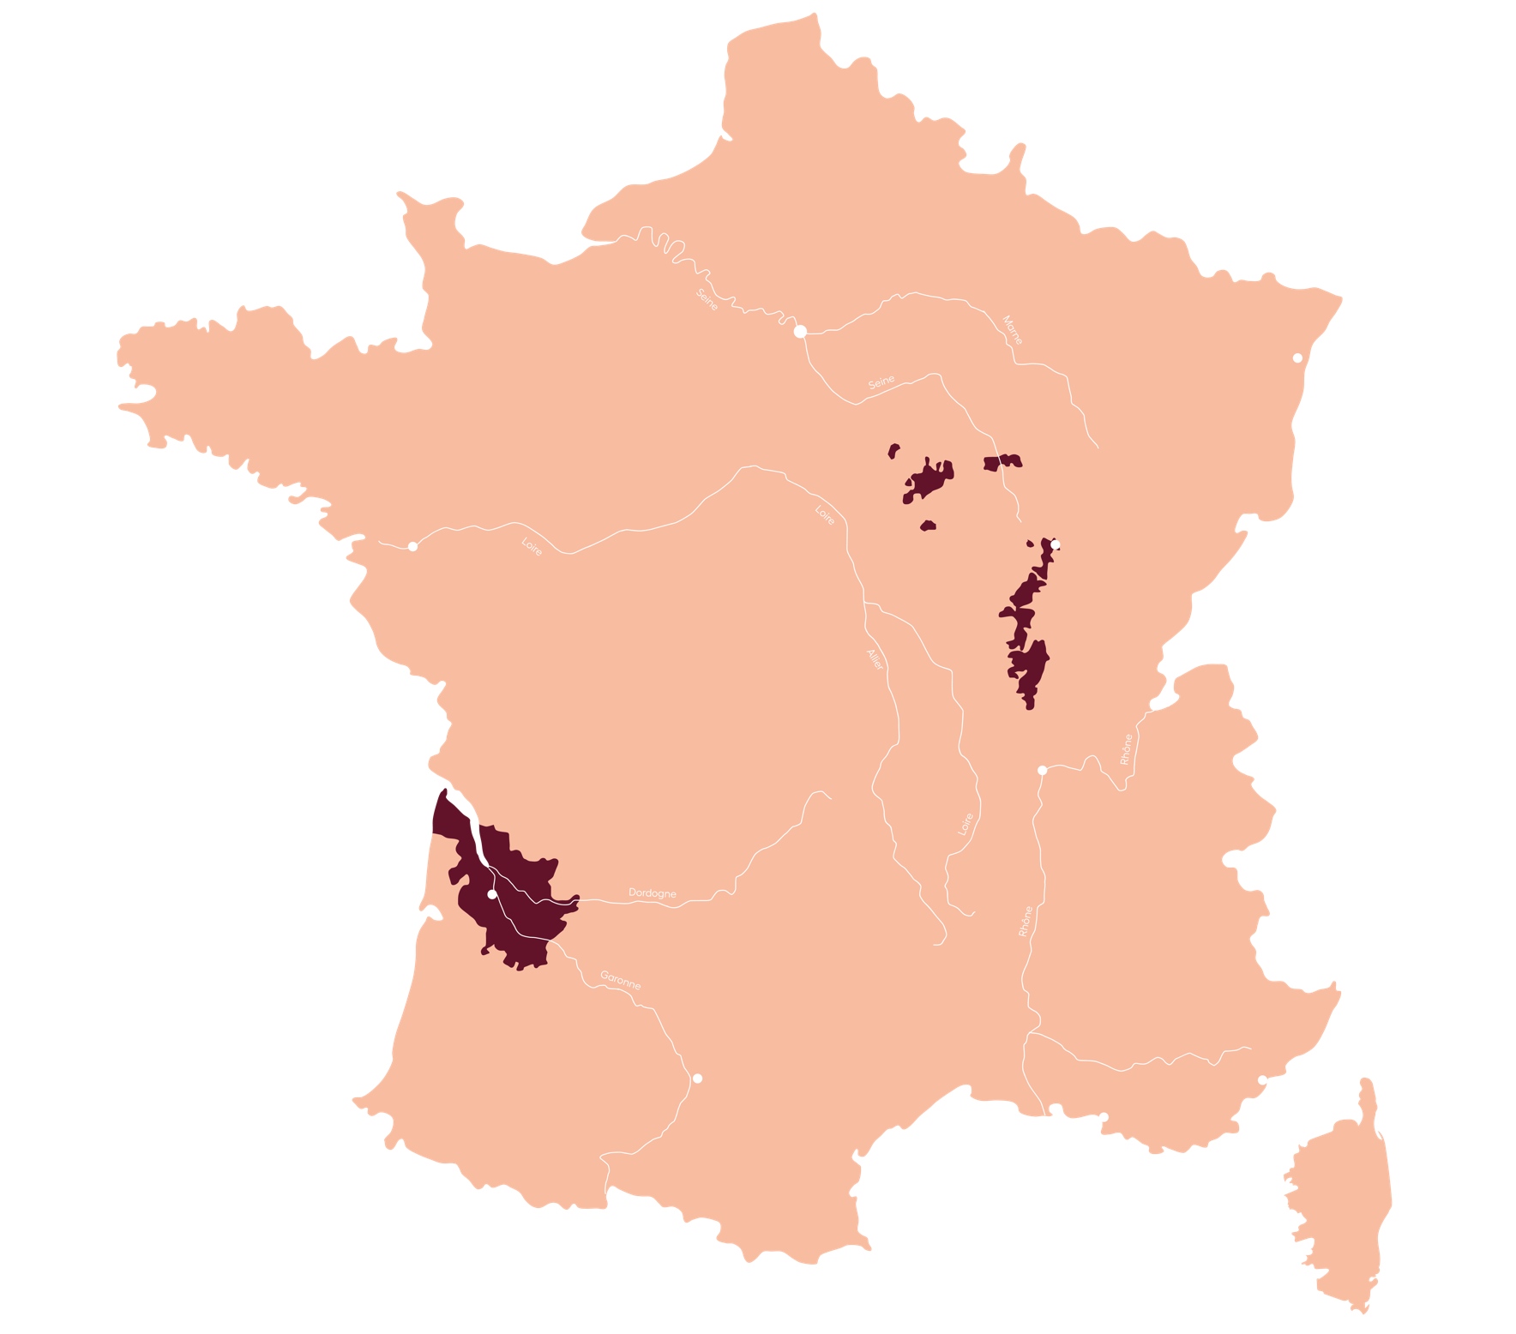
PARIS
STRASBOURG
Roughly
BURGUNDY
NANTES
145,000
DIJON
hectares, or
FRANCE
0.02%
of Australia’s total land mass is under vine.
This is approximately the same as Bordeaux and Burgundy combined.
LYON
BORDEAUX
BORDEAUX

Slide 11
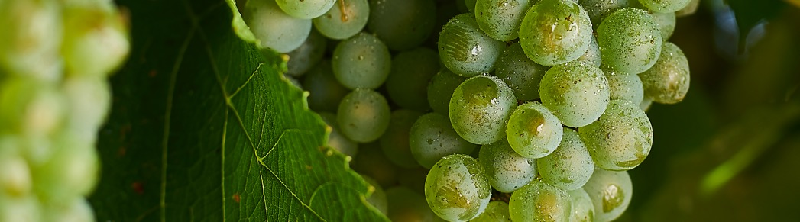
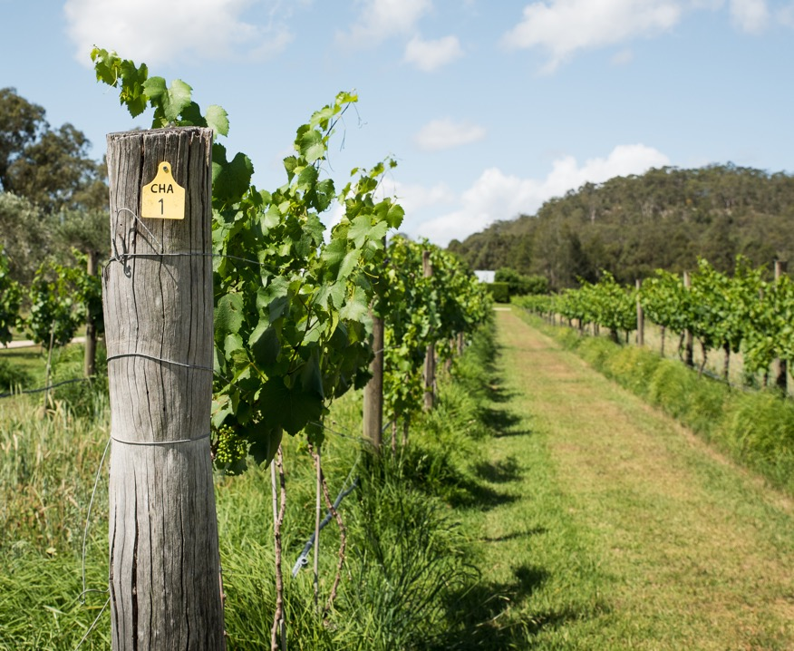
The varied climates
Of australia’s wine regions
Australia’s latitude, maritime influences and elevation all contribute to a surprising diversity of climates
Premium wine regions located in the country’s temperate areas
Concentrated in NSW, South Australia, Tasmania, Victoria and Western Australia
Notes:
Old vines
First vines -

Slide 12
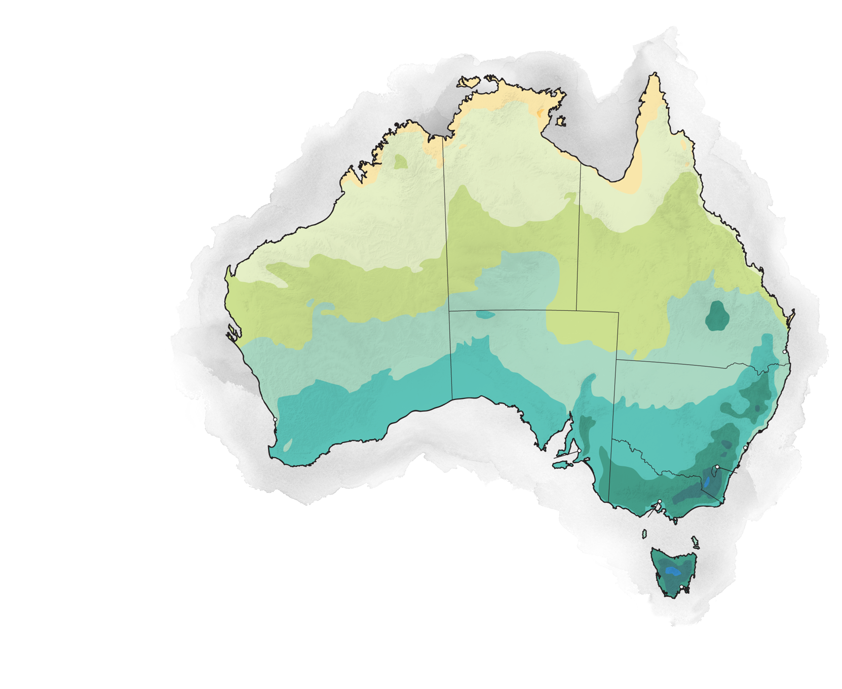
Temperature
Darwin
39ºC / 102ºF
36ºC / 97ºF
33ºC / 92ºF
30ºC / 86ºF
27ºC / 81ºF
NORTHERN TERRITORY
24ºC / 75ºF
21ºC / 70ºF
18ºC / 64ºF
QUEENSLAND
15ºC / 59ºF
WESTERN AUSTRALIA
12ºC / 54ºF
9ºC / 49ºF
SOUTH AUSTRALIA
6ºC / 43ºF
Brisbane
3ºC / 37ºF
0ºC / 32ºF
-3ºC / 27ºF
Perth
NEW SOUTH WALES
AUSTRALIAN
CAPITAL TERRITORY
Sydney
Adelaide
MINIMUM TEMPERATURE
Canberra
VICTORIA
Melbourne
Source: Bureau of Meteorology
ANNUAL 30-YEAR AVERAGE 1976–2005
TASMANIA
TASMANIA
Hobart
Notes:
Great Southern Ocean -

Slide 13
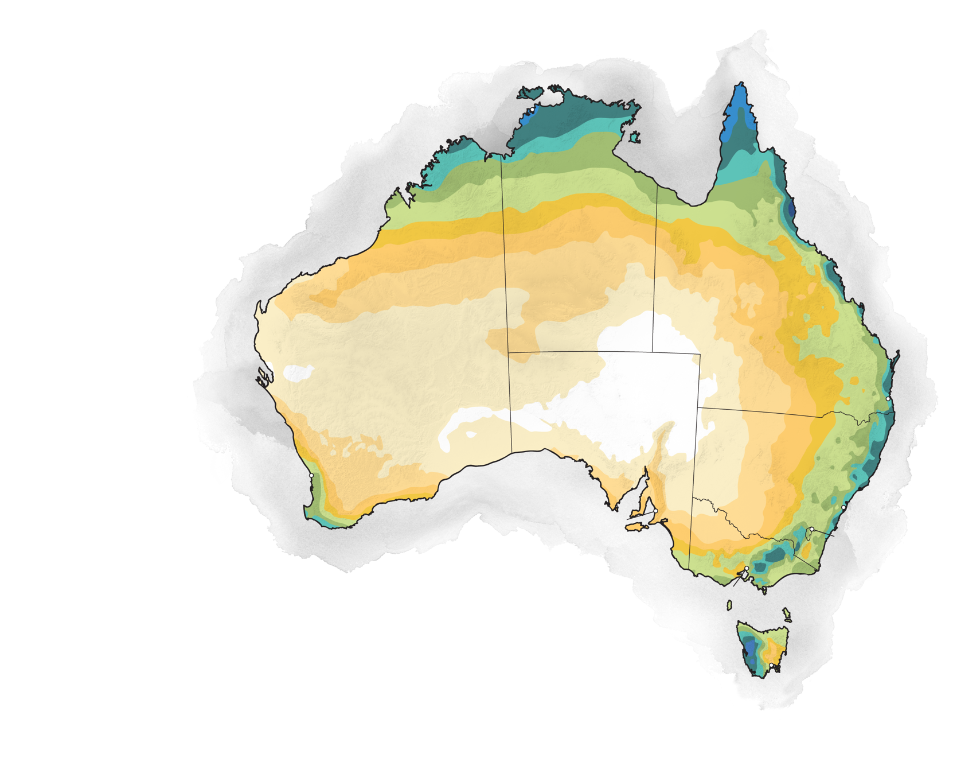
Darwin
Rainfall mm/in
3200 / 126
2400 / 94.5
2000 / 78.7
1600 / 63
NORTHERN TERRITORY
1200 / 47.2
100 / 39.40
800 / 31.5
QUEENSLAND
600 / 23.6
WESTERN AUSTRALIA
500 / 19.7
400 / 15.7
SOUTH AUSTRALIA
300 / 11.8
Brisbane
200 / 7.9
0 / 0
Perth
NEW SOUTH WALES
AUSTRALIAN
CAPITAL TERRITORY
Sydney
Adelaide
ANNUAL RAINFALL
Canberra
VICTORIA
Melbourne
Source: Bureau of Meteorology
30-YEAR AVERAGE 1976–2005
TASMANIA
TASMANIA
Hobart
Notes:
Great Southern Ocean -

Slide 14
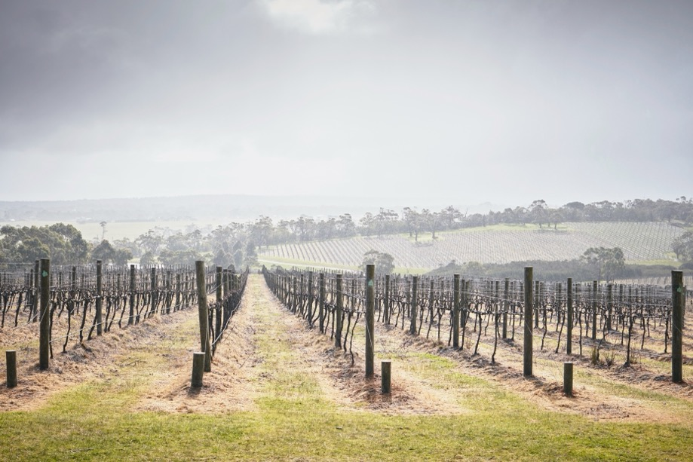
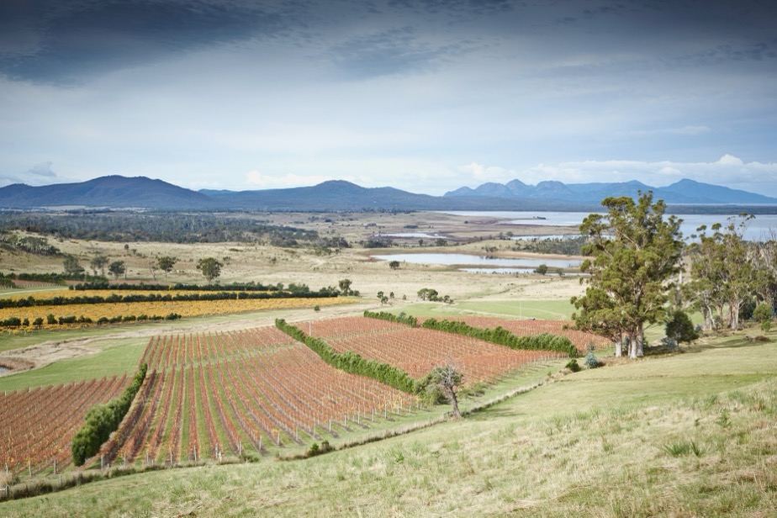
KEY FACTORS INFLUENCING CLIMATE IN PREMIUM VITICULTURAL AREAS
LATITUDE
Areas at higher latitudes – which are further from the equator – are cooler, making southern Australia much cooler than the north
COOLING WEATHER PATTERNS
Cold winds of the Southern Ocean moderate the weather in many of Australia’s famous wine regions

Slide 15
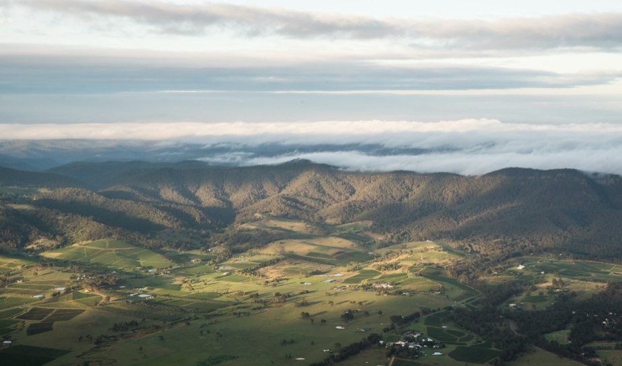
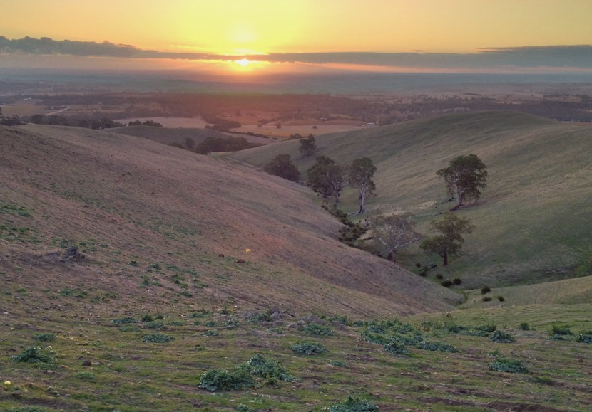
TODAY’S CLASSICS
GEOGRAPHICAL FEATURES
Three mountain ranges influence climate and weather:
Darling Scarp (WA)
Mount Lofty Ranges (SA)
The Great Dividing Range (QLD, NSW, VIC)
ALTITUDE
Temperatures decrease by approximately 0.65°C (33ºF) for every 100 metres (328ft) gain in altitude; the highest Australian wine regions are up to
1000–1200m
(3281–3937ft)

Slide 16
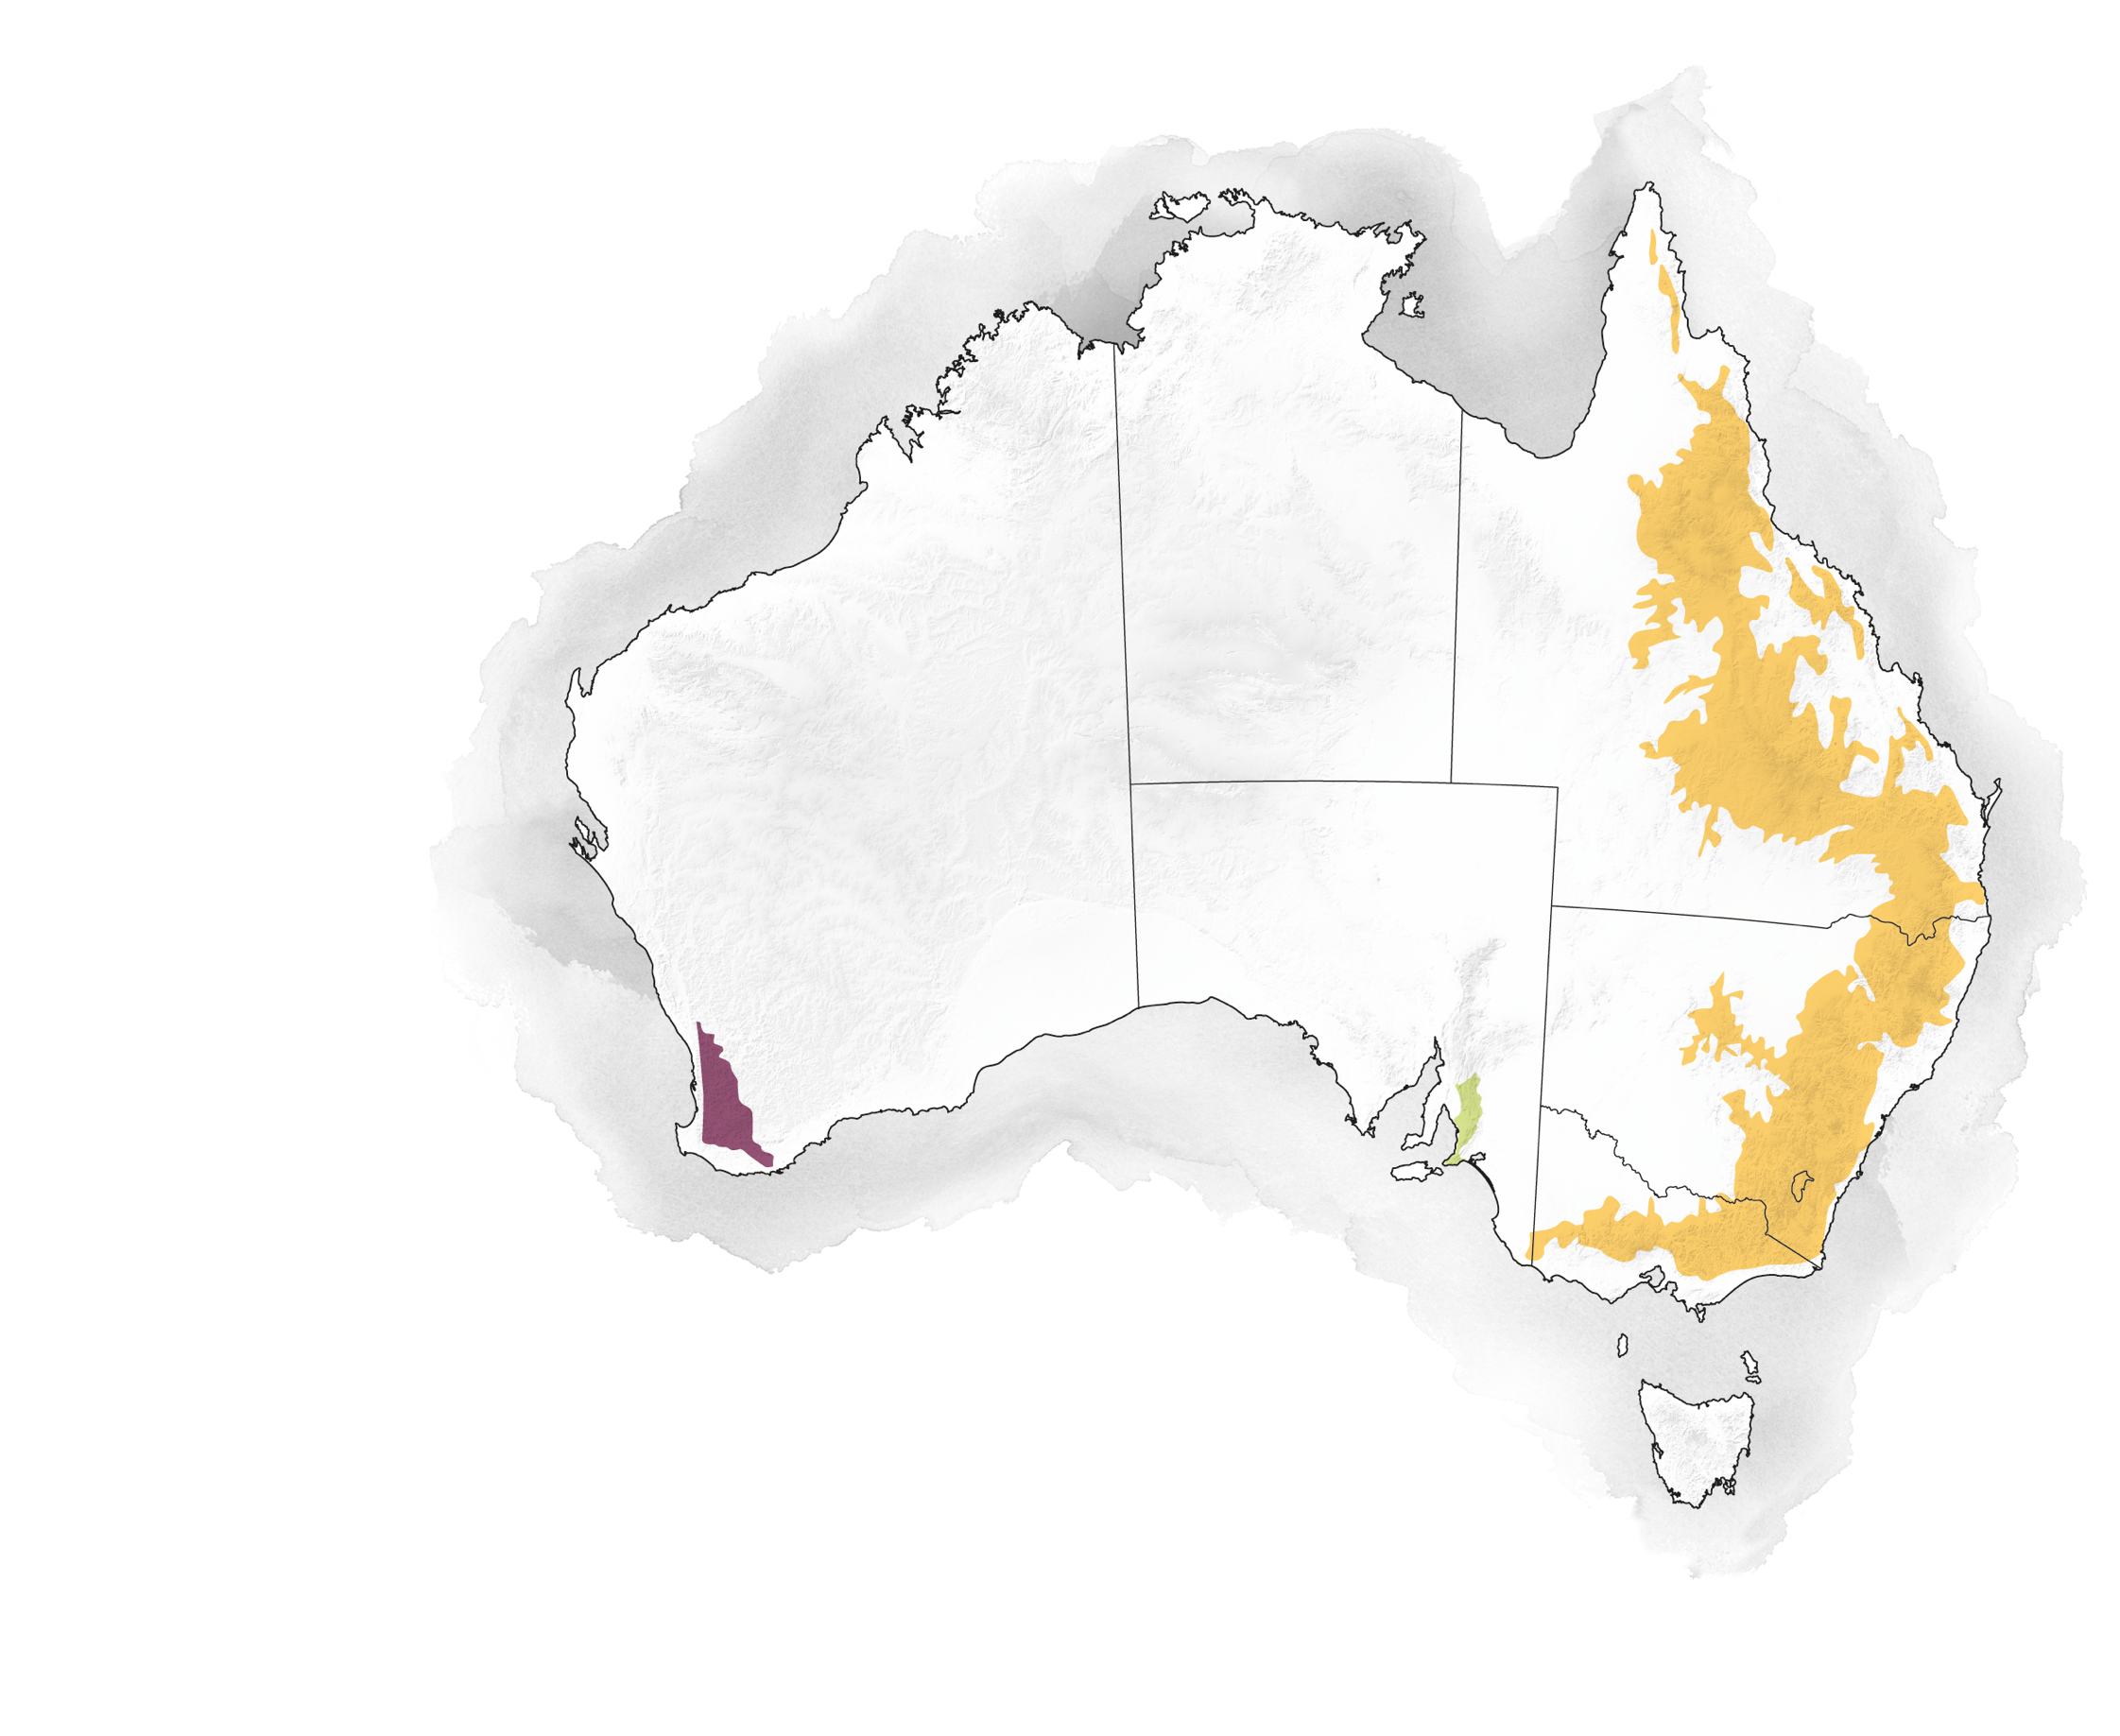
GEOGRAPHICAL FEATURES
NORTHERN TERRITORY
QUEENSLAND
WESTERN AUSTRALIA
GREAT DIVIDING
RANGE
SOUTH AUSTRALIA
NEW SOUTH WALES
DARLING SCARP
MOUNT LOFTY RANGES
AUSTRALIAN
CAPITAL TERRITORY
VICTORIA
Indicative only
TASMANIA

Slide 17
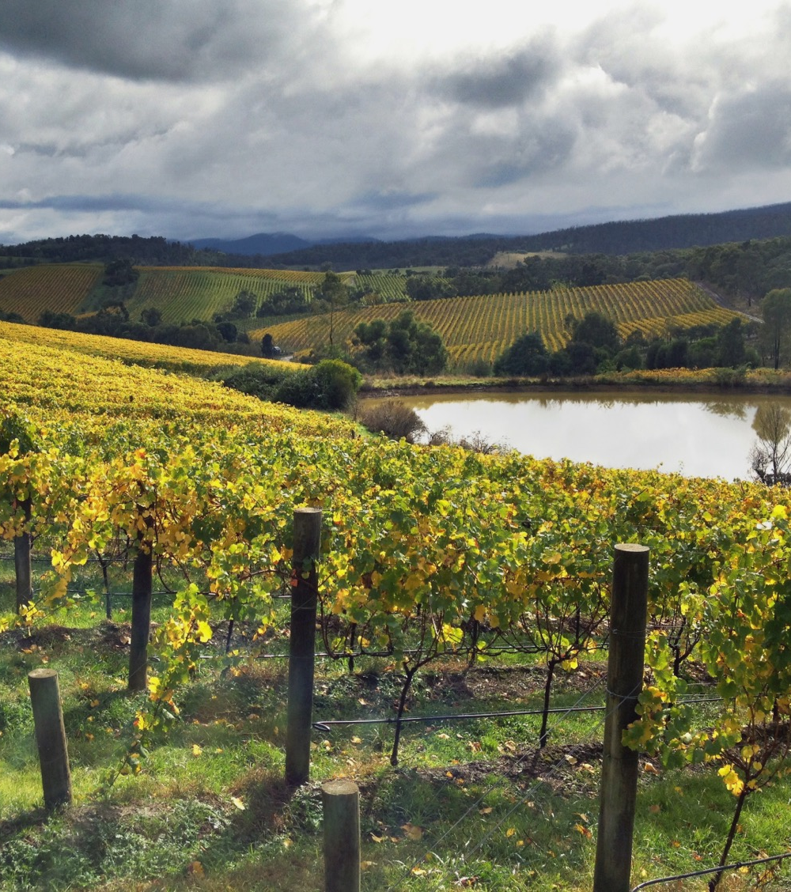
CONTINENTAL
CLIMATE
Regions in the centre of large land masses that tend to have hotter summers and colder winters.
CLARE VALLEY
RUTHERGLEN
Parts of GREAT SOUTHERN
CANBERRA DISTRICT

Slide 18
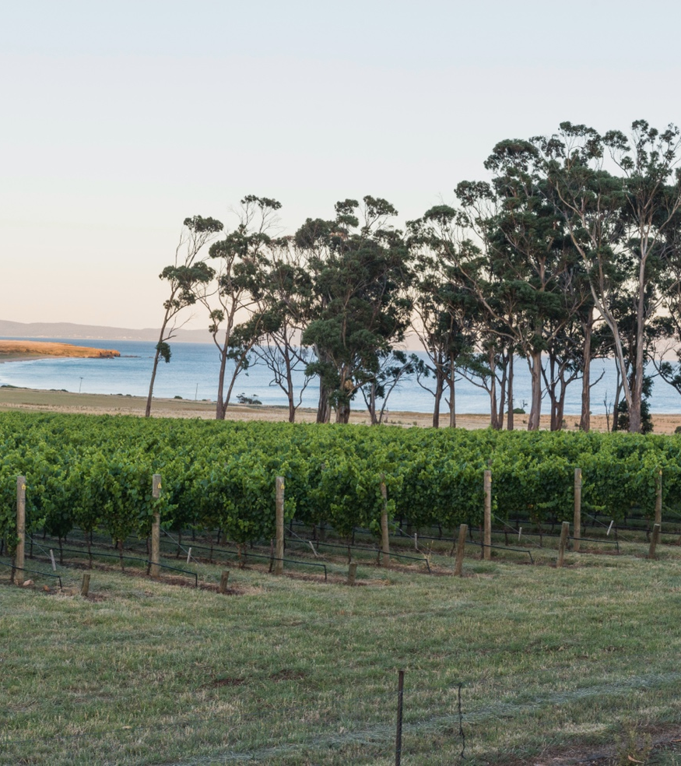
MARITIME
CLIMATE
Regions near the coast, where the climate has a narrower range of temperatures and rainfall is spread more evenly throughout the year.
MORNINGTON PENINSULA
TASMANIA
ADELAIDE HILLS
COONAWARRA

Slide 19
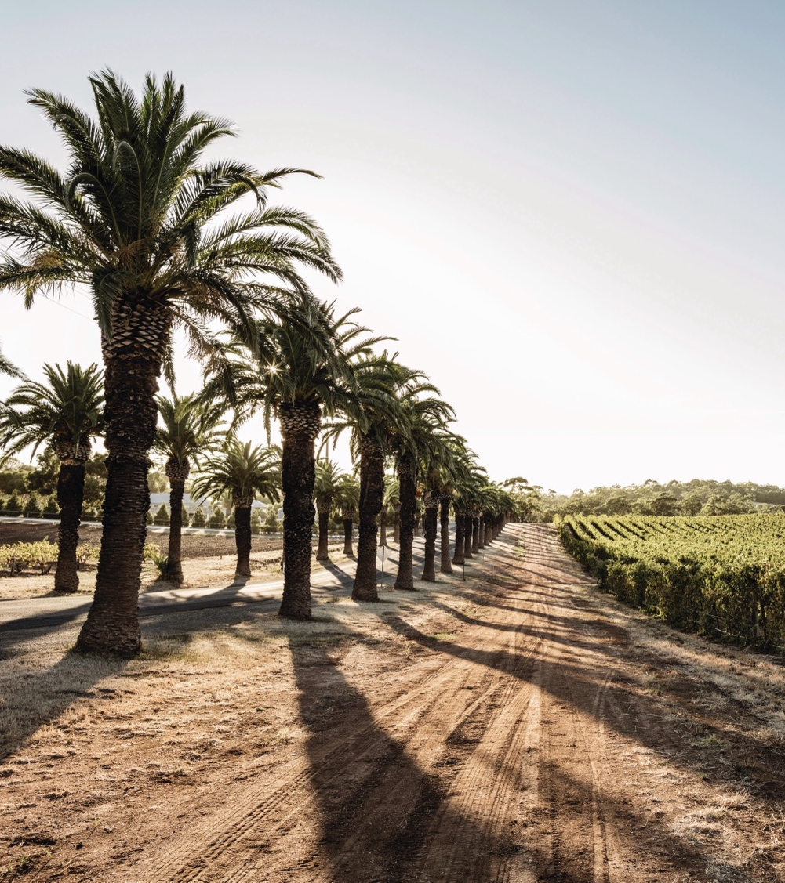
MEDITERRANEAN
CLIMATE
Similar to maritime climates, but summers tend to be warm and dry. There is less temperature variation between the hottest and coldest months.
BAROSSA VALLEY
GEOGRAPHE
McLAREN VALE
MARGARET RIVER
(with strong maritime influences)

Slide 20
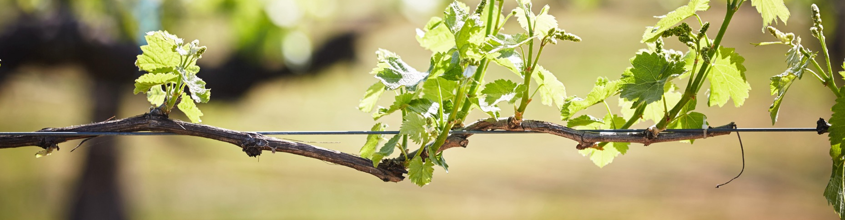
AUSTRALIA’S
GRAPE GROWING SEASONS
SPRING
SUMMER
AUTUMN
WINTER
September–November
Budburst, growth and flowering
December–February
Berry set and veraison
March–May
Veraison and harvest
June–August
Pruning and dormancy

Slide 21
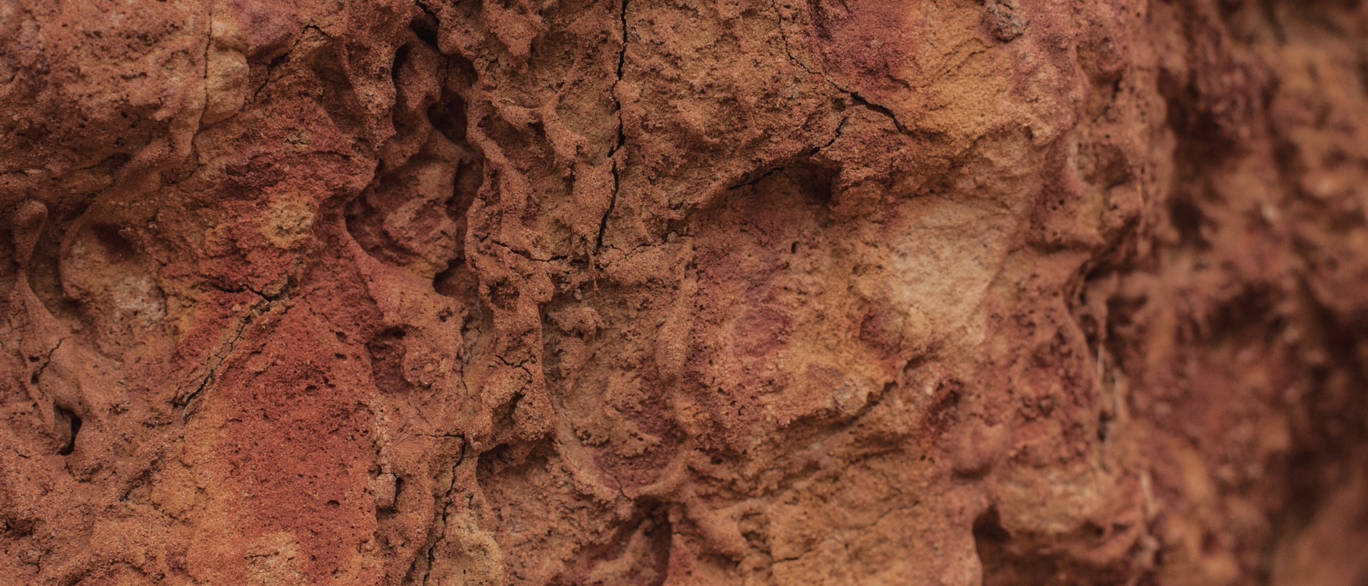
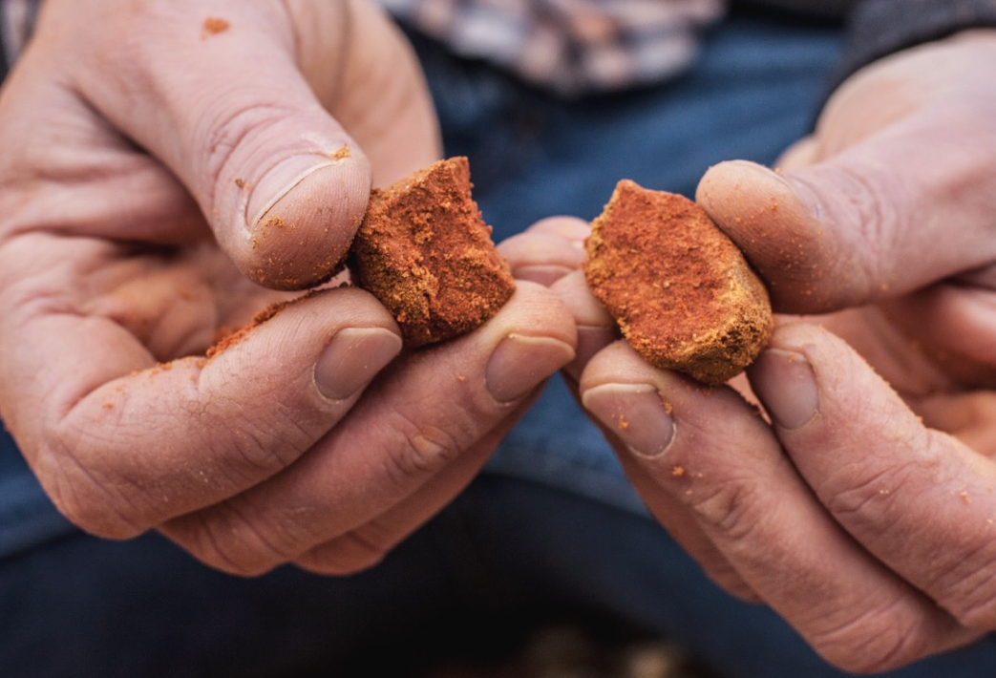
UNEARTHING AUSTRALIA’s ANCIENT SOILS
Australia has been a land mass for over 100 million years
Its soils are some of the most ancient on Earth
There are also younger sand and limestone soils, and fertile volcanic soils
Soil types can vary greatly between wine regions and within the regions themselves – even across a single vineyard block
Notes:
Old vines
First vines -

Slide 22
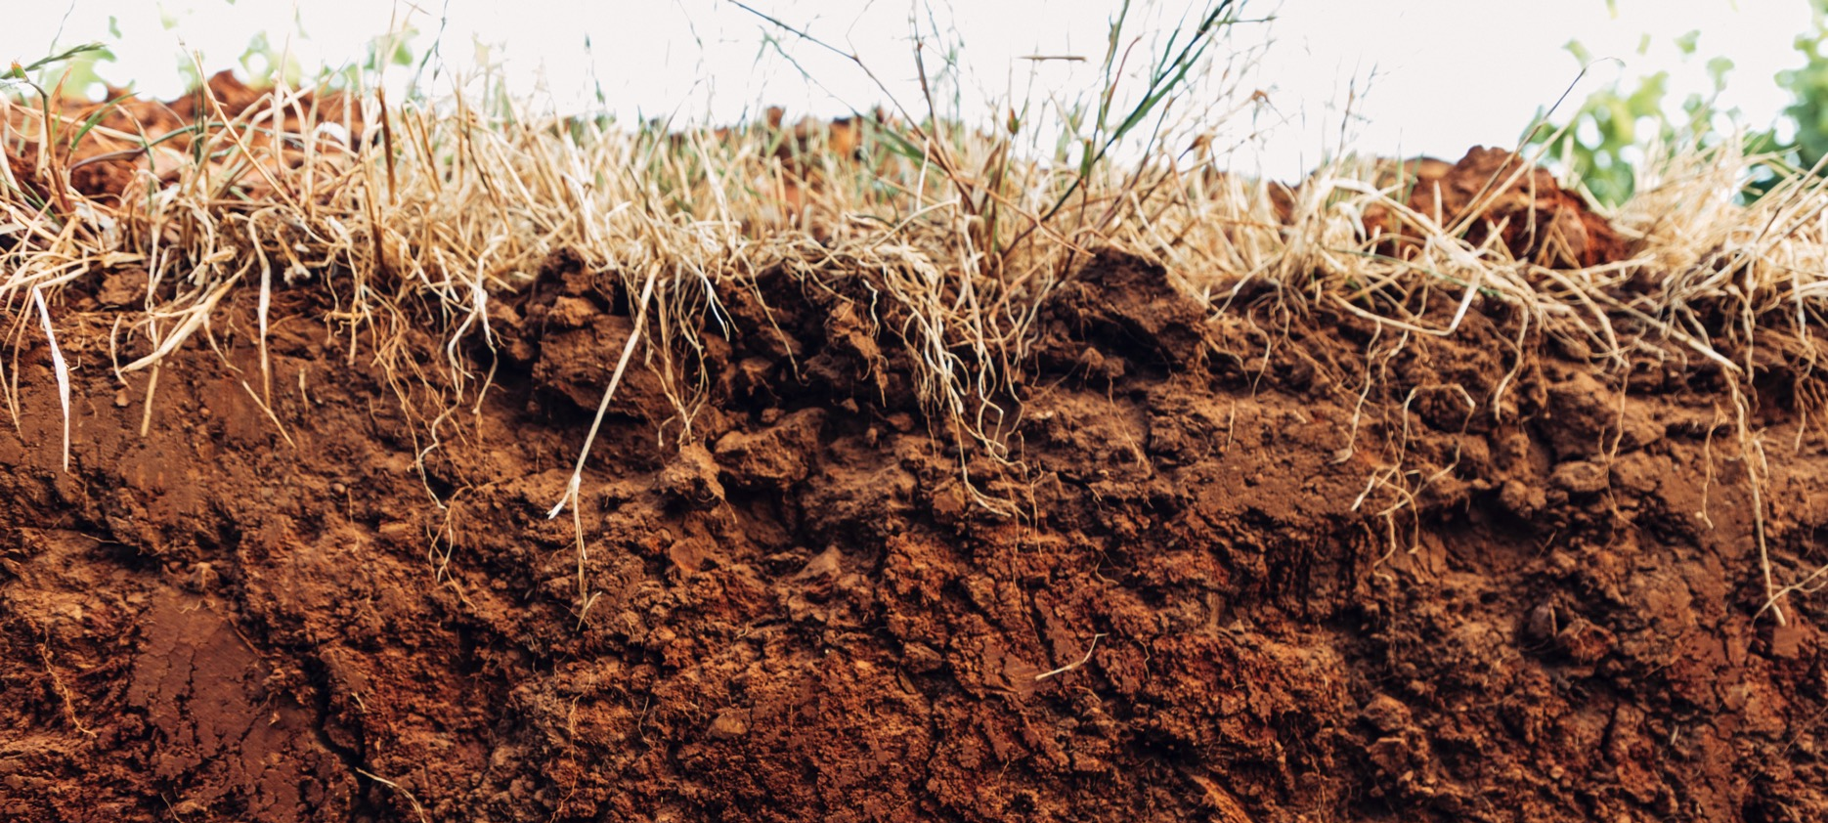
GEOLOGICAL CLASSIFICATIONS
MARITIME DEPOSITS (LIMESTONE)
Southeast South Australia, Western Victoria, Murray Valley
GRANITE
Margaret River, Mount Barker, Grampians, Northeast Victoria
VOLCANIC (BASALT)
Central Victoria, Northern Tasmania, Hunter Valley, Orange
PRE-CAMBRIAN AND CAMBRIAN METAMORPHOSED SEDIMENTARY STRATA
Barossa Valley, Eden Valley, Clare Valley, Adelaide Hills, Fleurieu Peninsula, Kangaroo Island

Slide 23
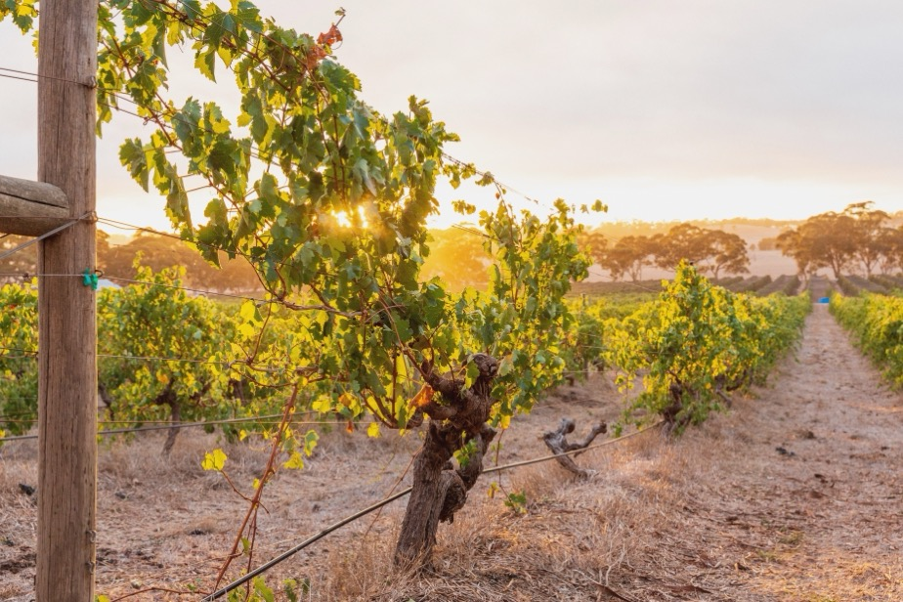

THE MAIN
SOIL GROUPS
IN AUSTRALIA’S WINE REGIONS
SAND
CLAY
Gritty, free-draining soils that retain heat. Easy to cultivate but can lack nutrients.
Heavy, poor-draining soils that are rock-hard when dry and tend to stay cooler.

Slide 24
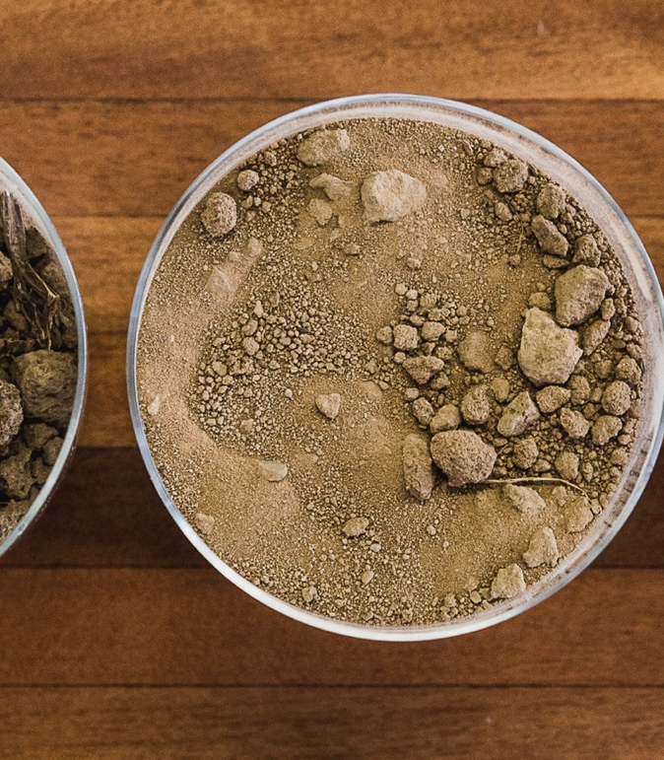
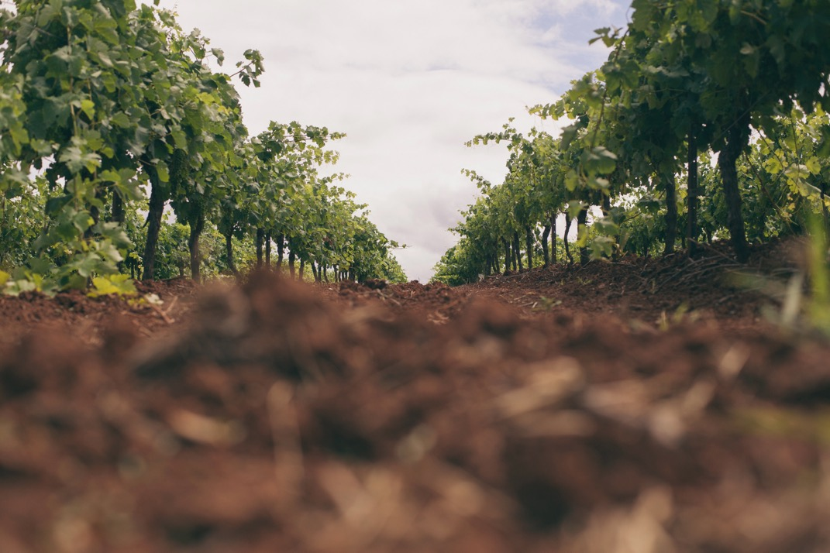
TODAY’S CLASSICS
LOAM
Nearly an equal mix of silt, clay and sand as well as organic matter. Well-drained fertile soils that promote vigorous vine growth, making rigorous pruning important.
SILT
Smooth, fine-grained soils that promote water retention and can be richer in nutrients than sandy soils.

Slide 25

PROMINENT REGIONS
NORTHERN TERRITORY
QUEENSLAND
WESTERN AUSTRALIA
SOUTH AUSTRALIA
CLARE VALLEY
NEW SOUTH WALES
HUNTER VALLEY
BAROSSA
MARGARET RIVER
McLAREN VALE
ORANGE
CANBERRA DISTRICT
ADELAIDE HILLS
COONAWARRA
VICTORIA
RUTHERGLEN
MORNINGTON PENINSULA
YARRA VALLEY
TASMANIA
TASMANIA

Slide 26
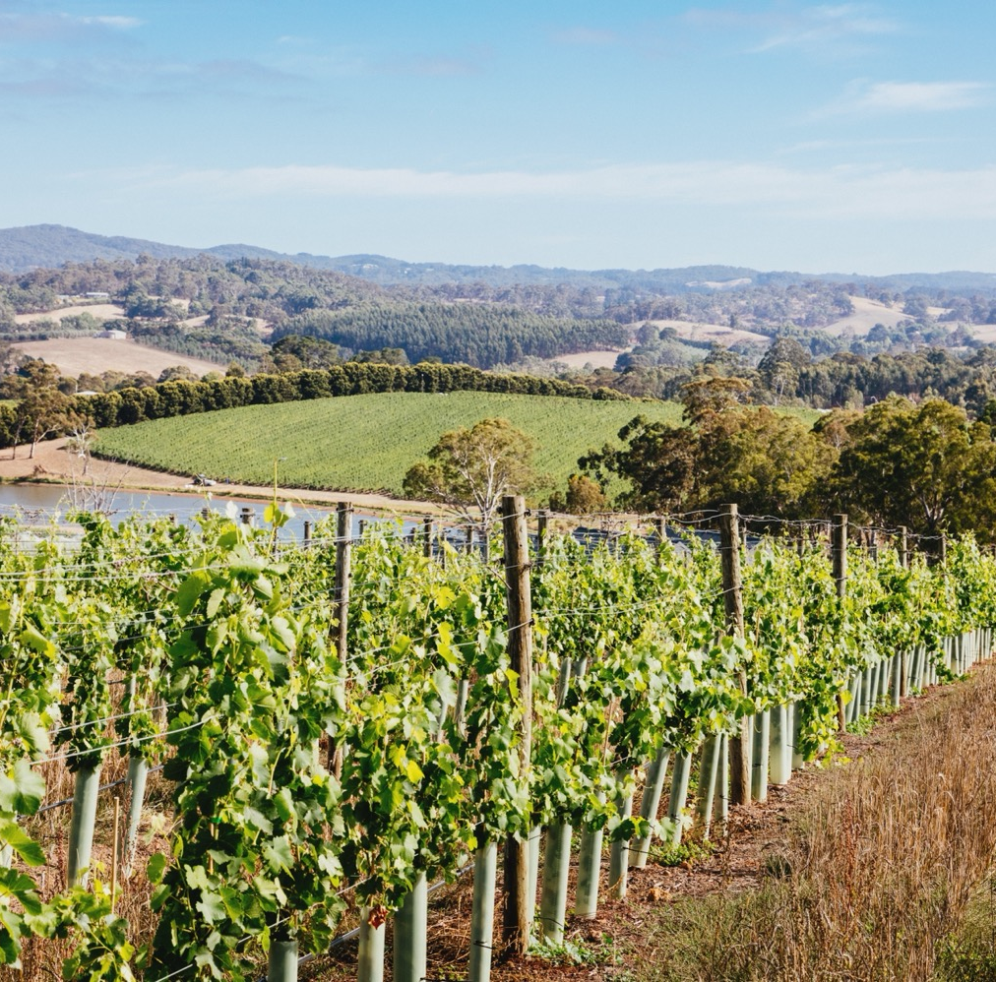
ADELAIDE HILLS
One of Australia’s most elevated and cool-climate wine regions
Reborn in the 1970s when vines were re‑planted. Today it’s key to the evolution of Australian wine.
Moderate maritime climate with cool-climate characteristics
  KEY VARIETIES
  Sauvignon Blanc
  Chardonnay
  Pinot Noir
  Shiraz
  Plus various alternative varieties

Slide 27
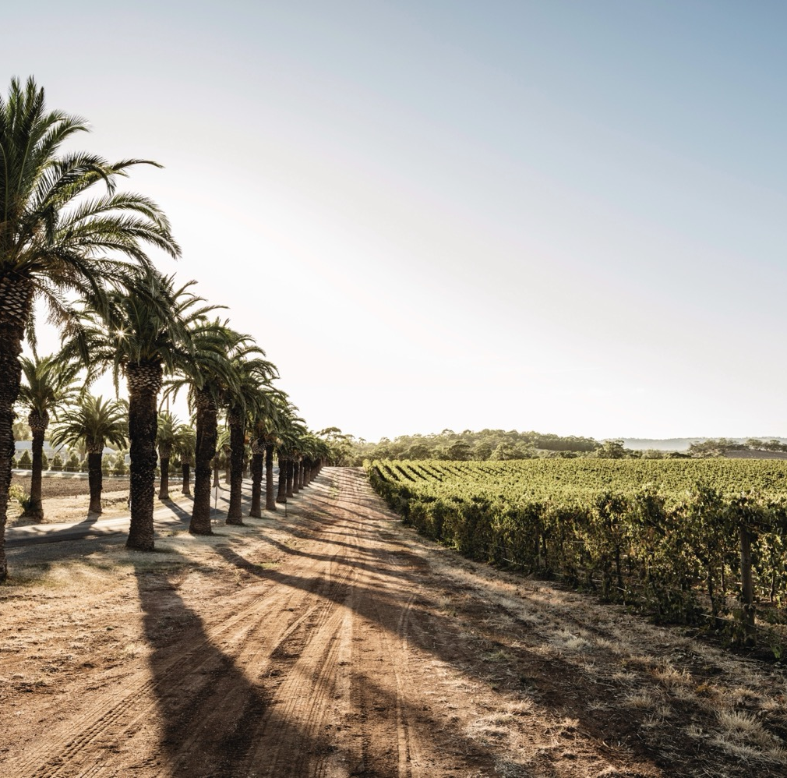
BAROSSA
Home to some of the oldest vines in the world
One of Australia’s most celebrated and historic wine regions
Barossa Valley – warm, Mediterranean climate
Eden Valley – cooler climate with various mesoclimates
KEY VARIETIES
Barossa Valley
Shiraz
Cabernet Sauvignon
Grenache
Eden Valley
Riesling
Chardonnay
Shiraz
Cabernet Sauvignon

Slide 28
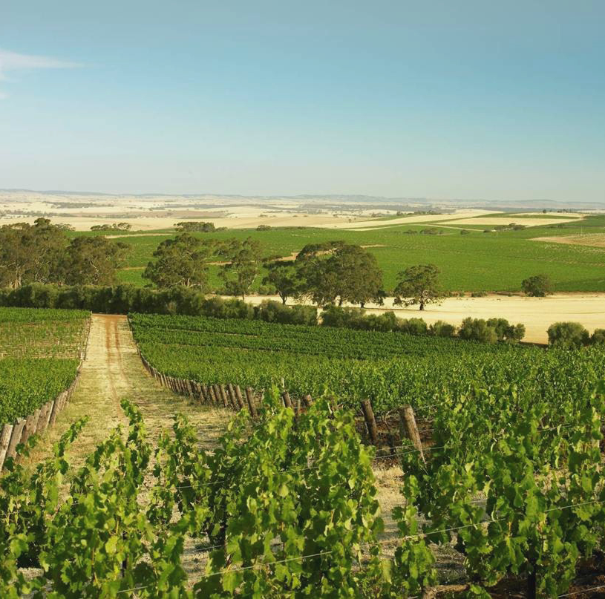
CLARE
VALLEY
Cornerstone of classic, traditional producers coupled with history of experimentation
Global reputation for Riesling, setting the benchmark for classic, age-worthy wines
Warm, continental climate with significant diurnal variation and cooling breezes
      KEY VARIETIES
      Riesling
      Shiraz
      Cabernet Sauvignon

Slide 29
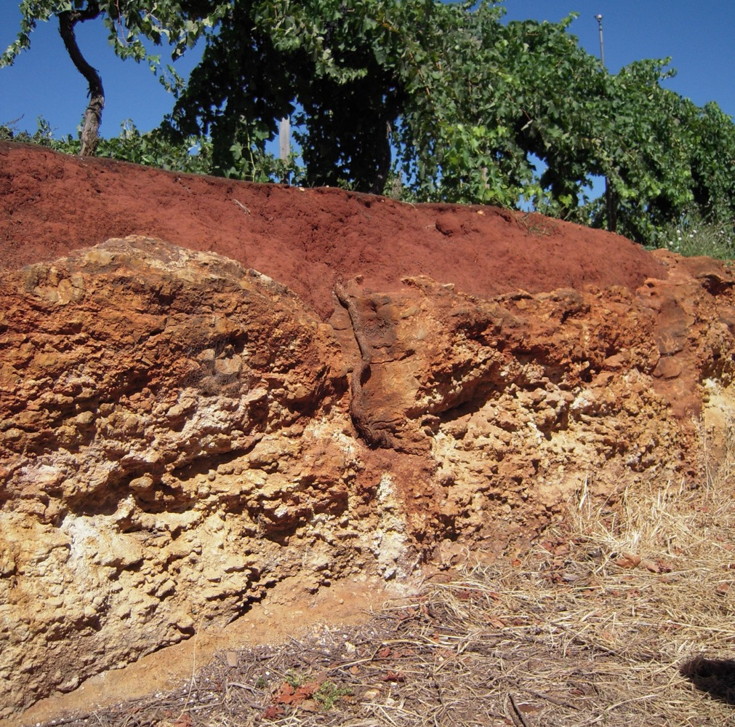
coonawarra
Renowned for producing premium, age‑worthy red wines
Famed for its strip of terra rossa (‘red soil’)
Maritime climate influenced with cooling effects of the Southern Ocean
      KEY VARIETIES
      Cabernet Sauvignon
      Shiraz
      Merlot

Slide 30
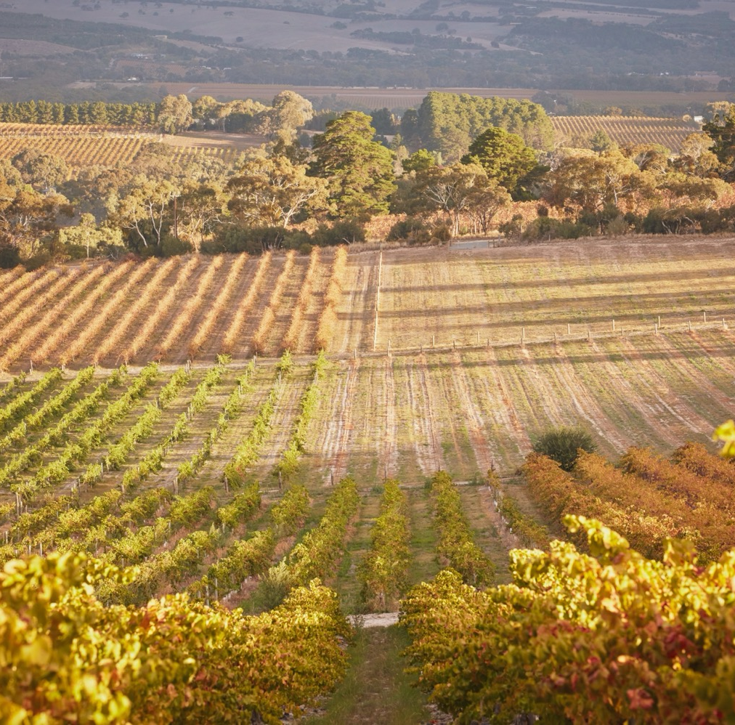
Mclaren vale
The birthplace of wine in South Australia
One of the most progressive and environmentally conscious wine communities in Australia
Warm Mediterranean climate, with a range of mesoclimates and microclimates
      KEY VARIETIES
      Shiraz
      Cabernet Sauvignon
      Grenache

Slide 31

Margaret river
One of the world’s youngest wine regions, but has quickly built a global reputation
Geographically isolated with ideal grape‑growing conditions
Mediterranean climate with strong maritime influences, with ocean on three sides
      KEY VARIETIES
      Semillon Sauvignon Blanc blends
      Chardonnay
      Cabernet Sauvignon

Slide 32
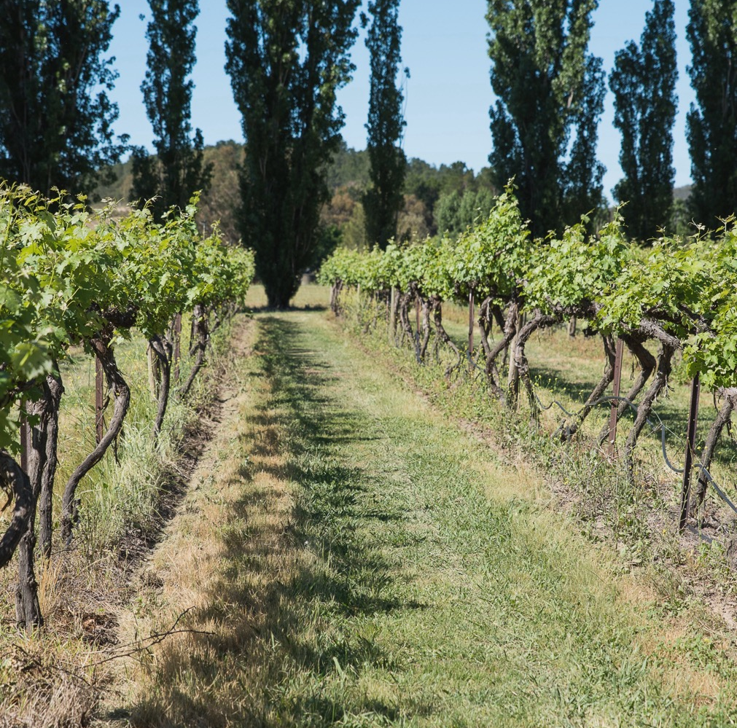
Canberra district
Relatively young region producing premium wines
Encompasses vineyards in ACT and NSW
Continental climate of extremes
      KEY VARIETIES
      Riesling
      Shiraz

Slide 33
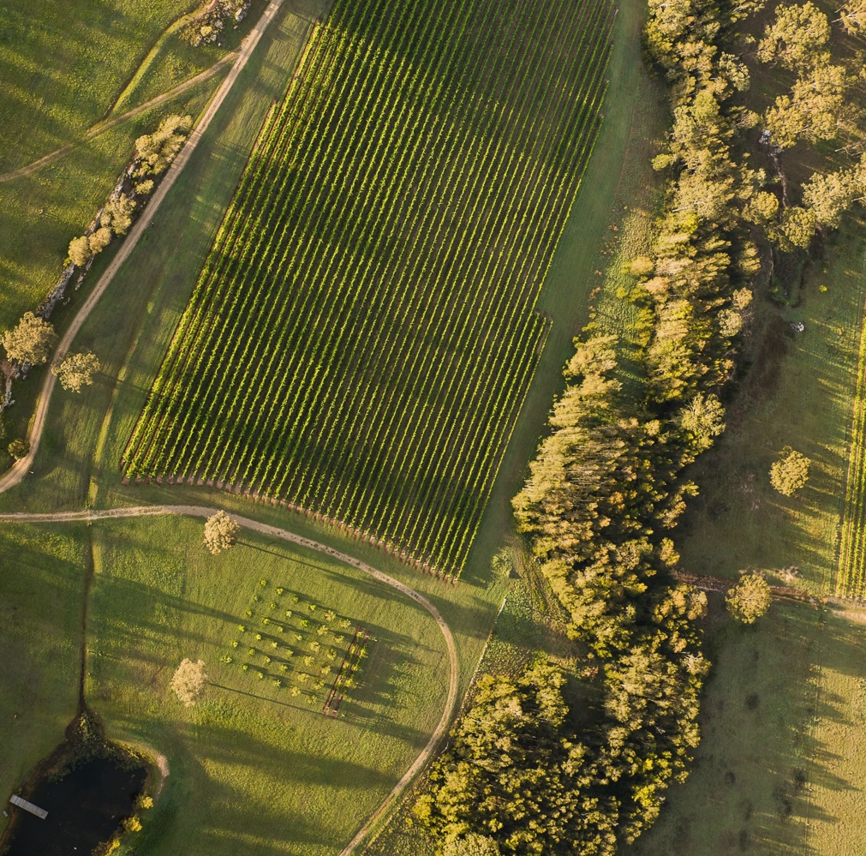
Hunter valley
Australia’s first commercial wine region
Home to some of the oldest vine stock in the world
Subtropical climate with maritime influences
        KEY VARIETIES
        Semillon
        Chardonnay
        Shiraz

Slide 34
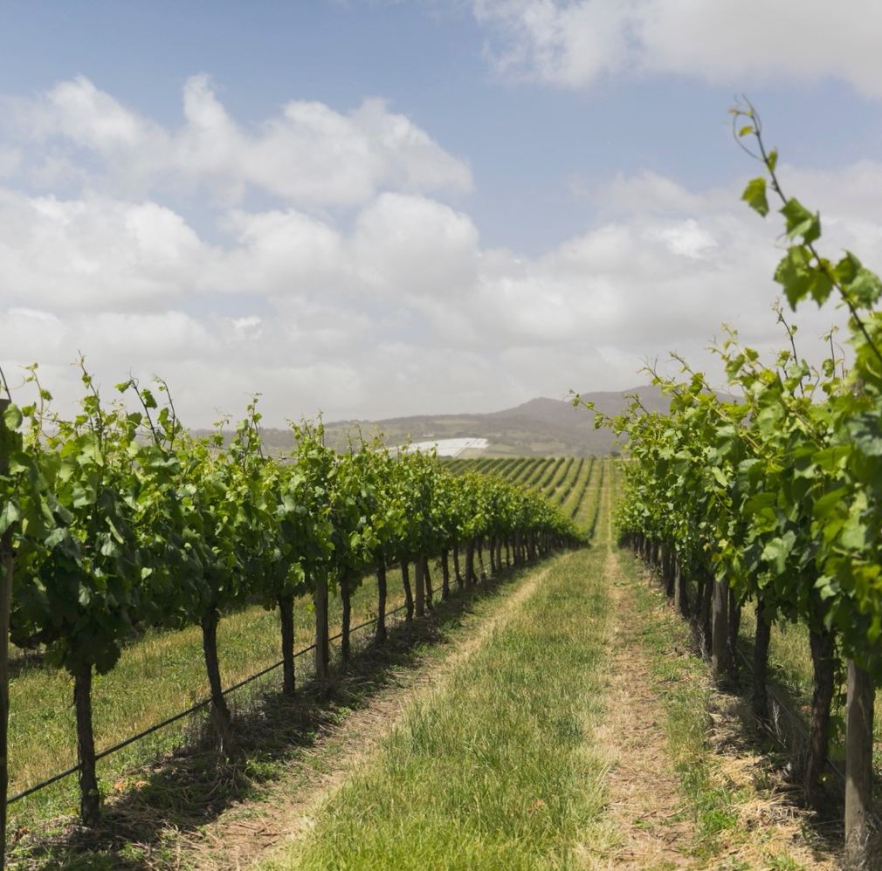
orange
Cool-climate region on the rise producing a growing range of premium wines
Some of the highest altitude vineyards in Australia
Continental climate featuring warm summer days, cool nights and dry autumn conditions
      KEY VARIETIES
      Chardonnay
      Sauvignon Blanc
      Shiraz
      Cabernet Sauvignon

Slide 35
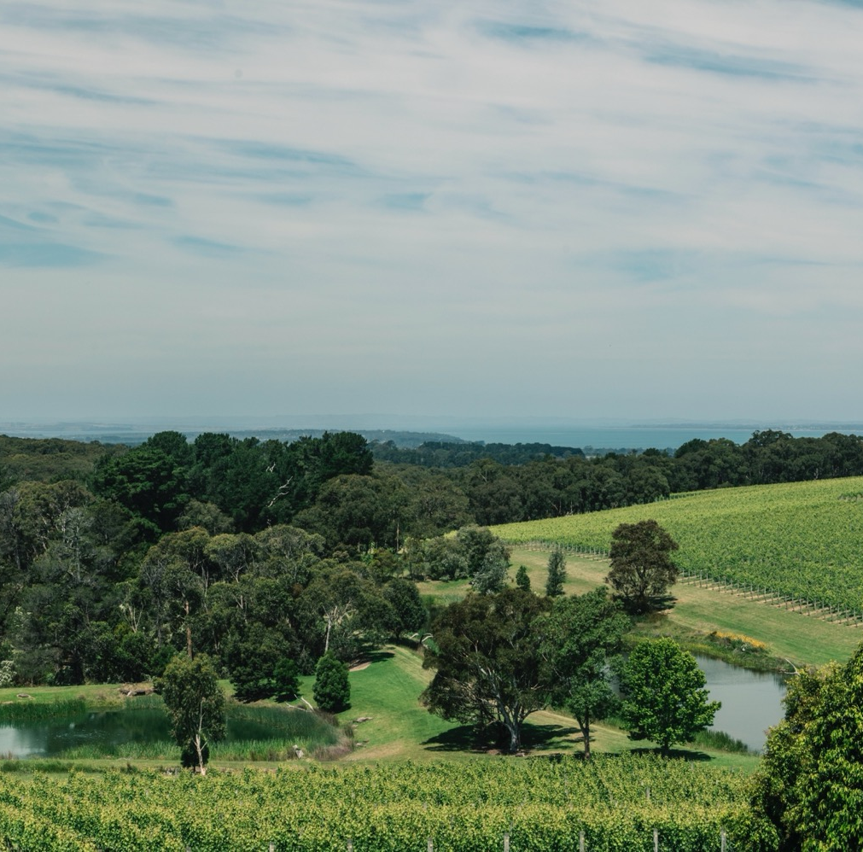
Mornington peninsula
Small seaside region surrounded by three bodies of water
Boutique wineries and vineyards producing premium cool‑climate wines
True maritime climate with an array of mesoclimates and microclimates
      KEY VARIETIES
      Pinot Noir
      Chardonnay
      Pinot Gris/Grigio

Slide 36
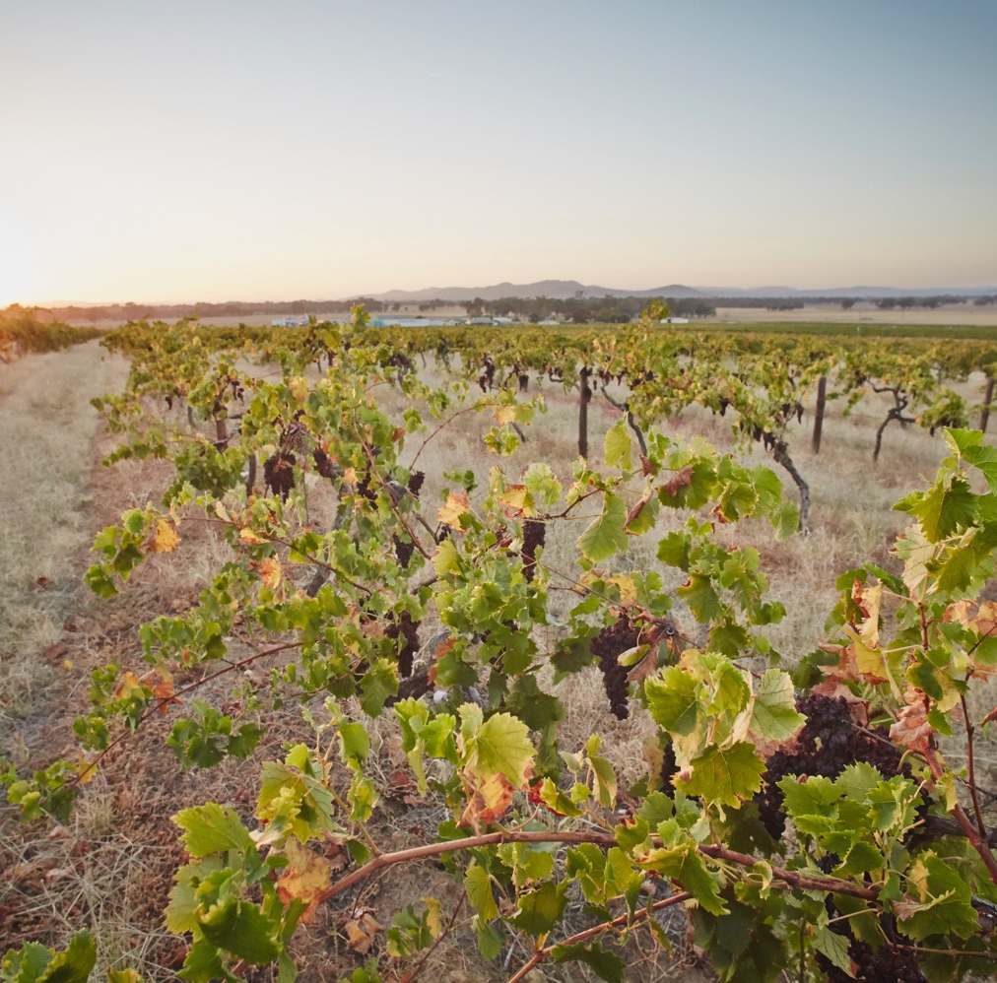
rutherglen
Historic region and Australia’s capital of fortified wines
Fifth- and sixth‑generation winemakers produce a range of award‑winning wines
Classic continental climate with cooling influences from the foothills of the Victorian Alps
      KEY VARIETIES
      Muscat and Muscadelle (fortified wines)
      Shiraz
      Durif

Slide 37

Yarra valley
Birthplace of Victoria’s wine industry
Diverse landscape with continental climate and substantial mesoclimatic variations
Leading cool-climate region with winemakers embracing both classic and boundary-pushing techniques
      KEY VARIETIES
      Chardonnay
      Pinot Noir
      Shiraz
      Cabernet Sauvignon

Slide 38
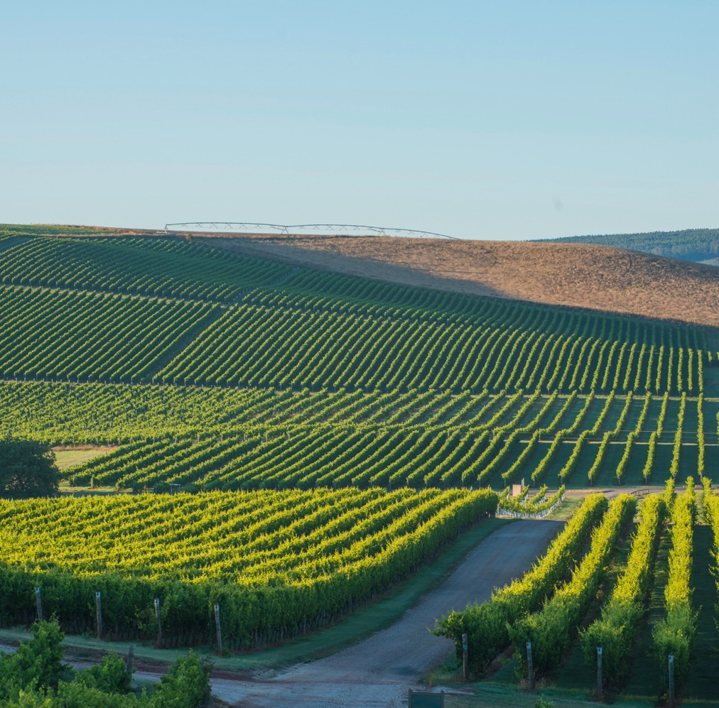
tasmania
This pristine island is one of Australia’s finest cool-climate wine regions
Modern wine Industry started in 1970s and has quickly built a global reputation, particularly for sparkling wines
Temperate climate with maritime influence (from Tasman Sea, Bass Strait and Southern Ocean)
      KEY VARIETIES
      Pinot Noir
      Chardonnay
      Riesling

Slide 39
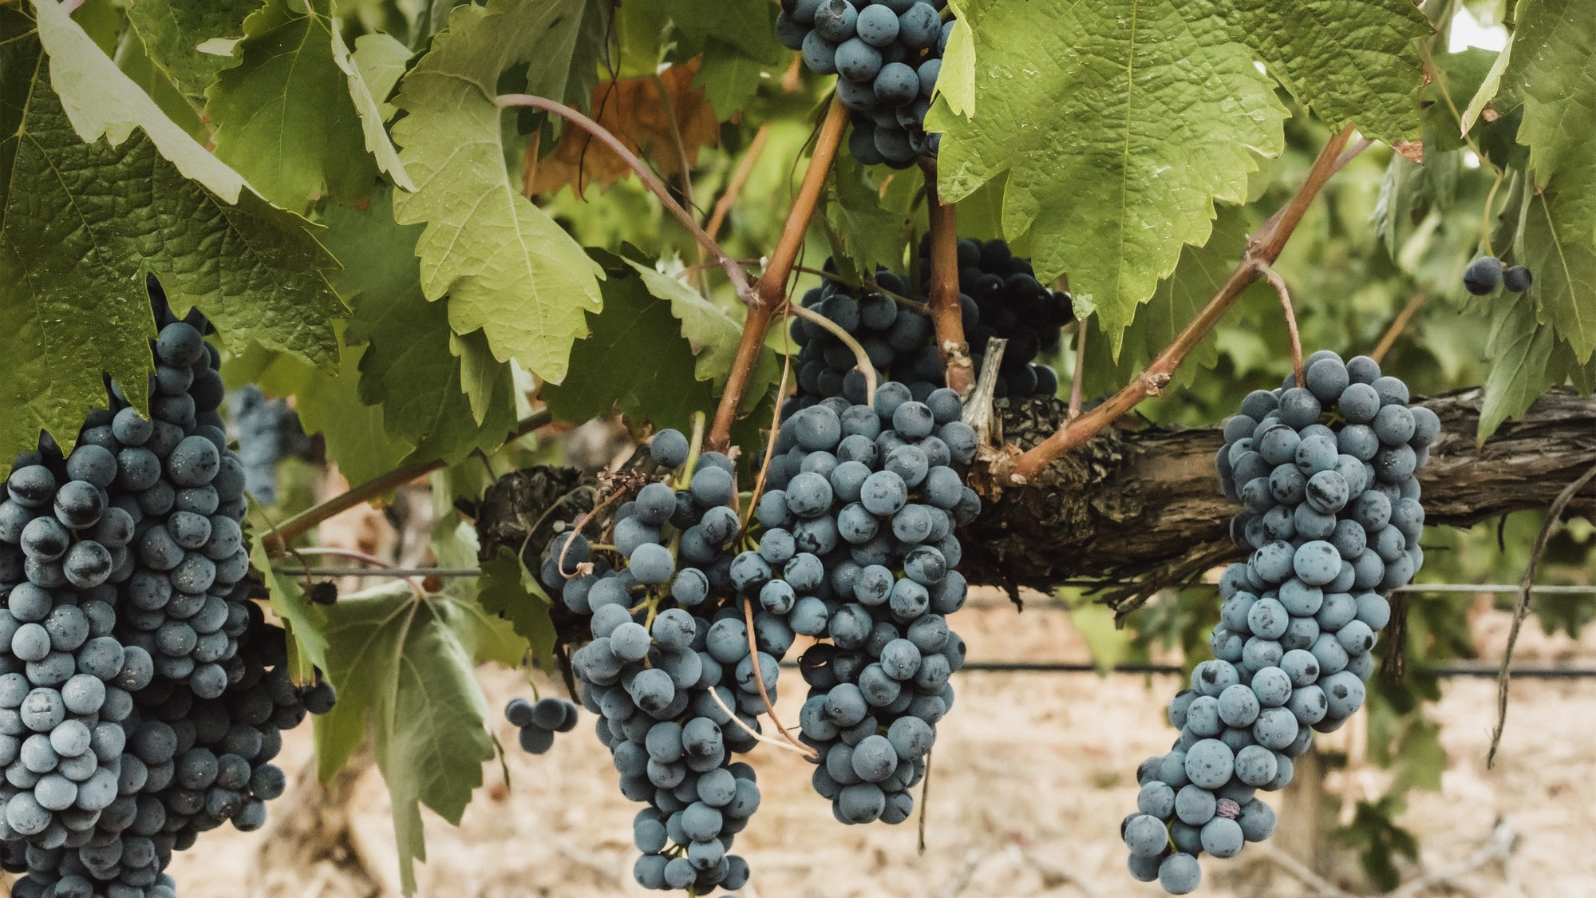
Noteworthy varieties and styles

Slide 40
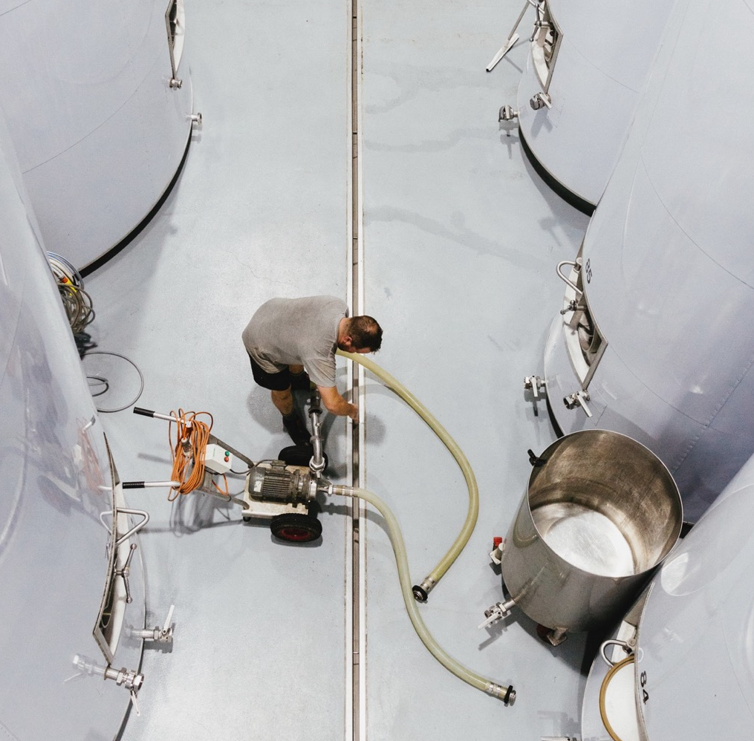
Sparkling wine
RIVALING THE WORLD’S BEST
Australia has been making sparkling wine since the late 19th century
Today, Australia is a world-leading producer of a range of styles
Sparkling wine represents a small but significant proportion of production
Considerable growth in recent years

Slide 41
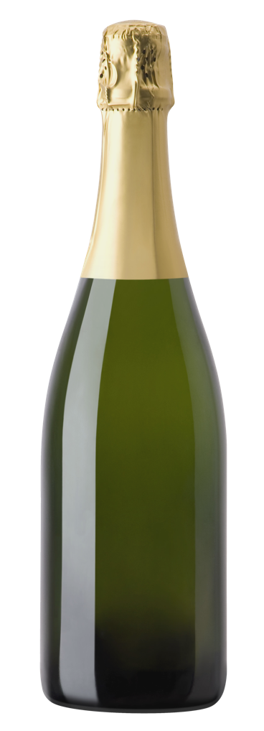
KEY REGIONS
STYLES AND
CHARACTERISTICS
THREE MAIN STYLES
ADELAIDE HILLS
One of Australia’s most exciting sparkling wine regions where crisp, cool‑climate wines meet subtlety and style
DRY BRUT STYLE
the most popular; aromas include biscuit, dough, toast, apple and grapefruit
TASMANIA
Produces sparkling wines of impeccable structure and style, many of which are premium, Traditional Method wines
SPARKLING RED, ESPECIALLY SHIRAZ
SPARKLING
a uniquely Australian style; crimson
coloured, juicy, fruity and refreshing
SPARKLING ROSÉ
YARRA VALLEY
a niche style; aromas include floral, rose petal, strawberry, raspberry and red currant
Cool climate and good soil have made it a magnet for exceptional sparkling wine producers

Slide 42
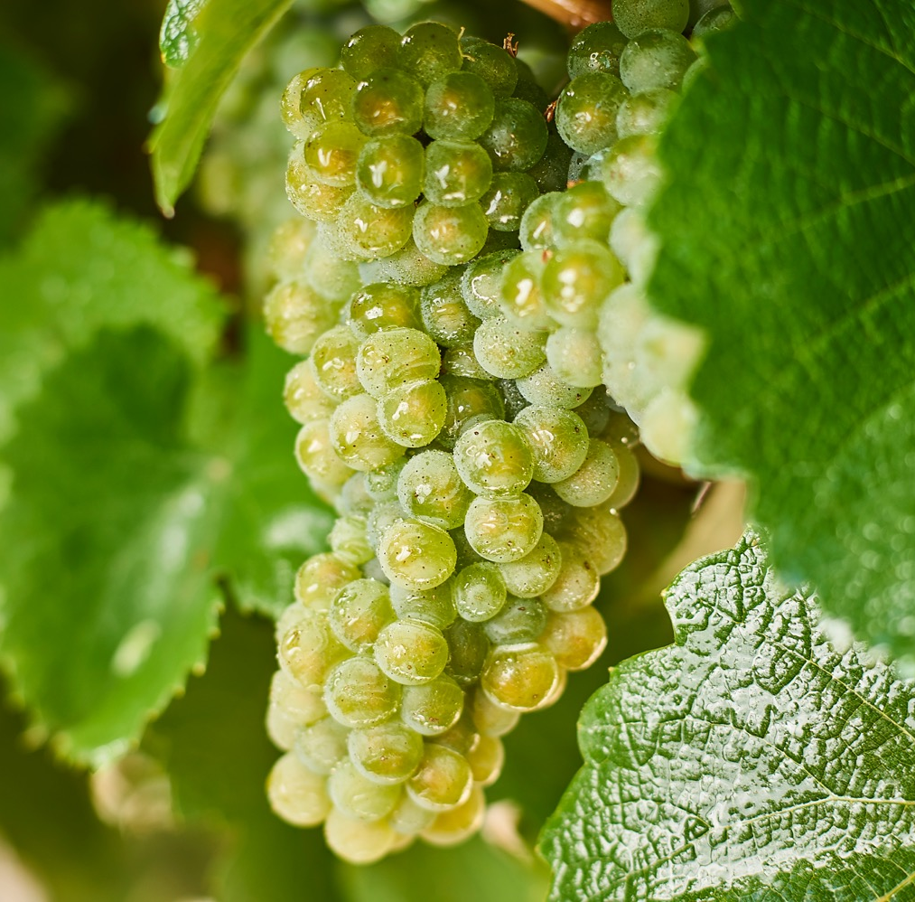
riesling
Diverse and distinctive
Australia is one of the world’s top Riesling producers
Long history in Australia; today one of the most renowned varieties
Planted in most wine regions; best examples from cooler areas
Minimal-intervention winemaking approach is common
Notes:
Old vines
First vines -

Slide 43

Styles and characteristics
THE MOST COMMON STYLE
IS DRY, WITH
SOME OFF-DRY AND DESSERT WINES ALSO PRODUCED
AROMATIC, LIGHT‑BODIED TO MEDIUM‑BODIED, HIGH ACID PRESENCE
RIESLING
TYPICAL
FLAVOURS
Citrus
Apple
Honey
YOUTHFUL
Zippy, fresh and drinkable
AGED
Honeyed, smooth and rich

Slide 44
KEY REGIONS
GREAT SOUTHERN
Rieslings of great intensity that are fresh and nervy in their youth and age superbly
CANBERRA DISTRICT
Typical style is crisp and dry; off-dry styles are making a comeback. Excellent ageing potential
CLARE VALLEY
Some of Australia’s best Riesling; signature notes of lemon and lime, with fruit richness and a long, lingering persistence
SOUTH WESTERN
VICTORIA
Fine, lime-accented and age-worthy wines
TASMANIA
Great length with citrus and mineral characters and high levels of natural acidity
RIESLING
EDEN VALLEY
Signature slate, mineral character, strong lime juice and fragrant floral aromas; can take 10+ years to reach peak

Slide 45
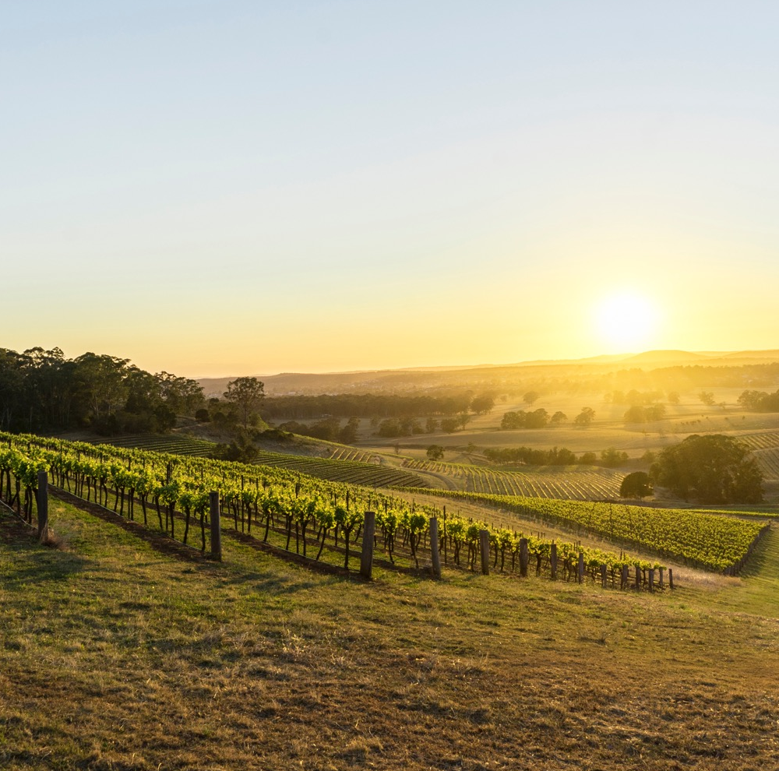
semillon
A truly unique expression of a classic
Long history in Australia
Delicate, versatile grape produced in a range of styles
Potential to age for many years
Lends itself to botrytis, or ‘noble rot’, to produce one of Australia’s most celebrated sweet wine styles
Notes:
Old vines
First vines -

Slide 46

Styles and characteristics
Light-bodied to medium-bodied dry wines
Crisp, clean, elegant and fruit-driven, and generally made for early drinking
FOUR DISTINCT STYLES:
BLENDS
Commonly blended with other varieties including Sauvignon Blanc
Semillon contributes flavour and roundness to the sharper Sauvignon Blanc notes
UNOAKED, OAKED, BLENDED,
DESSERT WINE
SEMILLON
TYPICAL FLAVOURS
Citrus
Apple
Honey
Youthful
Crisp, fresh and citrusy
Aged
Richer with notes of toast and honey

Slide 47
KEY REGIONS
MARGARET RIVER
BAROSSA VALLEY
Semillon Sauvignon Blanc blend is a signature style, known for its liveliness and bright personality
Typically riper, richer styles that are often barrel fermented, however styles are becoming more crisp and delicate
RIVERINA
Produces gloriously sweet, intense and complex botrytis Semillon dessert wines
HUNTER VALLEY
SEMILLON
Unoaked Hunter Valley Semillon is unique in the wine world, capable of ageing gracefully for well over 20 years

Slide 48
chardonnay
Australia’s
classic white
The most planted white variety and accounts for more than half of white wine production
Australia has some of the oldest plantings in the world
This versatile variety is vinified into all manner of expressions
Evolved from the big, oaky wines of the 1980s and ’90s to more restrained and elegant styles
Notes:
Old vines
First vines -

Slide 49
Styles and characteristics
AUSTRALIAN WINEMAKERS HAVE EMBRACED ALL FLAVOURS AND CHARACTERISTICS OF THIS VARIETY
UNOAKED
OAKED
SPARKLING
CHARDONNAY
Three broad styles
TYPICAL FLAVOURS
Styles range from lean and light-bodied cool-climate expressions to fuller-bodied, rich and ripe versions from warm climates
Citrus
Stone fruit
nuts

Slide 50
KEY REGIONS
ADELAIDE HILLS
MORNINGTON PENINSULA
Elegant, textured and lean, these wines stand up against the finest cool-climate Chardonnays in the world
Styles range from delicate and unoaked through to medium‑bodied wines with rich complexity. Typical flavours of melon, citrus and fig
HUNTER VALLEY
The previously oaky and rich styles of this warm-climate region have evolved into elegant and restrained yet full-flavoured wines
TASMANIA
Dry, delicate wines with piercing natural acidity and intense fine flavours
CHARDONNAY
MARGARET RIVER
YARRA VALLEY
World-class, age-worthy wines with fruit ripeness, flavour depth and refreshing acidity
Elegant and age-worthy cool-climate wines with high levels of acidity and flavours of citrus and stone fruit

Slide 51
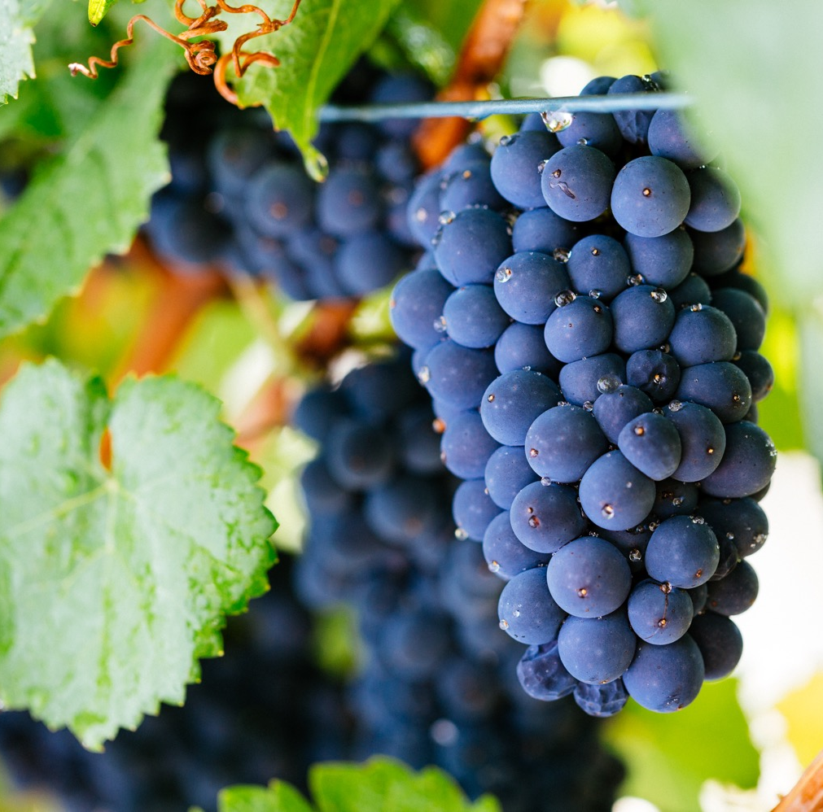
Pinot noir
Cool-climate charm
Relative latecomer to the commercial wine community but now an integral variety
One of the hardest grapes to grow
Best examples come from cool‑climate regions
Clonal diversity has been linked to an increase in wine quality and complexity
Notes:
Old vines
First vines -

Slide 52
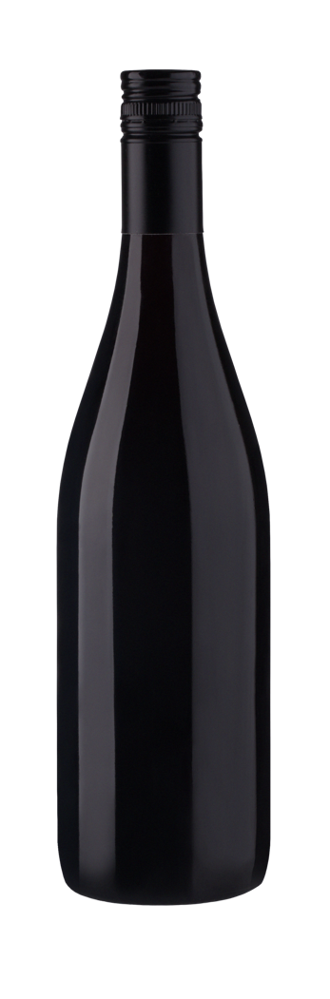
Styles and characteristics
PREMIUM
WINES CHARACTERISED BY SUBTLETY
AND FINESSE
LIGHT-BODIED TO MEDIUM-BODIED AND RESTRAINED IN NATURE
PINOT NOIR
TYPICAL FLAVOURS
Youthful
Fine cherry, red berry and herbal notes with silky or satiny texture
Aged
Develops classic earthy or ‘forest floor’ savoury characters
Cherry
Strawberry
Raspberry

Slide 53
KEY REGIONS
ADELAIDE HILLS
TASMANIA
The elevation and cool climate produces medium‑bodied styles with richer, ripe cherry and berry flavours
Ideal for producing high‑quality Pinot Noir due to its cool climate; typically light-bodied to medium‑bodied with delicate cherry and strawberry flavours
MORNINGTON PENINSULA
YARRA VALLEY
Cool, seaside region producing medium‑bodied wines with characters
of strawberry and cherry and a backbone of acidity
PINOT NOIR
Produces various expressions due to different elevations and aspects; typically light-bodied to medium‑bodied, with flavours of cherry, strawberry and plum

Slide 54
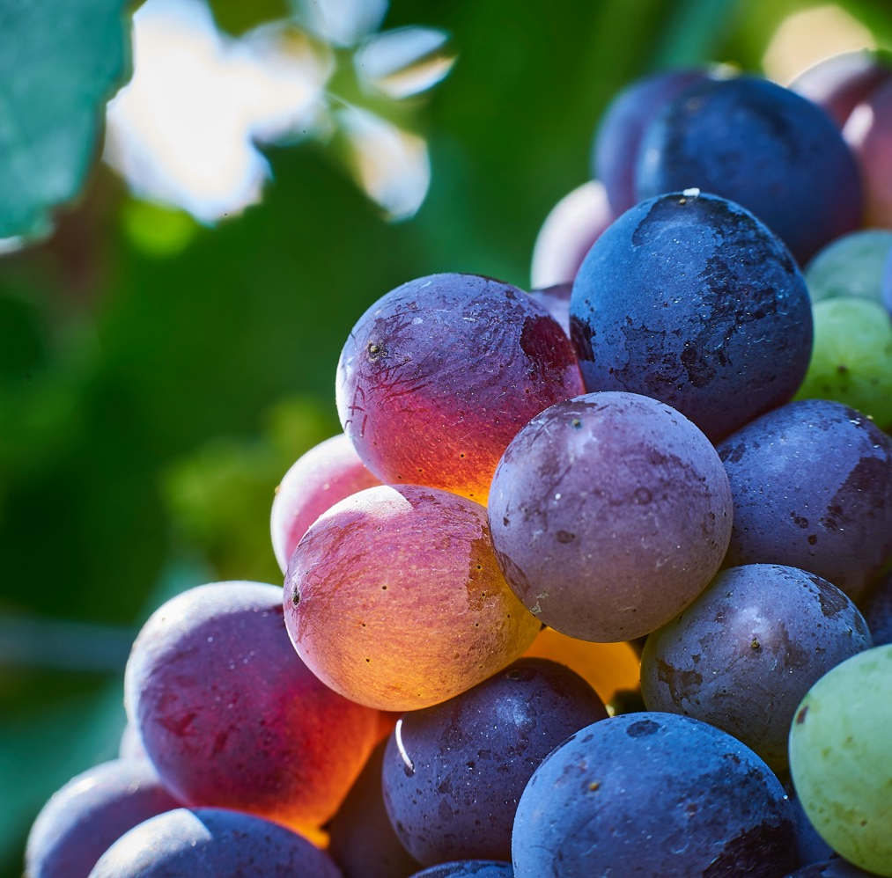
GRENACHE
REBIRTH OF A CLASSIC
One of the original varieties planted in Australia
Australia boasts some of the oldest Grenache vines in the world
A workhorse grape somewhat overlooked in the early years
Today it’s enjoying a revival as winemakers recognise its exciting potential
Notes:
Old vines
First vines -

Slide 55
Styles and characteristics
KEY REGIONS
Typically medium-bodied to full-bodied
Perfumed, elegant and food-friendly
Today’s styles vary from rich and intense to lighter, brighter wines
BAROSSA VALLEY
Warm conditions and cool nights produce medium-bodied to full-bodied wines with rich texture and notes of red fruit, earth and white pepper; GSM blends often consist of Grenache from old vines
USED IN SEVERAL WAYS: AS A VARIETAL RED WINE, IN BLENDS, IN ROSÉS AND
IN FORTIFIED WINES
GRENACHE
McLAREN VALE
Medium-bodied to full‑bodied wines with rich texture, spice and ripe, juicy fruit; GSMs are full-bodied, with a juicy mouthfeel, fine tannins and great length
TYPICAL FLAVOURS
Cherry
Berry
Spice

Slide 56

SHIRAZ
An Australian legend
Australia’s iconic grape and its most famous wine export
Grown in almost every region and accounts for nearly one-quarter of total wine production
Produced in a wide range of expressions, from affordable, quaffable reds to age-worthy classics
Australia has one of the oldest continuously producing Shiraz vines in the world
Notes:
Old vines
First vines -

Slide 57

Styles and characteristics
IDEAL BLENDING PARTNER –
GSM, SHIRAZ CABERNET, SHIRAZ VIOGNIER
Warm climate styles
Bold flavours, juicy jammy dark fruits, ripe tannins and seamless texture
Cooler climate styles
Elegant, food-friendly, medium-bodied
SHIRAZ
TYPICAL FLAVOURS
Youthful
Richly textured; ripe,
rich, dark fruits
Aged
Softer tannins; smoother character; spice, liquorice and earth characters
Warm climate
Cool climate
Dark cherry
Plum
Chocolate
Ripe red fruits

Slide 58
KEY REGIONS
THE GRAMPIANS
Elegant, savoury and spicy; deeply purple in colour
ADELAIDE HILLS
Moderate alcohol levels, pepper and spice aromas, fine tannins and acids
EDEN VALLEY
Medium-bodied to full-bodied with classic berry, sage and pepper notes
BAROSSA VALLEY
Bold Shiraz bursting with flavour and character
HUNTER VALLEY
Evolved into medium-bodied wines that are savoury, complex and food-friendly
CANBERRA DISTRICT
Powerful yet elegant Shiraz that’s spicy, balanced and full-flavoured
McLAREN VALE
SHIRAZ
Full-bodied with rich blueberry fruit and chocolate characters
CLARE VALLEY
Plush, full-bodied and richly textured, with flavours of blackberry, plum and liquorice
MOUNT BARKER
Silky, elegant Shiraz with notes of liquorice, black cherry and peppery spice

Slide 59
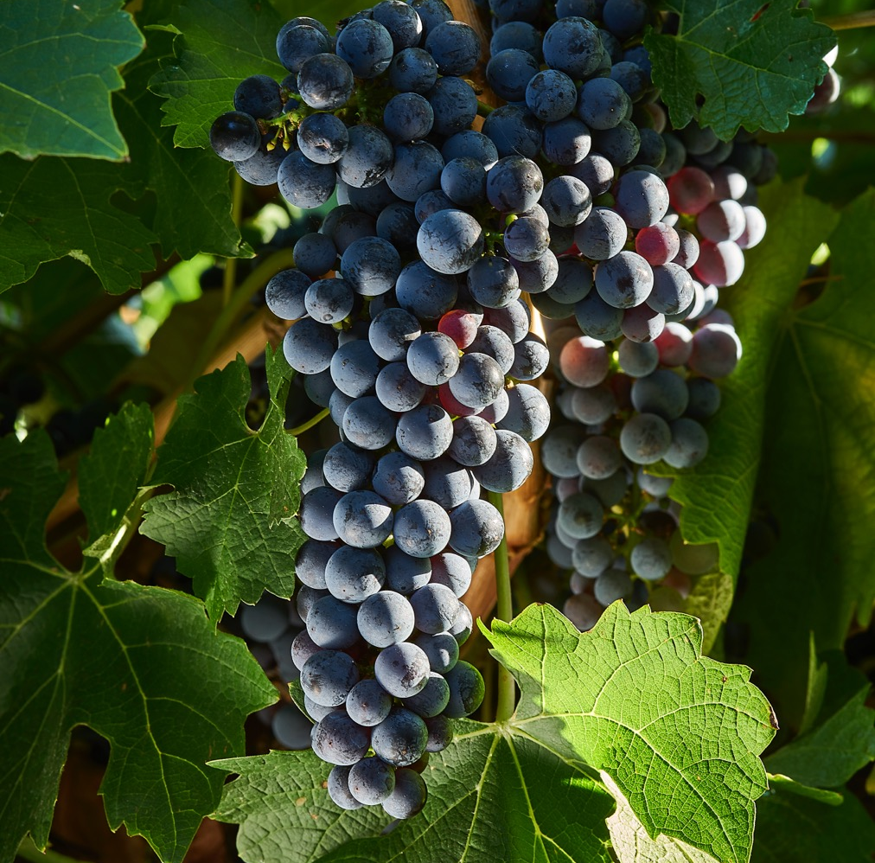
Cabernet sauvignon
Powerful and
age-worthy
Australia’s third most planted grape variety
Known for its intensity of colour, flavour, acidity and tannins, and its ability to age for many decades
A fixture in a lot of Australia’s most historic and successful wines
Grows best in warm to cool, dry regions
Notes:
Old vines
First vines -

Slide 60
Styles and characteristics
Australia is known for fuller-bodied, concentrated Cabernet, but also produces medium‑bodied, tannin‑driven styles
Successful as both a single-variety wine and a dominant feature in classic blends
Youthful
Firm tannins, high acidity, flavours of cassis, blackberry
and herbs
TYPICAL FLAVOURS
CABERNET SAUVIGNON
Blackberry
Cherry
Mint
Aged
Tannins soften, mellow and smooth, characteristics of cedar, tobacco, earth, cocoa

Slide 61
KEY REGIONS
COONAWARRA
Powerful, complex Cabernet wines; medium‑bodied to full-bodied with concentrated flavours of blackcurrant, mulberry, plum, blackberry and dark cherry
MARGARET RIVER
Medium-bodied to full‑bodied; richer and more rounded
in texture than those of Coonawarra; dark, blueberry fruit characters and bay leaf, bouquet garni or dried‑herb aromas
LANGHORNE CREEK
CABERNET SAUVIGNON
Full-bodied, rich, flavourful wines with soft tannins and ripe black-fruit flavours. Signature style blends Australian Shiraz with Cabernet

Slide 62
ALTERNATIVE VARIETIES:
INNOVATION AND DIVERSITY
Southern Mediterranean varieties well suited to Australia’s climate, food and lifestyle
Each year the number of alternative varieties being planted increases
They currently account for only 4% of Australia’s wine-producing vineyards, but are attracting attention worldwide

Slide 63
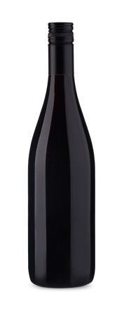


VARIETIES
ON THE RISE
FIANO:
Crisp, fresh and aromatic; flavours range from citrus to stone fruit to hazelnut
NEBBIOLO: Fruit-pure and fresh to powerful, aged and age-worthy
SANGIOVESE: Firm tannins; aromatic notes of plum, cherry, herbs
FIANO
NEBBIOLO
SANGIOVESE
GRÜNER VELTLINER: Aromatic and refreshing; quite dry,
savoury and somewhat fruity
NERO D’AVOLA: Medium‑bodied, naturally fresh acidity, generous tannins, food-friendly
VERMENTINO: Ranges from fresh to textural; notes of almond, citrus, green apple and ‘sea spray’
GRÜNER VELTLINER
NERO D’AVOLA
VERMENTINO
GRÜNER VELTLINER

Slide 64
Australian WINE: AS DIVERSE AS THE COUNTRY THAT MADE IT
KEY POINTS TO REMEMBER:
The first vines were planted in Australia in 1788; today there are 65 wine regions growing more than 150 grape varieties
Australia’s climate and soils are extremely diverse, and wine is produced across the country, although it’s concentrated around the southeast and southwest
Australia has been a land mass for over 100 million years, and its soils are some of the most ancient on Earth; soils vary greatly between and within regions

Slide 65
Latitude, maritime influences and elevation all contribute to a surprising diversity of climates – ranging from alpine zones, to Mediterranean areas, to the tropics, to the very dry centre
Each of Australia’s 65 wine regions has its own characteristics and wine styles; in general, higher-value premium wines come from smaller and cooler-climate regions
Australia’s most prominent varieties and wine styles are sparkling wines, Riesling, Semillon, Chardonnay, Pinot Noir, Grenache, Shiraz and Cabernet Sauvignon
Alternative varieties – largely Mediterranean vines – are rapidly growing in popularity, adding to the diversity of Australian wine

Slide 66
THANK YOU

