Slide 1
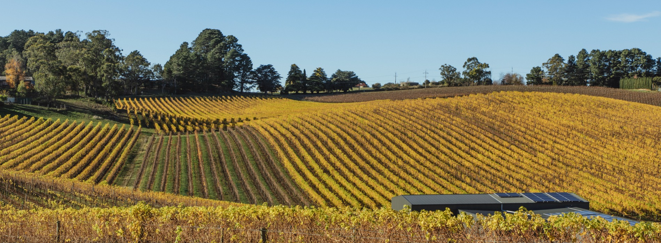
ADELAIDE HILLS

Slide 2


Crafted from grapes grown under vast and diverse climates, across landscapes millions of years in the making, every glass of Australian wine tells a story.
Like those who came before us, our modern growers and makers continue to be passionate, resilient and creative; constantly driven to explore new ways to perfect old techniques. Our community is connected by a mutual respect and shared love of crafting exceptional wine, while protecting the natural wonders for future generations to enjoy. Applying modern thinking to our ancient lands, we take playful experimentation very, very seriously.
So, if you’re looking for the taste of adventure, let Australian wine be your compass. Because in every bottle of Australian wine, you’ll experience the wonders of Australia – a reminder of the adventure and diversity that defines our culture and our land.

Slide 3

AUSTRALIA
ADELAIDE HILLS

Slide 4
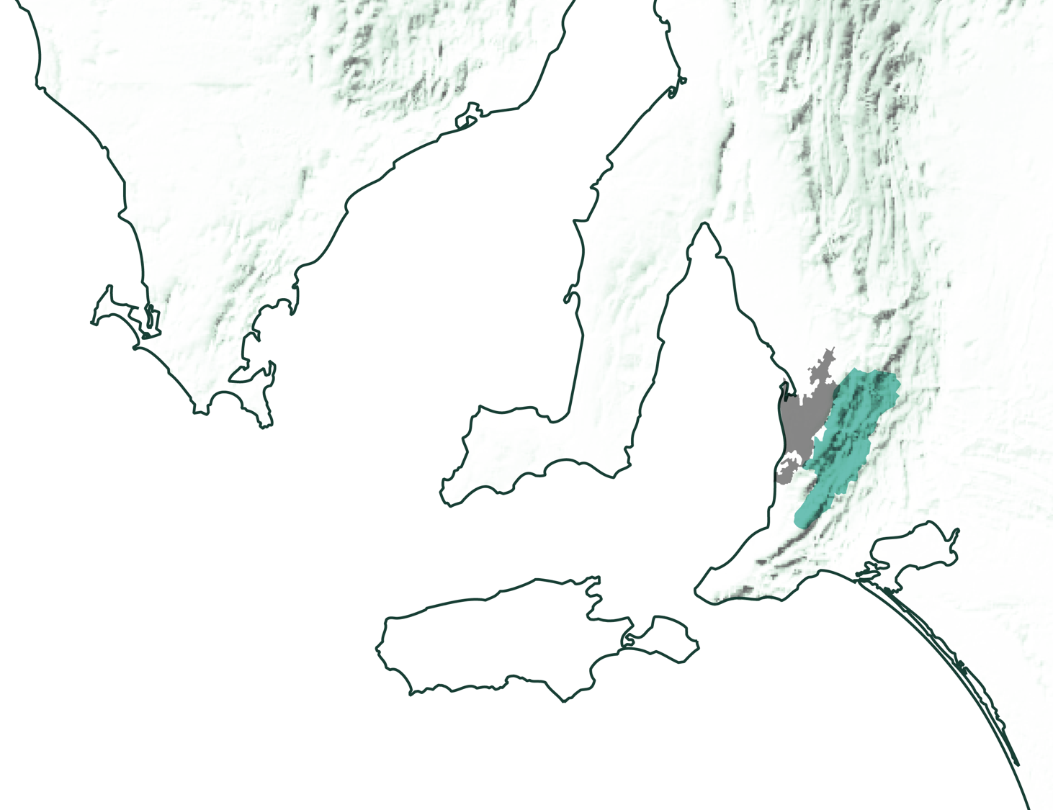
SOUTH
AUSTRALIA
ADELAIDE HILLS

Slide 5
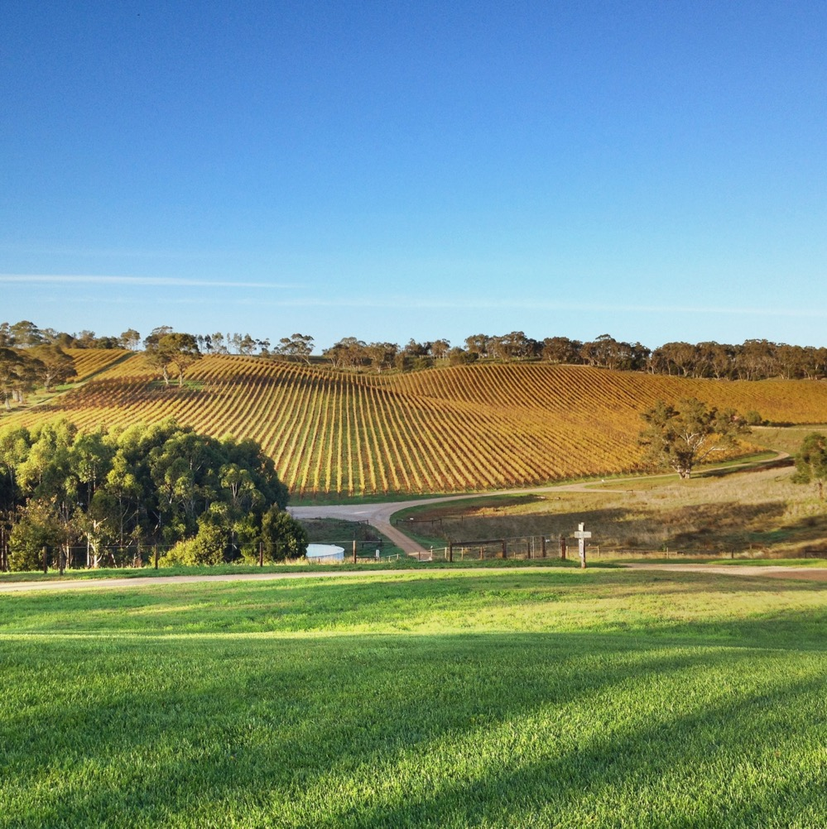
ADELAIDE HILLS
COOL CLIMATE ELEGANCE AND INNOVATION
The wine region has rapidly become one
of Australia’s most exciting, fostering a creative community and spearheading the evolution of Australian wine.
Varied landscape home to one of South Australia’s coolest-climate regions
Hub of quality and innovation in wine production
Elegance the common thread across a diversity of wines
Tourist hotspot on Adelaide’s doorstep

Slide 6
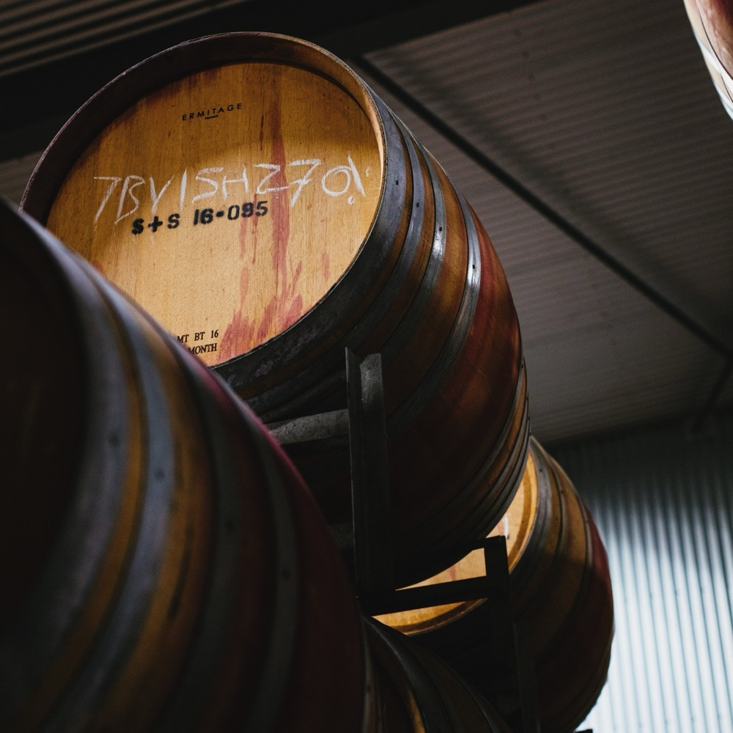
TODAY WE’LL COVER
The history of Adelaide Hills
Geography, climate and soil
Viticulture and winemaking
Prominent varieties

Slide 7
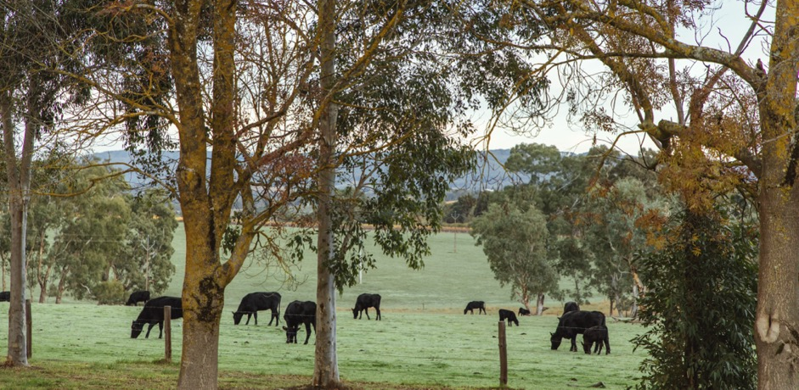
1840s – 1900
THE HISTORY OF ADELAIDE HILLS
1900 – 1960s
CONTEMPORARY COOL REBORN
Financial pressures and lack of viticulture experience means all vineyards are removed by the 1930s. For the next 40 years, the land is used for other purposes.
First commercial vines planted by John Barton Hack. Other vineyards soon follow, and from 1840 to 1900 there are more than 200 growers and winemakers in the region.

Slide 8
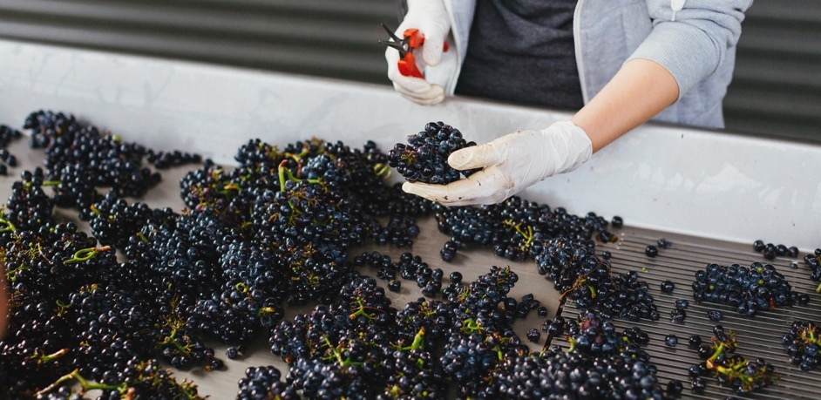
1998
The Geographical Indication (GI) Adelaide Hills is created.
1970s – 1980s
Today
Adelaide Hills is reborn as a wine region when Leigh and Jan Verrall plant a vineyard in 1971. Brian Croser founds Petaluma in 1976 and the modern-day region is born.
Adelaide Hills has a reputation for premium wines, becoming one of Australia’s most important cool-climate wine-growing areas. Wine styles range from elegant to edgy, which helps define modern Australian wine.

Slide 9
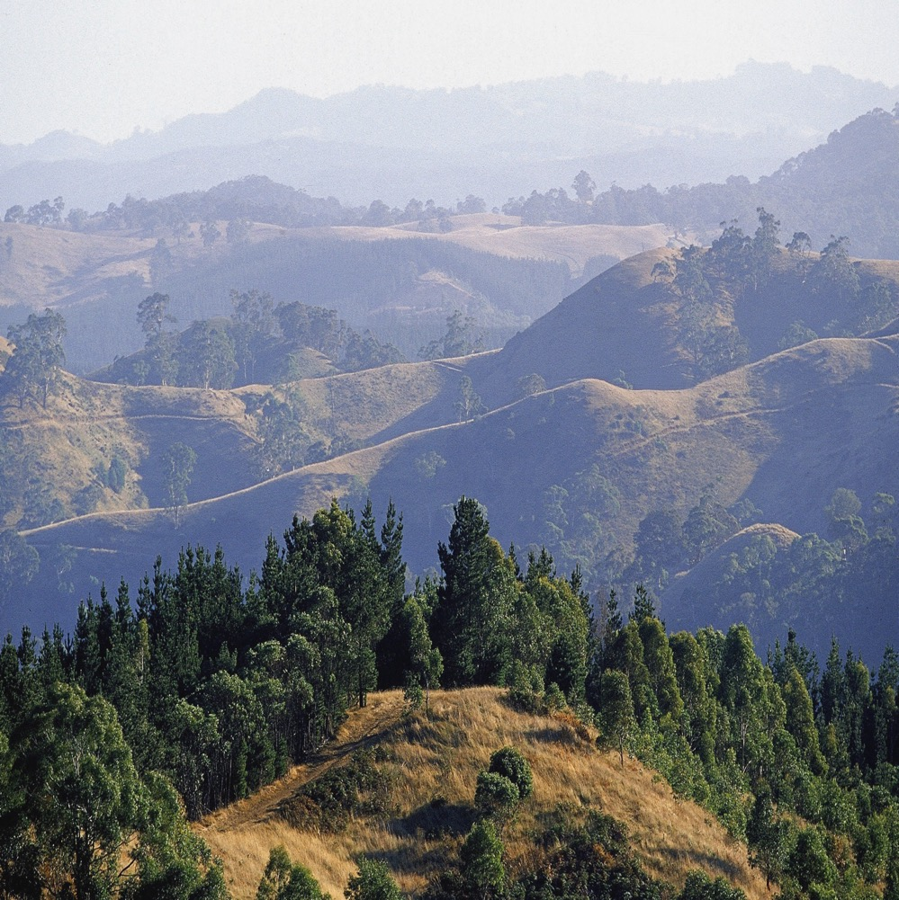
GEOGRAPHY, CLIMATE AND SOIL
Long, narrow region less than a 30-minute drive east of Adelaide
One of South Australia’s coolest‑climate wine regions
Diverse topography creates mesoclimates and microclimates
Two subregions: Lenswood and Piccadilly Valley

Slide 10

CLIMATE
ALTITUDE
MODERATE MARITIME
VERY HIGH
1000m +
(>3,280ft +)
WITH COOL-CLIMATE CHARACTERISTICS
ADELAIDE HILLS
230–650M (755–2,133FT)
HIGH
750–999m
(2,460–3,279ft)
MEDIUM
500–749m
(1,640–2,459ft)
LOW
0–499m
(0–1,639ft)

Slide 11
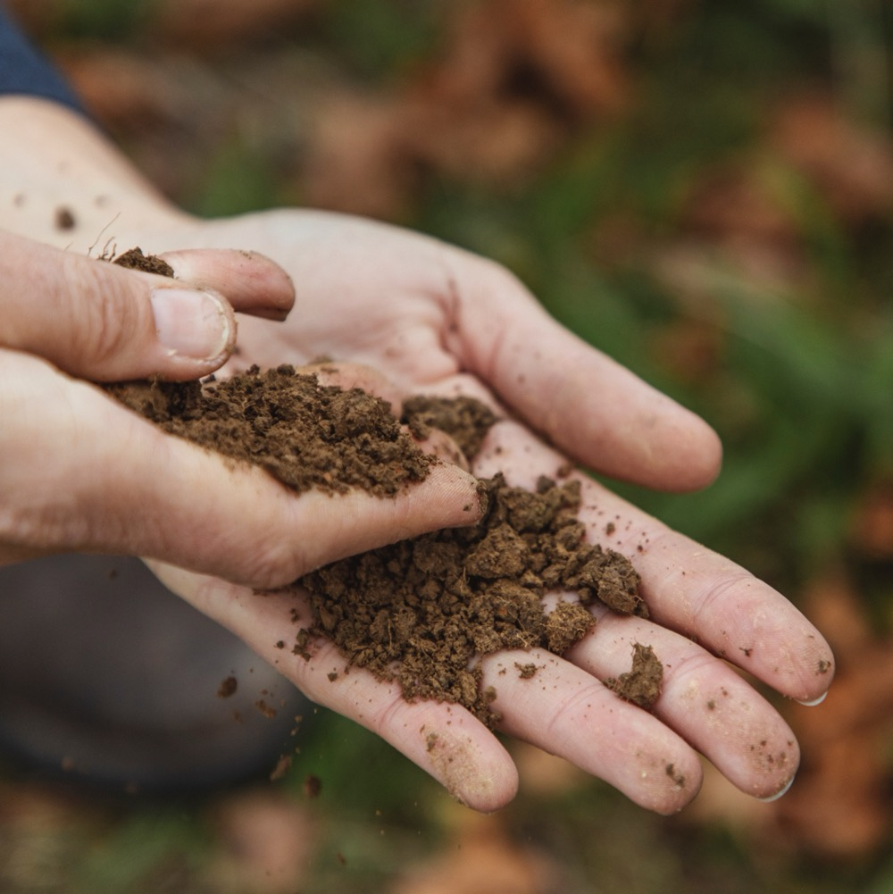
SOIL
Soils vary across the region. Low-lying areas with heavy soils provide potential for greater vigour, while higher, well‑drained stony soils allow vigour control.

Slide 12
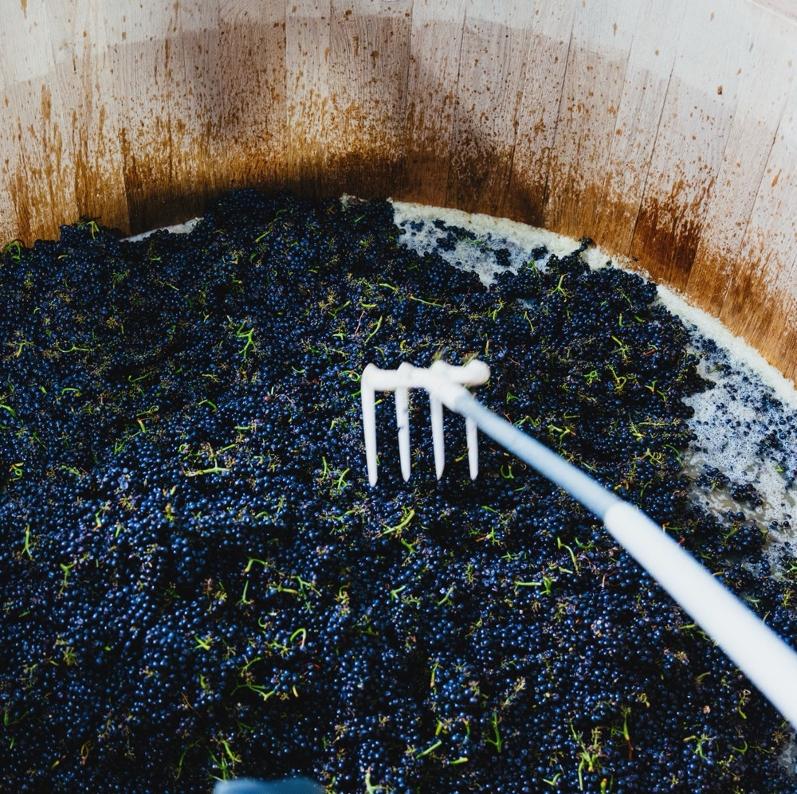
VITICULTURE AND WINEMAKING
IN PURSUIT OF PERFECTION

Slide 13
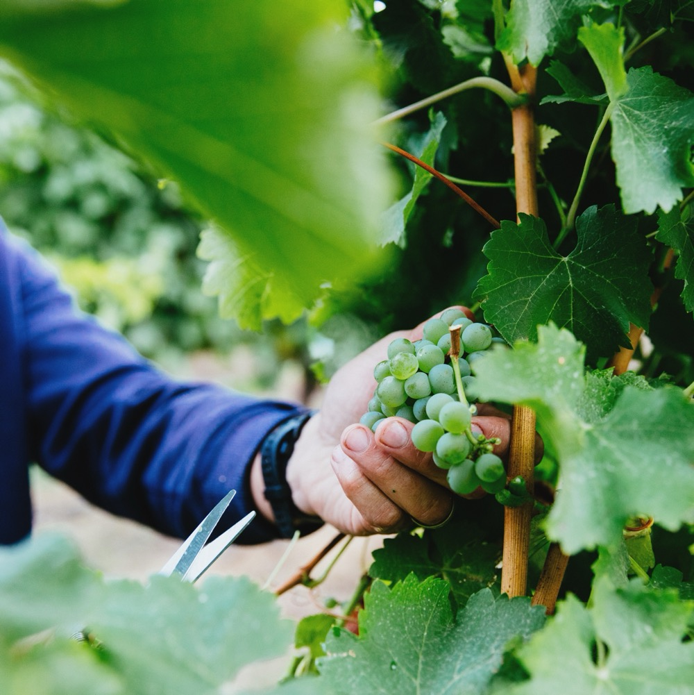
GRAPE GROWING
Topography and cool climate allow for production of premium fruit
Mix of large and small vineyards
Many vineyards worked by hand, as slopes make mechanisation difficult
Harvest: Early February to early April

Slide 14
WINEMAKING
MIX OF TRADITIONAL AND ALTERNATIVE TECHNIQUES
MINIMAL INTERVENTION
WILD FERMENTATION
WHOLE BUNCH FERMENTATION

Slide 15
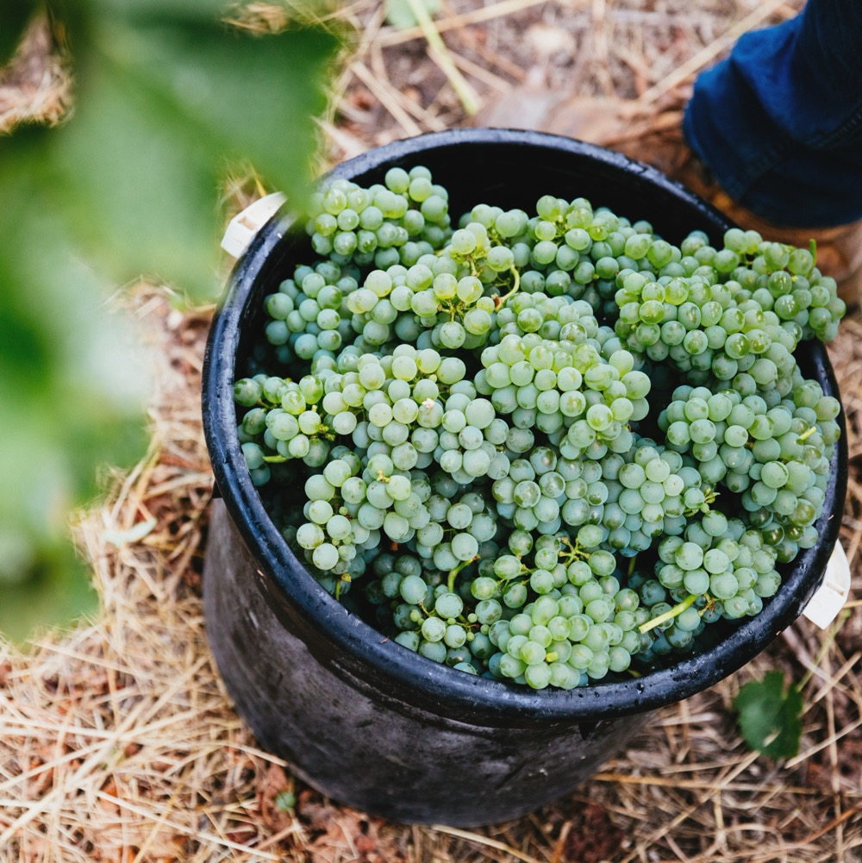
TASTE OF
ADELAIDE HILLS
NOTEWORTHY
VARIETIES

Slide 16


ADELAIDE HILLS
TOP 5 VARIETIES
SAUVIGNON
BLANC
CHARDONNAY
PINOT NOIR
PINOT GRIS
/GRIGIO
SHIRAZ
SAUVIGNON BLANC
30%
CHARDONNAY
25%
PINOT NOIR
20%
PINOT GRIS
/GRIGIO
9%
SHIRAZ
5%

Slide 17

ADELAIDE HILLS
SPARKLING
TRADITIONAL METHOD WINES MADE PRIMARILY
WITH PINOT NOIR AND CHARDONNAY
ALTITUDE AND COOL CLIMATE
IDEAL FOR PRODUCING PREMIUM SPARKLING WINE
SPARKLING
RANGLE OF STYLES PRODUCED
Red Apple
Citrus
Toast
Brioche
Grilled Nuts
Grilled Bread

Slide 18
SPARKLING characteristics
COLOUR
Sparkling wine
Light
Medium
Full
BODY
Dry
Medium dry
Sweet
SWEETNESS
SPARKLING
Unoaked/Low
Medium
High
OAK
ACIDITY
8%
12% – 12.5%
17%
ALCOHOL

Slide 19

ADELAIDE HILLS
SAUVIGNON BLANC
THE BENCHMARK SAUVIGNON BLANC IN AUSTRALIA
VIBRANT AND AROMATIC WITH NATURAL ACIDITY
SAUVIGNON BLANC
WELL OVER
1/3
OF ANNUAL
CRUSH
Kiwifruit
Pineapple
Gooseberry
Passionfruit
Herbs

Slide 20
SAUVIGNON BLANC characteristics
COLOUR
Sauvignon Blanc
Light
Medium
Full
BODY
Dry
Medium dry
Sweet
SAUVIGNON BLANC
SWEETNESS
Unoaked/Low
Medium
High
OAK
ACIDITY
8%
12% – 13.5%
17%
ALCOHOL

Slide 21
ADELAIDE HILLS
CHARDONNAY
‘NEW WAVE’ STYLES RIVALLING THE BEST COOL-CLIMATE CHARDONNAYS
MEDIUM-BODIED
ELEGANT WINES
CHARDONNAY
AROUND
1/4
OF ANNUAL
CRUSH
TYPICAL PRIMARY
FLAVOURS
Nectarine
Lemon
Grapefruit
Melon

Slide 22
CHARDONNAY characteristics
COLOUR
Chardonnay
Light
Medium
Full
BODY
Dry
Medium dry
Sweet
SWEETNESS
CHARDONNAY
Low
Medium
High
OAK
ACIDITY
8%
12.5% – 14.5%
17%
ALCOHOL

Slide 23

ADELAIDE HILLS
PINOT NOIR
USED IN BOTH TABLE AND SPARKLING WINES
LEADING REGION IN AUSTRALIA FOR PINOT NOIR
PINOT NOIR
AROUND
1/5
OF ANNUAL
CRUSH
Red berries
Cherry
Strawberry

Slide 24
PINOT NOIR characteristics
COLOUR
Pinot Noir
Light
Medium
Full
BODY
Dry
Medium dry
Sweet
SWEETNESS
Low
Medium
High
OAK
PINOT NOIR
TANNIN
ACIDITY
8%
13% – 14%
17%
ALCOHOL

Slide 25
ADELAIDE HILLS
SHIRAZ
FAST EMERGING AS HIGHLY ACCLAIMED STYLE
MEDIUM-BODIED SPICY AND ELEGANT STYLE
IN CONTRAST TO BOLD REDS FROM WARMER CLIMATES
SHIRAZ
TYPICAL FLAVOURS
Dark cherry
Plum
Pepper
Spice
Dark berries

Slide 26
SHIRAZ characteristics
COLOUR
Shiraz
Light
Medium
Full
BODY
Dry
Medium dry
Sweet
SWEETNESS
Low
Medium
High
SHIRAZ
OAK
TANNIN
ACIDITY
8%
17%
13% – 14%
ALCOHOL

Slide 27
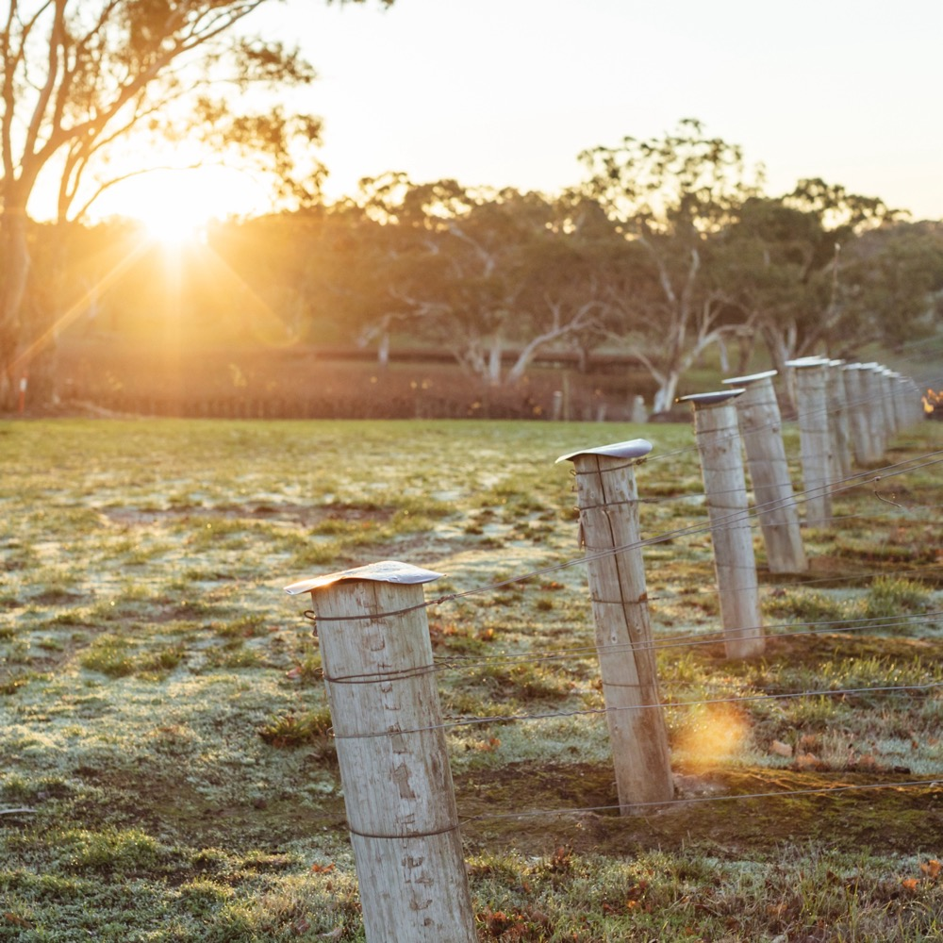
THE PEAK OF
COOL
CLIMATE WINE
A premium wine region at the
forefront of Australian cool-climate wine. Excitement, elegance,
elevation: the only way is up.

Slide 28
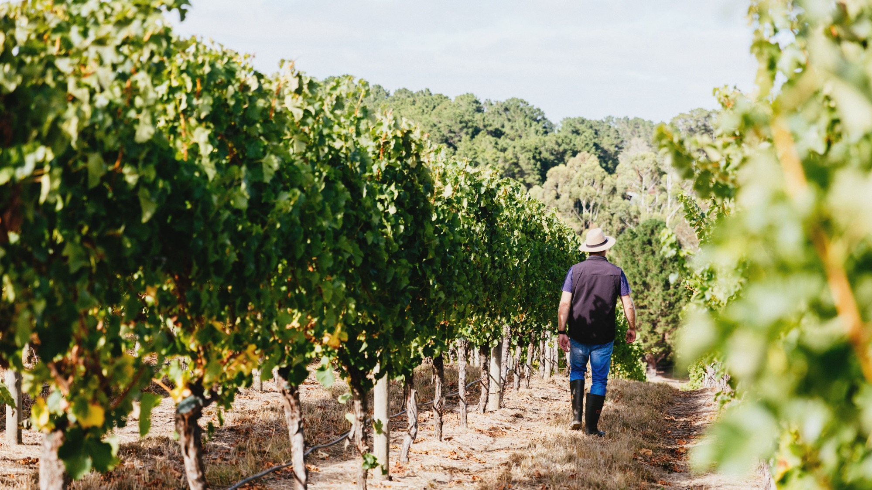
THANK YOU

