Slide 1
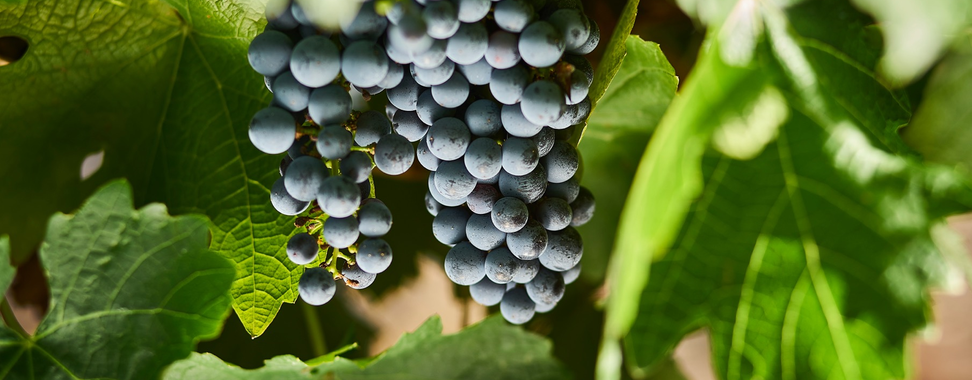
CABERNET SAUVIGNON
AND BLENDS

Slide 2


Crafted from grapes grown under vast and diverse climates, across landscapes millions of years in the making, every glass of Australian wine tells a story.
Like those who came before us, our modern growers and makers continue to be passionate, resilient and creative; constantly driven to explore new ways to perfect old techniques. Our community is connected by a mutual respect and shared love of crafting exceptional wine, while protecting the natural wonders for future generations to enjoy. Applying modern thinking to our ancient lands, we take playful experimentation very, very seriously.
So, if you’re looking for the taste of adventure, let Australian wine be your compass. Because in every bottle of Australian wine, you’ll experience the wonders of Australia – a reminder of the adventure and diversity that defines our culture and our land.

Slide 3
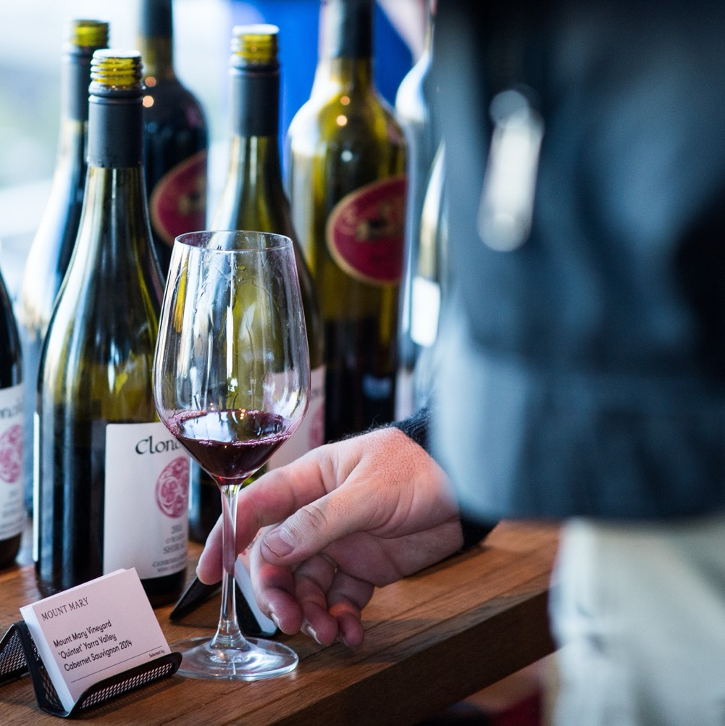
CABERNET SAUVIGNON
A TRUE AUSTRALIAN CLASSIC
Beauty is so much more than skin-deep with Cabernet Sauvignon, despite this deeply coloured black grape variety being so striking. Under the surface, Cabernet Sauvignon boasts lots of tannin, bright acidity and easily recognisable aromas.

Slide 4
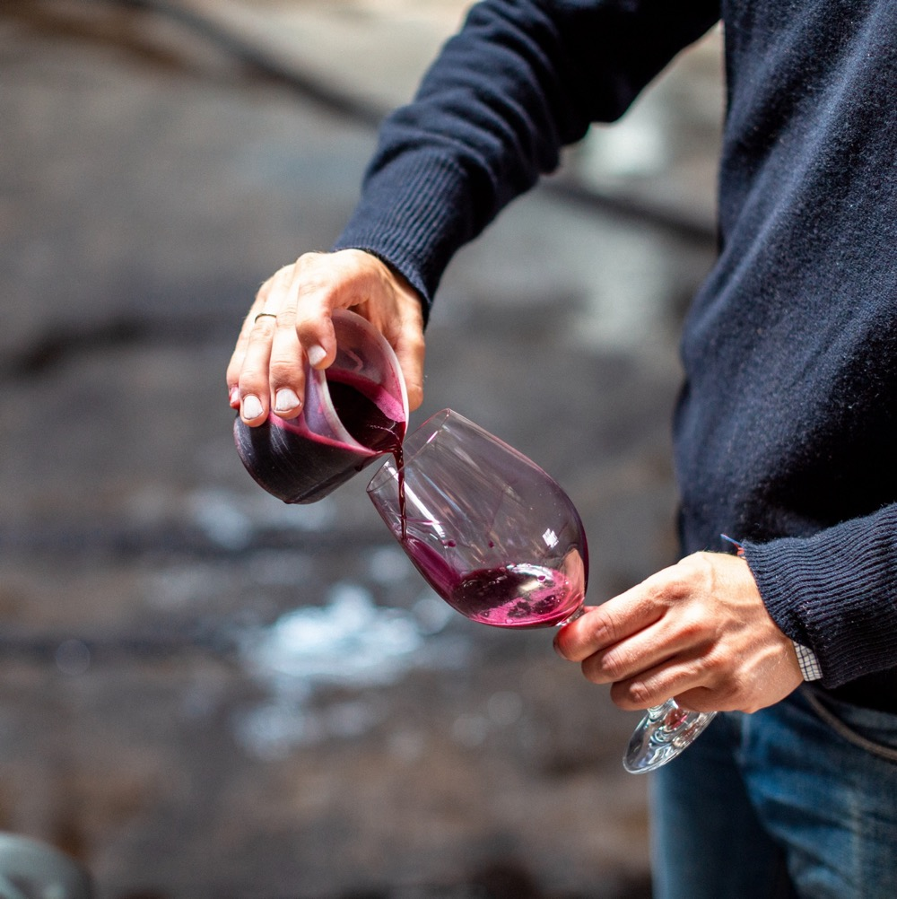
TODAY WE’LL COVER
The history of Cabernet Sauvignon
How it’s grown
Techniques influencing style
Blending
Where it’s grown
Characteristics and flavour profiles

Slide 5
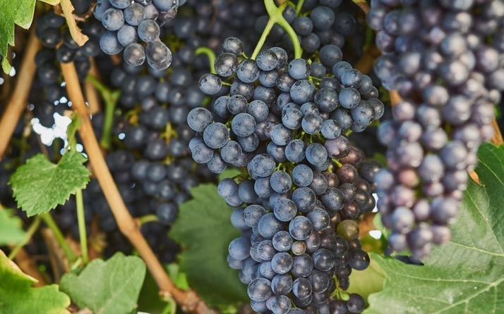
1832
THE HISTORY OF CABERNET SAUVIGNON IN AUSTRALIA
1888
What are believed to
be the world’s oldest productive Cabernet Sauvignon vines are planted at Penfolds Block 42 Kalimna.
1966
Cabernet Sauvignon arrives on Australian shores in the collection imported by wine pioneer James Busby.
Cabernet Sauvignon accounts for only 620 tonnes of the grapes crushed in Australia.

Slide 6
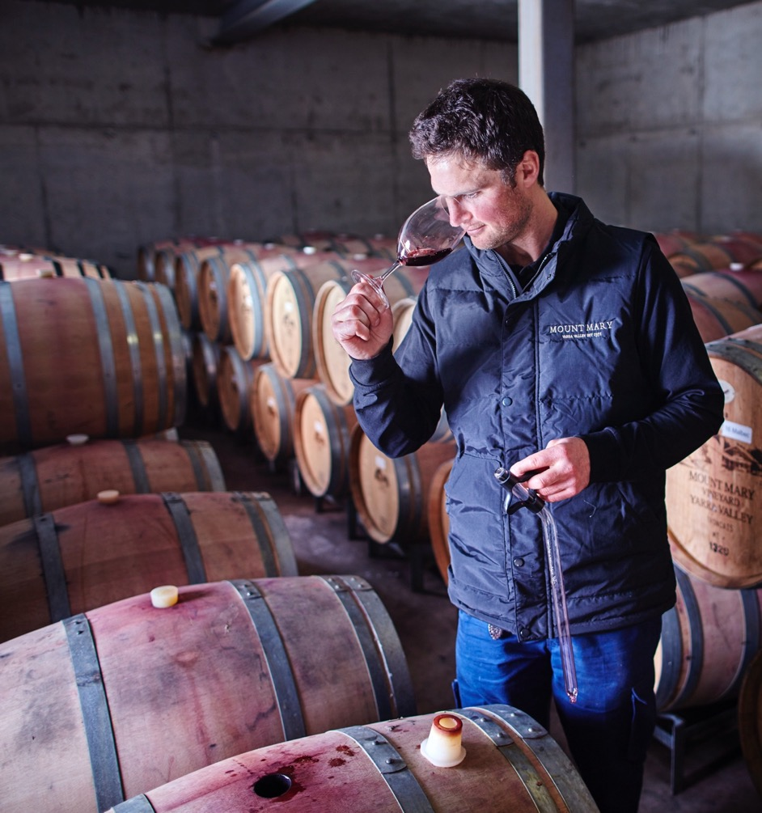
TODAY
Winemakers across Australia respect and honour the variety’s rich history while striving to make the best possible wines, crafting delicious Cabernet Sauvignons that reflect a sense of place.
2016
50 years later, through innovation and craftsmanship – and to meet demand for the popularity of this special style
– Australia crushes 255,000 tonnes of Cabernet Sauvignon.

Slide 7

VITICULTURE
HOW CABERNET SAUVIGNON IS GROWN
Site selection
Cabernet Sauvignon thrives in warm to cool, dry regions with a maritime influence. A site with plenty of sunshine and the right soil type are key.
Yield
Though Cabernet Sauvignon vines can yield a lot of fruit, overcropping is a risk.

Slide 8
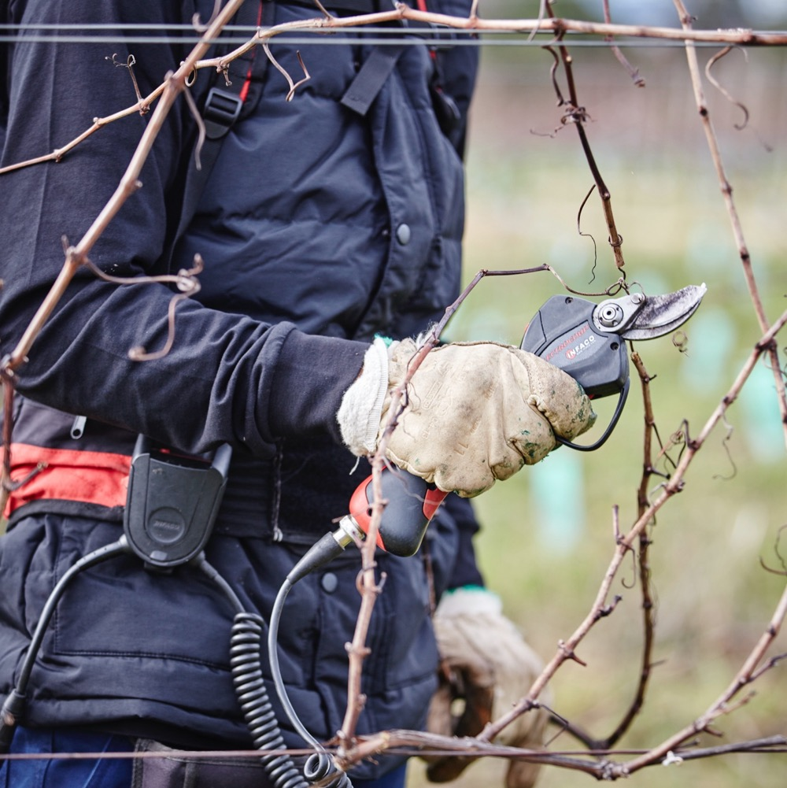
The vine
Cabernet Sauvignon vines are hardy and can produce vigorous yields.
Small to medium clusters with medium-long peduncles (stalks)
Small, round blue-black grapes
Thick skins
Medium-sized leaves
Irrigation
Viticulturists may irrigate Cabernet Sauvignon vines to introduce water during periods of inadequate rainfall and to help produce sufficient yields.

Slide 9
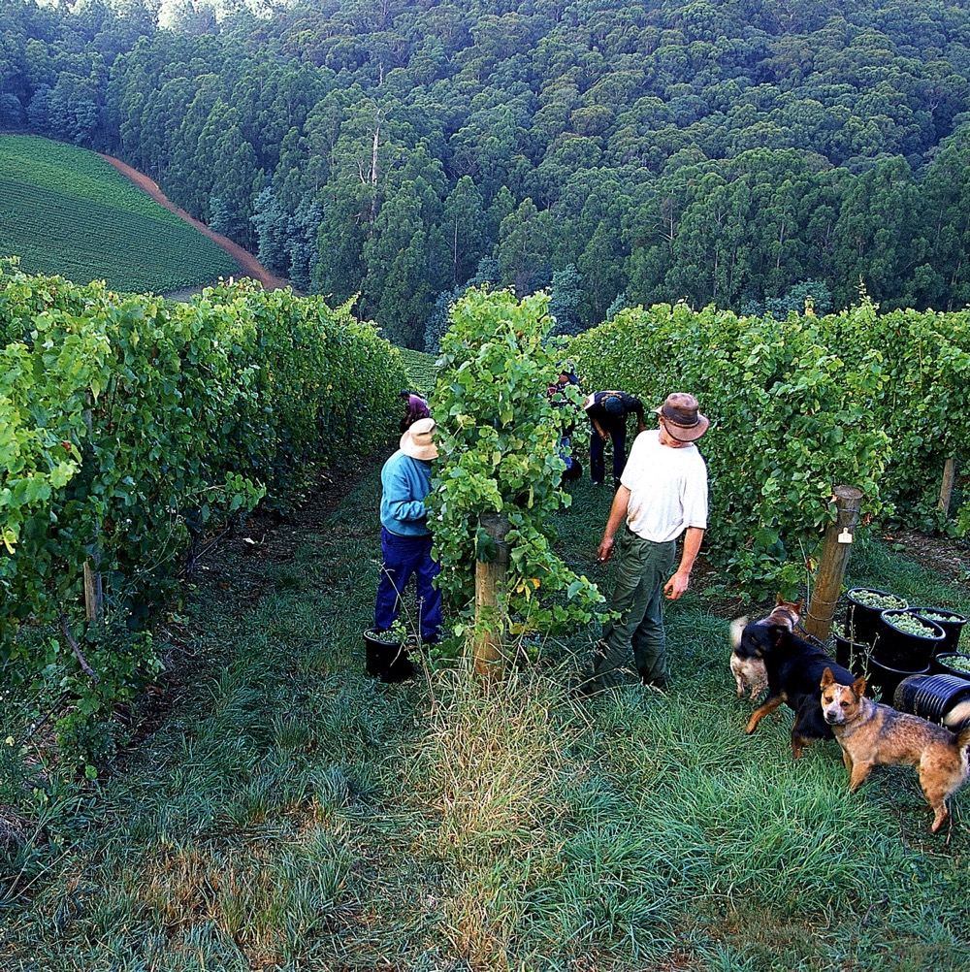
Harvest
As a late-ripening variety, Cabernet Sauvignon harvesting typically starts later in the season.
Pruning
Especially important to control excessive growth. A variety of canopy management techniques can be used to ensure the canopy is balanced and the fruit zone is appropriately shaded, avoiding sunburn and excessive ripeness.

Slide 10
WINEMAKING:
TECHNIQUES INFLUENCING CABERNET SAUVIGNON STYLE
GRAPES TYPICALLY DE-STEMMED
FERMENTATION
MACERATION
OAK MATURATION
BOTTLING AND AGEING

Slide 11

CABERNET SAUVIGNON
AND BLENDING
CABERNET
SAUVIGNON
CABERNET
FRANC
MERLOT
MALBEC
PETIT VERDOT
SHIRAZ
CABERNET SAUVIGNON
Lends firm structure, plentiful tannins, ‘doughnut’ (hollow mid-palate)
CABERNET FRANC
Brings aromatic lift, spice, red berry
and pepper characteristics
MERLOT
Adds fleshiness, richness to the
middle palate, smoothness, characters of
violet and plum
SHIRAZ
Brings upfront fruit
on the mid-palate, softness
MALBEC
Typically brings
weight to the
palate, dusty tannins, dark-fruit flavours
and deep colour
PETIT VERDOT
Adds fragrance,
rich, dark-fruit
flavours and colour

Slide 12
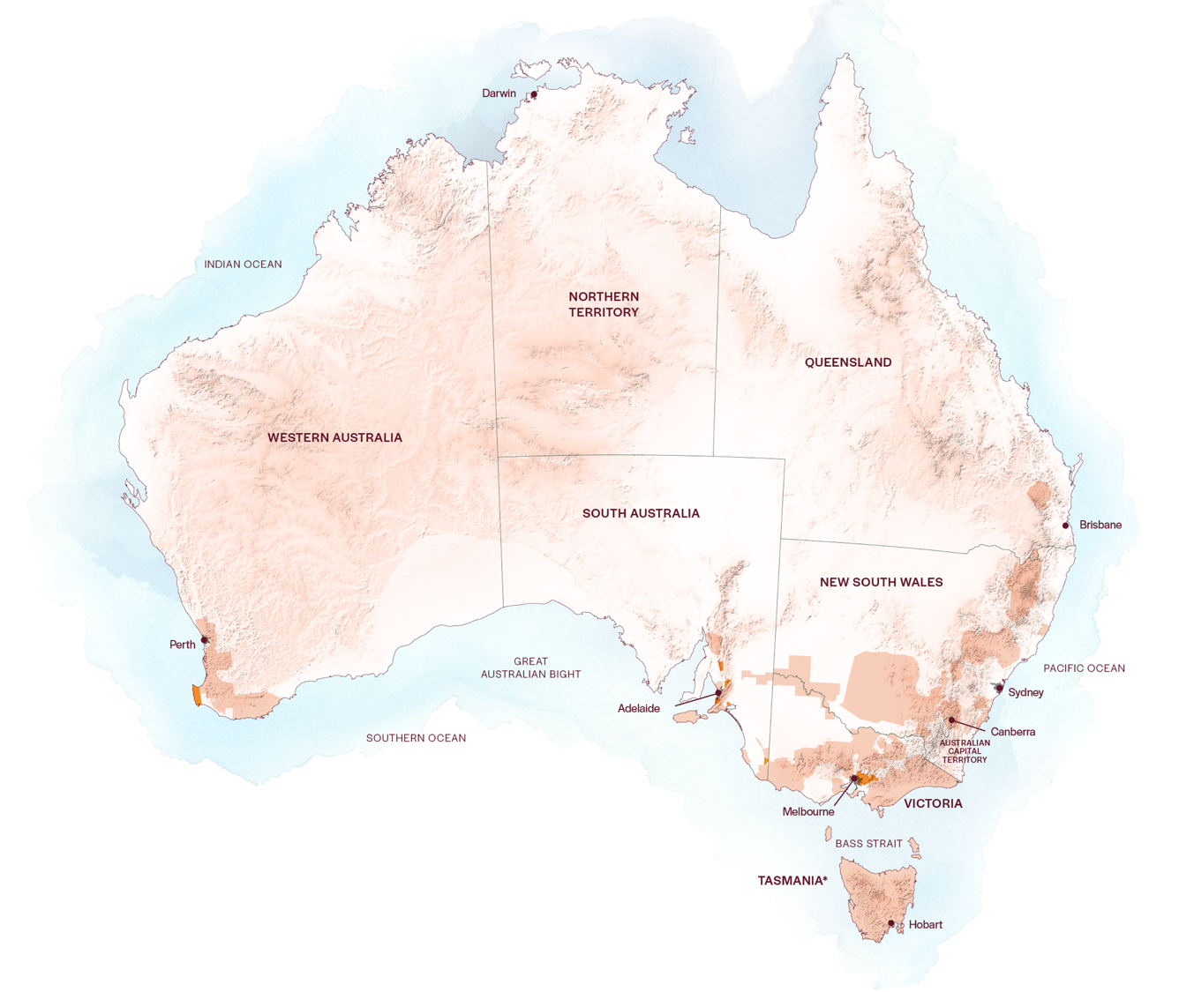
AUSTRALIAN
CABERNET
SAUVIGNON
REGIONS
CLARE VALLEY
MARGARET RIVER
BAROSSA VALLEY
McLAREN VALE
LANGHORNE CREEK
COONAWARRA
YARRA VALLEY

Slide 13
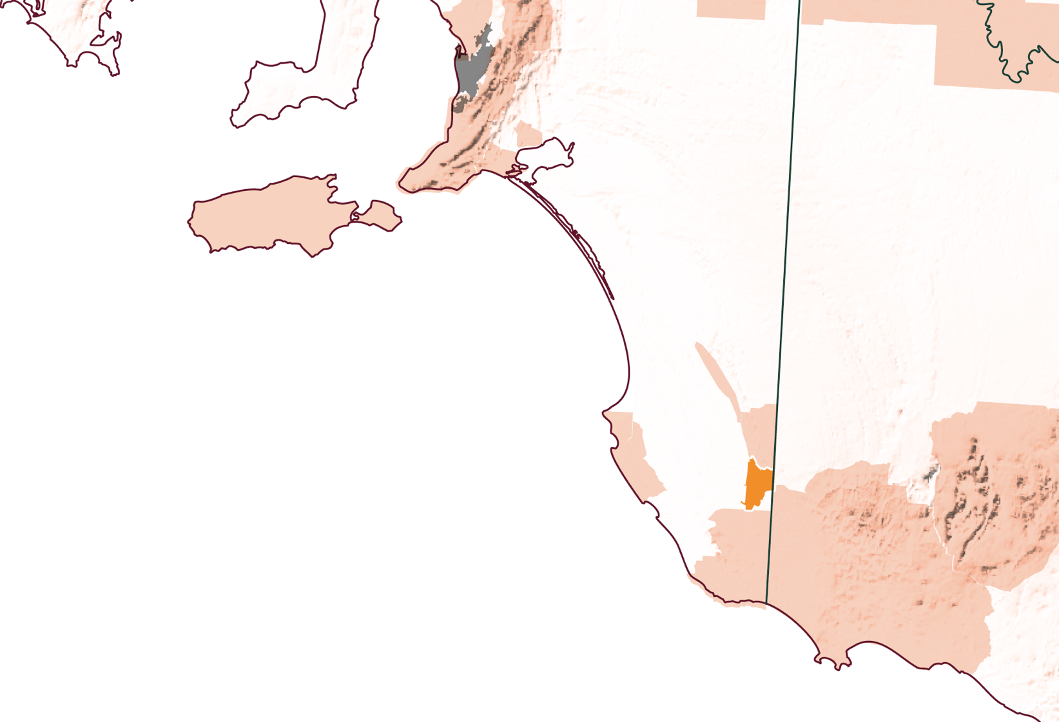
SOUTH
AUSTRALIA
COONAWARRA

Slide 14
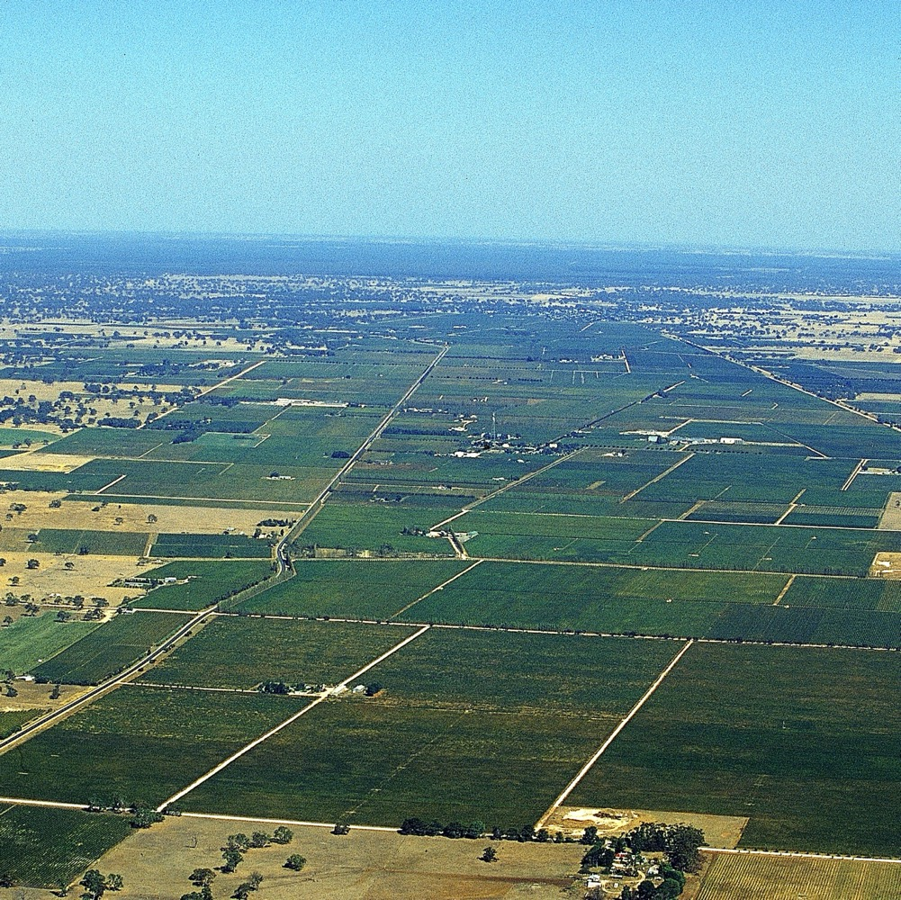
COONAWARRA
Maritime influence
Australia’s famous terra rossa soil
Strong winemaking heritage
Cabernet Sauvignon is king
A tradition of blending

Slide 15
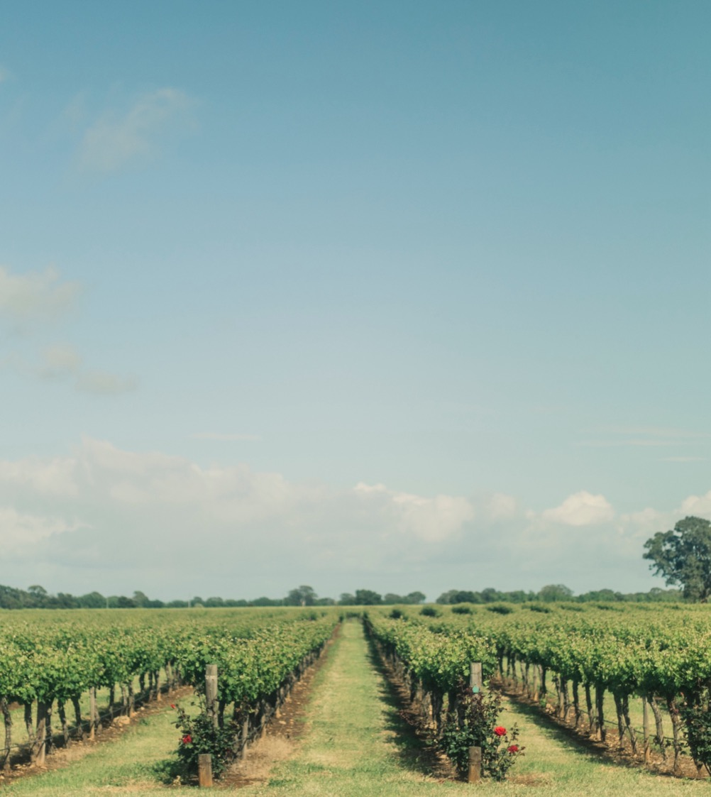
CLIMATE
ALTITUDE
MARITIME
VERY HIGH
1000m +
(>3,280ft +)
INFLUENCED WITH COOLING EFFECTS OF SOUTHERN OCEAN
HIGH
750–999m
(2,460–3,279ft)
COONAWARRA
50–110M (164–361FT)
MEDIUM
500–749m
(1,640–2,459ft)
LOW
0–499m
(0–1,639ft)

Slide 16
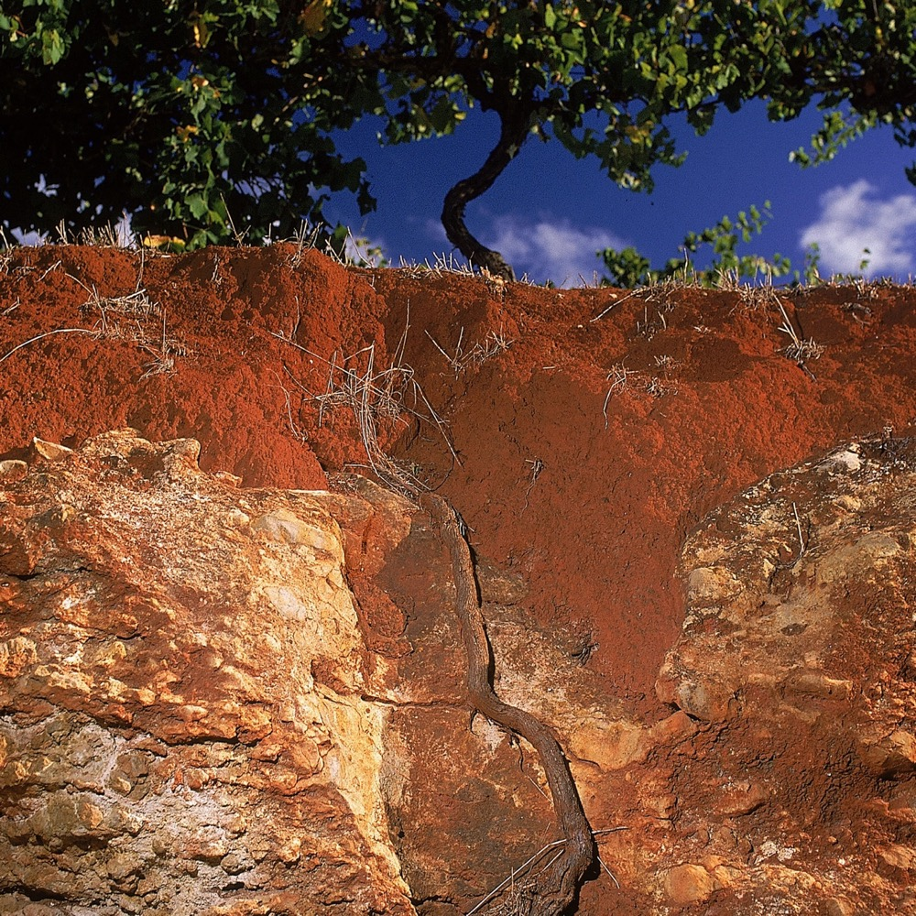
SOIL
Cabernet Sauvignon has seen great success from grape vines planted in Coonawarra’s famed terra rossa soil – thin, iron-oxide-based topsoil over limestone.

Slide 17
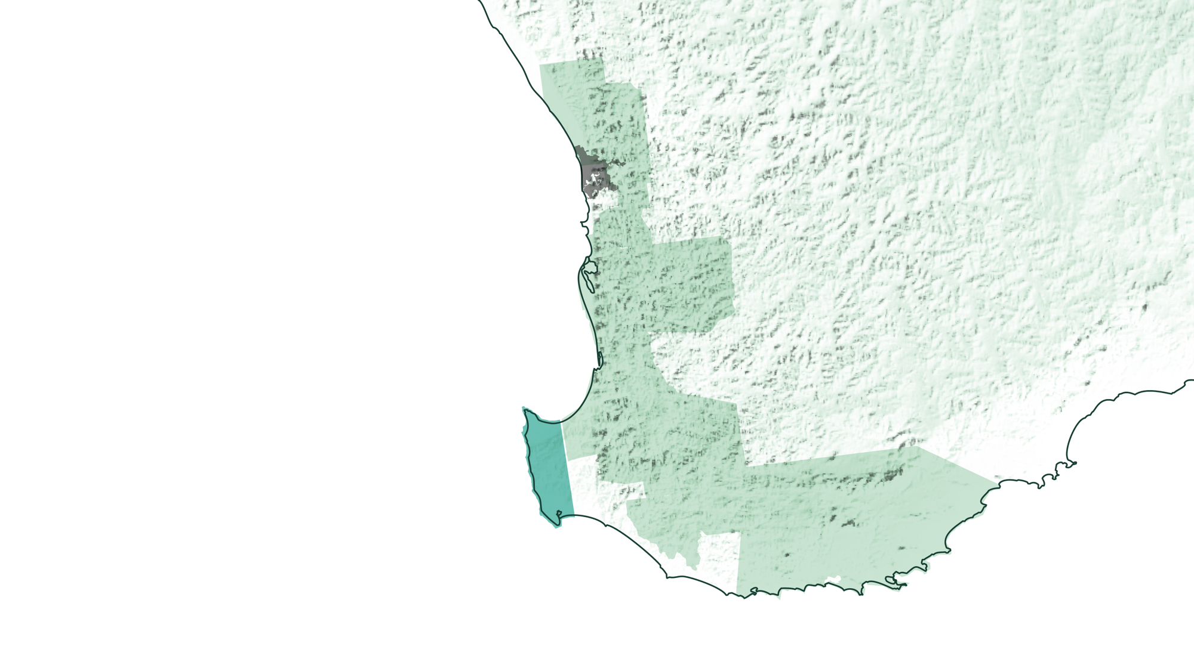
WESTERN
AUSTRALIA
MARGARET RIVER

Slide 18
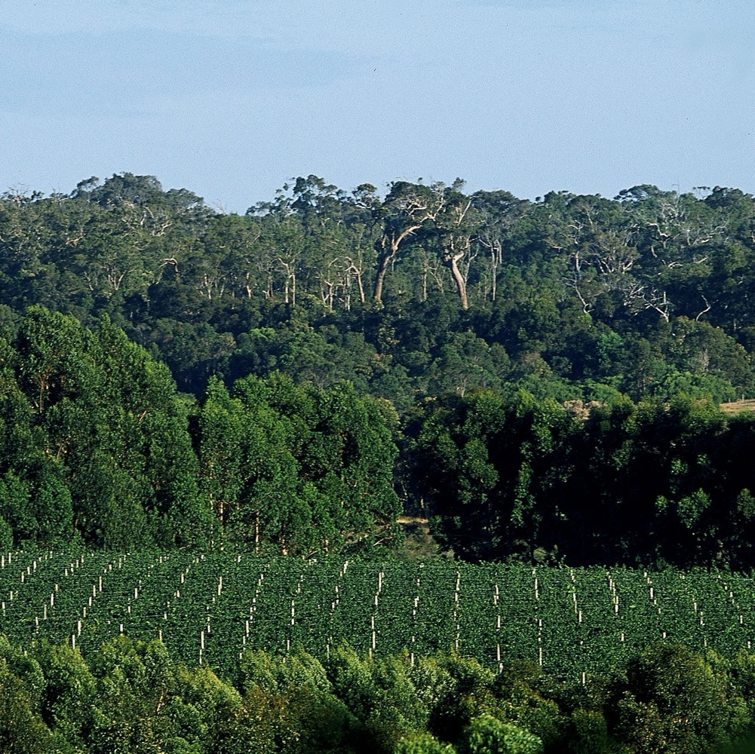
MARGARET RIVER
Gourmet paradise
Cabernet Sauvignon is the region’s hero wine
Stand-out blends
Innovative, experimental outlook

Slide 19

MEDITERRANEAN
ALTITUDE
CLIMATE
VERY HIGH
1000m +
(>3,280ft +)
STRONG MARITIME INFLUENCES WITH OCEANS ON THREE SIDES
HIGH
750–999m
(2,460–3,279ft)
MARGARET RIVER
0–231M (0–757FT)
MEDIUM
500–749m
(1,640–2,459ft)
LOW
0–499m
(0–1,639ft)

Slide 20
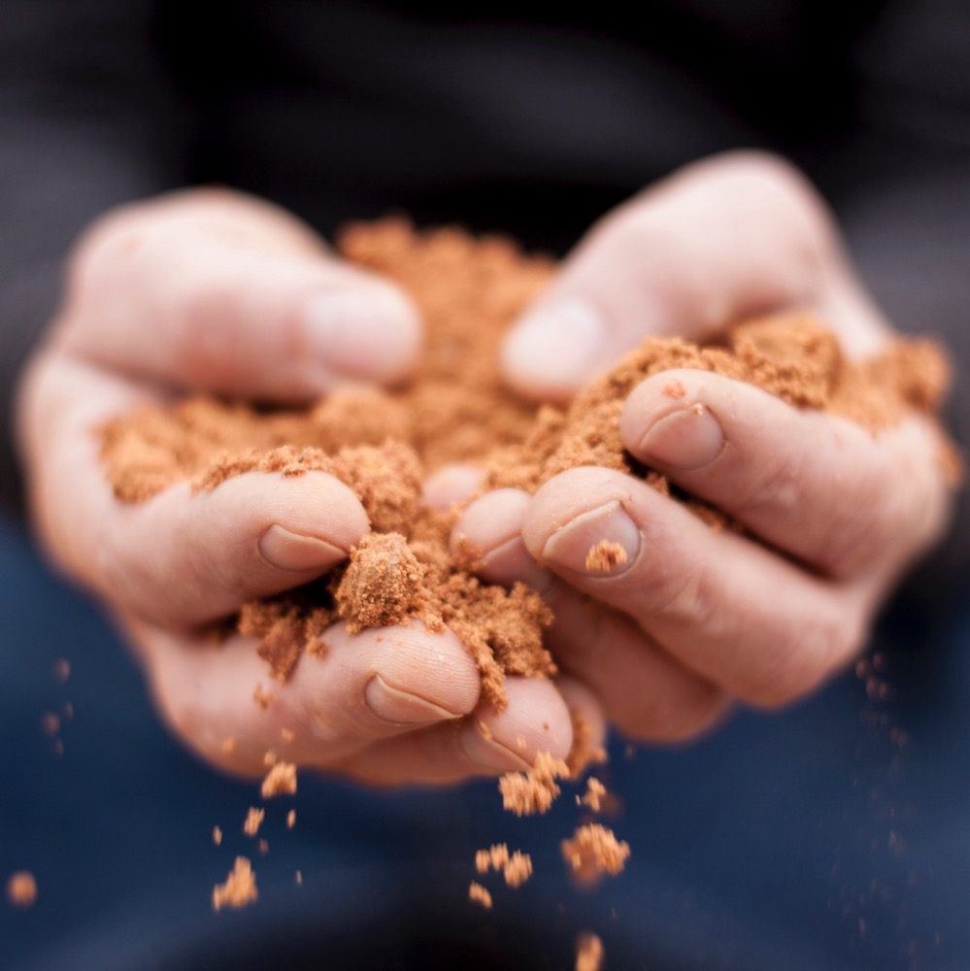
SOIL
Margaret River soils are predominantly gravelly loam on granite and gneiss, with low overall water-holding capacity.

Slide 21

VICTORIA
YARRA VALLEY

Slide 22

YARRA VALLEY
Victoria’s first major wine-growing district
Cool-climate style
Food and wine paradise and popular tourist destination

Slide 23

CLIMATE
ALTITUDE
VERY HIGH
1000m +
(>3,280ft +)
CONTINENTAL
WITH MEDITERRANEAN INFLUENCES
HIGH
750–999m
(2,460–3,279ft)
YARRA VALLEY
30–400M (98–1,312FT)
MEDIUM
500–749m
(1,640–2,459ft)
LOW
0–499m
(0–1,639ft)

Slide 24

SOIL
The Yarra Valley’s northern side feature soils of grey to grey-brown on the surface, and range from loamy sand to clay loam in consistency with red-brown clay subsoils, often filled with rock. The other major soil type is the immensely deep and fertile red volcanic soil on the southern side of the valley.

Slide 25
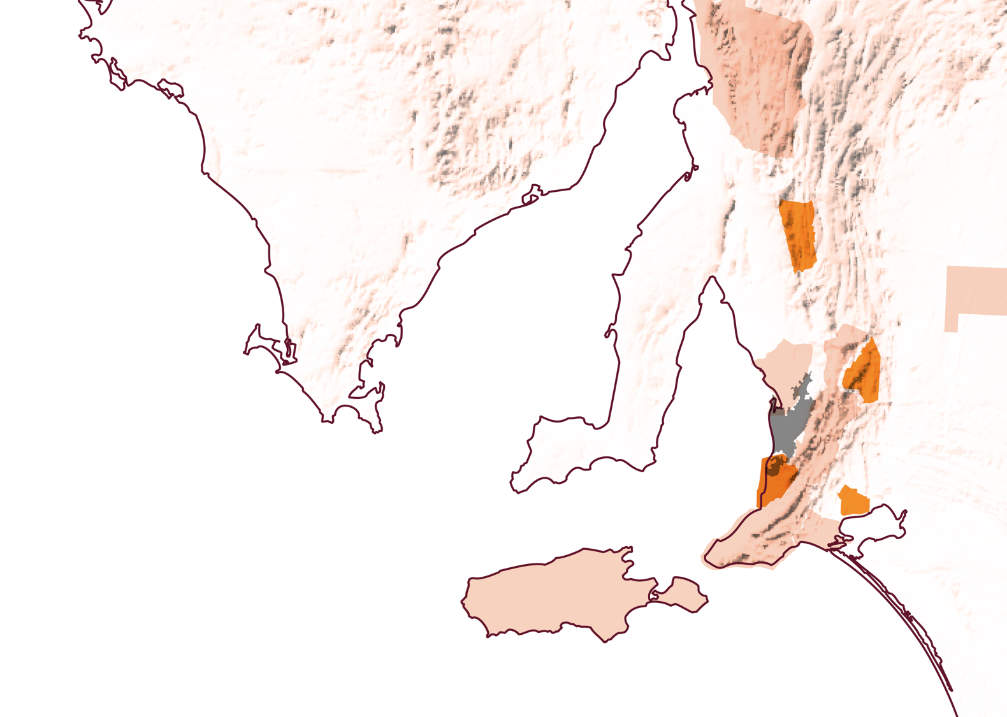
BEST OF
THE REST
CLARE VALLEY
EDEN VALLEY
McLAREN VALE
LANGHORNE CREEK

Slide 26

CABERNET SAUVIGNON
CHARACTERISTICS AND FLAVOUR PROFILES
OAK FLAVOURS
WITH NOTES OF TOAST OR VANILLA
COLOUR
Cabernet Sauvignon
Light
Medium
Full
BODY
Dry
Medium dry
Sweet
SWEETNESS
CABERNET SAUVIGNON
Low
Medium
High
TANNIN
FLAVOURS
Blackcurrant
Black cherry
Mint
Eucalyptus
Capsicum (bell pepper)
Cassis
ACIDITY
8%
13.5% – 15.5%
17%
ALCOHOL

Slide 27

FOOD PAIRINGS
FATTY MEATS
SUCH AS LAMB CHOPS
BEEF CUTS
SUCH AS RIBS AND SCOTCH FILLET
CABERNET
SAUVIGNON
BEEF STEW
DUCK BREAST

Slide 28

CABERNET SAUVIGNON
AUSTRALIA’S COMPLEX GEM

Slide 29
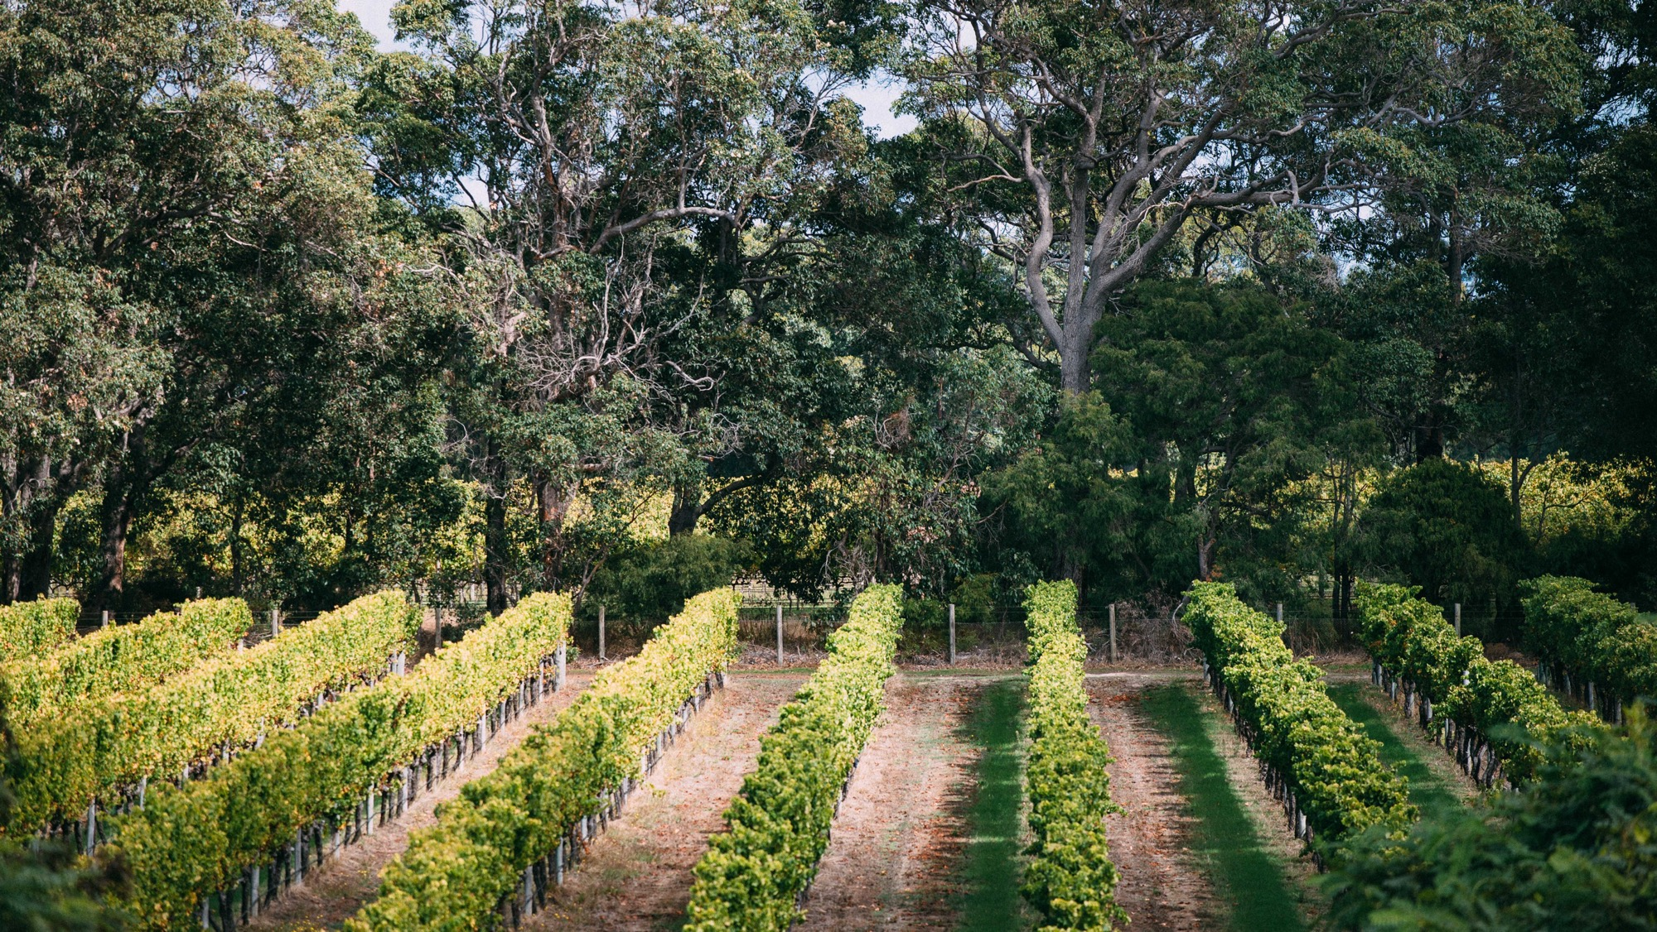
THANK YOU

