Slide 1
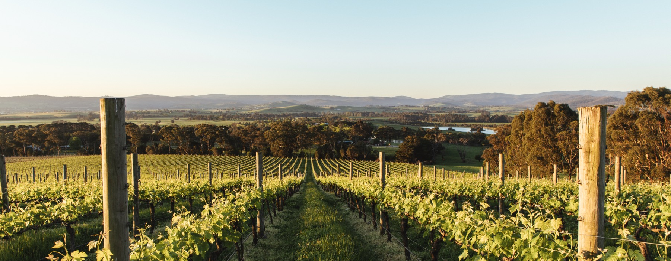
YARRA VALLEY

Slide 2


Crafted from grapes grown under vast and diverse climates, across landscapes millions of years in the making, every glass of Australian wine tells a story.
Like those who came before us, our modern growers and makers continue to be passionate, resilient and creative; constantly driven to explore new ways to perfect old techniques. Our community is connected by a mutual respect and shared love of crafting exceptional wine, while protecting the natural wonders for future generations to enjoy. Applying modern thinking to our ancient lands, we take playful experimentation very, very seriously.
So, if you’re looking for the taste of adventure, let Australian wine be your compass. Because in every bottle of Australian wine, you’ll experience the wonders of Australia – a reminder of the adventure and diversity that defines our culture and our land.

Slide 3
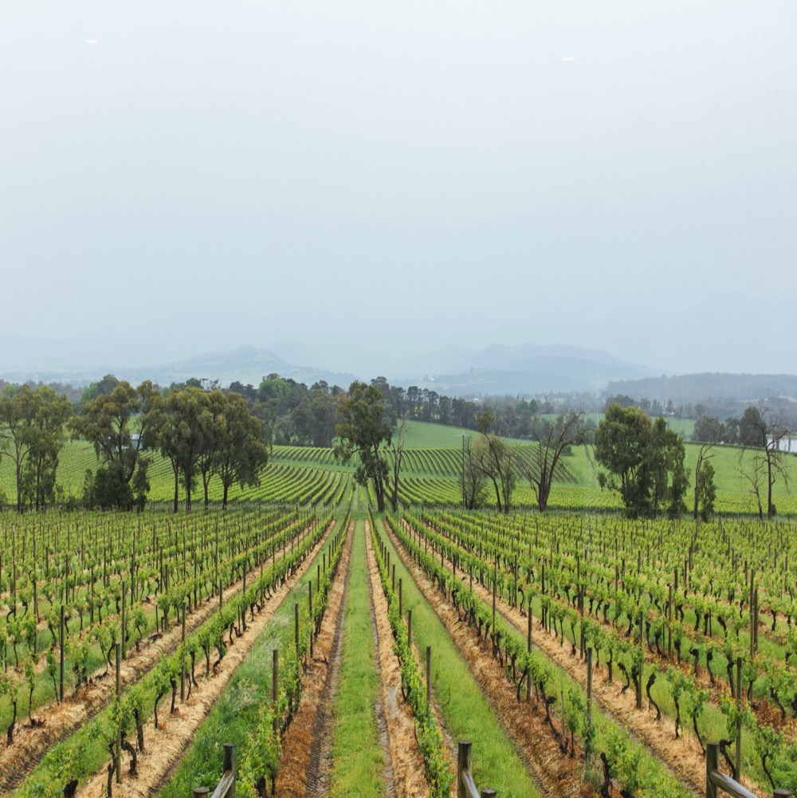
YARRA VALLEY
THE TALE
OF TWO BEGINNINGS
The Yarra Valley is a cool-climate region capable of making classic styles from a wide range of varieties. Its history is extensive, but it wasn’t until the 1970s that it really started to shine.
Colourful history
Cool-climate diversity
Innovative growers and winemakers
Natural beauty and tourism

Slide 4
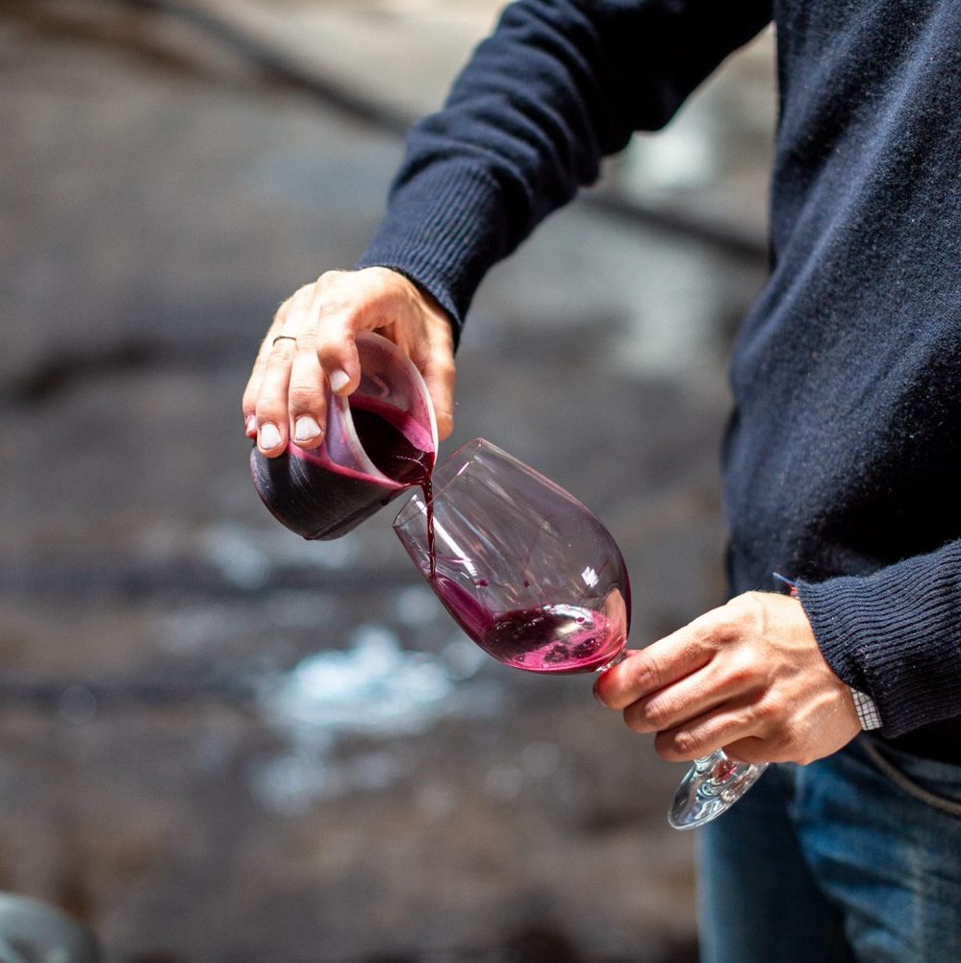
TODAY WE’LL COVER
The history of the Yarra Valley
Geography, climate and soil
The region’s approach to grape growing
Winemaking trends
Prominent varieties
Characteristics and flavour profiles

Slide 5

AUSTRALIA
YARRA VALLEY

Slide 6

VICTORIA
Melbourne
YARRA VALLEY

Slide 7
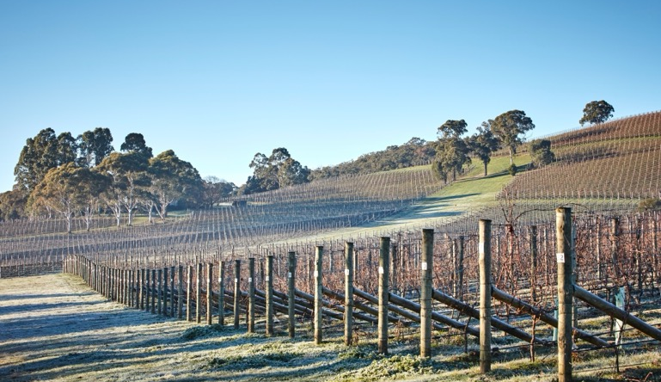
1838
THE HISTORY OF YARRA VALLEY
180 YEARS OF WINE HERITAGE AND EVOLUTION
1849
1863
Scottish-born Ryrie brothers plant first vines in the Yarra Valley, starting Victoria’s first major wine-growing district.
The first Lieutenant-Governor of Victoria invites a number of Swiss vignerons to the region and kickstarts a rich wine culture.
Paul de Castella purchases the Ryrie’s property and – after drinking his cellar dry – starts making local wine.
Hubert de Castella and Baron Guillaume de Pury join their friends in the Yarra Valley. They establish the three great wineries: Yering, Yeringberg and St Huberts.

Slide 8
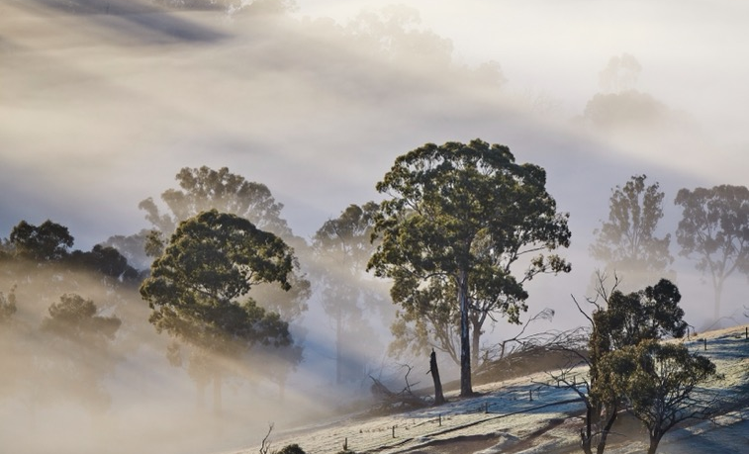
1877 – 1937
The first golden age of the Yarra Valley is short-lived. A series of events, including an economic depression, leads to the decline of the region. Increased demand for fortified wine sees wine production cease in 1921 and all vineyards are converted to pasture by 1937.
1973
Dr Bailey Carrodus makes the first commercial Yarra Valley vintage in 50 years. His innovative style paves the way for future cool-climate winemakers.
1875
1960s
St Huberts, covering 200 acres, produces over half a million bottles of wine. Yarra Valley wines start winning local and international awards.
Vines – and winemakers – return to the Yarra Valley and a staple of new-generation wines are established.

Slide 9
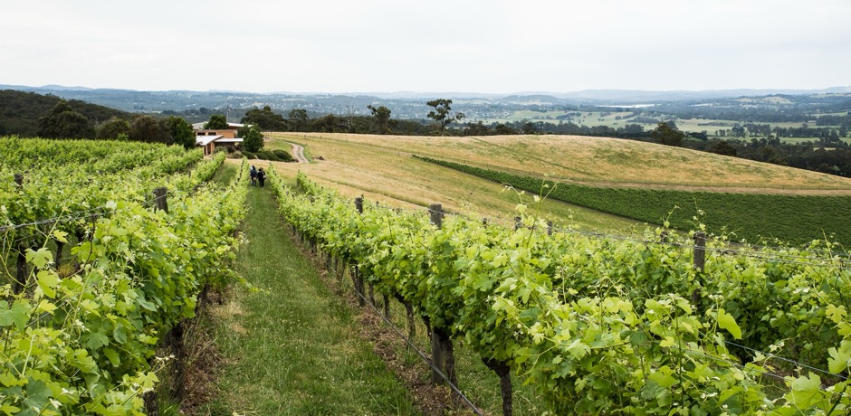
1990s & 2000s
New wineries continue to open as the Australian wine industry booms. Local winemakers buck the trend for big, intense styles of wine, instead embracing the region’s cool climate and creating an exciting culture of experimentation.
1980 – 1985
Today
The momentum of this resurgence paves the way for a list of new wineries, firmly establishing the Yarra Valley as a serious wine region.
This premier cool-climate region is a hotbed of creativity. Winemakers are reducing the amount of intervention in the winery while spending more time in the vineyard.

Slide 10
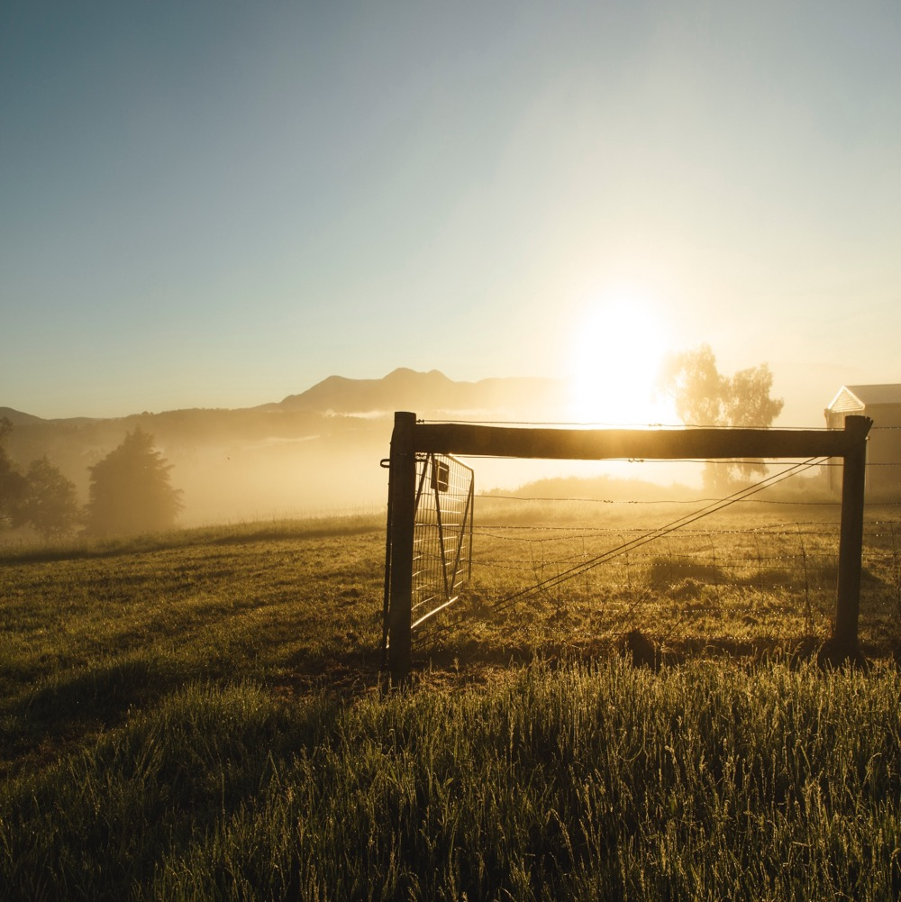
A COOL, MISTY VALLEY
WITH DIVERSE OFFERINGS
Only 45km northeast of Melbourne
Divided into the Lower Yarra and Upper Yarra
Bordered by mountain ranges
Diverse geography, climatic differences and soil types allow several varieties to excel

Slide 11

CLIMATE
ALTITUDE
CONTINENTAL
VERY HIGH
1000m +
(>3,280ft +)
WITH MEDITERANEAN INFLUENCES
HIGH
750–999m
(2,460–3,279ft)
YARRA VALLEY
30–400M (98–1,312FT)
MEDIUM
500–749m
(1,640–2,459ft)
LOW
0–499m
(0–1,639ft)

Slide 12

SOIL
Two prominent and radically different soil types create regional diversity and interest:
Northern side features soils of grey to grey-brown on the surface, with red-brown clay subsoils often filled with rock.
Southern side features much younger, immensely deep, fertile red volcanic soil.

Slide 13
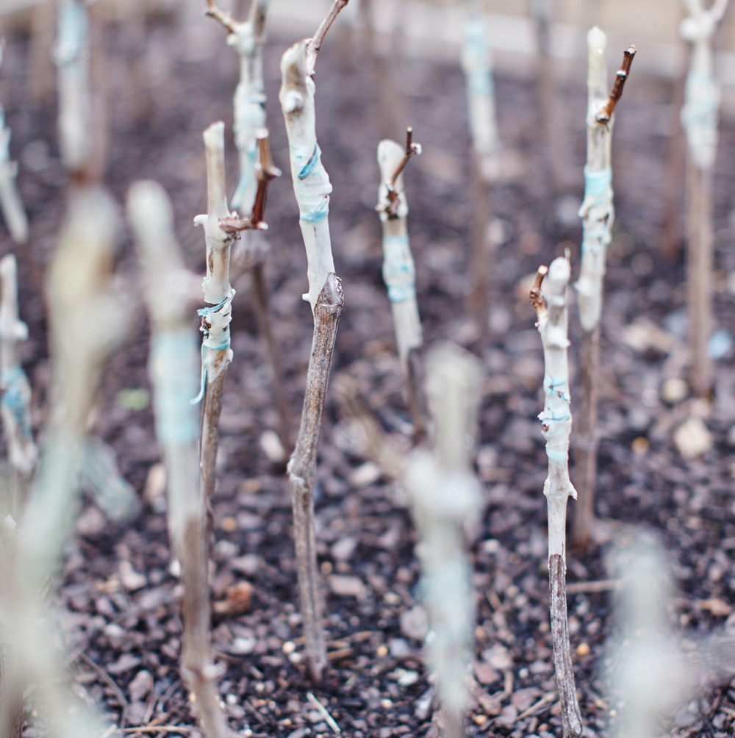
VITICULTURE AND WINEMAKING IN
YARRA VALLEY
A passionate past and progressive future
Respect for diverse climatic influences
Commitment to innovation and experimentation
More time in the vineyard, less intervention in the winery
Cool-climate classics alongside alternative varieties

Slide 14


YARRA VALLEY
TOP 5 VARIETIES
PINOT NOIR
CABERNET
SAUVIGNON
PINOT GRIS/
GRIGIO
CHARDONNAY
SHIRAZ
PINOT NOIR
36%
CHARDONNAY
33%
SHIRAZ
8%
CABERNET
SAUVIGNON
6%
PINOT GRIS
/GRIGIO
5%

Slide 15

YARRA VALLEY
CHARDONNAY
FINE, TEXTURAL AND RESTRAINED
GROWN ON DIVERSE SITES
TYPICAL FRUIT
FLAVOURS
Apple
Pear
Peach
Nectarine
Melon
Mango
Pineapple
Fig
TYPICAL
SECONDARY
FLAVOURS
Toast
Vanilla
Butter
Toffee
Honey
Spice
Coconut
Nougat
Tasted Almond
Créme brulée
Chalk
Minerality
CHARDONNAY
MORE THAN
1/3
OF TOTAL
ANNUAL CRUSH

Slide 16
CHARDONNAY characteristics
COLOUR
Chardonnay
Light
Medium
Full
BODY
Dry
Medium dry
Sweet
SWEETNESS
CHARDONNAY
Low
Medium
High
OAK
ACIDITY
8%
11.5% – 13.5%
17%
ALCOHOL

Slide 17

YARRA VALLEY
PINOT NOIR
RANGING
FROM
LIGHT-BODIED
TO MORE MEDIUM WEIGHT, SILKY AND TEXTURAL
PERFUMED AND
MINERALLY
PINOT NOIR
MORE THAN
1/3
OF TOTAL
ANNUAL CRUSH
FLAVOURS
Strawberry
Cherry
Violets
Plum Earth
Roses
Savoury

Slide 18
PINOT NOIR characteristics
COLOUR
Pinot Noir
Light
Medium
Full
BODY
Dry
Medium dry
Sweet
SWEETNESS
Low
Medium
High
OAK
PINOT NOIR
TANNIN
ACIDITY
8%
13% – 14%
17%
ALCOHOL

Slide 19

YARRA VALLEY
CABERNET SAUVIGNON
AROMATIC AND ELEGANT
BEST SUITED TO WARMER SITES IN NORTHERN YARRA VALLEY
CABERNET SAUVIGNON
TYPICAL FLAVOURS
Cassis
Blackcurrant
Blueberry
Mint
Eucalyptus
Capsicum (bell pepper)
TYPICALLY BLENDED
WITH SMALL PROPORTIONS OF CABERNET FRANC AND MERLOT

Slide 20
CABERNET SAUVIGNON characteristics
COLOUR
Cabernet Sauvignon
Light
Medium
Full
BODY
Dry
Medium dry
Sweet
SWEETNESS
CABERNET SAUVIGNON
Low
Medium
High
OAK
TANNIN
ACIDITY
8%
13.5% – 14.5%
17%
ALCOHOL

Slide 21
YARRA VALLEY
SHIRAZ
BEST SUITED TO WARMER LOW ALTITUDE SITES
RICHER, FULL-BODIED STYLES LABELLED SHIRAZ
SHIRAZ
MEDIUM-BODIED
WITH SAVOURY, SMOKY CHARACTERISTICS, SOMETIMES LABELLED SYRAH
TYPICAL FLAVOURS
Pepper
Blackberry
Spice
Plum
Dark cherry
Chocolate
Coffee

Slide 22
SHIRAZ characteristics
COLOUR
Shiraz
Light
Medium
Full
BODY
Dry
Medium dry
Sweet
SWEETNESS
Low
Medium
High
SHIRAZ
OAK
TANNIN
ACIDITY
8%
17%
13.5% – 15.5%
ALCOHOL

Slide 23
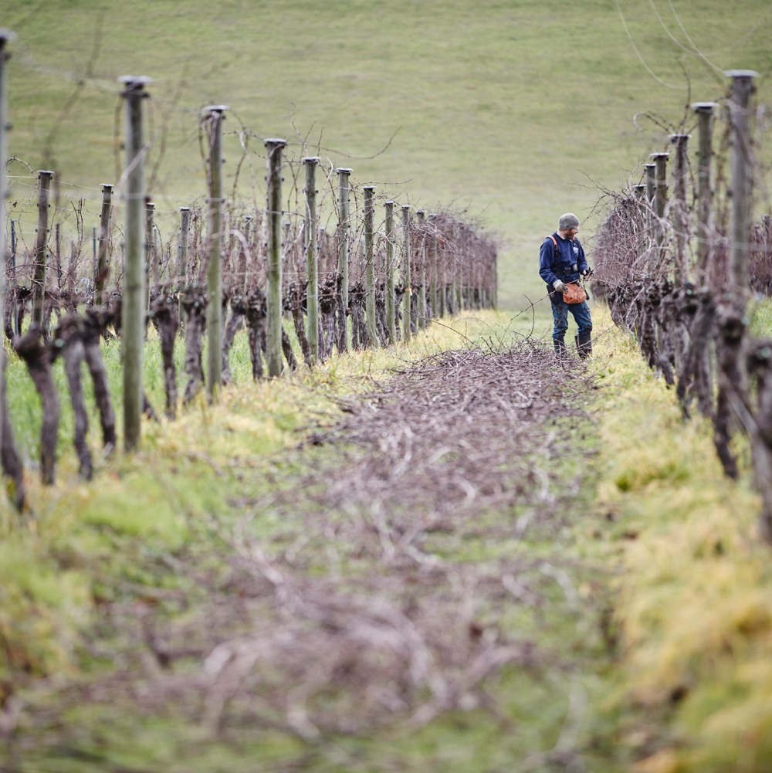
ALTERNATIVE
VARIETIES IN
YARRA VALLEY
Climatic and soil diversity allows local producers to experiment with emerging and re-emerging varieties, often with promising results.
Arneis
Gewürztraminer
Grüner Veltliner
Pinot Meunier
Gamay
Brachetto
Tempranillo
Sangiovese
Nebbiolo

Slide 24
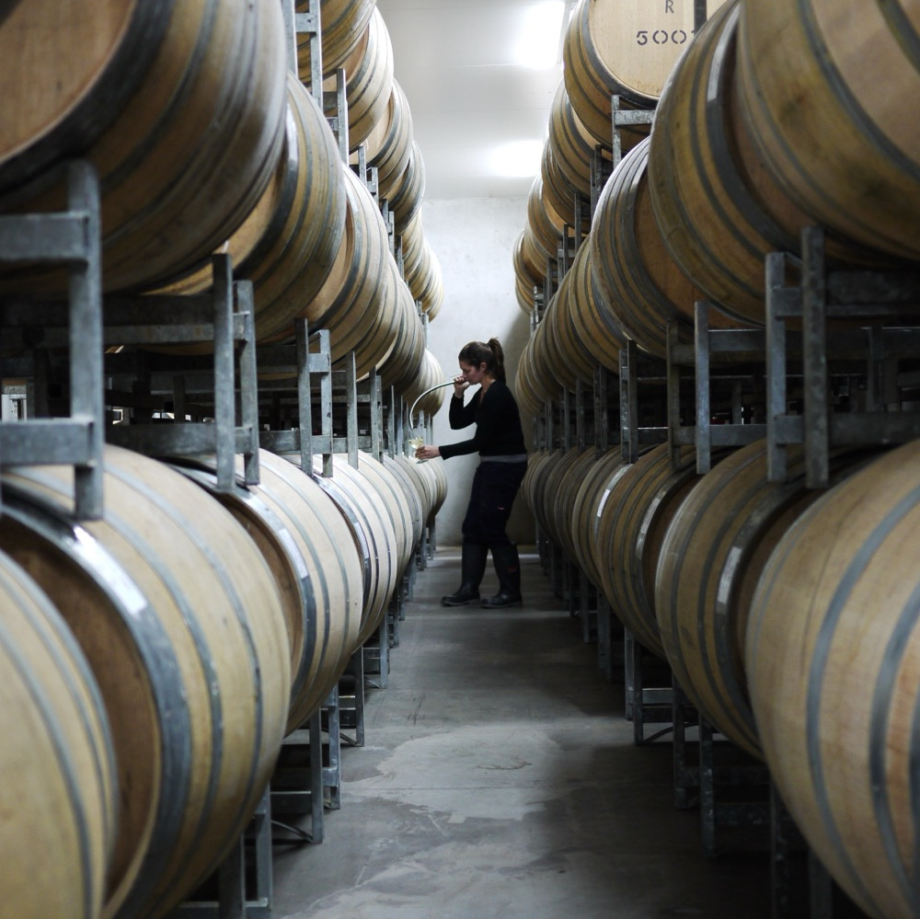
YARRA VALLEY
A RICH HISTORY,
A FRESH REVIVAL AND
A FUTURE
OF INNOVATION

Slide 25
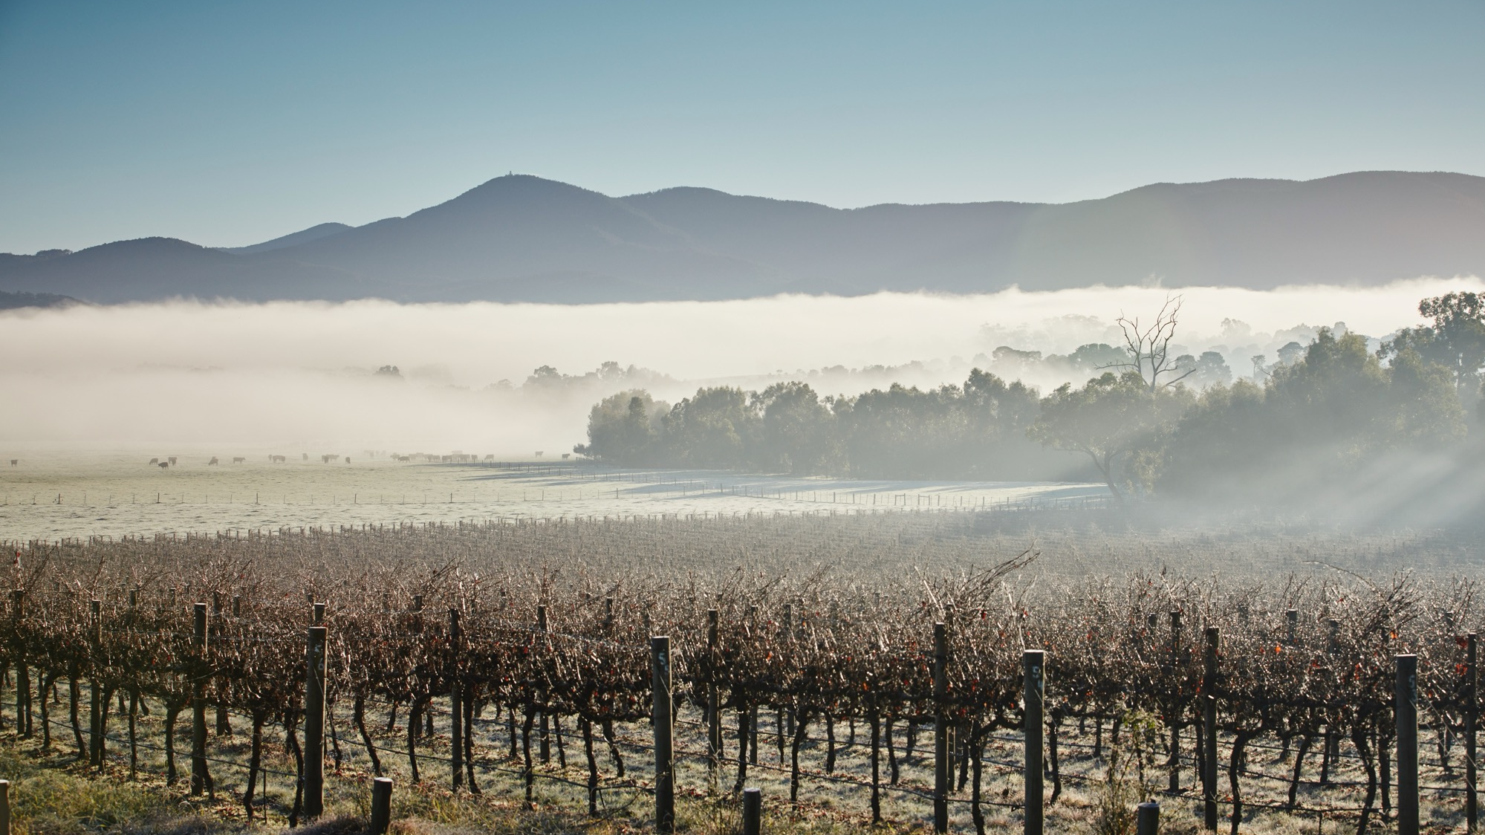
THANK YOU

