Slide 1
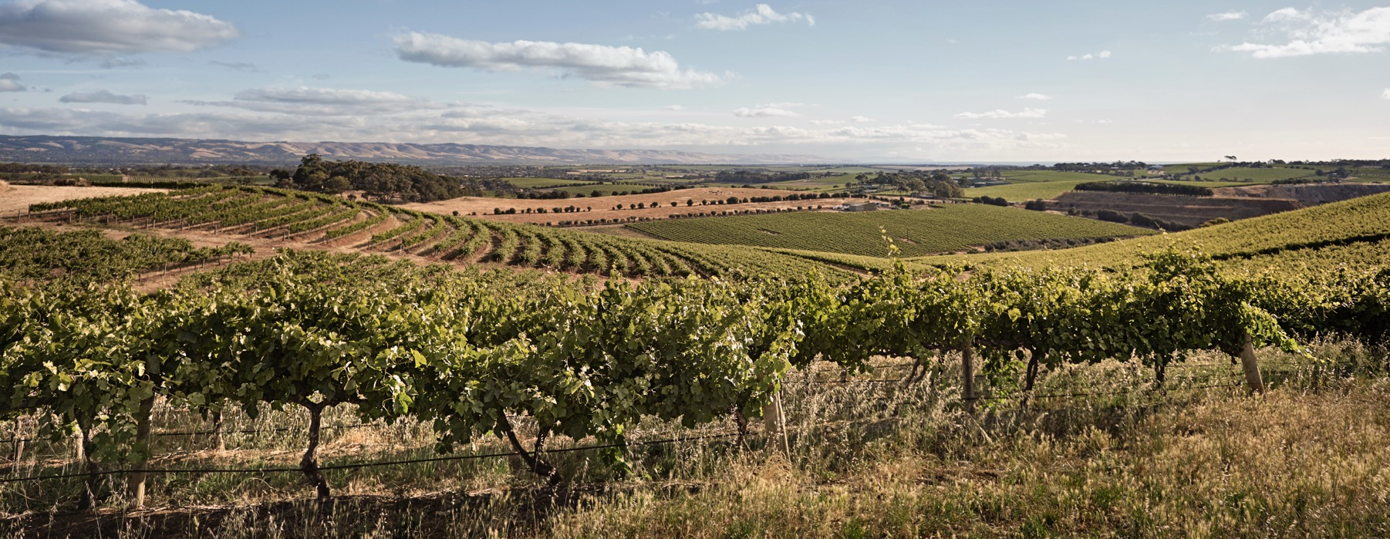
McLAREN VALE

Slide 2


Crafted from grapes grown under vast and diverse climates, across landscapes millions of years in the making, every glass of Australian wine tells a story.
Like those who came before us, our modern growers and makers continue to be passionate, resilient and creative; constantly driven to explore new ways to perfect old techniques. Our community is connected by a mutual respect and shared love of crafting exceptional wine, while protecting the natural wonders for future generations to enjoy. Applying modern thinking to our ancient lands, we take playful experimentation very, very seriously.
So, if you’re looking for the taste of adventure, let Australian wine be your compass. Because in every bottle of Australian wine, you’ll experience the wonders of Australia – a reminder of the adventure and diversity that defines our culture and our land.

Slide 3

AUSTRALIA
McLAREN VALE

Slide 4
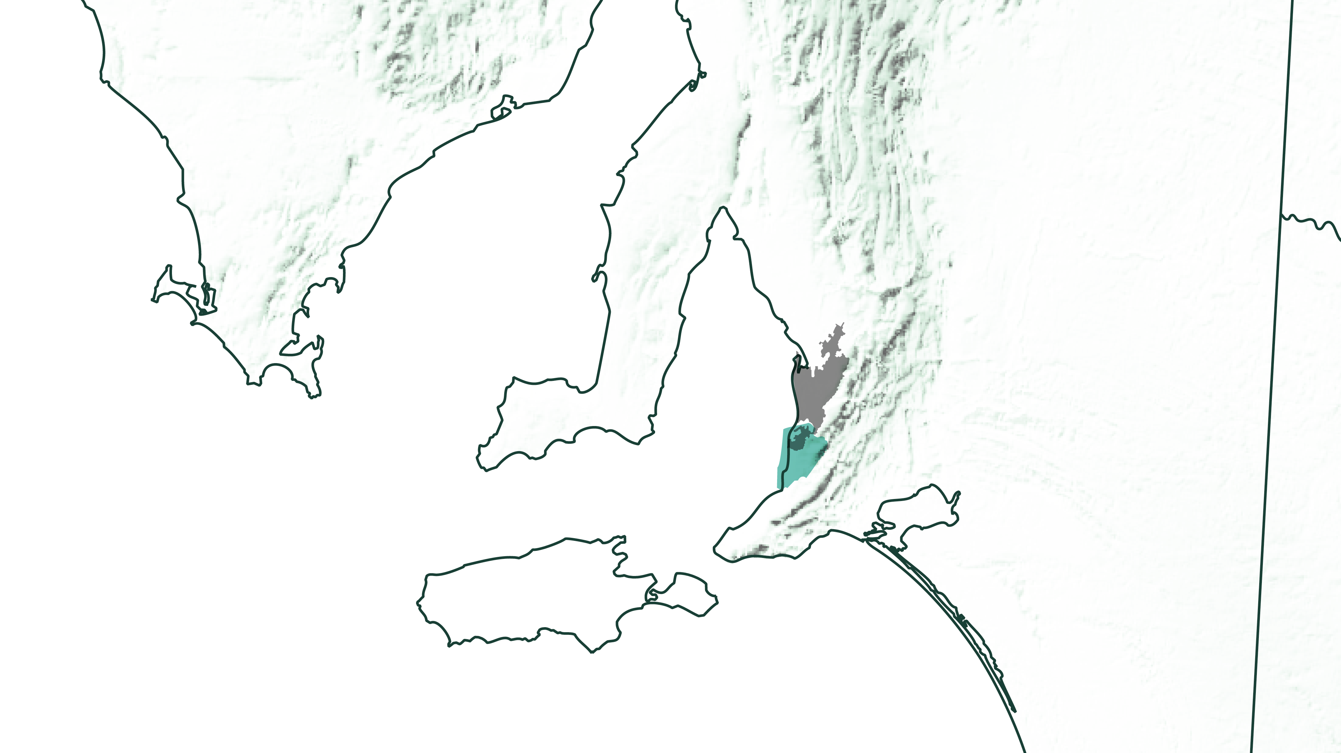
SOUTH
AUSTRALIA
Adelaide
McLAREN VALE

Slide 5
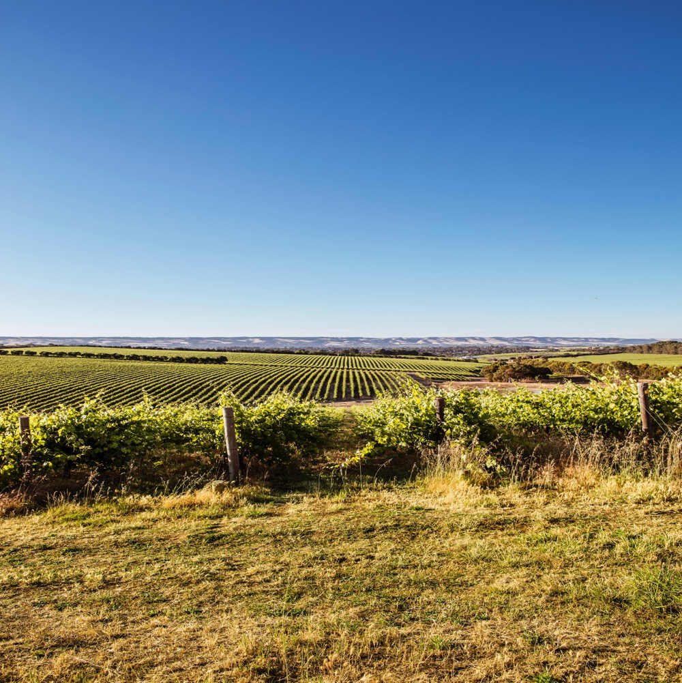
McLAREN VALE AN ANCIENT REGION WITH
A PROGRESSIVE OUTLOOK
McLaren Vale is one of the oldest and most historically significant wine regions in Australia. It’s also one of the most innovative and exciting.
Diversity
Innovation
Sustainability
Natural beauty

Slide 6
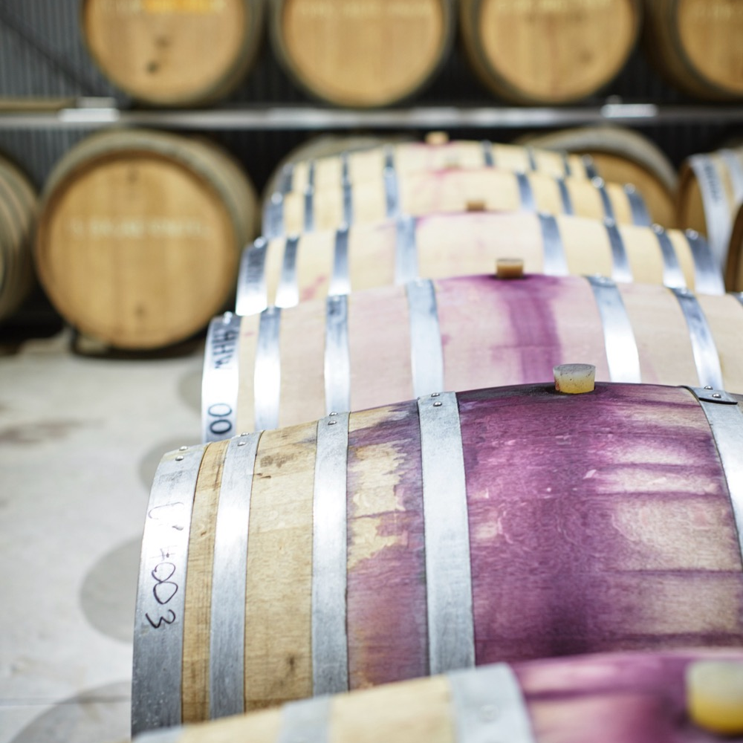
TODAY WE’LL COVER
The history of McLaren Vale
Climate and soil
Viticulture
Winemaking
Notable varieties
Characteristics and flavour profiles

Slide 7
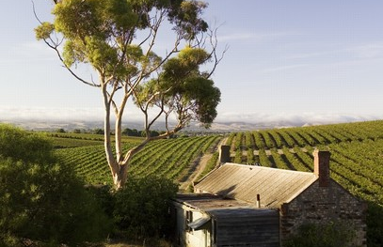
1838
THE HISTORY OF McLAREN VALE
1850s
WINE HERITAGE REVIVAL AND SOME CONTROVERSY
The now-legendary winemaker Thomas Hardy establishes his own property and delivers the largest bulk wine export to England.
1840s
McLaren Vale is founded, two years after the state of South Australia is established.
John Reynell establishes South Australia’s first commercial vineyard.

Slide 8
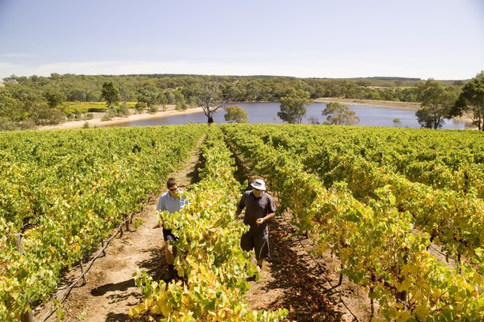
Today
1970s & 1980s
With so much to offer winemakers, and a propensity for experimentation, McLaren Vale is increasingly known as one of Australia’s most exciting wine regions.
2010
McLaren Vale’s table wines take their place on the world stage. The number of wineries grows along with the region’s reputation for fine wine.
Legislation passed to protect the character of McLaren Vale from urban sprawl.
1999
Mid 1920s – Late 1960s
Australia's first reclaimed water network is built in McLaren Vale.
Production is focused on fortified wine and business booms. Immigrants from post-war Italy bring fresh vitality and add to the region’s reputation as a centre of gastronomy.

Slide 9

ANCIENT LANDS AND
DIVERSE SOILS
Just 40km south of Adelaide
One of the most ancient and geologically diverse regions in the world
19 distinct areas based on climate and geology

Slide 10

CLIMATE
ALTITUDE
MEDITTERANEAN
VERY HIGH
1000m +
(>3,280ft +)
WITH A RANGE OF MESOCLIMATES AND MICROCLIMATES
HIGH
750–999m
(2,460–3,279ft)
MEDIUM
500–749m
(1,640–2,459ft)
McLAREN VALE
10–350M (33 – 1,148FT)
LOW
0–499m
(0–1,639ft)

Slide 11

SOIL
McLaren Vale has over 40 unique geologies that vary in age from 15,000 years to more than 550 million years.
Its wide variety of soil types reflect its varied terrain:
Red-brown sandy loams
Grey-brown loamy sands
Distinctly sandy soils
Patches of red or black friable loams
Yellow clay subsoils interspersed
with lime

Slide 12
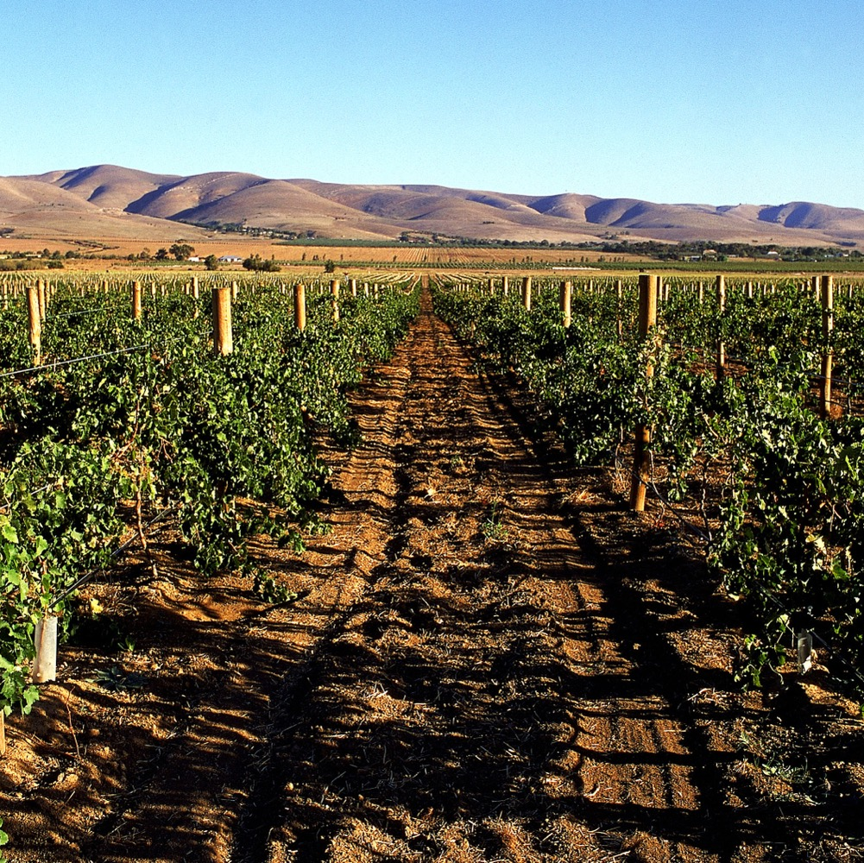
VITICULTURE AND WINEMAKING
McLAREN VALE

Slide 13
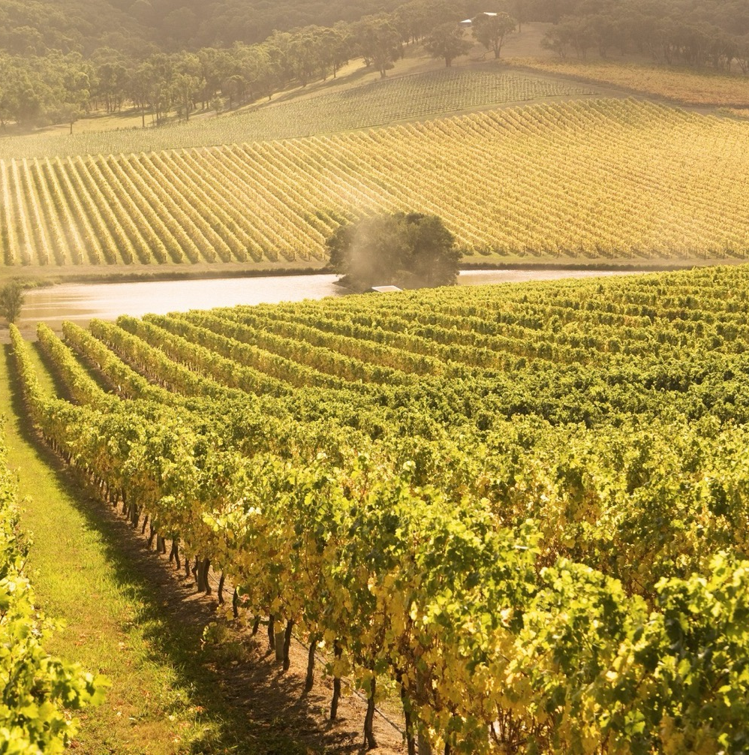
PROUD HISTORY AND
PROGRESSIVE THINKING
Mediterranean varieties
Many old vines
Innovative viticulture practices
Phylloxera-free
Commitment to experimentation

Slide 14
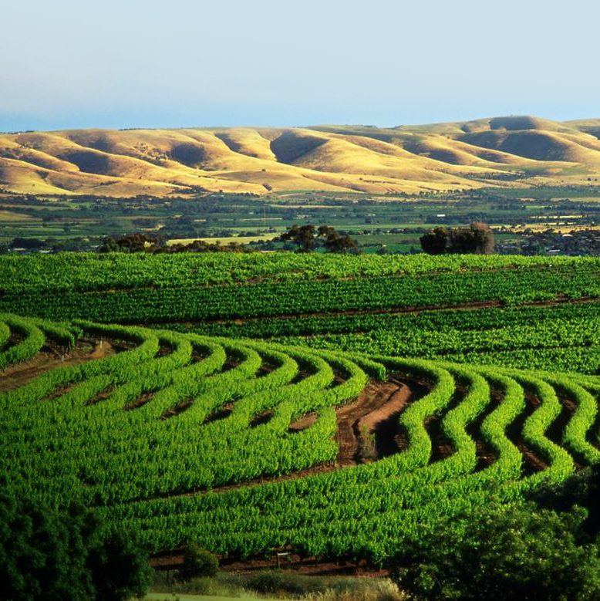
SUSTAINABILITY
One of Australia’s ‘greenest’
wine regions
Organic products and biodynamic practices
Minimal chemical intervention
Climate-appropriate varieties
World-leading water management
DID YOU KNOW?
McLaren Vale has the highest number of certified organic and biodynamic vineyards in Australia, and one of the lowest usage rates of sprays and agro-chemicals.

Slide 15
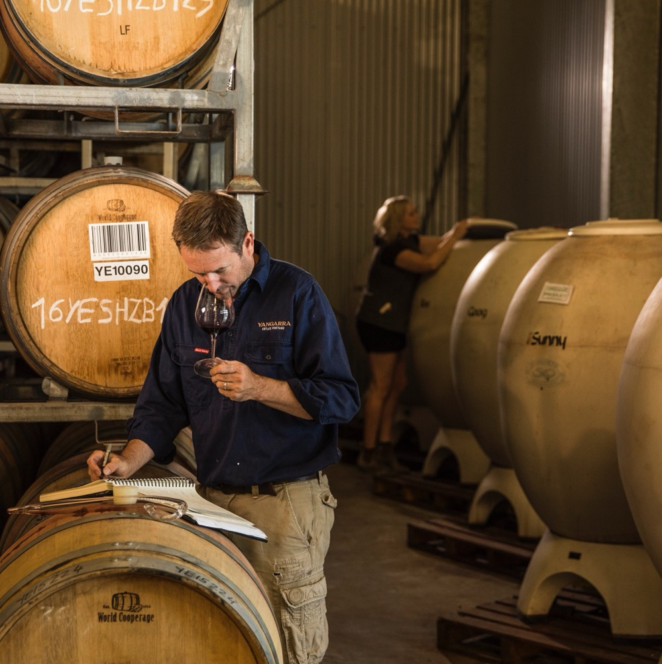
WINEMAKING IN
McLAREN VALE
Collaboration
Experimentation
Adaptability
KEY TRENDS
Minimal intervention
Reviving ancient techniques
Showcasing varietal characters and influences of terroir
Picking grapes earlier and using less new oak to produce fresher, lighter wines

Slide 16
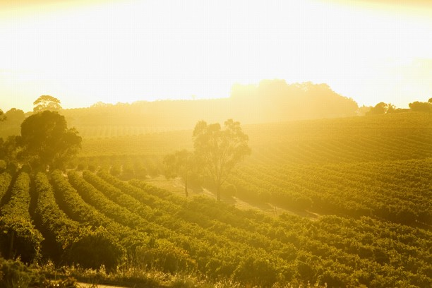
TASTE OF
McLAREN VALE
NOTEWORTHY
VARIETIES

Slide 17


McLAREN VALE
TOP 5 VARIETIES
CABERNET
SAUVIGNON
GRENACHE
SHIRAZ
CHARDONNAY
MERLOT
SHIRAZ
58%
CABERNET
SAUVIGNON
19%
GRENACHE
5%
CHARDONNAY
5%
MERLOT
3%

Slide 18

McLAREN VALE
SHIRAZ
McLAREN VALE’S SIGNATURE VARIETY
NO TYPICAL STYLE DUE TO VARYING GEOLOGY AND SOIL TYPES
SHIRAZ
SMALLER GRAPES
= MORE COMPLEX AND INTENSE WINES
FLAVOURS
Blackcurrant
Blueberry
Liquorice
Black olive
Dark chocolate
Spice
GREATER LONGEVITY
FOR SHIRAZ WITH AGEING POTENTIAL

Slide 19
SHIRAZ characteristics
COLOUR
Shiraz
Light
Medium
Full
BODY
Dry
Medium dry
Sweet
SWEETNESS
Low
Medium
High
SHIRAZ
OAK
TANNIN
ACIDITY
8%
17%
13.5% – 15.5%
ALCOHOL

Slide 20

McLAREN VALE
CABERNET SAUVIGNON
BEST EXAMPLES TEND TO BE FROM COOLER VINEYARD SITES AND MILDER VINTAGES
OPULENT WINES WITH LAYERS OF FLAVOUR
CABERNET SAUVIGNON
FLAVOURS
Blackcurrant
Black cherry
Blackberry
Chocolate
Liquorice
Green Capsicum
FULL BODIED AND RICH WITH STRUCTURE FOR AGEING

Slide 21
CABERNET SAUVIGNON characteristics
COLOUR
Cabernet Sauvignon
Light
Medium
Full
BODY
Dry
Medium dry
Sweet
SWEETNESS
CABERNET SAUVIGNON
Low
Medium
High
OAK
TANNIN
ACIDITY
8%
13.5% – 15.5%
17%
ALCOHOL

Slide 22
McLAREN VALE
GRENACHE
ONCE OVERLOOKED NOW A STAR PERFORMER
WELL SUITED TO THE REGION AND PRODUCES A VARIETY OF STYLES
GRENACHE
FLAVOURS
Cherry
Dark raspberry
Strawberry
White pepper
Earth
Spice
OLDEST VINES PLANTED IN
LATE 1800s

Slide 23
GRENACHE characteristics
COLOUR
Grenache
Light
Medium
Full
BODY
Dry
Medium dry
Sweet
SWEETNESS
Low
Medium
High
OAK
GRENACHE
TANNIN
ACIDITY
8%
17%
13.5% – 15.5%
ALCOHOL

Slide 24

McLAREN VALE
CHARDONNAY
MAJOR WHITE GRAPE PLANTED
WIDELY GROWN
FOR AFFORDABLE,
EASY-DRINKING STYLES
CHARDONNAY

Slide 25

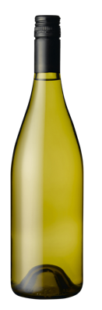
EMERGING AND
RE-EMERGING VARIETIES
VERMENTINO
FIANO
SANGIOVESE
TEMPRANILLO
ZINFANDEL
VERMENTINO
Medium-bodied wine
FIANO
Medium-bodied wine
SANGIOVESE
Medium-bodied red
TEMPRANILLO
Medium-bodied red
ZINFANDEL
Medium-bodied red
MONTEPULCIANO
BARBERA
NERO D’AVOLA
MATARO
MONTIPULCIANO
Medium to
full-bodied red
BARBERA
Full-bodied red
NERO D’AVOLA
Full-bodied red
MATARO (Mourvédre)
Full-bodied red

Slide 26
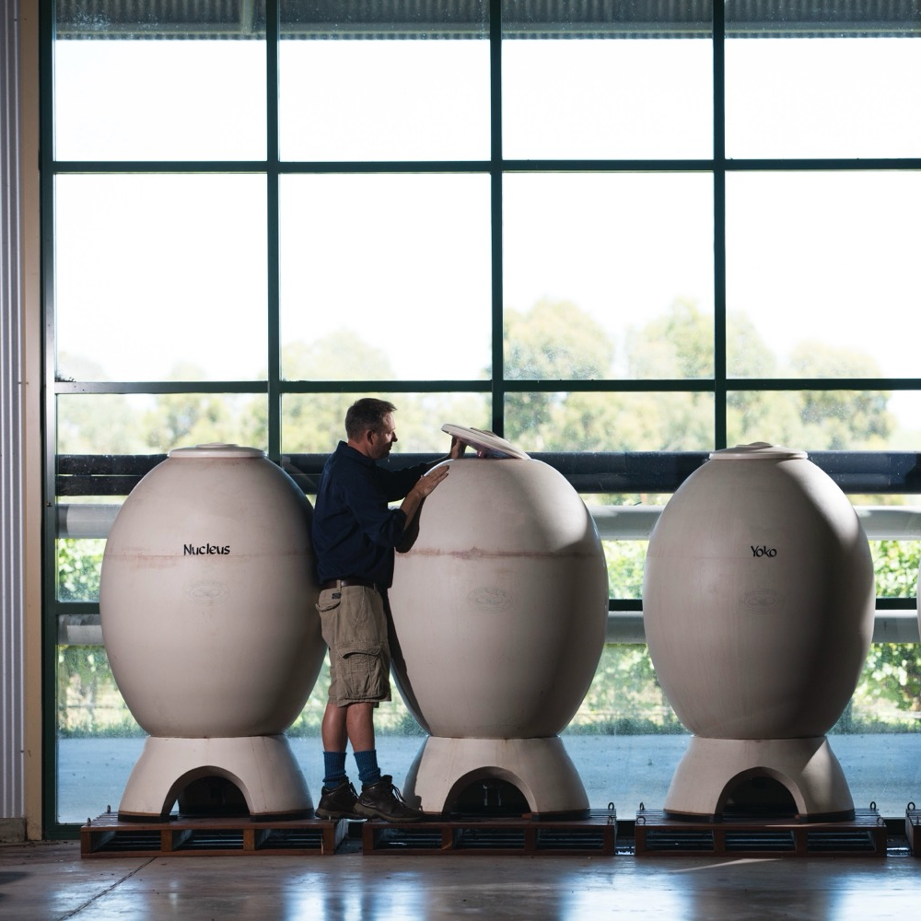
McLAREN VALE
A FUTURE OF INNOVATION BUILT ON STRONG FOUNDATIONS

Slide 27
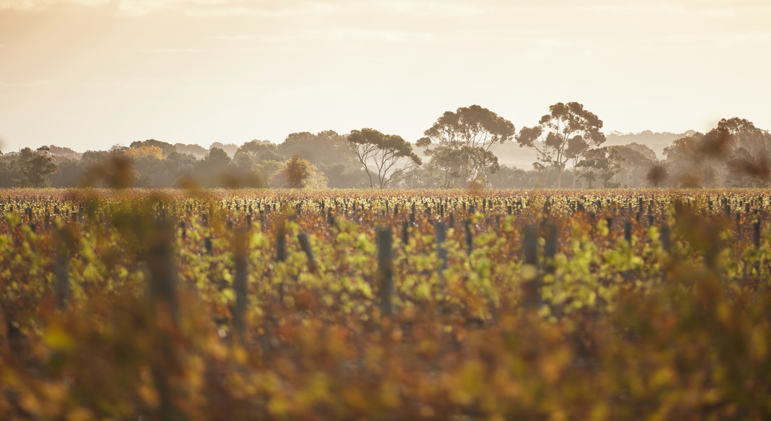
THANK YOU

