Slide 1
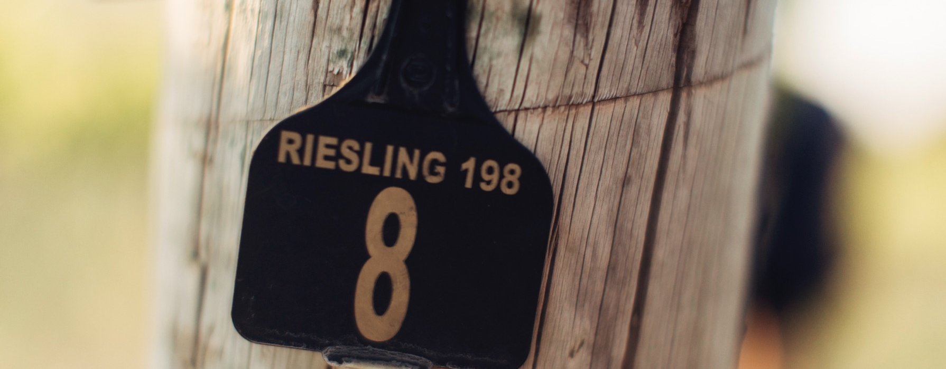
RIESLING

Slide 2


Crafted from grapes grown under vast and diverse climates, across landscapes millions of years in the making, every glass of Australian wine tells a story.
Like those who came before us, our modern growers and makers continue to be passionate, resilient and creative; constantly driven to explore new ways to perfect old techniques. Our community is connected by a mutual respect and shared love of crafting exceptional wine, while protecting the natural wonders for future generations to enjoy. Applying modern thinking to our ancient lands, we take playful experimentation very, very seriously.
So, if you’re looking for the taste of adventure, let Australian wine be your compass. Because in every bottle of Australian wine, you’ll experience the wonders of Australia – a reminder of the adventure and diversity that defines our culture and our land.

Slide 3
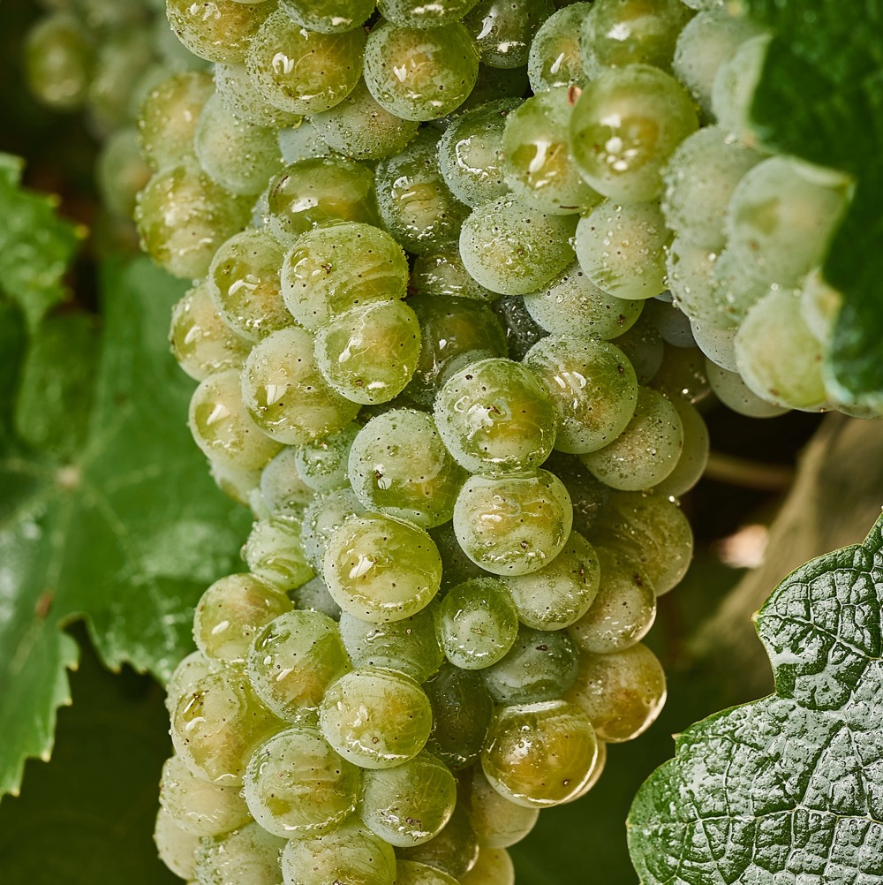
RIESLING
MINIMAL INTERVENTION MASTERY
One of Australia’s premier
white grape varieties, Riesling
is a delicate, expressive and versatile variety that benefits from a minimalist winemaking approach.
Australia is home to some of the world’s oldest Riesling vines and a leading global producer.

Slide 4
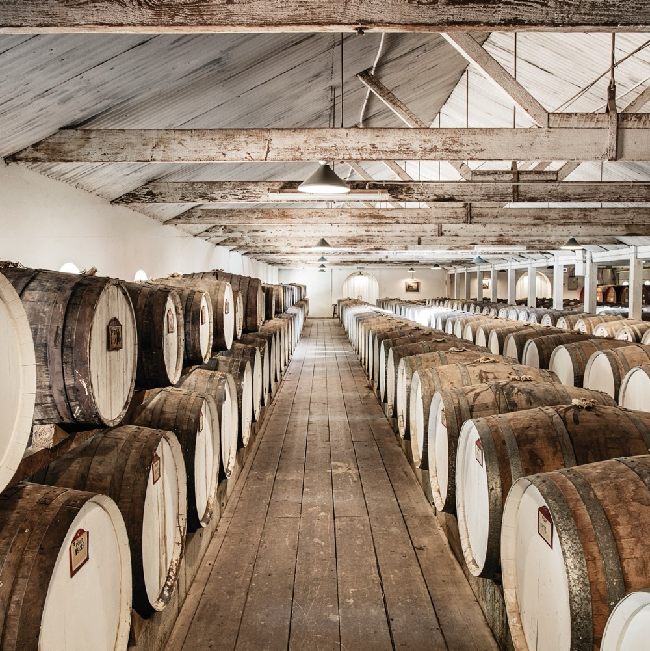
TODAY WE’LL COVER
The history of Riesling in Australia
How it’s grown
How it’s made
Where it’s grown
Common styles
Characteristics and flavour profiles

Slide 5
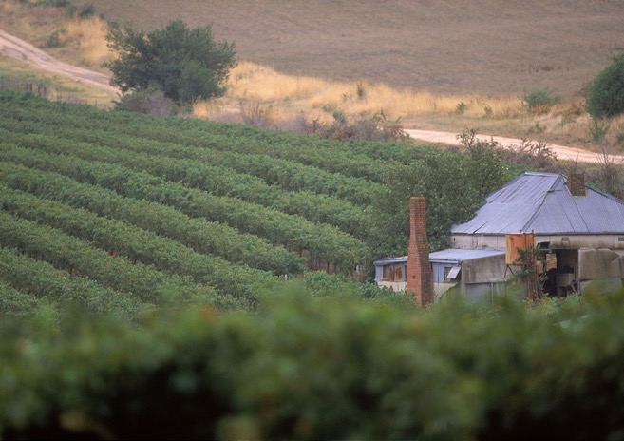
1800s
THE HISTORY OF RIESLING IN AUSTRALIA
1930s
New technology makes its way into the Australian wine community. Refrigeration is used to cool fermentation temperatures, helping to preserve Riesling’s delicate aromatics.
Mid 1800s
First recorded as being imported by William Macarthur in 1837. Riesling is embraced by German, Polish and Czech settlers and soon finds a home in the Clare Valley, Eden Valley, Tasmania, Victoria, Mudgee and Western Australia.
Riesling is highly regarded and in demand, becoming synonymous with ‘dry white wine’.

Slide 6
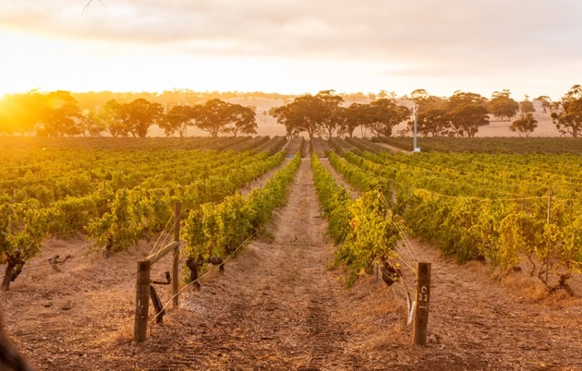
1960s
1990s
Riesling becomes Australia’s leading variety in the white wine boom of the late 1960s and 1970s, despite a common misconception that it’s always sweet.
Chardonnay’s surge in popularity coincides with Riesling’s decline from being Australia’s most popular white wine.
1950s
1970s & 1980s
Today
Australian Riesling is further revolutionised when Colin Gramp uses cold-pressure fermentation to prevent the escape of carbon dioxide and control fermentation temperatures.
The mislabelling of Riesling wines is corrected and Riesling shakes off its image as a sweet wine. Many famous Australian wine companies include dry Riesling in their ranges.
Riesling is one of Australia's most important grape varieties – and its reputation is once again soaring.

Slide 7
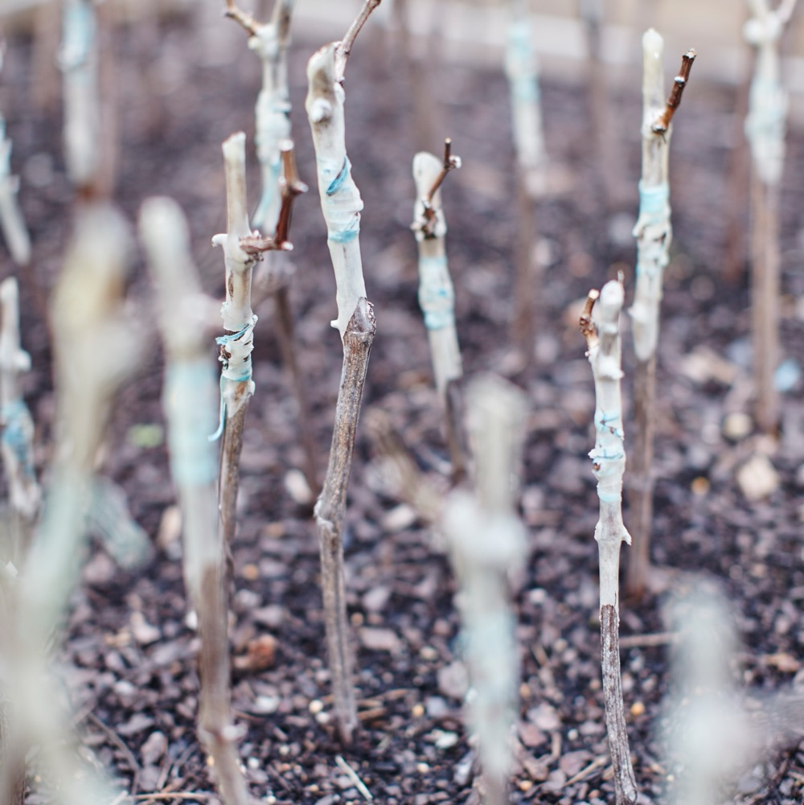
VITICULTURE
HOW RIESLING IS GROWN IN AUSTRALIA
Riesling is highly expressive of grape and terroir, showcasing the grapegrower’s skill.
Grows best in climates with cool nights and a long ripening season
Thrives in a wide variety of soil types
Small and compact grape clusters susceptible to disease
Produces better quality wine when yields are kept low

Slide 8
WINEMAKING:
TECHNIQUES INFLUENCING RIESLING
EXTENDED MACERATION TIMES
WHOLE BUNCH FERMENTATION
COLD FERMENTATION
EXTENDED SKIN CONTACT
COLD STABILISATION
STERILE FILTRATION
EARLY BOTTLING

Slide 9
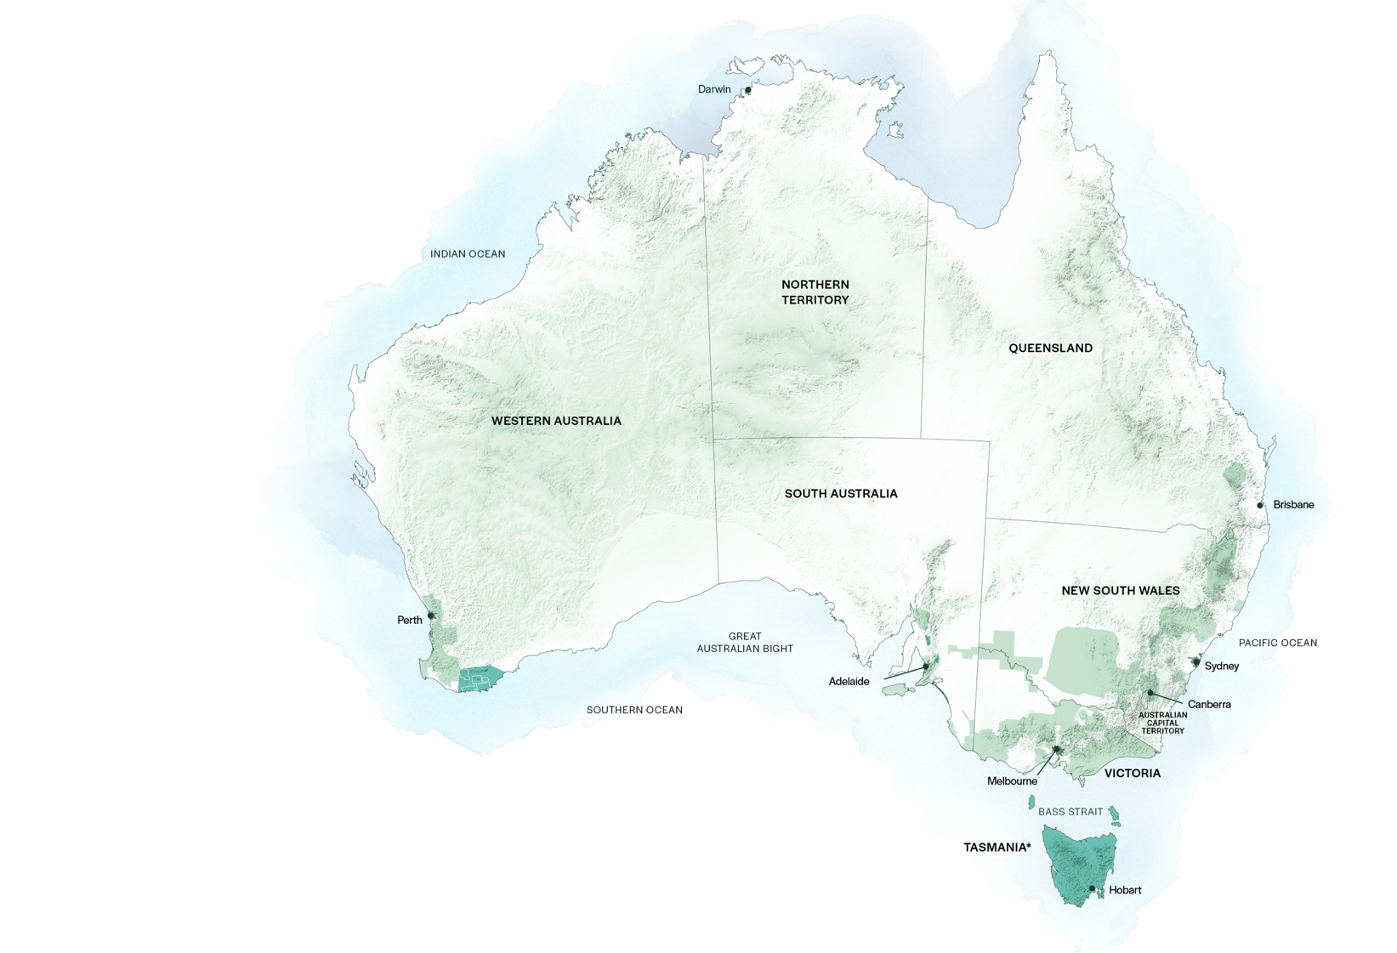
AUSTRALIAN
RIESLING
REGIONS
GREAT SOUTHERN
CLARE VALLEY
EDEN VALLEY
TASMANIA

Slide 10

SOUTH AUSTRALIA
CLARE VALLEY

Slide 11
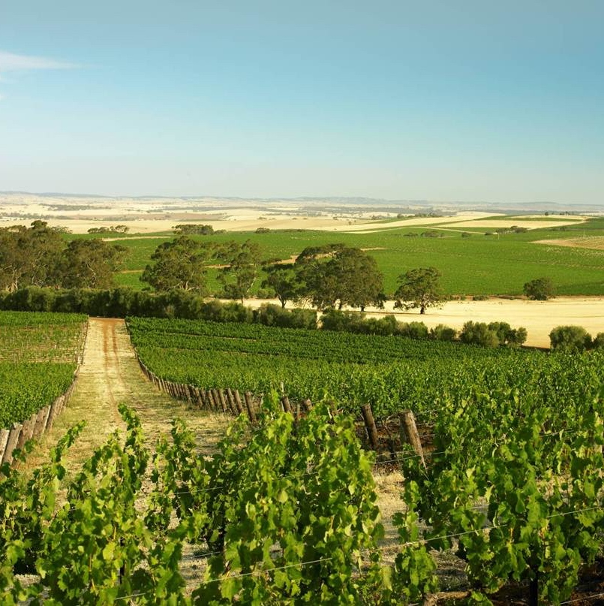
CLARE VALLEY
Five distinct areas
Picturesque and geographically blessed
Tradition of winemaking innovation
World-famous Riesling region
FUN FACT
Clare Valley has its very own Riesling Trail, which runs along a disused railway line.

Slide 12
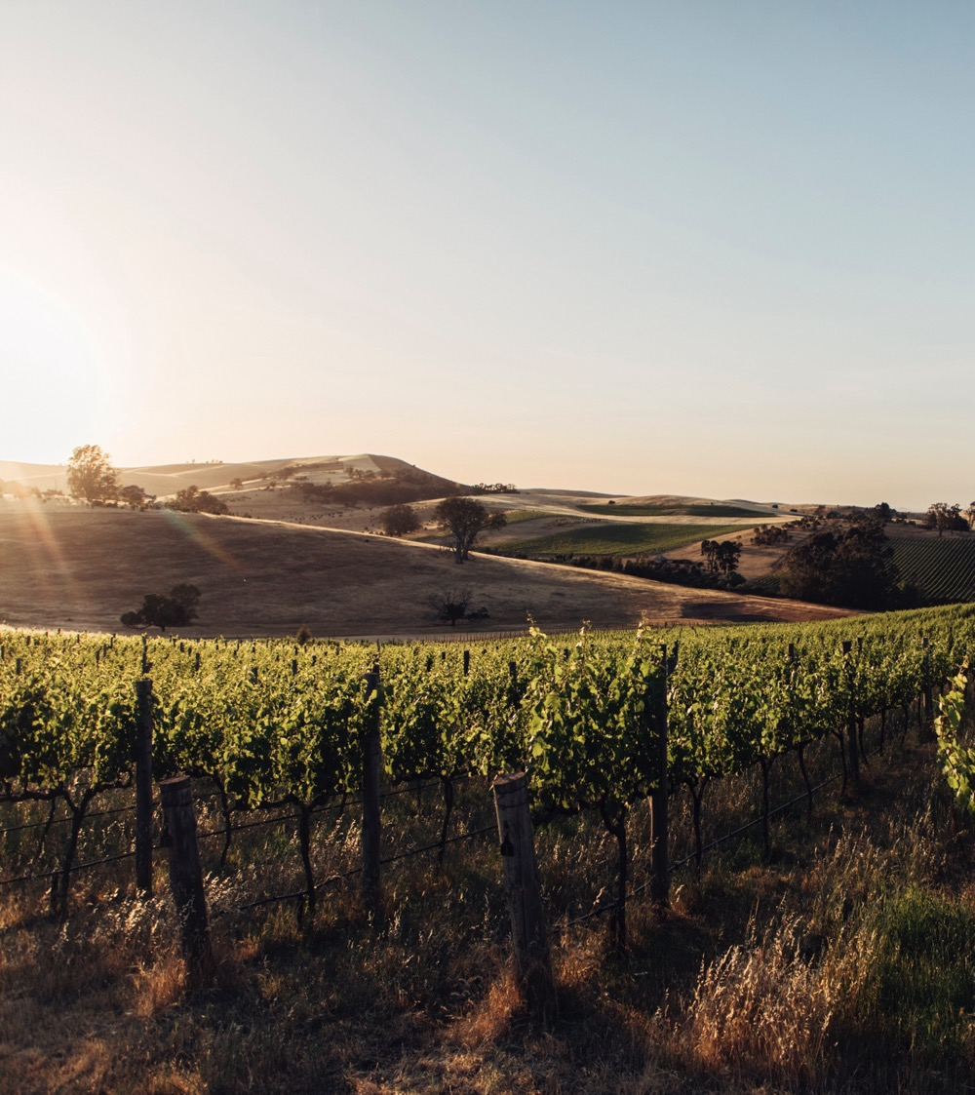
CLIMATE
ALTITUDE
CONTINENTAL
VERY HIGH
1000m +
(>3,280ft +)
WITH SIGNIFICANT DIURNAL VARIATION AND COOLING BREEZES
CLARE VALLEY
250–550M (820–1,804FT)
HIGH
750–999m
(2,460–3,279ft)
MEDIUM
500–749m
(1,640–2,459ft)
LOW
0–499m
(0–1,639ft)

Slide 13

SOIL
Clare Valley has 11 recognised soil types, ranging from classic terra rossa red topsoil over limestone (Watervale) to broken slate (Polish Hill River). Vineyards in the northern Clare Valley are grown in deep, fertile alluvial soils, while vineyards in the west are grown in sandy loam dotted with fragments of quartz.

Slide 14
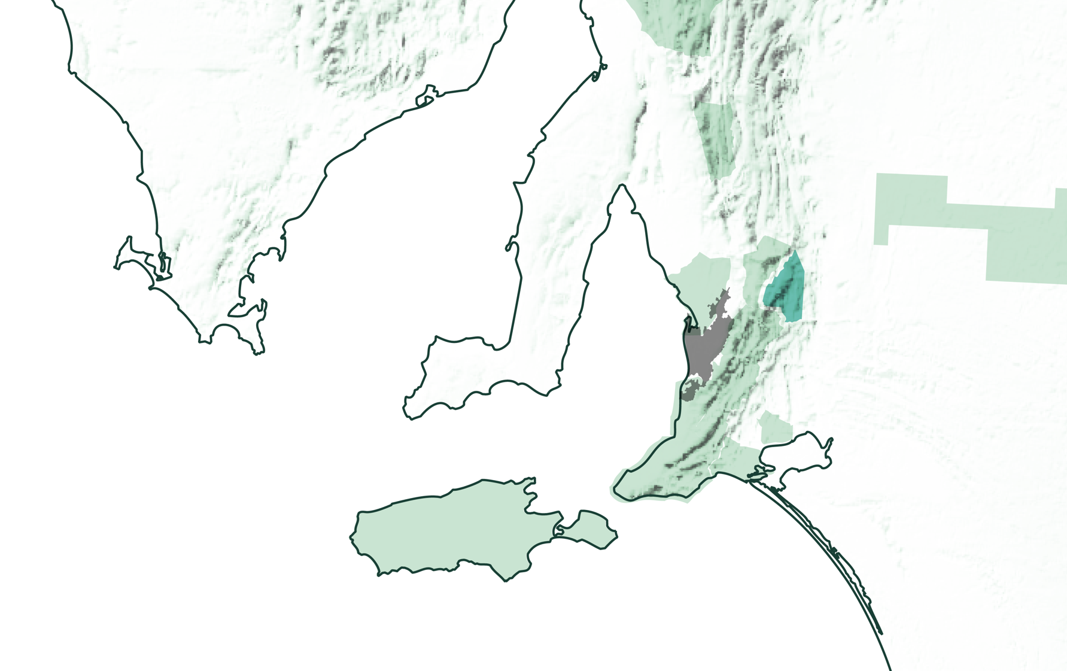
SOUTH AUSTRALIA
EDEN VALLEY

Slide 15
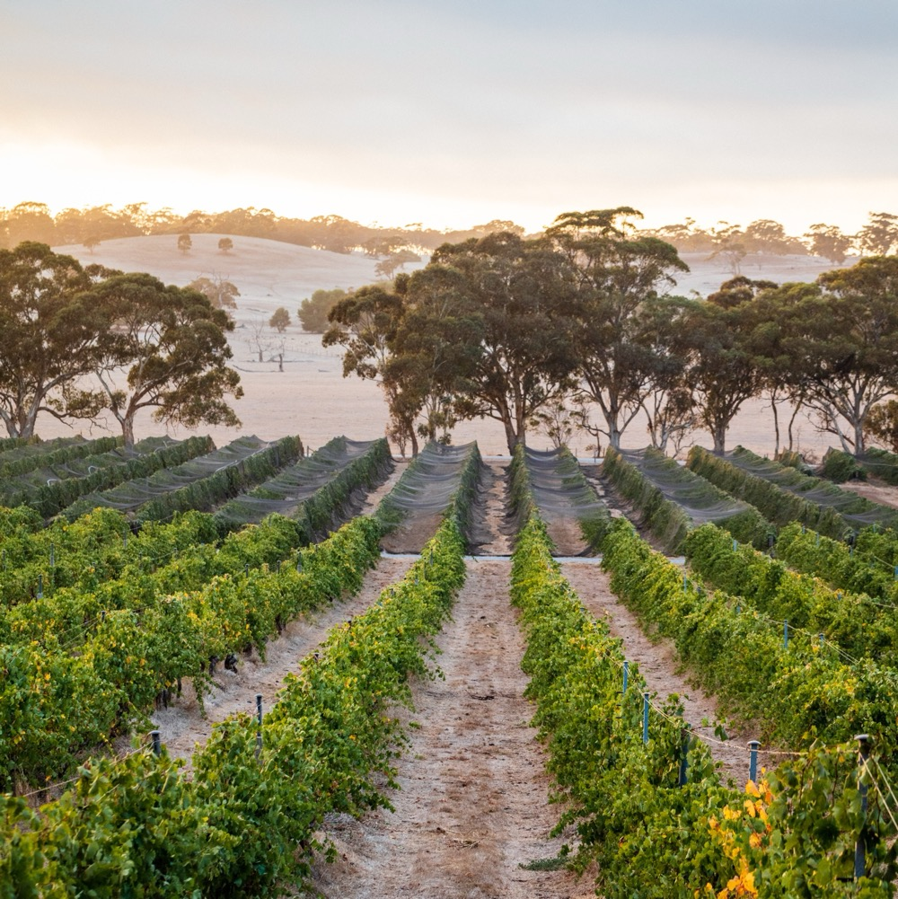
EDEN VALLEY
Cool-climate neighbour
of Barossa Valley
Strong winemaking tradition
Renowned for producing premium wines
FUN FACT
Eden Valley was named by the surveyors of the area after they found the word Eden carved into a tree.

Slide 16
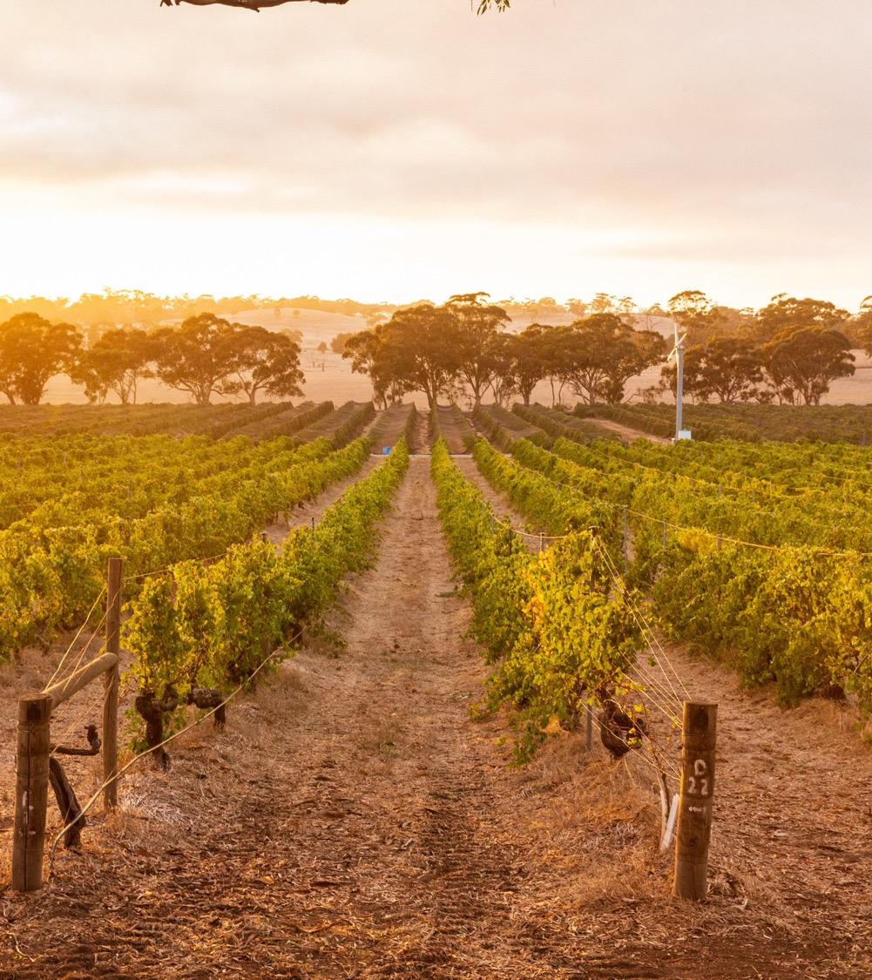
CLIMATE
ALTITUDE
CONTINENTAL
VERY HIGH
1000m +
(>3,280ft +)
COOLER CLIMATE WITH VARIOUS MESOCLIMATES
HIGH
750–999m
(2,460–3,279ft)
EDEN VALLEY
310–540M (1,017–1,772FT)
MEDIUM
500–749m
(1,640–2,459ft)
LOW
0–499m
(0–1,639ft)

Slide 17
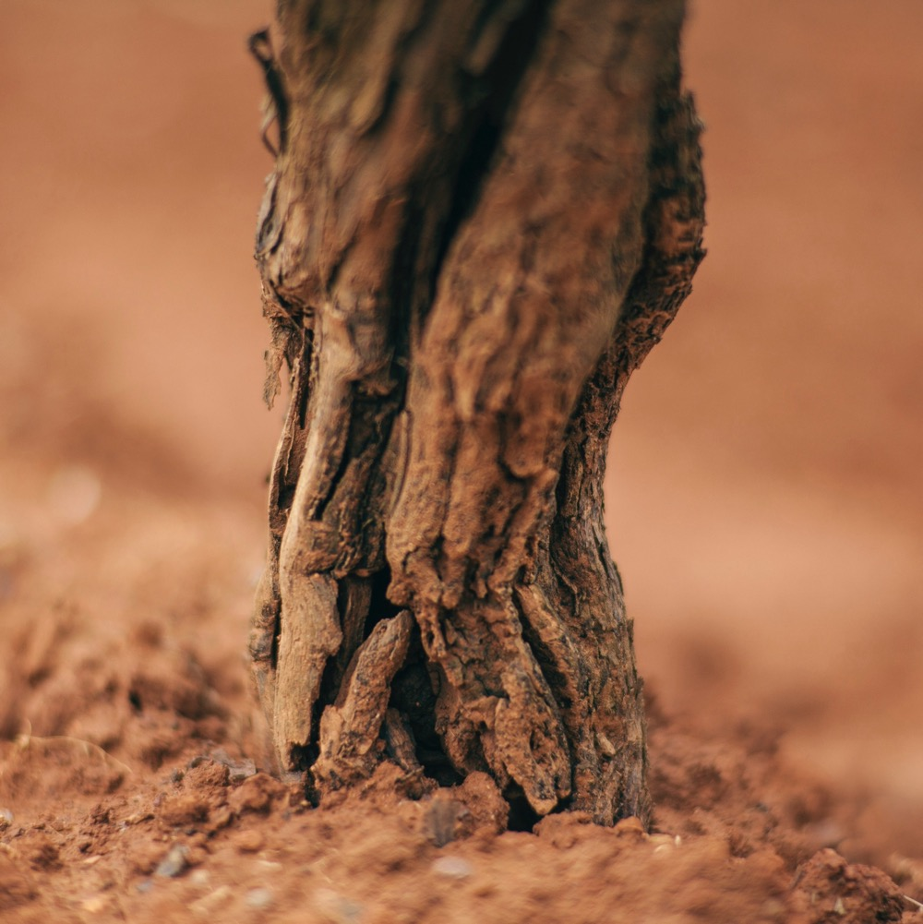
SOIL
Varied soil types ranging from grey to brown in colour, and from loamy sand to clay loams. Soils are generally well-suited to dry land viticulture, but there are patches of weaker sandy soils on the slopes, which have reduced water-holding capacity.

Slide 18

TASMANIA
NORTH-WEST
WINE GROWING AREAS
PIPERS RIVER
TAMAR VALLEY
EAST COAST
COAL RIVER VALLEY
DERWENT
VALLEY
HUON / CHANNEL

Slide 19
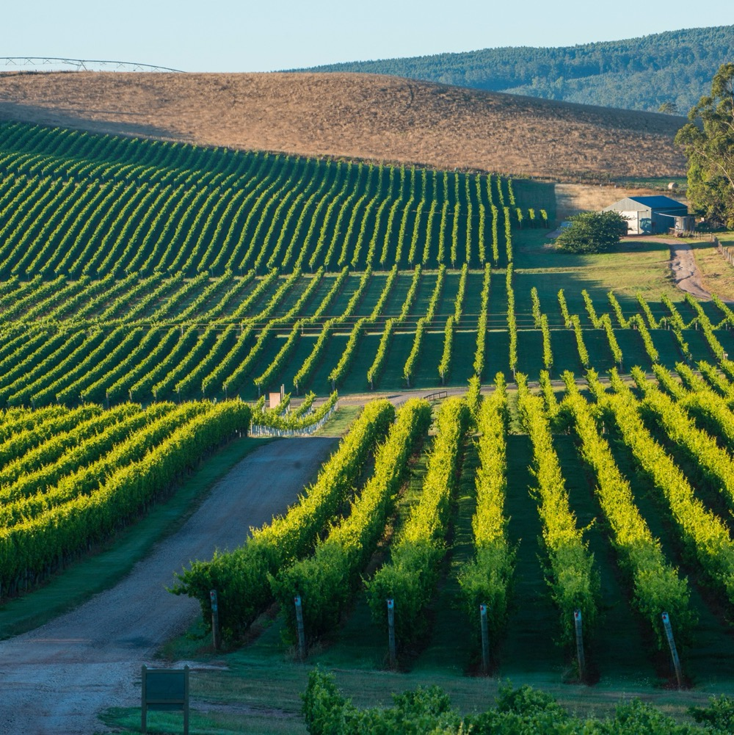
TASMANIA
Fine cool-climate region
Innovative wine community
Gourmet paradise

Slide 20

CLIMATE
ALTITUDE
VERY HIGH
1000m +
(>3,280ft +)
TEMPERATE
HIGH
750–999m
(2,460–3,279ft)
TASMANIA
10–330M (32–1,083FT)
WITH VAST MAJORITY OF VINEYARDS BELOW 100M
WITH MARITIME INFLUENCE FROM TASMAN SEA, BASS STRAIT AND INDIAN OCEAN
MEDIUM
500–749m
(1,640–2,459ft)
LOW
0–499m
(0–1,639ft)

Slide 21
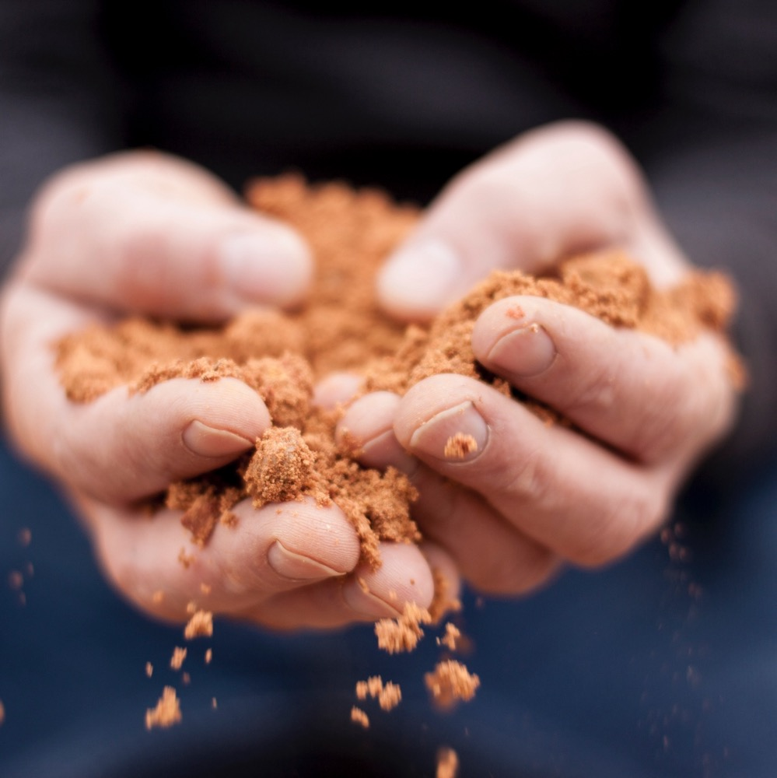
SOIL
On the lower slopes, the vineyard soils feature ancient sandstones, mudstones, river sediments and igneous rock of volcanic origin. Sandstone and schist appear in Derwent Valley. Peaty alluvial and sandy low humus soil appear in Coal River Valley. Pipers River boasts deep, free-draining, friable soils, while Tamar Valley is gravelly basalt on a clay and limestone base.

Slide 22
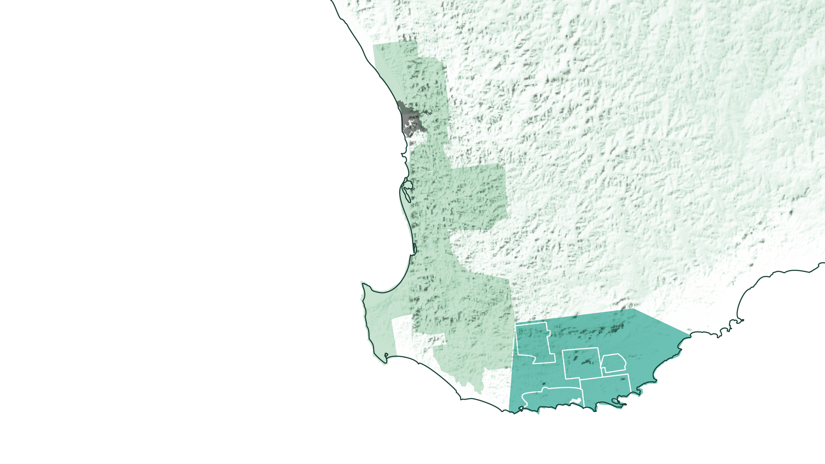
WESTERN AUSTRALIA
GREAT SOUTHERN

Slide 23
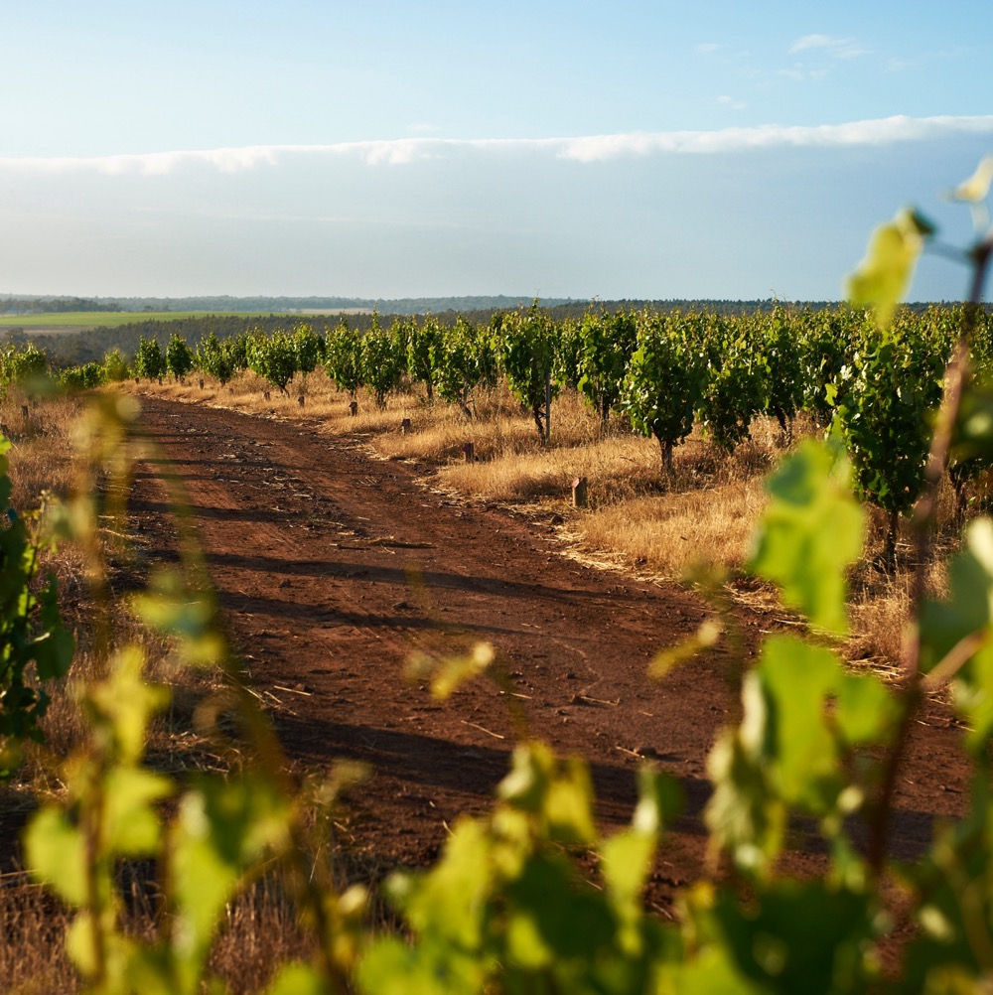
GREAT SOUTHERN
Vast wine region
One of Australia’s most rugged and remote
Produces established and emerging styles

Slide 24
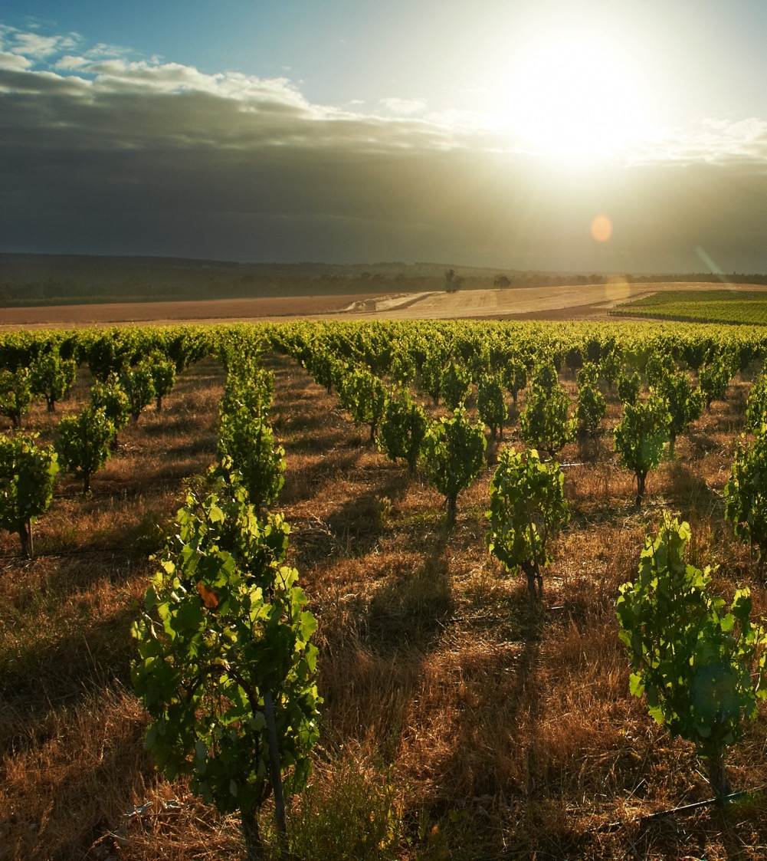
CLIMATE
ALTITUDE
MARITIME
VERY HIGH
1000m +
(>3,280ft +)
ALBANY
DENMARK
CONTINENTAL
HIGH
750–999m
(2,460–3,279ft)
MOUNT BARKER
PORONGURUP
FRANKLAND RIVER
GREAT SOUTHERN
0–360M (0–1,118FT)
MEDIUM
500–749m
(1,640–2,459ft)
LOW
0–499m
(0–1,639ft)
PHOTO ©Swinney Vineyards, Frankland River WA

Slide 25
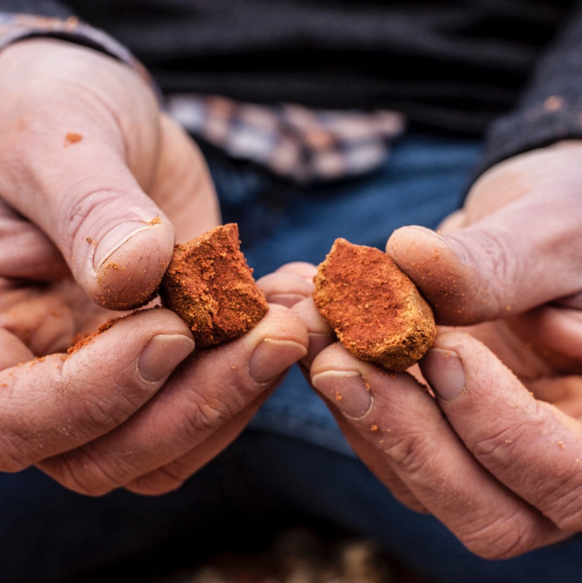
SOIL
The predominant soils are similar to those of the Margaret River region – either lateritic gravelly sandy loams (marri country) or sandy loams deriving directly from granite and gneissic bedrocks. They are typically brown to grey-brown in colour, with the percentage of clay varying from one location to another. Fertility is moderate, as are typical yields.

Slide 26
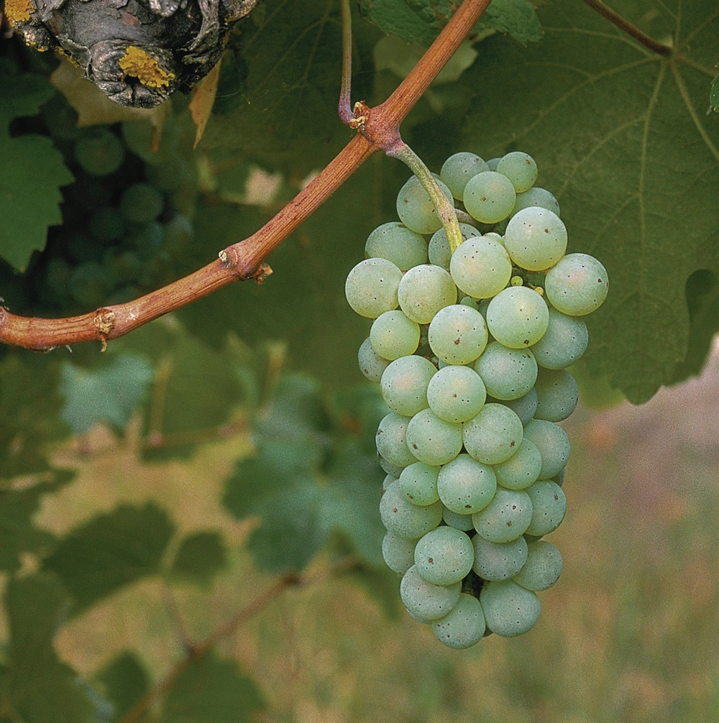
COMMON
RIESLING STYLES
Riesling is a versatile variety that’s all about tension and balance, with styles ranging from dry to sweet.
3 common styles in Australia:
Dry: Lean, citrus-driven, low residual sugar
Off-dry: A hint more residual sweetness balanced by acidity
Dessert wine: Sweet, age-worthy, rich

Slide 27

RIESLNG
CHARACTERISTICS AND FLAVOUR PROFILES
COLOUR
Riesling
Light
Medium
Full
BODY
Dry
Medium dry
Sweet
SWEETNESS
RIESLING
Low
Medium
High
FLAVOURS
Lime zest
Preserved Lemon
Apple
Orange blossom
OAK
ACIDITY
8%
11% – 13.5%
17%
ALCOHOL

Slide 28
RIESLING
COMPLEXITY OVER TIME
Mellow, toast, honey, brûlée
Softer acidity, lemon curd, toast, honey
Developing complexity, floral, lemon/lime, honey
Juicy acidity, fresh lime zest
1
2
5
10+
AGE IN
YEARS

Slide 29

FOOD PAIRINGS
OYSTERS
PRAWNS/SHRIMPS
WHITE FISH
RIESLING
CHICKEN
PORK
SPICY FOOD
SOFT CHEESE

Slide 30
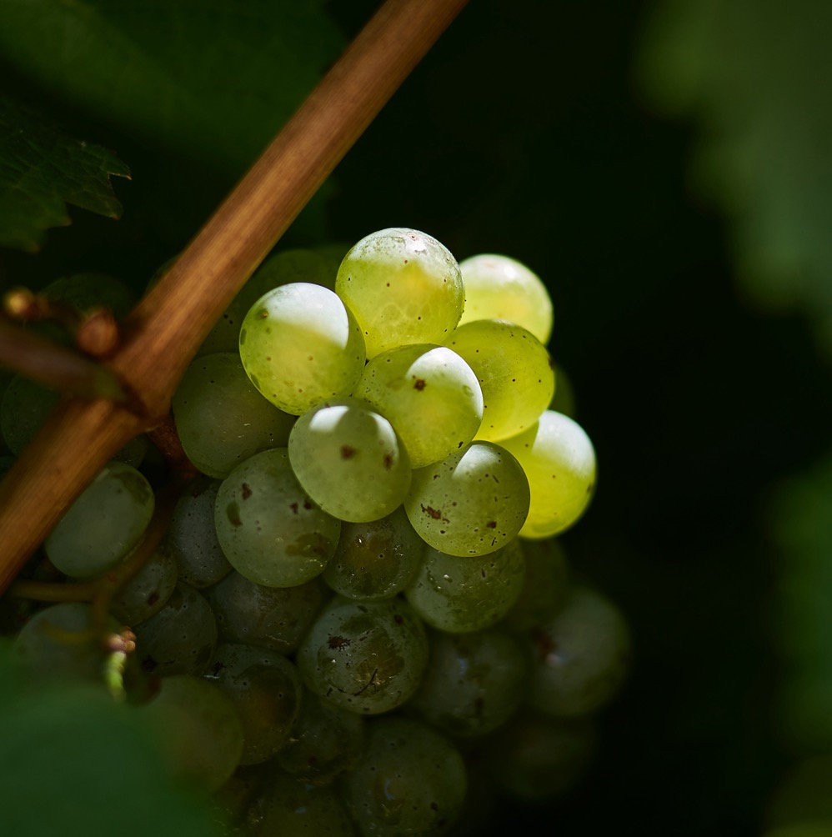
AUSTRALIAN RIESLING
A FUTURE OF POSSIBILITY AND POTENTIAL

Slide 31
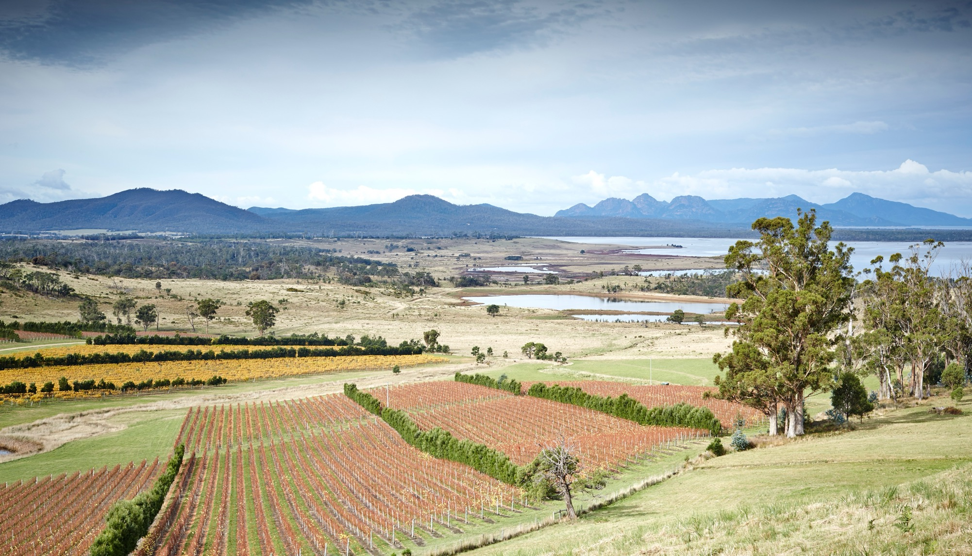
THANK YOU

