Slide 1
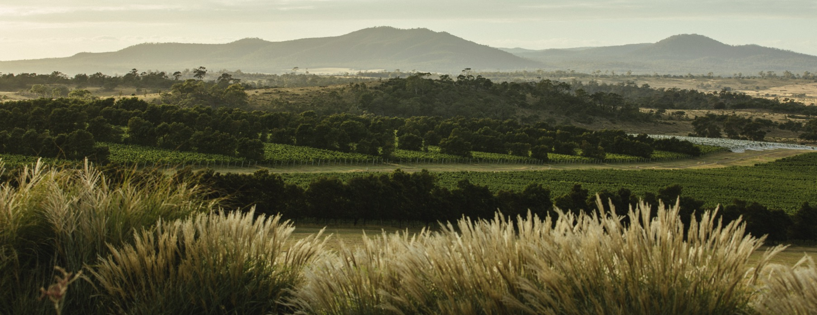
TASMANIA

Slide 2


Crafted from grapes grown under vast and diverse climates, across landscapes millions of years in the making, every glass of Australian wine tells a story.
Like those who came before us, our modern growers and makers continue to be passionate, resilient and creative; constantly driven to explore new ways to perfect old techniques. Our community is connected by a mutual respect and shared love of crafting exceptional wine, while protecting the natural wonders for future generations to enjoy. Applying modern thinking to our ancient lands, we take playful experimentation very, very seriously.
So, if you’re looking for the taste of adventure, let Australian wine be your compass. Because in every bottle of Australian wine, you’ll experience the wonders of Australia – a reminder of the adventure and diversity that defines our culture and our land.

Slide 3
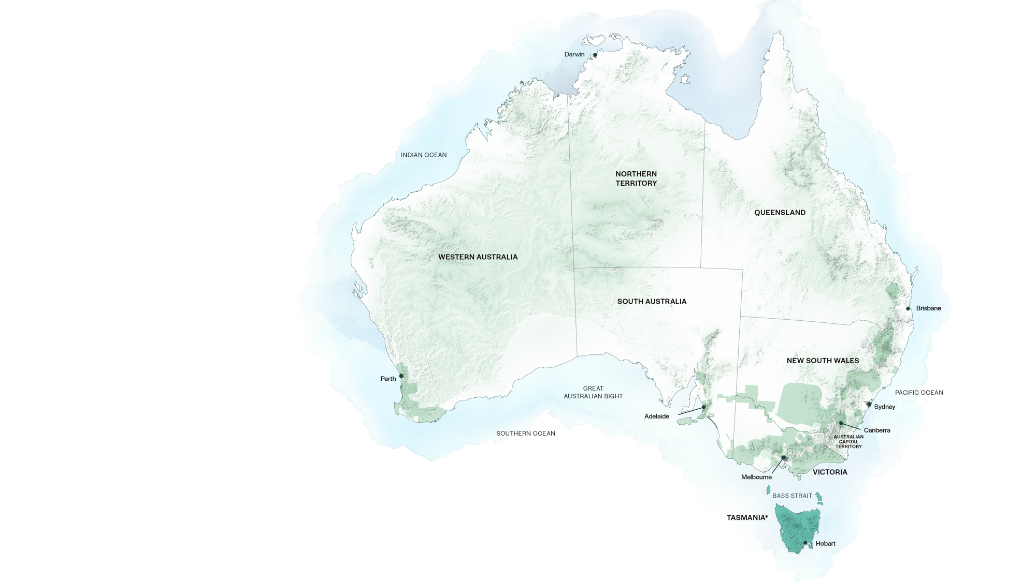
AUSTRALIA

Slide 4

TASMANIA
WINE GROWING AREAS
PIPERS RIVER
NORTH-WEST
TAMAR VALLEY
EAST COAST
COAL RIVER VALLEY
DERWENT
VALLEY
HUON / CHANNEL

Slide 5
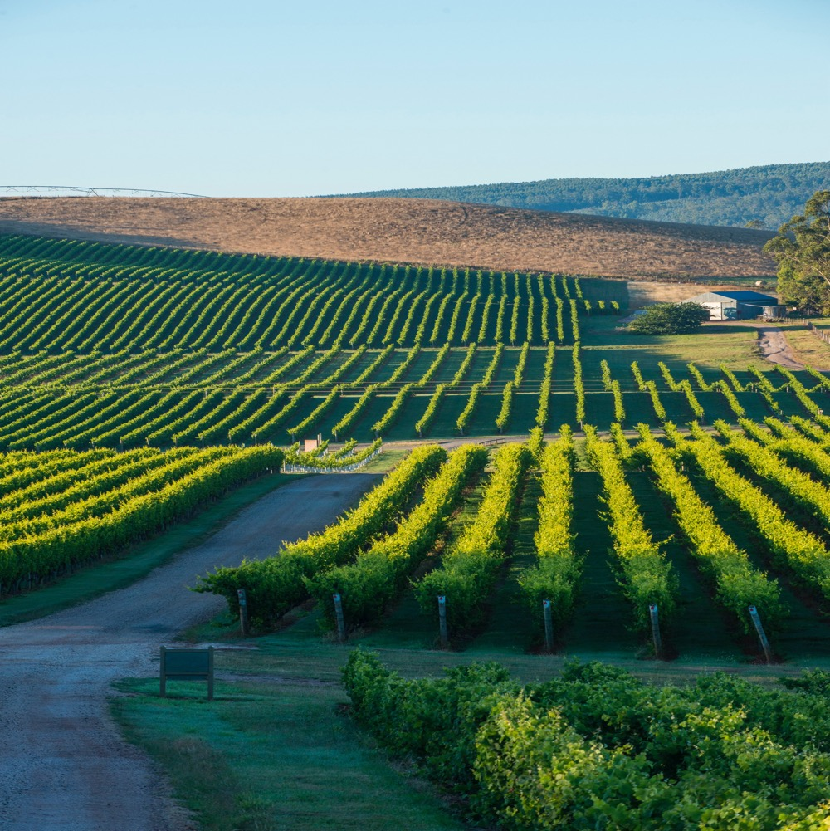
TASMANIA
TINY ISLAND, BIG PRESENCE
Celebrated as one of Australia’s finest cool-climate wine-growing areas, Tasmania is turning heads as one of the world’s premier wine regions.
Small, isolated island at the
south-eastern tip of Australia
Cool climate and diverse,
unique terroirs
Ideal conditions for Chardonnay, Pinot Noir and sparkling wines
Booming food and wine tourism industry

Slide 6
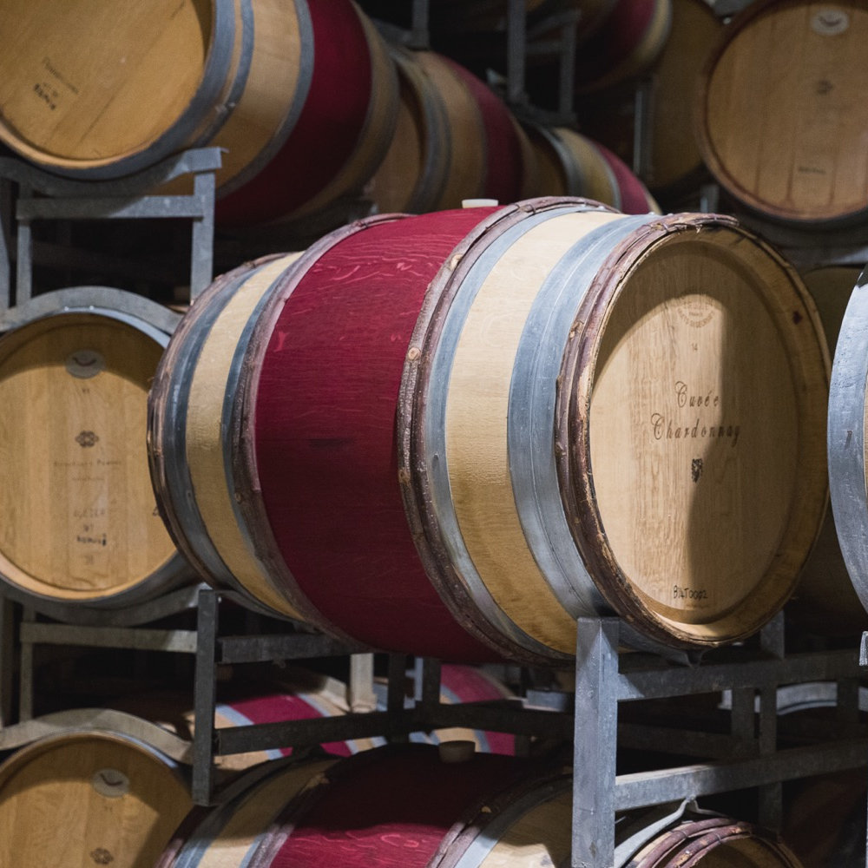
TODAY WE’LL COVER
The history of Tasmania
Geography, climate and soil
Viticulture and winemaking
Prominent varieties

Slide 7
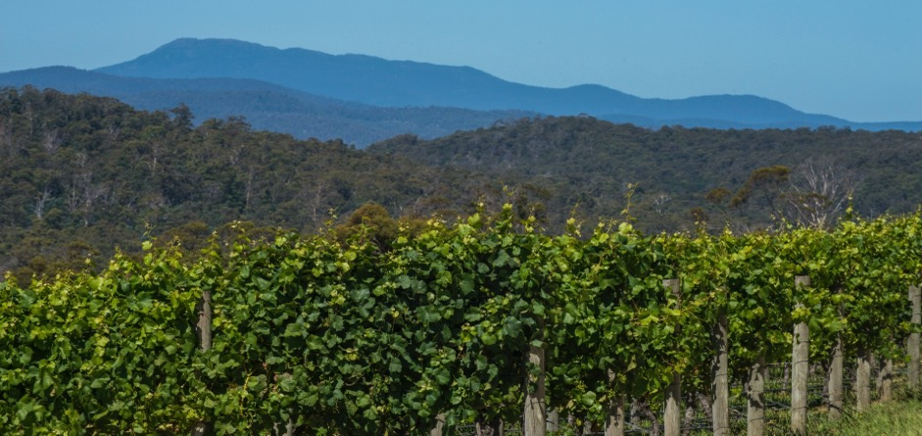
1788
THE HISTORY OF TASMANIA
1834
Settler William Henty sails
from Tasmania to Victoria,
bringing with him local
grapevine cuttings; these
cuttings would become
Victoria’s and South
Australia’s first vineyards.
1823
Bartholomew Broughton establishes first significant vineyard in the colony.
Vines first arrive in Van Diemen’s Land on the HMS Bounty; William Bligh plants them at Bruny Island. Early experimental plantings flounder.

Slide 8
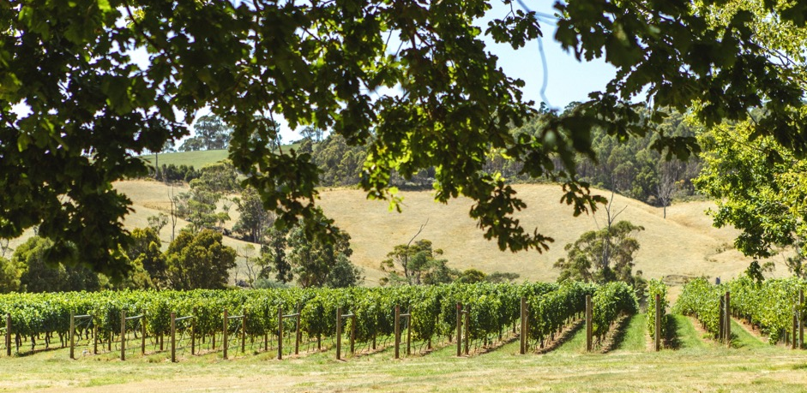
1956
Jean Miguet plants
first (new) vineyard,
La Provence - near Launceston.
Mid 1800s
1958
Van Diemen’s Land is renamed Tasmania in 1856. The Tasmanian wine and grape community all but disappears due to the Victorian gold rush.
Claudio Alcorso plants second vineyard, Moorilla Estate - in Hobart.

Slide 9
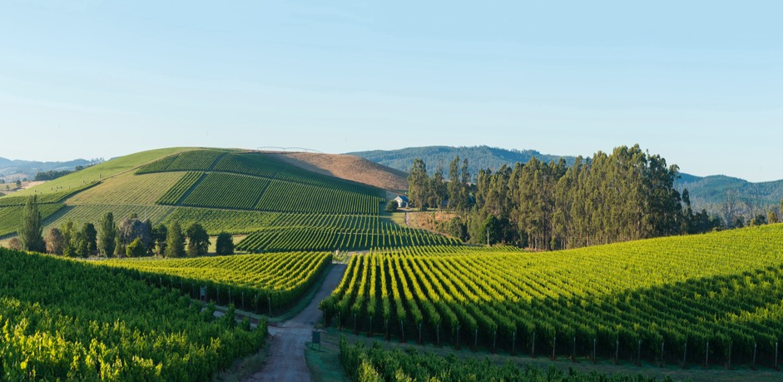
1990s
More trailblazing winemakers arrive; Tasmania begins to truly capitalise on its cool climate and unique terroirs – with great success.
1960s – 1980s
Today
Tasmanian grape and wine community enjoys period of remarkable growth; several distinct winemaking areas emerge.
Tasmania is home to a thriving wine and grape community, with around 230 individual vineyards and some of the best cool-climate wines anywhere.

Slide 10
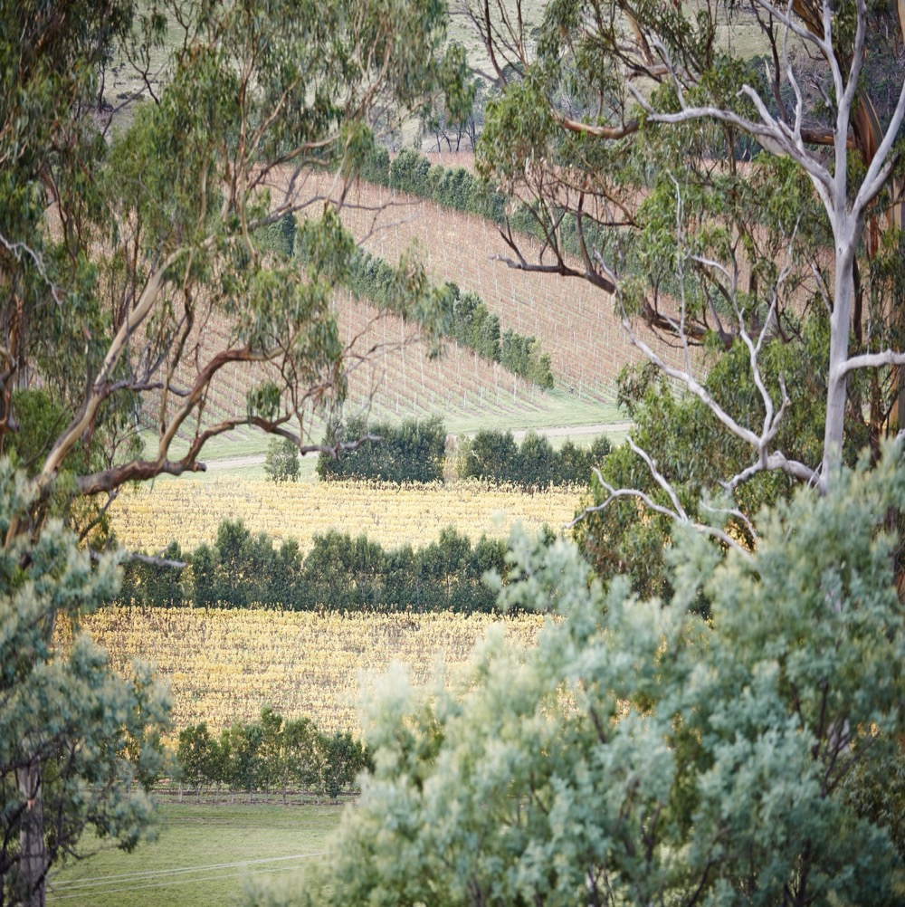
GEOGRAPHY, CLIMATE AND SOIL
A COOL-CLIMATE CHAMPION

Slide 11
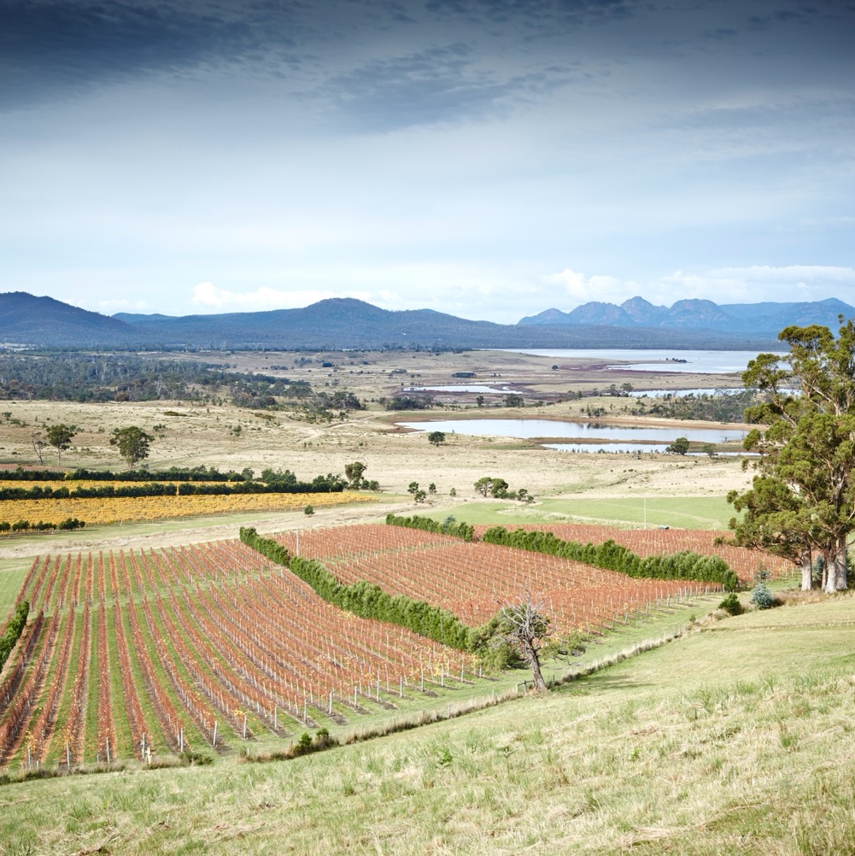
GEOGRAPHY
The only officially recognised geographic indication (GI), or appellation, for Tasmania is Tasmania itself. But it has seven distinct wine-growing areas.

Slide 12

CLIMATE
ALTITUDE
TEMPERATE
VERY HIGH
1000m +
(>3,280ft +)
WITH MARITIME INFLUENCE FROM TASMAN SEA, BASS STRAIT AND INDIAN OCEAN
HIGH
750–999m
(2,460–3,279ft)
TASMANIA
0–126M (0–4,147FT)
WITH VAST MAJORITY OF VINEYARDS BELOW 100M
MEDIUM
500–749m
(1,640–2,459ft)
LOW
0–499m
(0–1,639ft)

Slide 13

SOIL
Extremely varied soils from north to south
Sandstone and schist in Derwent Valley
Peaty alluvial and sandy low-humus soils
in Coal River Valley
Pipers River has deep, free-draining, friable soils
Tamar Valley has gravelly basalt on a clay and limestone base; friable soils
East Coast is volcanic

Slide 14
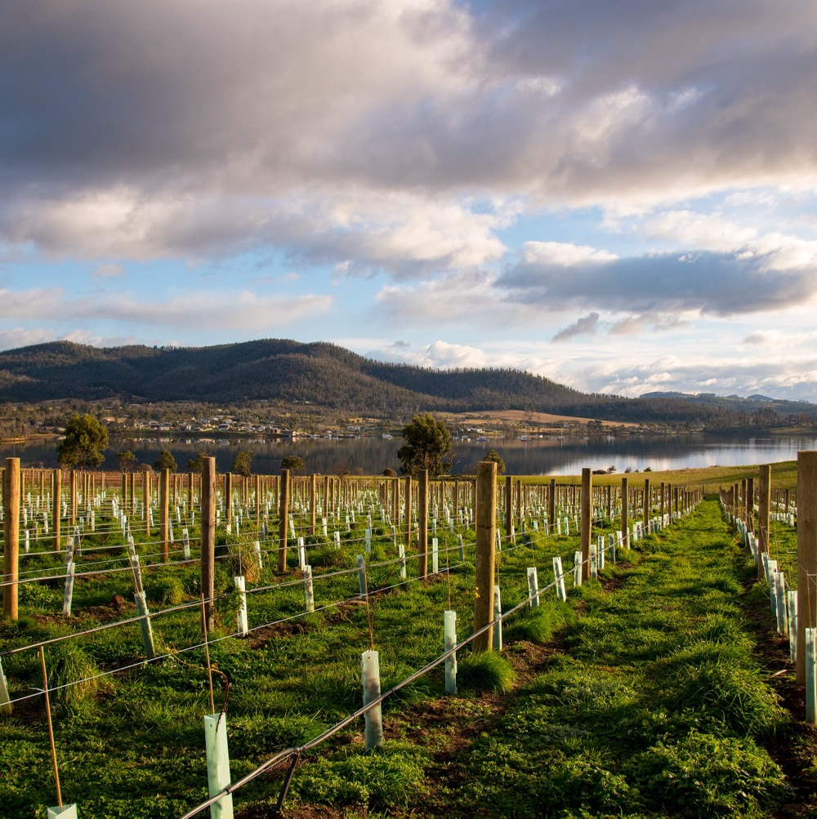
VITICULTURE IN TASMANIA
COOL-CLIMATE CHALLENGES AND OPPORTUNITIES
Risks of wind, rain, frost, drought and pests
Site selection, vintage variation and vineyard management are key

Slide 15
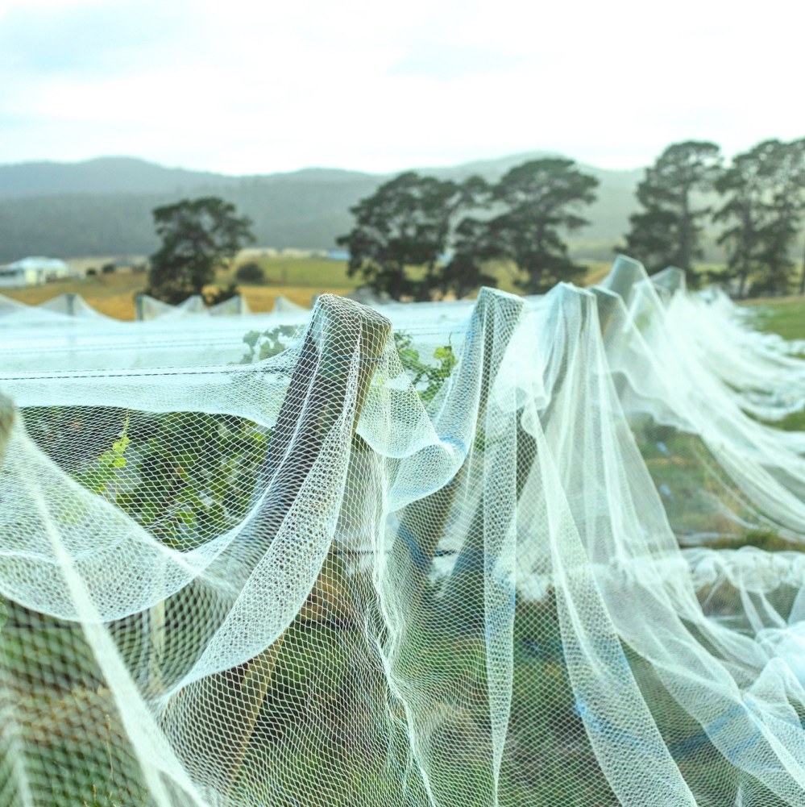
VINEYARD AND CANOPY MANAGEMENT STRATEGIES:
CONQUERING THE CHALLENGES
Windbreaks
Drip irrigation
Netting
Leaf removal

Slide 16
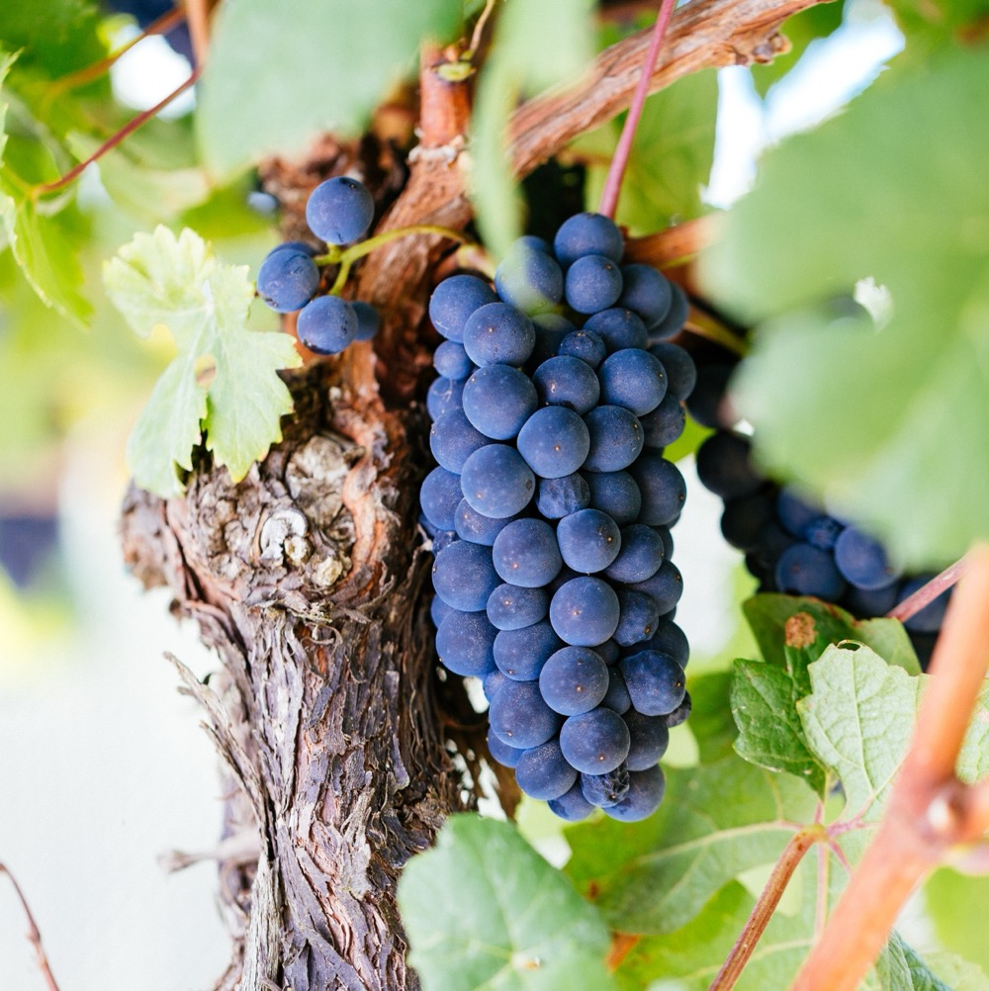
WINEMAKING IN TASMANIA
Has moved beyond first- and second-generation
Classic techniques influenced by the local climate and terroirs
Celebrates classic varieties and traditional methods but welcomes experimentation, innovative techniques and alternative varieties

Slide 17
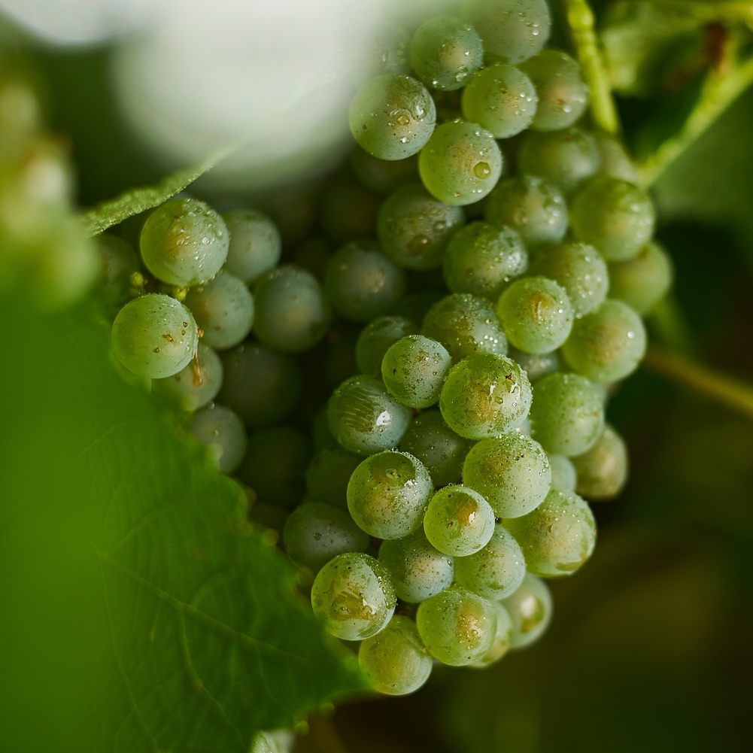
TASMANIA
NOTEWORTHY
VARIETIES

Slide 18


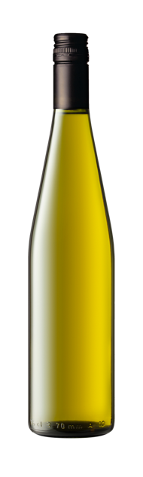
TASMANIA
TOP 5 VARIETIES
PINOT NOIR
SAUVIGNON
BLANC
PINOT GRIS
/GRIGIO
SHIRAZ
CHARDONNAY
RIESLING
PINOT NOIR
43%
CHARDONNAY
28%
SAUVIGNON BLANC
11%
PINOT GRIS
/GRIGIO
8%
RIESLING
6%

Slide 19

TASMANIA
SPARKLING
TOP NOTCH TRADITIONAL-METHOD SPARKLING WINES MADE PRIMARILY WITH PINOT NOIR AND CHARDONNAY,
AMONG THE BEST
IN AUSTRALIA
CLIMATE AND GROWNG CONDITIONS SIMILAR TO THOSE OF CHAMPAGNE, FRANCE
SPARKLING
MORE THAN
40%
OF TASMANIA’S WINES MADE
INTO SPARKLING WINES
Red Apple
Citrus
Toast
Brioche
Grilled Nuts
Grilled Bread

Slide 20
SPARKLING characteristics
COLOUR
Sparkling wine
Light
Medium
Full
BODY
Dry/Off Dry
Medium dry
Sweet
SWEETNESS
SPARKLING
Unoaked/Low
Medium
High
OAK
ACIDITY
8%
12% – 12.5%
17%
ALCOHOL

Slide 21

TASMANIA
CHARDONNAY
OAK AGEING CAN DRAMATICALLY INFLUENCE STYLE
ELEGANT, COMPLEX AND SUBTLE STYLE WITH HIGH NATURAL ACIDITY
USED EXTENSIVELY IN SPARKLING WINE PRODUCTION
CHARDONNAY
AROUND
1/4
OF TASMANIA’S PLANTINGS
FLAVOURS
Crisp apple
Pear

Slide 22
CHARDONNAY characteristics
COLOUR
Chardonnay
Light
Medium
Full
BODY
Dry
Medium dry
Sweet
SWEETNESS
CHARDONNAY
Low
Medium
High
OAK
ACIDITY
8%
12.5% – 14.5%
17%
ALCOHOL

Slide 23

TASMANIA
PINOT NOIR
PROMINENT IN THE PRODUCTION OF SPARKLING WINES
DELICATE, FRAGRANT, AROMATIC STYLE
DOMINANT
VARIETY
SLIGHTLY LESS THAN
1/2
OF THE REGION’S PLANTINGS
PINOT NOIR
FLAVOURS
Juicy red fruits
Cherry
Strawberry

Slide 24
PINOT NOIR characteristics
COLOUR
Pinot Noir
Light
Medium
Full
BODY
Dry
Medium dry
Sweet
SWEETNESS
Low
Medium
High
OAK
PINOT NOIR
ACIDITY
8%
12.5% – 13.5%
17%
ALCOHOL

Slide 25
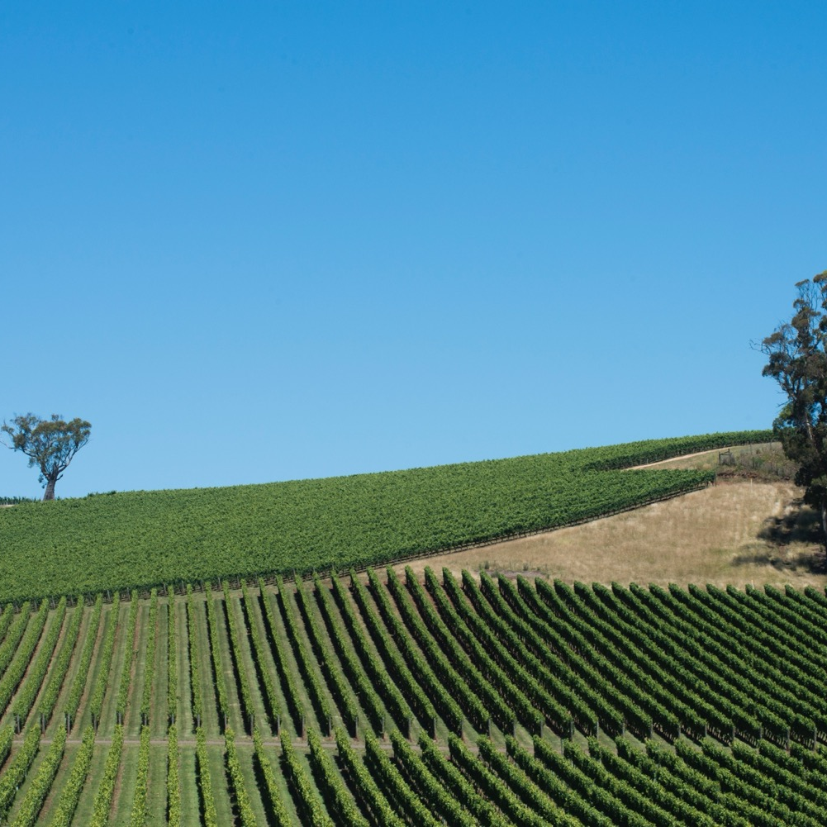
BEST OF THE REST
The cool climate suits the production of high-quality, age-worthy Riesling, vibrant Sauvignon Blanc and crisp Pinot Gris, among other varieties.
Pinot Gris
Sauvignon Blanc
Gewürztraminer
Riesling
Merlot
Cabernet Sauvignon

Slide 26
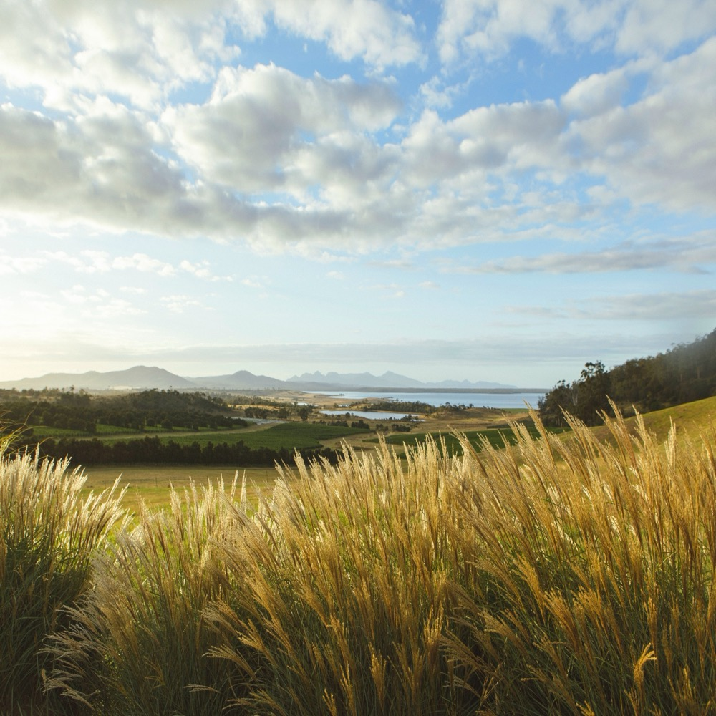
TASMANIA
A COOL-
CLIMATE CLASSIC
This tiny island’s diverse and innovative winemaking scene and increasingly sought-after wines ensure the region’s prominence on the world wine map for years to come. Indeed, the future of Tasmanian wine couldn’t be brighter.

Slide 27
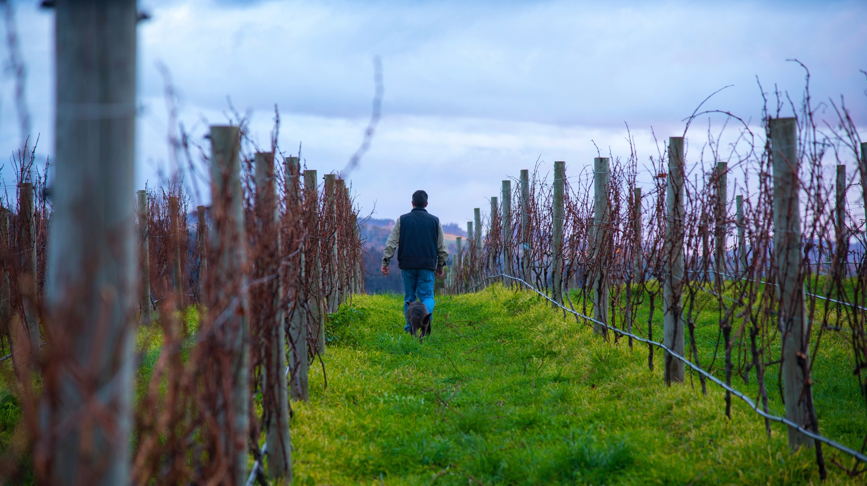
THANK YOU

