Slide 1
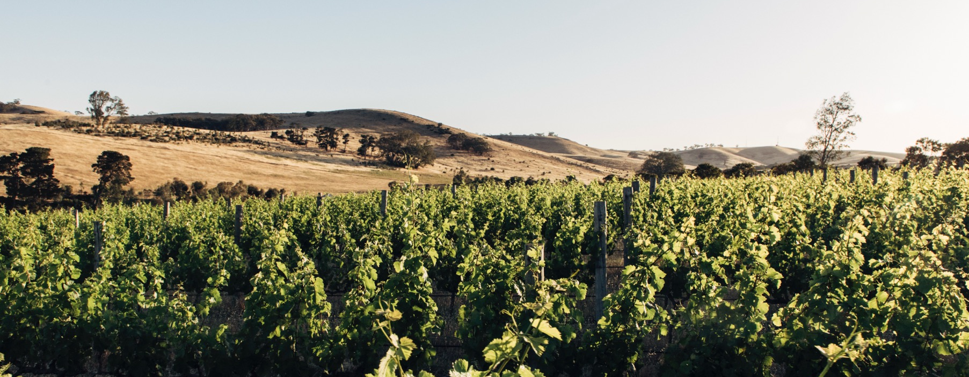
CLARE VALLEY

Slide 2


Crafted from grapes grown under vast and diverse climates, across landscapes millions of years in the making, every glass of Australian wine tells a story.
Like those who came before us, our modern growers and makers continue to be passionate, resilient and creative; constantly driven to explore new ways to perfect old techniques. Our community is connected by a mutual respect and shared love of crafting exceptional wine, while protecting the natural wonders for future generations to enjoy. Applying modern thinking to our ancient lands, we take playful experimentation very, very seriously.
So, if you’re looking for the taste of adventure, let Australian wine be your compass. Because in every bottle of Australian wine, you’ll experience the wonders of Australia – a reminder of the adventure and diversity that defines our culture and our land.

Slide 3
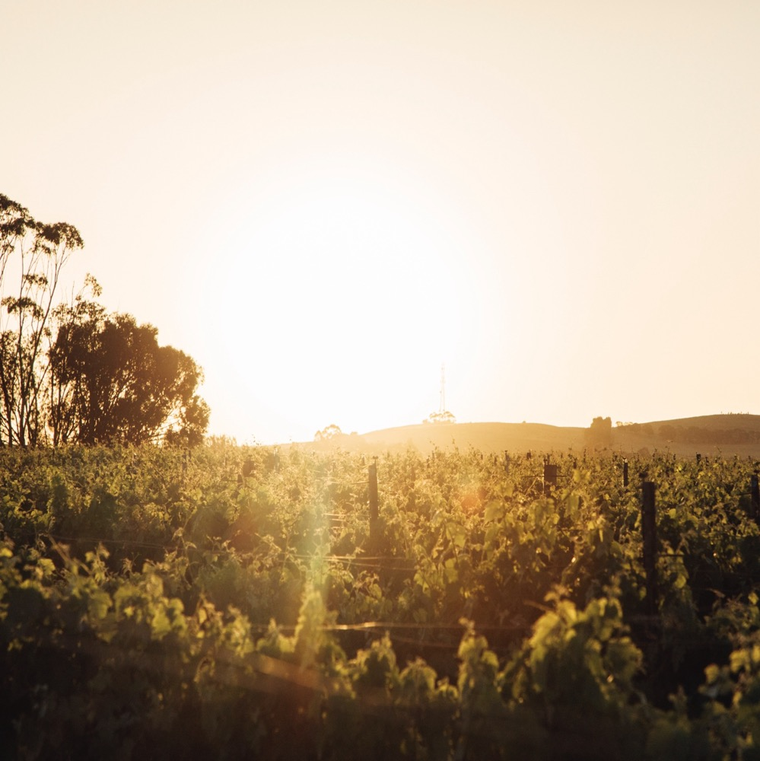
CLARE VALLEY
THE QUIET REVOLUTIONARY
Small wine region with a big reputation
Long history in Australia coupled with tradition of innovation
Variation in altitude and aspect allows for both full-bodied reds and delicate whites
Ancient soils growing diverse varieties
Renowned for Riesling, Shiraz and Cabernet Sauvignon

Slide 4
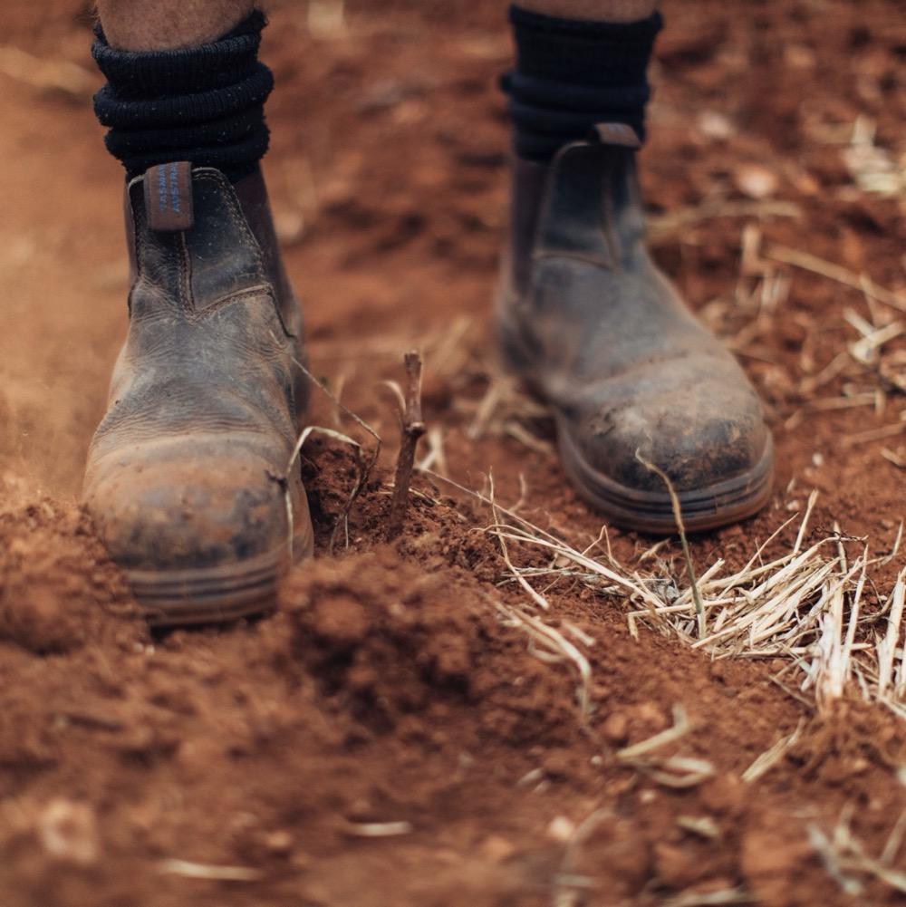
TODAY WE’LL COVER
The history of Clare Valley
Geography, climate and soil
Viticulture and winemaking
Prominent varieties

Slide 5
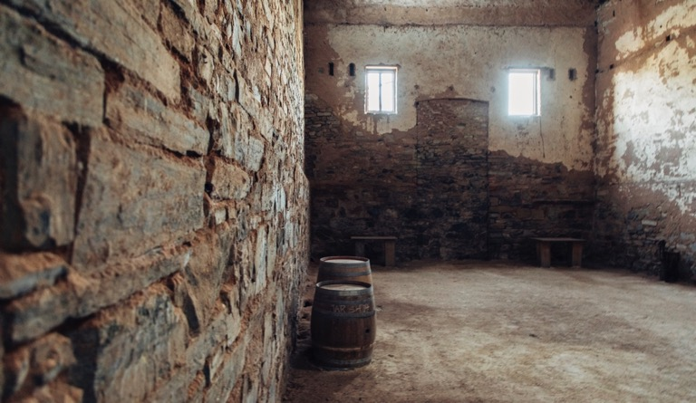
1840s
TRADITION AND TRANSFORMATION
THE HISTORY OF CLARE VALLEY
1851
1893
1900s
First vines planted by settlers John Horrocks and Edward Gleeson.
The first winery, Sevenhill Cellars, is established by the Jesuits to produce sacramental wine. It still exists today.
Alfred Percy Birks establishes the Wendouree vineyard, planting vines that are still thriving today.
The number of vineyards and wineries grows steadily, with many becoming household names.

Slide 6
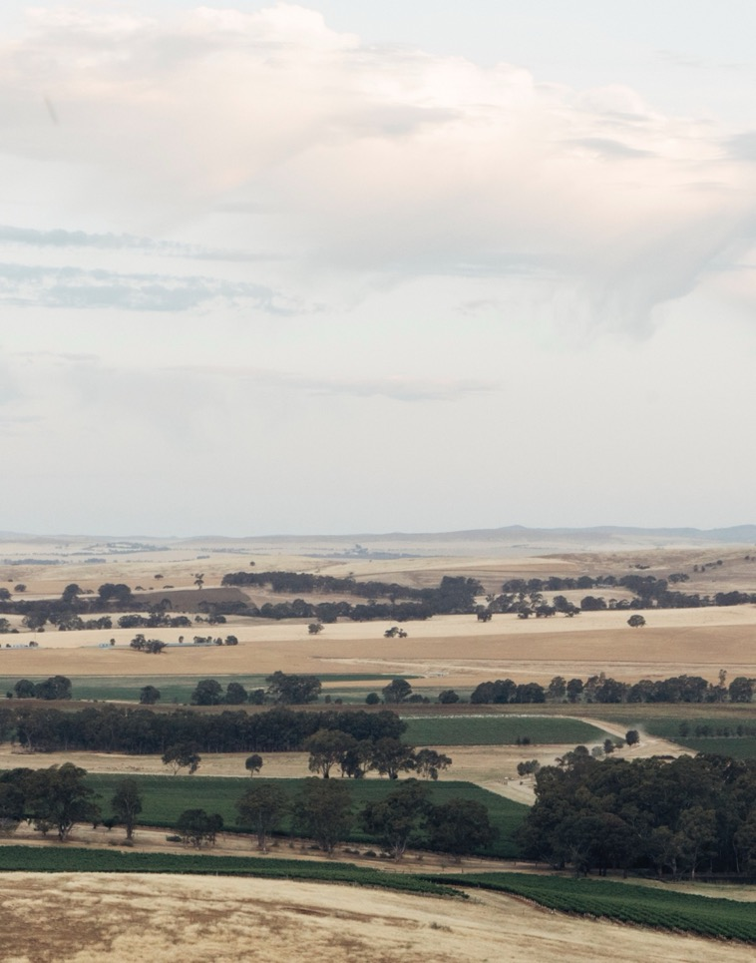
Today
2000
Clare Valley is an influential wine region producing world‑class red and white wines.
13 Clare Valley winemakers champion the screw-cap closure.
1993
2012
A disused railway line is reborn as the Riesling Trail.
Jim Barry Wines becomes the first Australian vineyard to grow the Greek variety Assyrtiko.

Slide 7
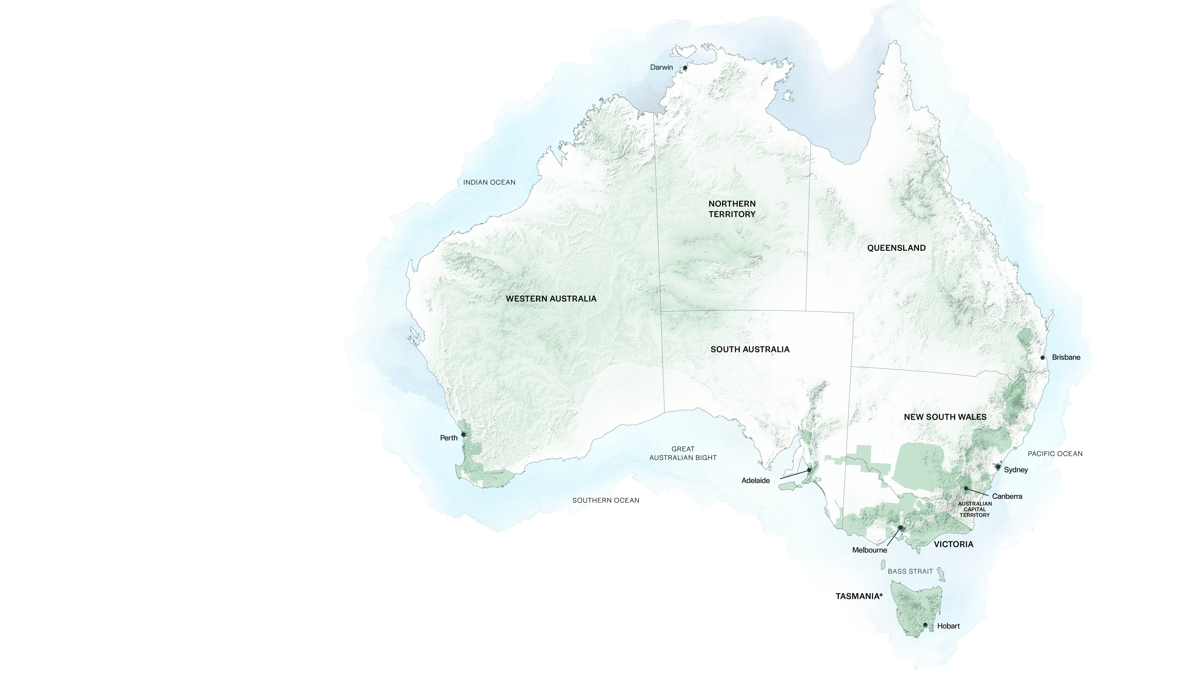
AUSTRALIA
CLARE VALLEY

Slide 8

SOUTH
AUSTRALIA
CLARE VALLEY

Slide 9
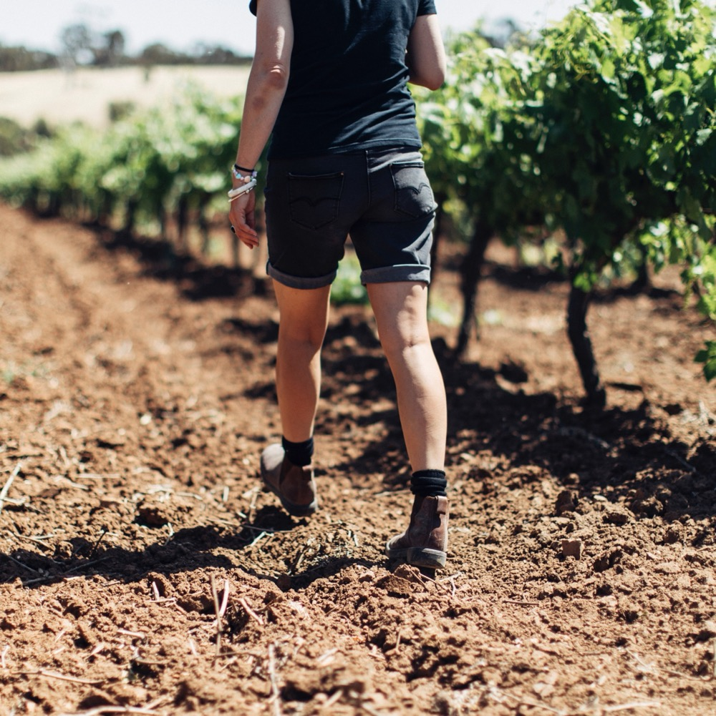
GEOGRAPHY,
CLIMATE AND SOIL
Around 130km north of Adelaide
Warm climate moderated by cold nights and afternoon breezes
Undulating landscape creates different mesoclimates
Ancient and diverse soils

Slide 10

CLIMATE
ALTITUDE
VERY HIGH
1000m +
(>3,280ft +)
CONTINENTAL
WITH SIGNIFICANT DIURNAL VARIATION AND COOLING BREEZES
CLARE VALLEY
250–550M (820–1,804FT)
HIGH
750–999m
(2,460–3,279ft)
MEDIUM
500–749m
(1,640–2,459ft)
LOW
0–499m
(0–1,639ft)

Slide 11
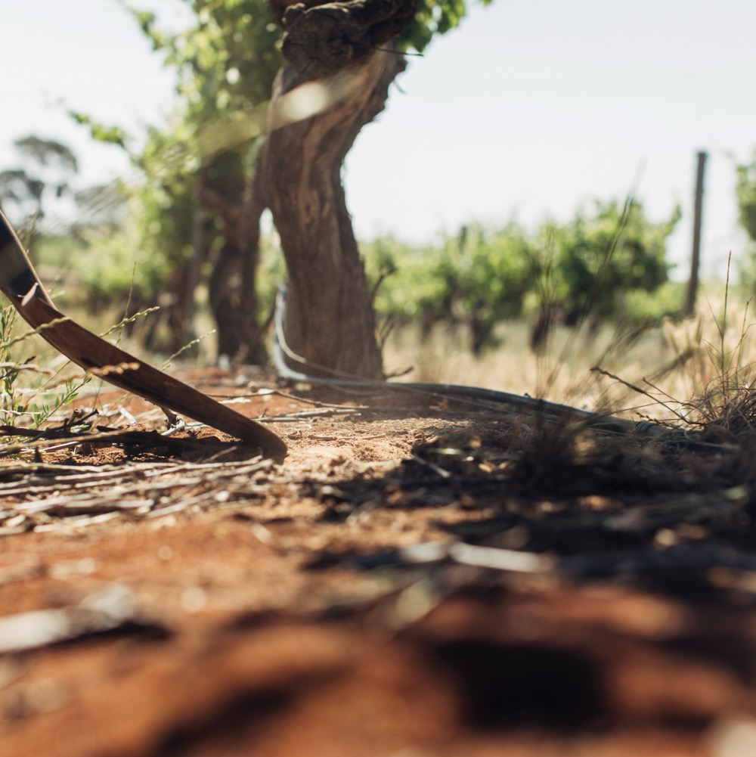
SOIL
Clare Valley has 11 recognised soil types, ranging from terra rossa red topsoil over limestone (Watervale) to broken slate (Polish Hill River). Sandy loams and degraded quartz are also found in the region’s west.

Slide 12
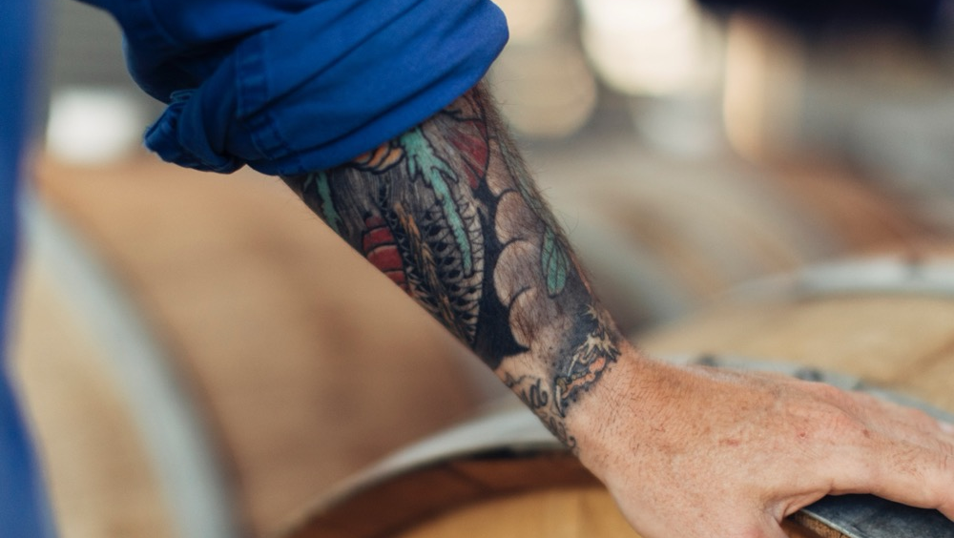
VITICULTURE AND WINEMAKING
TRAILBLAZERS AND
TRADITIONALISTS

Slide 13
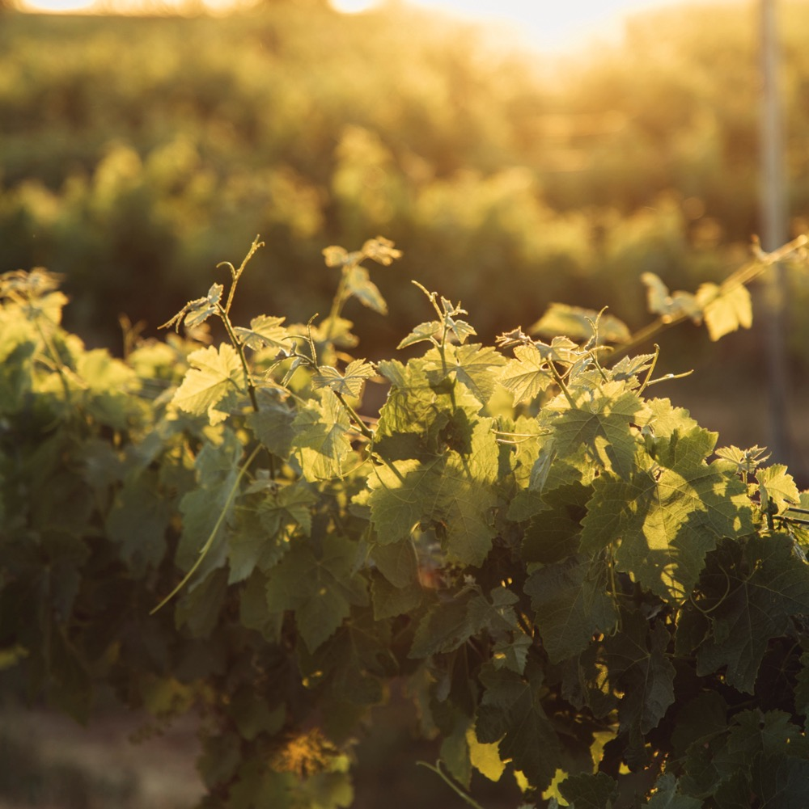
GRAPE GROWING
Variety of vineyard management systems; Vertical Shoot Positioned trellising common
Vineyards are low to moderate vigour
Soil management is a growing focus
Harvest: Early Feb to mid-April

Slide 14
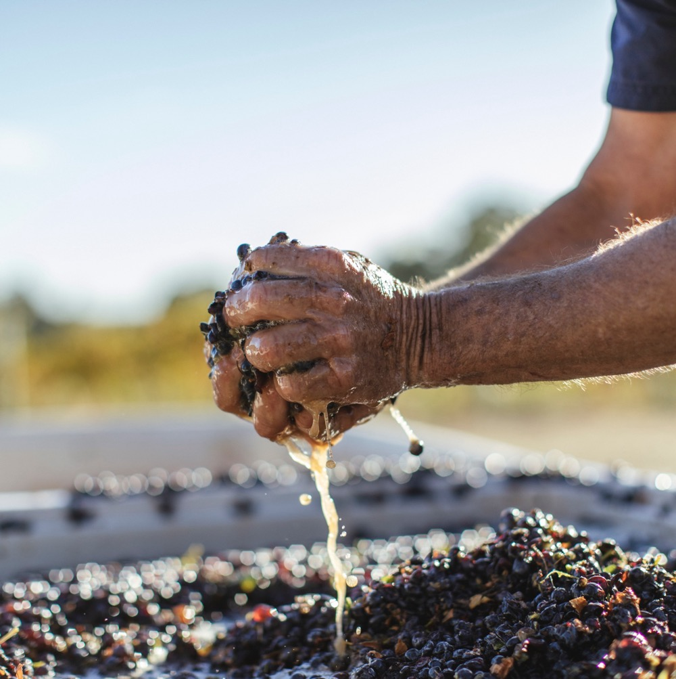
WINEMAKING IN
CLARE VALLEY
Wide variety of techniques used
Experimenting with varieties
and styles
Move away from high volume to
small batches

Slide 15
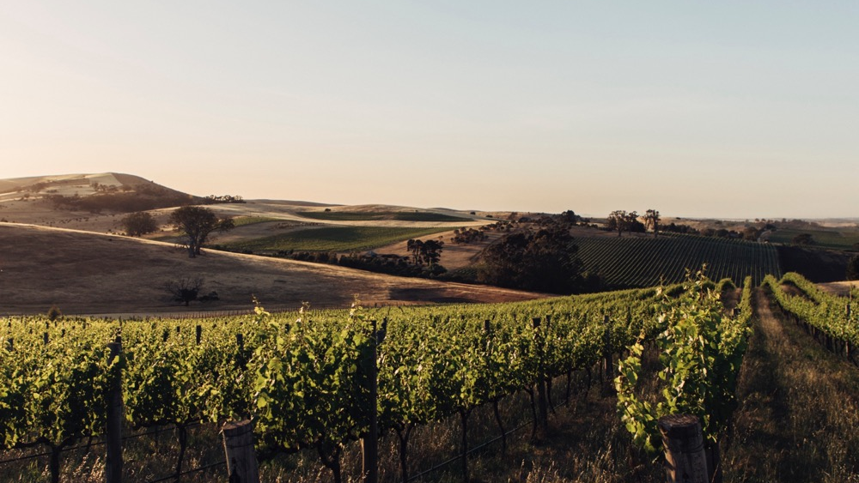
TASTE OF CLARE VALLEY
NOTEWORTHY VARIETIES

Slide 16

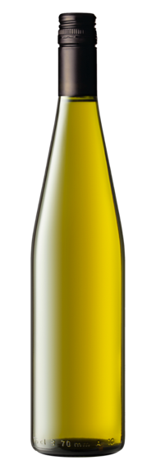

CLARE VALLEY
TOP 5 VARIETIES
RIESLING
CABERNET
SAUVIGNON
MERLOT
SHIRAZ
CHARDONNAY
RIESLING
29%
SHIRAZ
32%
CABERNET
SAUVIGNON
18%
MERLOT
6%
CHARDONNAY
5%

Slide 17

CLARE VALLEY
RIESLING
DISTINCTIVE STYLE
MANY CAN BE AGED FOR DECADES
TYPICAL FLAVOURS
Lemon zest
Lemon
Apple
Orange blossom
Honey
Toast
AROUND
1/3
OF TOTAL
ANNUAL CRUSH
RIESLING

Slide 18
RIESLING characteristics
COLOUR
Riesling
Light
Medium
Full
BODY
Dry
Medium dry
Sweet
SWEETNESS
RIESLING
Low
Medium
High
OAK (Unoaked)
ACIDITY
8%
11% – 13.5%
17%
ALCOHOL

Slide 19

CLARE VALLEY
SHIRAZ
RICH AND TEXTURED, YET WELL BALANCED
WARM DAYS PRODUCE FULL-FLAVOURED FRUIT
SHIRAZ
AROUND
1/3
OF TOTAL
ANNUAL CRUSH
TYPICAL FLAVOURS
Blackberry
Black cherry
Plum Liquorice

Slide 20
SHIRAZ characteristics
COLOUR
Shiraz
Light
Medium
Full
BODY
Dry
Medium dry
Sweet
SWEETNESS
Low
Medium
High
SHIRAZ
OAK
TANNIN
ACIDITY
8%
17%
13.5% – 15.5%
ALCOHOL

Slide 21
CLARE VALLEY
CABERNET SAUVIGNON
MORE RESTRAINED STYLE THAN SOME WARM-CLIMATE CABERNETS
RICH YET ELEGANT WITH DARK FRUIT CHARACTERS
CABERNET SAUVIGNON
ALMOST
1/5
OF TOTAL
ANNUAL CRUSH
TYPICAL FLAVOURS
Cassis
Blackcurrant
Blueberry
Dark cherry
Dark chocolate

Slide 22
CABERNET SAUVIGNON characteristics
COLOUR
Cabernet Sauvignon
Light
Medium
Full
BODY
Dry
Medium dry
Sweet
SWEETNESS
CABERNET SAUVIGNON
Low
Medium
High
OAK
TANNIN
ACIDITY
8%
13.5% – 15.5%
17%
ALCOHOL

Slide 23
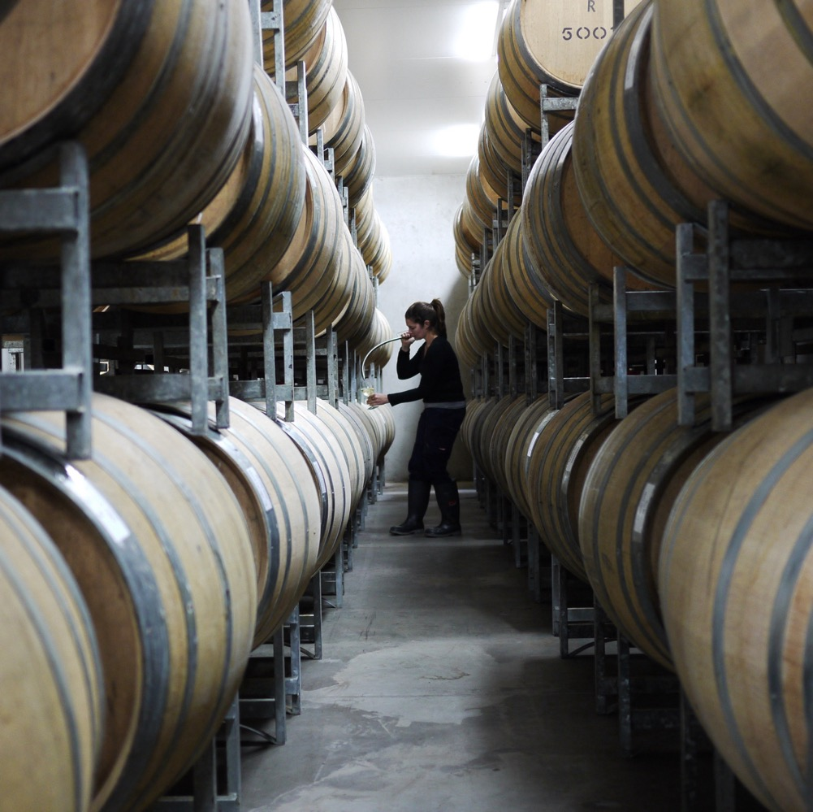
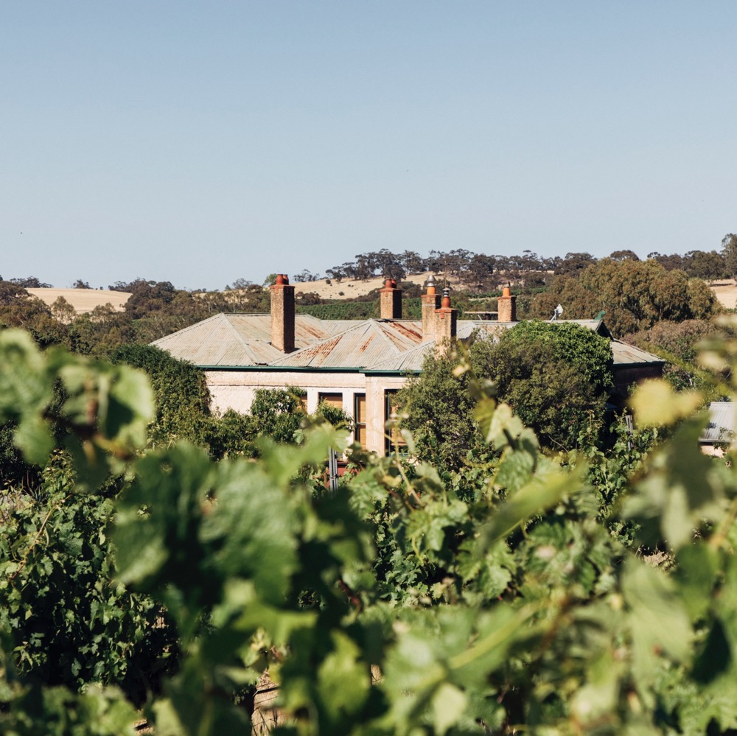
CLARE VALLEY
HISTORY AND
EVOLUTION
World-class wines and old vines in a picturesque region that continues to influence Australia’s wine scene.

Slide 24
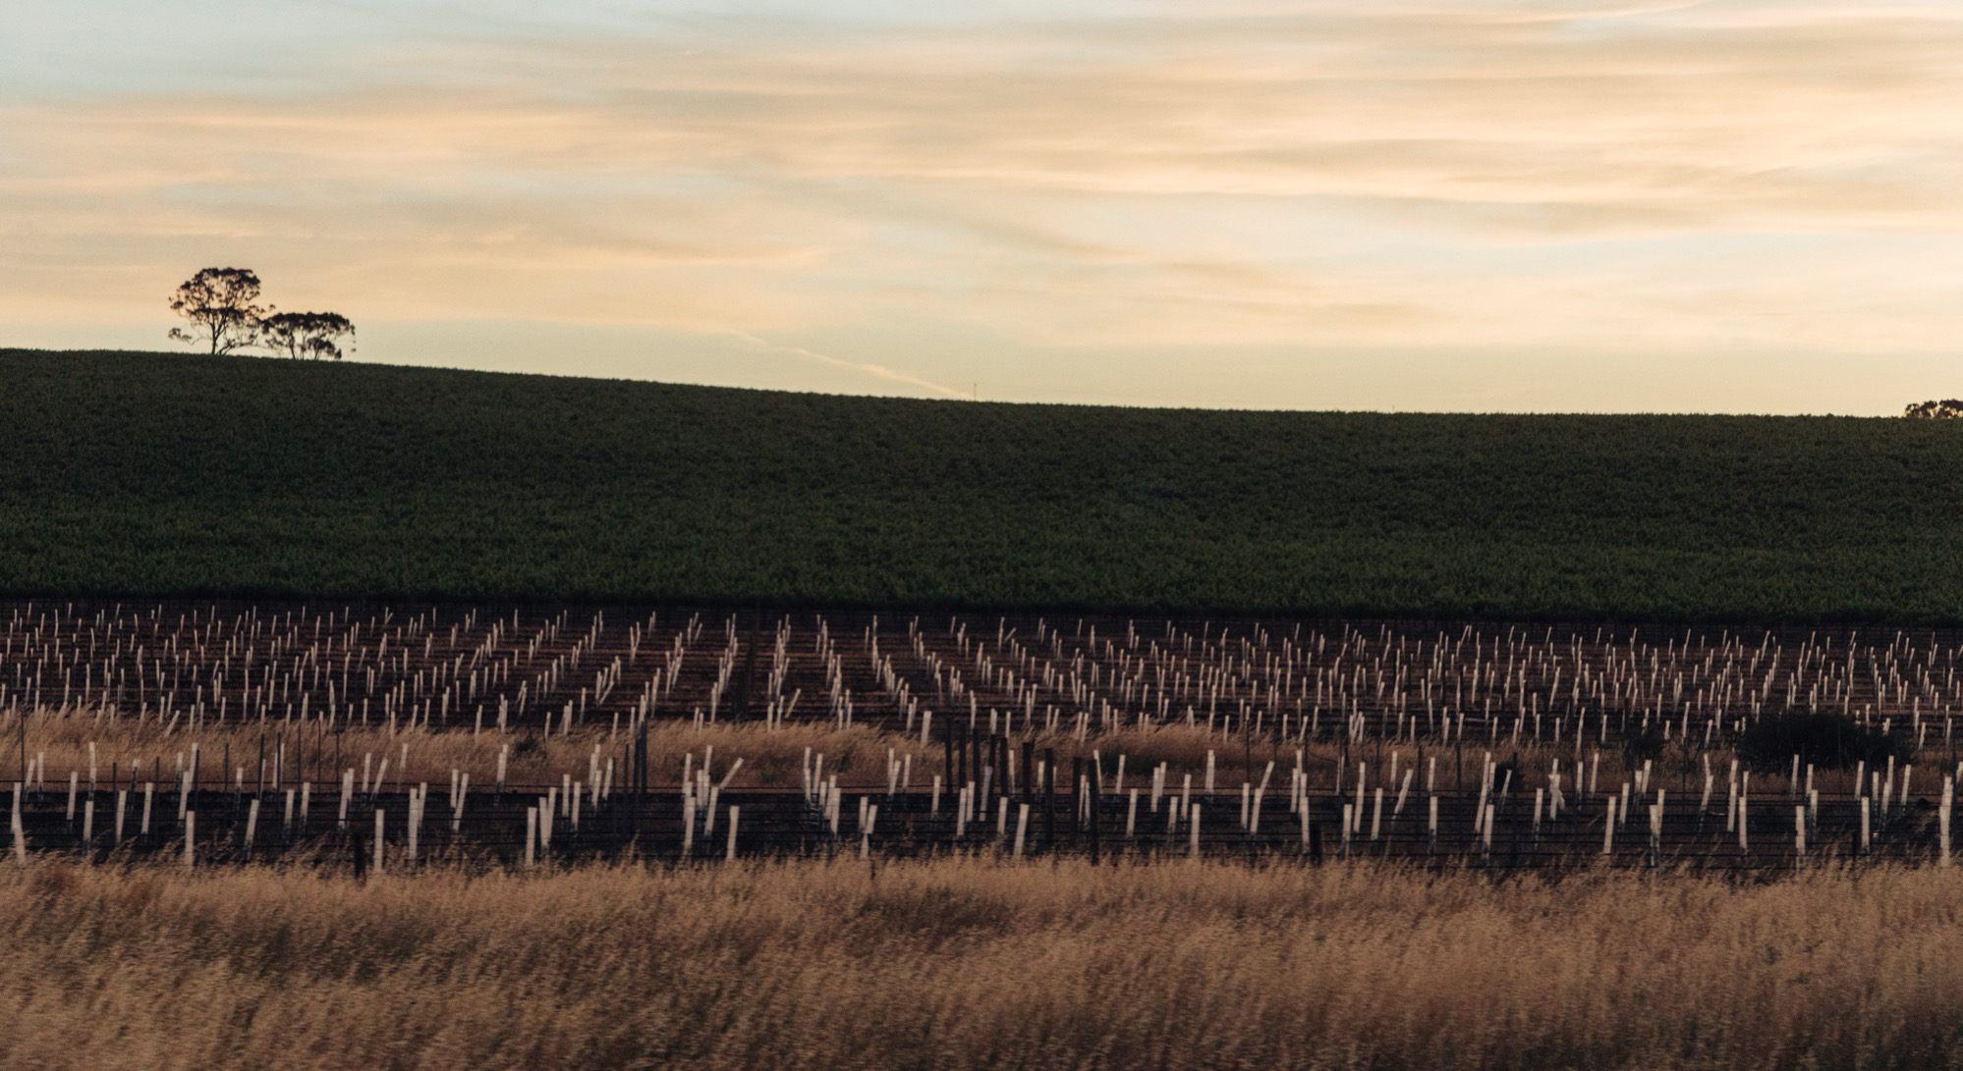
THANK YOU

