Slide 1
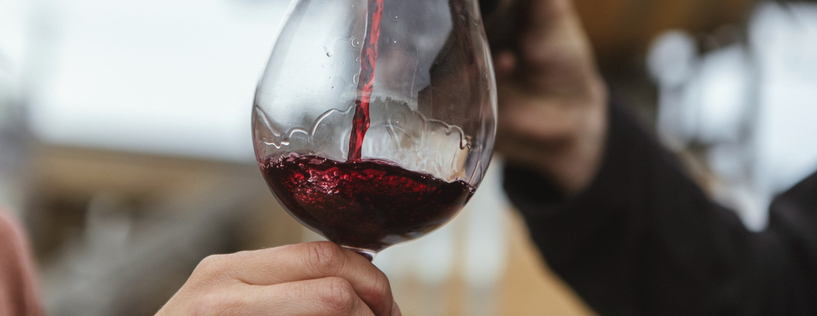
PINOT NOIR

Slide 2


Crafted from grapes grown under vast and diverse climates, across landscapes millions of years in the making, every glass of Australian wine tells a story.
Like those who came before us, our modern growers and makers continue to be passionate, resilient and creative; constantly driven to explore new ways to perfect old techniques. Our community is connected by a mutual respect and shared love of crafting exceptional wine, while protecting the natural wonders for future generations to enjoy. Applying modern thinking to our ancient lands, we take playful experimentation very, very seriously.
So, if you’re looking for the taste of adventure, let Australian wine be your compass. Because in every bottle of Australian wine, you’ll experience the wonders of Australia – a reminder of the adventure and diversity that defines our culture and our land.

Slide 3
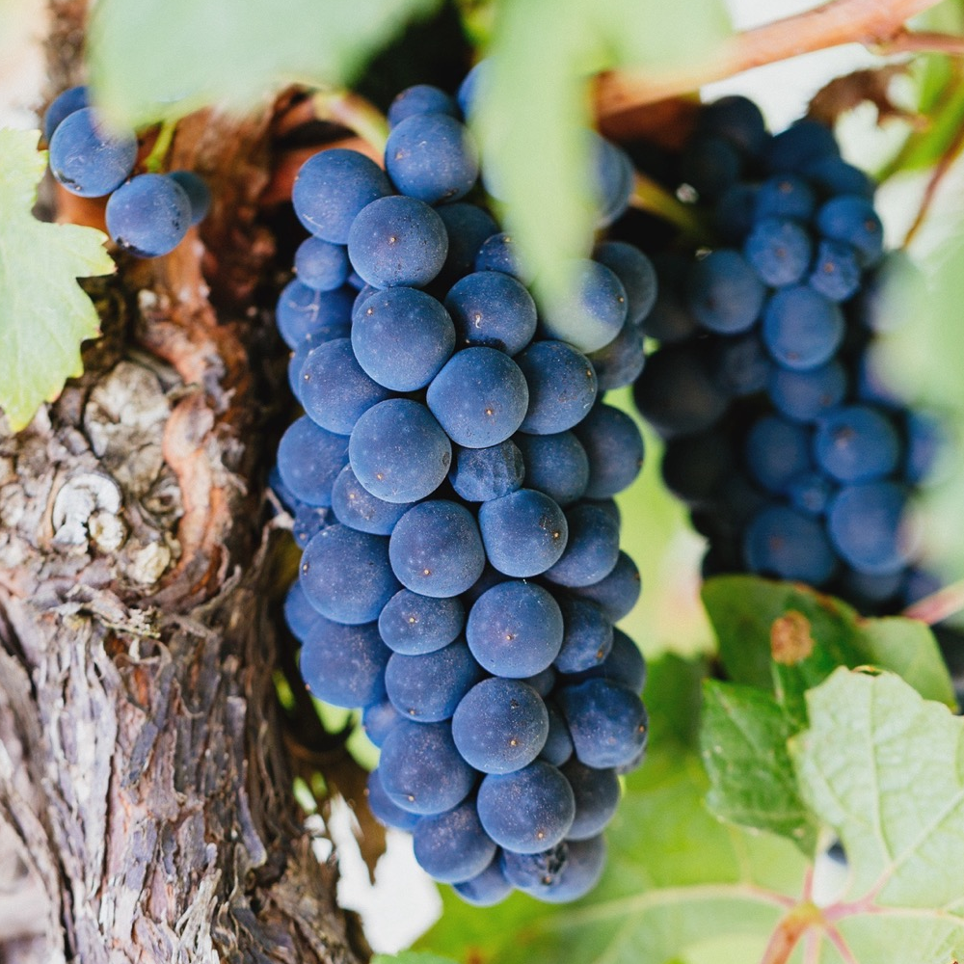
PINOT NOIR
THE DIFFICULT DARLING
Delicate Pinot Noir is a darling of the Australian wine community. Its journey started with a falter but it’s now a vital player in the evolution of Australian
wine, with demand and quality at an all‑time high.

Slide 4
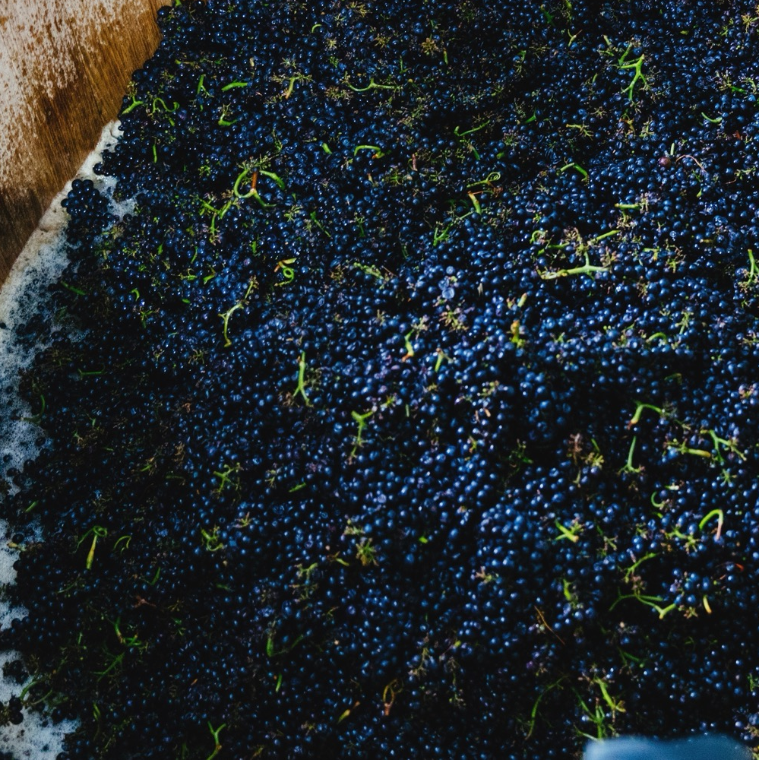
TODAY WE’LL COVER
The history of Pinot Noir in Australia
How it’s grown
How it’s made
Where it’s grown
Characteristics and flavour profiles

Slide 5
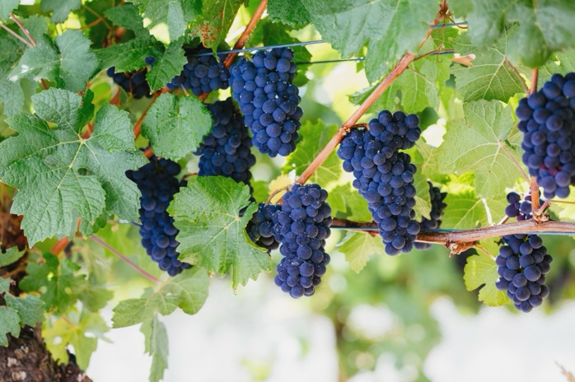
1830s
THE HISTORY OF PINOT NOIR IN AUSTRALIA
1970s
Pinot Noir begins to take off in Australia, with wineries starting to produce commercial amounts of wine. Clonal selection becomes important.
1920s
Pinot Noir cuttings from Burgundy are planted in Australia. Clones from these vines become known as the MV6 clones, still used today.
Pinot Noir begins to find its place in Australia, with wine legend Maurice O’Shea growing vines at Mount Pleasant in the Hunter Valley.

Slide 6
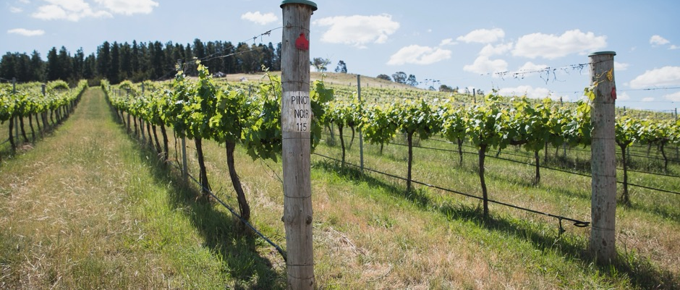
1990s
Australia sees an influx of Dijon clones, adding to the diversity of clonal material available. Pinot becomes particularly successful in Victoria, Tasmania and Adelaide Hills.
1980s
Today
The Australian wine community expands into cool-climate wine regions that are better suited to Pinot Noir.
Australian Pinot Noir today is better than ever, as vines grow older and the wine community learns more about this unique grape.

Slide 7
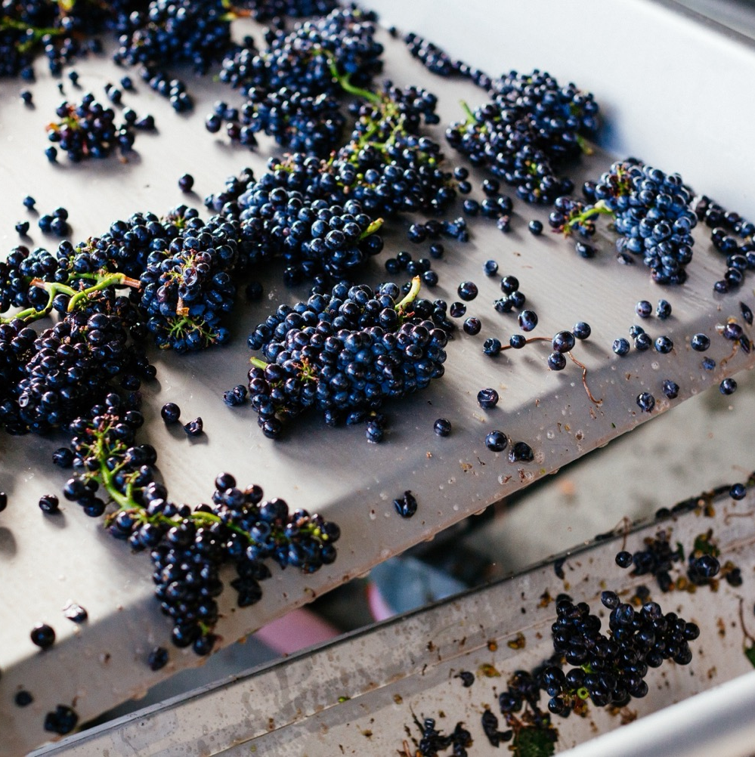
VITICULTURE
HOW PINOT NOIR IS GROWN IN AUSTRALIA
A fickle vine requiring cool or temperate climate with cooling influences
Tight clusters and thin skins make the grapes susceptible to disease, pests and rot. Careful vineyard management is key
Hundreds of different Pinot Noir clones – in Australia, MV6 and Dijon clones are mainly used
Early harvest and balanced yields produce the best results
FUN FACT
Pinot Noir has around 30,000 genes in its DNA – more than the human genome, which contains 20,000 to 25,000.

Slide 8
WINEMAKING:
TECHNIQUES INFLUENCING PINOT NOIR
KEEPS SKINS FROM GETTING TOO EXTRACTED
STEMS LEFT IN CONTACT
COLD SOAK
PUNCH DOWN
WHOLE BERRY FERMENTATION
STEM INCLUSION
WHOLE BUNCH FERMENTATION

Slide 9
WINEMAKING:
TECHNIQUES INFLUENCING PINOT NOIR
WILD FERMENTATION
COLD FERMENTATION
EXTENDED MACERATION
MATURATION

Slide 10
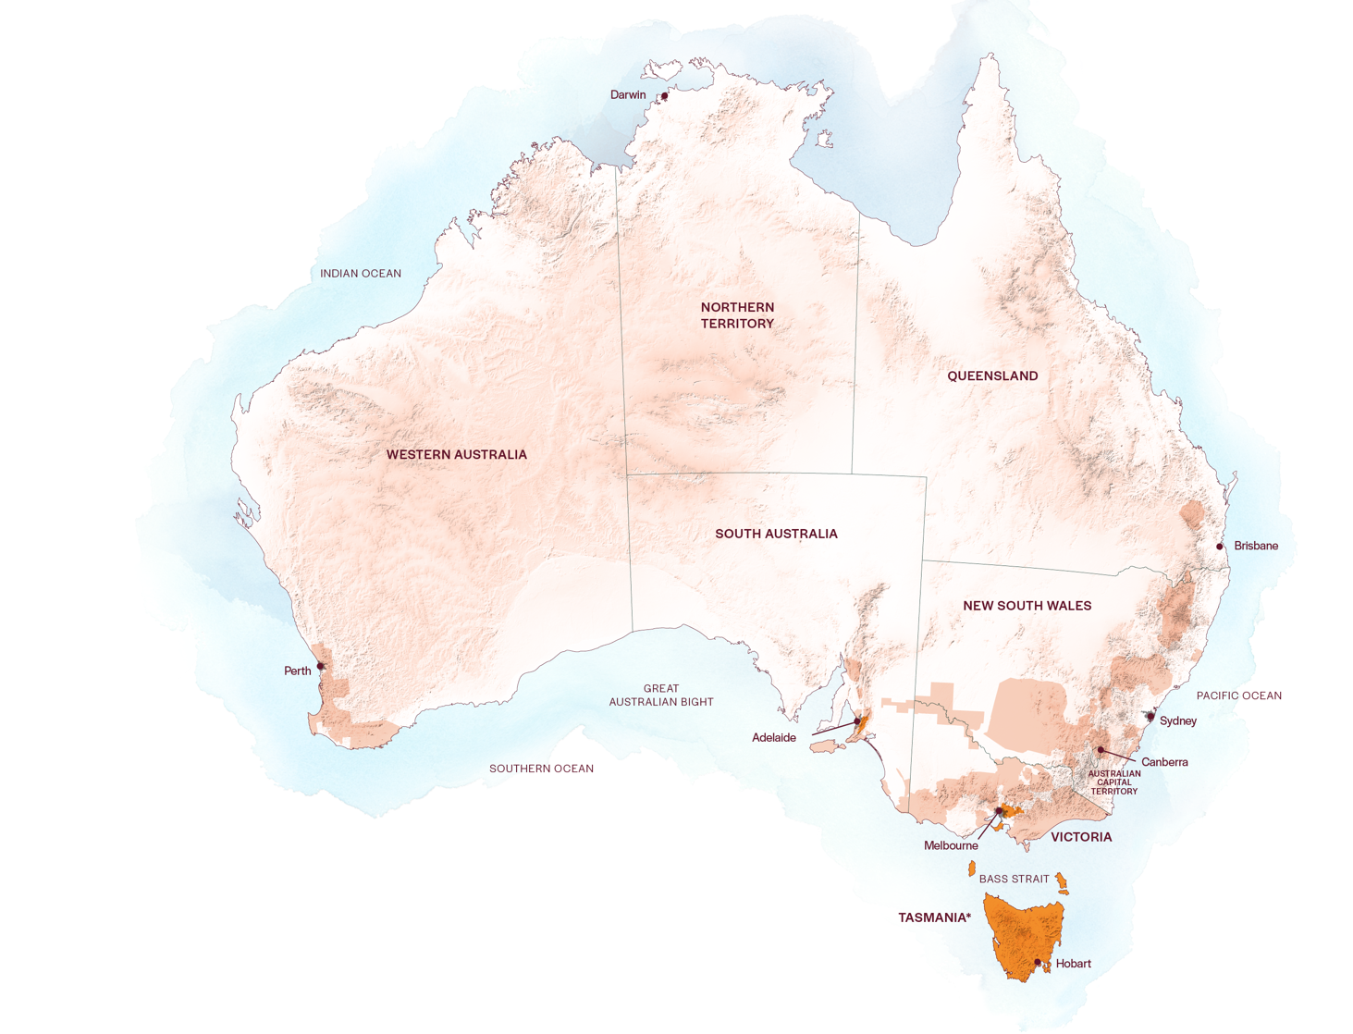
AUSTRALIAN
PINOT NOIR
REGIONS
ADELAIDE HILLS
MORNINGTON PENINSULA
YARRA VALLEY
TASMANIA

Slide 11

TASMANIA
Fine cool-climate region
Sparkling wine wonderland
Gourmet paradise

Slide 12

CLIMATE
ALTITUDE
VERY HIGH
1000m +
(>3,280ft +)
TEMPERATE
HIGH
750–999m
(2,460–3,279ft)
WITH MARITIME INFLUENCE FROM TASMAN SEA, BASS STRAIT AND INDIAN OCEAN
TASMANIA
10–330M (32–1,083FT)
WITH VAST MAJORITY OF VINEYARDS BELOW 100M (328FT)
MEDIUM
500–749m
(1,640–2,459ft)
LOW
0–499m
(0–1,639ft)

Slide 13

SOIL
On the lower slopes, the vineyard soils feature ancient sandstones, mudstones, river sediments and igneous rock of volcanic origin. Sandstone and schist appear in Derwent Valley. Peaty alluvial and sandy low humus soils appear in Coal River Valley. Pipers River boasts deep, free‑draining, friable soils, while Tamar Valley is gravelly basalt on a clay and limestone base.

Slide 14

VICTORIA
YARRA VALLEY

Slide 15

YARRA VALLEY
Popular tourist destination
Colourful history
Groundbreaking winemakers
Food and wine paradise

Slide 16

CLIMATE
ALTITUDE
VERY HIGH
1000m +
(>3,280ft +)
CONTINENTAL
WITH MEDITERRANEAN INFLUENCES
HIGH
750–999m
(2,460–3,279ft)
YARRA VALLEY
30–400M (98–1,312FT)
MEDIUM
500–749m
(1,640–2,459ft)
LOW
0–499m
(0–1,639ft)

Slide 17
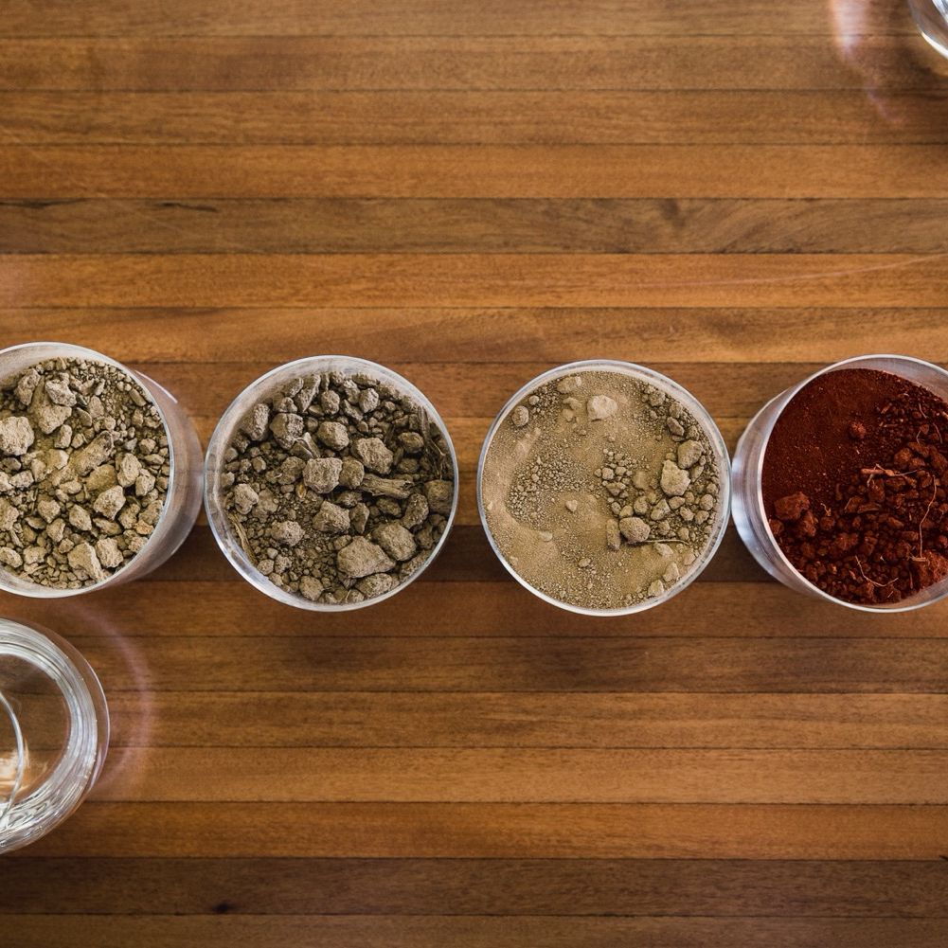
SOIL
The Yarra Valley’s northern side feature soils of grey to grey-brown on the surface, and with red‑brown clay subsoils often filled with rock. The other major soil type is the fertile red volcanic soil on the southern side of the valley.

Slide 18
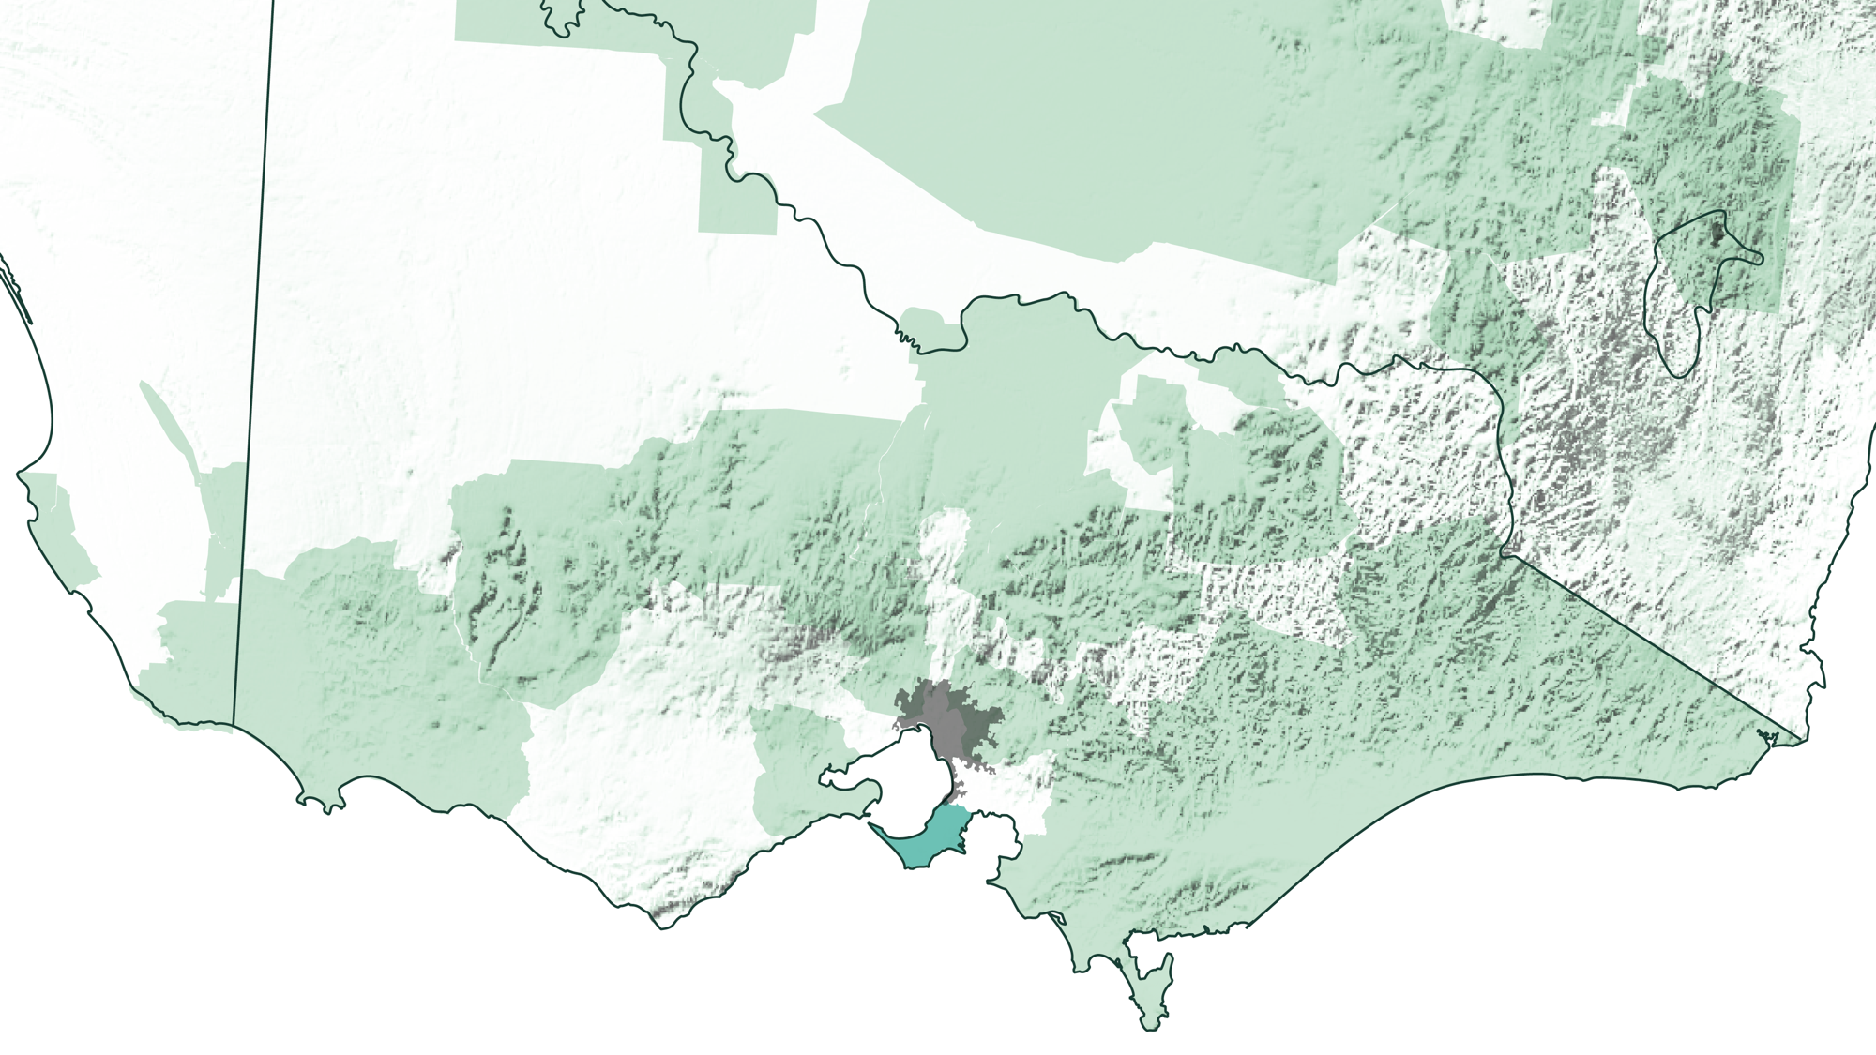
VICTORIA
MORNINGTON PENINSULA

Slide 19

MORNINGTON PENINSULA
Diverse maritime climate
Pinot paradise
Boutique producers
Melbourne's seaside playground
FUN FACT
No vineyard site in the Mornington Peninsula is further than 7km from the ocean

Slide 20

CLIMATE
ALTITUDE
TRUE MARITIME
VERY HIGH
1000m +
(>3,280ft +)
HIGH
750–999m
(2,460–3,279ft)
MORNINGTON PENINSULA
10–260M (32–853FT)
WITH AN ARRAY OF MESOCLIMATES AND MICROCLIMATES
MEDIUM
500–749m
(1,640–2,459ft)
LOW
0–499m
(0–1,639ft)

Slide 21

SOIL
The Mornington Peninsula’s soils differ across the region, ranging from deep fertile sandy soils in the northern area, yellow and brown soils over friable, well-drained clay and russet-red volcanic-based soils in the south.

Slide 22
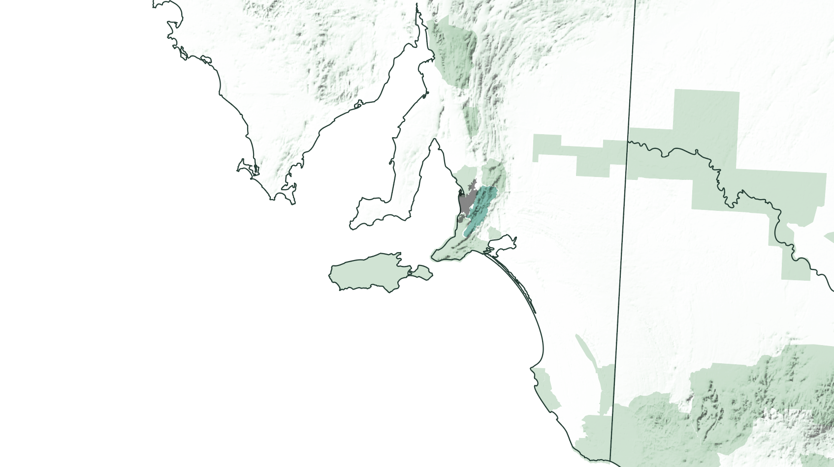
SOUTH AUSTRALIA
ADELAIDE HILLS

Slide 23
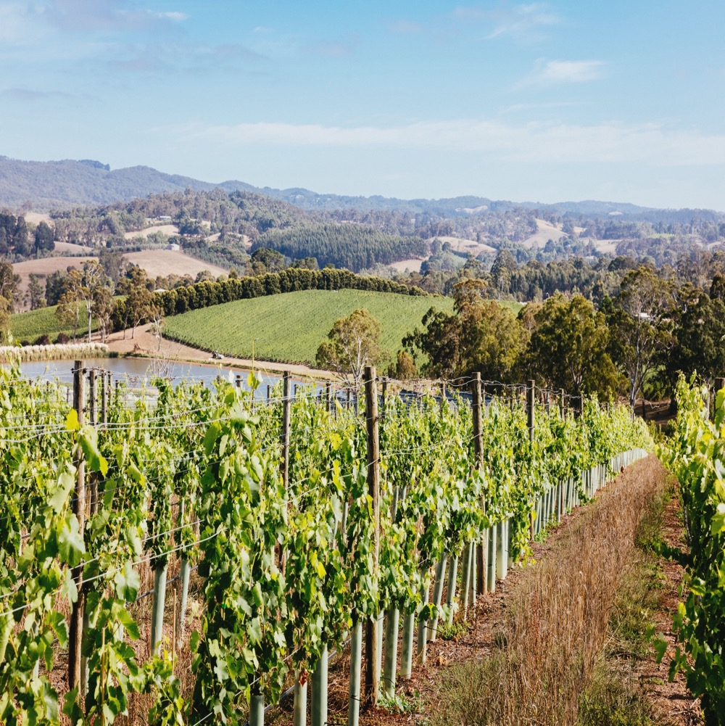
ADELAIDE HILLS
German heritage
Food lovers’ haven
Rebirth of a region
Cool-climate centre

Slide 24

CLIMATE
ALTITUDE
MODERATE MARITIME
VERY HIGH
1000m +
(>3,280ft +)
WITH COOL-CLIMATE CHARACTERISTICS
ADELAIDE HILLS
230–650M (755–2,133FT)
HIGH
750–999m
(2,460–3,279ft)
MEDIUM
500–749m
(1,640–2,459ft)
LOW
0–499m
(0–1,639ft)

Slide 25

SOIL
Adelaide Hills’ soils are highly variable in structure and chemistry. The region has a mixture of grey-brown or brown loamy sands, while soil depth is variable due to topography.

Slide 26

PINOT NOIR
CHARACTERISTICS AND FLAVOUR PROFILES
COLOUR
Pinot Noir
Light
Medium
Full
BODY
Dry
Medium dry
Sweet
FLAVOURS
Cherry
Strawberry
Plum
Roses
Violets
Earth
SWEETNESS
Low
Medium
High
PINOT NOIR
OAK
TANNIN
ACIDITY
8%
13% – 14%
17%
ALCOHOL

Slide 27

FOOD PAIRINGS
SALMON
CHICKEN
DUCK
PINOT NOIR
PORK
CHARCUTERIE
PATÉ AND TERRINE
COMTÉ CHEESE

Slide 28

THE RISE AND RISE OF
AUSTRALIAN PINOT NOIR
The future is bright, with Pinot plantings increasing and cool‑climate winemakers continually making adjustments, perfecting traditional techniques and inventing their own ways of doing things.

Slide 29
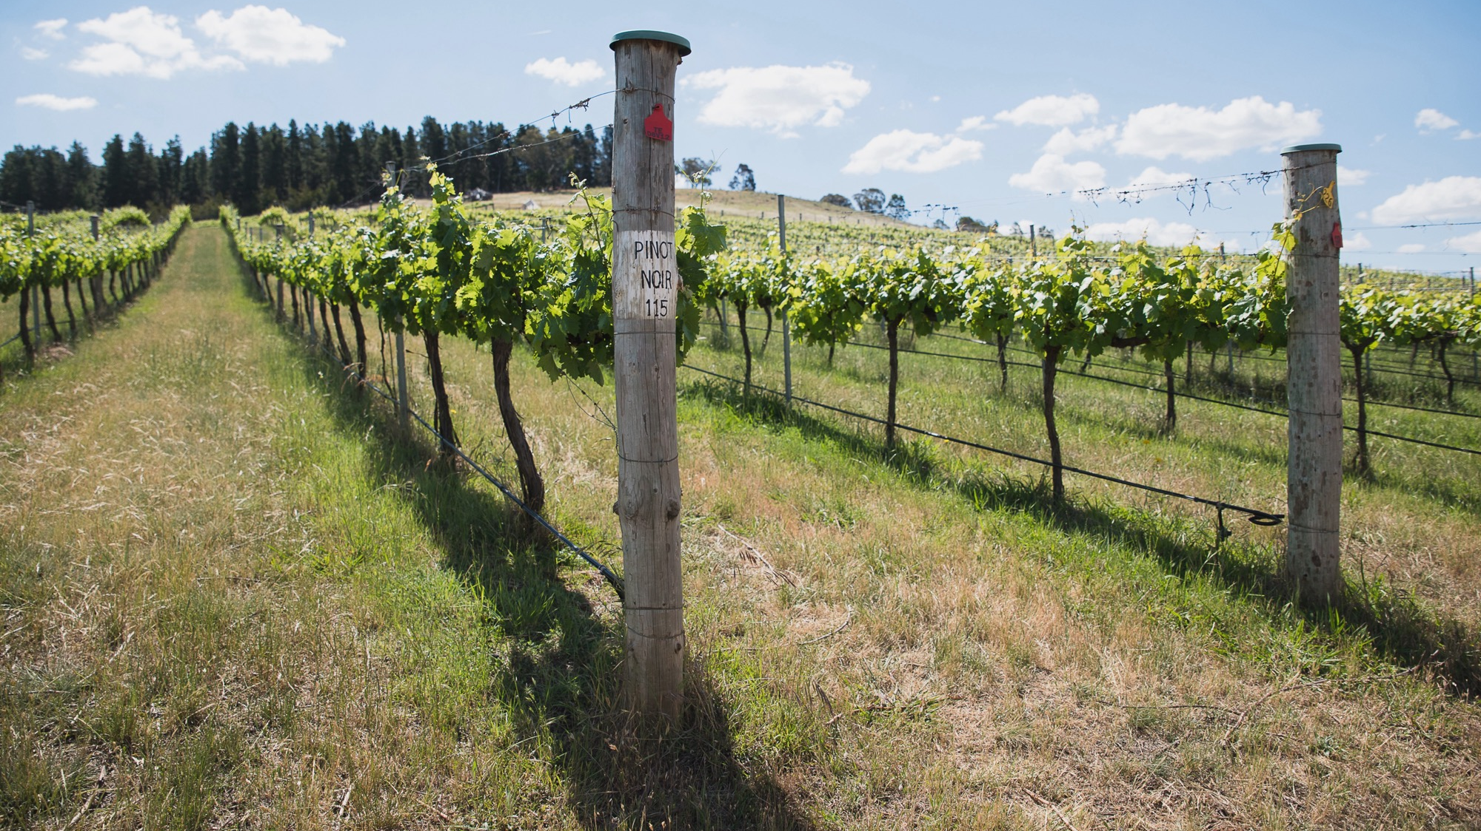
THANK YOU

