Slide 1
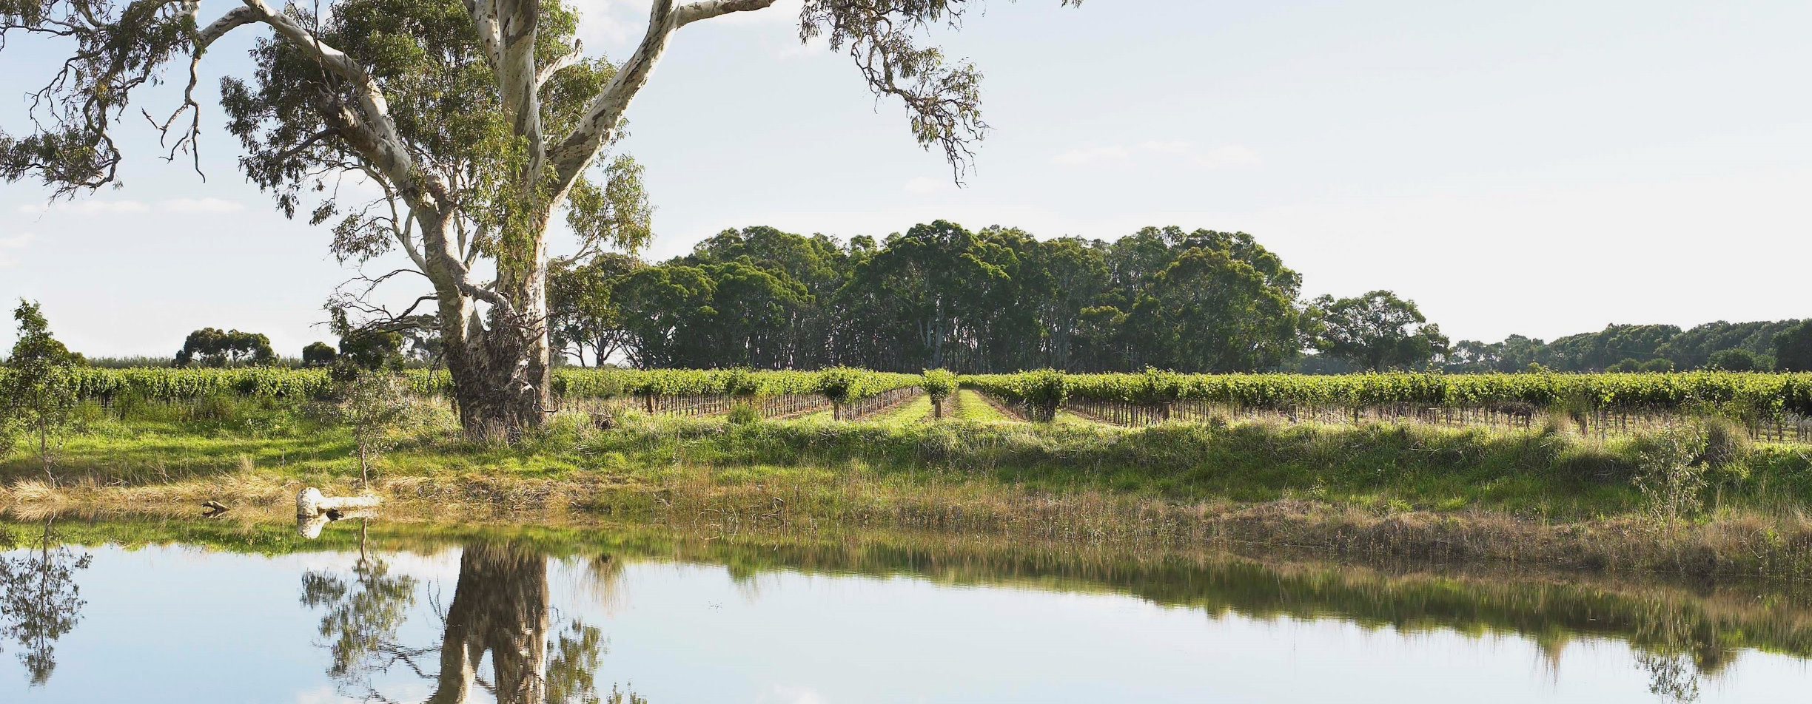
LANGHORNE CREEK

Slide 2


Crafted from grapes grown under vast and diverse climates, across landscapes millions of years in the making, every glass of Australian wine tells a story.
Like those who came before us, our modern growers and makers continue to be passionate, resilient and creative; constantly driven to explore new ways to perfect old techniques. Our community is connected by a mutual respect and shared love of crafting exceptional wine, while protecting the natural wonders for future generations to enjoy. Applying modern thinking to our ancient lands, we take playful experimentation very, very seriously.
So, if you’re looking for the taste of adventure, let Australian wine be your compass. Because in every bottle of Australian wine, you’ll experience the wonders of Australia – a reminder of the adventure and diversity that defines our culture and our land.

Slide 3
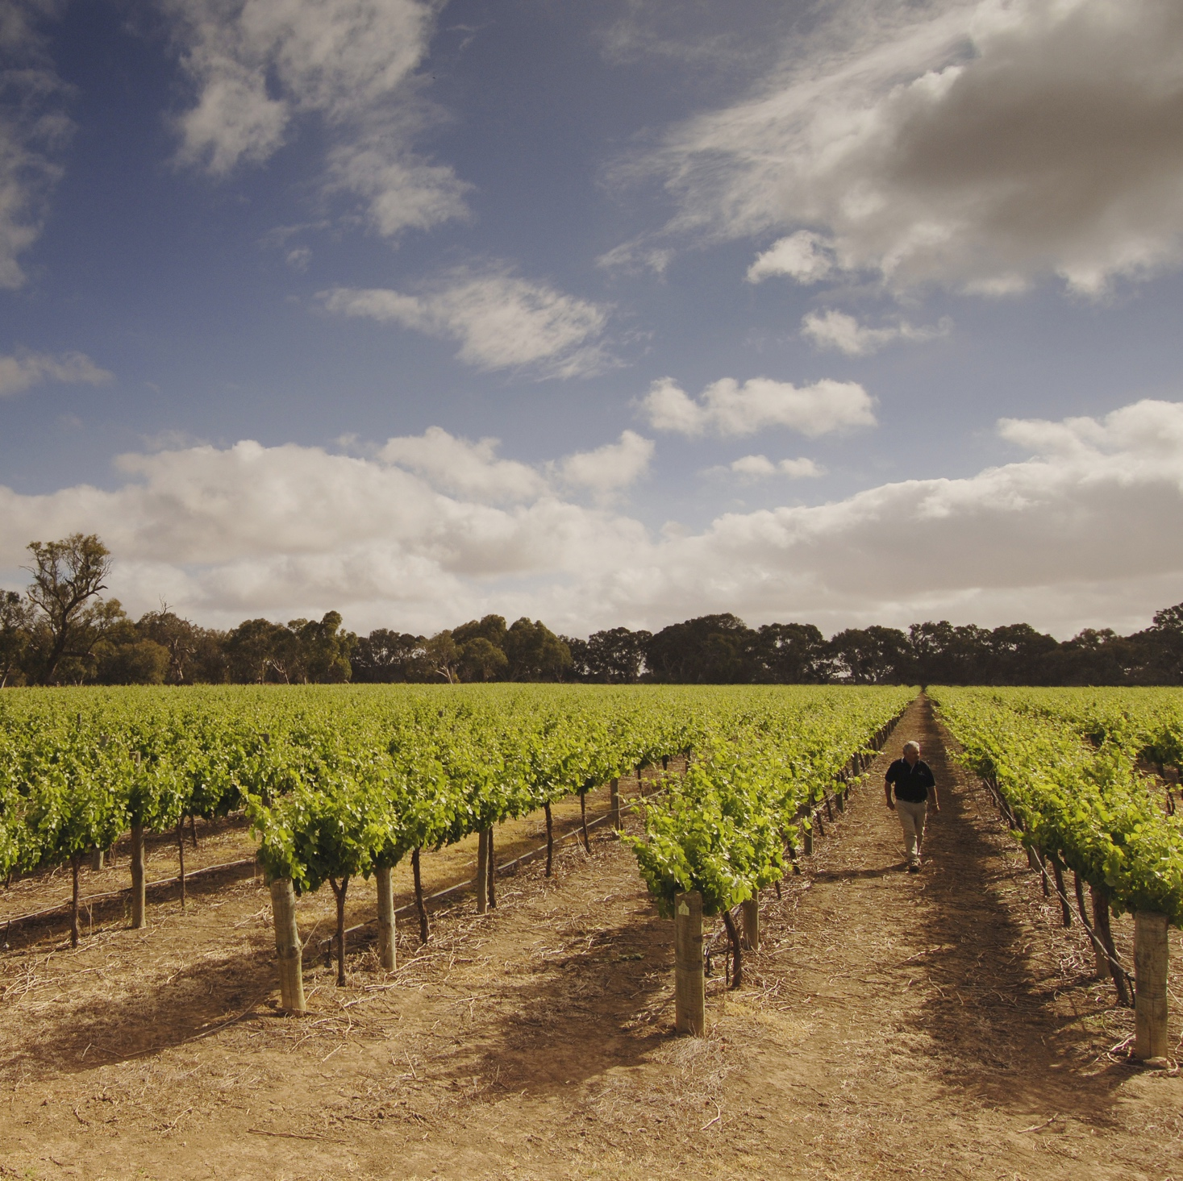
LANGHORNE CREEK
HUMBLE WINE HERO
Langhorne Creek is a hardworking wine region with a long history of producing quality grapes and premium red wines.
Home to sixth-generation growers and
old vines
Temperate, maritime climate and fertile soils
Focus on Shiraz, Cabernet Sauvignon
and Malbec
Growing number of boutique producers crafting traditional and innovative styles
Credit: FPT/Adam Bruzzone

Slide 4
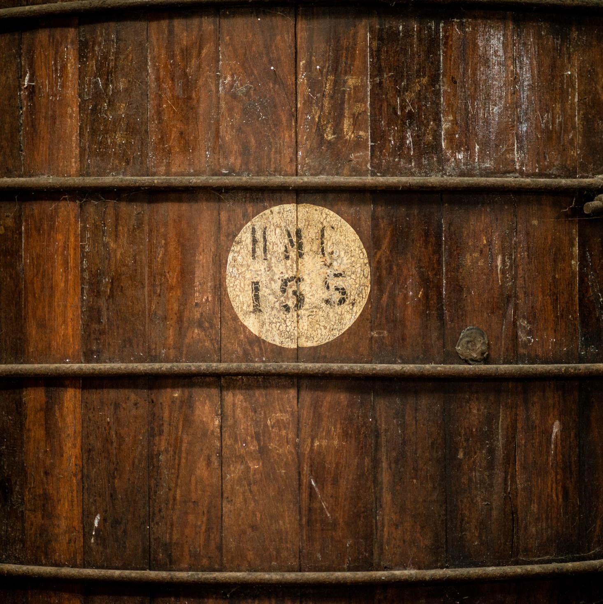
TODAY WE’LL COVER
The history of Langhorne Creek
Geography, climate and soil
Viticulture
Winemaking
Prominent varieties

Slide 5
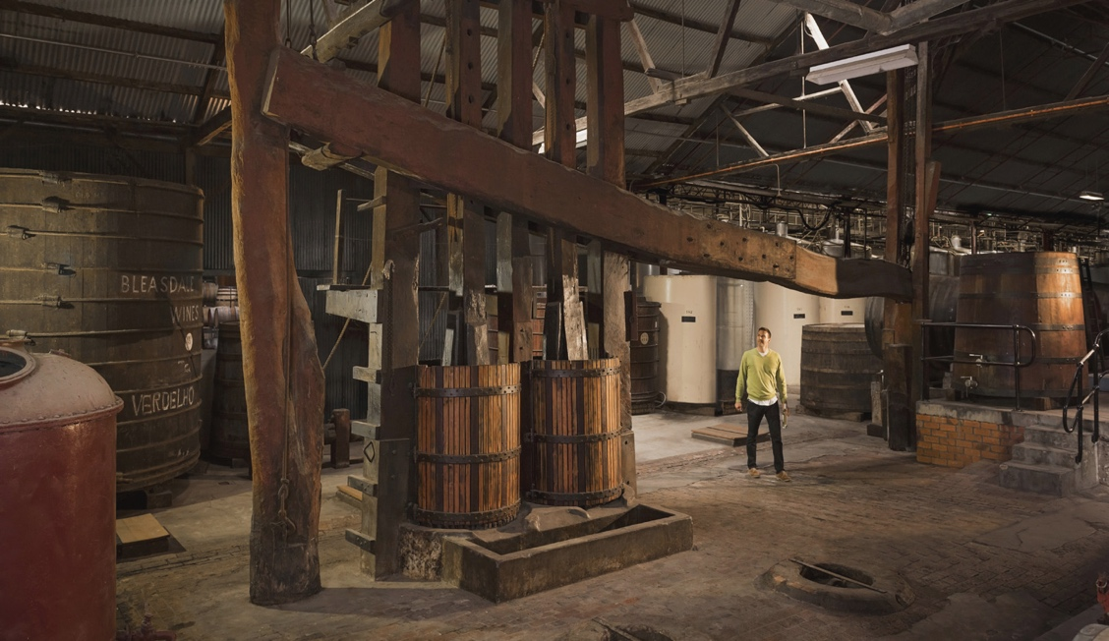
1860
HISTORY OF LANGHORNE CREEK
HERITAGE, TRADITION AND A MODERN TWIST
1891
1961
1962
Frank Potts plants the first vineyard, comprising Shiraz and Verdelho, and builds Bleasdale winery.
Arthur Formby establishes the Metala Vineyard, planting Shiraz and Cabernet Sauvignon.
Bleasdale produces
its first table wine, a Malbec.
Stonyfell ‘Metala’ Cabernet Shiraz 1961 wins the inaugural Jimmy Watson Trophy.

Slide 6
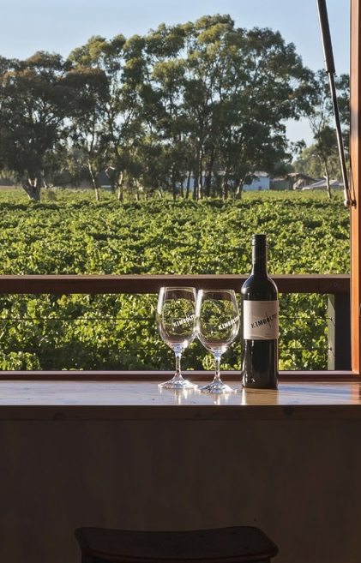
1995
Today
Growers form the Langhorne Creek Water Company and develop a community
pipeline scheme.
Orlando Wyndham Group invests millions into a vineyard for the Jacob’s Creek brand. The region grows dramatically.
Langhorne Creek is one of Australia’s most important wine regions. There’s an increasingly boutique feel, with winemakers crafting a range of wines and styles.
1967
2013
Wolf Blass makes his first wines with fruit from
Langhorne Creek. In the1970s, he wins three consecutive Jimmy Watson Trophies.
7th edition of The World Atlas of Wine states “Langhorne Creek, it could be argued, is South Australian wine’s big secret.”

Slide 7
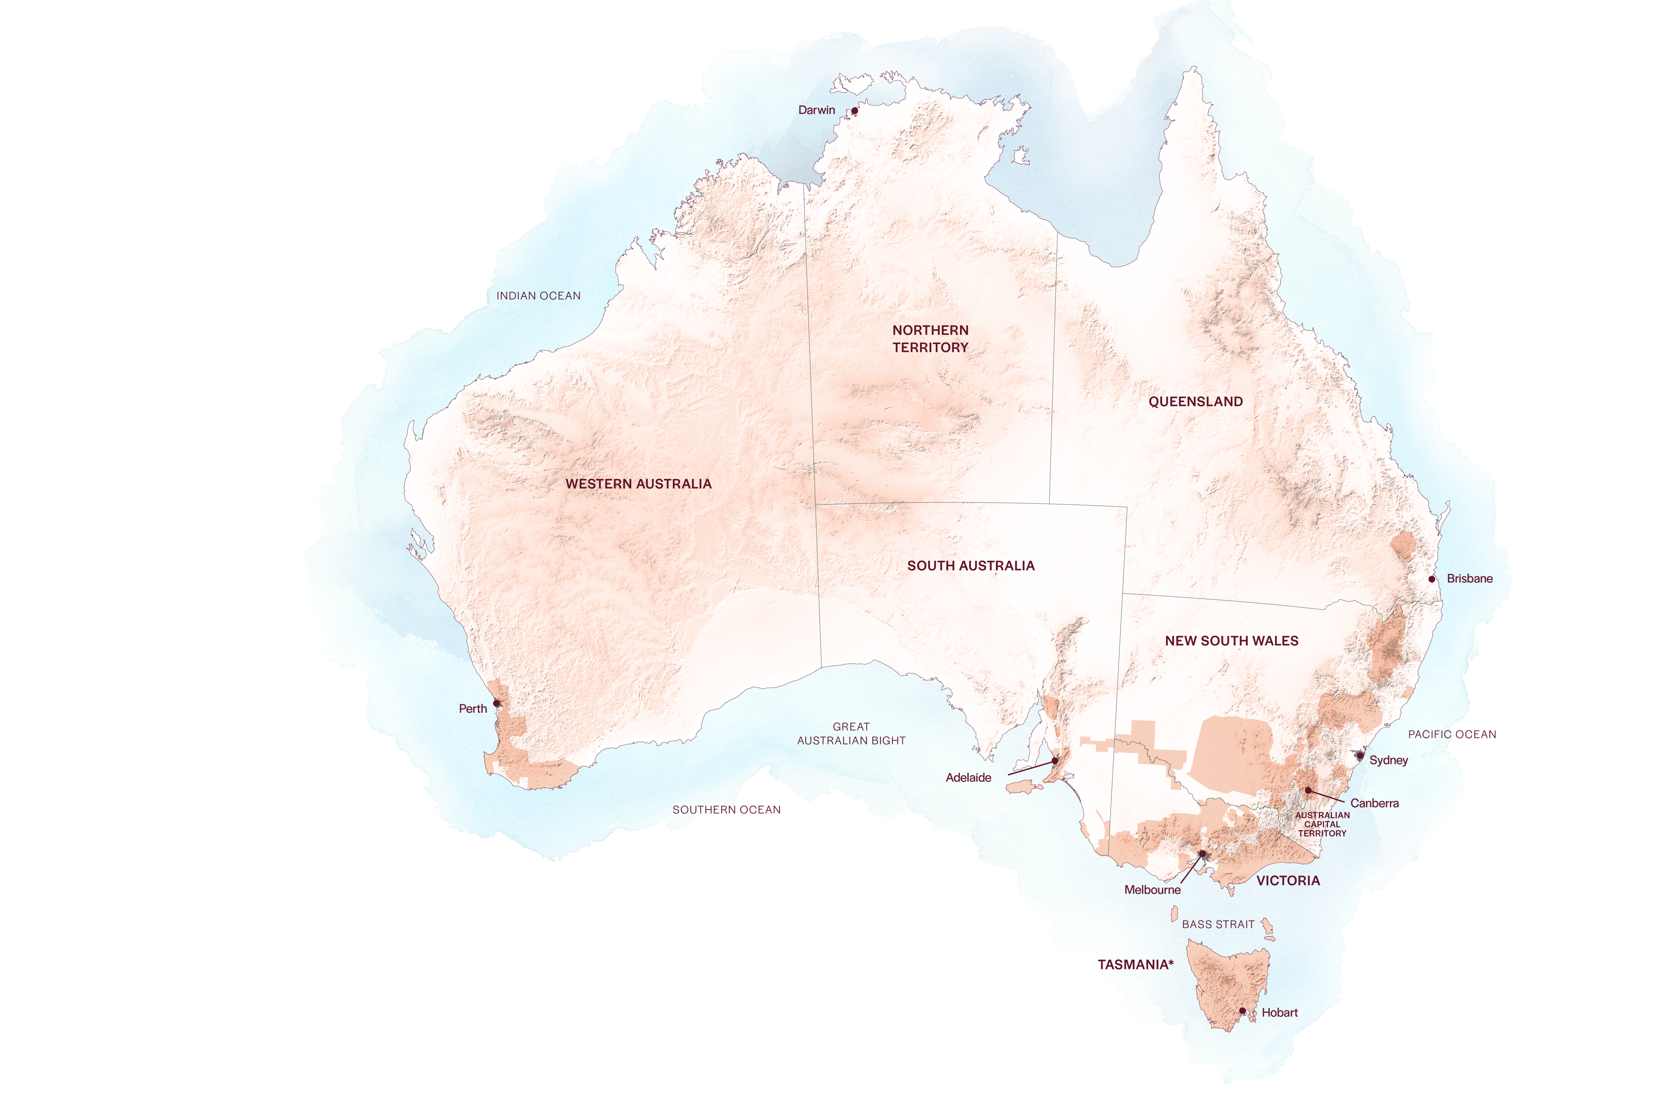
AUSTRALIA
LANGHORNE CREEK

Slide 8

SOUTH AUSTRALIA
LANGHORNE CREEK

Slide 9
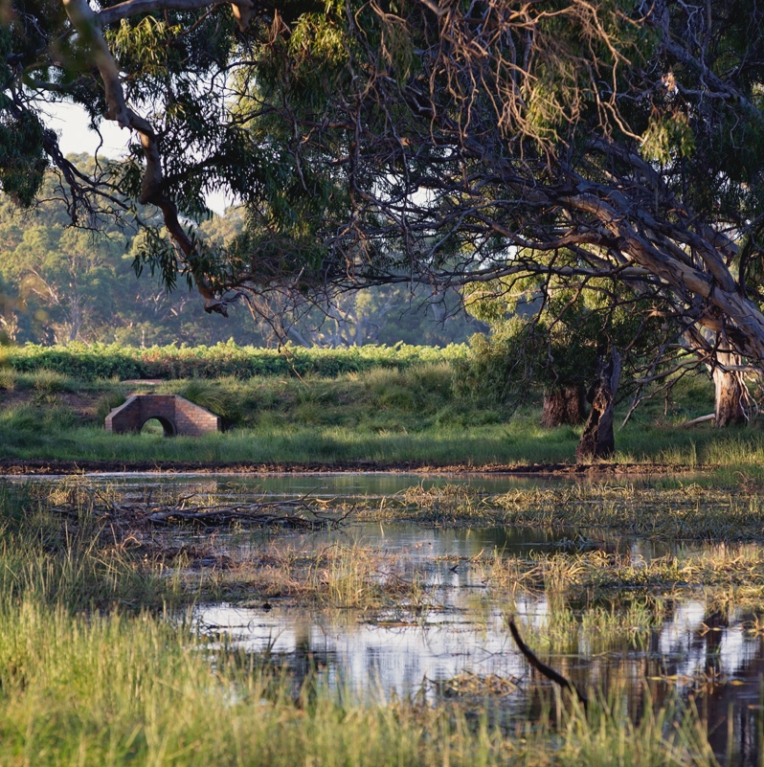
GEOGRAPHY, CLIMATE AND SOIL
ANCIENT PLAINS ON WATER’S EDGE
On the Fleurieu Peninsula, around 70km from Adelaide
A flat, picturesque region of neat vineyards and old river red gums
Sits on an ancient natural floodplain
Moderate climate influenced
by Lake Alexandrina and the Southern Ocean

Slide 10
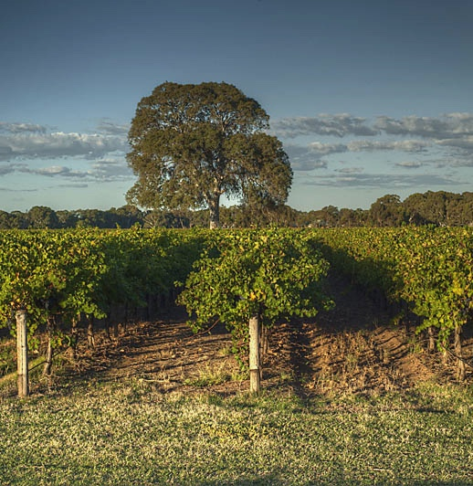
CLIMATE
ALTITUDE
MODERATE MARITIME
VERY HIGH
1000m +
(>3,280ft +)
HIGH
750–999m
(2,460–3,279ft)
WITH MEDITERRANEAN INFLUENCES
LANGHORNE CREEK
10–50M (33–164FT)
MEDIUM
500–749m
(1,640–2,459ft)
LOW
0–499m
(0–1,639ft)

Slide 11
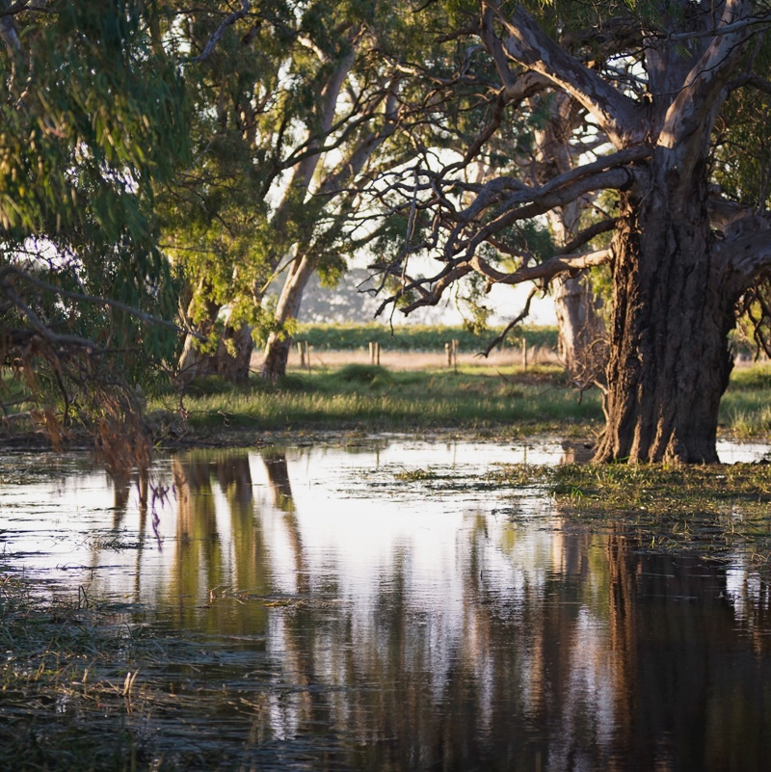
SOIL
Alluvial soils alongside the rivers are deep, friable, brown, dark or red soils, and produce wines that are fuller-bodied but rounder and softer. Away from the rivers, soils are mostly sand over clay, which produce more intense, structured wines.

Slide 12
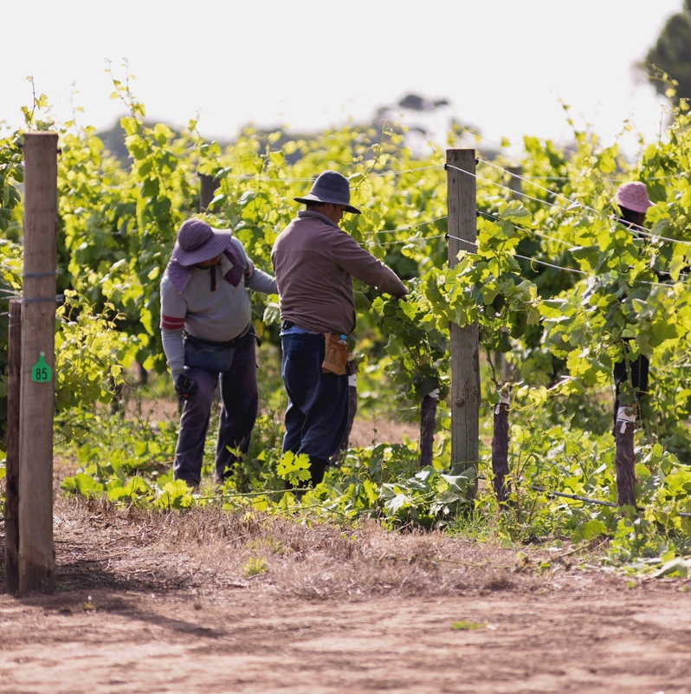
VITICULTURE AND WINEMAKING
GRAPE GROWING IN LANGHORNE CREEK
History of sending fruit to companies outside the region; recent trend to retain grapes
Sixth-generation grape-growing families
Vineyard management more straightforward than other regions
Some vineyards utilise natural floodwaters
for irrigation
Harvest: early February to late April

Slide 13
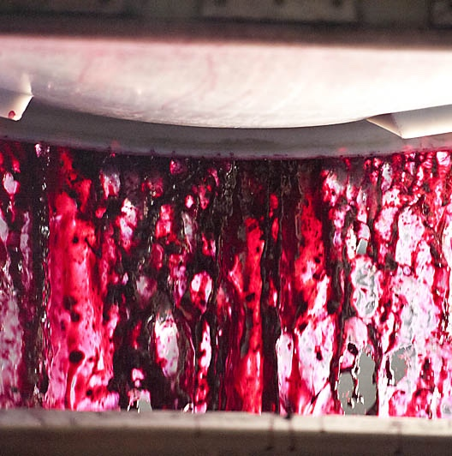
WINEMAKING IN
LANGHORNE CREEK
Typically produces more wine than McLaren Vale and almost as much as the Barossa
Most wines are red; open fermentation and oak ageing is typical
Blending is a common technique
More focus on vineyard to minimise intervention in winery

Slide 14



LANGHORNE CREEK
TOP 5 VARIETIES
CABERNET
SAUVIGNON
CHARDONNAY
MERLOT
RIESLING
SHIRAZ
SHIRAZ
38%
CABERNET SAUVIGNON
29%
CHARDONNAY
10%
MERLOT
9%
RIESLING
3%

Slide 15

LANGHORNE CREEK
SHIRAZ
COMMONLY BLENDED WITH CABERNET SAUVIGNON
GENEROUS AND
RICHLY FLAVOURED
SHIRAZ
OVER
1/3
OF TOTAL
ANNUAL
CRUSH
TYPICAL FLAVOURS
Dark berries
Plum
Liquorice
Pepper
Spice

Slide 16
SHIRAZ characteristics
COLOUR
Shiraz
Light
Medium
Full
BODY
Dry
Medium dry
Sweet
SWEETNESS
Low
Medium
High
SHIRAZ
OAK
TANNIN
ACIDITY
8%
17%
14% – 15%
ALCOHOL

Slide 17
LANGHORNE CREEK
CABERNET SAUVIGNON
EXCELS IN MODERATE MARITIME CLIMATE
SOFT AND APPROACHABLE YET AGE-WORTHY
COMMONLY BLENDED
WITH SHIRAZ
CABERNET SAUVIGNON
TYPICAL FLAVOURS
Blackcurrant
Plum
Choc-mint
Eucalyptus
APPROACHING
1/3
OF TOTAL
ANNUAL
CRUSH

Slide 18
CABERNET SAUVIGNON characteristics
COLOUR
Cabernet Sauvignon
Light
Medium
Full
BODY
Dry
Medium dry
Sweet
SWEETNESS
CABERNET SAUVIGNON
Low
Medium
High
OAK
TANNIN
ACIDITY
8%
14% – 14.5%
17%
ALCOHOL

Slide 19

LANGHORNE CREEK
CABERNET SAUVIGNON SHIRAZ
ICONIC BLEND OF THE REGION
PLUSH, GENEROUS
AND WELL BALANCED
CABERNET SAUVIGNON
SHIRAZ
TYPICAL FLAVOURS
Blackcurrant
Blackberry
Black cherry
Cassis
Mint
Eucalyptus
Spice
CABERNET BRINGS SOFTNESS AND SILKINESS
SHIRAZ ADDS SAVOURY SPICE

Slide 20
CABERNET SAUVIGNON SHIRAZ characteristics
COLOUR
Cabernet Sauvignon Shiraz
Light
Medium
Full
BODY
Dry
Medium dry
Sweet
SWEETNESS
CABERNET SAUVIGNON
SHIRAZ
Low
Medium
High
OAK
TANNIN
ACIDITY
8%
14% – 14.5%
17%
ALCOHOL

Slide 21
LANGHORNE CREEK
MALBEC
ONE OF THE MOST IMPORTANT REGIONS FOR MALBEC
VELVETY TANNINS
HIGHLY PERFUMED, AGE-WORTHY
MALBEC
TYPICAL FLAVOURS
Plum
Red berry
Pepper
Spice
WELL SUITED TO THE CLIMATE

Slide 22
MALBEC characteristics
COLOUR
Malbec
Light
Medium
Full
BODY
Dry
Medium dry
Sweet
SWEETNESS
Low
Medium
High
MALBEC
OAK
TANNIN
ACIDITY
8%
13.5% – 14.5%
17%
ALCOHOL

Slide 23
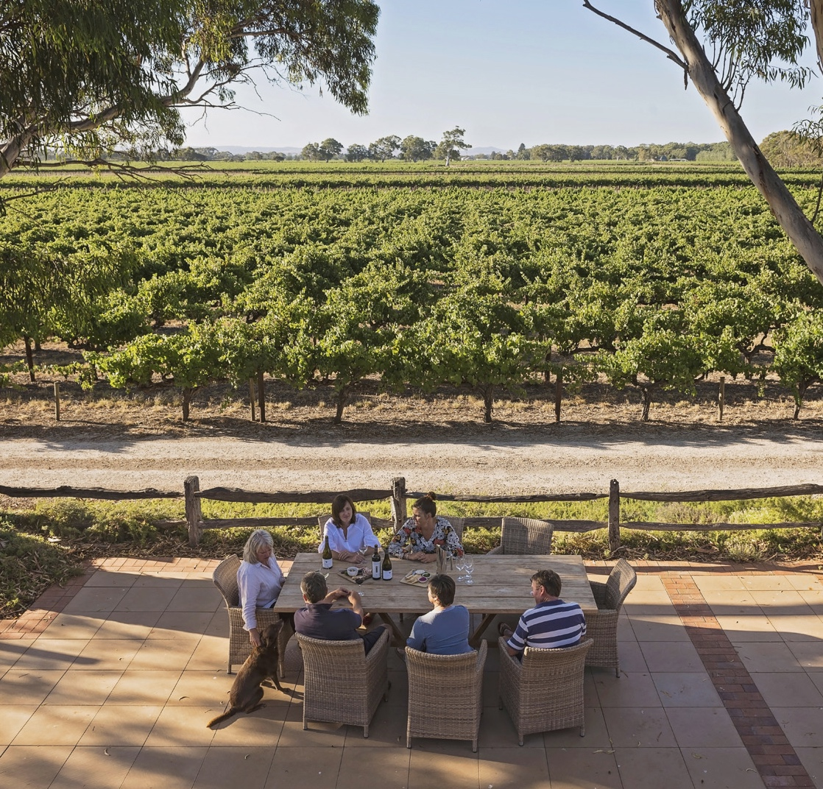
LANGHORNE CREEK
RISE TO PROMINENCE
Historic wine region with a growing reputation for its vibrant red wines and passionate, close-knit community.

Slide 24
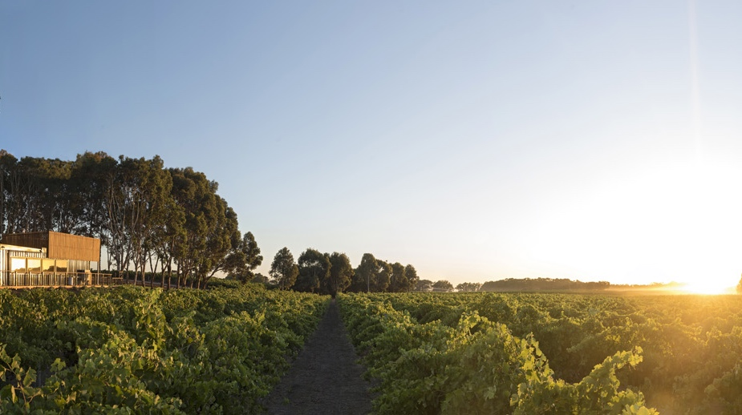
THANK YOU

