Slide 1
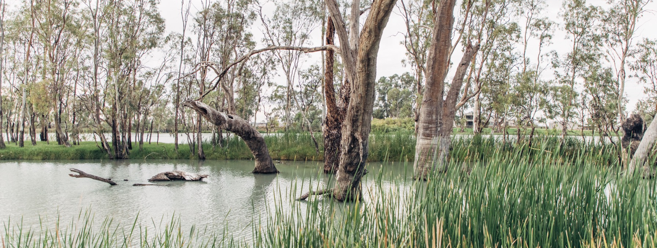
RIVERLAND, RIVERINA AND MURRAY DARLING
AUSTRALIA’S HEARTLAND REGIONS
Notes:
Riverland, Riverina and Murray Darling are powerhouses of industry, renowned for their production prowess and export success. Their story goes beyond volume, with a growing number of premium producers and alternative varieties adding diversity to the landscape. These notes provide additional slide information and suggested discussion points. To download more topics and resources, including presentations like this one, visit www.australianwinediscovered.com

Slide 2


Crafted from grapes grown under vast and diverse climates, across landscapes millions of years in the making, every glass of Australian wine tells a story.
Like those who came before us, our modern growers and makers continue to be passionate, resilient and creative; constantly driven to explore new ways to perfect old techniques. Our community is connected by a mutual respect and shared love of crafting exceptional wine, while protecting the natural wonders for future generations to enjoy. Applying modern thinking to our ancient lands, we take playful experimentation very, very seriously.
So, if you’re looking for the taste of adventure, let Australian wine be your compass. Because in every bottle of Australian wine, you’ll experience the wonders of Australia – a reminder of the adventure and diversity that defines our culture and our land.

Slide 3
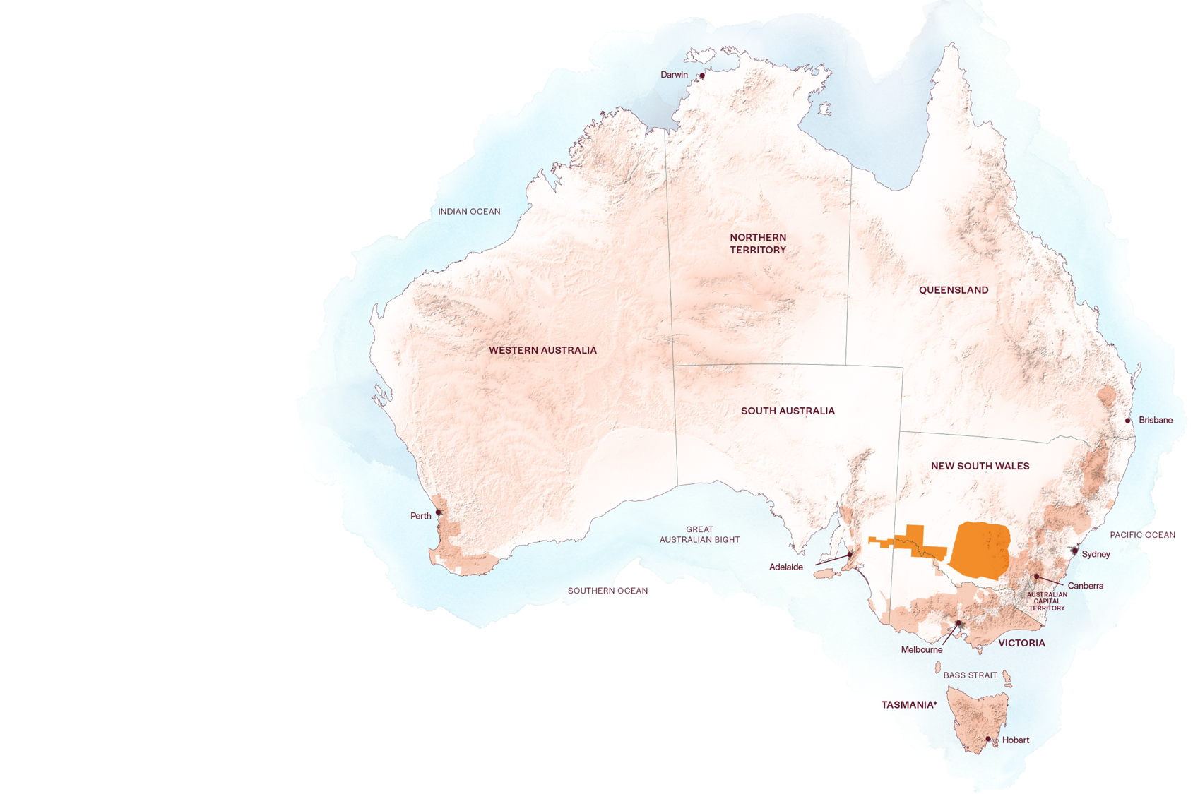
AUSTRALIA
RIVERINA
RIVERLAND
MURRAY DARLING

Slide 4
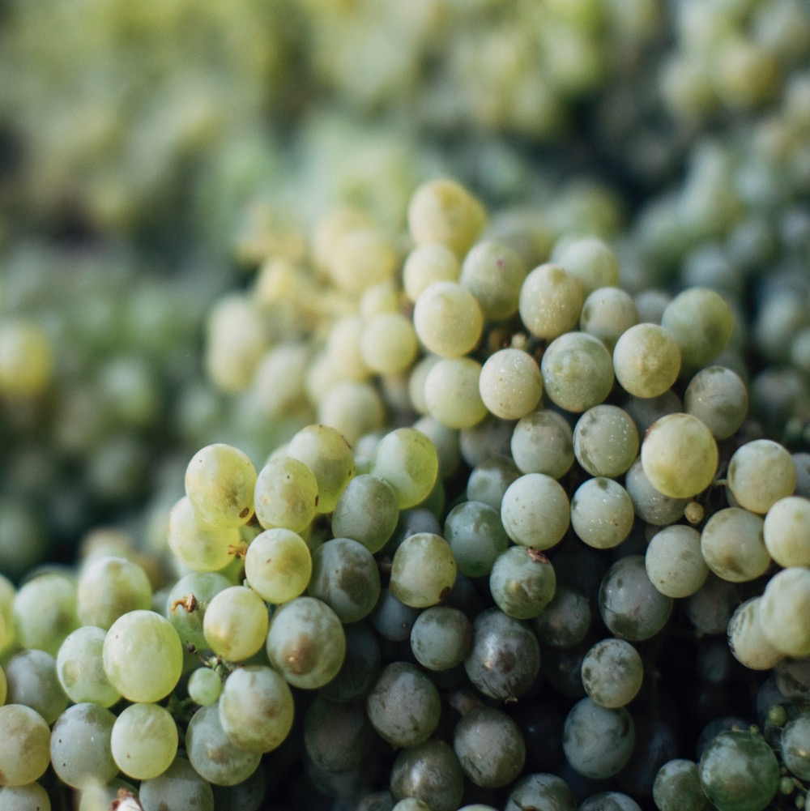
AUSTRALIA’S
INLAND POWERHOUSE
At the heart of Australia’s wine scene are Riverland, Riverina and Murray Darling – the nation’s production powerhouses.
Large-scale production in these regions has allowed for great international export success with both white and red varieties.
Today, the regions are recognised for their contribution to a wider discourse that celebrates ecologically-minded decisions and innovative winemaking practices.
Notes:
This may be a good opportunity to give everyone a taste of a classic regional wine. The full tasting comes later in the program.

Slide 5
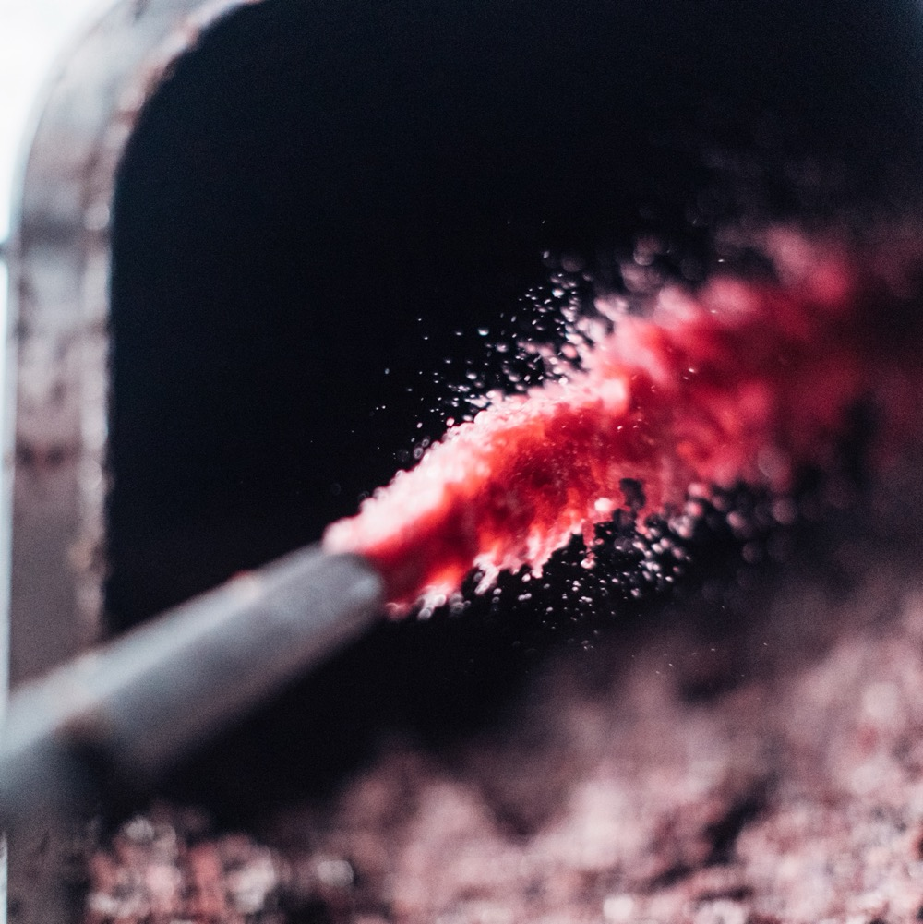
TODAY WE’LL COVER
Riverland, Riverina and Murray Darling
Introduction
History
Geography
Notable varieties

Slide 6
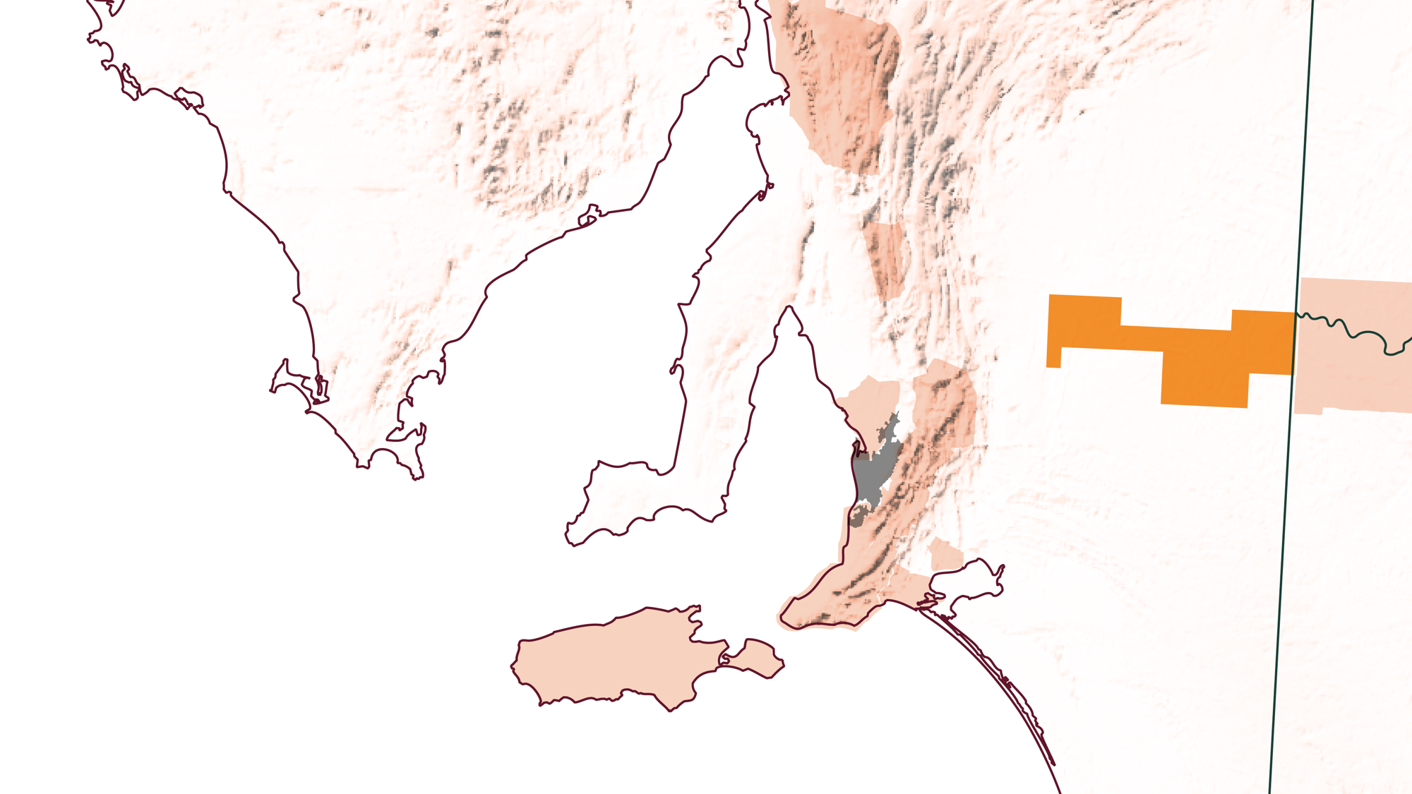
SOUTH
AUSTRALIA
RIVERLAND
Notes:
Often referred to as the ‘backbone’ of the Australian wine industry, Riverland is a critical player in the local viticulture scene. Its commitment to the highest-quality yield with a focus on scaled farming over 21,000 hectares of land is unparalleled on Australian soil. This makes it an immensely important GI, providing over 70% of South Australia’s annual crush and more than 30% of the nation’s.

Slide 7
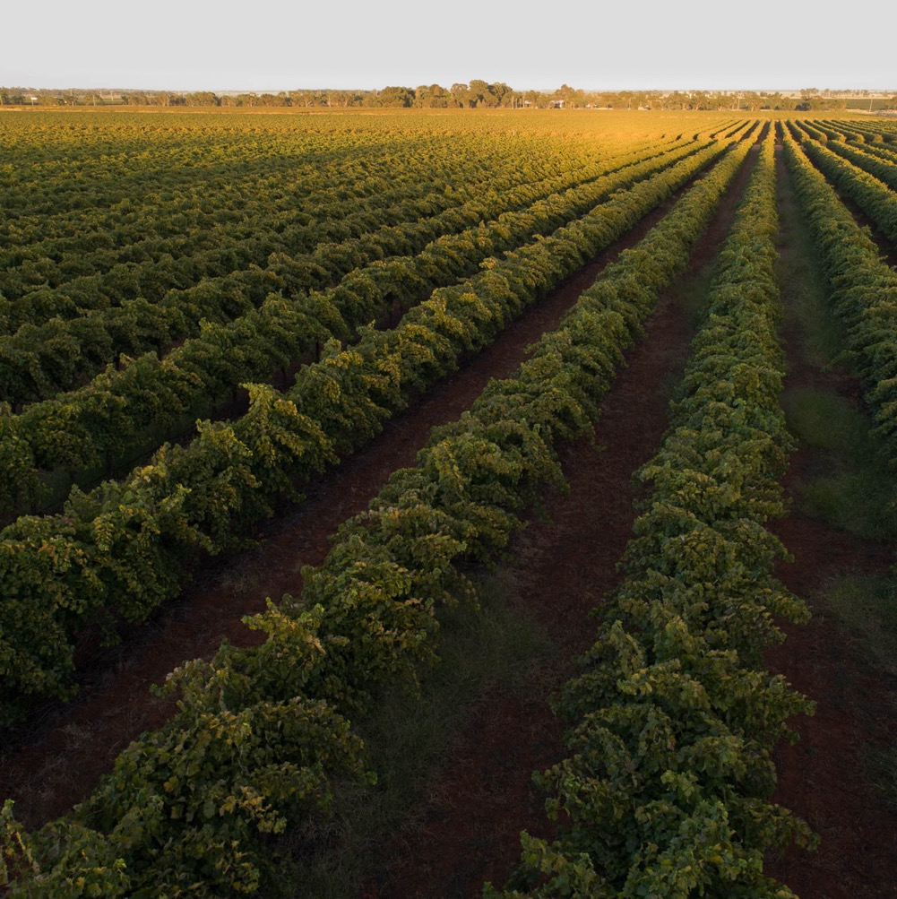
RIVERLAND
VOLUME AND VARIETY
Ancient red soils from the Murray River, long sunny days and viticultural expertise are the hallmarks of this South Australian wine region.
Just two hours northeast of Adelaide, the region reaches from the iconic Murray River to the edge of the Great Australian Outback.
As the largest wine hub in Australia, Riverland combines modern innovation with time - tested technique.
Notes:
Riverland is home to over 80 different grape varieties. Shiraz, Chardonnay, Cabernet Sauvignon and Merlot are grown extensively, used both for single-variety wines and in blends. The Murray River is the lifeblood of the region, providing precious resources for growers and winemakers. As one of the world’s longest and largest river systems, its influence on viticulture in the region cannot be overstated; protection of this significant natural asset is paramount.

Slide 8
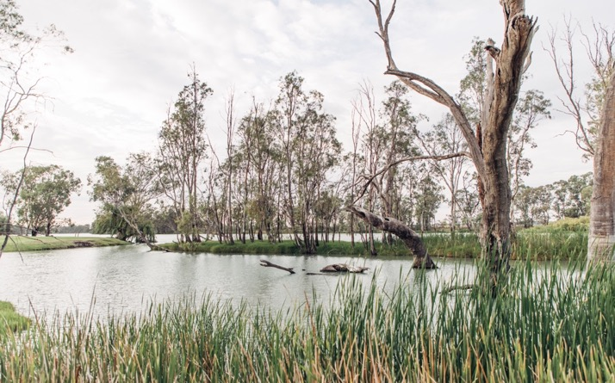
In the Beginning
THE HISTORY OF THE RIVERLAND
A PIONEERS DREAM
1830
Traditional owners of Riverland are joined by European settlers.
1919
‘Soldier Settlement Bill’ passed. Many immigrants move to the area, bringing their European farming and vineyard practices.
The traditional owners of Riverland, home to many sacred cultural sites, are the Erawirung people.

Slide 9
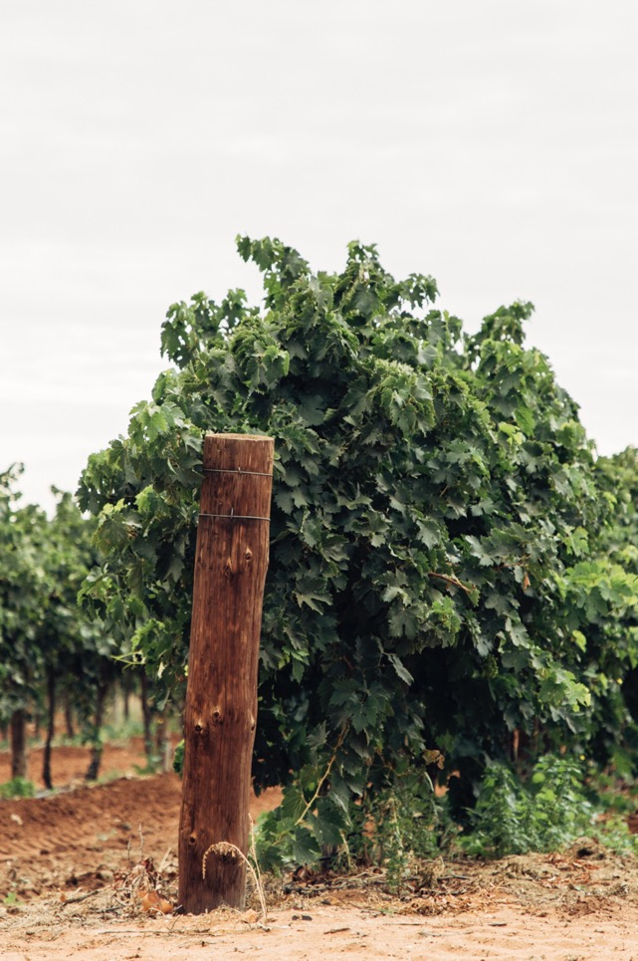
Today
1960s – 1980s
Riverland balances traditional winemaking expertise with technical innovation to provide a third of Australia’s national crush.
Region interest explodes, with over
85 varieties planted.
1920s – 1950s
2000s
Riverland gains momentum as Berri Co-Op opens, providing an outlet for new vineyards to process fruit.
Vine plantings double

Slide 10
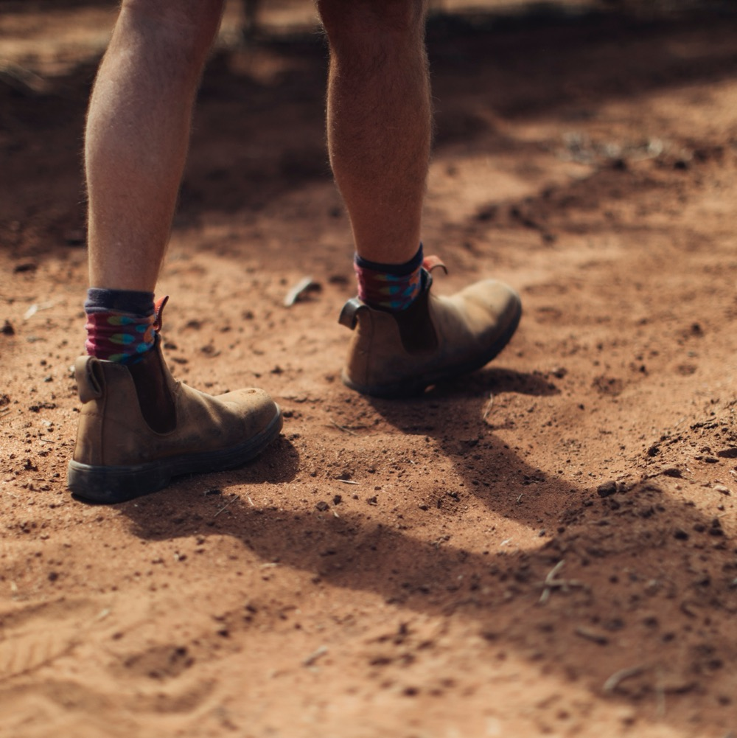
GEOGRAPHY, CLIMATE AND SOIL
RIVER HARMONY AND REMARKABLE TERROIR
Generously sized region reaching from Murray River to edges of the outback.
Continental climate: long sunny days, cooler nights, low annual rainfall.
Nutrient-rich soils that vary across the landscape.
Notes:
With balmy summers and mild winters, Riverland is an ideal home for growers and grapes. Long sunshine hours ensure fruit ripens fully and low relative humidity results in little or no disease pressures. For white wine grapes, the vintage appears early, kicking off in late January. Red varieties follow shortly after in mid-February, with some holding off until March and April.

Slide 11
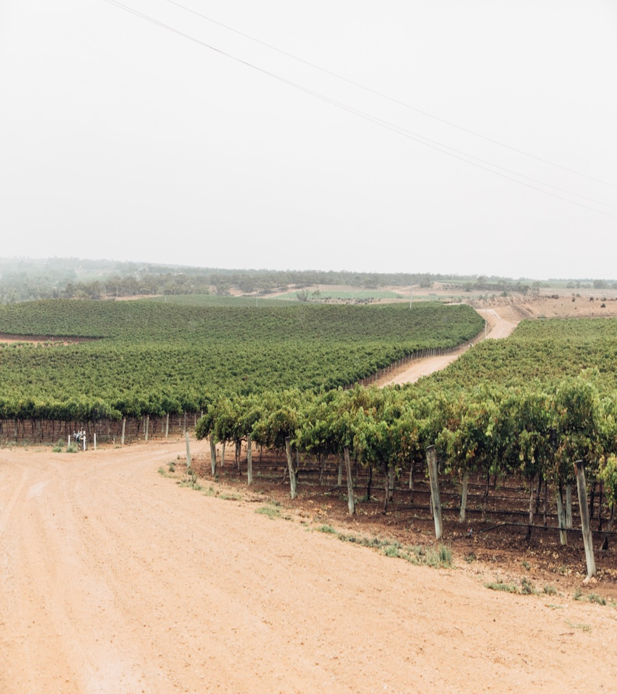
CLIMATE
ALTITUDE
CONTINENTAL
VERY HIGH
1000m +
(>3,280ft +)
LONG SUNNY DAYS AND COOLER NIGHTS
HIGH
750–999m
(2,460–3,279ft)
RIVERLAND
10–80M (33–262FT)
MOSTLY LESS THAN 30M
MEDIUM
500–749m
(1,640–2,459ft)
LOW
0–499m
(0–1,639ft)
Notes:
- Mean January Temperature (MJT): 24.3℃ (76°F)
- Growing season rainfall (GSR): 145mm (5.7in)

Slide 12
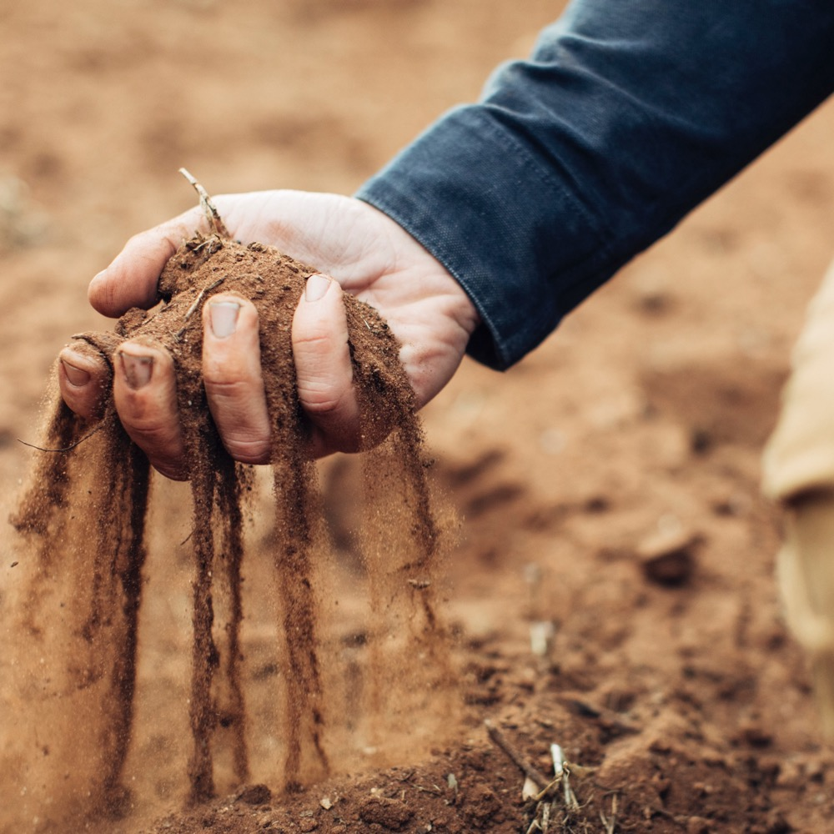
SOIL
Ancient soils range from those in the river valley – sandy loams over clay subsoils – and those on higher ground, consisting of wind- blown sands over lime and clay.
Notes:
When the Murray River formed a valley 600,000 years ago, nutrient-rich soil was deposited across the broad delta we now call Riverland. If you stand by the water’s edge, you rest on alluvial terraces of mixed sands, silts and clay. This unique combination contributes to the remarkable terroir of the region and its unique expression of wine.
SUGGESTED DISCUSSION POINTS:
– Why do you think Riverland has emerged as one of South Australia’s premier wine destinations?
– Has Riverland’s warm climate helped or hindered its progress as an Australian wine region?
– Why do you think there is such a diverse range of growers and wine styles? Consider changes in consumer preferences.

Slide 13
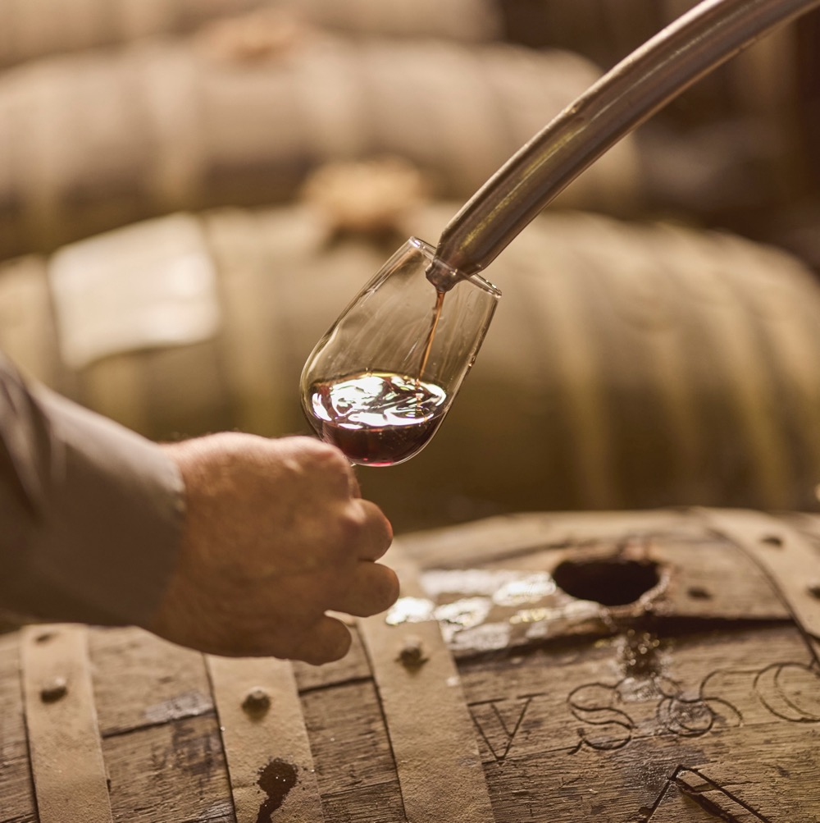
TASTE OF RIVERLAND
NOTEWORTHY VARIETIES
Retention of primary fruit character is a top priority
Fermentation with both cultured and wild yeasts
Maturation vessels vary, with larger oak formats on the rise
New generation of innovative winemakers experimenting with low-intervention techniques
Notes:
NOW IS AN APPROPRIATE TIME TO TASTE AND DISCUSS YOUR SELECTED MIX OF WINES.
+ COMPLEMENTARY GUIDES: You’ll find materials these varieties and more at www.australianwinediscovered.com

Slide 14

CHARDONNAY characteristics
COLOUR
Chardonnay
TYPICAL FLAVOURS
Light
Medium
Full
Peach
Nectarine
Apricot
Melo
Citrus
Vanilla
BODY
Dry
Medium dry
Sweet
SWEETNESS
CHARDONNAY
Low
Medium
High
OAK
ACIDITY
8%
12.5% – 14.5%
17%
ALCOHOL
Notes:
Riverland boasts more Chardonnay plantings than the combined total of any other region in South Australia. Riverland Chardonnay often exhibits vivacious and ripe flavours, with the preference of oak barrels supporting the richness of the wine and adding further complexity to the palate. It’s full-flavoured and rich with tropical fruit flavours and a luscious texture.

Slide 15

SHIRAZ characteristics
COLOUR
Shiraz
Light
Medium
Full
TYPICAL FLAVOURS
Dark berries
Blackberry
Dark Cherry
Plum
Spice
Pepper
BODY
Dry
Medium dry
Sweet
SWEETNESS
Low
SHIRAZ
Medium
High
OAK
TANNIN
ACIDITY
8%
17%
13.5% – 15.5%
ALCOHOL
Notes:
A fair proportion of Australia’s Shiraz grapes are used by big-volume producers to make easy-drinking, approachable Australian wine. Much of this fruit is grown in Riverland, whose long-established, warm-climate wineries are primed for full-bodied Shiraz. Shiraz is currently the most significant red variety grown in the region, with the temperate conditions producing deliciously fruity wines filled with bountiful berry flavours.

Slide 16
CABERNET SAUVIGNON characteristics
COLOUR
Cabernet Sauvignon
Light
Medium
Full
TYPICAL FLAVOURS
Dark berries
Blackberry
Dark Cherry
Plum
Spice
Pepper
BODY
Dry
Medium dry
Sweet
SWEETNESS
Low
Medium
High
CABERNET SAUVIGNON
OAK
TANNIN
ACIDITY
8%
13.5% – 14.5%
17%
ALCOHOL
Notes:
Used as single-variety wines and in blends, Riverland’s Cabernet Sauvignon is usually deep purple with intense flavours of raspberry and blackberry and a rich texture. The region’s warm temperatures tend to bring out the richer raspberry characteristics, while in cooler years the overall profile reveals mint and blackcurrant.

Slide 17
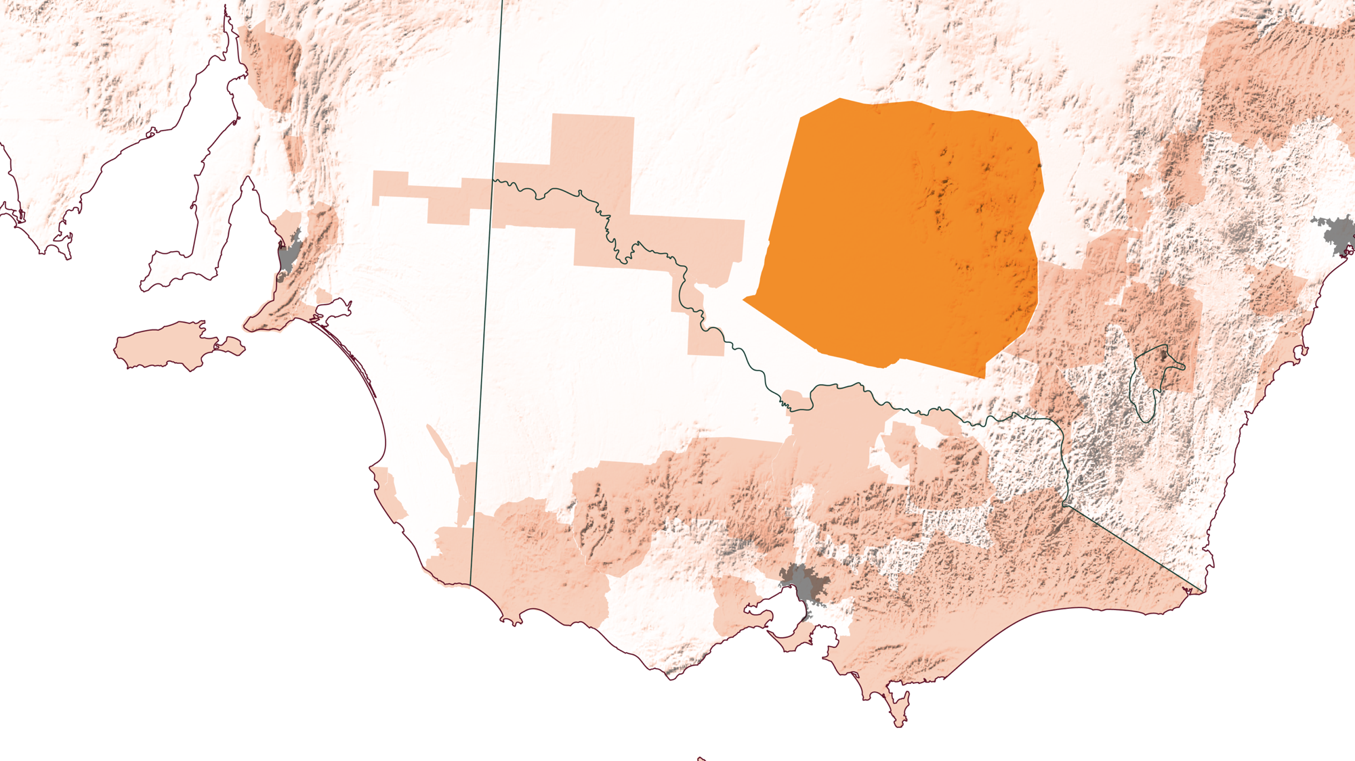
NSW
RIVERINA
Notes:
Riverina spans across a flat tract of land on the state’s southwest plains, with vineyards spread across thousands of hectares. The region’s climate, including low relative humidity, ample sunshine and low natural rainfall, allows for the consistent production of grapes assisted by modern drip irrigation. High productivity has allowed for great export success with both whites and reds.

Slide 18
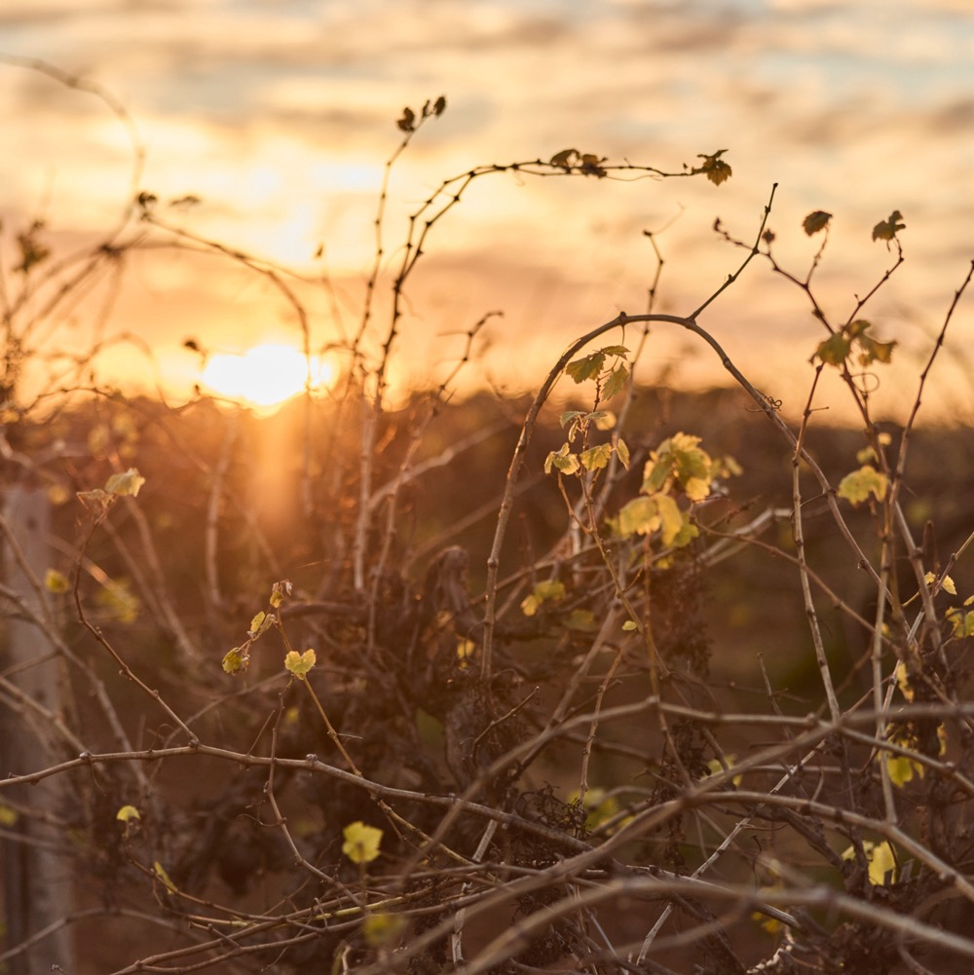
RIVERINA
WHERE INNOVATION AND TRADITION MEET
NSW’s largest wine-producing region and home to some of the country’s most well-known wine brands.
Ample sunshine and low humidity allow for consistent grape production across the region’s flat plains.
Growers benefit from new research into heat-resistant varieties and vine stress assessment tech.
Riverina is renowned for its Botrytis Semillon, a rich, honeyed wine that results from the action of the ‘noble rot’.
Notes:
Producers in the region are benefiting from a recent renaissance driven by its producers, many boasting a rich Italian heritage including DeBortoli, Calabaria Family Wines and the Casella family, whose winery produces the internationally successful Yellow Tail wines.

Slide 19
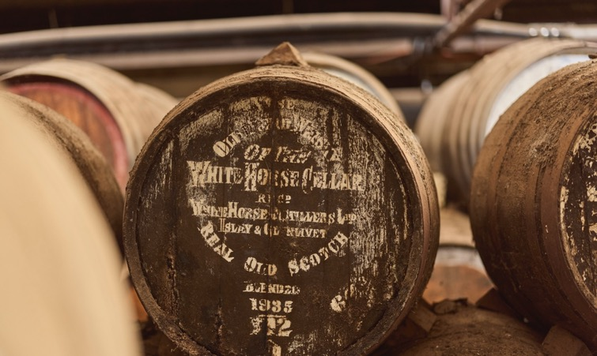
1913
THE HISTORY OF
THE RIVERINA
A CENTURY OF WINE PRESTIGE
1920s – 1950s
Many Italian immigrants move to the region, expanding the region’s Mediterranean varieties.
1916 – 1919
J.J. McWilliam plants 50,000 cuttings, pioneering wine trade in the region.
Region develops, with prominent wineries set up. New irrigation schemes and dam development allow for viticulture to prosper.

Slide 20
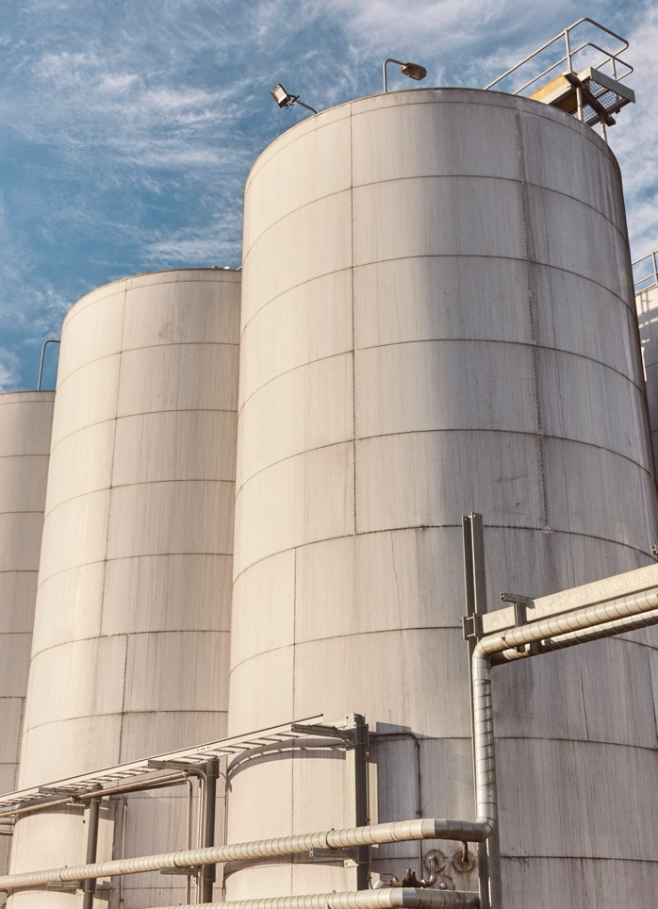
2000s
Climatic factors call for new production methods and disease-resistant cultivars.
1960s – 1980s
Today
Botrytis, the ‘noble rot’, first observed and developed in Semillon wines.
16 wineries lead the charge, producing almost three quarters of NSW annual wine output.

Slide 21
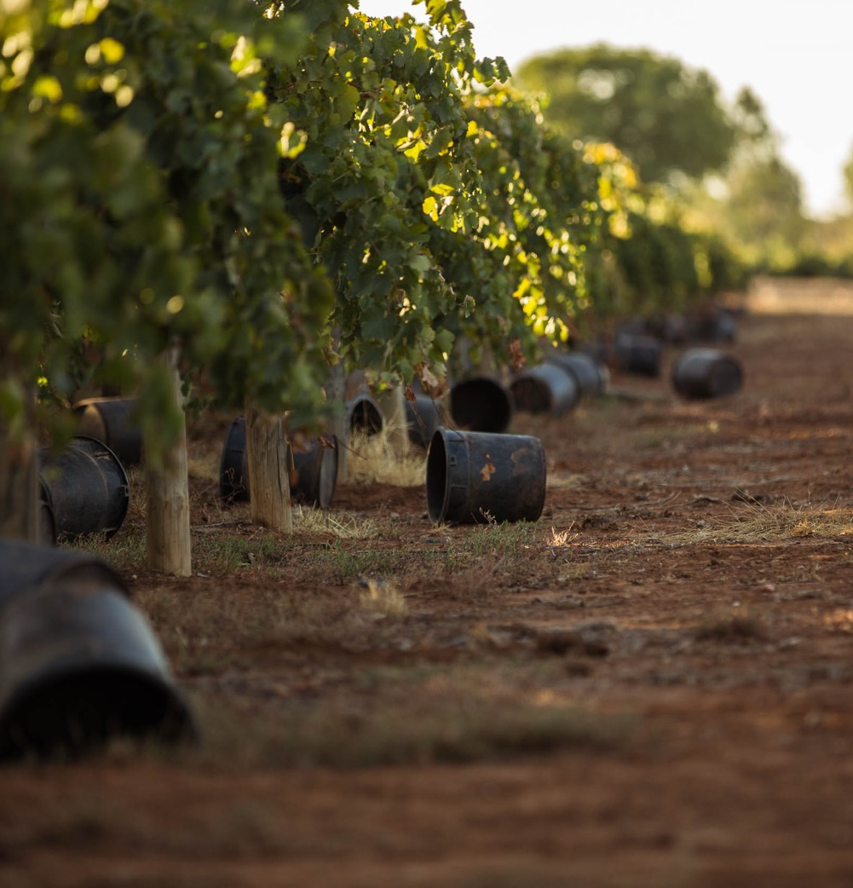
GEOGRAPHY, CLIMATE AND SOIL
ANCIENT PLAINS AND NOT
MUCH RAIN
Located on a flat tract of land in NSW’s southwest plains, centred on Griffith.
Mediterranean climate sees high evaporation, low humidity and plenty of sunshine in summer.
Highly variable alluvial soil, deposited from the Murray and Darling rivers.
Notes:
Riverina experiences high growing-season temperatures, with autumn conditions favouring the onset and spread of aforementioned ‘noble rot’. Higher humidity later in the season allows Botrytis development to occur after the picking of most red and white varieties. Given the region’s low rainfall, grapes can only be grown here economically with irrigation.

Slide 22
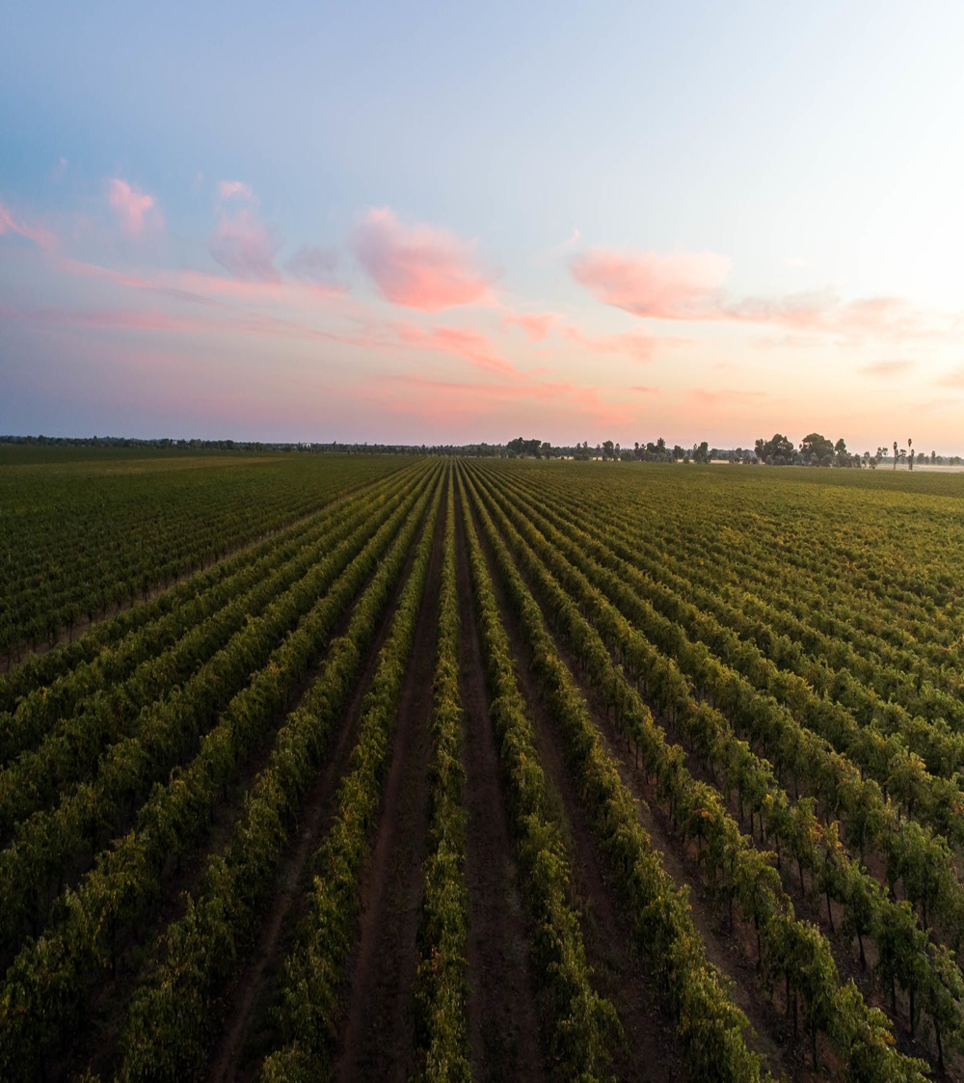
CLIMATE
ALTITUDE
MEDITERRANEAN
VERY HIGH
1000m +
(>3,280ft +)
HIGH
750–999m
(2,460–3,279ft)
RIVERINA
80–164M (262–538FT)
MEDIUM
500–749m
(1,640–2,459ft)
LOW
0–499m
(0–1,639ft)
Notes:
- Mean January temperature: 26℃ (79°F)
- Growing season rainfall: 230mm (9in)

Slide 23
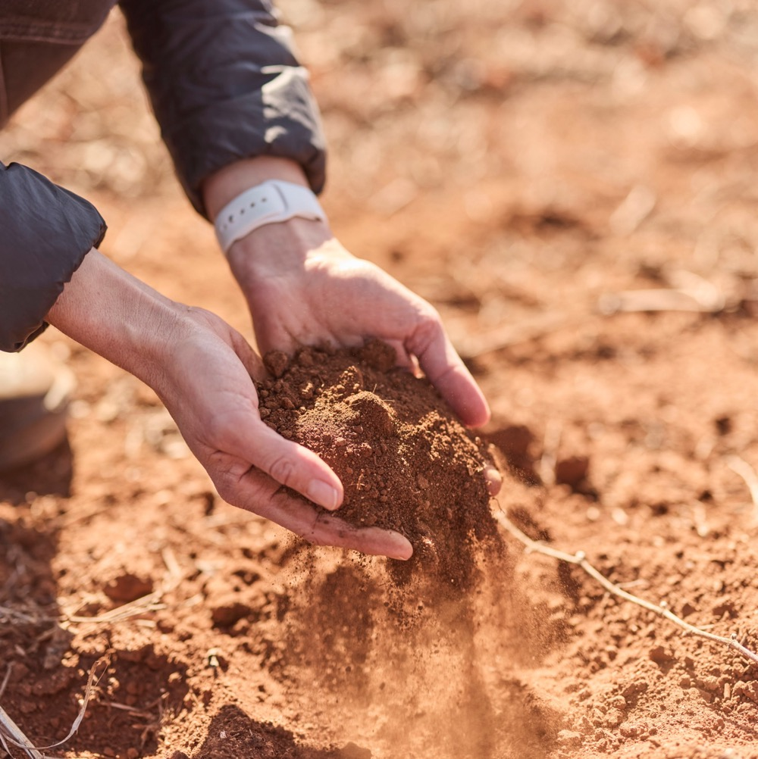
SOIL
Deposited by ancient streams, Riverina has variable alluvial soils embedded with sands, gravel and clay.
Notes:
The main soil type of Riverina is red-brown earth. It has a loamy surface horizon 10–35cm deep and passes abruptly to a reddish-brown clay which contains lime at a depth of about 70cm. Many of these also contain limestone rubble. It is on these soils that the majority of vines are planted.

Slide 24
TASTE OF RIVERINA
NOTEWORTHY VARIETIES
Notes:
NOW IS AN APPROPRIATE TIME TO TASTE AND DISCUSS YOUR SELECTED MIX OF WINES.
+ COMPLEMENTARY GUIDES: You’ll find materials these varieties and more at www.australianwinediscovered.com

Slide 25
CHARDONNAY characteristics
COLOUR
Chardonnay
TYPICAL FLAVOURS
Light
Medium
Full
Peach
Apricot
Melo
Pineapple
Toast
Vanilla
BODY
Dry
Medium dry
Sweet
SWEETNESS
CHARDONNAY
Low
Medium
High
OAK
ACIDITY
8%
13% – 14.5%
17%
ALCOHOL
Notes:
Chardonnay is the region’s third-most-important grape variety. Typically full-flavoured and affordable, these wines are ideal to enjoy with food. Judicious use of oak produces a wine of pleasant varietal flavour, weight and style. Chardonnay is also blended with other white varieties.

Slide 26
SHIRAZ characteristics
COLOUR
Shiraz
Light
Medium
Full
TYPICAL FLAVOURS
Dark berries
Blackberry
Dark Cherry
Plum
Spice
Pepper
BODY
Dry
Medium dry
Sweet
SWEETNESS
Low
SHIRAZ
Medium
High
OAK
TANNIN
ACIDITY
8%
13.5% – 15.5%
17%
ALCOHOL
Notes:
While cool-climate Shiraz often receives the limelight, the variety favours moderate to warm climates. Riverina is the perfect match for Australia’s number-one wine grape, as its fruit reaps the benefits of warm, sunny days, delivering wine with a bold upfront flavour kick, juicy jammy fruits and seamless texture from ripe tannins.

Slide 27
BOTRYTIS SEMILLON characteristics
COLOUR
Botrytis Semillon
TYPICAL FLAVOURS
Light
Medium
Full
Dried apricot
Apricot nectar
Peach
Citrus
Marmalade
Mango
BODY
Dry
Medium dry
Sweet
SWEETNESS
BOTRYTIS SEMILLON
Low
Medium
High
OAK
ACIDITY
8%
17%
9.5% – 11%
ALCOHOL
Notes:
This rich, honeyed wine is a product of ‘noble rot’, a benevolent form of the fungus Botrytis cinerea that dehydrates the grapes and concentrates their sweetness. Along with late-harvest Riesling, it’s one of Australia’s most celebrated and successful sweet wine styles. Riverina Botrytis Semillon is a gloriously sweet, opulent and complex dessert wine with impressive intensity and length, and a refreshing citrus lift. It is pale golden in colour with aromas of dried apricot, marmalade, honey and crème brûlée, and flavours of stone fruits and citrus. Oak ageing can lend the wine nutty, vanilla and biscuit characters. These rich, elegant wines will generally benefit from ageing for five to 10 years.
SUGGESTED DISCUSSION POINTS:
– Why is Riverina Semillon so revered?
– How does the region’s warm climate influence practices in the vineyard and winery?
– Why do you think Riverina has become a hub for experimental and innovative winemakers?

Slide 28
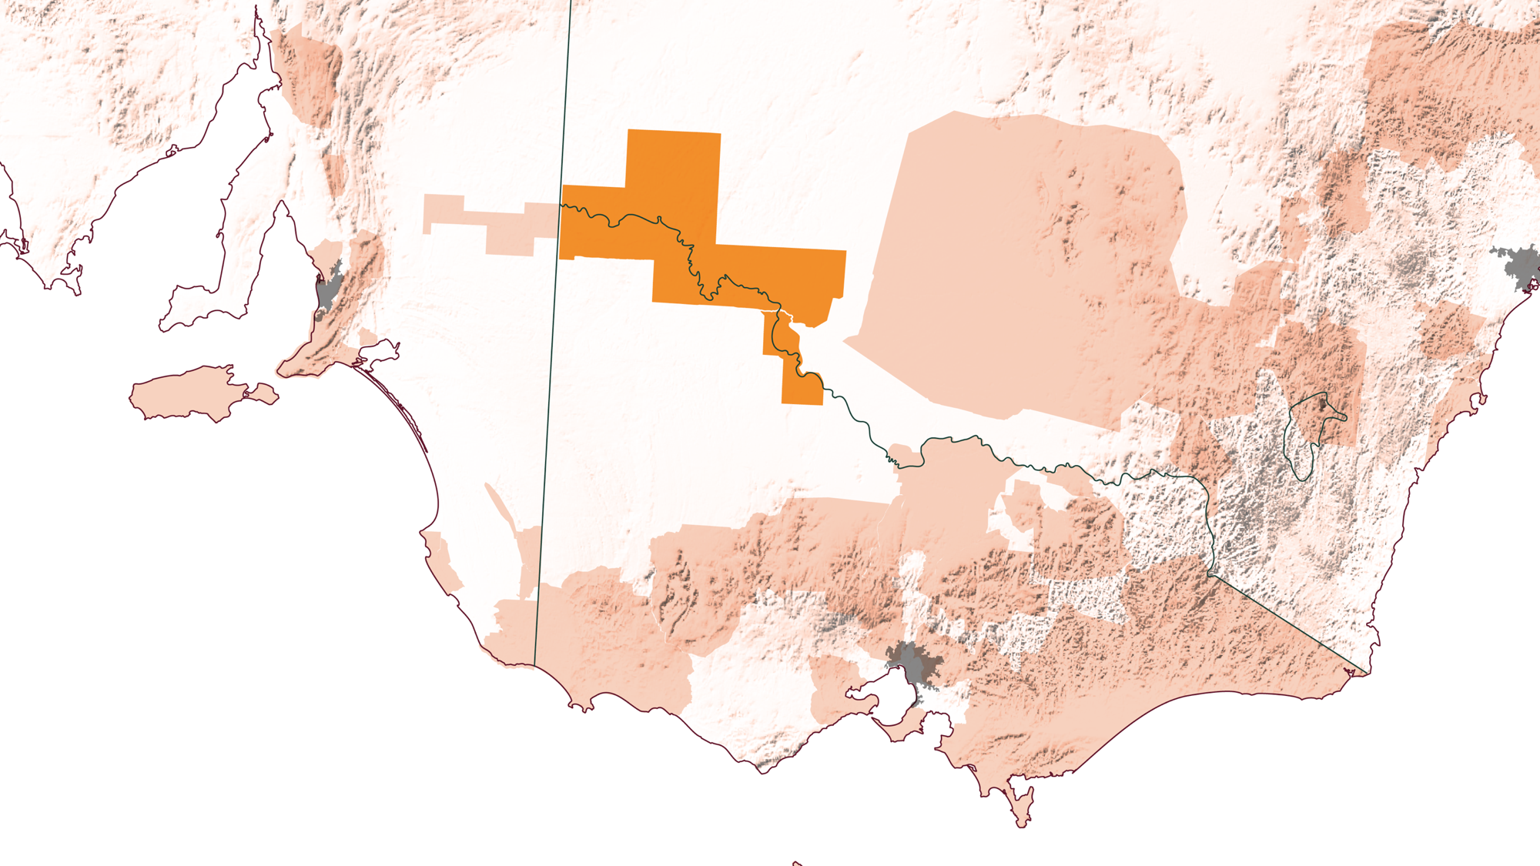
NSW
MURRAY DARLING
SWAN HILL
Notes:
Straddling the Murray River in northwest Victoria and western New South Wales, the Murray Darling is a vast region. Combined with Swan Hill immediately to the southeast, it is the third-largest wine-growing region in Australia after Riverland and Riverina. Much like its other Heartland cousins, the Murray Darling has experienced a resurgence of wine production, combining structural prowess and boutique spirit to become a deeply cultural and economically prosperous region.

Slide 29
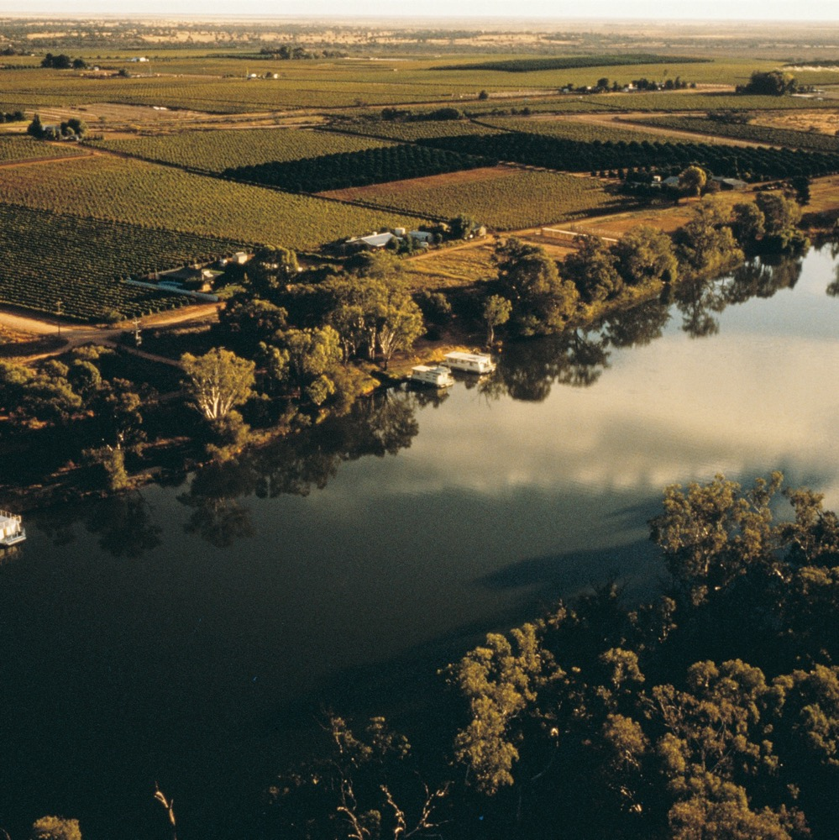
MURRAY DARLING
AUSSIE INDUSTRY DARLING
The region is a viticulture hub, combining production prowess with boutique spirit.
Marked by the presence of the Murray River,
the region’s geography consists of mostly flat semi-arid plains.
New technologies for irrigation systems and drought-resistant grapes are some of the techniques used by growers to manage changes in climate.
The region is closely linked with Swan Hill, a fully independent wine region with its own GI.

Slide 30
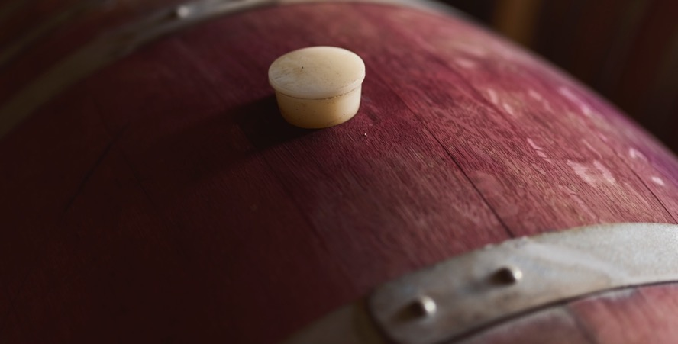
1888
THE HISTORY OF
THE MURRAY DARLING
FROM QUANTITY TO QUALITY
1920s – 1940s
First vines planted in region
New irrigation efforts allow for pioneer scheme success. Returned soldiers from WW1 bolster the growing wine industry.

Slide 31
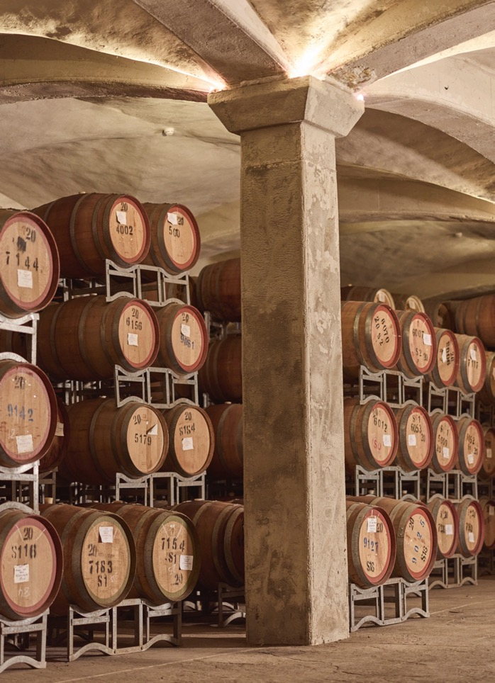
2000s
Water management becomes a focus of the region as production increases, producing a quarter of the nation’s crush each year.
1960s – 1980s
Today
Region experiences drought, with growers moving to less water-intensive techniques and varieties.
Region shifts from quantity to quality, with a burgeoning boutique wine scene and cellar- door culture.

Slide 32
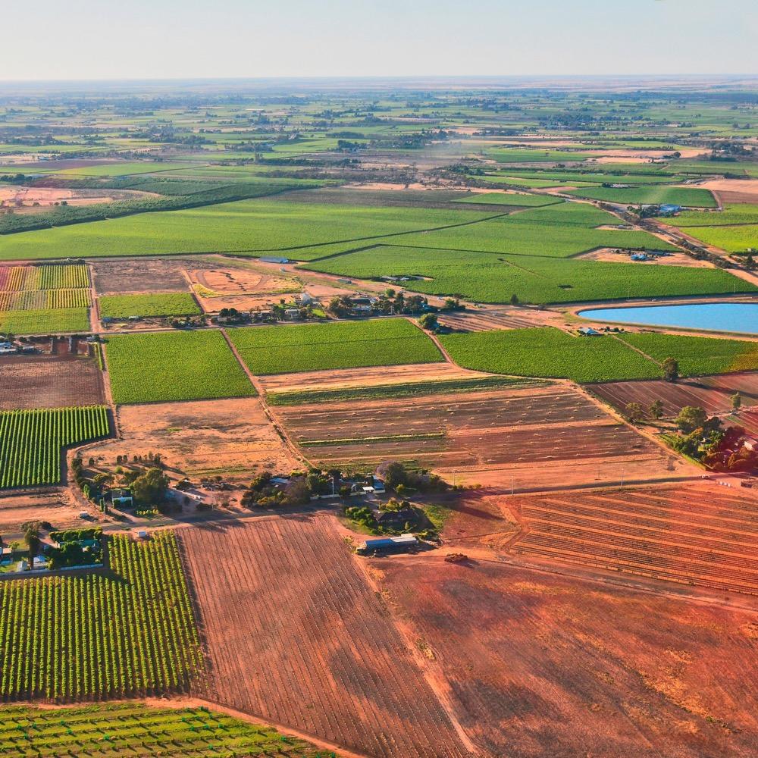
GEOGRAPHY, CLIMATE AND SOIL
THE TALE OF TWO REGIONS
Geography marked by presence of Murray River – mostly flat semi-arid plains in both Murray Darling and Swan Hill regions.
Hot-climate region with relatively low annual rainfall and negligible disease pressures.
Soils ranging from brown to red-brown loamy sand, sandy loam or loam.
Notes:
Despite the size of the Murray Darling GI, the climate throughout is virtually identical. It is hot, with long sunshine hours, low humidity and negligible growing season rainfall, making irrigation essential. The continental influence is strong, with high shifts in diurnal temperature ranges, but these shifts are insufficient to make spring frosts a problem. Disease pressure remains low throughout the year.

Slide 33
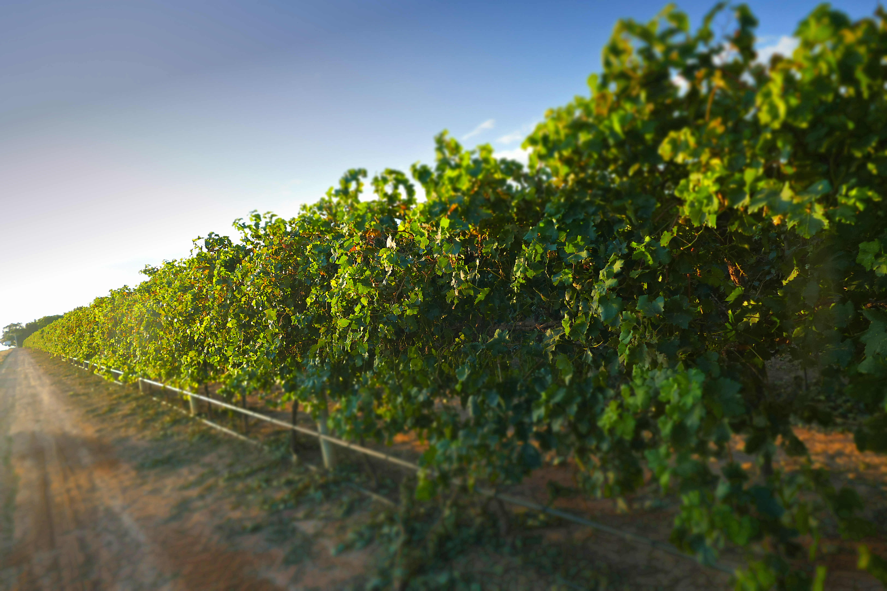
CLIMATE
ALTITUDE
CONTINENTAL
VERY HIGH
1000m +
(>3,280ft +)
HIGH
750–999m
(2,460–3,279ft)
INFLUENCED BY HOT SUMMERS, MILD WINTERS AND COOLER NIGHTS
MURRAY DARLING
30–80M (98–262FT)
MEDIUM
500–749m
(1,640–2,459ft)
LOW
0–499m
(0–1,639ft)
Notes:
- Mean January temperature: 25.5℃ (88°F)
- Growing season rainfall: 159mm (6.3in)

Slide 34
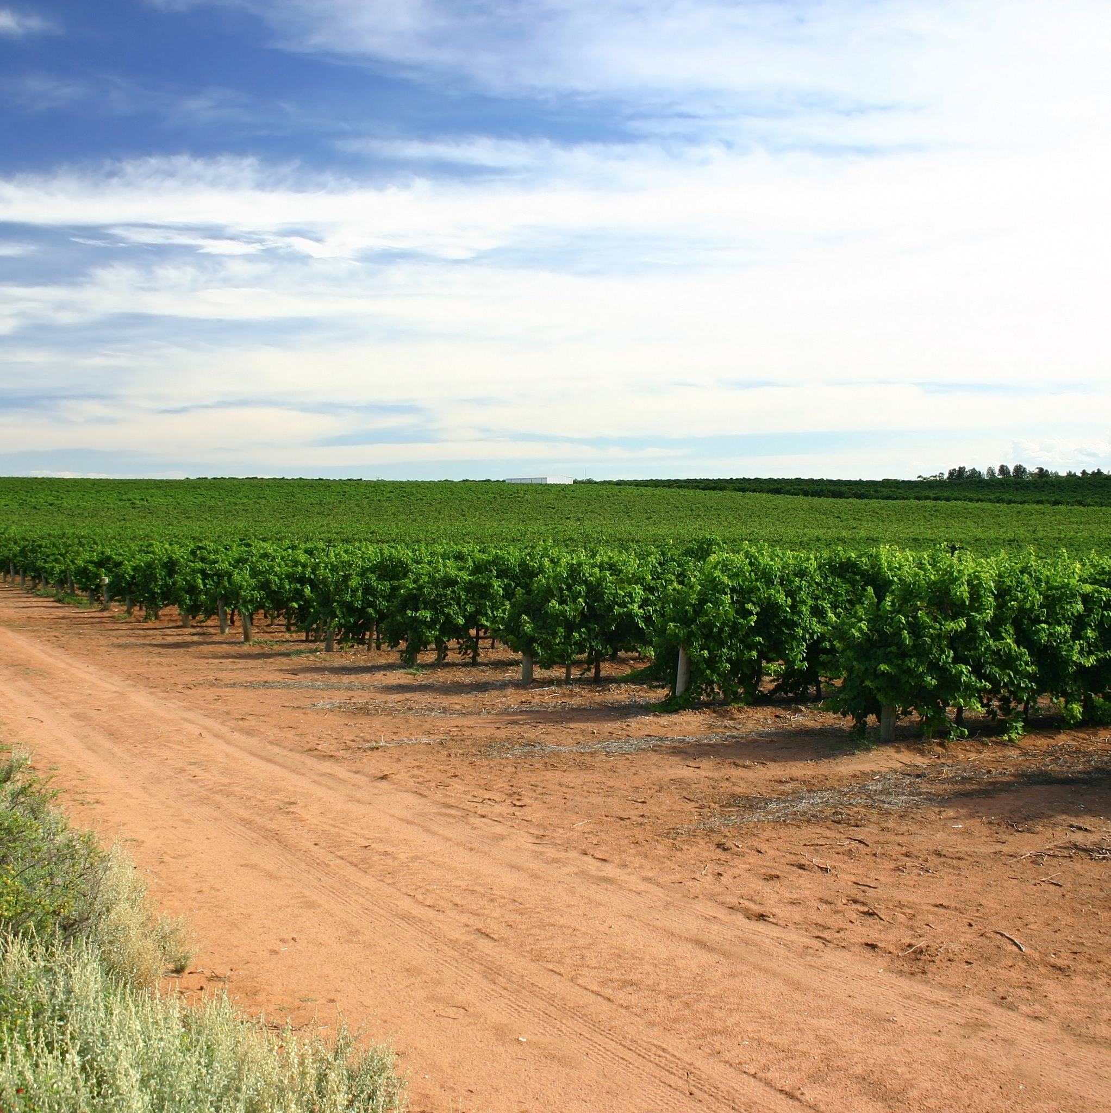
SOIL
Soil in both regions supports vigorous growth and wine health. Murray Darling has mostly calcareous earth with neutral to moderately alkaline properties. Swan Hill enjoys soil structures of limestone, marine sands and clay with neutral to alkaline properties.
Notes:
When the Murray River formed a valley 600,000 years ago, nutrient-rich soil was deposited across the broad delta we now call Riverland. If you stand by the water’s edge, you rest on alluvial terraces of mixed sands, silts and clay. This unique combination contributes to the remarkable terroir of the region and its unique expression of wine.
SUGGESTED DISCUSSION POINTS:
– Why do you think Riverland has emerged as one of South Australia’s premier wine destinations?
– Has Riverland’s warm climate helped or hindered its progress as an Australian wine region?
– Why do you think there is such a diverse range of growers and wine styles? Consider changes in consumer preferences.

Slide 35
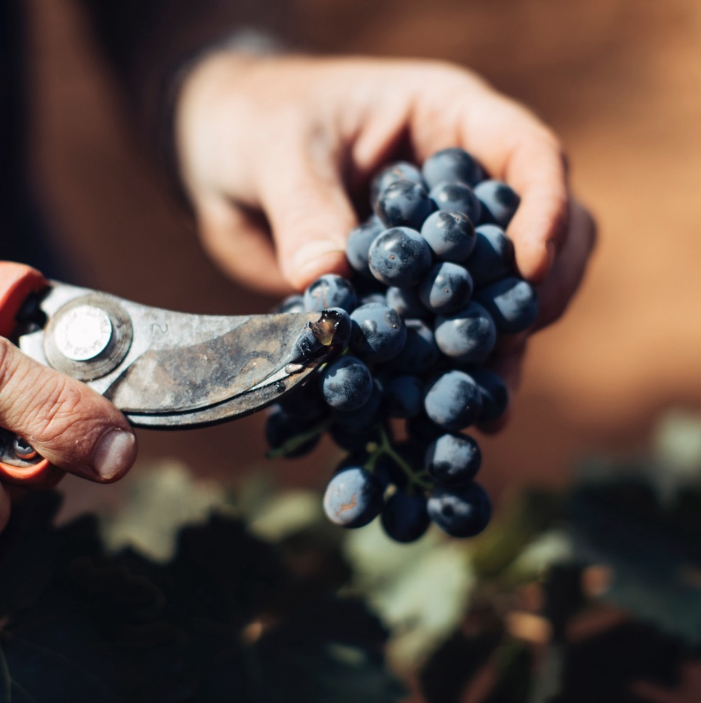
TASTE OF MURRAY DARLING
NOTEWORTHY VARIETIES
Notes:
NOW IS AN APPROPRIATE TIME TO TASTE AND DISCUSS YOUR SELECTED MIX OF WINES.
+ COMPLEMENTARY GUIDES: You’ll find materials these varieties and more at www.australianwinediscovered.com

Slide 36

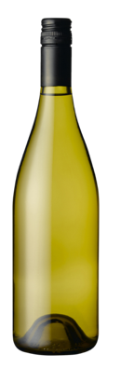
ALTERNATIVE
VARIETIES
PINOT GRIGIO
VERMENTINO
SANGIOVESE
Mediterranean varieties like Pinot Grigio are perfectly suited to a warm climate, with a growing list of wineries producing alternative varieties such as Nero d’Avola.
PINOT GRIGIO
Medium-bodied wine
VERMENTINO
Medium-bodied wine
SANGIOVESE
Medium-bodied red
BARBERA
NERO D’AVOLA
BARBERA
Full-bodied red
NERO D’AVOLA
Full-bodied red
Notes:
Although the Murray areas are a major source of economically priced wines, several wineries are striking success by planting varieties from across the Mediterranean that are perfectly suited to the warm climate of Murray Darling.

Slide 37
CHARDONNAY characteristics
COLOUR
Chardonnay
TYPICAL FLAVOURS
Light
Medium
Full
Rip peach
Melon
Pineapple
Vanilla Toast
BODY
Dry
Medium dry
Sweet
SWEETNESS
CHARDONNAY
Low
Medium
High
OAK
ACIDITY
8%
13% – 14.5%
17%
ALCOHOL
Notes:
An important variety for the region, renowned for producing crowd-pleasing wines with tropical fruit and citrus flavours. Styles have shifted over the years, from big, oaky and buttery Chardonnays to wines that have a fruity softness and generosity with a lighter, more aromatic style.
SUGGESTED DISCUSSION POINTS:
– How does the topography of the Murray River influence the expression of wine?
– What commonalities do the Murray Darling and Swan Hill GIs share? What sets them apart?
– How has the shift from traditional to alternative varieties shaped the wine landscape of Murray Darling?

Slide 38
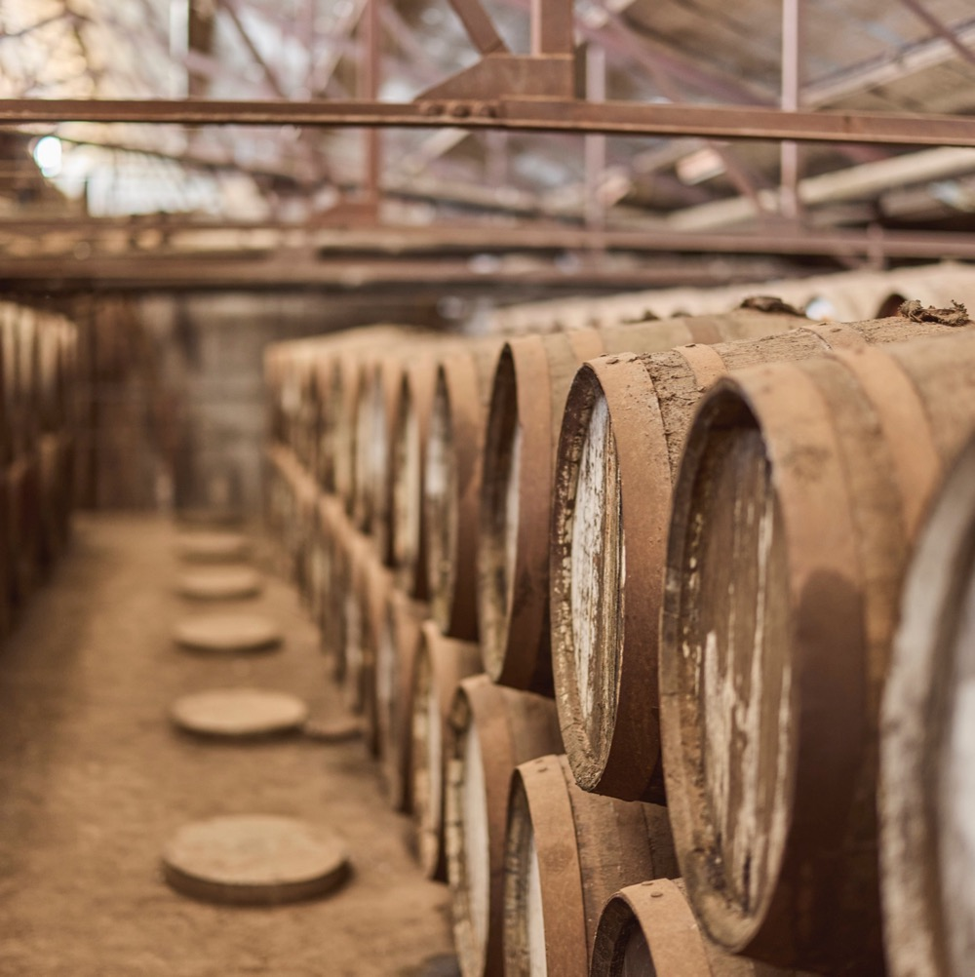
MURRAY DARLING
RENAISSANCE IN AUSTRALIA’S HEARTLAND REGION
Riverland, Riverina and Murray Darling are powerhouses of industry, renowned for their production prowess and export success. Their story goes beyond volume, with a growing number of premium producers and alternative varieties adding diversity to the landscape.

Slide 39
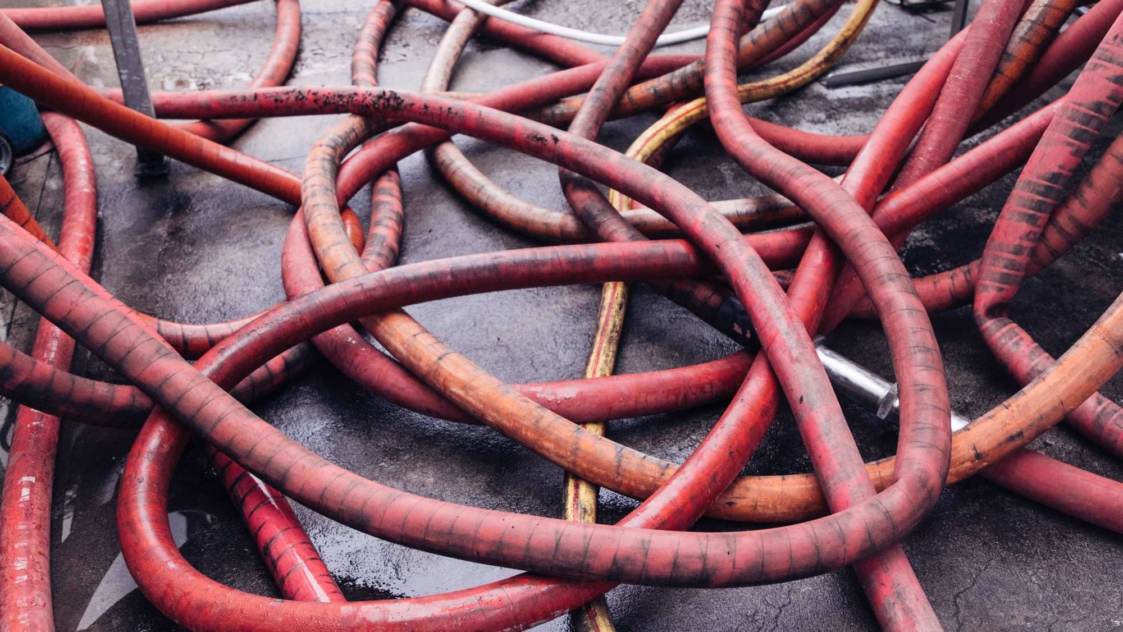
THANK YOU
Notes:
For more programs, tools and resources, visit www.australianwinediscovered.com
For enquiries, email discovered@wineaustralia.com

