Slide 1
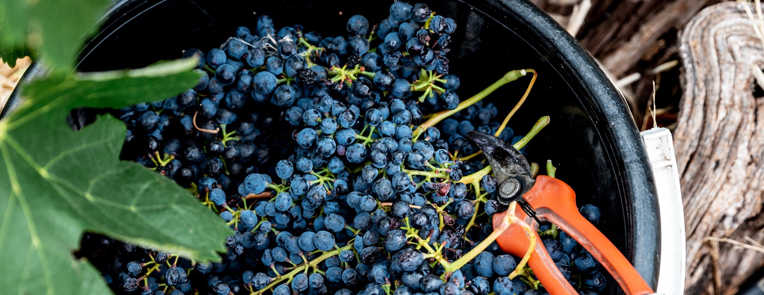
SHIRAZ
AND BLENDS

Slide 2


Crafted from grapes grown under vast and diverse climates, across landscapes millions of years in the making, every glass of Australian wine tells a story.
Like those who came before us, our modern growers and makers continue to be passionate, resilient and creative; constantly driven to explore new ways to perfect old techniques. Our community is connected by a mutual respect and shared love of crafting exceptional wine, while protecting the natural wonders for future generations to enjoy. Applying modern thinking to our ancient lands, we take playful experimentation very, very seriously.
So, if you’re looking for the taste of adventure, let Australian wine be your compass. Because in every bottle of Australian wine, you’ll experience the wonders of Australia – a reminder of the adventure and diversity that defines our culture and our land.

Slide 3
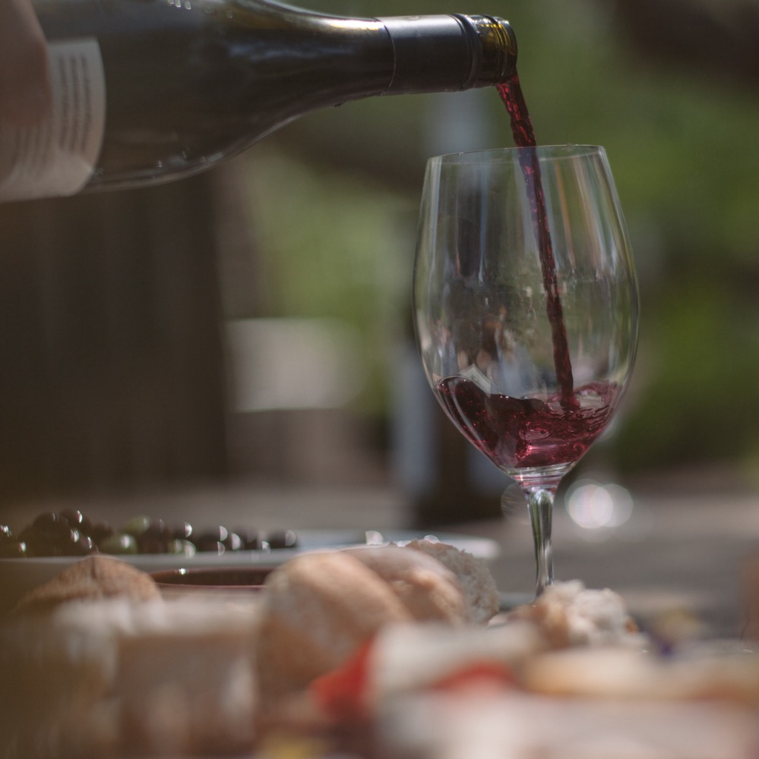
SHIRAZ
THE STORY OF AN AUSTRALIAN LEGEND
Shiraz is one of Australia’s most established and loved varieties
Grown by 4 out of 5 wineries
Represents nearly half of planted red grapes
Nearly 1/4 of total wine production.
You say Syrah, we say Shiraz
This variety is called Syrah almost everywhere else in the world. However, due to its commercial success internationally, Australian producers have chosen to label their own wine “Shiraz”.

Slide 4
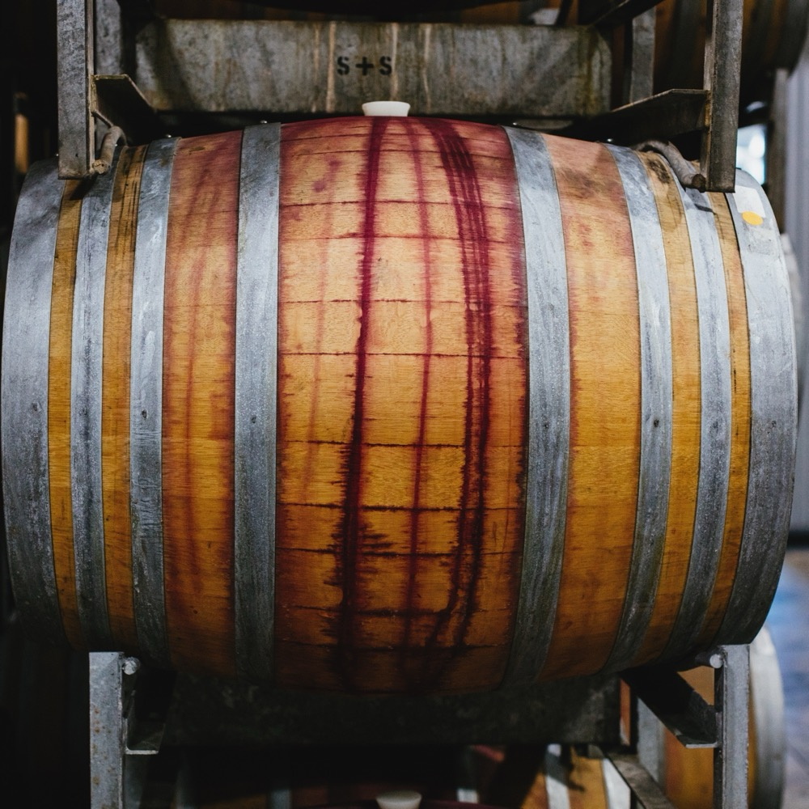
TODAY WE’LL COVER
The history of Australian Shiraz
How it’s grown
How it’s made
The different styles
Where it’s grown
Characteristics and flavour profiles

Slide 5
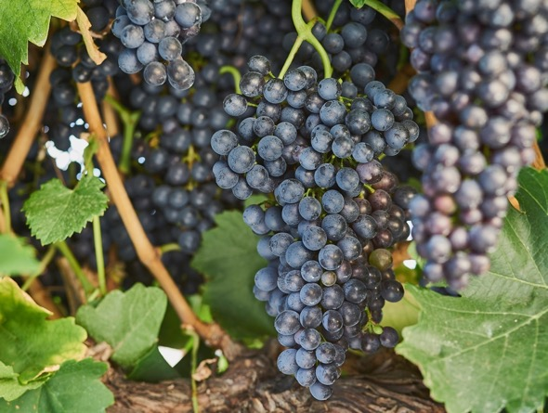
1820s – 1830s
THE HISTORY OF SHIRAZ IN AUSTRALIA
1840s – 1890s
Shiraz vines are planted in South Australia and Victoria, with some of these vines still producing fruit today.
1860
Shiraz is one of the original varieties brought to Australia and thrives in the warm, dry climate.
Tahbilk is established in Victoria and is home to some of the world’s oldest ungrafted, pre‑phylloxera plantings of Shiraz.

Slide 6
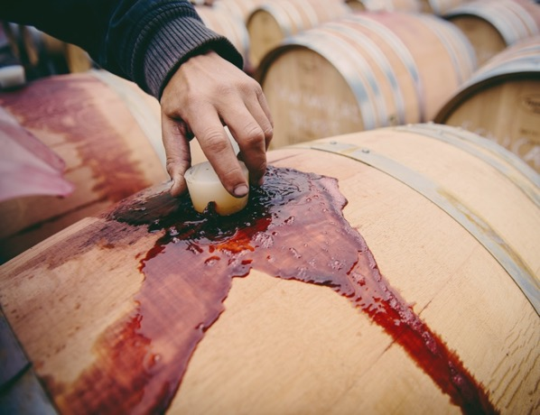
Early 1900s
1980s – 1990s
Shiraz continues to prosper in almost every corner of the country, with its suitability to Australia’s various climates, topography and soils superseding other varieties.
Australia’s winemakers craft wines with deeper colour, higher alcohol levels and new oak maturation.
1867
1950s – 1970s
Henry Best plants Shiraz in his Great Western vineyard in Victoria, and these vines continue to thrive today
Shiraz makes its move to become the most popular wine in the country.

Slide 7
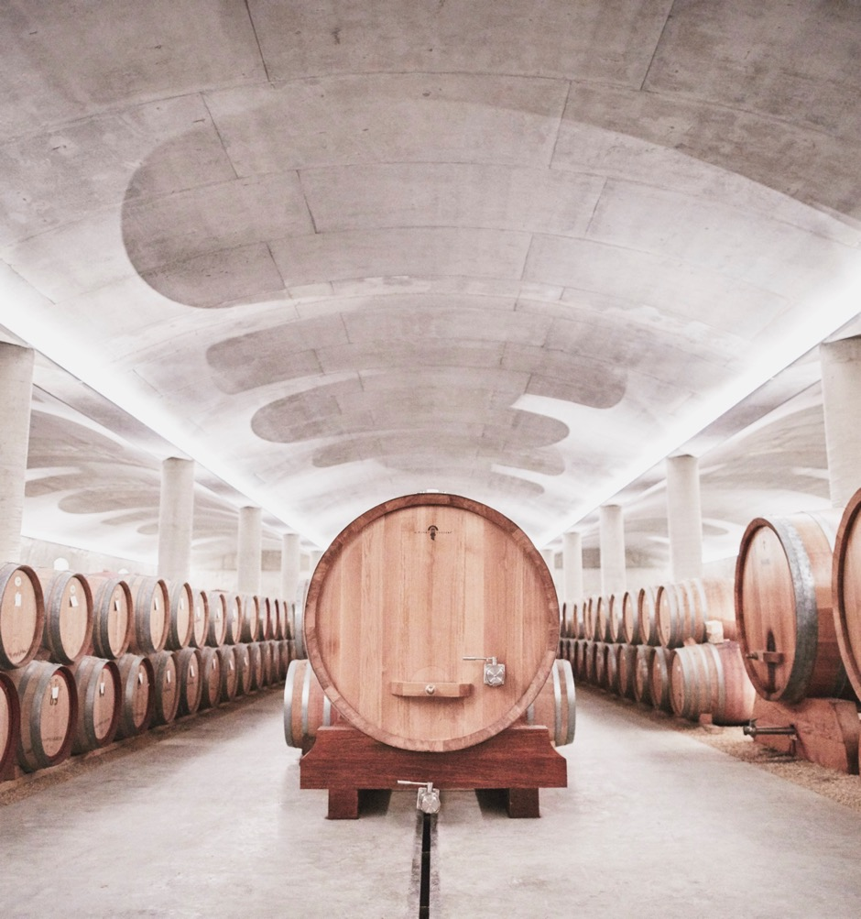
TODAY
The reputation of cool‑climate Shiraz grows, standing proudly alongside traditional, rich, full‑bodied warm-climate styles of Australian Shiraz that are enjoyed all over the world.
2000s
While blockbuster Shiraz is still being made, with inky depth and syrupy richness, tastes are increasingly appeased by more moderate styles.

Slide 8

THE STORY OF
MAX SCHUBERT
THE EVOLUTION OF AN ICON
In 1951, Max Schubert set out to make the “Great Australian Red”, but was ordered to cease production by Penfolds management
In 1960, Penfolds Grange Bin 1 hit the market to great critical acclaim, and Penfolds ordered Schubert to resume production
Penfolds Grange has become one of the world’s most iconic, collected and revered wines, largely thanks to the American wine media and critics such as Robert Parker and Wine Spectator

Slide 9
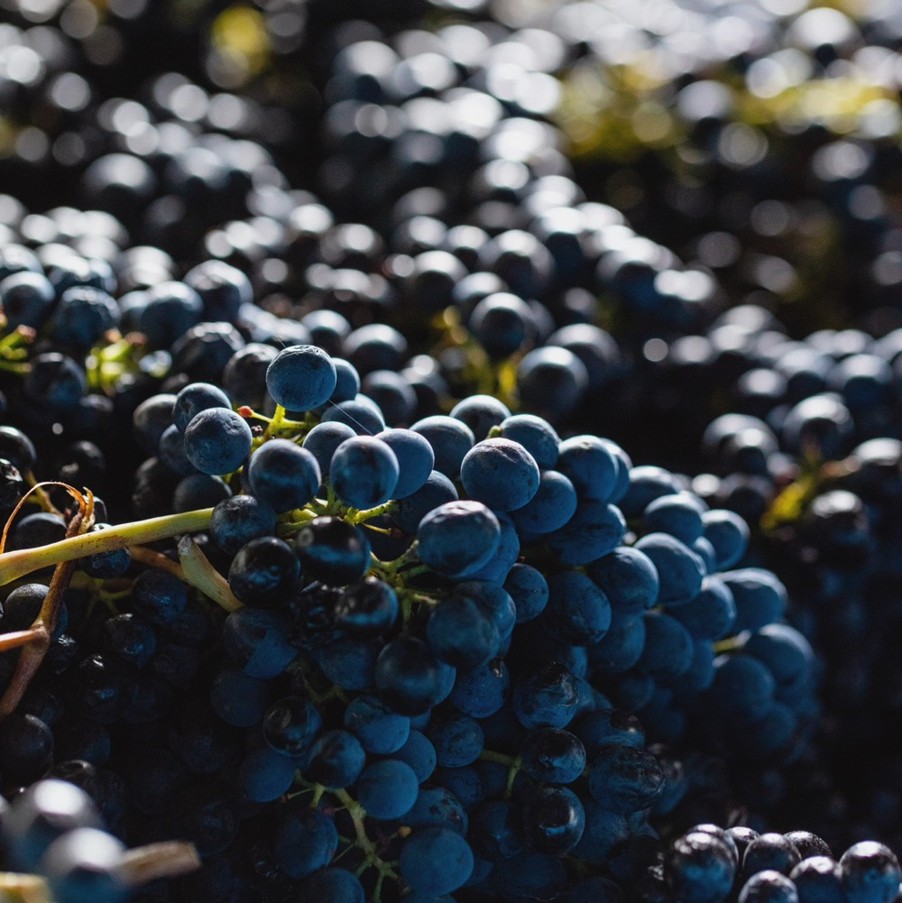
THE STORY OF
MAX SCHUBERT
THE EVOLUTION OF AN ICON
Shiraz: Just what the doctor ordered
Many of Australia’s early wine promoters were doctors, among them Dr Christopher Rawson Penfold, who arrived in Adelaide in 1844 and established Magill Estate. Penfolds’ first wines were available on prescription, thought to be of benefit to anaemic patients.

Slide 10
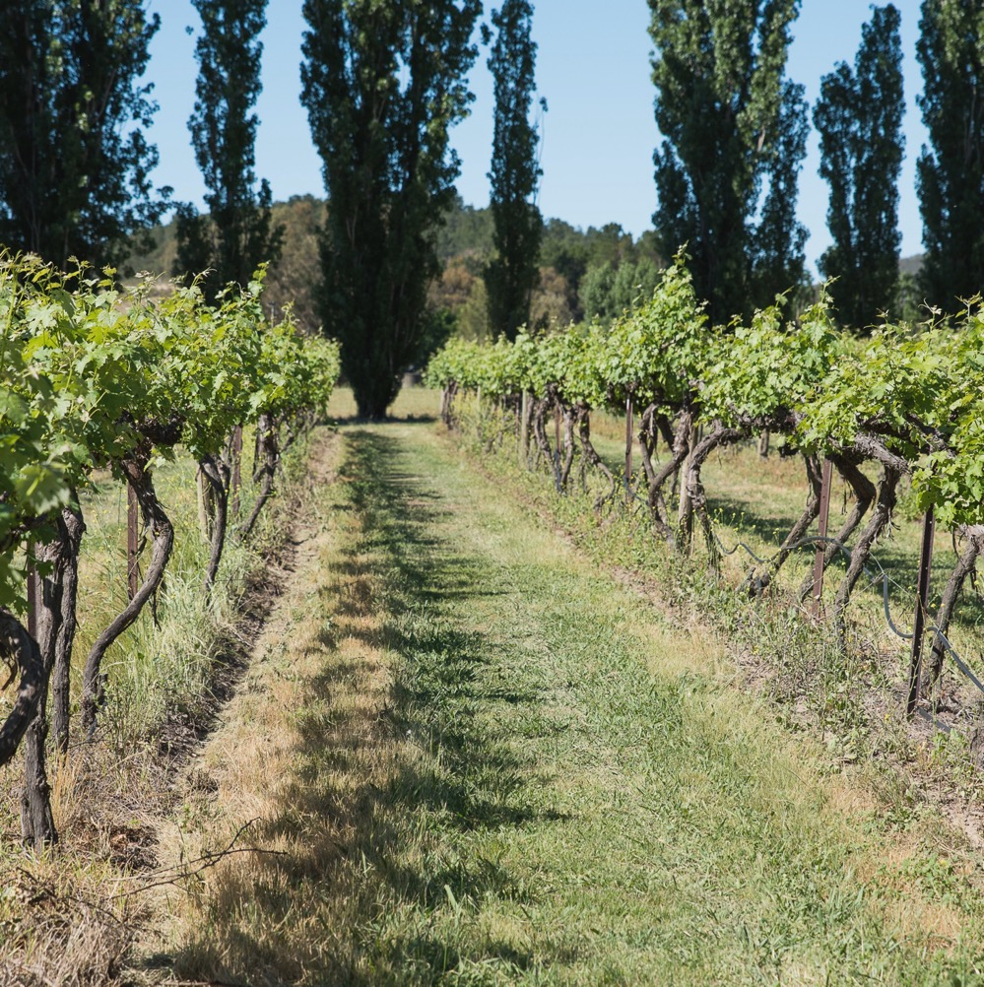
VITICULTURE
HOW SHIRAZ
IS GROWN
The Vine
Irrigation
Pruning
Yield
Harvest

Slide 11
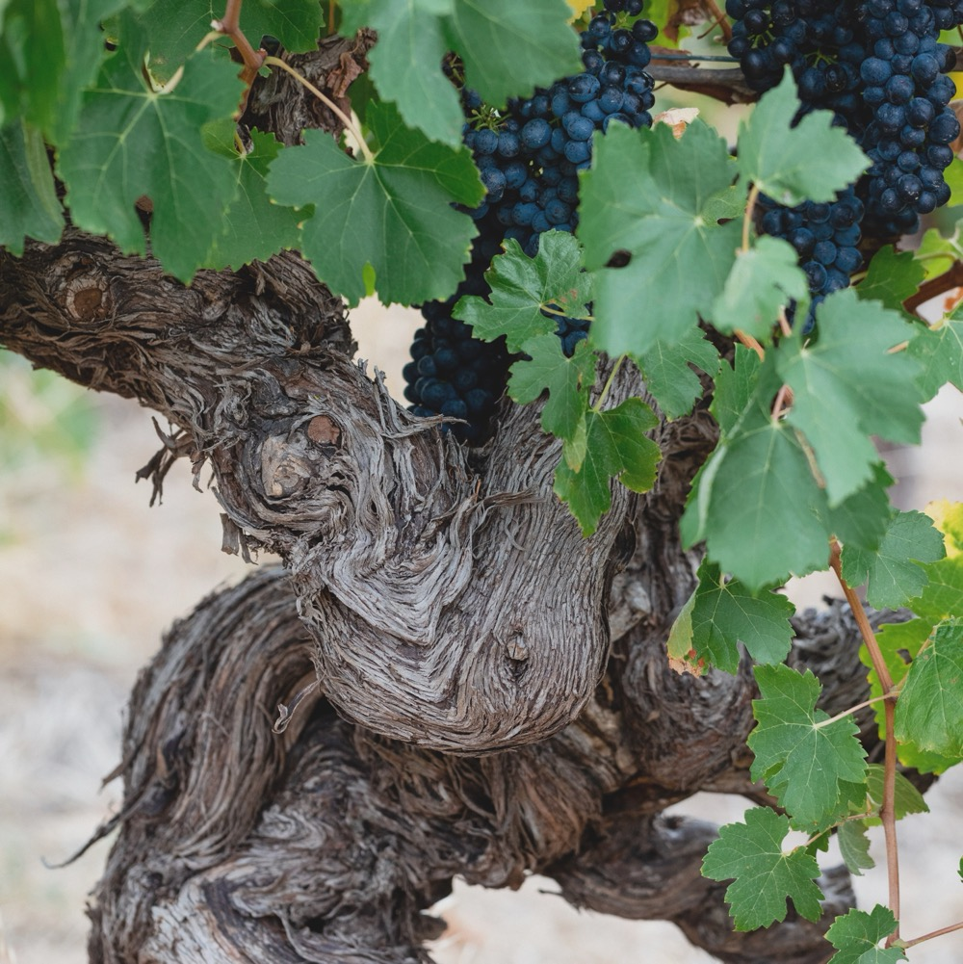
THE VINE
Vigorous, adaptable vine that can yield large quantities of grapes on a single vine, even in low-fertile soils.

Slide 12
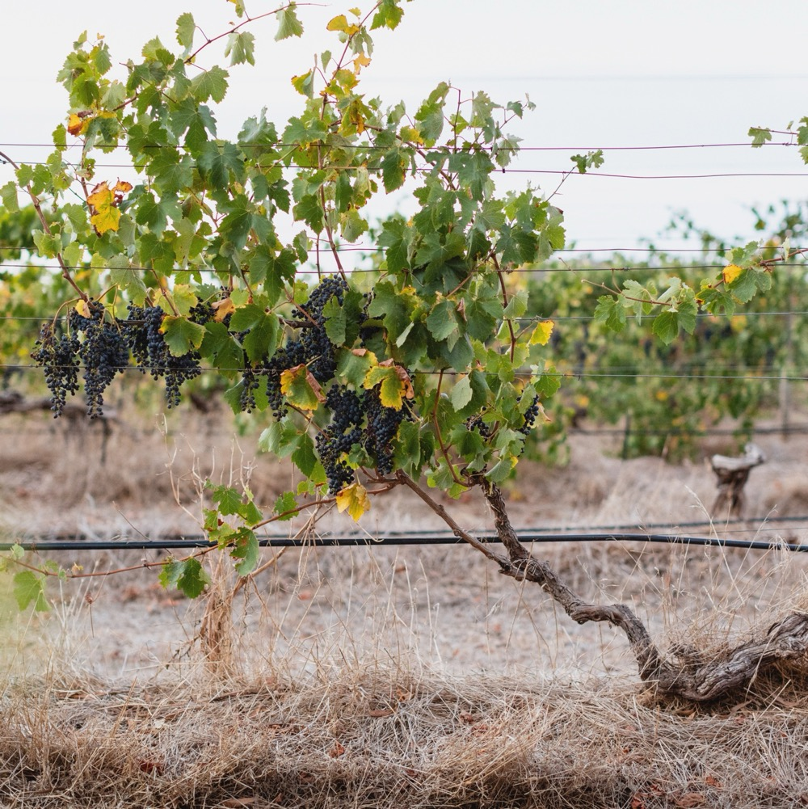
IRRIGATION
Vines on shallow soil require irrigation, while old vines are largely dry-grown
Shiraz vines can cope in adverse conditions
If irrigated too generously, wines can lack flavour concentration

Slide 13
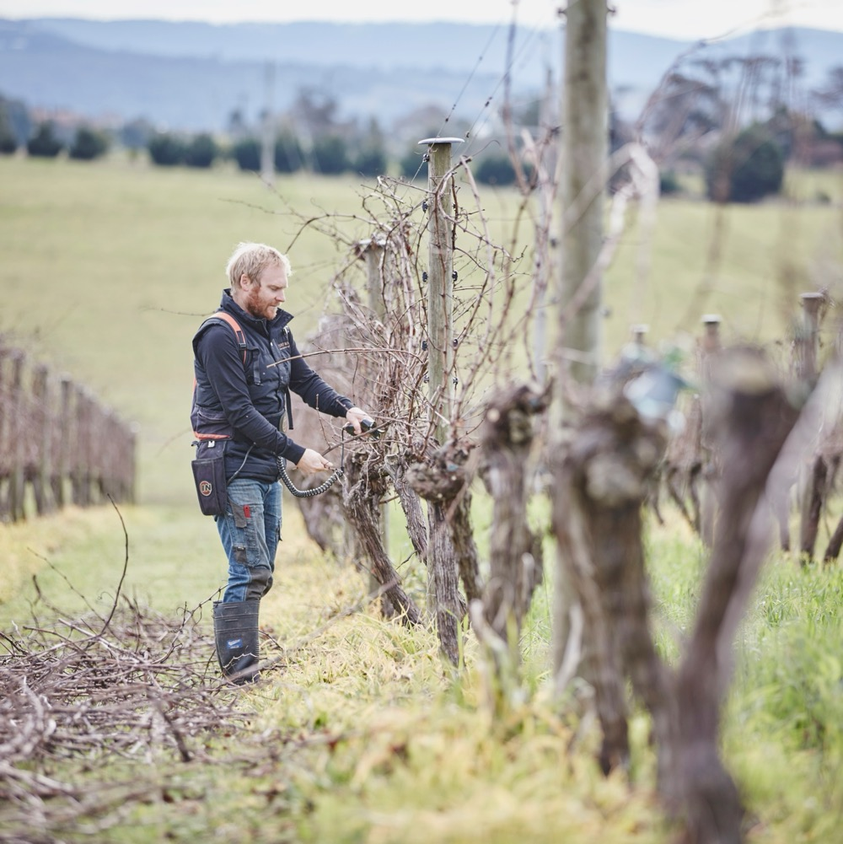
PRUNING
Especially important to control excessive growth. A variety of canopy management techniques can be used to ensure the canopy is balanced and the fruit zone is appropriately shaded, avoiding sunburn and excessive ripeness.

Slide 14

YIELD
Dependent on several factors, including:
Age of vine
Vine vigour
Site characteristics

Slide 15
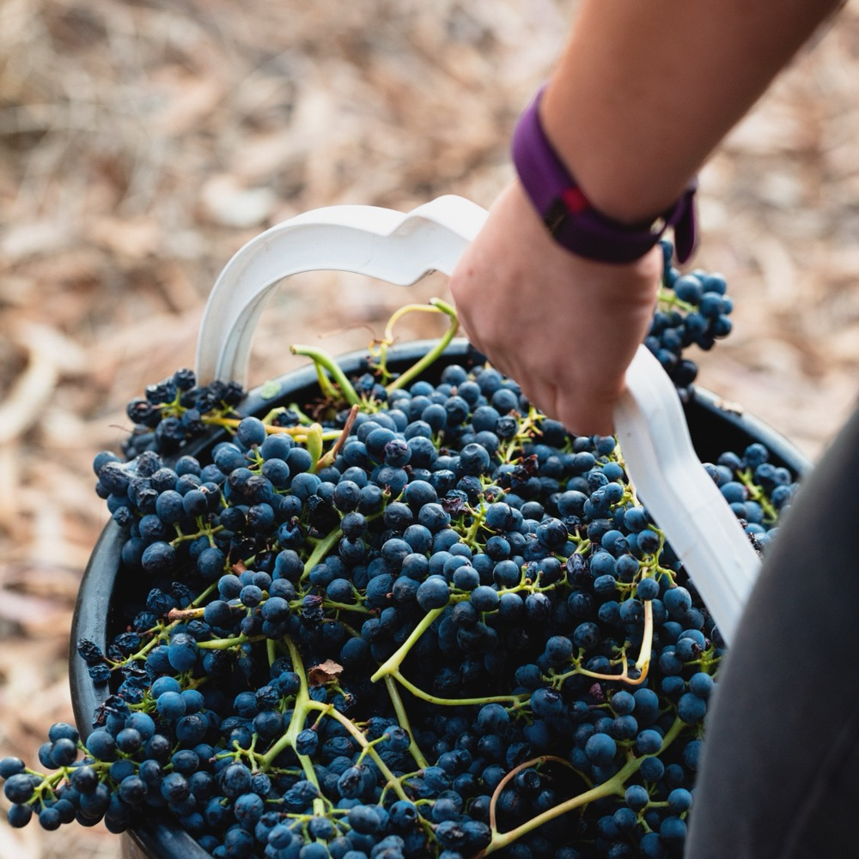
HARVEST
Shiraz demands a good ripening season. As grapes ripen, sugar content increases and acid content decreases. The key to an ideal harvest is to find the point when sugar‑acid balance is just right.

Slide 16
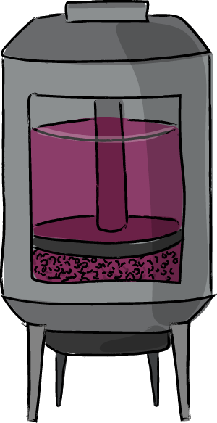
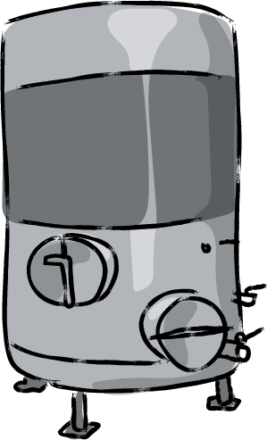


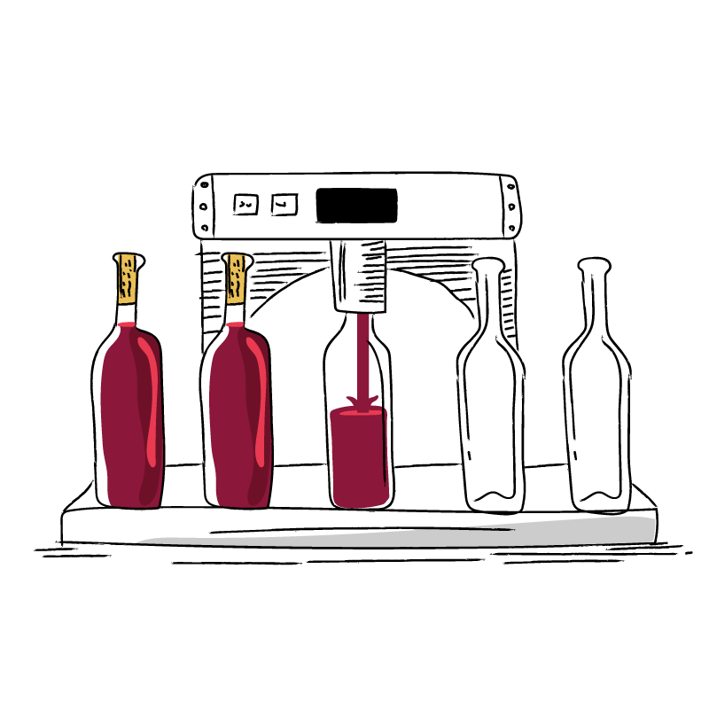
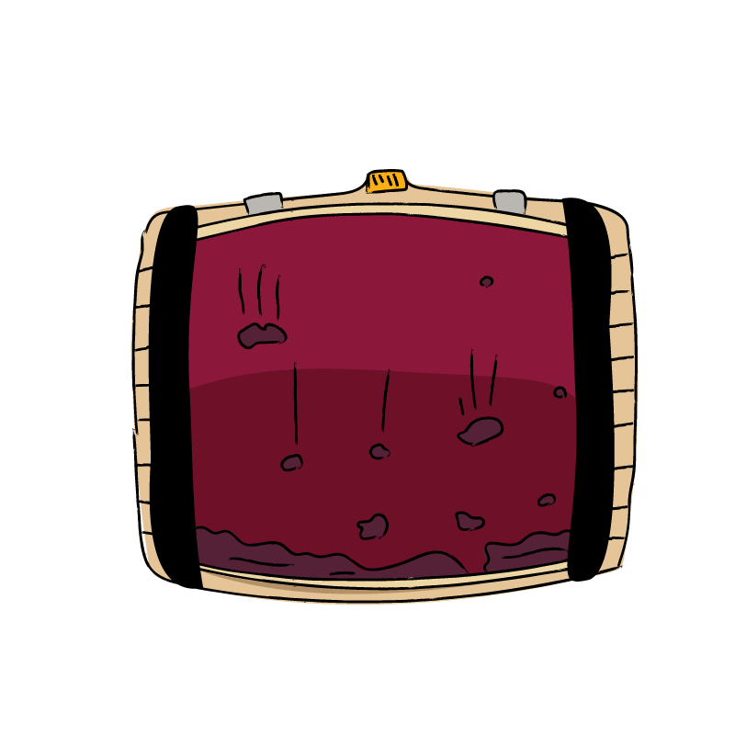
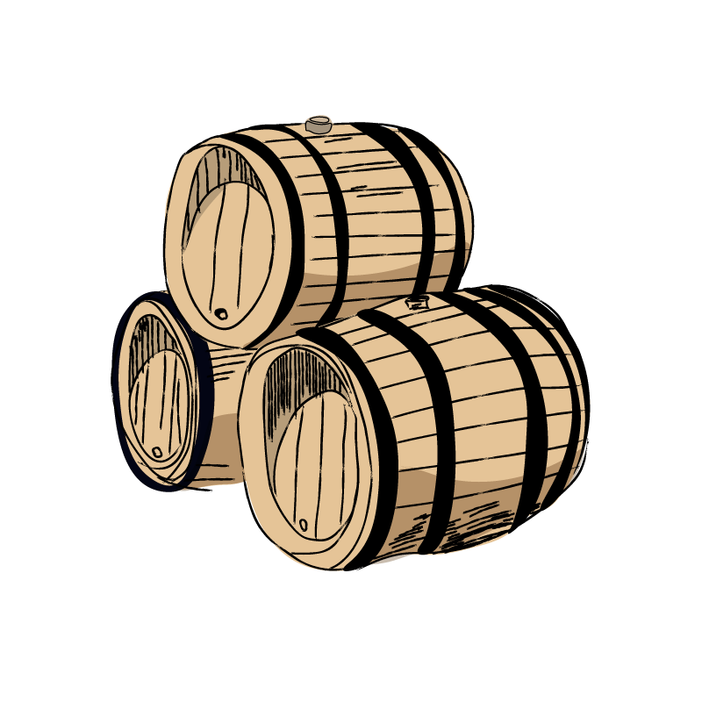
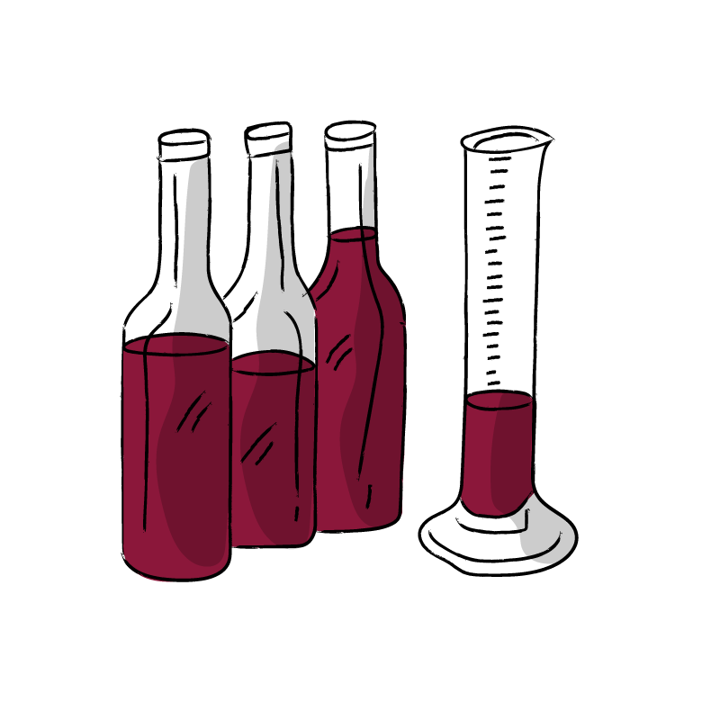
HOW RED WINE IS MADE
1. HARVEST
2. DESTEMMING AND CRUSHING
3. FERMENTATION
4. PRESSING
5. MALOLACTIC FERMENTATION
9. BOTTLING
8. FINING AND FILTERING
7. MATURATION
6. BLENDING

Slide 17
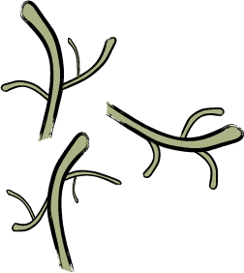
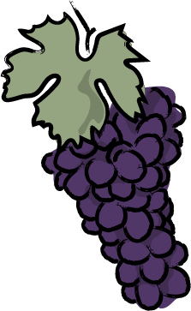
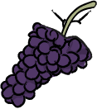
WINEMAKING:
TECHNIQUES INFLUENCING SHIRAZ
UNBROKEN GRAPE CLUSTERS STILL ON STEMS
STEMS LEFT IN CONTACT
STEMS ADDED
WHOLE BUNCH FERMENTATION
STEM
INCLUSION
CARBONIC MACERATION
MALOLACTIC FERMENTATION
WILD
FERMENTATION

Slide 18
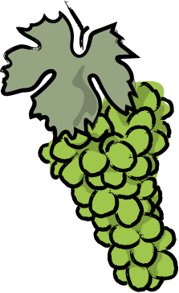

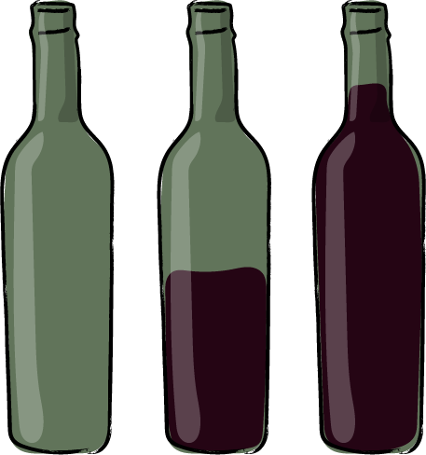
WINEMAKING:
TECHNIQUES INFLUENCING SHIRAZ
EXTENDED MACERATION TMES
CO-FERMENTATION
WITH VIOGNIER
RACK AND RETURN
POST-FERMENTATION MACERATION / EXTENDED SKIN CONTACT
OAK MATURATION
BOTTLING AND AGEING

Slide 19
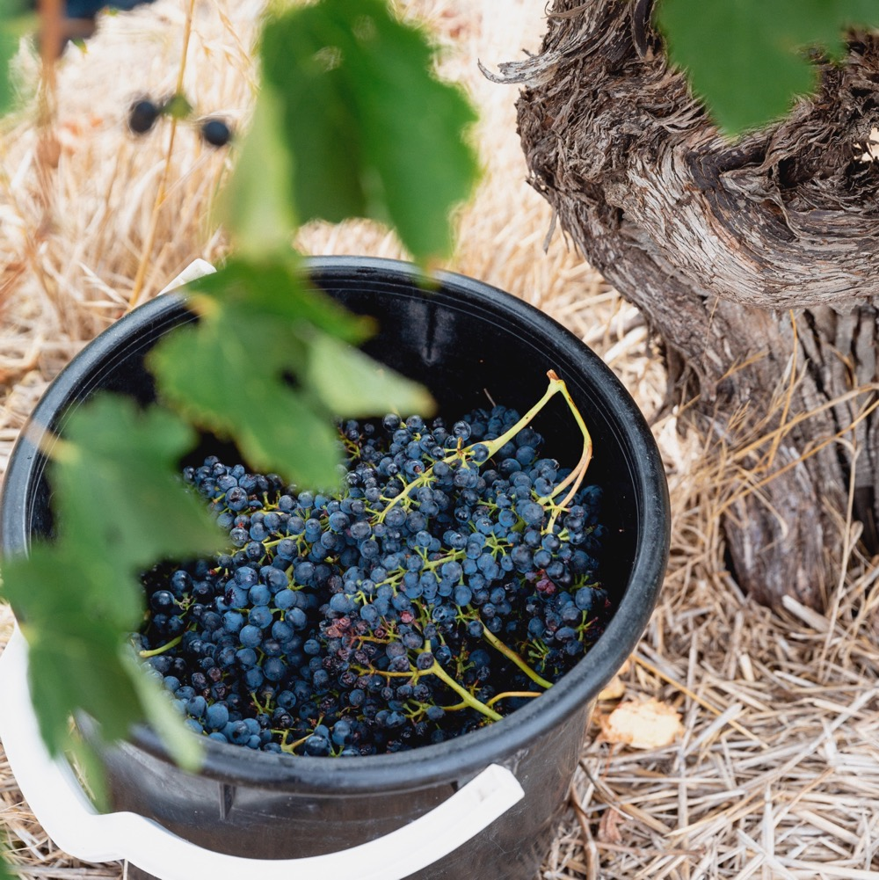
COMMON STYLES OF SHIRAZ AND
ITS BLENDING PARTNERS
“The whole is greater than the sum of its parts” applies well to blended Shiraz. Its colour, aroma, texture and flavours are boosted by the traits of its blending partner.

Slide 20

SHIRAZ AS A BLENDING MATERIAL IN
GSM BLENDS
ADDS
SAVOURY NOTES AND UPFRONT FLAVOUR
CAN CONTRIBUTE TO ELEVATED ALCOHOL LEVELS
SHIRAZ
GRENACHE
ADDS:
Blackberry
Mulberry
Blueberry
Plum
Black Olive
GSM
MOURVÉDRE
ADDS:
Fragrance
Strawberry
Spice
LIGHTEST BODIED OF GSM TRIO
ADDS:
Aromatics
Flavour persistence
Length and drive

Slide 21
SHIRAZ AS THE EQUAL PARTNER IN
SHIRAZ CABERNET BLENDS
AFTER GRANGE
SCHUBERT PODUCED FIRST VINTAGE OF PENFOLDS BIN 389, A MULTI-REGIONAL BLEND THAT POPULARISED THIS STYLE
SHIRAZ CABERNET
BLOCKBUSTER AUSTRALIAN BLEND
COMPLEX AND ROBUST
WITH INCREDIBLE AGEING POTENTIAL

Slide 22
SHIRAZ AS THE DOMINANT PARTNER IN
SHIRAZ VIOGNIER BLENDS
IN SMALL QUANTITIES
VIGNIER LIFTS THE AROMATICS ADDING
Sheen
Perfume
This unlikely partnership
(a red-wine grape blended with a white-wine grape) was first employed in France’s Northern Rhône
SHIRAZ VIOGNIER
ONE OF
AUSTRALIA’S
MOST ESTEEMED
EXAMPLES IS
CREATED BY WINEMAKER
TIM KIRK, OF CLONAKILLA
ADDING UP TO 5% VIOGNIER
DELIVERS
Aroma
Texture
Flavour

Slide 23
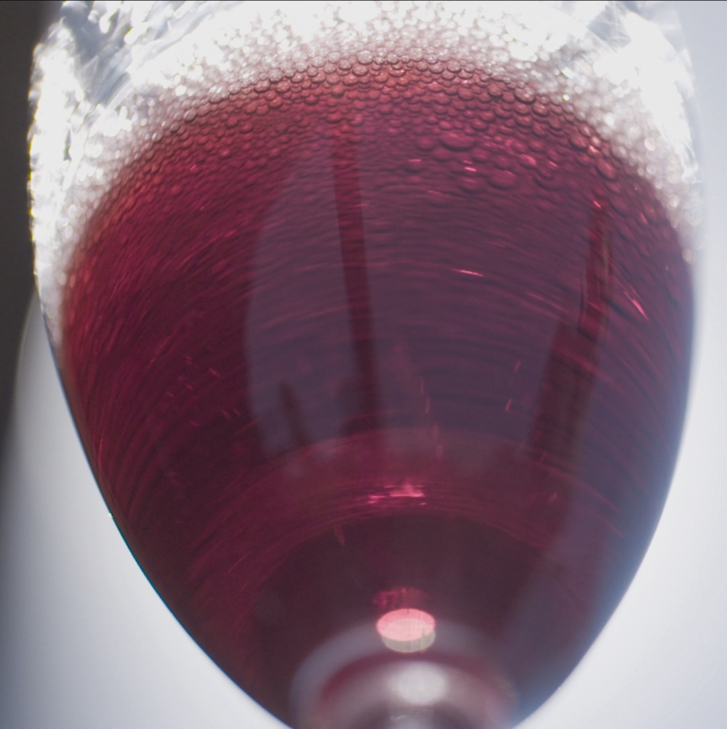
AN AUSTRALIAN TREASURE
SPARKLING RED
Australian ‘sparkling Burgundy’ has been produced with Shiraz grapes since 1881
Despite a small number of Australian producers creating this variety, its fans are devoted to its heady, rich and juicy-fruit flavour
Best examples boast a velvety palate, sweet blackberries and blueberries, cherries and spices
One of the differences between red and white sparkling is that red typically undergoes oak maturation, displaying complexity and richness
Sparkling reds are made from a range of varieties, but sparkling Shiraz is the predominant one

Slide 24
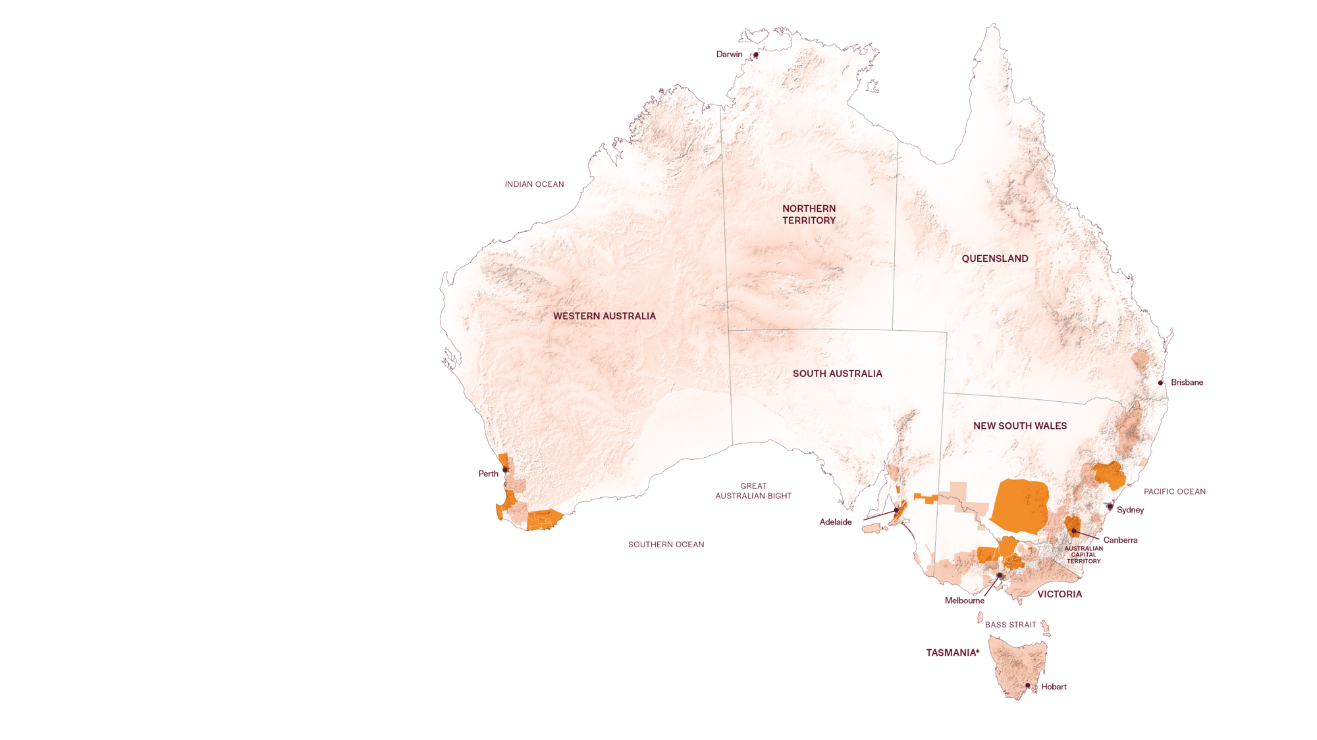
AUSTRALIAN
SHIRAZ REGIONS
RIVERLAND
HUNTER
SWAN DISTRICT
CLARE VALLEY
RIVERINA
GEOGRAPHE
BAROSSA
CANBERRA DISTRICT
MARGARET RIVER
McLAREN VALE
ADELAIDE HILLS
BEECHWORTH
GREAT SOUTHERN
CENTRAL VICTORIA

Slide 25
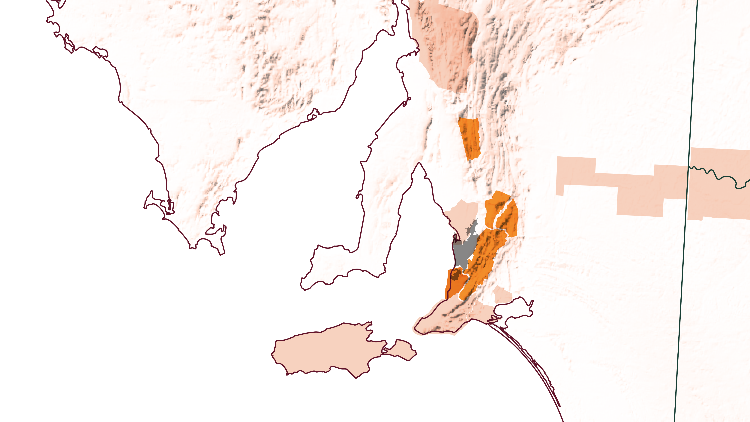
SOUTH AUSTRALIA
CLARE VALLEY
BAROSSA VALLEY
EDEN VALLEY
ADELAIDE HILLS
McLAREN VALE

Slide 26
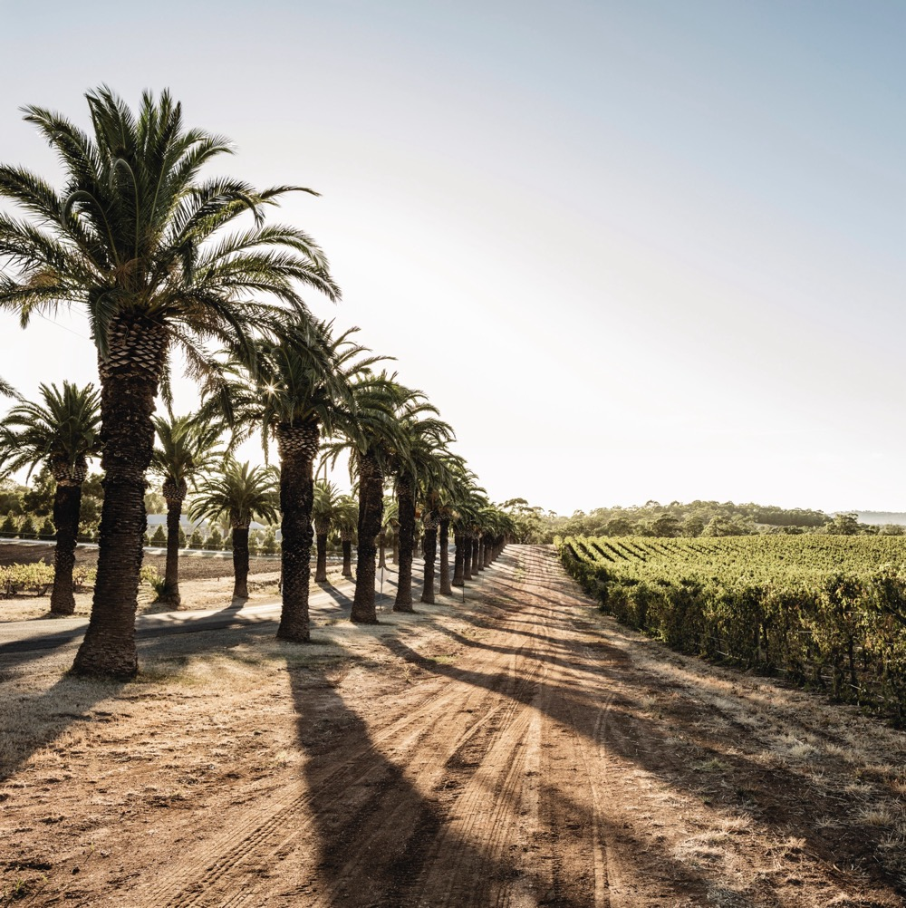
BAROSSA VALLEY
One of Australia's oldest and
best-known Shiraz regions
Barossa Shiraz is one of the most widely available and best-known red wines in the global market
An important component in classic Shiraz-Cabernet and GSM blends
Full-bodied, richly textured wines with black fruit, pepper and spice characters

Slide 27
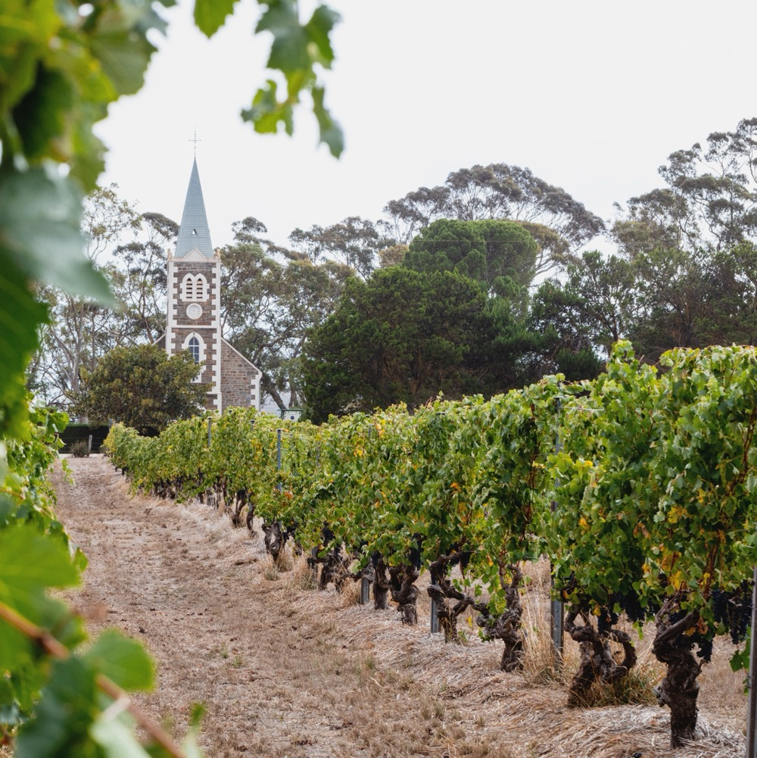
EDEN
VALLEY
Part of the greater Barossa Zone
High-altitude vineyards
Later harvest timing
Home to Henschke ‘Hill of Grace’ Shiraz
Medium-bodied to full-bodied Shiraz with classic blackberry, sage and pepper notes

Slide 28

McLAREN
VALE
One of world’s most geologically diverse regions
Red wine wonderland
Shiraz is the most planted
red variety in the region
Full-bodied Shiraz with rich blueberry fruit and chocolate characters
ONE OF AUSTRALIA'S PREMIER
SHIRAZ-GROWING REGIONS

Slide 29
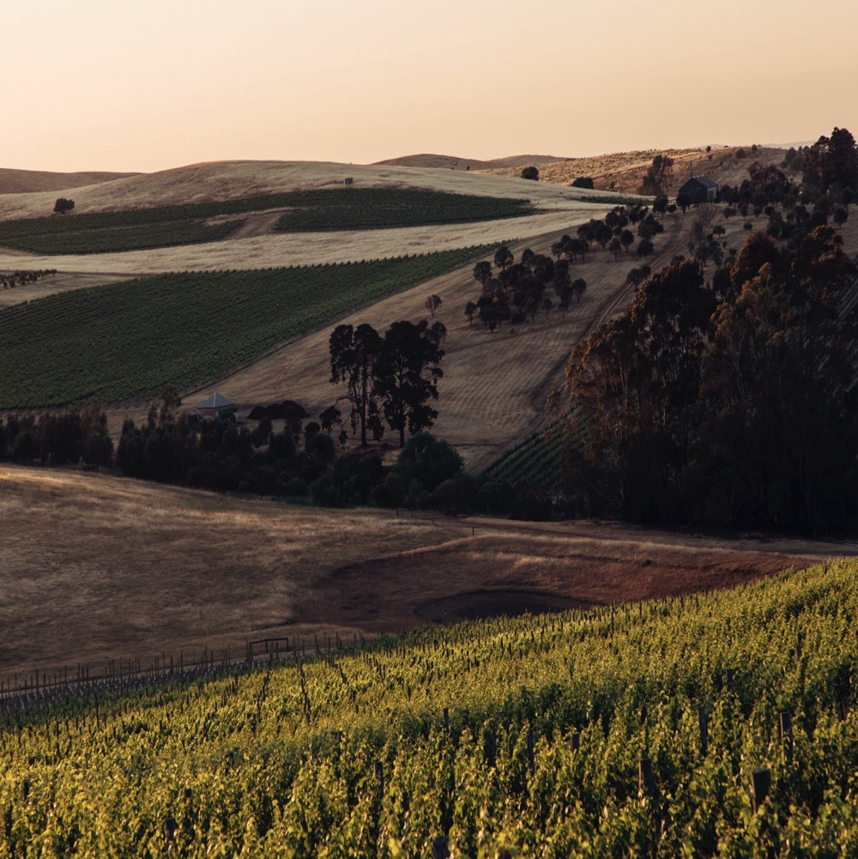
CLARE
VALLEY
Fertile farming/agricultural region
Warm days help Shiraz develop richness, depth of flavour and fruit concentration
Consistently cool nights aid
in acid retention
Decadent, opulent, rich Shiraz with black fruit flavours and an almost creamy texture

Slide 30
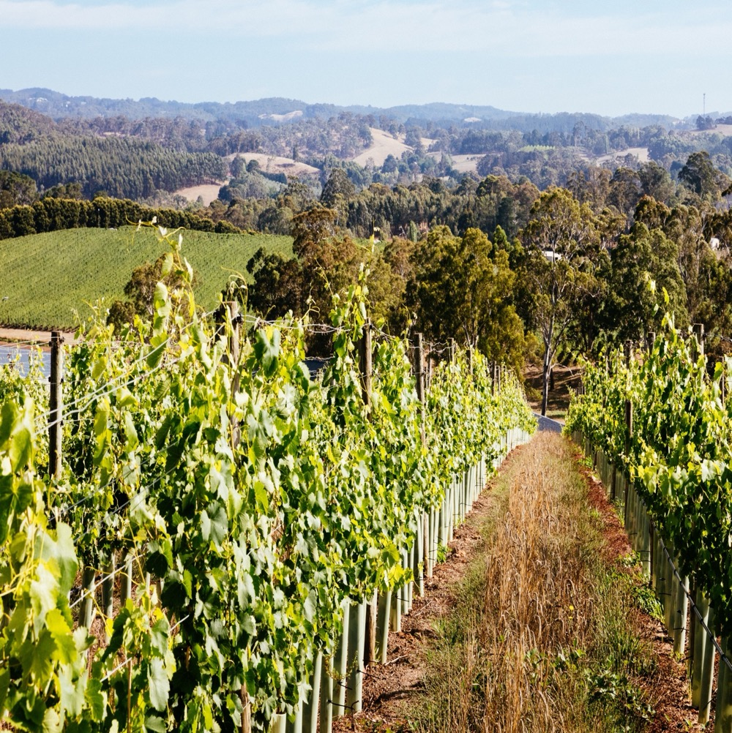
ADELAIDE HILLS
Oldest surviving German
settlement in Australia
Cool maritime climate with
high-elevation vineyards
Adelaide Hills Shiraz flouts the big-bodied robust nature of neighbouring Barossa and McLaren Vale wines
Elegant, medium-bodied Shiraz,
with fragrant pepper and spice,
and fine tannins
Lower alcohol levels make this cool-climate style a very food-friendly wine

Slide 31
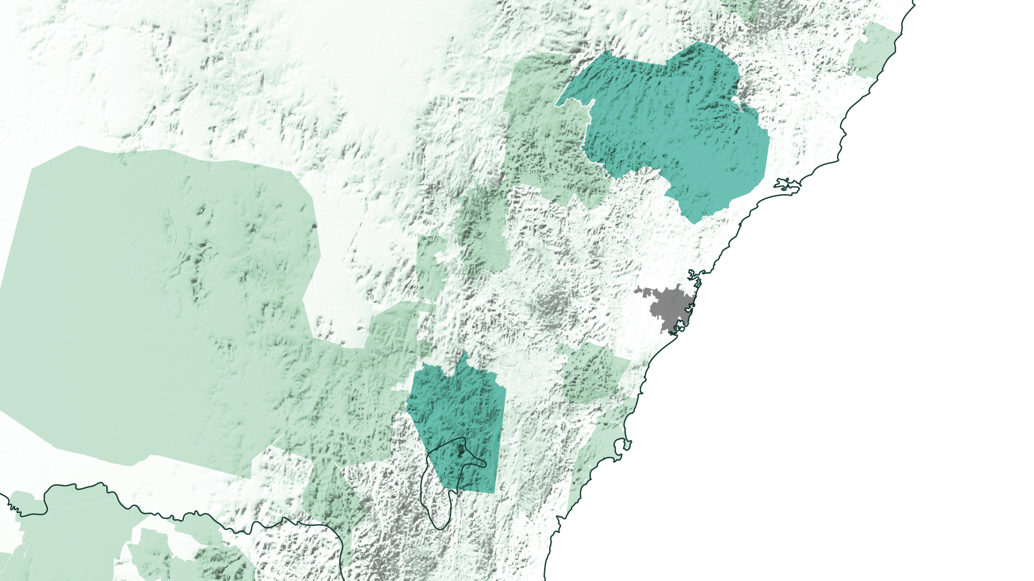
NSW AND
ACT REGION
HUNTER VALLEY
Sydney
CANBERRA DISTRICT
AUSTRALIAN CAPITAL TERRITORY
VICTORIA

Slide 32
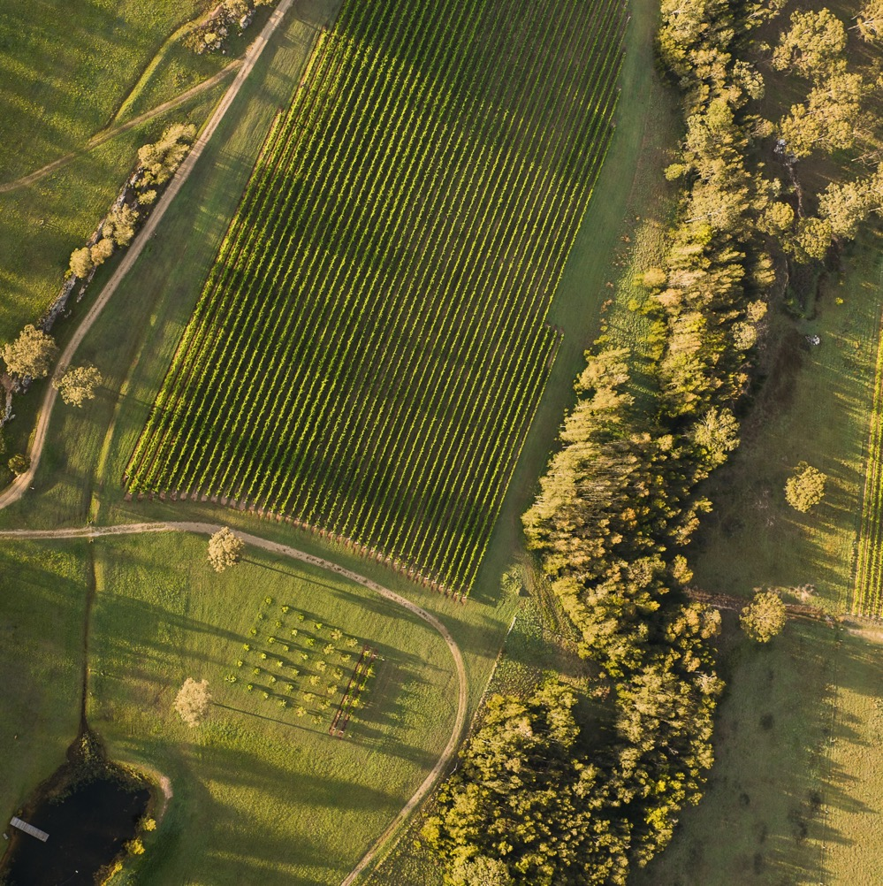
HUNTER VALLEY
Birthplace of Australian wine industry
Warm, humid climate ideal
for Shiraz fruit ripeness
Known for medium-bodied, savoury, complex wines
Young Hunter Shiraz displays
red and dark berries, spice and
lots of tannin
Aged Hunter Shiraz is smooth
and richly flavoured with earthy
tones and complexity

Slide 33
CANBERRA DISTRICT
Emerging winemaking scene with strong drive for innovation
Shiraz is the red wine that has brought the Canberra District
its greatest fame
Mix of geology, climate and expertise creates spicy, peppery, lean yet balanced
and flavoursome Shiraz
Home to Clonakilla, producer of acclaimed Shiraz-Viognier blend

Slide 34
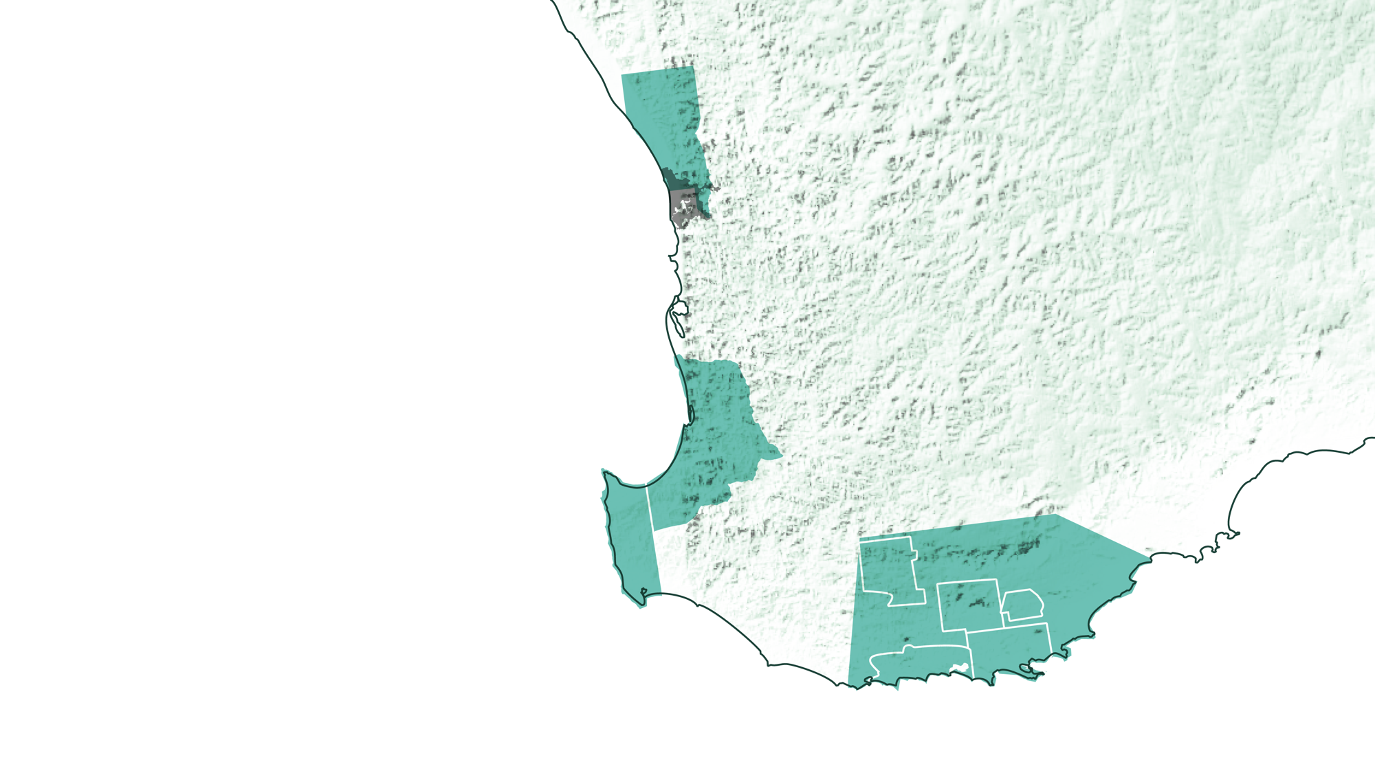
WESTERN AUSTRALIA
SWAN DISTRICT
Perth
GEOGRAPHE
MARGARET RIVER
GREAT SOUTHERN

Slide 35
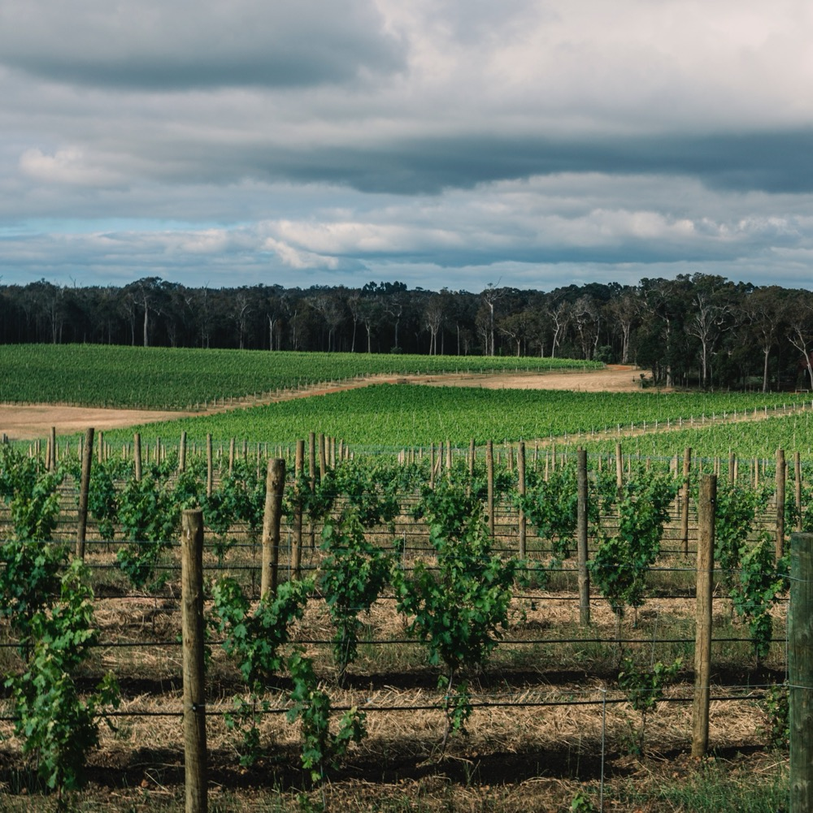
MARGARET RIVER
Shiraz is the second most planted
red grape, behind well-renowned Cabernet Sauvignon
Mediterranean climate with strong maritime influences, with oceans on three sides
Shiraz displays fruit ripeness, vibrancy, flavour depth and roundness of texture
Good acid level allows Shiraz to age gracefully

Slide 36
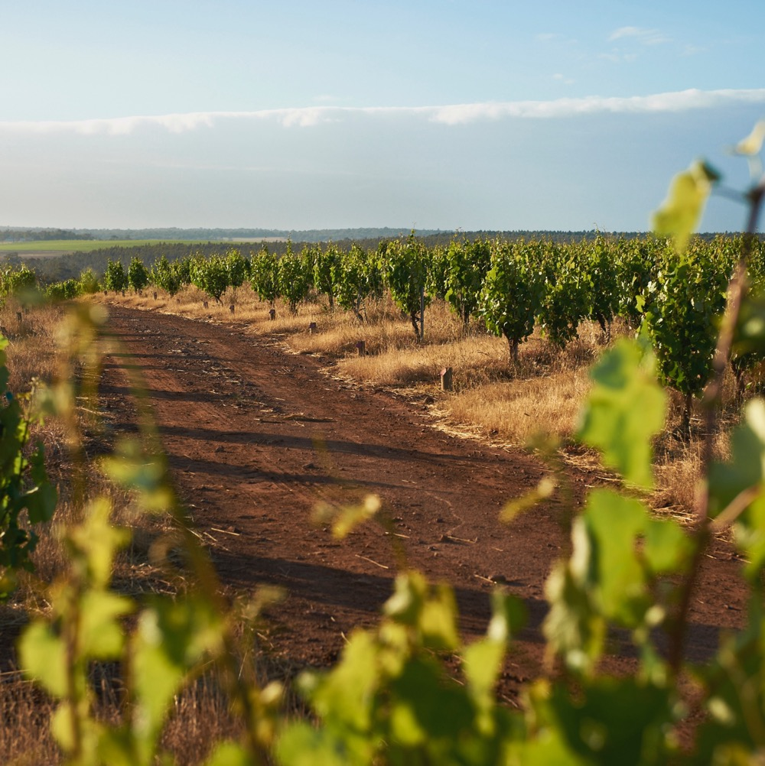
GREAT SOUTHERN
Southerly location gives it a cool maritime climate
Five distinct sub-regions
A healthy place for vine growth, almost free of pests and disease
Shiraz is medium in weight and exhibits an earthy blend of liquorice, spice, pepper, cherry and plum
Many producers avoid the heavy-handed use of American oak, allowing the fruit to shine through

Slide 37
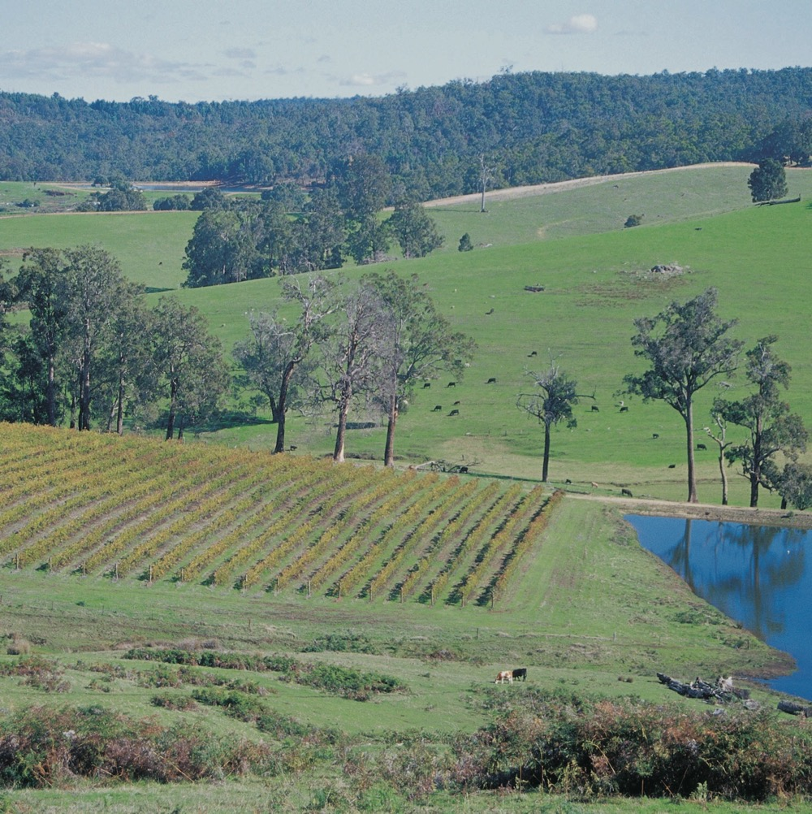
GEOGRAPHE
Warm climate modified by Indian Ocean breeze
Shiraz tends to be bold in flavour, but soft in texture
Producers are shifting their style to be more medium-bodied in weight than fuller-bodied styles
Fruit characters on the cherry or red berry fruit spectrum, with hints of mint and peppery spice

Slide 38
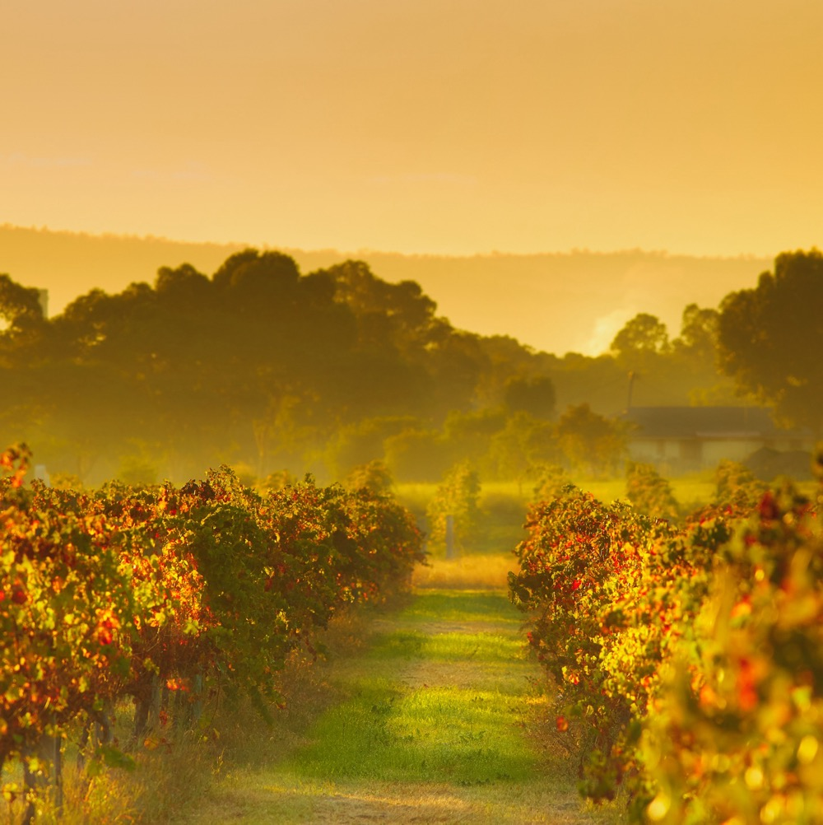
SWAN
VALLEY
One of Australia’s warmest and oldest wine regions
Perfect conditions for Shiraz production, with a warm to hot Mediterranean climate and very dry conditions for ripening season
Shiraz shows a spectrum of ripe and dried fruit in a full-bodied drop
Softness and length to Swan Valley Shiraz, providing a suppleness and drinkability in young wines
Credit: Tourism Western Australia

Slide 39
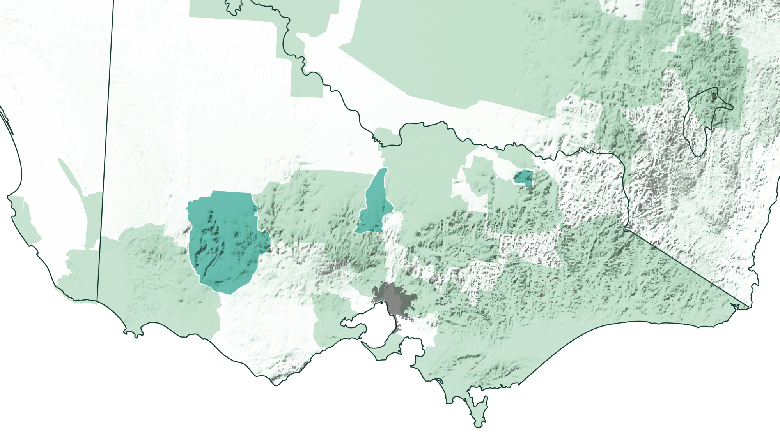
VICTORIA
HEATHCOTE
BEECHWORTH
GRAMPIANS
Melbourne

Slide 40
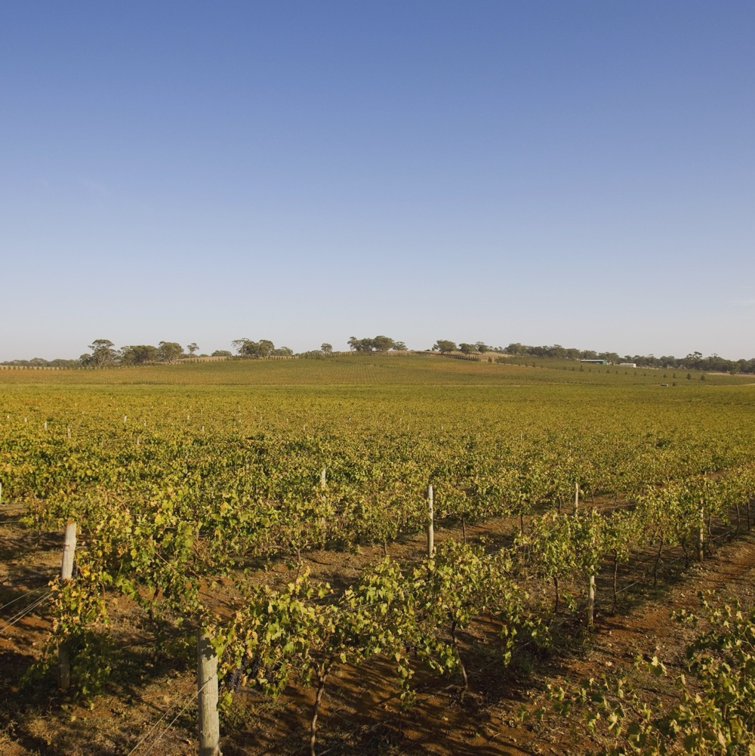
HEATHCOTE
One of Australia’s warmest and oldest wine regions
Perfect conditions for Shiraz production, with a warm to hot Mediterranean climate and very dry conditions for ripening season
Shiraz shows a spectrum of ripe and dried fruit in a full-bodied drop
Softness and length to Swan Valley Shiraz, providing a suppleness and drinkability in young wines

Slide 41
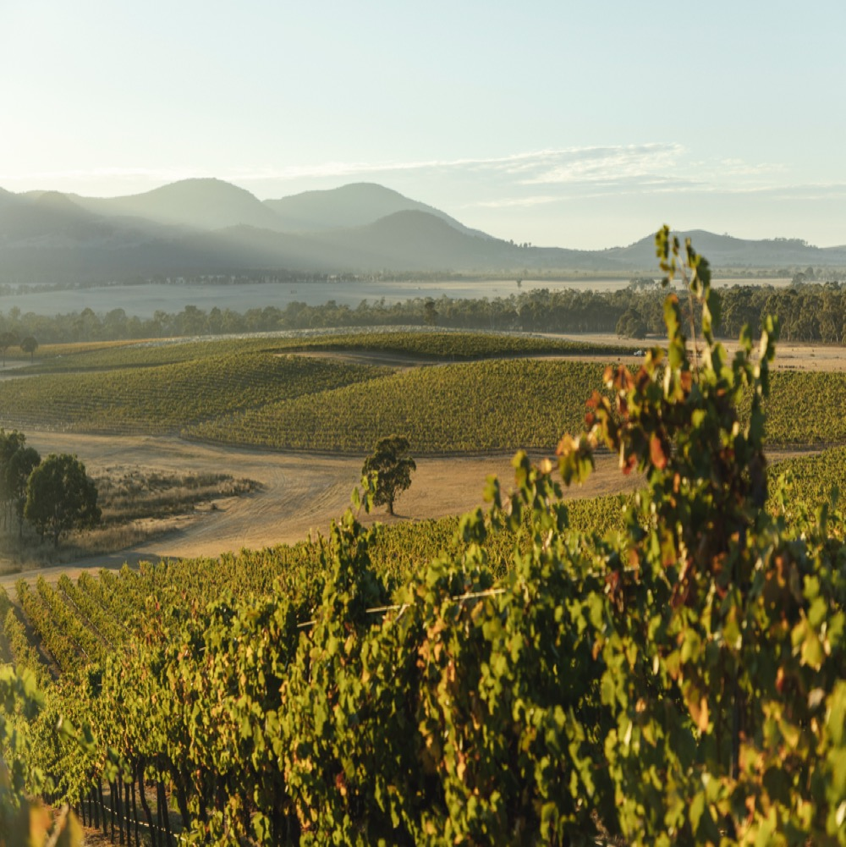
GRAMPIANS
One of the country's oldest Shiraz vineyards planted in 1860s
Cooler-climate region – warm to hot days, cool nights
Region is especially well suited to later-ripening red varieties such as Shiraz
The Great Western sub-region is adept at producing elegant Shiraz of deep purple
Great Western Shiraz displays black pepper, plum, mint and clove, with fine but firm tannins

Slide 42
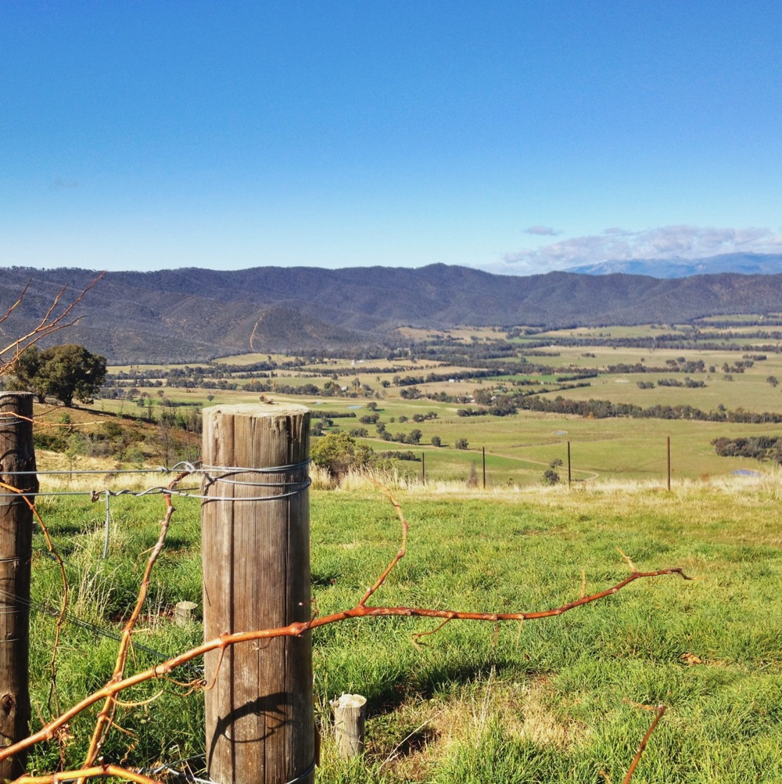
BEECHWORTH
Cool climate, at the foothills of the Victorian Alps
Shiraz thrives in this cool
sub-alpine climate
Shiraz expressions are medium in body, with savoury, spicy and earthy characters
Home to Giaconda, one of Australia’s premier producers of Shiraz and Chardonnay

Slide 43
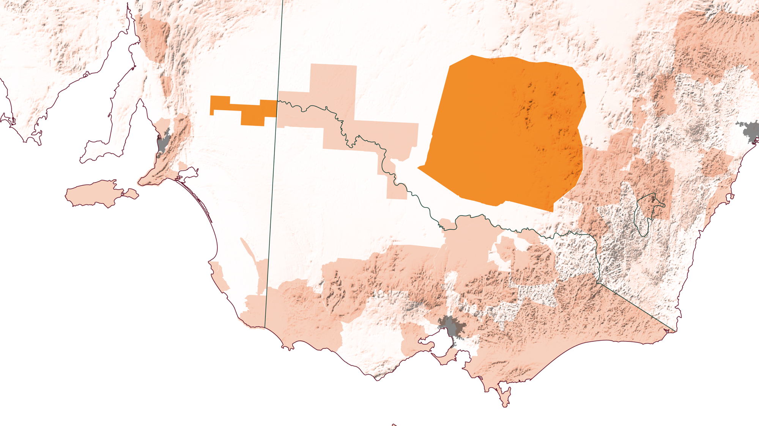
SHIRAZ IN THE RIVERLAND AND RIVERINA
RIVERLAND
Sydney
RIVERINA
Adelaide
Without these regions, Australia’s wine sector would not be the world’s fourth largest exporter of wine or a significant contributor to the Australian economy as a whole.
Melbourne

Slide 44
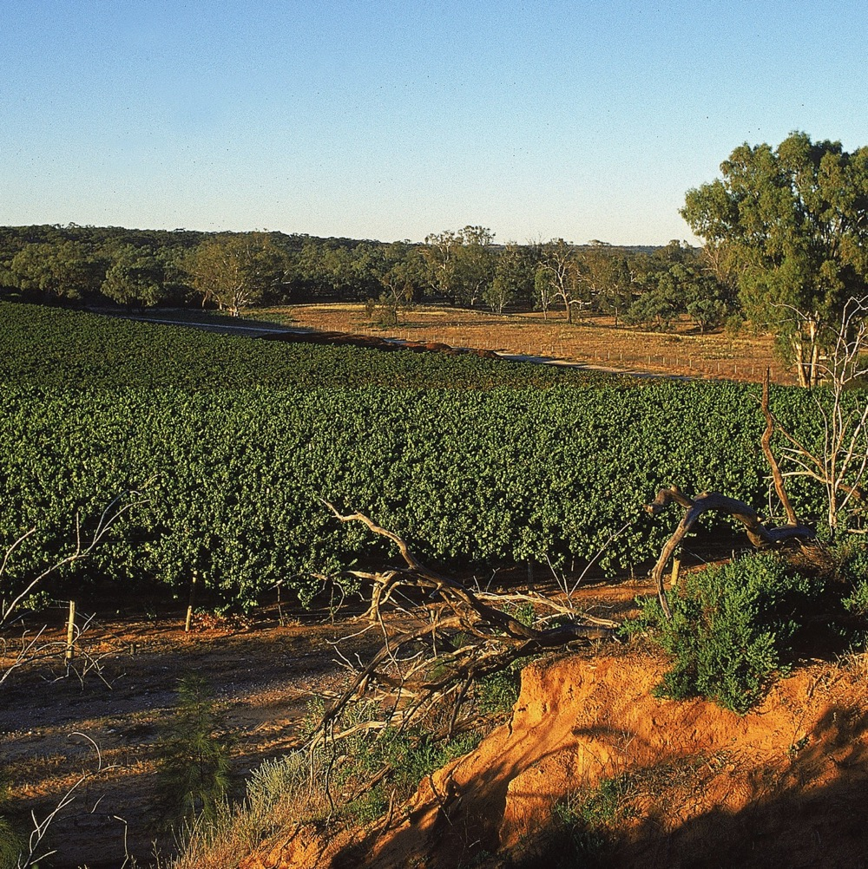
RIVERLAND
Long-established, warm-climate winemaking powerhouse, located east of the Barossa Valley
Producers are encouraging modern style development, with full-flavoured, generous and approachable Shiraz

Slide 45
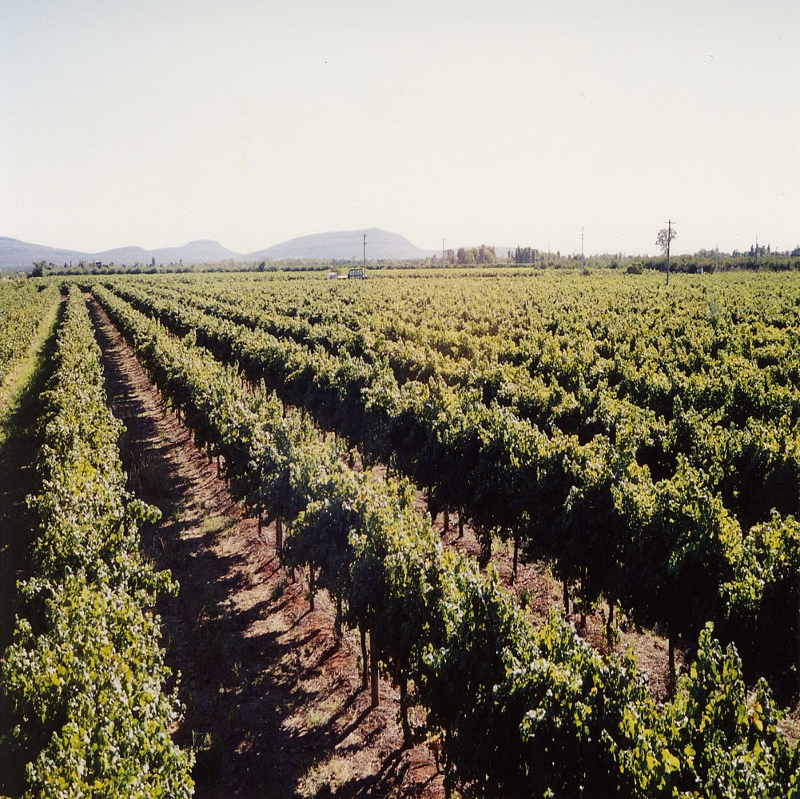
RIVERINA
Efficient and innovative production methods have allowed for strong export success
Riverina Shiraz includes easy‑drinking wines with vibrant juicy-ripe fruit, sweet vanilla and spice, through to more elegant, refined expressions
Home to ‘critter’ wine phenomenon

Slide 46
BAROSSA SHIRAZ
characteristics
COLOUR
Shiraz
Light
Medium
Full
BODY
FLAVOURS
Dry
Medium dry
Sweet
SWEETNESS
Pepper
Blackberry
Spice
Plum
Dark Cherry
Chocolate
Coffee
Low
Medium
High
SHIRAZ
OAK
TANNIN
ACIDITY
8%
17%
13.5% – 15.5%
ALCOHOL

Slide 47

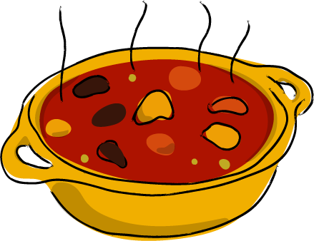
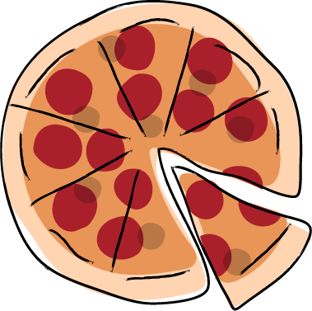
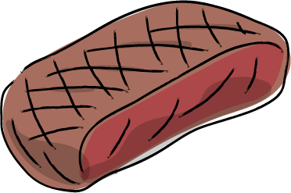
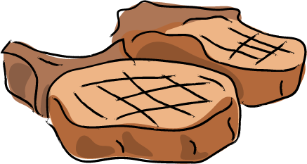
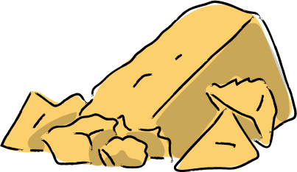

FOOD PAIRINGS
Pork, lamb and beef in casseroles flavoured with wine, onions and spices
Gamey meats such as kangaroo or venison
Salami-topped pizza or beef ragu pasta
SHIRAZ
Intensely flavoured hard cheese, such as cheddar, pecorino or Parmesan, smoked gouda
Grilled and BBQ meats seasoned with pepper
Dark chocolate
(70% cocoa)

Slide 48

AS DIVERSE AS
THE COUNTRY THAT MADE IT
Australia’s fine Shiraz wines are an expression of place: a distillation of our distinct terroir, climate and community.
Our winemakers are curious by nature, perfecting old concepts and playing with new ideas to create something extraordinary. And that’s what makes the future of Shiraz so exciting.

Slide 49

THANK YOU

