Slide 1
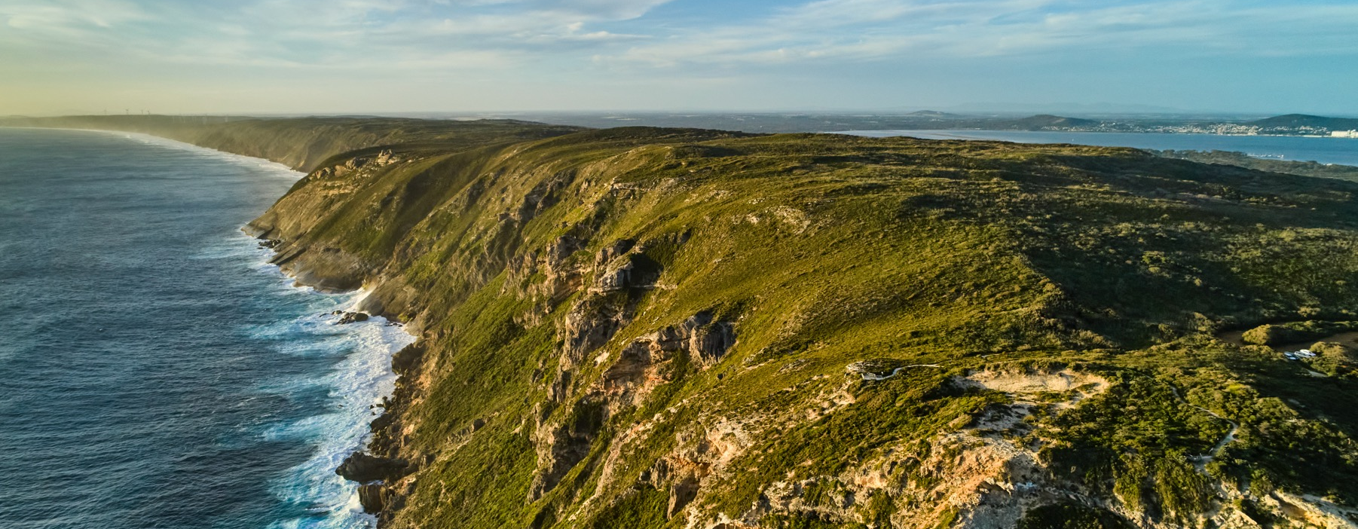
GREAT SOUTHERN
Photo courtesy of Wines of Western Australia
Notes:
Explore the unique history, growing conditions, viticulture and celebrated wines that make Australia’s largest wine region such a standout. Check these notes for additional slide information and suggested discussion points. To download more topics and resources, including presentations like this one, visit www.australianwinediscovered.com

Slide 2


Crafted from grapes grown under vast and diverse climates, across landscapes millions of years in the making, every glass of Australian wine tells a story.
Like those who came before us, our modern growers and makers continue to be passionate, resilient and creative; constantly driven to explore new ways to perfect old techniques. Our community is connected by a mutual respect and shared love of crafting exceptional wine, while protecting the natural wonders for future generations to enjoy. Applying modern thinking to our ancient lands, we take playful experimentation very, very seriously.
So, if you’re looking for the taste of adventure, let Australian wine be your compass. Because in every bottle of Australian wine, you’ll experience the wonders of Australia – a reminder of the adventure and diversity that defines our culture and our land.

Slide 3
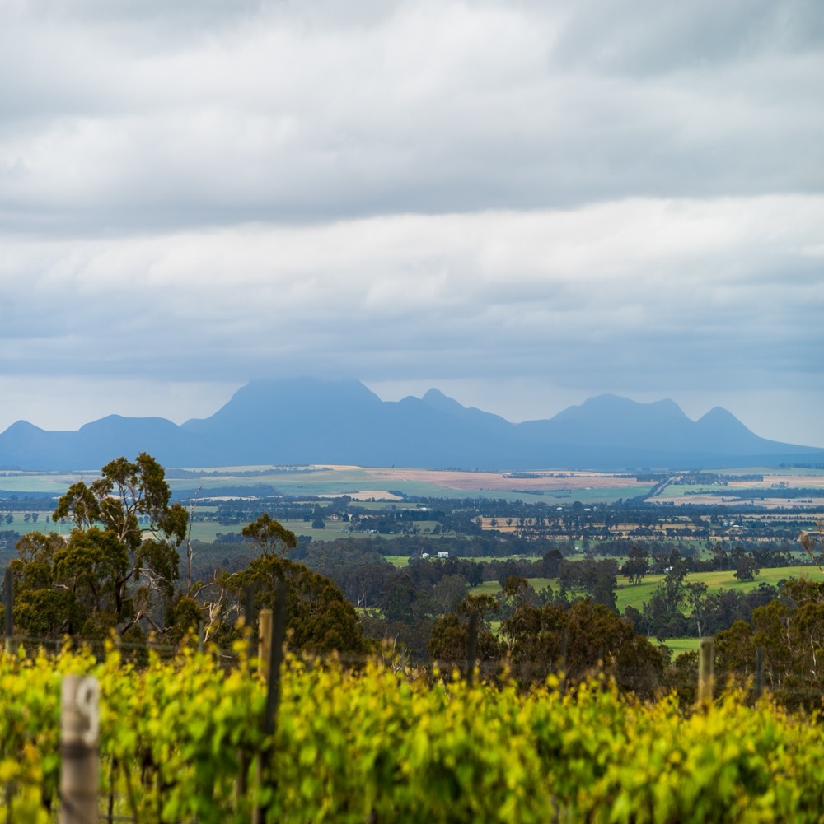
GREAT SOUTHERN
RICH, VAST AND VARIED
Australia’s largest wine region is as vast and isolated as it is diverse, with a reputation for high-quality wines.
Home to five distinct subregions
Western Australia’s coolest wine region with favourable growing conditions
Exceptional Riesling and Shiraz
Increasing focus on sustainable vineyard practices
A mix of traditional and minimal- intervention winemaking practices
Photo courtesy of Great Southern Wines
Notes:
This may be a good opportunity to give everyone a taste of a classic Great Southern wine. The full tasting comes later.
Deep down at the very bottom of Western Australia lies Great Southern, a patchwork of coastal maritime land, gently undulating hills, open grazing country, eucalypt forests and granite outcrops, spanning 150 kilometres from north to south and 100 kilometres east to west. The region has grown substantially in its short history, and is now home to a sprawling network of growers and producers known for crafting high-quality wines increasingly judged as some of the nation’s best.

Slide 4
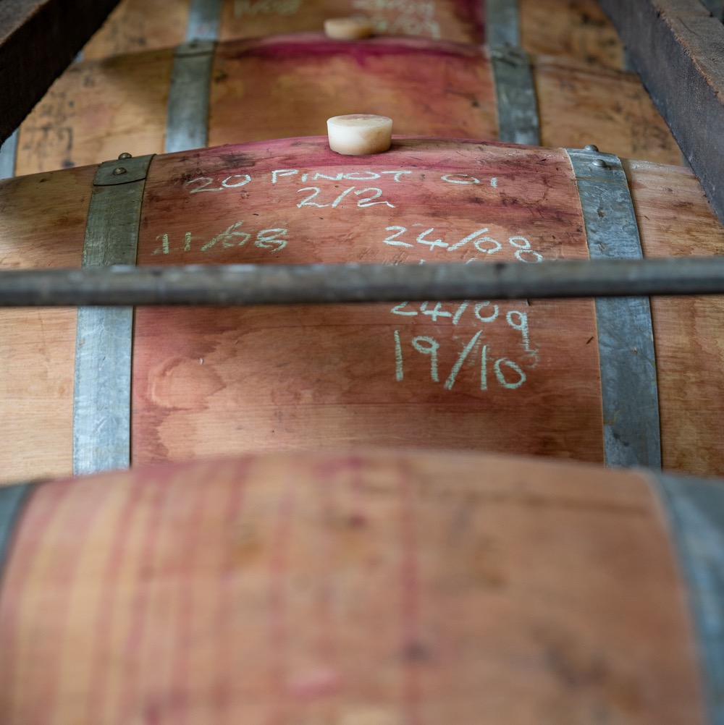
TODAY WE’LL COVER
The history of Great Southern
Geography, climate and soil
Viticulture and winemaking
Prominent varieties

Slide 5
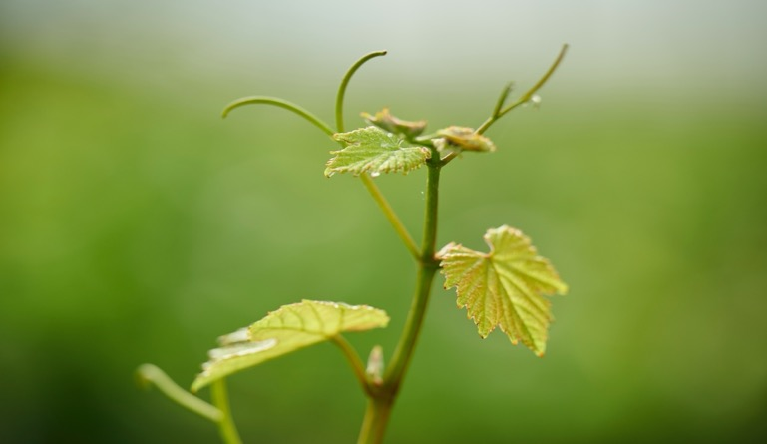
1859
THE HISTORY OF
GREAT SOUTHERN
1930
Viticulturist Bill Jamieson’s experimental plantings lay the groundwork for the region’s commercial development.
1955
1956
1965
Settler George Egerton-Warburton plants the region’s first vines on his property near Mount Barker.
The WA Government
invites viticulture professor Harold Olmo and Dr Penfold Hyland to investigate the region, hoping to stimulate economic growth.
Professor Olmo’s report concludes that Mount Barker and Frankland River show promise for wine production.
The region’s first commercial vineyard is established at Forest Hill near Mount Barker.

Slide 6
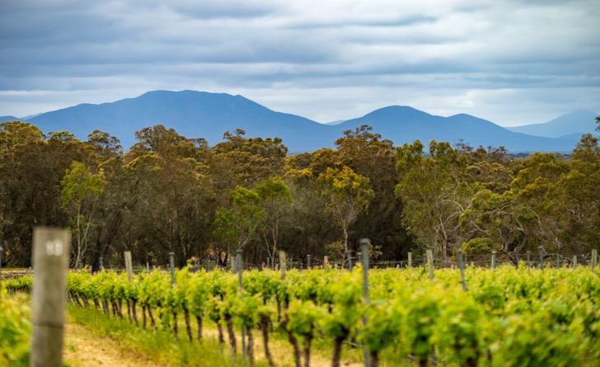
Early 1970s
Photo courtesy of Great Southern Wines
Mid-Late 1970s
Late 1960s
Wines from Forest Hill, Plantagenet and Alkoomi capture handfuls of awards
across the country. Regional development continues with vineyard plantings in Albany, Denmark and Porongurup.
The early days of grape growing prove challenging due to adverse environmental conditions and inadequate technology.
1996
1997
The first vintage of the Forest Hill plantings is released in 1972, and the Forest Hill Riesling is named the best West Australian white wine the following year.
The Australian Geographical Indication (GI) “Great Southern” is created.
Mount Barker is officially registered as the first GI subregion within Great Southern.

Slide 7
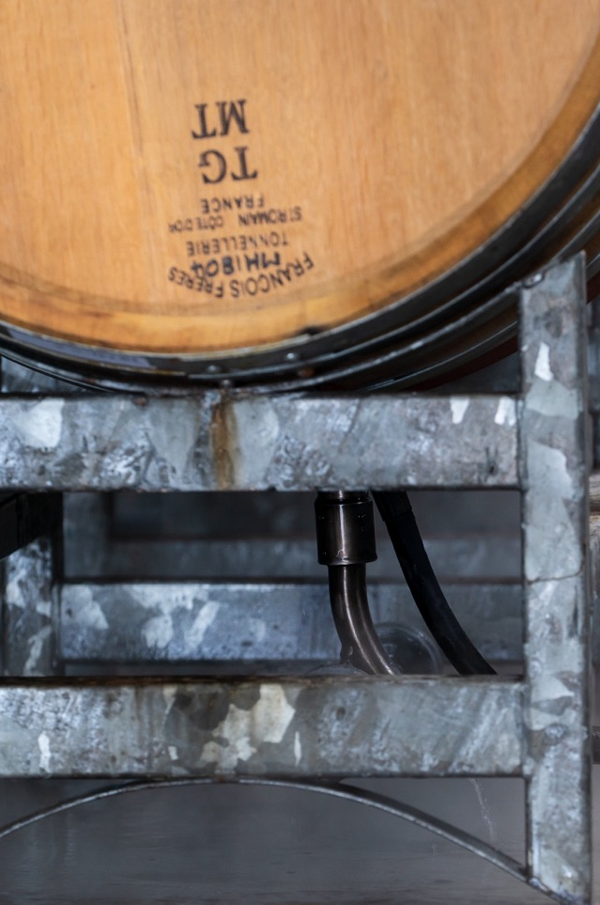
Today
Great Southern is now home to more than 70 producers – a mixture of established icons, small family businesses and young innovators forging a new path with modern approached in the vineyards and the cellar.
2000
Frankland River became the fourth official subregion in Great Southern.
1999
2003
The region’s second and third subregional GIs, Porongurup and Albany, were entered into the Register of Protected Names.
Denmark joined the ranks as Great Southern’s fifth official subregion.

Slide 8
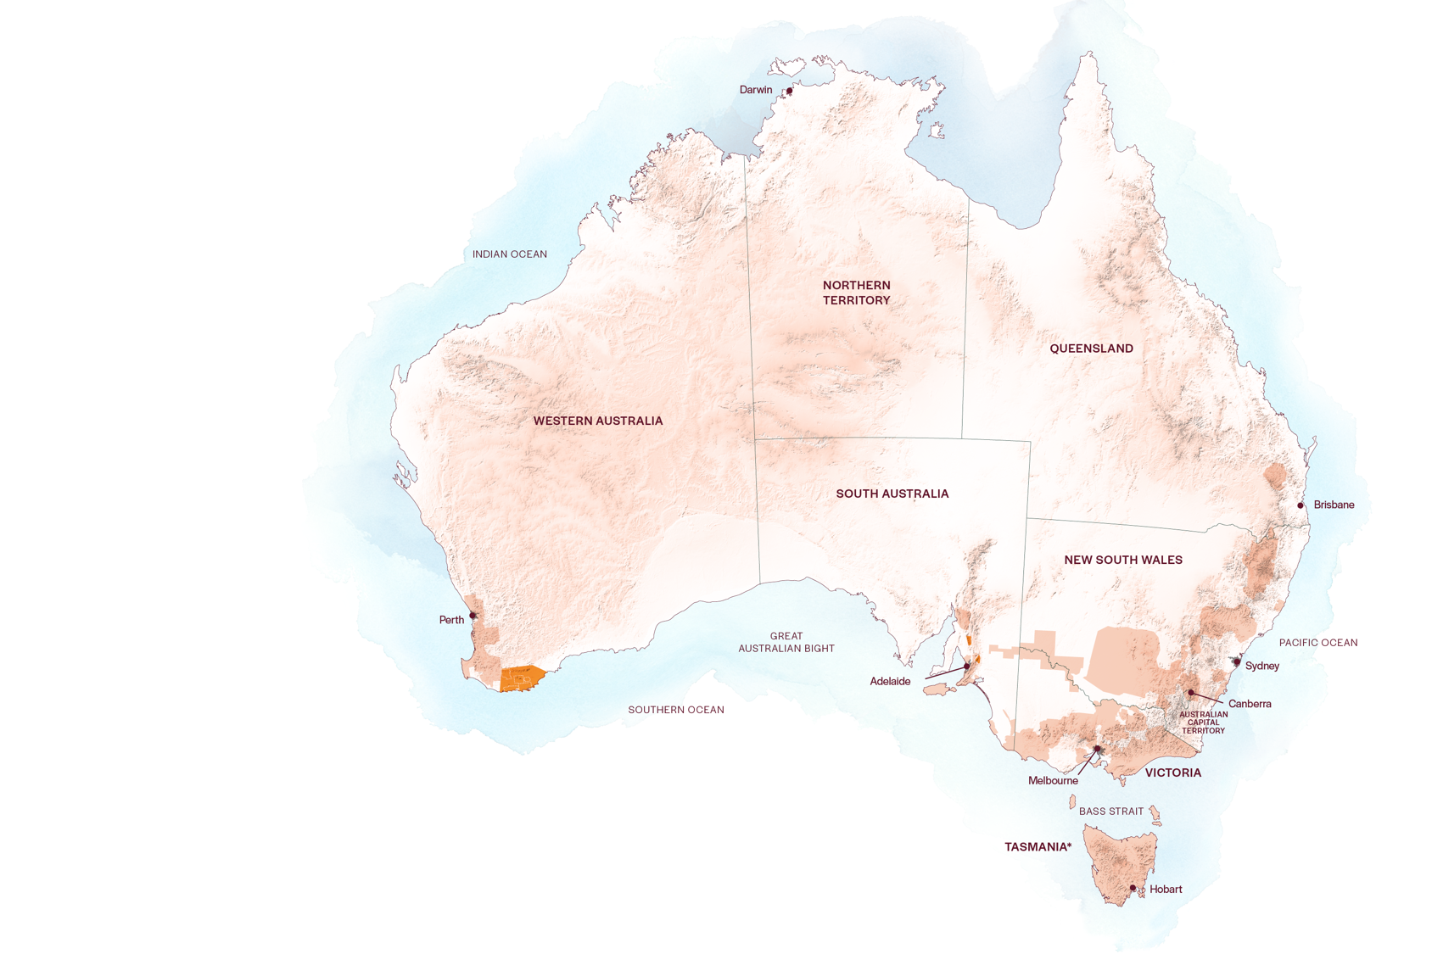
AUSTRALIA
GREAT SOUTHERN

Slide 9
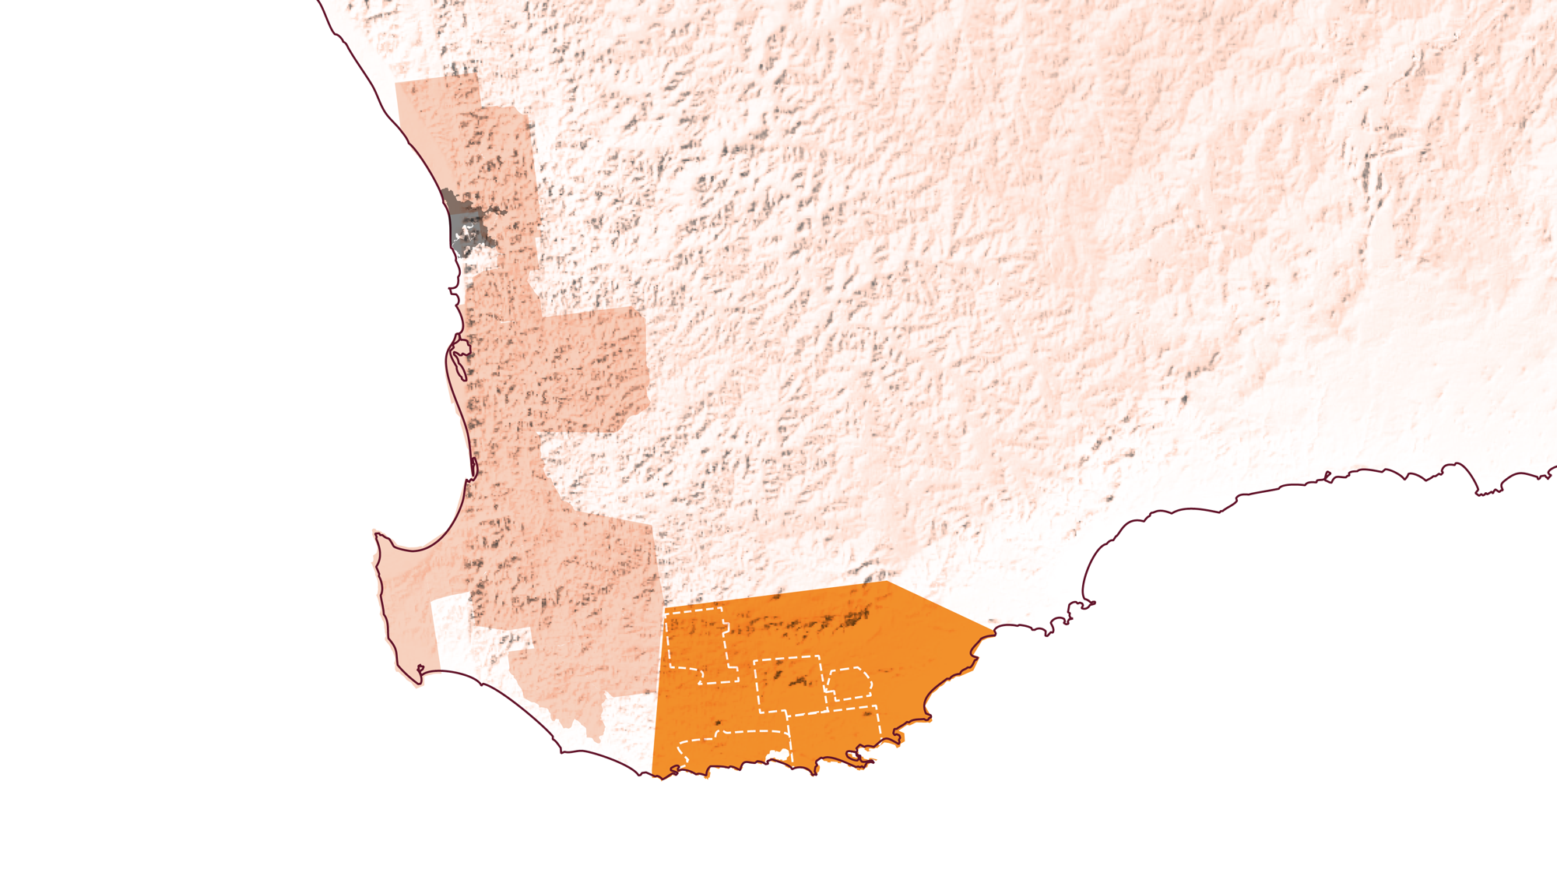
WESTERN
AUSTRALIA
FRANKLAND RIVER
MOUNT BARKER
PORONGURUP
GREAT SOUTHERN
ALBANY
DENMARK

Slide 10

GEOGRAPHY, CLIMATE AND SOIL
A STRIKING BACKDROP OF NATURAL LANDSCAPES
Approximately 360km from Perth, in Western Australia’s remote southwest
Made up of five subregions
WA’s coolest region, with a variable Mediterranean climate that moves from maritime to continental
Topographically diverse, with moderately fertile soils named after the predominant eucalypt species
Photo courtesy of Great Southern Wines

Slide 11
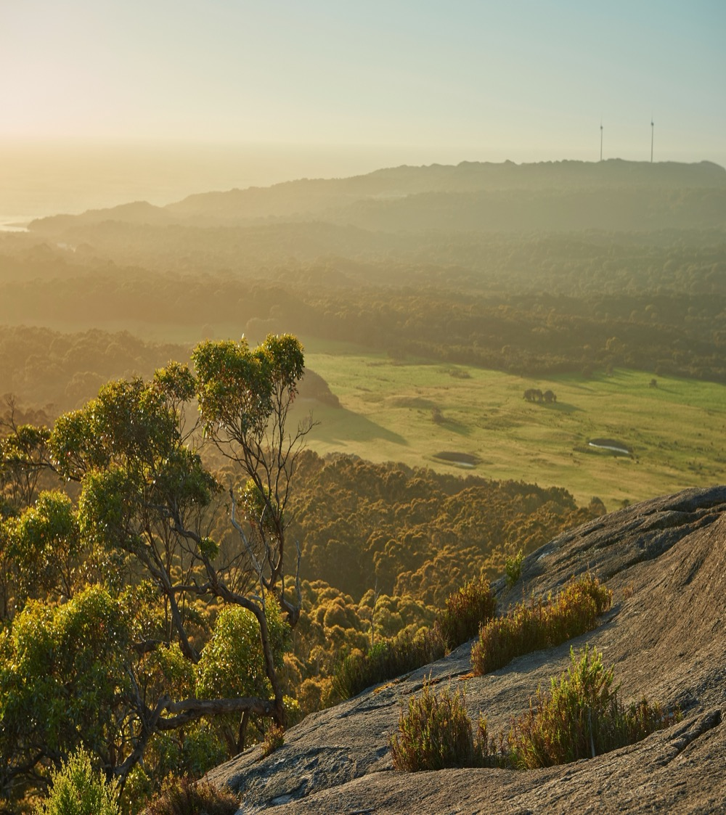
CLIMATE
ALTITUDE
BROADLY MEDITTERANEAN
VERY HIGH
1000m +
(>3,280ft +)
SHIFTING FROM MARITIME ALONG THE COAST TO MORE CONTINENTAL FURTHER NORTH AND INLAND
HIGH
750–999m
(2,460–3,279ft)
GREAT SOUTHERN
10–380M (33–1,247FT)
MEDIUM
500–749m
(1,640–2,459ft)
LOW
0–499m
(0–1,639ft)
Photo courtesy of Wines of Western Australia
Notes:
As you move north, away from the coastal subregions of Albany and Denmark, overall temperatures increase and climatic conditions shift from maritime to continental. Heat summation and sunshine hours do not change greatly, so careful site selection allows the production of virtually every wine style. Mean January Temperature (MJT) is 20.1°C (68°F). Regional average Growing Season Rainfall (GSR) is 240mm.

Slide 12
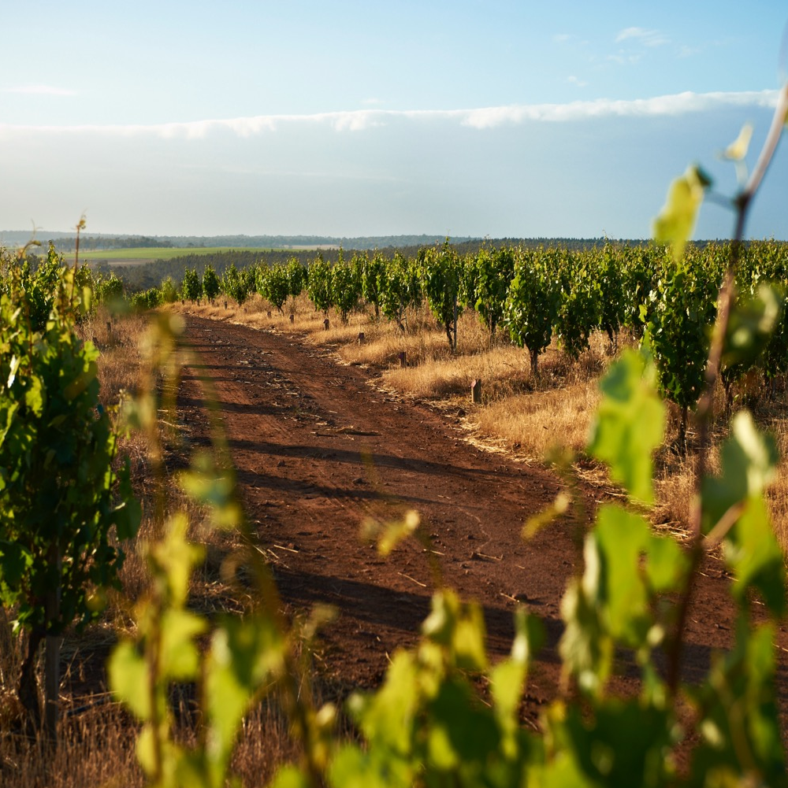
SOIL
Soil types vary considerably, but Frankland River, Albany and Mount Barker feature lateritic gravelly sands and loams over clay. Albany is home to sandy gravelly soils, while Porongurup consists of karri loams.
Photo courtesy of Swinney Vineyards, Frankland River
Notes:
SUGGESTED DISCUSSION POINTS:
- What are the key differences between Great Southern’s five subregions in terms of geography, climate and soils?
- Has the vastness of the region and the diversity of growing conditions helped or hindered Great Southern’s progress as an Australian wine region?

Slide 13
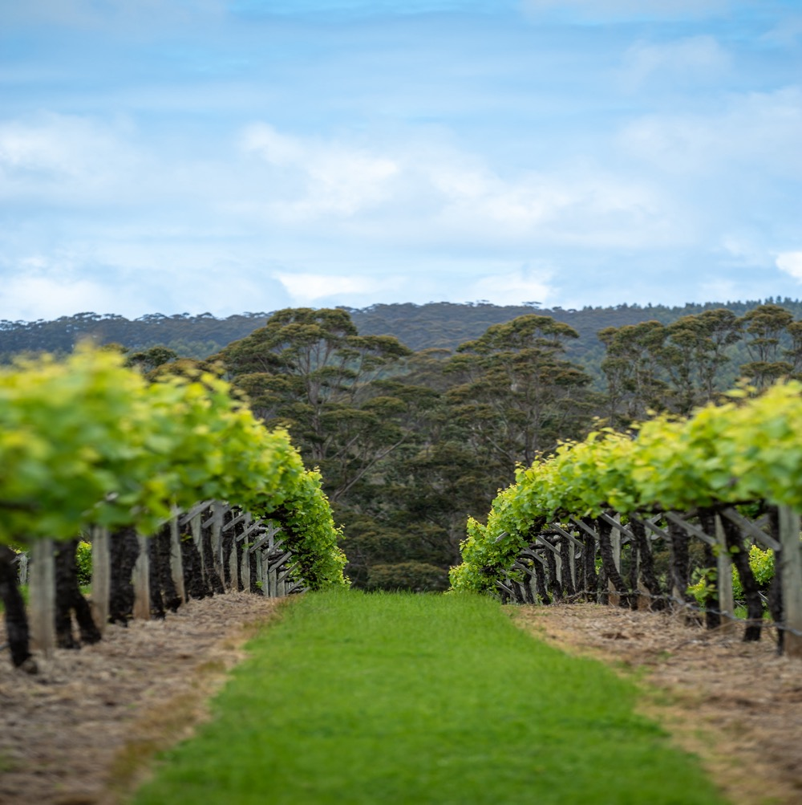
GRAPE GROWING IN
GREAT SOUTHERN
Conditions are favourable for a multitude of grape varieties
Site selection is key, with producers taking a terroir-minded approach
Vineyards are labour intensive, with workforce and water shortages posing substantial challenges
Sustainable farming practices are a growing focus
Harvest: mid-February to late April
Photo courtesy of Great Southern Wines
Notes:
Denmark and Albany are cool, humid and wet enough to allow certain sites to be dry-grown, but rainfall decreases drastically as you head inland, hence most vineyards, especially larger ones, employ drip irrigation during critical stages of the growing season. Water availability is the biggest challenge the region faces.

Slide 14

WINEMAKING IN
GREAT SOUTHERN
Highly dependent on subregion, grape variety and desired style
Retention of primary fruit character is a top priority
Fermentation with both cultured and wild yeasts
Maturation vessels vary, with larger oak formats on the rise
New generation of innovative winemakers experimenting with low-intervention techniques
Photo courtesy of Great Southern Wines
Notes:
Producers employ a combination of traditional and experimental techniques, with the number of smaller, avant-garde winemakers steadily increasing and focusing on minimal intervention. The consumer preference for lighter, more fruit-forward and elegant wines that are lower in alcohol plays to Great Southern’s strengths and continues to shape the evolution and refinement of winemaking in the region.
SUGGESTED DISCUSSION POINTS:
- Compared to other regions in Australia, why might site selection be especially important in Great Southern?
- Why have more sustainable vineyard practices become prominent in recent years? How have these affected the winemaking process in the region?
- What impact do whole-bunch fermentation, maturation on lees and the transition to larger-format barrels have on wines?

Slide 15


GREAT SOUTHERN
TOP 5 VARIETIES
CABERNET
SAUVIGNON
SAUVIGNON BLANC
SHIRAZ
CHARDONNAY
SEMILLON
SHIRAZ
29%
CABERNET
SAUVIGNON
18%
SAUVIGNON BLANC
14%
CHARDONNAY
14%
SEMILLON
9%
Notes:
Despite what’s top in terms of tonnage, Great Southern’s most well-renowned wines are Riesling, Shiraz, Cabernet Sauvignon, Chardonnay and Pinot Noir.

Slide 16
TASTE OF
GREAT SOUTHERN
NOTEWORTHY VARIETIES
Photo courtesy of Great Southern Wines
Notes:
NOW IS AN APPROPRIATE TIME TO TASTE AND DISCUSS YOUR SELECTED MIX OF WINES.
+ COMPLEMENTARY PROGRAMS: You’ll find program materials for these varieties and more at www.australianwinediscovered.com

Slide 17

GREAT SOUTHERN
RIESLING
THE
REGION’S STAR
WINE
EXQUISITE AGEING POTENTIAL
TYPICAL FLAVOURS
Lime
Lemon
Green apple
White flowers
Chalk
Stone fruit
Mineral
SINGLE VINEYARD RELEASES
RANK AMONG AUSTRALIA’S BEST
RIESLING
Notes:
Great Southern is known for producing exceptional Rieslings of great intensity, typically in the citrus spectrum with an underlay of herbs and minerals. Fresh and nervy in their youth, they tend to age superbly, seldom reaching the peak of their maturity in less than 10 years. Linear bone-dry styles are common. Wild fermentation, riper fruit spectrum, higher residual sugar, neutral oak and extended ageing on lees are becoming increasingly common with single-vineyard releases.

Slide 18
RIESLING characteristics
COLOUR
Riesling
Light
Medium
Full
BODY
Dry
Medium dry
Sweet
SWEETNESS
Low
Medium
High
RIESLING
OAK
(most unoaked, SOME USED IN PARTICULAR STYLES)
ACIDITY
8%
11% – 13.5%
17%
ALCOHOL

Slide 19

GREAT SOUTHERN
CHARDONNAY
ELEGANT
AND STRUCTURED WINES
SUITED TO THE REGION’S COOL CONDITIONS
TYPICAL FLAVOURS
Grapefruit
Nectarine
Peach
Toast
Flint
STYLES VARY
FROM UNWOODED TO BARREL FERMENTED
CHARDONNAY
Notes:
Elegant, tightly structured, grapefruit-accented Chardonnay that ages well is produced in the region. Styles vary, although the majority are barrel-fermented, but typically the wines are intense without being as heavy as some other Chardonnays. Wines of the south can be a little finer and more elegant, while those of the north are slightly more powerful.

Slide 20
CHARDONNAY characteristics
COLOUR
Chardonnay
Light
Medium
Full
BODY
Dry
Medium dry
Sweet
SWEETNESS
Low
Medium
High
CHARDONNAY
OAK
(UNWOODED STYLES)
ACIDITY
8%
12% – 14%
17%
ALCOHOL

Slide 21

GREAT SOUTHERN
PINOT NOIR
LARGELY DEPENDANT ON VINTAGE CONDITIONS
LIGHT,
PRECISE
AND
PERFUMED
MOSTLY PRODUCED
IN ALBANY, DENMARK AND MOUNT BARKER
PINOT NOIR
TYPICAL FLAVOURS
Cherry
Plum
Roses
Earth
Baking spice
Notes:
Until recently, Pinot Noir came from the southern area around Denmark and Albany, but some exciting wines have appeared from Mount Barker in slightly cooler years.

Slide 22
PINOT NOIR characteristics
COLOUR
Pinot Noir
Light
Medium
Full
BODY
Dry
Medium dry
Sweet
SWEETNESS
Low
Medium
High
PINOT NOIR
OAK
TANNIN
ACIDITY
8%
12.5% – 13.5%
17%
ALCOHOL

Slide 23
GREAT SOUTHERN
CABERNET SAUVIGNON
THRIVES ACROSS THE REGION
CLASSIC
VARIETAL CHARACTERISTICS
DEEPLY COLOURED
AND INTENSELY
FLAVOURED
CABERNET SAUVIGNON
TYPICAL FLAVOURS
Blackberry
Bay leaf
Mulberry
Blackcurrant
Dried herbs
Tobacco
Notes:
Long-lived wines of deep colour, intense flavour and powerful structure – though they are not as full-bodied as those from Margaret River.

Slide 24
CABERNET SAUVIGNON characteristics
COLOUR
Cabernet Sauvignon
Light
Medium
Full
BODY
Dry
Medium dry
Sweet
SWEETNESS
CABERNET SAUVIGNON
Low
Medium
High
OAK
TANNIN
ACIDITY
8%
13.5% – 14.5%
17%
ALCOHOL

Slide 25
GREAT SOUTHERN
SHIRAZ
THE REGION’S MOST RENOWNED RED WINE
RESTRAINED USE OF NEW FRENCH OAK
WITH OTHER PRODUCERS OPTING FOR NO NEW OAK
SHIRAZ
TYPICAL FLAVOURS
Blackberry
Black cherry
Plum
Liquorice
Pepper
Spice and florals
MEDIUM BODIED
SMOOTH AND SPICY IN CONTRAST TO BOLD REDS FROM WARMER CLIMATES
Notes:
Typically complex, silky and medium in body with a fine tannin profile. Many producers stay away from the heavy-handed use of new oak, allowing the fruit to shine through. Frankland River and Mount Barker are the hero subregions for Shiraz production.

Slide 26
SHIRAZ characteristics
COLOUR
Shiraz
Light
Medium
Full
BODY
Dry
Medium dry
Sweet
SWEETNESS
Low
Medium
High
SHIRAZ
OAK
TANNIN
ACIDITY
8%
13.5% – 14.5%
17%
ALCOHOL
Notes:
The diversity of soil types and climatic conditions in Great Southern means winemakers are able to grow and produce an array of styles, using a mixture of classic and emerging grape varieties. Other noteworthy varieties include Sauvignon Blanc, Grüner Veltliner, Gewürztraminer, Malbec, Mourvèdre and Grenache.
SUGGESTED DISCUSSION POINTS:
- Do the wines of Great Southern have defining regional characteristics as a whole, or are they shaped more by their respective subregions and single sites?
- Riesling is grown in many regions across Australia. What distinguishes Great Southern Riesling?
- What are the differences between Great Southern’s cool-climate Shiraz and Shiraz from warm-climate regions, such as the Barossa Valley or the Hunter Valley?

Slide 27
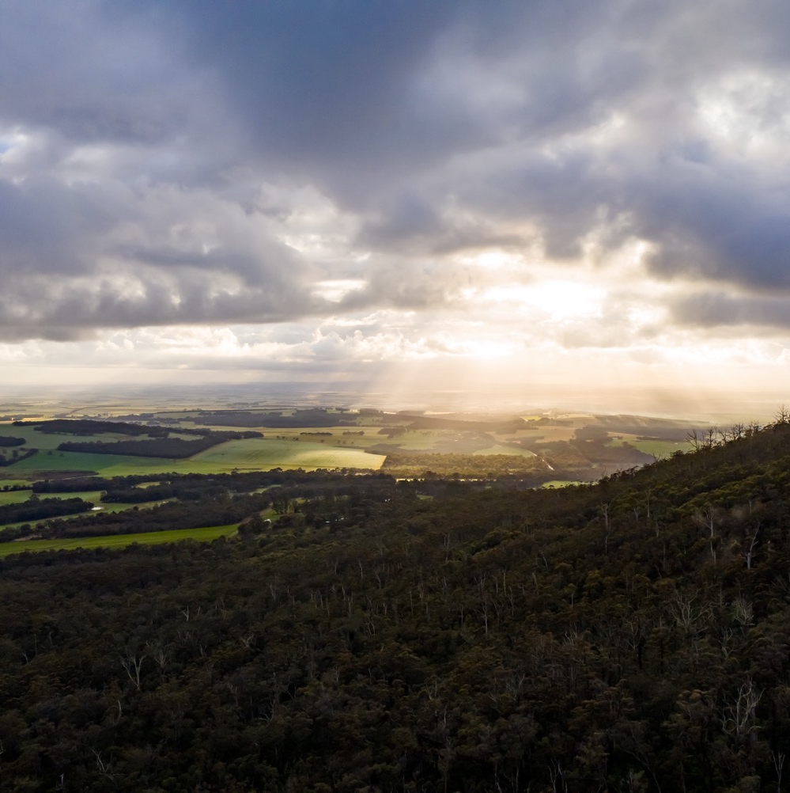
GREAT SOUTHERN
REMOTE AND REWARDING
A dynamic, sprawling region on the rise with a bright future ahead.
Photo courtesy of Great Southern Wines

Slide 28
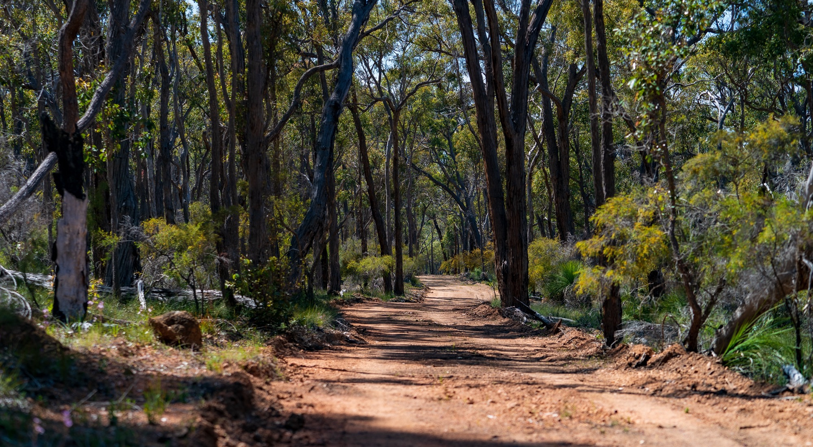
Photo courtesy of Great Southern Wines
THANK YOU
Notes:
For more programs, tools and resources, visit www.australianwinediscovered.com
For enquiries, email discovered@wineaustralia.com

