Slide 1
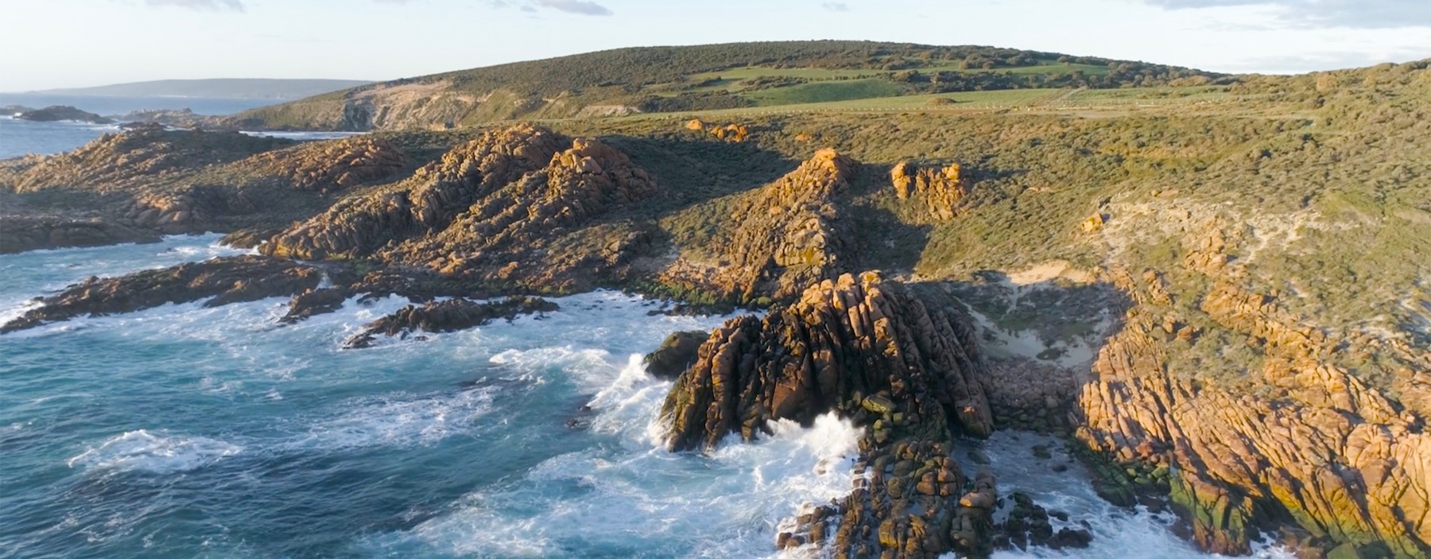
MARGARET RIVER

Slide 2


Crafted from grapes grown under vast and diverse climates, across landscapes millions of years in the making, every glass of Australian wine tells a story.
Like those who came before us, our modern growers and makers continue to be passionate, resilient and creative; constantly driven to explore new ways to perfect old techniques. Our community is connected by a mutual respect and shared love of crafting exceptional wine, while protecting the natural wonders for future generations to enjoy. Applying modern thinking to our ancient lands, we take playful experimentation very, very seriously.
So, if you’re looking for the taste of adventure, let Australian wine be your compass. Because in every bottle of Australian wine, you’ll experience the wonders of Australia – a reminder of the adventure and diversity that defines our culture and our land.

Slide 3
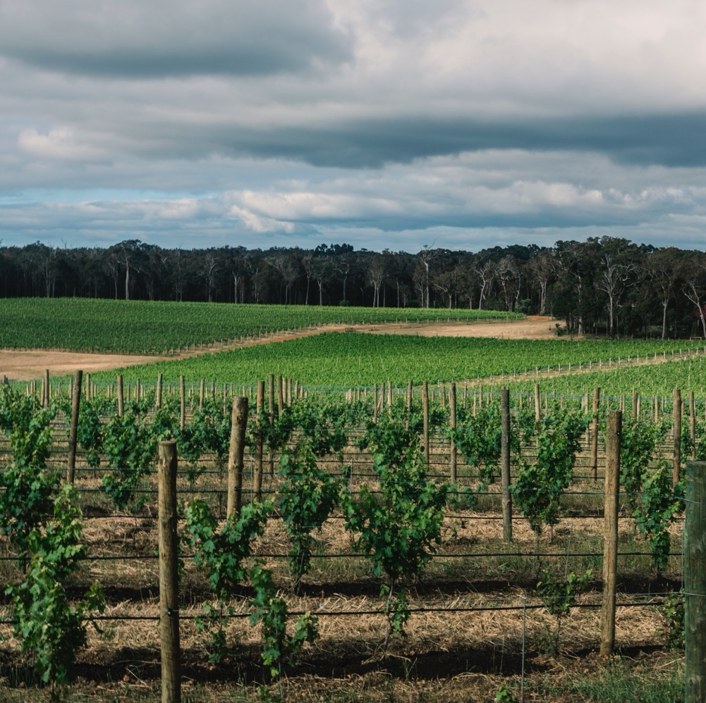
MARGARET RIVER
A FRESH VOICE IN FINE WINE
One of the world’s youngest wine regions, Margaret River is something of a prodigy, achieving success, prestige and international acclaim
at an early age.
Powerful yet elegant Cabernet Sauvignon,
Semillon Sauvignon Blanc blends and Chardonnay
Grape-growing paradise
One of the world’s most geographically isolated wine regions
Minimal-intervention farming and a dynamic winemaking community

Slide 4
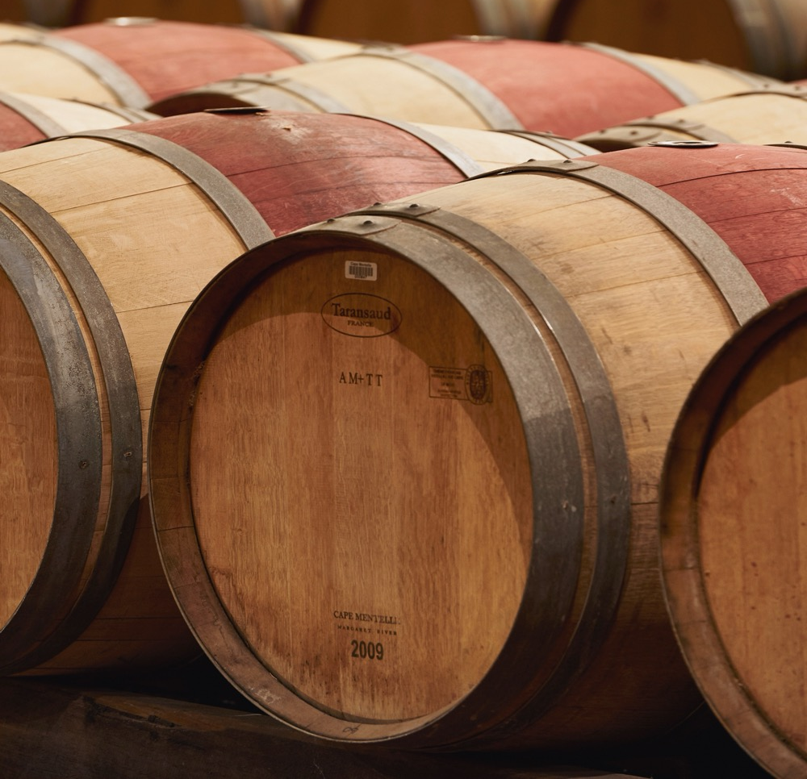
TODAY WE’LL COVER
The history of Margaret River
Geography, climate and soil
Viticulture and winemaking
Prominent varieties

Slide 5
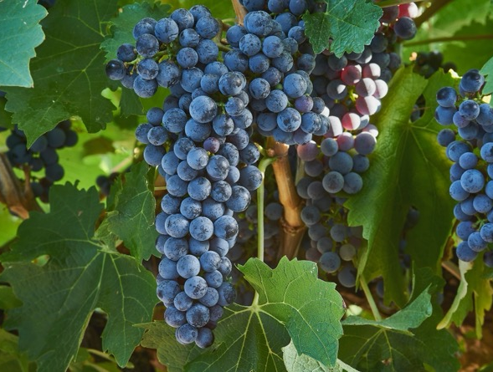
1955
THE HISTORY OF MARGARET RIVER
1965
A BRIGHT YOUNG STAR
Dr John Gladstones, an agronomist from the University
of Western Australia, identifies that the climatic conditions of
the region are ideal for producing premium wines.
1967
Harold Olmo, professor of viticulture at the University of California, takes the first step in establishing Margaret River as a wine region, recommending the planting of wine grapes in Australia’s south-west.
Dr Tom Cullity plants the first modern commercial vineyard at Vasse Felix. The vineyard’s original Cabernet Sauvignon and Malbec plantings still grow today.

Slide 6

1982
International acclaim arrives when the second vintage of Leeuwin Estate’s ‘Art Series’ (1981) is named “the best Chardonnay in the world” by Decanter magazine.
1996
The Geographical Indication (GI) Margaret River is registered.
1976
1983–1984
Today
The first Chardonnay vines are planted at Leeuwin Estate, Cullen Wines and
Moss Wood.
Margaret River’s reputation as a producer of fine Cabernet Sauvignon is cemented when Cape Mentelle wins back-to-back Jimmy Watson Trophies at the Melbourne Wine Show.
The region continues to grow and cement its international reputation for producing iconic, fine wine.

Slide 7

AUSTRALIA
MARGARET RIVER

Slide 8
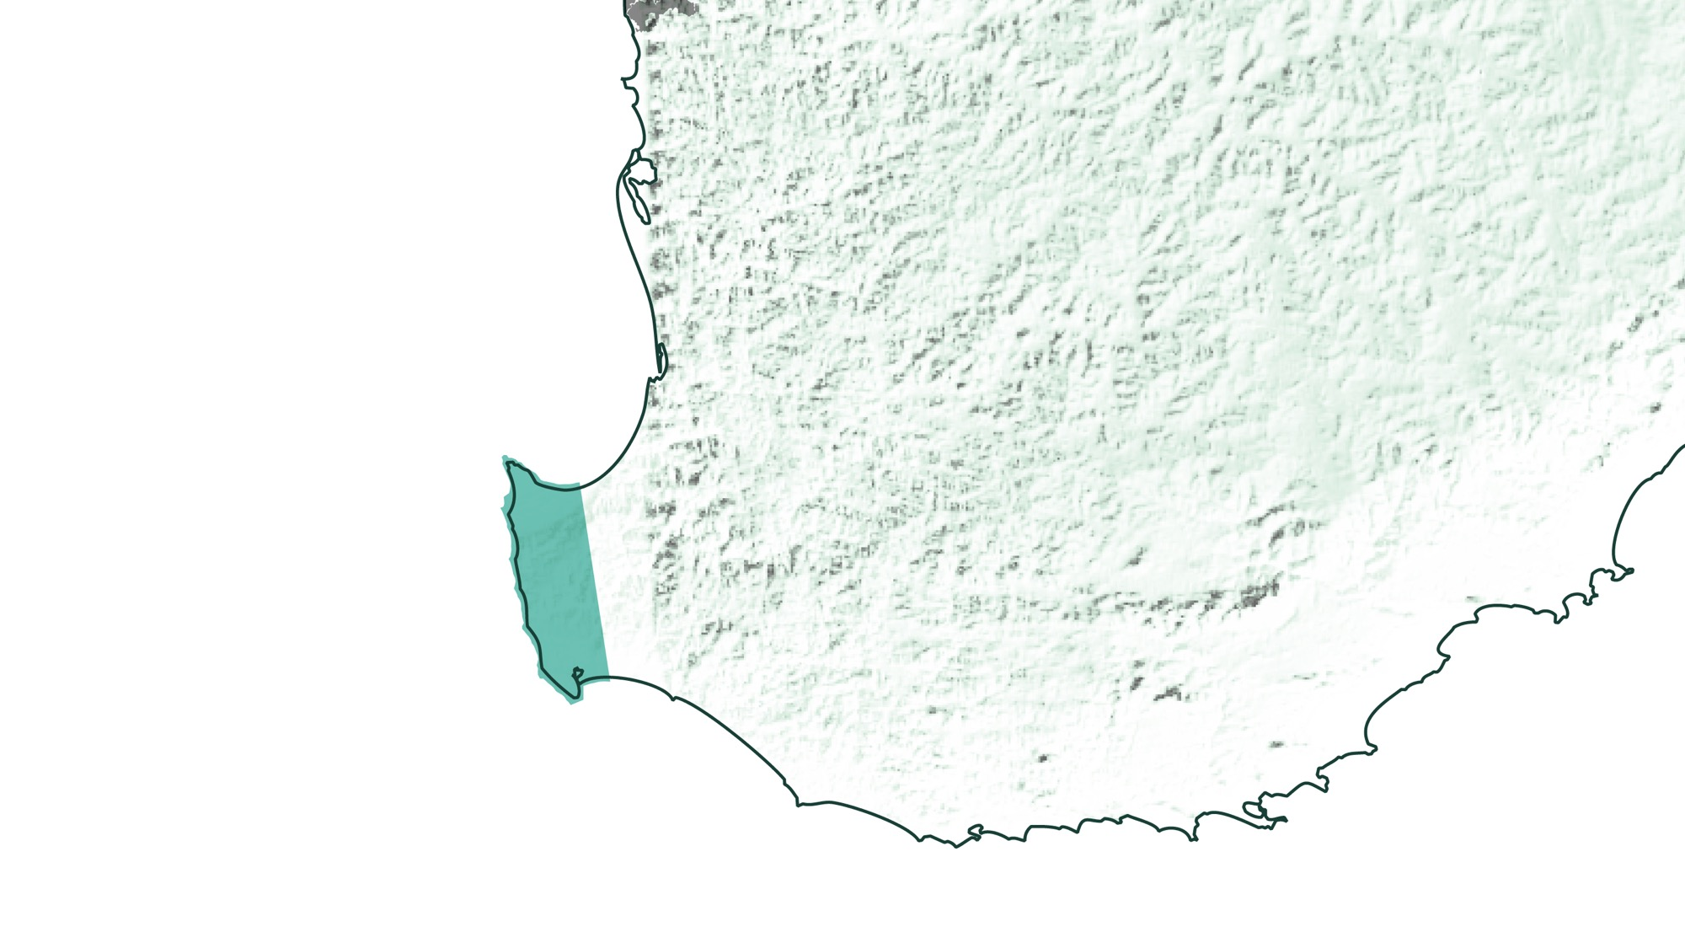
WESTERN AUSTRALIA
MARGARET RIVER

Slide 9
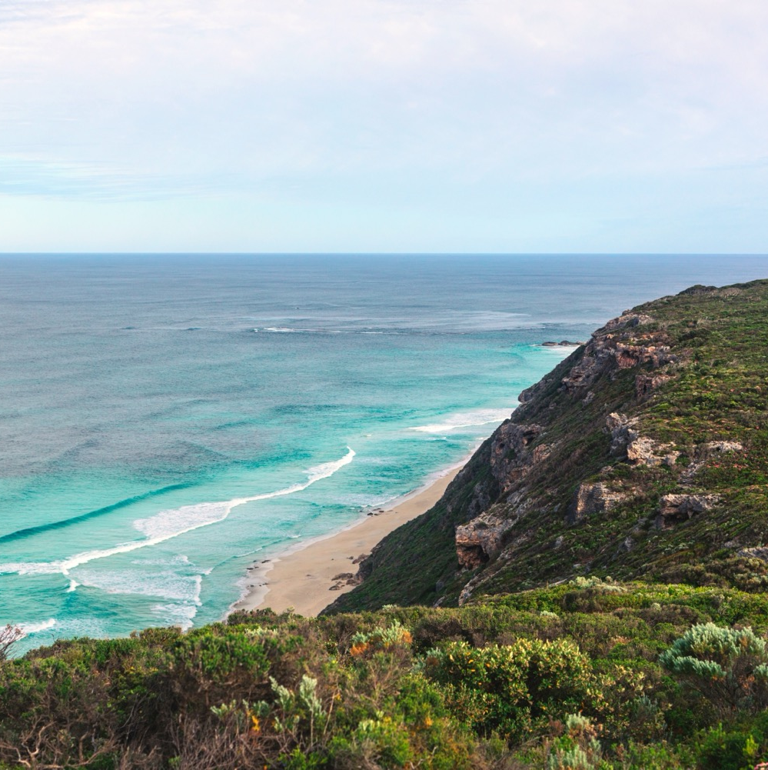
GEOGRAPHY, CLIMATE AND SOIL
A GRAPE GROWING PARADISE
Long, narrow region commencing
230km south of Perth
Hugged by the Indian and Southern Oceans
Geographically isolated, bestowed with ancient soils and a unique biodiversity
Ideal grape-growing conditions

Slide 10
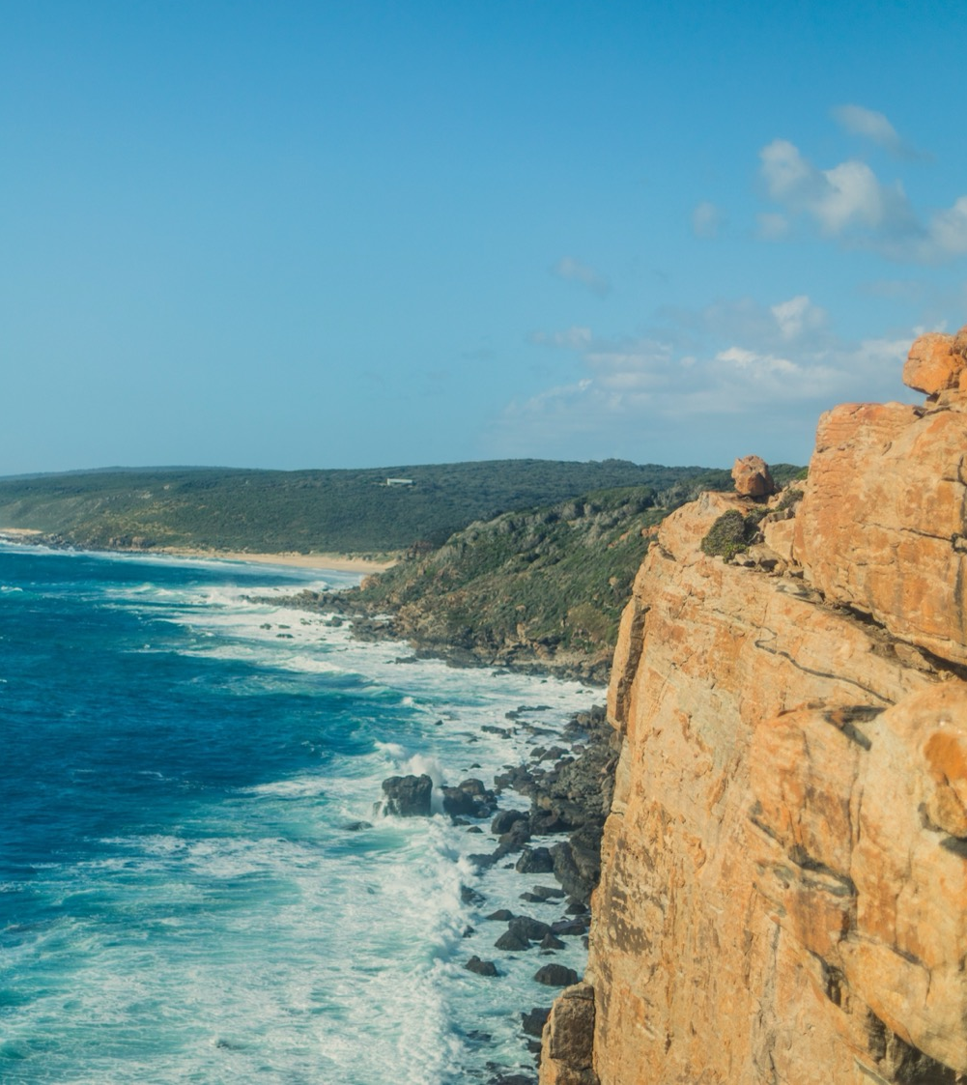
MEDITERRANEAN
ALTITUDE
CLIMATE
VERY HIGH
1000m +
(>3,280ft +)
STRONG MARITIME INFLUENCES WITH OCEANS ON THREE SIDES
HIGH
750–999m
(2,460–3,279ft)
MARGARET RIVER
0–231M (0–757FT)
MEDIUM
500–749m
(1,640–2,459ft)
LOW
0–499m
(0–1,639ft)

Slide 11

SOIL
Predominantly deep, well-drained, red gravelly loams on granite and gneiss. These ancient soils are low in nutrients and ideal for growing high-quality grapes.

Slide 12
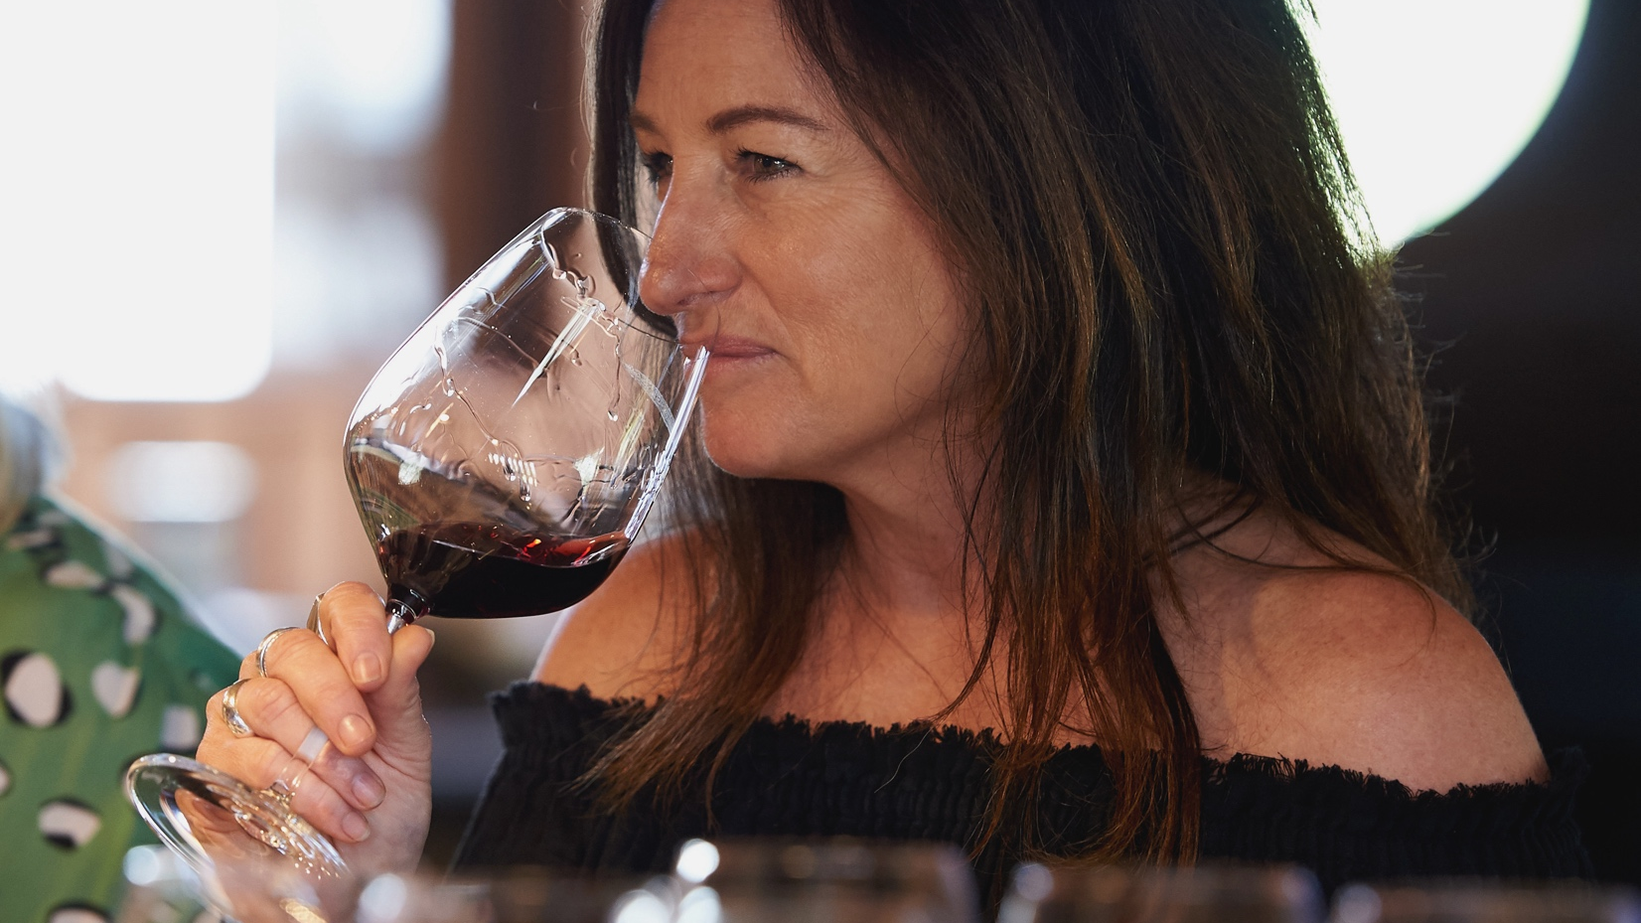
MASTERS MEET THE MASTERFULLY EXPERIMENTAL
VITICULTURE AND WINEMAKING

Slide 13
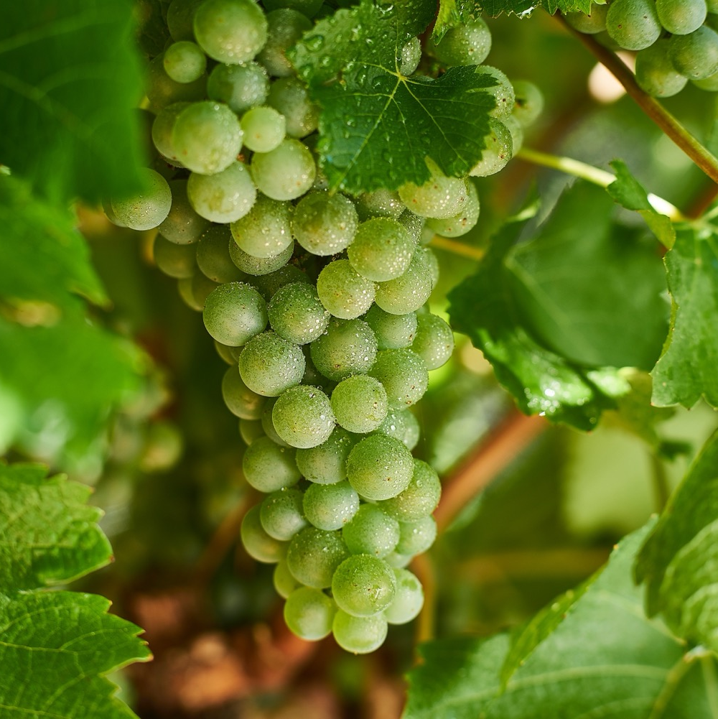
GRAPE GROWING
Minimal intervention to produce pristine fruit that expresses terroir
Growing adoption of sustainable, organic and biodynamic practices
High-quality heritage clones
Harvest: February–April

Slide 14
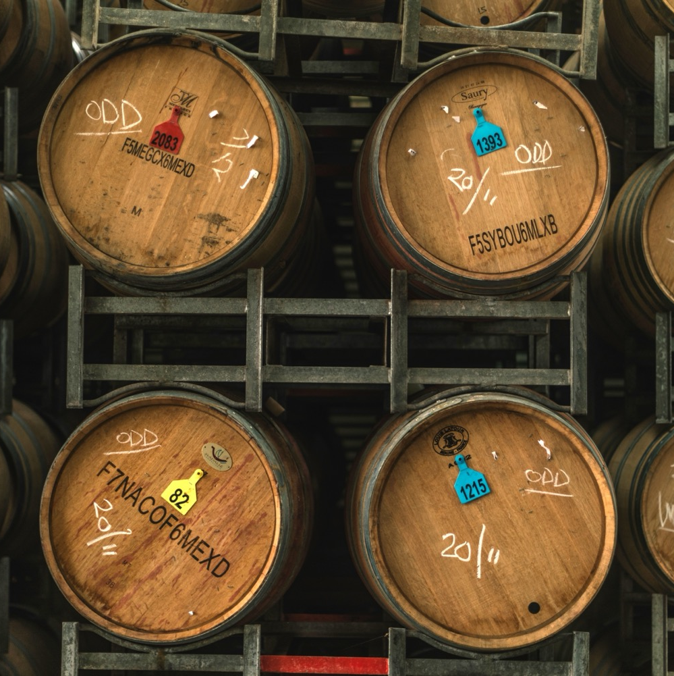
WINEMAKING
Classic techniques influenced by the local environment
Climate lends itself to
low-intervention approach
Most wines see oak but winemakers practice restraint
New generation of innovative winemakers experimenting with alternative techniques

Slide 15

NOTEWORTHY VARIETIES
TASTE OF MARGARET RIVER

Slide 16


MARGARET RIVER
TOP 5 VARIETIES
CABERNET
SAUVIGNON
SAUVIGNON
BLANC
CHARDONNAY
SEMILLON
SHIRAZ
CABERNET
SAUVIGNON
20%
SAUVIGNON
BLANC
20%
CHARDONNAY
17%
SEMILLON
17%
SHIRAZ
13%

Slide 17

MARGARET RIVER
SEMILLON SAUVIGNON BLANC
HELPED PUT MARGARET RIVER ON THE WINE MAP
SEMILLON
SAVIGNON
BLANC
TYPICAL FLAVOURS
TWO VARIETIES THAT ARE INHERENTLY COMPLEMENTARY
Gooseberry
Passionfruit
Lime
Lemon Curd
Grapefruit

Slide 18
MARGARET RIVER SEMILLON/SAUVIGNON BLANC
CHARACTERISTICS
COLOUR
Semillon/Sauvignon Blanc
Light
Medium
Full
BODY
Dry
Medium dry
Sweet
SEMILLON
SAVIGNON
BLANC
SWEETNESS
Low
Medium
High
OAK
ACIDITY
8%
12% – 13.5%
17%
ALCOHOL

Slide 19
MARGARET RIVER
CHARDONNAY
WORLD CLASS!
CHARDONNAY
TYPICAL PRIMARY
FLAVOURS
Gooseberry
Passionfruit
Lime
Lemon Curd
Grapefruit
TYPICAL SECONDARY
FLAVOURS
Toast
Toasted Almond
Spice
Chalk
Gunflint
Nougat
Minerality
RICHER, POWERFUL STYLES
PROVIDE A CONTRAST TO LEANER, COOL-CLIMATE STYLES

Slide 20
MARGARET RIVER CHARDONNAY characteristics
COLOUR
Chardonnay
Light
Medium
Full
BODY
Dry
Medium dry
Sweet
CHARDONNAY
SWEETNESS
Low
Medium
High
OAK
ACIDITY
8%
12.5% – 13.5%
17%
ALCOHOL

Slide 21

MARGARET RIVER
CABERNET SAUVIGNON
HERO VARIETY FOR MANY LOCAL PRODUCERS
TYPICAL PRIMARY
FLAVOURS
Cassis
Blackcurrant
Blueberry
Red currant
Bay leaf
Dried herbs
CABERNET SAUVIGNON
TYPICAL SECONDARY
FLAVOURS
Smoke
Cedar
HIGH QUALITY AND SUITED TO LONG-TERM CELLARING

Slide 22
MARGARET RIVER
CABERNET SAUVIGNON characteristics
COLOUR
Cabernet Sauvignon
Light
Medium
Full
BODY
Dry
Medium dry
Sweet
SWEETNESS
CABERNET SAUVIGNON
Low
Medium
High
OAK
TANNIN
ACIDITY
8%
13% – 14%
17%
ALCOHOL

Slide 23
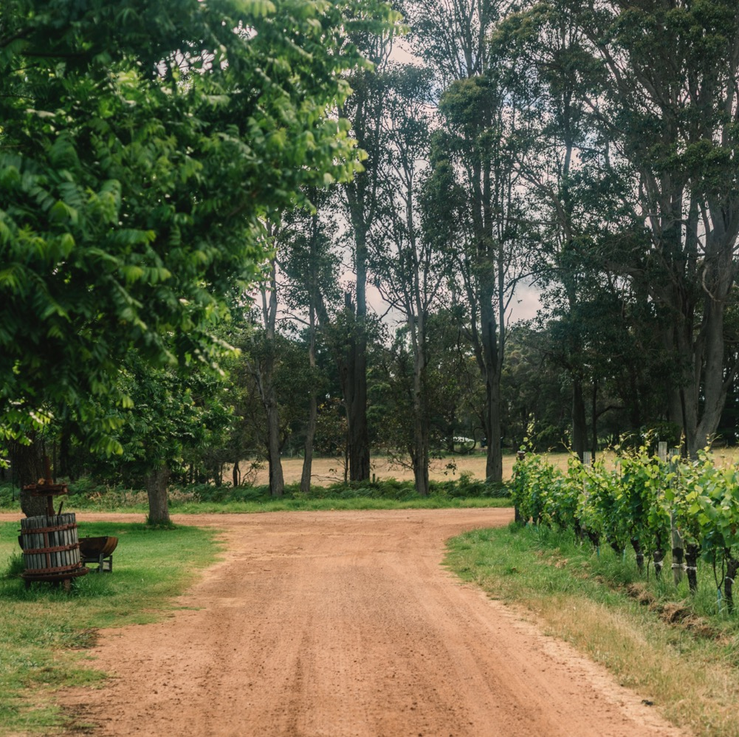
SHORT HISTORY
LONG FUTURE
Fine wines and innovative winemaking techniques that are setting the standard for Australian wine.

Slide 24
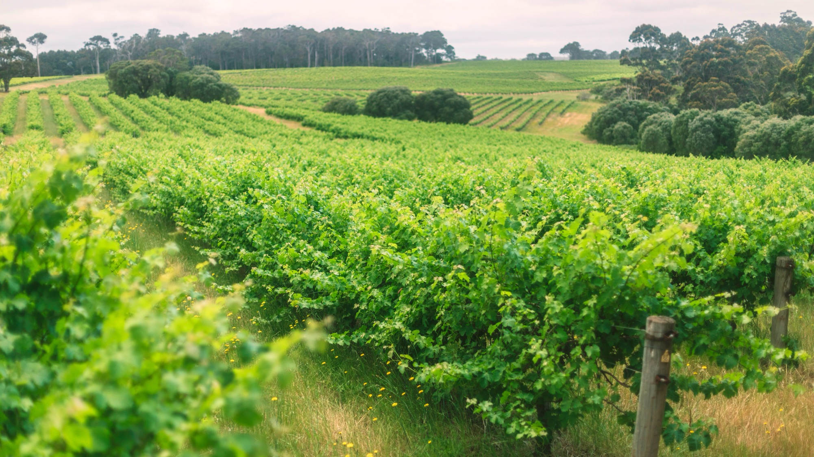
THANK YOU

