Slide 1
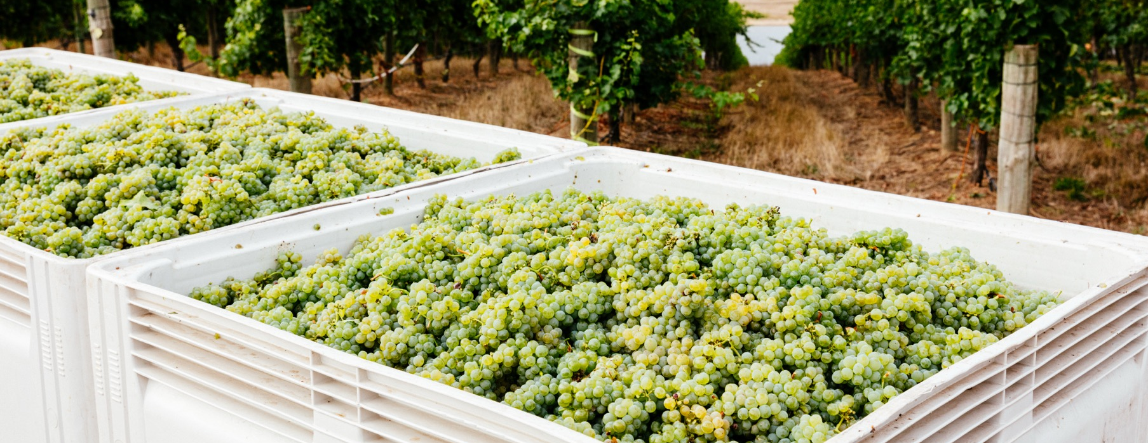
SEMILLON AND SAUVIGNON BLANC

Slide 2


Crafted from grapes grown under vast and diverse climates, across landscapes millions of years in the making, every glass of Australian wine tells a story.
Like those who came before us, our modern growers and makers continue to be passionate, resilient and creative; constantly driven to explore new ways to perfect old techniques. Our community is connected by a mutual respect and shared love of crafting exceptional wine, while protecting the natural wonders for future generations to enjoy. Applying modern thinking to our ancient lands, we take playful experimentation very, very seriously.
So, if you’re looking for the taste of adventure, let Australian wine be your compass. Because in every bottle of Australian wine, you’ll experience the wonders of Australia – a reminder of the adventure and diversity that defines our culture and our land.

Slide 3
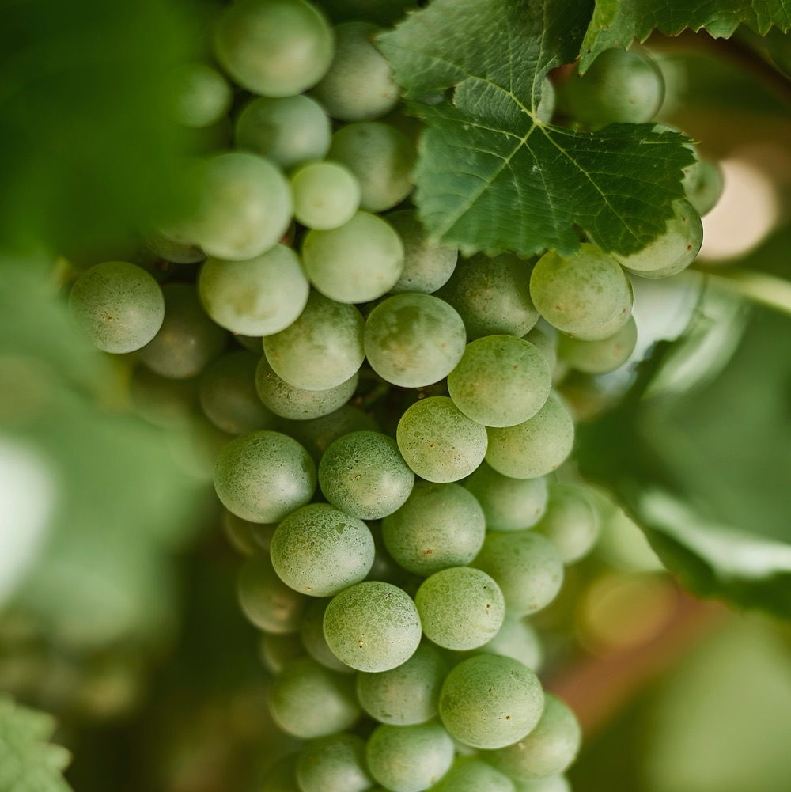
SEMILLON AND SAVIGNON BLANC
VERSATILE VARIETIES THAT SING TOGETHER
Semillon and Sauvignon Blanc are two of Australia’s most prominent white grape varieties, coming together to create one of the country’s best-known blends.

Slide 4
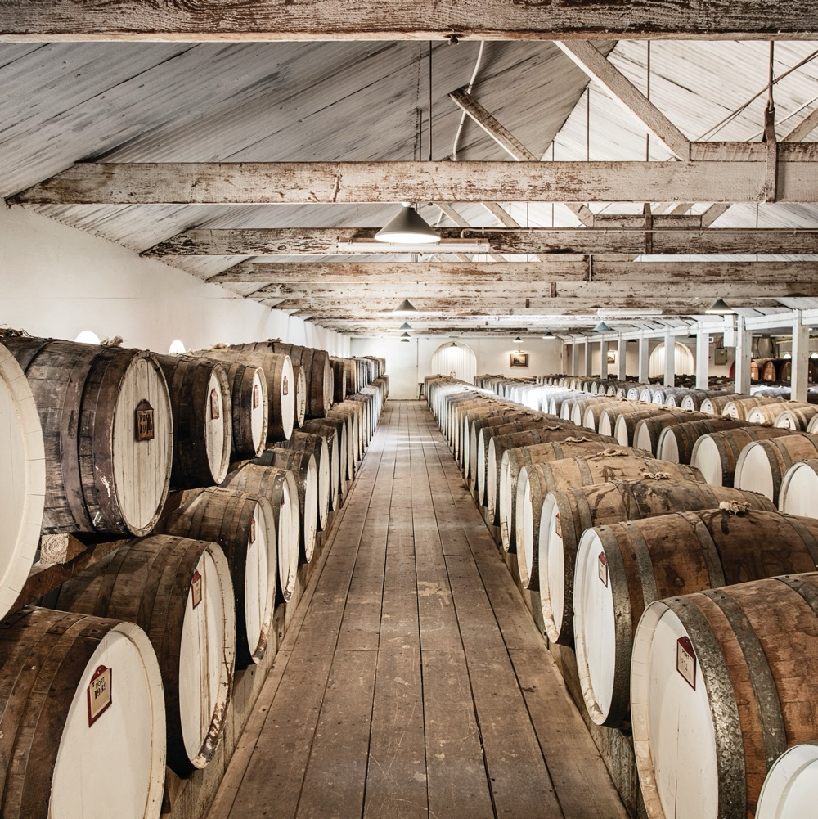
TODAY WE’LL COVER
The history and evolution of Australian Semillon and Sauvignon Blanc
Hunter Valley Semillon
Adelaide Hills Sauvignon Blanc
Margaret River Semillon and Sauvignon Blanc blends
Riverina Botrytis Semillon
Semillon and Sauvignon Blanc
by numbers

Slide 5
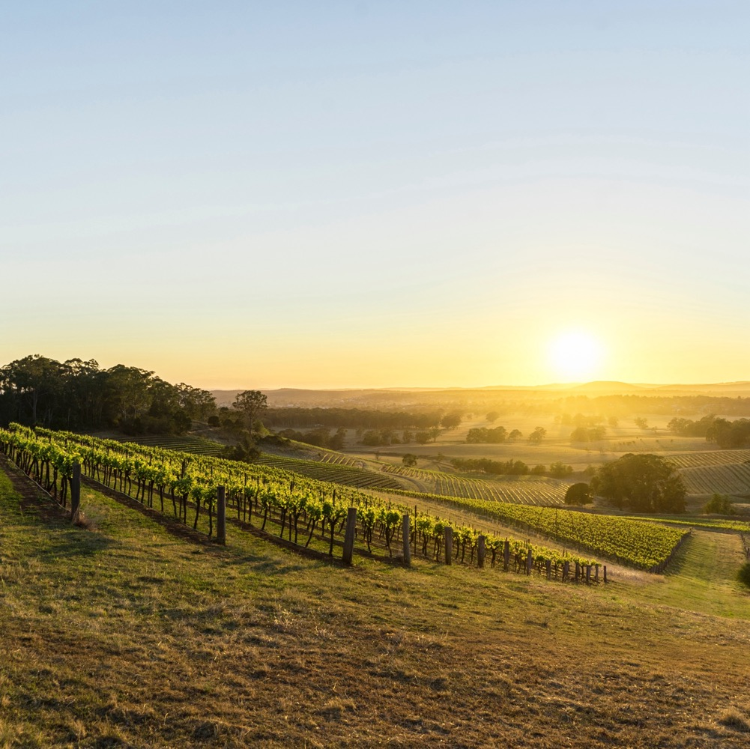
SEMILLON AND SAUVIGNON BLANC
HISTORY AND EVOLUTION

Slide 6
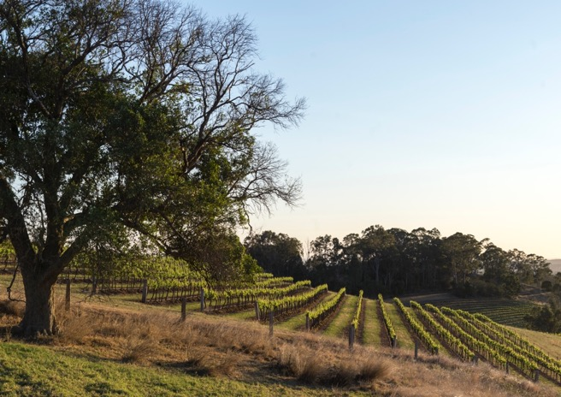
SEMILLON:
AN AUSTRALIAN ICON
A new wave of winemakers showing the potential of this exciting white variety.
Found a home in the Hunter Valley, with vines dating back to early 1900s.
Comparatively low profile among consumers.
Arrived in Australia in 1832 as part of James Busby’s collection.
Key variety in the success of the
Hunter Valley.

Slide 7
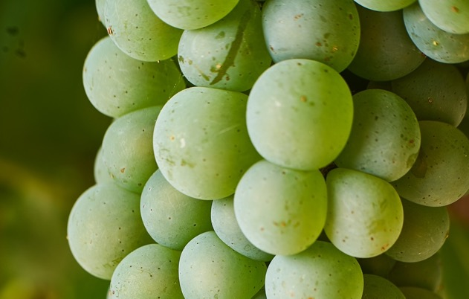
SAVIGNON BLANC:
A RAPID RISE
Wine quality improved as consumer expectations increased
First planted Australia in the 1800s, then popularity exploded in late 1990s/early 2000s.
Ancient grape parent to Cabernet Sauvignon (together with genetic links to Savagnin and Chenin Blanc)
Overtook Chardonnay as Australia’s highest selling white wine.
Today a growing number of experimental producers are creating more interesting, complex, textural wines

Slide 8
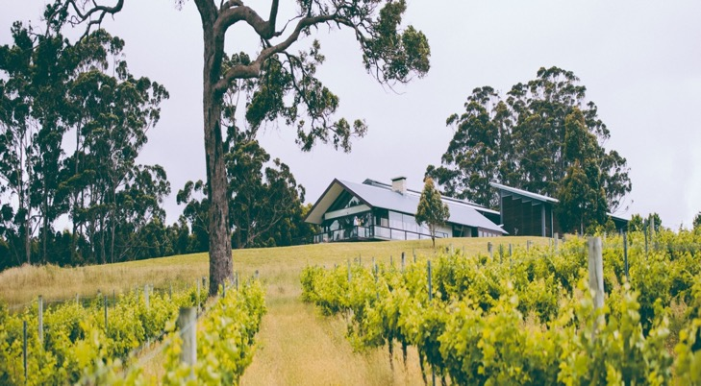
SEMILLON + SAVIGNON BLANC =
THE PERFECT PAIR
Winemakers saw an opportunity to blend Semillon and Sauvignon Blanc
Margaret River wine region was established in the mid-1960s
The blend was hugely successful and helped put the Margaret River wine region on the map
Today it’s one of Margaret River’s signature styles

Slide 9
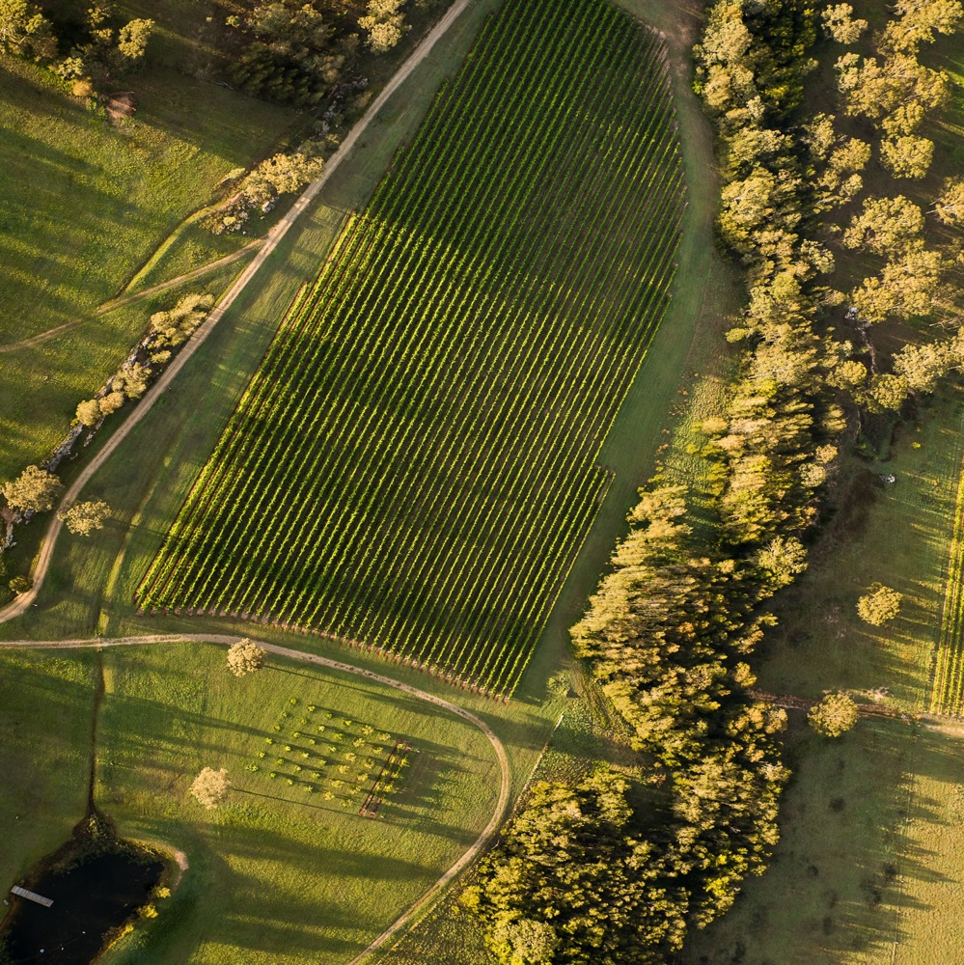
HUNTER VALLEY SEMILLON
AN AUSTRALIAN ORIGINAL
Benchmark style from the
Hunter Valley
Transforms over time from a zesty, crisp youngster into aged wine of deep golden hue, with nutty, honey and straw characters
Retains distinctive stamp of primary fruit and acidity even after decades in the cellar

Slide 10
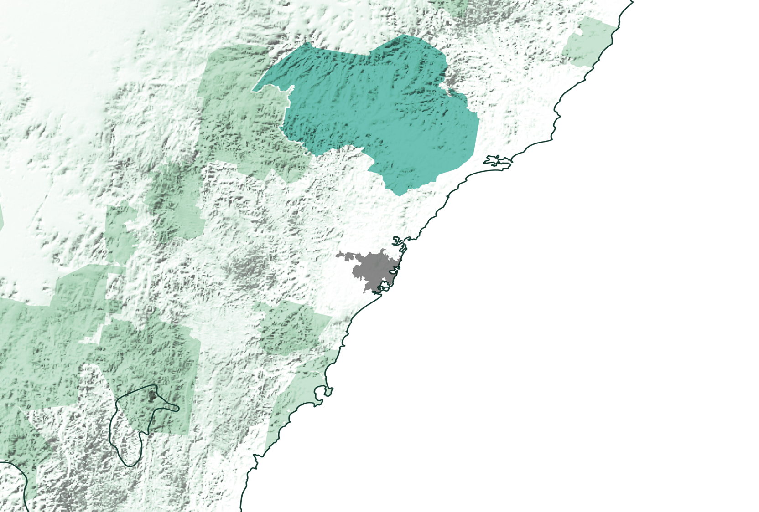
NSW
HUNTER VALLEY
Sydney

Slide 11
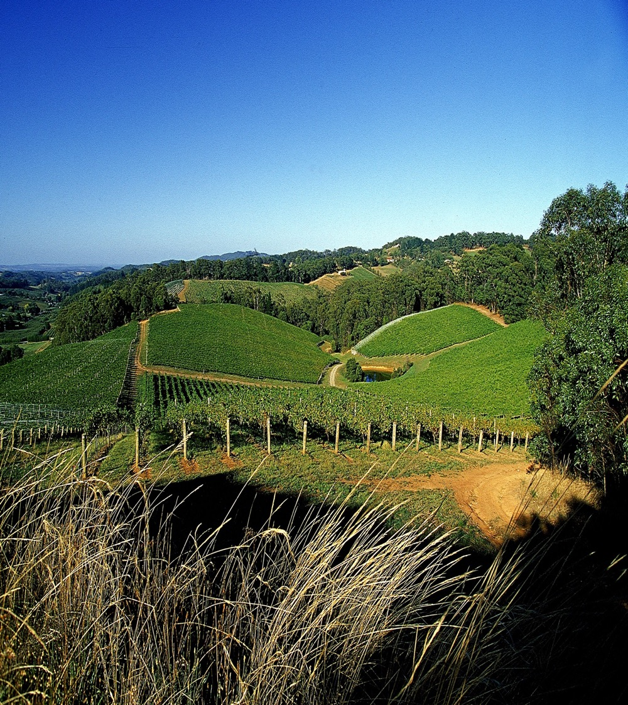
CLIMATE
ALTITUDE
SUBTROPICAL
VERY HIGH
1000m +
(>3,280ft +)
WITH MARITIME INFLUENCES
HIGH
750–999m
(2,460–3,279ft)
HUNTER VALLEY
22–254M (72–833FT)
MEDIUM
500–749m
(1,640–2,459ft)
LOW
0–499m
(0–1,639ft)

Slide 12
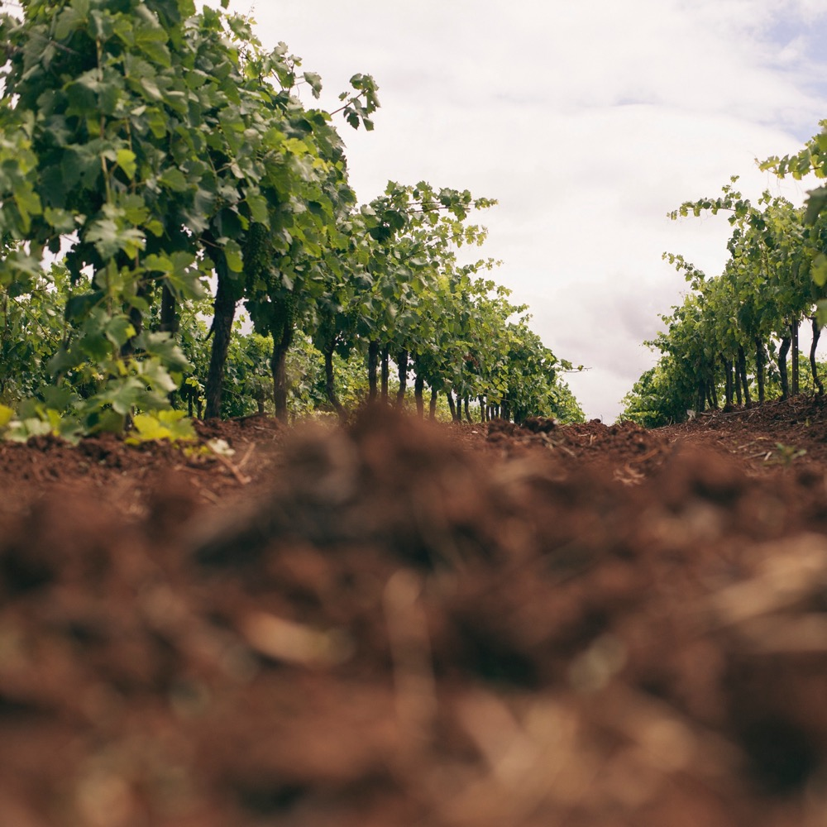
SOIL
Soils vary across the region from sandy alluvial flats to deep loam and friable red duplex soils. Semillon typically does best on sandy alluvial flats.

Slide 13
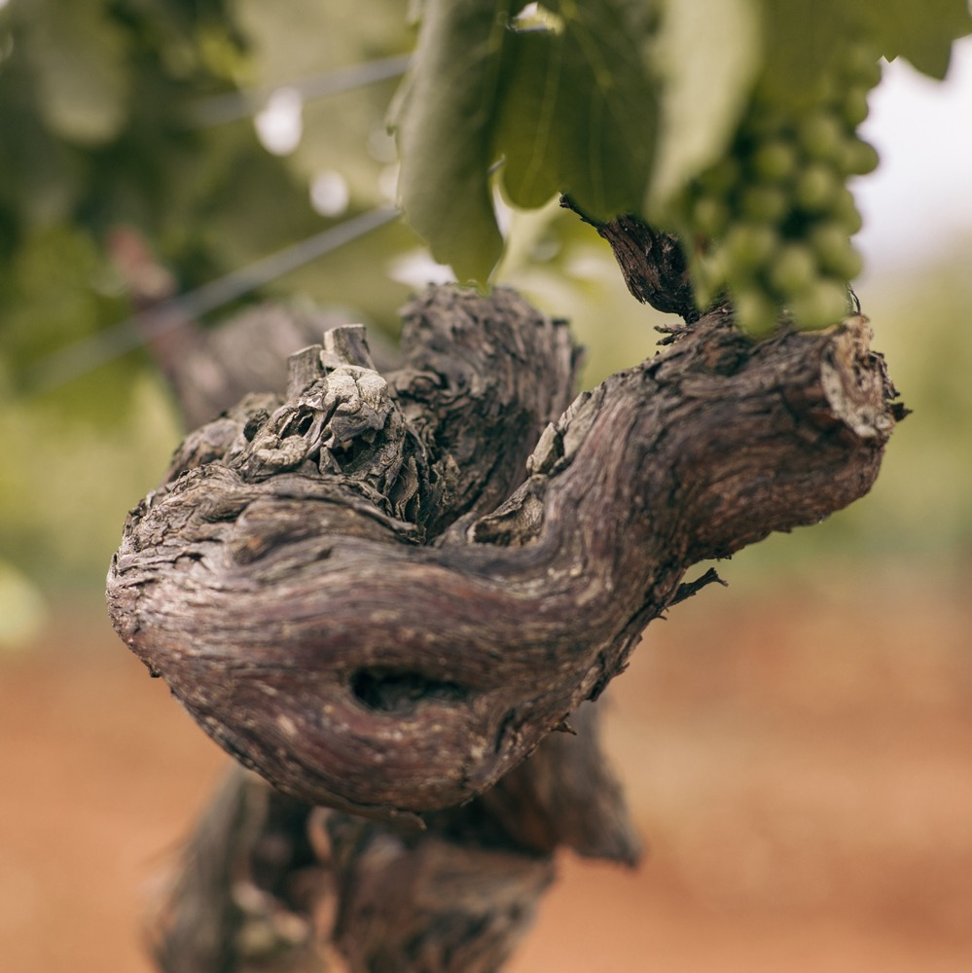
VITICULTURE
The Hunter Valley’s warm climate, humidity, heavy rains and storms present a challenge
Skilful growers have adapted
and established the region as the
top producer of quality Semillon
Harvest: January to mid-February; Semillon one of the first to be picked

Slide 14
WINEMAKING:
COLD FERMENTATION IN STAINLESS STEEL
SOME BARREL FERMENTATION
BARREL MATURATION
MINIMAL INTERVENTION APPROACH

Slide 15
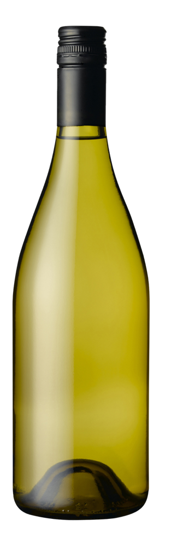
HUNTER VALLEY SEMILLON characteristics
Youthful, unoaked style
COLOUR
Semillon
FLAVOURS
Light
Medium
Full
BODY
TYPICAL FRUIT FLAVOURS
Lemon
Green apple
Quince
Dry
Medium dry
Sweet
SWEETNESS
SEMILLON
Low
Medium
High
TYPICAL SECONDARY FLAVOURS
OAK
Herbs
Grassiness
ACIDITY
8%
10% – 11.5%
17%
ALCOHOL

Slide 16
HUNTER VALLEY SEMILLON characteristics
Bottle
aged, unoaked style
COLOUR
Semillon
FLAVOURS
Light
Medium
Full
BODY
TYPICAL FRUIT FLAVOURS
Lemon
Apple
Quince
Fig
Dry
Medium dry
Sweet
SWEETNESS
SEMILLON
Low
Medium
High
TYPICAL SECONDARY FLAVOURS
OAK
Toast
Straw
Honey
Honeysuckle
Vanilla
ACIDITY
8%
10% – 11.5%
17%
ALCOHOL

Slide 17

FOOD PAIRINGS
YOUNG SEMILLON
OYSTERS
PRAWNS/SHRIMPS
WHITE FISH
BOTTLE - AGED SEMILLON
SEMILLON
SMOKED CHICKEN
CHICKEN
PORK
SOFT CHEESE

Slide 18
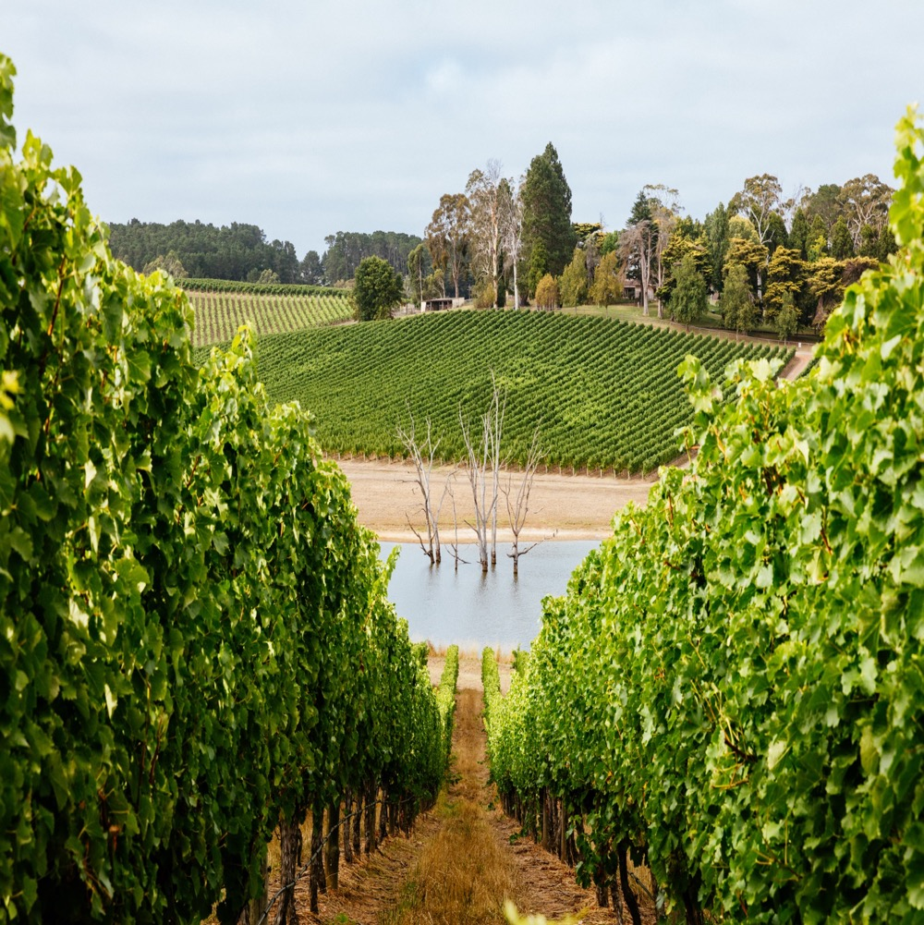
ADELAIDE HILLS SAVIGNON BLANC
A FRUITY
CROWD PLEASER
Well suited to cool climate
Produces vibrant, aromatic wines
bursting with natural acidity
Benchmark style from Adelaide Hills

Slide 19
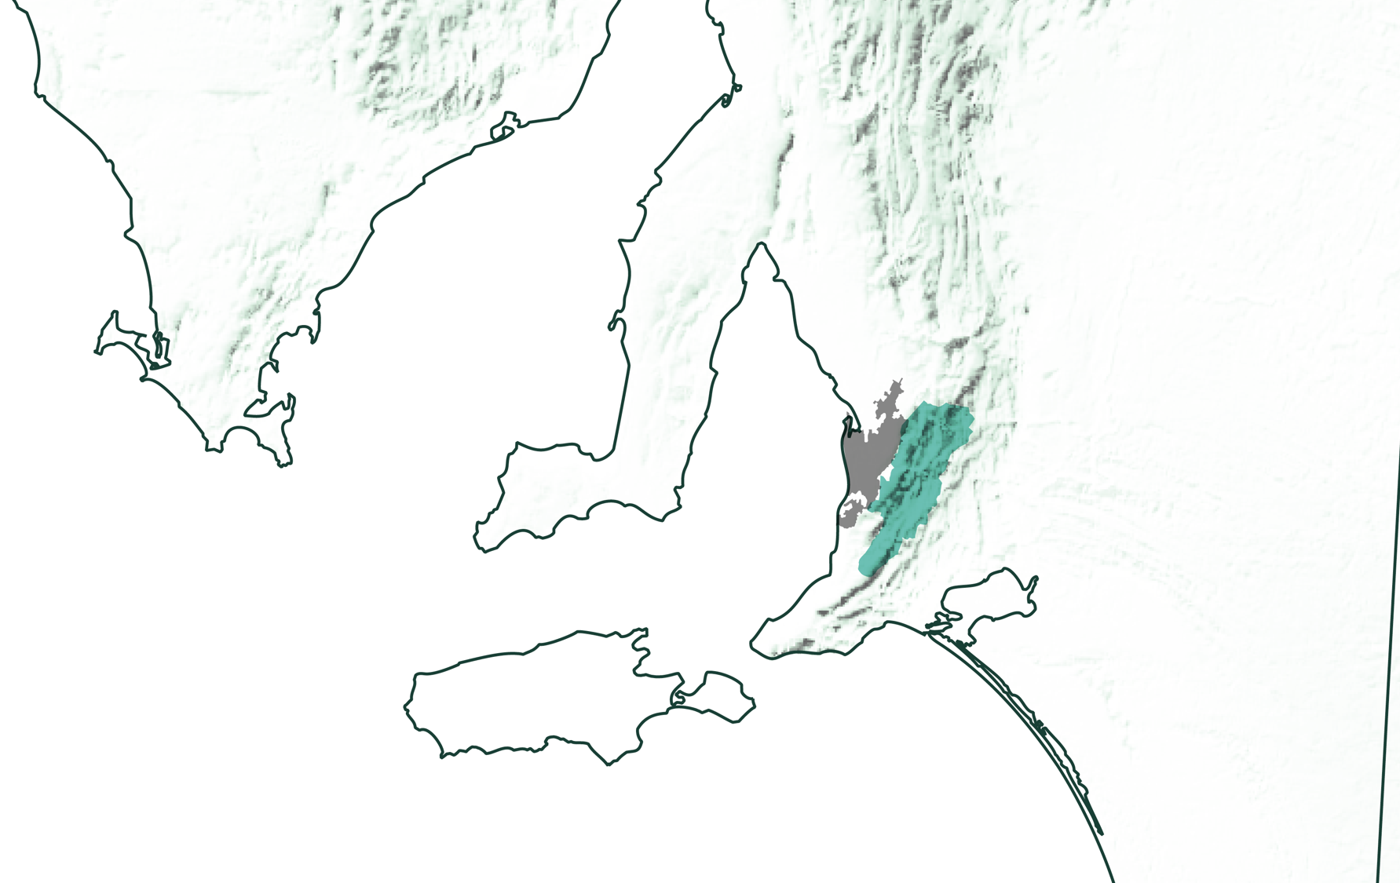
SOUTH AUSTRALIA
ADELAIDE HILLS

Slide 20

CLIMATE
ALTITUDE
MODERATE MARITIME
VERY HIGH
1000m +
(>3,280ft +)
WITH COOL-CLIMATE CHARACTERISTICS
ADELAIDE HILLS
230–650M (755–2,133FT)
HIGH
750–999m
(2,460–3,279ft)
MEDIUM
500–749m
(1,640–2,459ft)
LOW
0–499m
(0–1,639ft)

Slide 21
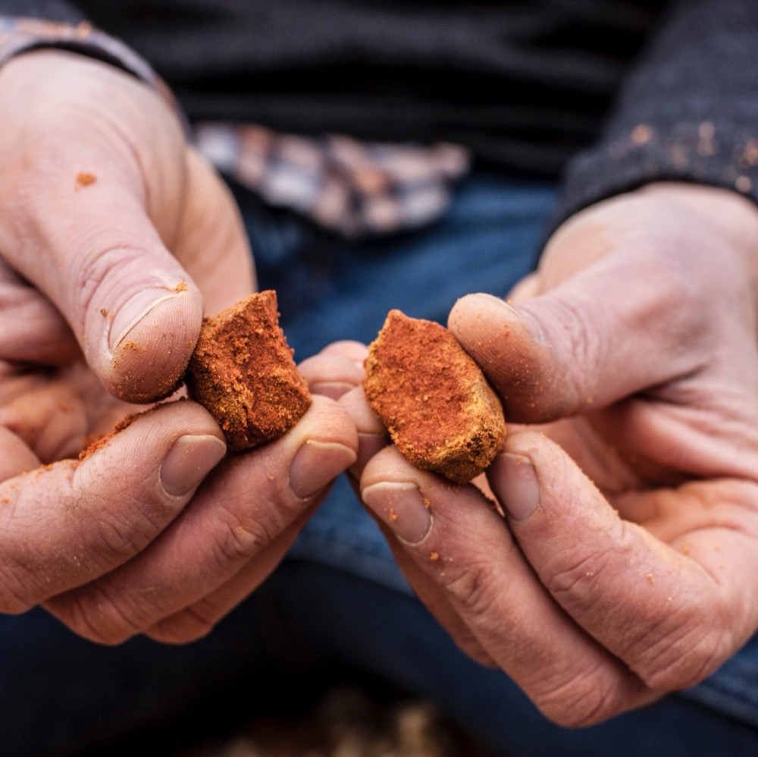
SOIL
Soils vary with a mixture of grey-brown or brown loamy sands, and patches of sandy
soils over clay subsoils. Low-lying areas with heavy soils provide potential for greater vigour, while higher, well-drained stony soils allow vigour control.

Slide 22
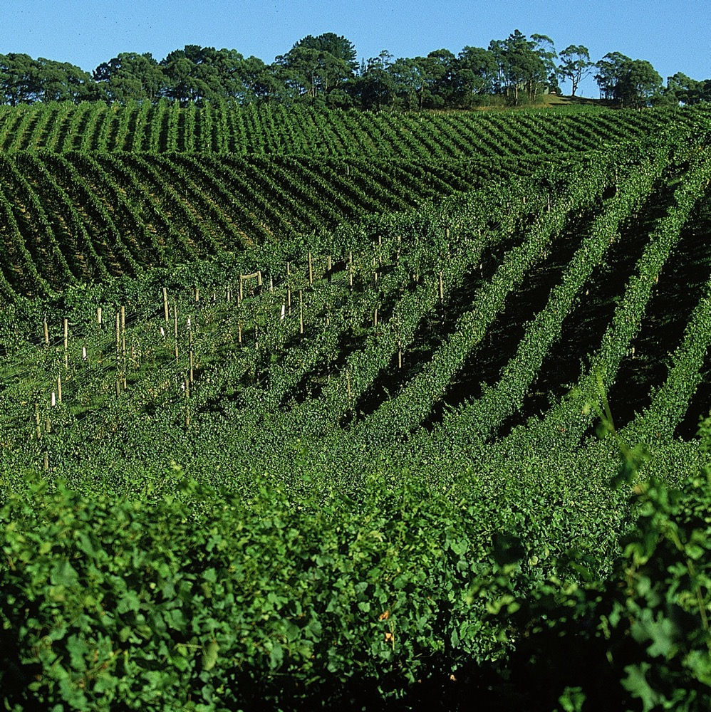
VITICULTURE
Relatively early-ripening variety
Canopy management is vital
Integrated management
regimes to reduce chemical use
Hand-pruning and harvesting
Harvest: early February to March

Slide 23
WINEMAKING:
COLD FERMENTATION IN STAINLESS STEEL
BARREL FERMENTATION
EXTENDED SKIN CONTACT
BARREL MATURATION
NEW AND EXPERIMENTAL TECHNIQUES

Slide 24
ADELAIDE HILLS SAUVIGNON BLANC characteristics
COLOUR
Sauvignon Blanc
FLAVOURS
Light
Medium
Full
BODY
Kiwifruit
Pineapple
Gooseberry
Passionfruit
Herbs
Dry
Medium dry
Sweet
SWEETNESS
SAUVIGNON BLANC
Low
Medium
High
OAK
ACIDITY
8%
12% – 13.5%
17%
ALCOHOL

Slide 25
FOOD PAIRINGS
GOAT’S CHEESE
GREEN VEGETABLES
OYSTERS
SAUVIGNON BLANC
SHELLFISH
CHICKEN

Slide 26
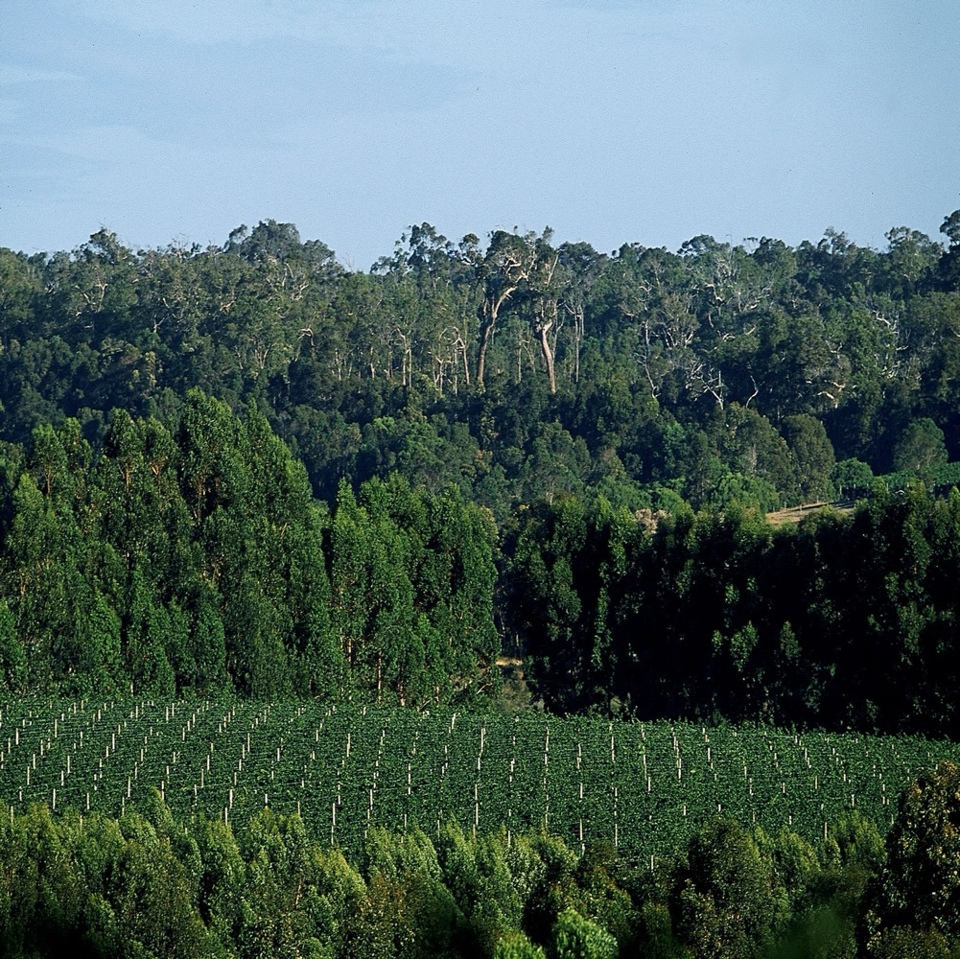
MARGARET RIVER
SEMILLON SAUVIGNON BLANC BLENDS
MORE THAN THE SUM OF ITS PARTS
Two varieties that are inherently complementary
Benchmark style from Margaret River
Crisp, elegant and fruit-driven

Slide 27
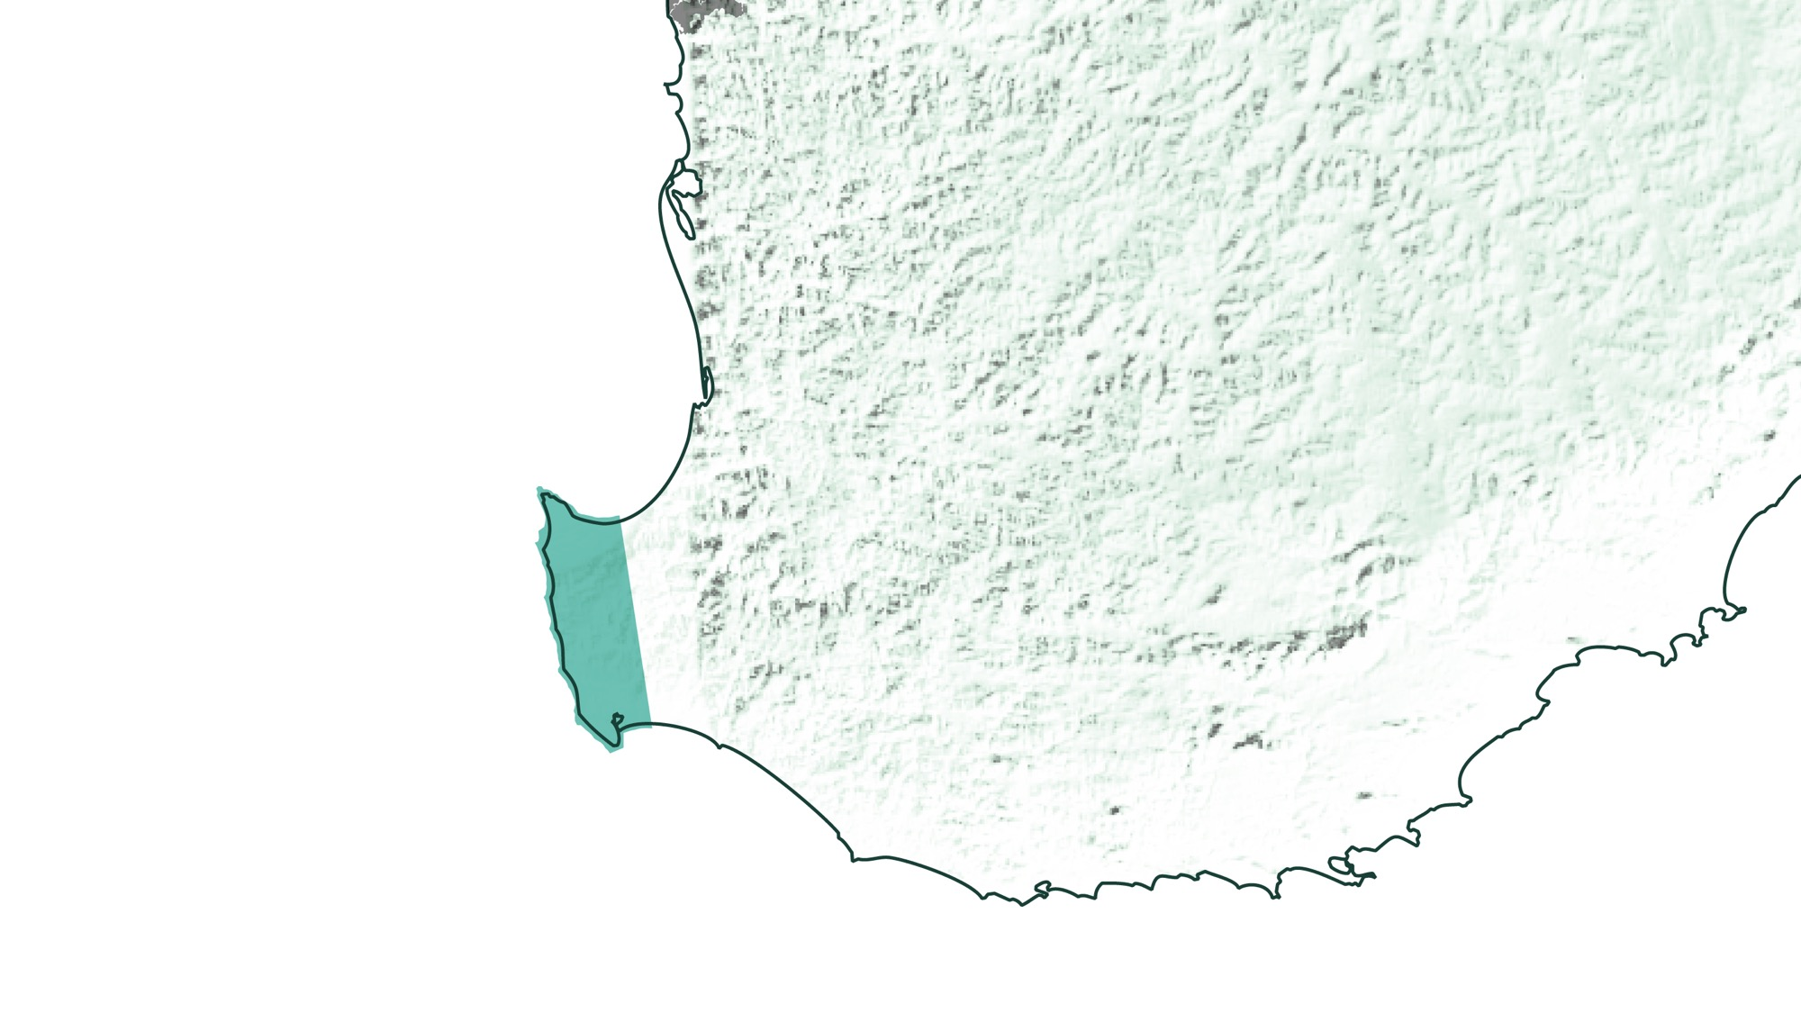
WESTERN AUSTRALIA
MARGARET RIVER

Slide 28

MEDITERRANEAN
ALTITUDE
CLIMATE
VERY HIGH
1000m +
(>3,280ft +)
STRONG MARITIME INFLUENCES WITH OCEANS ON THREE SIDES
HIGH
750–999m
(2,460–3,279ft)
MARGARET RIVER
0–231M (0–757FT)
MEDIUM
500–749m
(1,640–2,459ft)
LOW
0–499m
(0–1,639ft)

Slide 29
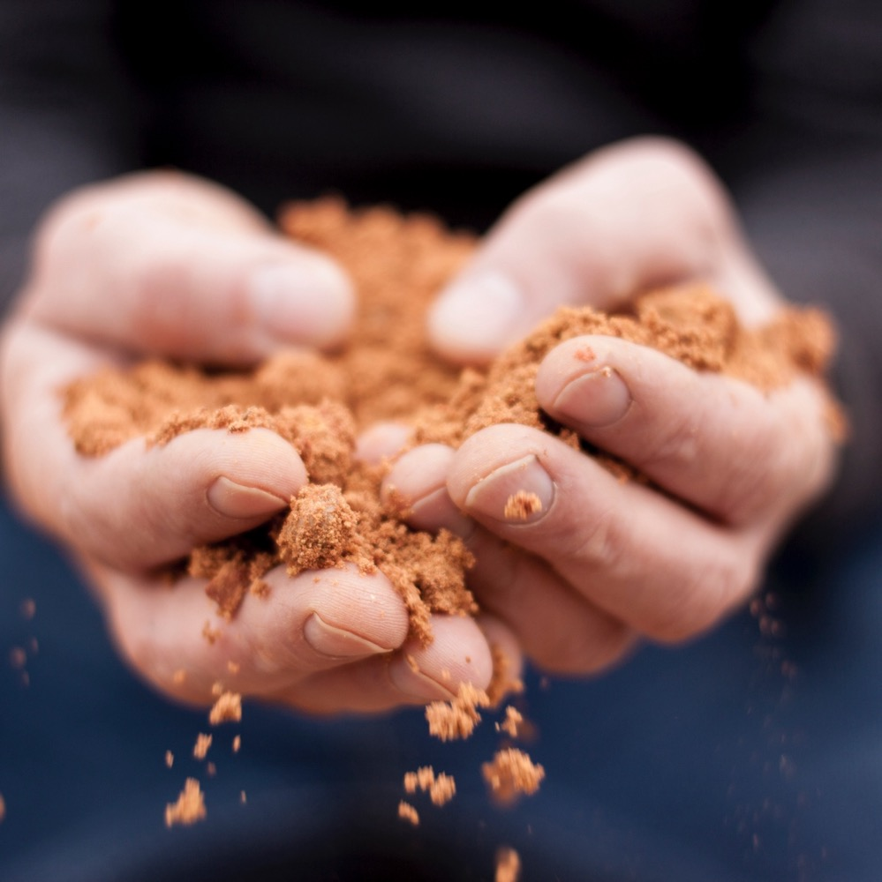
SOIL
Predominantly gravelly or gritty sandy loams on granite and gneiss, with low overall water-holding capacity.

Slide 30
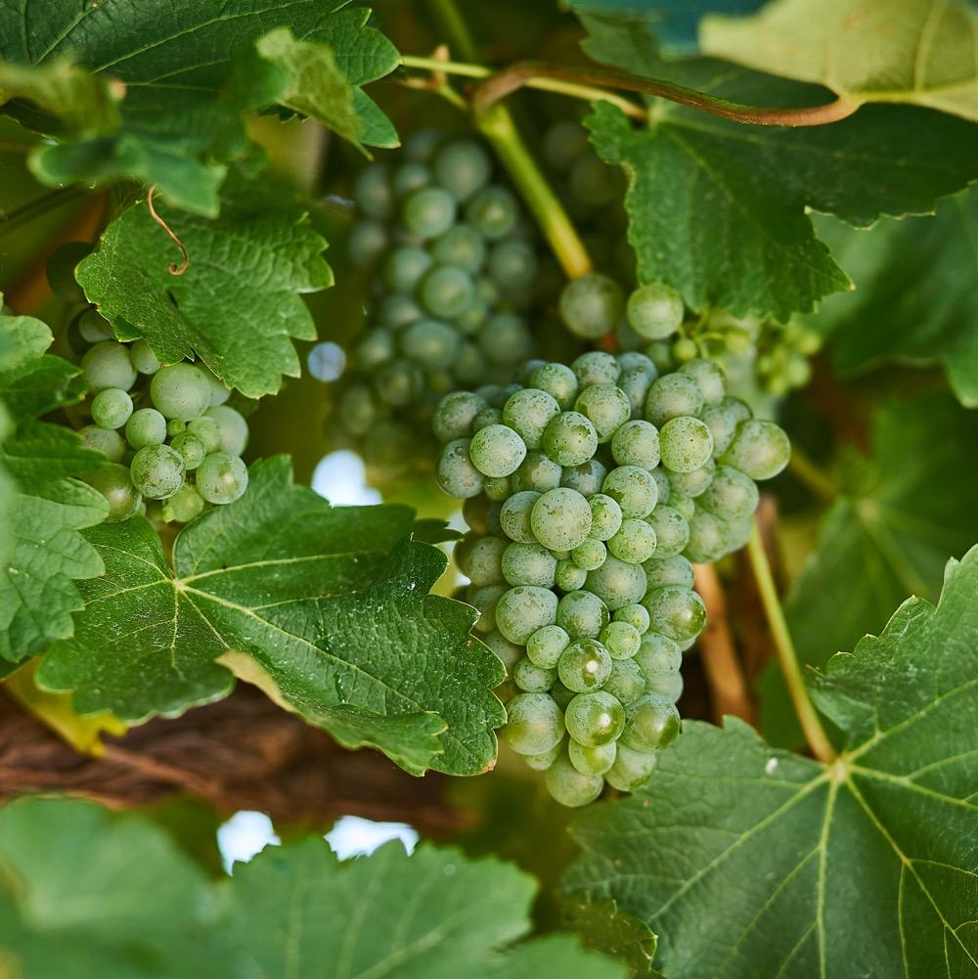
VITICULTURE
Region ideally suited to grape growing
Semillon and Sauvignon Blanc
top two planted varieties
Minimal-intervention, sustainable, organic and biodynamic practices

Slide 31
WINEMAKING:
A
B
A
B
VARIETIES CAN BE BLENDED IN DIFFERENT PROPORTIONS
BLENDED SOON AFTER FERMENTATION OR JUST BEFORE BOTTLING
OAKED OR UNOAKED

Slide 32
MARGARET RIVER SEMILLON
SAUVIGNON BLANC characteristics
COLOUR
Semillon Sauvignon Blanc
FLAVOURS
Light
Medium
Full
BODY
Gooseberry
Passionfruit
Lime
Lemon curd
Grapefruit
Dry
Medium dry
Sweet
SWEETNESS
SEMILLON SAUVIGNON
BLANC
Low
Medium
High
OAK
ACIDITY
8%
12% – 13.5%
17%
ALCOHOL

Slide 33
FOOD PAIRINGS
SEAFOOD
MILD CURRIES
SEMILLON SAUVIGNON BLANC
CHICKEN
CITRUSY SAUCES

Slide 34
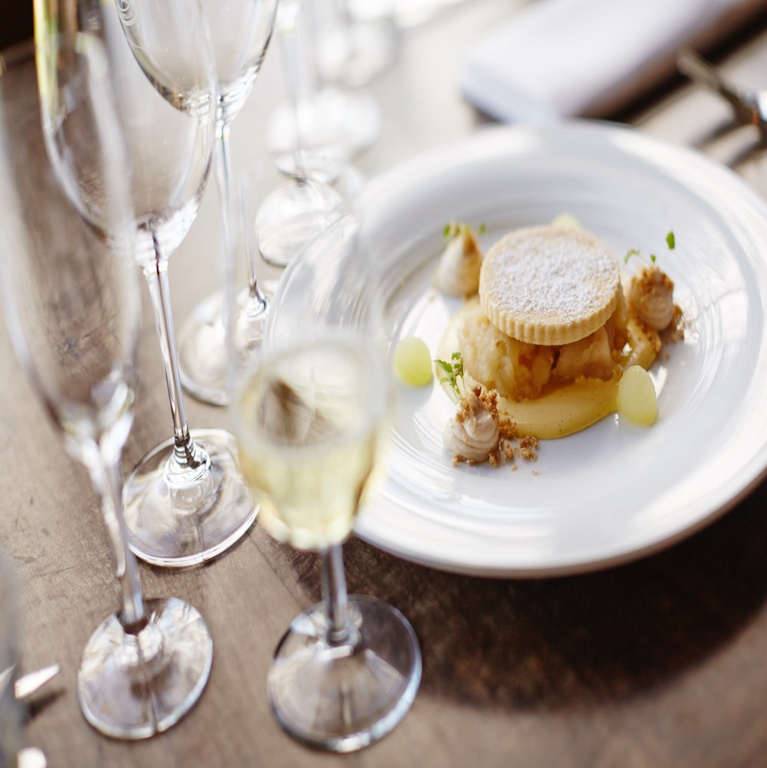
RIVERINA BOTRYTIS SEMILLON
WORLD-CLASS DESSERT WINE
Rich, honeyed dessert wine
Product of the fungus Botrytis
or ‘noble rot’
One of Australia’s most celebrated sweet wine styles
Benchmark style from the Riverina

Slide 35
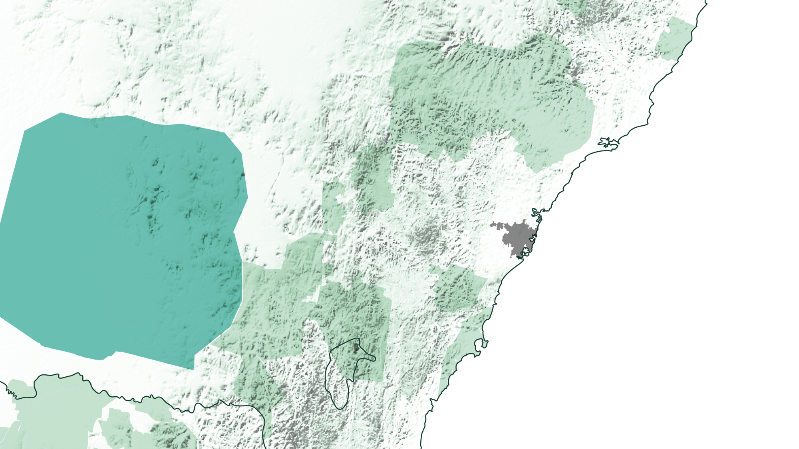
NSW
RIVERINA

Slide 36
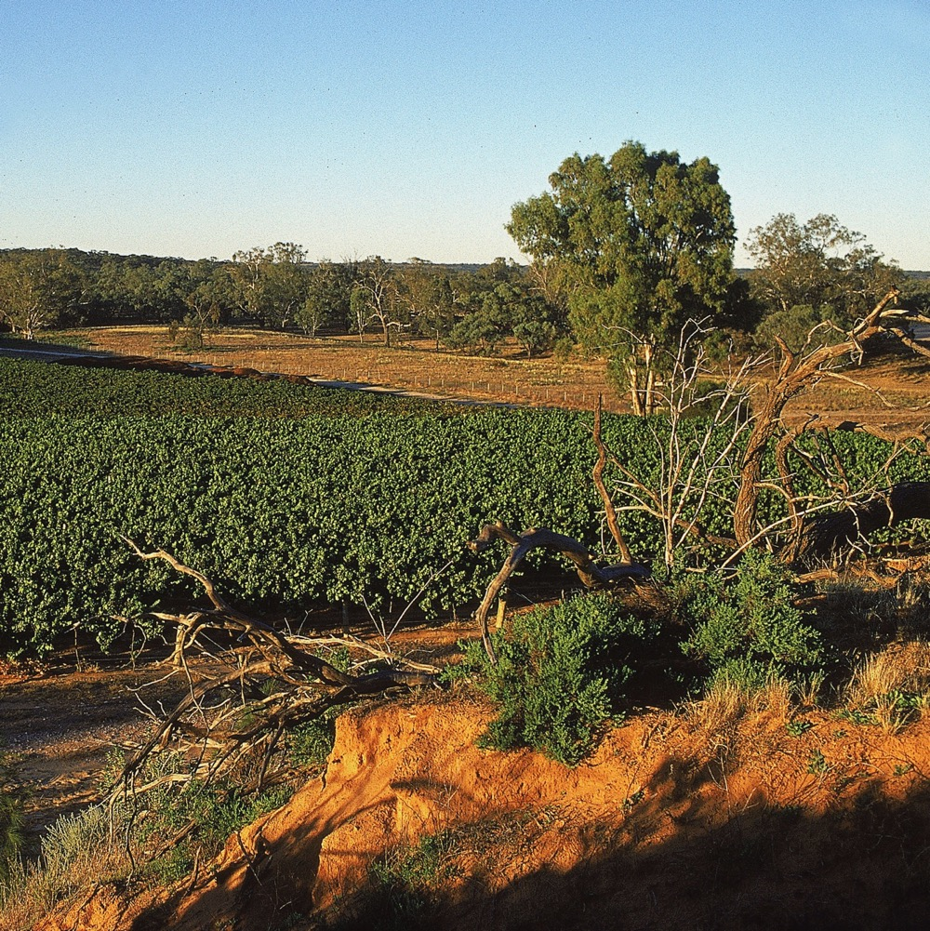
VITICULTURE
Riverina’s humid mornings and
warm, sunny afternoons are ideal
for Botrytis
Grapes are left on the vine two
months after maturity for Botrytis
to develop
Hand-picked around May

Slide 37
WINEMAKING:
A
B
FERMENTED IN OAK AND/OR STAINLESS STEEL
MATURED IN OAK FOR UP TO 12 MONTHS
MAY BE BLENDED WITH SOME UNOAKED WINE TO ADD FRESHNESS

Slide 38
RIVERINA BOTRYTIS
SEMILLON characteristics
COLOUR
Botrytis Semillon
FLAVOURS
Light
Medium
Full
BODY
Dried apricot
Apricot nectar
Peach
Citrus
Marmalade
Mango
Dry
Medium dry
Sweet
SWEETNESS
BOTRYTIS
SEMILLON
Low
Medium
High
OAK
ACIDITY
8%
9.5% – 11%
17%
ALCOHOL

Slide 39
FOOD PAIRINGS
FRUIT-BASED DESSERTS
CRÉME BRÜLÉE
SEMILLON SAUVIGNON BLANC
BLUE CHEESE
AGED CHEDDAR

Slide 40

AUSTRALIAN SEMILLON and sauvignon blanc
POTENTIAL AND POSSIBILITY
The future of these versatile varieties is bright, with great potential and new possibilities ahead.

Slide 41
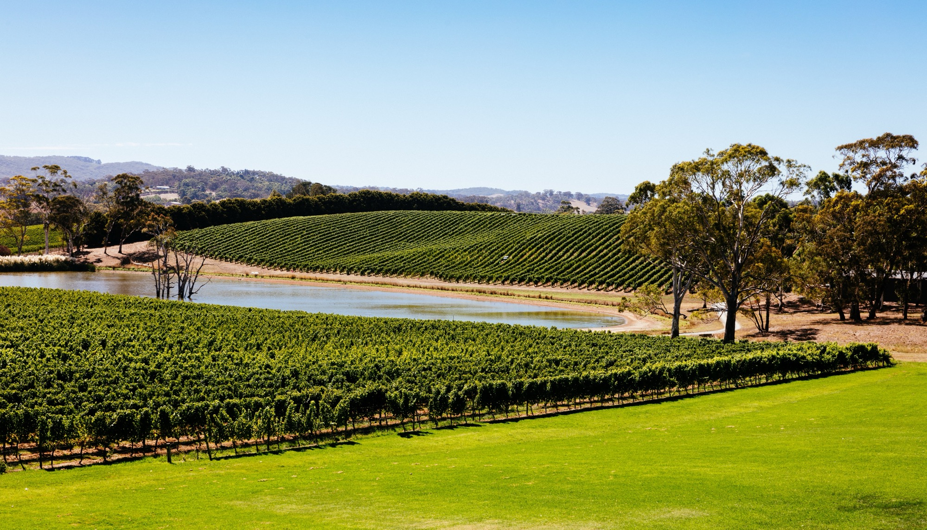
THANK YOU

